Slide 1
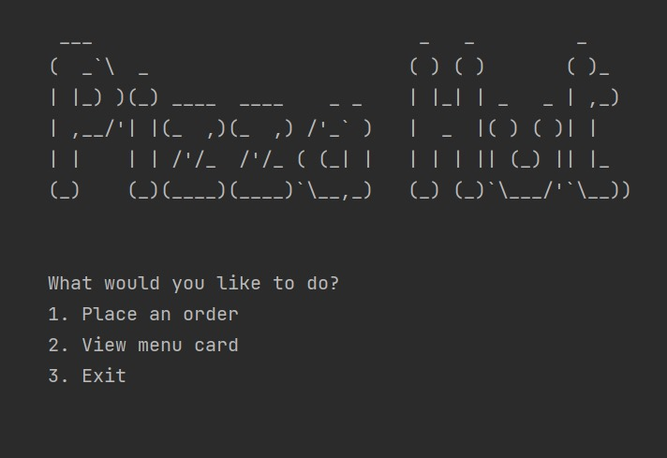

Slide 2
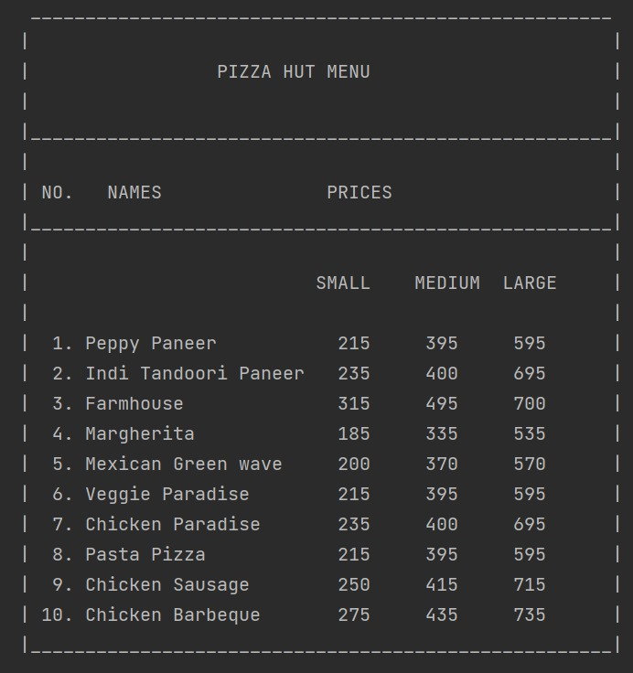
MENU

Slide 3
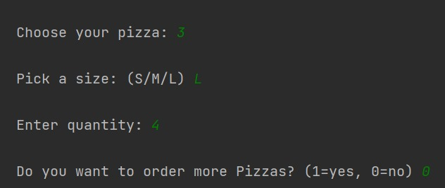
Place Order

Slide 4
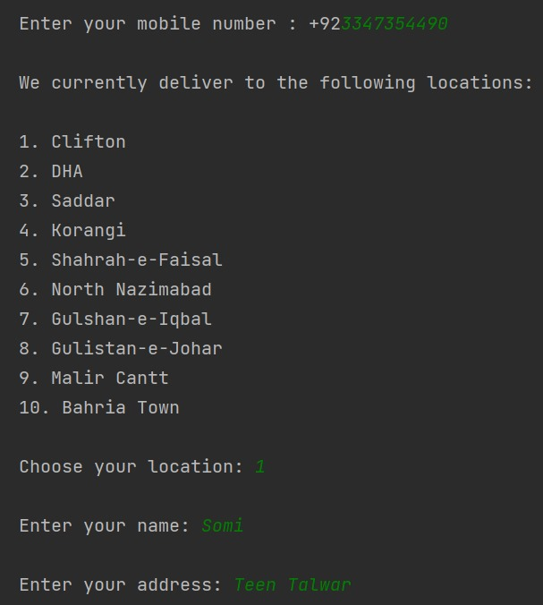
Enter Personal Details and Delivery Location

Slide 5
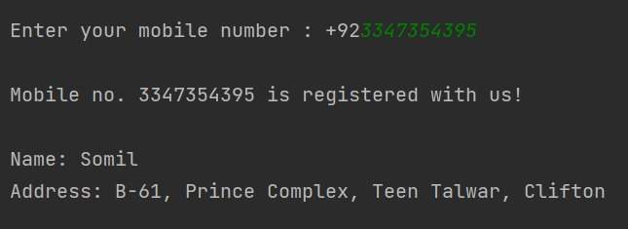
Automatic Retrieval of Registered Customer Details

Slide 6
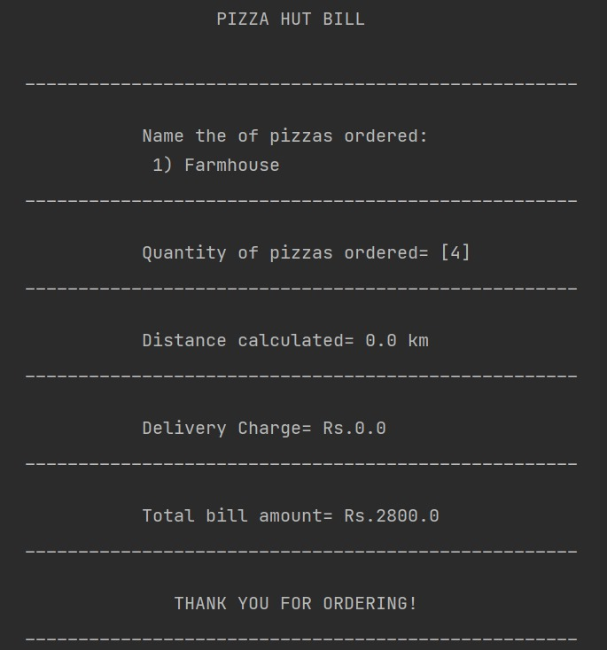
Total Bill Amount Calculation

Slide 7
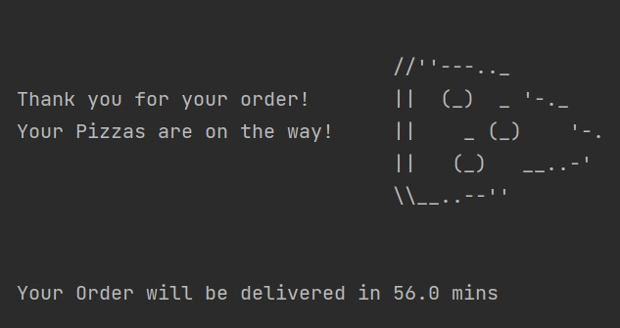
Estimated Delivery Time and Charges

