Slide 1
CYBERSECURITY & CRYPTOGRAPHY
Classical Ciphers: Attack & Prevention
A Hands-On Demonstration of Caesar & Substitution Ciphers, Vulnerabilities, and Modern Defense Mechanisms
Project By: Somish Jain | GitHub: github.com/Somishjain123/cyber-project | Stack: Python, Tkinter

Slide 2
1. INTRODUCTION
Project Overview & Core Objectives
Background
• Classical ciphers form the bedrock of cryptographic history.
• Caesar & Substitution ciphers are intuitive but mathematically fragile.
• Understanding how these algorithms break is foundational to mastering modern secure systems.
Problem Statement
• Monolithic shifts and static substitutions leak statistical characteristics.
• Small keyspaces allow trivial brute-force exploitation.
• Letter distribution patterns in human languages allow rapid cryptanalysis without known keys.
Key Contributions
• Interactive Python GUI application for live demonstration.
• Implementation of automated brute-force with English scoring.
• Frequency analysis attack engine.
• Multi-shift and hybrid defense architecture to withstand attacks.

Slide 3
2. THEORETICAL FOUNDATION
Classical Ciphers Architecture & Mechanics
Caesar Cipher (Shift Cipher)
• Type: Monoalphabetic substitution cipher.
• Mathematical Rule: E_k(x) = (x + k) mod 26, D_k(y) = (y - k) mod 26.
• Key Space: Extremely small, exactly 25 non-trivial keys.
• Vulnerability: Trivially broken via exhaustive search in seconds.
• Use Case: Historical military communications (Julius Caesar).
Monoalphabetic Substitution Cipher
• Type: Arbitrary 1-to-1 mapping of alphabet letters.
• Key Space: 26! ≈ 4.03 × 10^26 possible permutations.
• False Sense of Security: While immune to brute force, it preserves the frequency distribution of the plaintext language.
• Vulnerability: Defeated by Frequency Analysis and n-gram statistical pattern matching.

Slide 4
3. ATTACK DEMONSTRATIONS
Cryptanalysis & Attack Methodologies
Attack 1: Brute Force Attack
• Target: Caesar Cipher.
• Mechanism: Iterates through all 25 possible shift keys in milliseconds.
• English Frequency Scoring: Applies chi-square / standard English letter scoring (ETAOIN SHRDLU).
• Automated Ranking: Automatically surfaces the most probable plaintext to the analyst without human inspection.
Attack 2: Frequency Analysis Attack
• Target: Substitution Cipher.
• Mechanism: Analyzes character occurrences in the ciphertext.
• Statistical Rule: In English, 'E' (~12.7%), 'T' (~9.1%), and 'A' (~8.2%) dominate.
• Result: High-frequency ciphertext characters correlate directly to high-frequency alphabet letters, exposing the substitution key.

Slide 5
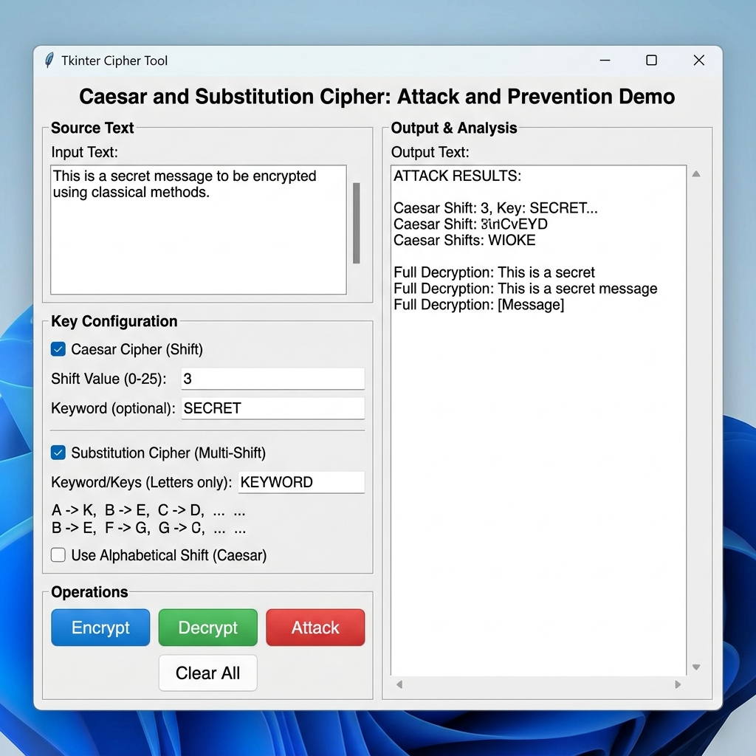
4. IMPLEMENTATION
Software Architecture & Desktop GUI
System Design
• Built with Python & Tkinter for a responsive, cross-platform interface.
• cipher_logic.py: Decoupled cryptographic core containing pure algorithms and testable logic.
• main.py: GUI driver with interactive tabs, status bars, and real-time computation.
• Modular tabs: Caesar, Substitution, Attacks, and Defenses.
• Includes test suites in test_logic.py validating 100% of cipher logic.

Slide 6
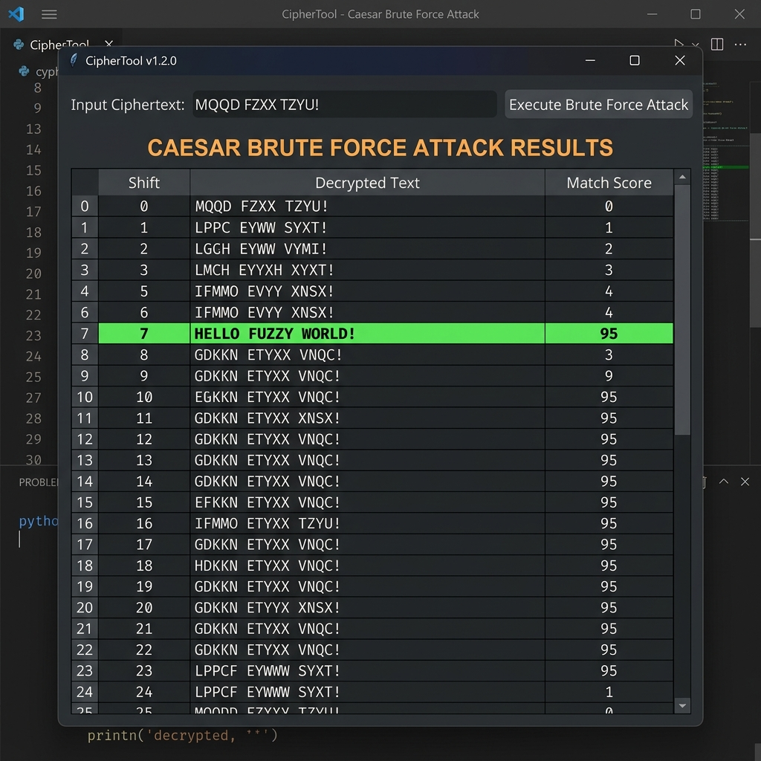
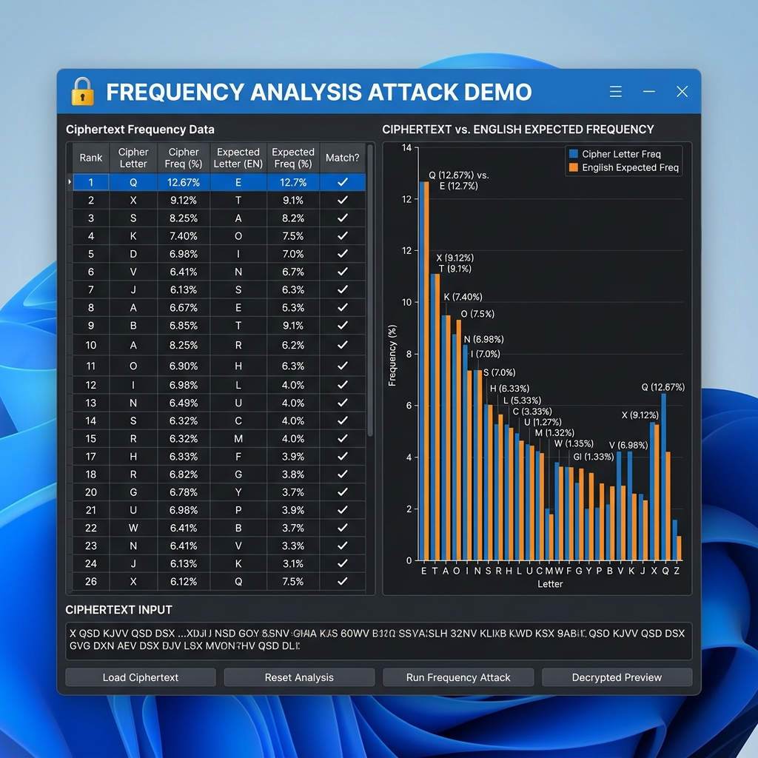
5. ATTACK SIMULATION
Live Cryptanalysis: Brute Force & Frequency Analysis

Slide 7
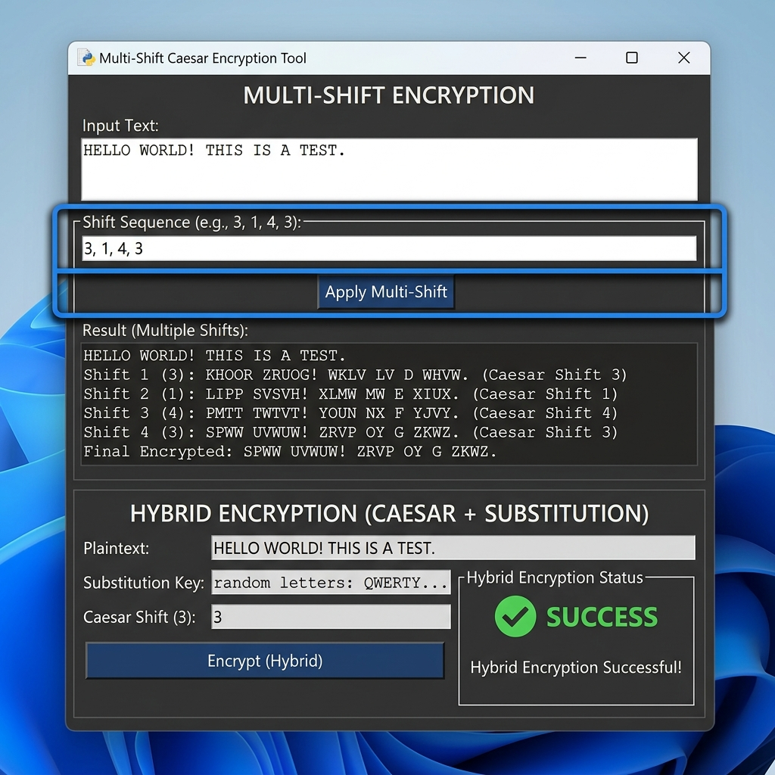
6. PREVENTION STRATEGIES
Countermeasures & Defense Mechanisms
Multi-Shift & Hybrid Defenses
• Multi-Shift (Polyalphabetic): Uses an array of shift keys repeating cyclically across the message (Vigenère principle).
• Flattening Frequencies: Identical plaintext characters encrypt to different ciphertext characters, neutralizing single-character frequency analysis.
• Hybrid Layering: Combines Caesar shift with full substitution mapping.
• Result: Thwarts both single-shift brute force and direct frequency matching.

Slide 8
7. ANALYSIS
Comparative Security Matrix & Experimental Findings
Encryption Method | Key Space Complexity | Vulnerability Level | Defense Efficacy
Caesar Cipher | 25 Keys | Critical (Brute Force in <1ms) | Low - Not secure for real data
Substitution Cipher | 26! (~4 × 10^26) | High (Vulnerable to Frequency Analysis) | Moderate - Easily cracked with text samples
Multi-Shift Cipher | 26^L (L = Key Length) | Low against simple Caesar brute force | High - Flattens single-letter frequencies
Hybrid (Caesar + Sub) | Layered Complexity | Very Low against basic classical attacks | Maximum - Multi-layer obfuscation

Slide 9
8. CONCLUSION
Conclusion & Future Directions
Key Takeaways
• Security through obscurity fails: Large key spaces alone do not guarantee security if statistical properties leak.
• Frequency analysis easily breaks monoalphabetic substitution despite massive 26! possibilities.
• Polyalphabetic and hybrid approaches bridge the gap towards modern block and stream ciphers (such as AES).
• Demonstrated full lifecycle: Implementation → Vulnerability Analysis → Exploitation → Mitigation.
Future Enhancements
• Automated Bigram and Trigram frequency substitution solver.
• Kasiski examination module for multi-shift period detection.
• Integration of modern symmetric (AES) and asymmetric (RSA) algorithms.
• Web-based interactive sandbox version using FastAPI and React.

Slide 10
Thank You!
Questions & Discussion
GitHub Repository: https://github.com/Somishjain123/cyber-project

