Slide 1

CAMPUSPULSE 2026
A cloud-native smart campus operations platform
Built, deployed and tested on AWS — eu-west-3 (Paris)
Big Data Infrastructure & Cloud Computing
SG
Somitha Gudivada
ME
Meha
MA
Madhavan
MD
MD
Architecture & ingestion
Identity & security
Simulator, testing & demo
Dashboard, monitoring & cost
Notes:
SOMITHA (about 15 s): Good morning. We are Team 4, and this is CampusPulse 2026, a platform that monitors a university campus in real time. It is deployed on AWS in Paris, and every number today comes from the running system. Each of us built one part and will present it: I cover architecture and ingestion, Meha security, Madhavan the simulator, tests and demo, and MD the dashboard, monitoring and cost.

Slide 2




The problem and what we delivered
Somitha
SG
Questions the operations team asks
What we delivered
Which rooms are overloaded right now?
7
5
Which buildings use the most energy?
REST endpoints behind one HTTPS API
Lambda functions, one IAM role each
Is anything abnormal: temperature, humidity, equipment?
61
176
Which student requests are urgent?
AWS resources, all in Terraform
automated checks, 0 failures
Thousands of readings a day; nobody can watch them all.
5 buildings
11 rooms
6 event types
3 severity levels
Notes:
SOMITHA (about 30 s): A campus produces thousands of readings a day. Individually they mean nothing; the operations team only needs answers to the four questions on the left. CampusPulse answers them automatically. We delivered a working system: seven API endpoints, five Lambda functions, sixty-one AWS resources in Terraform, and a hundred and seventy-six automated checks, all passing, on a simulated campus of five buildings and eleven rooms.

Slide 3












Solution architecture
Users & devices
AWS Cloud · eu-west-3 (Paris)
9
Frontend hosting
Compute · Lambda
Data
Operations & governance
1
cp-ingest POST /events
6
Web browser
Amazon S3
IAM
CloudWatch
ops / staff users
Static dashboard
7
5 least-priv. roles
4 alarms · 1 board
Public edge
cp-query /events /alerts
7
DynamoDB
2
2 GSIs · TTL · PITR
5
3
cp-stats GET /stats
Identity
API Gateway
AWS Budgets
Terraform
HTTP API · JWT check
$10 monthly alert
61 resources
8
cp-auth POST /login
Cognito
No VPC, no NAT Gateway, no EC2: nothing in this design bills by the hour.
groups: ops · staff
Campus simulator
Python, stdlib only
cp-health GET /health
4
Notes:
SOMITHA (about 45 s): This is the deployed system. Users load the dashboard from S3 (1). All API calls, from the browser (2) or the simulator (3), enter through API Gateway, whose JWT authorizer checks the token against Cognito before our code runs (4). Each route goes to one of five small Lambdas (5). cp-ingest writes to DynamoDB (6), query and stats only read (7), and cp-auth talks to Cognito (8). Everything logs to CloudWatch (9). We chose serverless because our load is bursty and our budget fixed: an idle Lambda costs nothing, while a private network would need a NAT Gateway at about thirty-two dollars a month.

Slide 4
One event, end to end
1
2
3
4
5
Simulator
API Gateway
cp-ingest
DynamoDB
Dashboard
Room A203: 58 people, sent as "normal"
Valid JWT? Otherwise 401
Validates 8 fields, recomputes severity
One PutItem; alert index only if not normal
Red alert in under 10 s
The server decides severity, not the sensor
Data model: one table, no Scan anywhere
Client sent: severity = "normal"
Room A203 capacity: 45 people
58 ÷ 45 = 129 % > 120 % threshold
Stored as: CRITICAL
pk / sk | DAY#<date> · <timestamp>#<event_id>
GSI1 | events by building and day
GSI2 | sparse: holds only alerts
TTL · PITR | 30-day expiry · restore to any second
A device must never be able to declare itself normal.
Every query names a partition key, so cost stays flat as data grows.
Notes:
SOMITHA (about 45 s): Here is one real event. The simulator reports fifty-eight people in room A203 and labels it normal. cp-ingest validates every field, then discards the client's severity and recomputes it: the room holds forty-five, fifty-eight is a hundred and twenty-nine per cent, above the hundred-and-twenty threshold, so it is stored as critical. A sensor must never be able to declare itself normal. On the right, the data model: one table keyed by day and time, a building index, and a sparse index that contains only alerts. There is no Scan anywhere. Meha will explain who is allowed to send that event.

Slide 5





Authentication with Amazon Cognito
Manimegalai
ME
User
POST /login
cp-auth
Cognito
JWT
email + password
public route
calls InitiateAuth
checks the password
60 min · carries group
Email is the username
No username guessing
Users are created by an admin only; there is no public sign-up page.
Wrong password and unknown user return the identical error message.
Two groups in the token
Essentials tier on purpose
ops (operations team) and staff (teaching staff) travel inside the JWT.
10,000 monthly users free; the Plus tier has no free allowance at all.
Notes:
MEHA (about 40 s): Thank you. Identity is handled by Amazon Cognito. A user, or the simulator, sends an email and password to POST /login. My function, cp-auth, passes them to Cognito, which checks the password, so our code never stores one. Cognito returns a JWT valid for sixty minutes that carries the user's group. Deliberate choices: users are created by an admin only; a wrong password and an unknown user get the same error, so nobody can probe which emails exist; and we chose the Essentials tier because it has ten thousand free monthly users, while Plus has none.

Slide 6
Three independent security layers
1
JWT authorizer
401
2
Group check
403
3
IAM role
Denied
API Gateway checks signature, issuer and expiry before our code runs
The Lambda reads the group in the token and checks the route
Each function may touch only its own resource and action
Route permissions by role
Evidence from the live API (5 Oct 2026)
Route | ops | staff
POST /events | ✓ 201 | ✗ 403
GET /events | ✓ 200 | ✓ 200
GET /stats | ✓ 200 | ✓ 200
GET /alerts | ✓ 200 | ✗ 403
POST /requests | ✓ 201 | ✓ 201
# no token → GET /events
{"message":"Unauthorized"}
# staff token → GET /alerts
{"error": "Forbidden",
"message": "This action requires one of: ops"}
# staff token → GET /events
{"count": 36, "date": "2026-10-05", "events": [...]}
Output from docs/evidence/auth-401.png and auth-403-200.png
Defeat one layer and the other two still stand.
Notes:
MEHA (about 50 s): Every request passes three independent layers. First, the JWT authorizer: a missing or forged token gets a 401 before any Lambda runs, so fake tokens cost us nothing. Second, the function checks the group in the token: the wrong role gets a 403. 401 means we do not know you; 403 means we know you and the answer is still no. Third, IAM limits what each function can touch. The table shows the two roles really differ: staff cannot submit events or read alerts. On the right is real output from our deployed API: 401 without a token, 403 for staff on alerts, 200 on events.

Slide 7
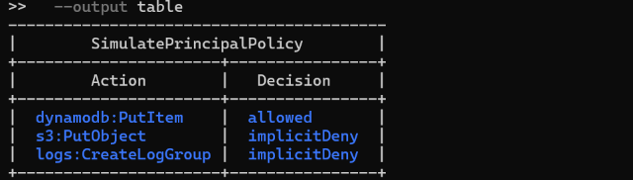




Least privilege, audited
Function | Allowed | Cannot
cp-ingest | dynamodb:PutItem on one table | read anything
cp-query | dynamodb:Query | write anything
cp-stats | dynamodb:Query | write anything
cp-auth | cognito-idp:InitiateAuth | touch the database
cp-health | write its own logs | anything else
Proof: IAM policy simulator on the cp-ingest role
aws iam simulate-principal-policy: PutItem allowed; S3 writes and log-group creation denied
Why five small functions?
Every AWS call in the code matched against every permission granted: exact match, no extras
cp-ingest faces the internet. If someone found a flaw in it, the worst they could do is add junk events. They could not read a single student request, delete data or reach another service.
dynamodb:Scan is granted to nobody, so an accidental full-table read fails loudly
No AWS keys anywhere in the code; functions get temporary credentials from their role
Threat model: 7 threats, each with controls marked implemented or configured
Notes:
MEHA (about 40 s): Least privilege in practice: five functions, five roles. cp-ingest, the one facing the internet, can write to one table and cannot read anything; the query functions read but never write; cp-auth only calls Cognito. We audited it: every AWS call in the code against every permission granted, an exact match. Nobody may Scan, and there are no AWS keys in the code. On the right, the IAM policy simulator on the deployed ingest role: PutItem allowed, everything else denied. Madhavan will now show where the events come from.

Slide 8
The campus simulator
Madhavan
MA
What it does
Terminal
Plays the role of the campus IoT sensors
Logs in through Cognito like any user and refreshes its token
Sends realistic readings for 5 buildings and 11 rooms
Mixes normal readings with a controllable rate of anomalies
Python standard library only: nothing to install on demo day
# steady stream, 1 event every 5 s (default)
python simulator.py --interval 5
# guarantee a critical alert for the demo
python simulator.py --force-alert -n 1
# refuses --interval below 0.5 s (cost guard)
Six event types
A bug we found and fixed
occupancy
people
temperature
°C
humidity
%
--force-alert first used 105-145 % occupancy, which straddles the 120 % critical line, so a forced alert sometimes arrived as only a warning. We moved the range well past critical and checked it over 300 generated events.
energy
kWh
equipment
status
service_request
priority
Notes:
MADHAVAN (about 40 s): Thank you. With no real sensors, I built a simulator that plays the campus devices. It logs in through Cognito like a user, keeps its token fresh, and sends readings for all five buildings and eleven rooms, with a controllable share of anomalies. It uses only the Python standard library, so nothing can fail to install on demo day, and it refuses to send faster than every half second, to protect our budget. One real bug: force-alert used a range that straddled the critical threshold, so a forced alert sometimes arrived as a warning. We fixed the range and verified it over three hundred events.

Slide 9
Testing: 176 checks, 0 failures
131
45
0
unit tests in about 1 second, no AWS account needed
API checks against the live deployment (5 Oct 2026)
failures in either suite
Unit tests (pytest)
API suite (no dependencies)
Suite | # | Proves
test_validation | 30 | every kind of invalid event rejected
test_rules | 37 | both sides of every threshold
test_queries | 24 | 5 access patterns; no query can become a Scan
test_aggregate | 15 | every /stats field
test_keys | 7 | keys, TTL, sparse alert index
test_generator | 18 | 1,000 simulated events through the real validator
Group | Checks
T1 Reachability | 2
T2 Authentication | 6
T3 Authorization | 8
T4 Ingestion | 12
T5 Invalid input | 7
T6 Queries & stats | 6
T7 End-to-end | 4
Key checks
T3: staff gets 403 on /alerts, 200 on /events
T4.4: client sends normal, server returns critical
Notes:
MADHAVAN (about 45 s): We test in two layers. A hundred and thirty-one unit tests run in about a second with no AWS account, because the business logic contains no cloud code. Two are design guarantees: no query we build can become a table scan, and a thousand simulated events pass through the real validator. Then forty-five API checks run against the live system for what unit tests cannot see: routing, permissions and tokens. All passed on the fifth of October. The key ones: staff gets 403 on alerts, and an over-capacity event comes back critical even when the client says normal.

Slide 10






Live demo
1
Dashboard open, signed in as ops
10 s
About 1 minute
Five tiles, alerts, occupancy and energy from earlier runs
Smoke test run 30 minutes before, which also warms up the Lambdas so the first call is not a cold start.
2
Start the simulator
15 s
Events stream in; tiles update within 10 seconds
3
python simulator.py --force-alert -n 1
15 s
If anything fails
A red CRITICAL row appears with its reason
Switch to the recorded backup video and the evidence screenshots on the next slides. No live debugging on stage.
4
Sign in as staff
15 s
The alerts panel is gone; /alerts returns 403
Notes:
MADHAVAN (about 55 s, mostly the demo): [1] The dashboard is open, signed in as ops. [2] I start the simulator; readings stream in and the tiles update within ten seconds. [3] Now I force one alert: the simulator sends one reading pushed well past the critical threshold, while the client still labels it normal. A red critical row appears with the reason in plain words. [4] I sign in as staff: the alerts panel disappears, and the API returns 403 on that route. Hiding the panel is convenience; the 403 is the control. If the network fails, we switch to the backup video. MD, over to you.

Slide 11
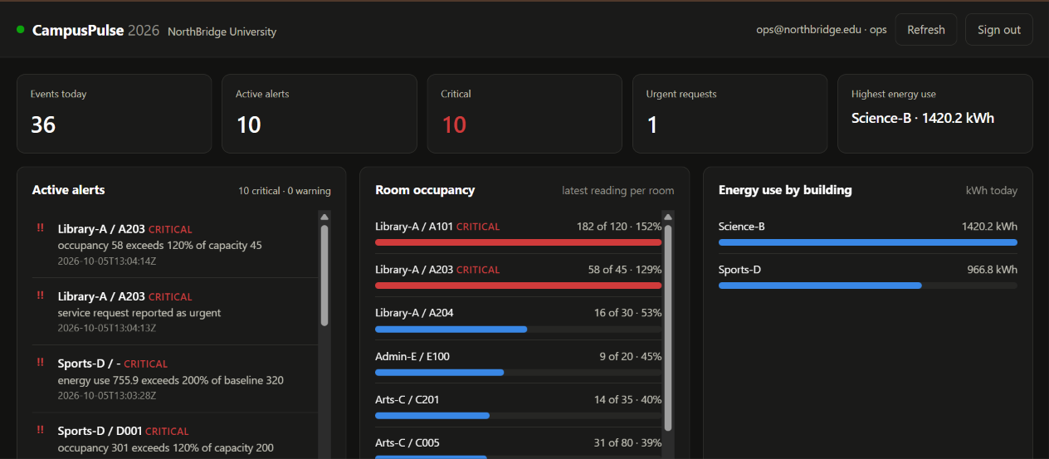




The operations dashboard
MD
MD
Polls every 10 seconds
GET /events, /alerts and /stats
Stops when nobody looks
Pauses when hidden or after 15 idle minutes: a forgotten tab would cost ~17,000 calls a day
Role-aware
staff never see the alerts panel; the token lives in sessionStorage, cleared when the tab closes
Page holds no data
Live dashboard, signed in as ops, 5 Oct 2026
S3 serves HTML, CSS and JS; every number comes from the API
A bug no test could catch: the login form rendered underneath the dashboard. The hidden attribute was set, but a CSS rule (display: grid) overrode it. Every test passed; we found it only by opening the page and looking. Fixed with one line.
Notes:
MD (about 40 s): Thank you. This is the dashboard the operations team uses, with real data from our deployment: five tiles, active alerts with their reasons, occupancy against capacity, and energy by building. It is plain HTML, CSS and JavaScript. It polls every ten seconds but stops when the tab is hidden or idle for fifteen minutes, because a forgotten tab would make about seventeen thousand paid requests a day. The page holds no data, so it can sit in a public S3 bucket safely. One lesson: the login form once rendered under the dashboard; every test passed, and we only found it by looking.

Slide 12
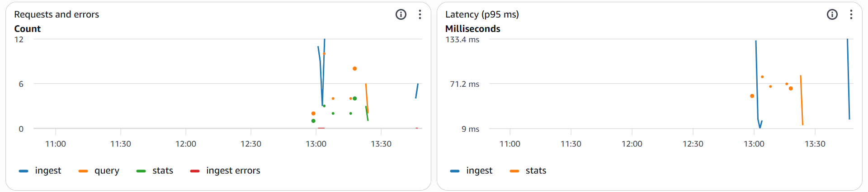
Observability with Amazon CloudWatch
133.4 ms
Lambda p95 latency under simulator load (p95, not an average that hides a slow tail)
CloudWatch dashboard campuspulse-dev-operations: requests, errors and p95 latency
Structured JSON logs
Four alarms
One request_id links the API access log, the function log and the error response
Alarm | Fires at | Watches
ingest-errors | ≥ 1 Lambda error / 5 min | the system
api-5xx | ≥ 1 server error / 5 min | the front door
alert-burst | ≥ 20 alerts / 5 min | the campus
invocation-ceiling | ≥ 2,000 calls / 5 min | the budget
Metrics from log lines (EMF)
EventsIngested, AlertsRaised, StatsRequested with no extra API call
7-day log retention
Set explicitly; the default is never expire
Missing data is treated as OK, so quiet nights don't leave alarms grey and ignored.
Notes:
MD (about 40 s): To watch the system itself we use CloudWatch. Every function writes structured JSON logs with a request id that also appears in the API access log, so one id ties an error to its whole story. Our metrics come straight out of those log lines with Embedded Metric Format, with no extra API calls. Under simulator load, p95 latency was 133 milliseconds. Four alarms: two watch the system, one watches the campus for a burst of alerts, and one watches the budget, because a runaway loop is a spending problem before it is a technical one.

Slide 13
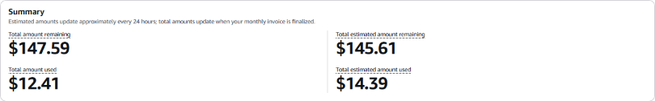
Cost: measured, not guessed
$1.98
$14.39
≈ $32
billed this month against a $10 budget
estimated credit use of $160 (whole account)
per month saved by having no NAT Gateway
Decisions that keep it cheap
Evidence from the AWS billing console
Decision | Effect
No VPC, EC2, RDS or load balancer | nothing bills by the hour
HTTP API instead of REST API | 3.5× cheaper per request
Log retention 7 days, TTL 30 days | storage cannot grow forever
Cognito Essentials, not Plus | stays in the free allowance
Dashboard polling pauses when idle | no forgotten-tab traffic
Budget | Limit | Used | Forecast
campuspulse-dev-monthly | $10.00 | $1.98 | $14.62
Credits page: $14.39 estimated used, $145.61 remaining
The forecast alert has already fired ($14.62 forecast > $10), so the budget alarm is proven to work.
Notes:
MD (about 45 s): Cost, with real numbers from the billing console. This month our budget shows a dollar ninety-eight billed against a ten-dollar limit. The credits page shows about fourteen dollars of estimated usage out of a hundred and sixty; that covers the whole account, which also holds other coursework. The forecast alert has already fired, so we know the alarm works. The biggest saving is architectural: no VPC means no NAT Gateway, about thirty-two dollars a month avoided. Nothing in this design bills by the hour. To close, one lesson from each of us.

Slide 14
What we did
SG
Somitha Gudivada
ME
Meha
A careful data model shapes every query after it: the partition key and TTL decided our speed and our cost.
Authentication working is not authorization being correct. We had to audit every single route.
MA
Madhavan
MD
MD
Testing against the live API found three validation gaps that unit tests had missed.
Some bugs only exist visually. We found the hidden-login bug by looking at the page, not by a test.
Honest limits: single region · ~1,000 writes/s per day partition (fix designed: shard the key) · threshold rules, not ML · tokens valid until expiry
Notes:
ALL FOUR (about 40 s, in order). SOMITHA: A careful data model shapes every query after it; our partition key and TTL decided our speed and our cost. MEHA: Authentication working is not authorization being correct; we audited every route. MADHAVAN: Testing against the live API found three validation gaps unit tests missed. MD: Some bugs only exist visually; we found one by looking at the page. SOMITHA: Our limits are stated: one region, a write ceiling with a designed fix, threshold rules rather than machine learning. Thank you, we are happy to take questions.

Slide 15
Thank you
Notes:
ALL FOUR (about 40 s, in order). SOMITHA: A careful data model shapes every query after it; our partition key and TTL decided our speed and our cost. MEHA: Authentication working is not authorization being correct; we audited every route. MADHAVAN: Testing against the live API found three validation gaps unit tests missed. MD: Some bugs only exist visually; we found one by looking at the page. SOMITHA: Our limits are stated: one region, a write ceiling with a designed fix, threshold rules rather than machine learning. Thank you, we are happy to take questions.

