Slide 1


SMART INDIA HACKATHON 2026
Problem Statement ID –​ SIH26012
Problem Statement Title- AI-Based Automated Urban Parcel Mapping and Cadastral Feature Extraction System using Drone lmagery
Theme- Smart automation
PS Category- Software
Team ID-
Team Name (Registered on portal)-CT Naksha

Slide 2


CadAstra-AI Urban Parcel Mapping
Turning data into Smarter yields
CT
Naksha
Core Concept --> It is a modern, production‑ready web application that turns UAV/drone imagery into verified cadastral parcels.
Data Ingestion: Upload and read image data.
Parcel Generation: Create parcel polygons.
Human Verification: Review and edit parcels.
Configuration & Governance: Manage settings and system status.
-> How It Addresses the Problem:
The solution reduces manual parcel mapping through AI, improves accuracy with confidence-based human verification, and enables fast change detection.
->Innovation and Uniqueness:
Hybrid AI + Human: Combines AI detection with human approval.
Swipe-Map Detection: Easily compares current and historical parcels.
Zero-Code Deployment: Runs the demo without complex setup.

Slide 3
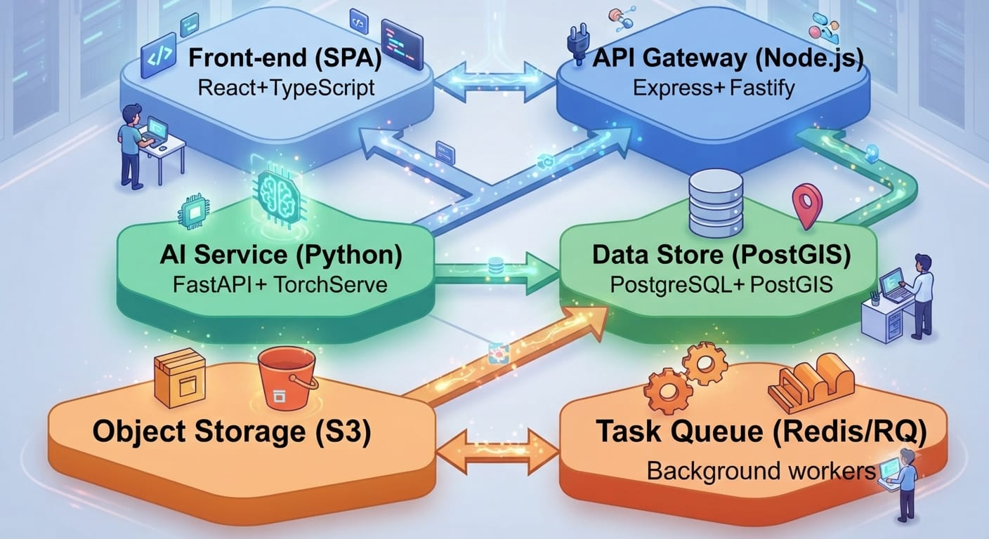
TECHNICAL APPROACH
CT Naksha
AI/ML Processing: Uses PyTorch + U-Net (ResNet-34) for building-footprint extraction, with OpenCV for detecting fences, walls, roads, and other physical boundaries.
Geospatial Processing: Applies Rasterio, GeoPandas, Shapely, and Watershed-based constrained tessellation to generate topology-aware cadastral parcel polygons.
• Data Storage & Management: Stores drone GeoTIFF/PNG imagery and outputs in S3/MinIO, while PostgreSQL + PostGIS manages spatial geometries, project metadata, and GeoJSON results.
• Asynchronous & Scalable Architecture: Uses Node.js API Gateway + Redis + RQ/Celery to handle long-running AI jobs asynchronously, with Docker and Kubernetes enabling scalable GPU-based workers.
• Accuracy, Validation & Delivery:Assigns boundary confidence scores, performs human-in-the-loop validation, and delivers verified cadastral polygons through an interactive React + Mapbox/Leaflet interface.

Slide 4
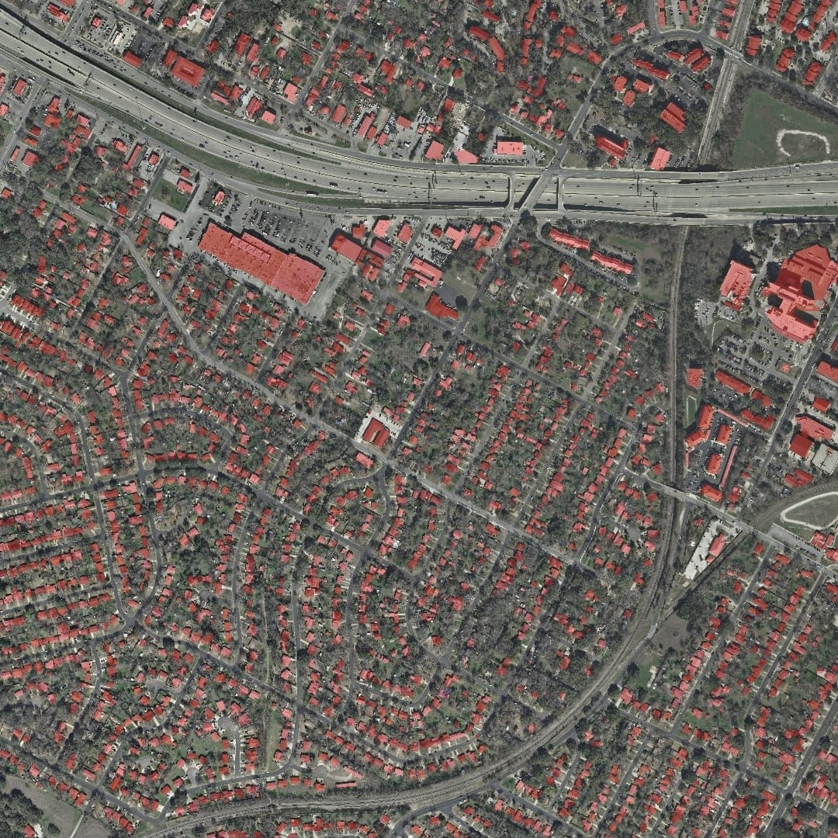
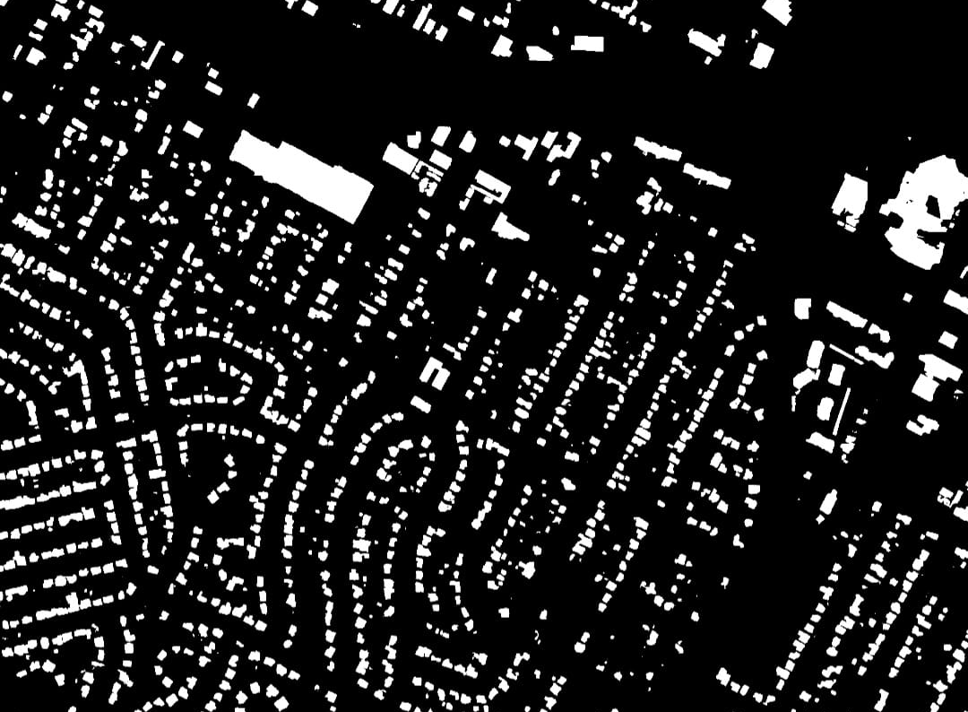

FEASIBILITY AND VIABILITY
CT
Naksha
FEASIBILITY:
AI & Inference: Proven AI models can accurately detect parcels and process imagery quickly using GPUs.
Data & UI: PostGIS/S3 reliably handle large geospatial data, while MapLibre provides fast map visualization.
Scalability & Security: Docker/Kubernetes enable scaling, while authentication, encryption, and audit logs support secure deployment.
Potential Challenges and Risks:
Data Privacy: Land records and geospatial data may contain sensitive information requiring strong security.
Problem & Competition: Replaces slow manual GIS workflows with affordable, AI-powered cadastral mapping.
User Adoption: Government organizations may be slow to adopt new AI-based systems due to existing workflows and resistance to change.
Strategies for Overcoming Challenges:
Accuracy: Use human verification, quality checks, and continuous AI model training with local survey data.
Adoption: Provide training, guided demonstrations, simple workflows, and pilot projects before large-scale deployment.
                @SIH Idea submission- CT Naksha

Slide 5
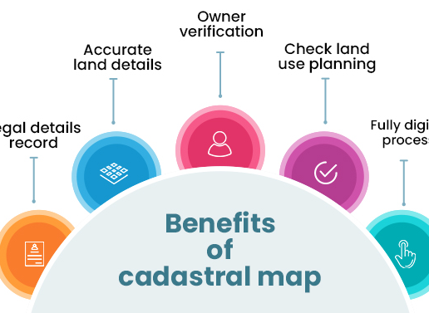
IMPACT AND BENEFITS
CT
Naksha
Faster Operations: Reduces time required for parcel mapping and verification.
Better Accuracy: Improves cadastral data quality and reduces human errors.
Lower Costs: Reduces manual surveying and digitization expenses.
Greater Transparency: Provides audit trails and human-verified records.
Environmental Benefit: Reduces repeated field surveys and unnecessary travel.
Better Planning: Enables faster land-use monitoring and informed urban planning.
.
                @SIH Idea submission- CT Naksha

Slide 6
RESEARCH AND REFERENCES
Here are few references and research links:
CT
Naksha
https://arxiv.org/abs/1505.04597
https://arxiv.org/abs/2103.14030
https://ieeexplore.ieee.org/document/9511234
https://bhuvan-panchayat3.nrsc.gov.in/
https://project.inria.fr/aerialimagelabeling/
https://spacenet.ai/dataset/
https://www.mdpi.com/2072-4292/12/5/803
https://openaccess.thecvf.com/content_cvpr_2017/html/Zhang_Bi-Directional_Cascade_Network_CVPR_2017_paper.html
https://bhuvan-ows.nrsc.gov.in/bhuvan/wms

