Slide 1
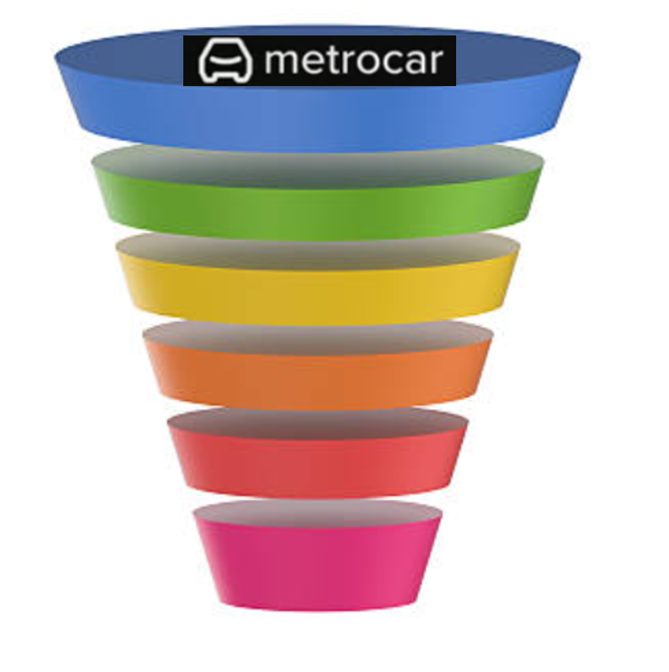
Metrocar
Funnel Analysis
Somiya Khurram

Slide 2
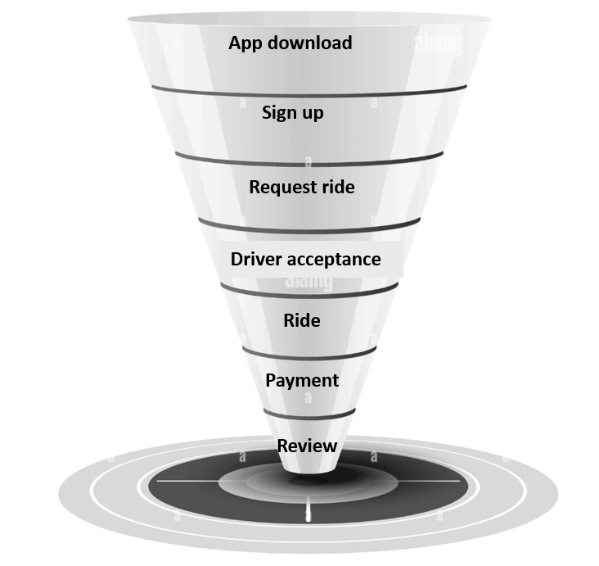
Metrocar's User Funnel

Slide 3
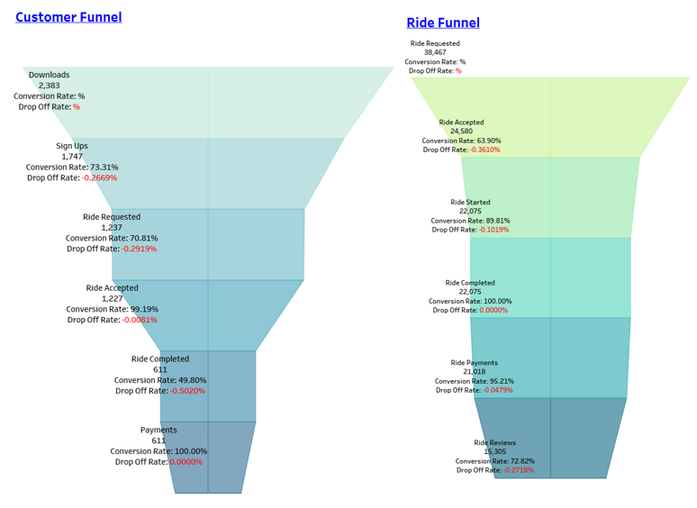
Understanding the Power of Funnel Analysis
Quantifying Drop-off: Identify where users exit the funnel and understand bottlenecks.
Identifying Causes: Uncover the reasons behind attrition and address root causes.
Taking the Right Actions: Develop data-informed strategies to improve user engagement and conversion.

Slide 4
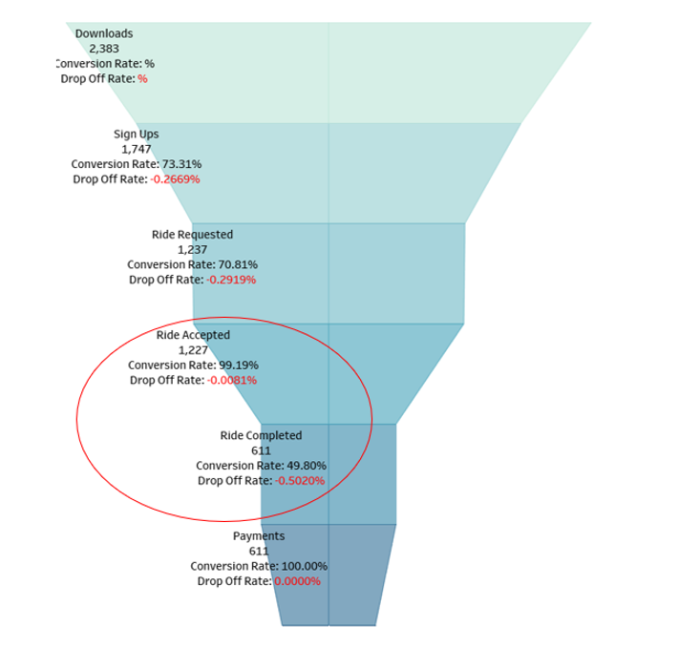
What steps of the funnel should we research and improve?
Drop-off between "Rides Accepted" and "Completed" is significant (50% drop).
Waiting time impacts cancellation rates.
Huge volume during peak hours

Slide 5
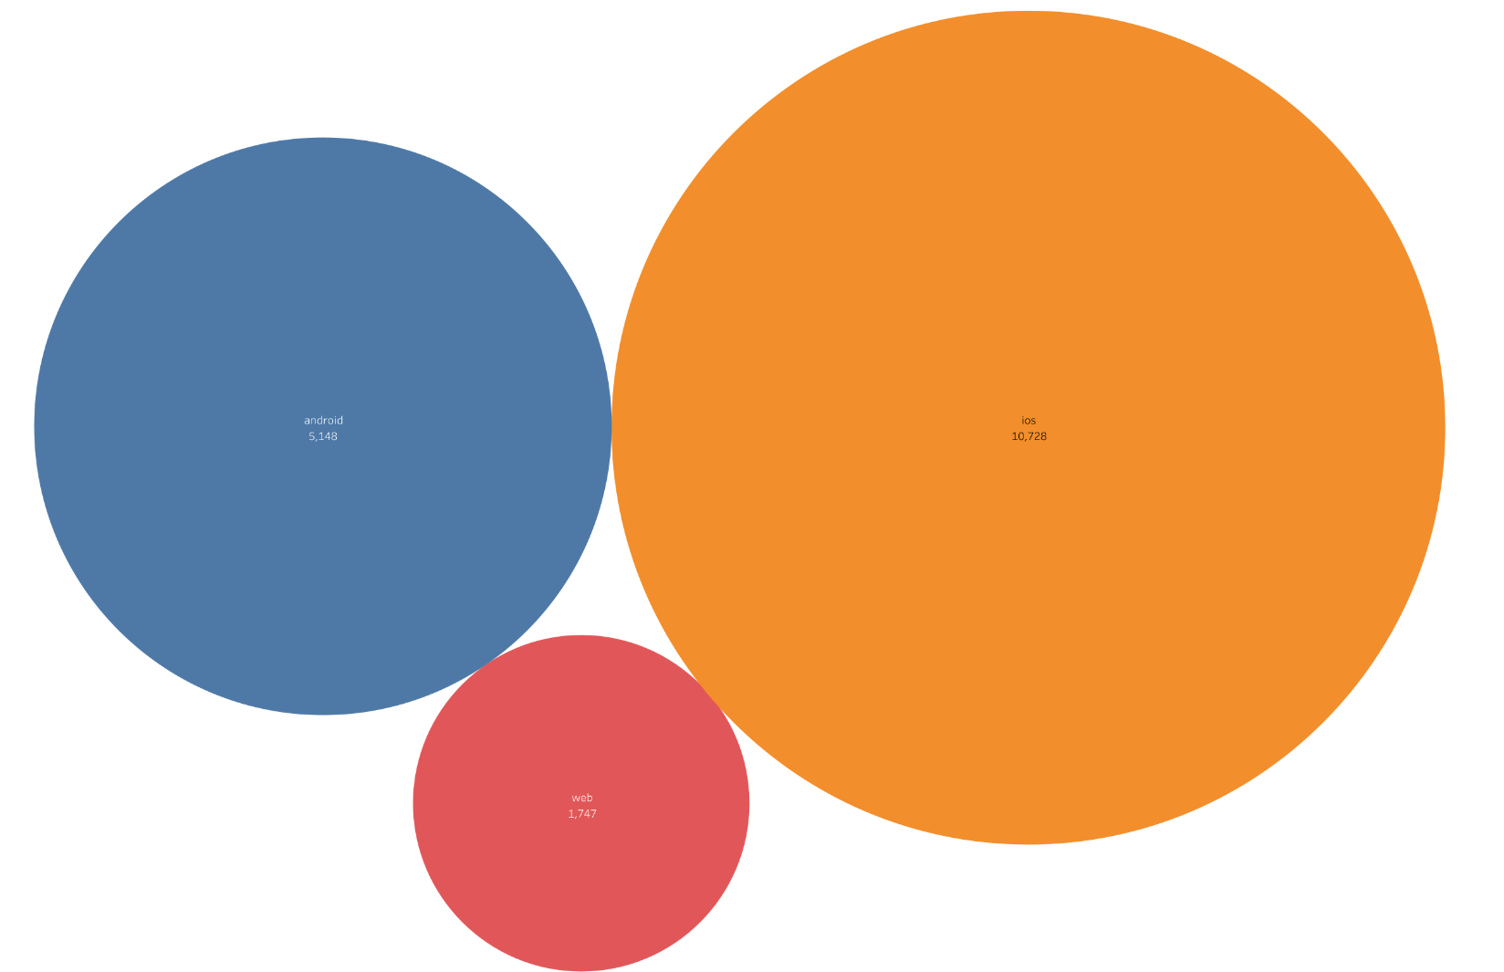
Where to focus marketing budget based on platforms?
Allocate budget primarily to iOS, the best-performing platform(55%)
Reduce web channel budget due to underperformance
Consider reallocating resources to Android due to its wider user base

Slide 6
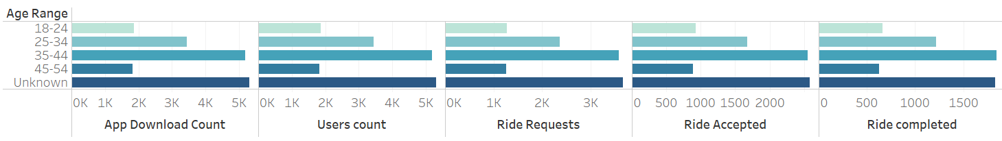
Which age groups perform best at each stage?
Ages 35-44 have the highest user performance.
Consider focusing on age groups 25-34 and 35-44.
Note that many users did not share their age.

Slide 7
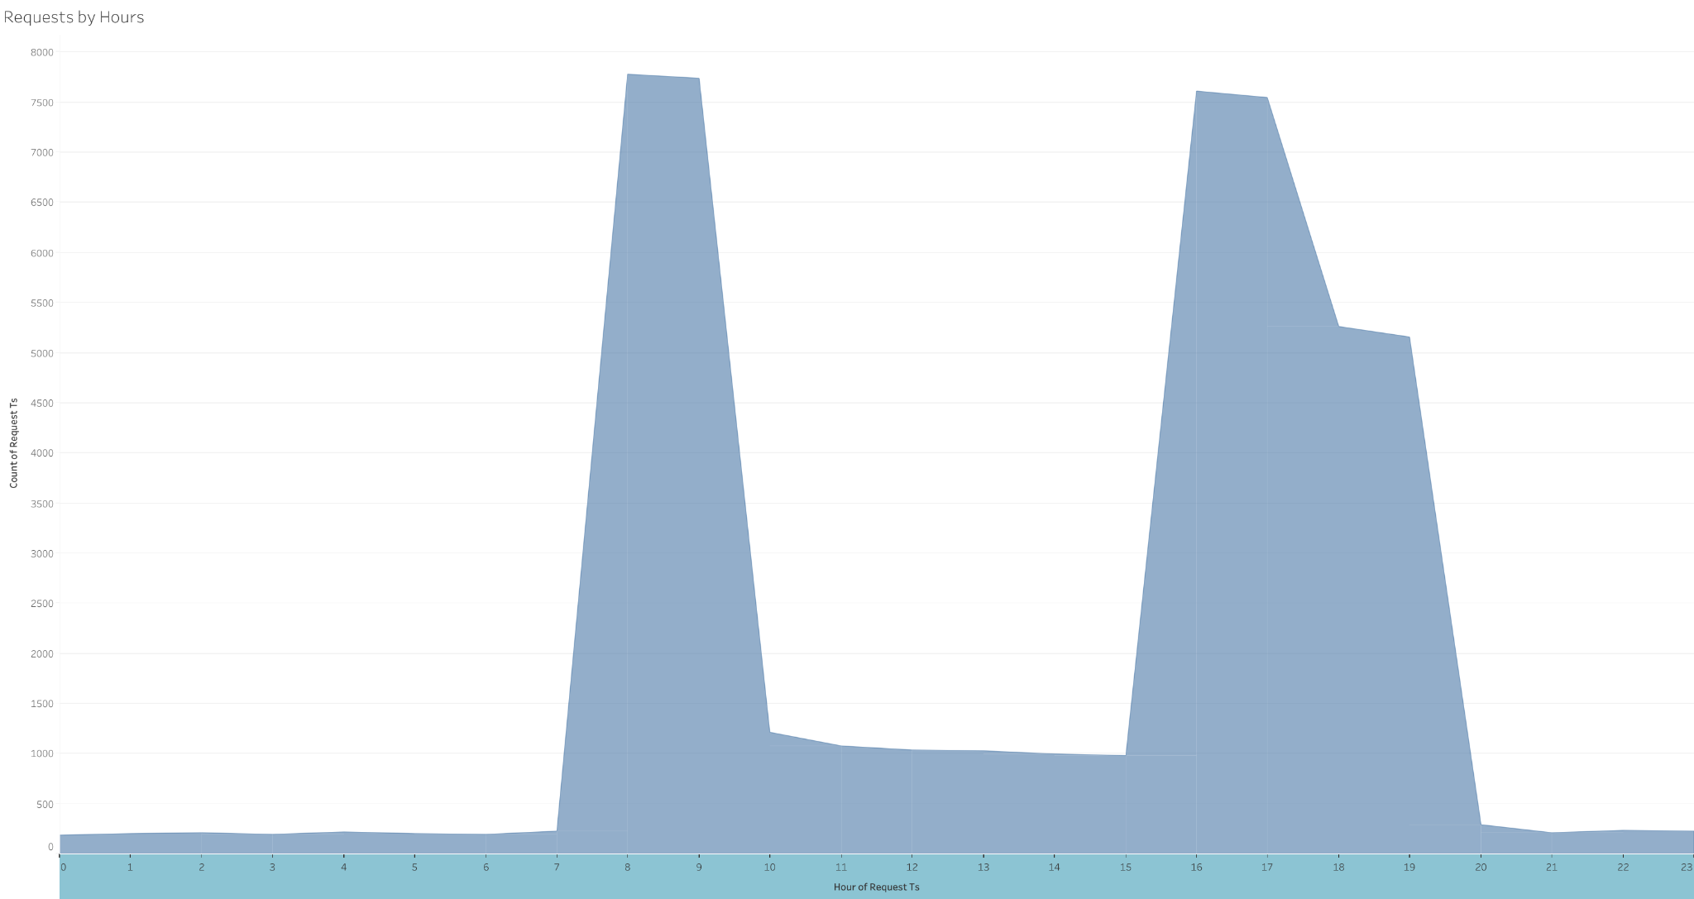
What does the distribution of ride requests look like throughout the day?
Two daily peaks: 8-10 AM and 3-8 PM.
Surge pricing can help balance supply and demand.
Be cautious about negative impacts on reputation and customer churn.

Slide 8
What part of our funnel has the lowest conversion rate?
Lowest conversion rate at the "Ride Completed" stage.
Suggest offering a discount after the first ride.

Slide 9
Recommendations
Promote driver availability in regions with a high incidence of ride cancellations.
Implement price surge strategies to enhance driver availability during peak hours
Introduce a ride-sharing feature: potential to reduce CO2 emissions through minimizing unnecessary driver travel
Metrocar's primary target demographic consists of individuals aged 35 to 44
Allocate marketing budgets with a focus on iOS platforms (55%)

Slide 10
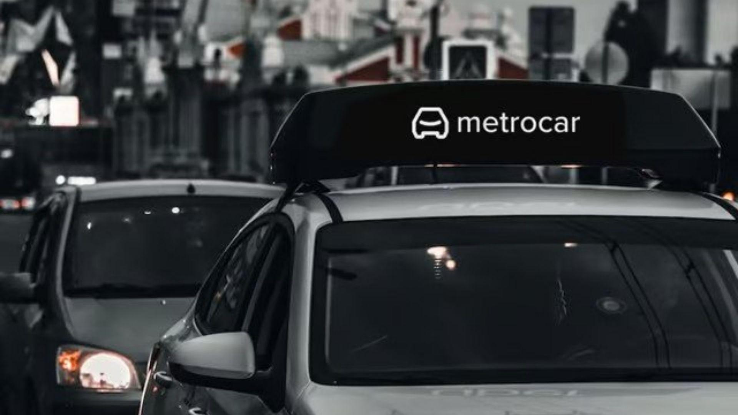
Thank You!

