Slide 1

FACEBOOK 2.0
PHP - DATABASE

Slide 2




START
MARCH 14th
DEVELOP
MARCH 21th Midnight
PRESENT
MARCH 24th
DESIGN
CODE
END
JURY

Slide 3

HOW WILL WE EVALUATE ?
YOUR
PROJECT
YOUR
PRESENTATION
30 %
70 %

Slide 4

YOUR PROJECT
Project development | 30
Features | 70

Slide 5




PROJECT DEVELOPMENT
E1
E2
E3
E4
E5
DATABASE DESIGN
UX/UI
GIT WORKFLOW
TEAM WORK
CLEAN CODE
10
10
10
10
10

Slide 6





MANDATORY FEATURES
F1
F2
F3
F4
ADD POST
DISPLAY POSTS
DELETE POST
EDIT POST
10
10
10
20

Slide 7








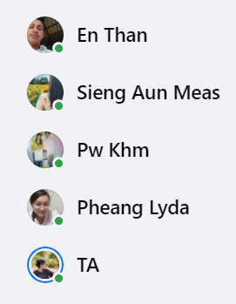


OPTIONAL FEATURES
F5
F6
F7
F8
F9
F10
F11
VALIDATION INPUT
UPLOAD IMAGE IN POST
LIKE POST
ADD COMMENT ON POST
EDIT COMMENT
DELETE COMMENT
DISPLAY COMMENTS
20
30
30
10
20
10
20
F12
F13
F14
F15
F16
F17
F18
ADD FRIEND
REGISTER ACCOUNT
SIGNIN / SIGNOUT
LIST ALL FRIENDS
UPDATE PROFILE
MANAGE ROLE
SEARCH POST
30
20
20
20
20
20
20

