Slide 1



Mindful Minutes
Somnath, 28
Upload Photo
Today |  | This Week
7m |  | 46m
Lifetime 2.1k
 |  | Settings
Badge 1 | Badge 2 | Badge 3
Badge k
J• uInri s
Meditate

Slide 2


Mindful Minutes
Today
15min
Week
1hr45min
Month
5hr3omin
Mindful minutes per week
Week
Mon
Tue
Wed
Thu
Fri
Sat
Sun
Start a new session Mindfulness for eve yday life 2 -10 non
Learn more about mindfulness
Home
Mindfulness Mend i'ate
Sleep
Pratice

Slide 3
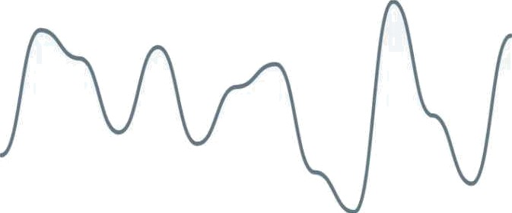

Mindful Minutes
Today
Smin
Week
2omin
Mindful minutes overtime
3omin
week +10%
Mon
Tue
Wed
Thu
Fri
Sat
Sun
New mindful session Start a new meditation or mindfulness session
Home
My Day
Trackers
Profile

Slide 4
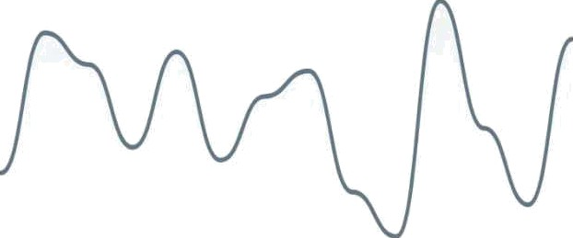

Mindful Minutes
Today
7m
This Week
46m
Lifetime
2.1k
Mindful Minutes
7m
Tacay +15%
Mon
Tue
Wed
Tnu
Fri
Sat
Sun
J WL›! f^‹aI
Meditate

