Slide 1


UK Road Accidents
(2005-2017)

Slide 2
1. Approach
2. Question
3. Timeframe of Accidents and possible reason
4. Presence of Police Officer with respect to Urban or Rural Area and Districts where police came late
Contents
5. Effect of Light Condition and Weather Condition on Number of Accidents
6. Highest Number of Accidents in Day of Week and Possible Reason
7. Relation of Number of Casualties with Speed Limit
8. Relation of Number of Vehicles with Number of Casualties

Slide 3
Approach
1. Data tables downloaded from UK Road Safety: Traffic Accidents and Vehicles | Kaggle (primary source)
2. Formatted, compiled and cleaned in one single dataset
3. The columns Time, Police Presence, Urban or Rural Area, Local District Authority, Light Condition, Weather Condition, Day of Week, Number of Accidents, Number of Casualties , Speed Limit and Number of Vehicles.be considered to answer our questions
Github Repo :
SomnathTheAnalyst/UK_Road_Accidents (github.com)
SQl Code :
UK_Road_Accidents/UK_Road_Accidents.sql at main · SomnathTheAnalyst/UK_Road_Accidents (github.com)
Cleaned Datasets :
https://www.kaggle.com/datasets/somnathnaskar/uk-road-accidents-cleaned

Slide 4
Questions
1. Timeframe of Accidents and possible reason
2. Presence of Police Officer with respect to Urban or Rural Area and Districts where police came late
3. Effect of Light Condition and Weather Condition on Number of Accidents
4. Highest Number of Accidents in Day of Week and Possible Reason
5. Relation of Number of Casualties with Speed Limit
6. Relation of Number of Vehicles with Number of Casualties

Slide 5
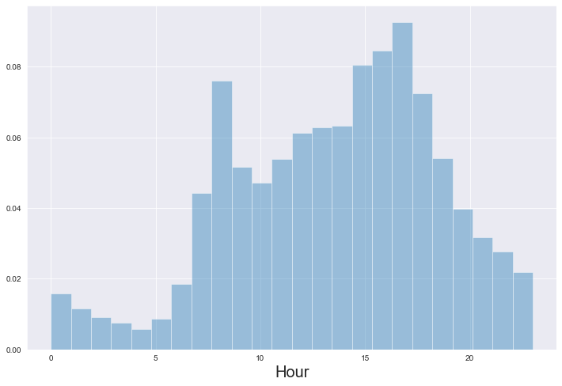
1. Timeframe of Accidents and possible reason
From 8-10AM and 15-17PM, there is a higher Number of Accidents than rest of the day. Reason may be there is a hurry to leave for workplace and getting back from workplace.

Slide 6
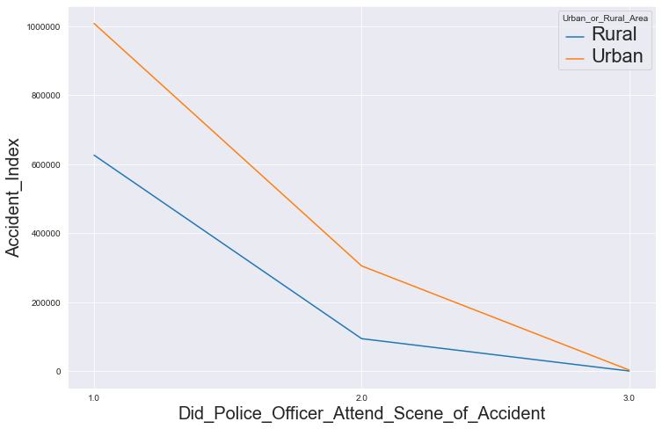
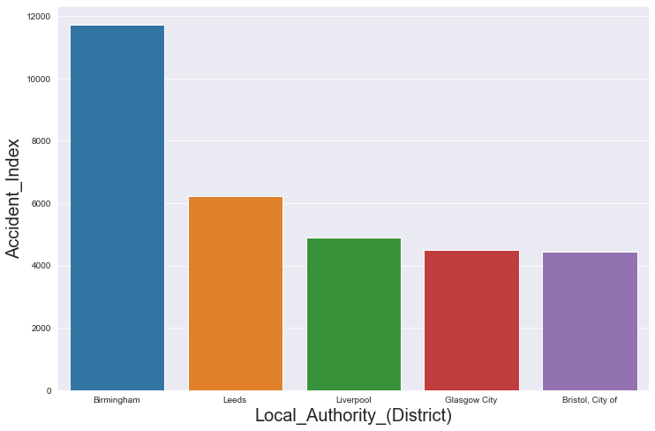
2. Presence of Police Officer with respect to Urban or Rural Area and Districts where police came late
It is evident that in Urban areas , the Number of Police came late to the Accident spot is less than Rural areas. The top 5 Local_Authority_(District), where Police came late are Birmingham, Leeds, Liverpool, Glasgow City and Bristol.

Slide 7
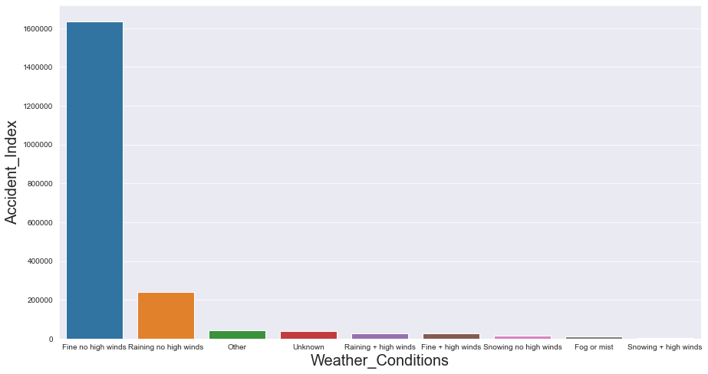
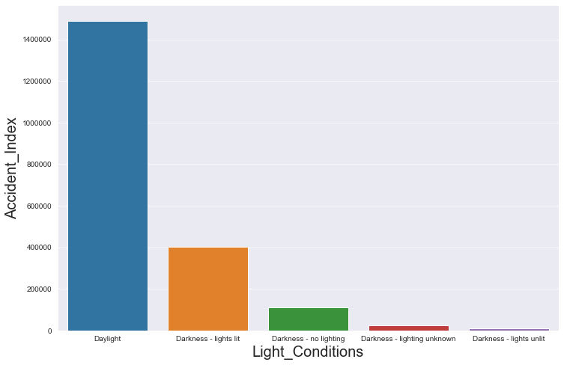
3. Effect of Light Condition and Weather Condition on Number of Accidents
Highest number of accidents happened in Fine no high winds-Daylight conditions. Second highest number accidents happened in Raining no high winds-Darkness light lit conditions. So it is evident that more than 70% of the accidents haven't affected by adverse conditions of Light and Weather. .

Slide 8
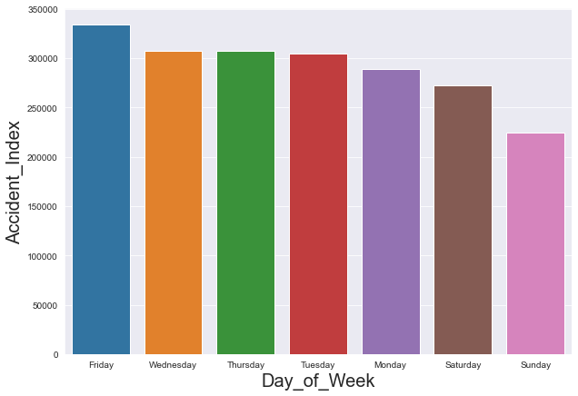
4. Highest Number of Accidents in Day of Week and Possible Reason
Highest number of accidents happened in Friday and Lowest Number of accidents happened in Sunday. Friday being the last day of work and Sunday being Holiday in a week .

Slide 9
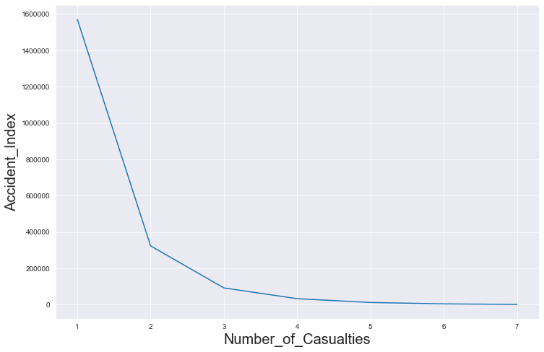
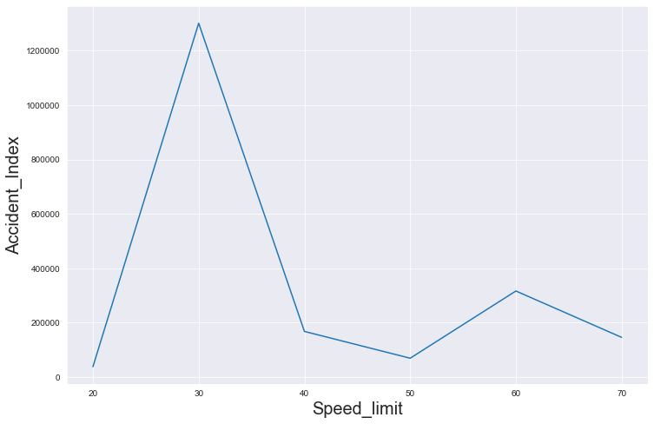
5. Relation of Number of Casualties with Speed Limit
Number of accidents below 20 Speed Limit is very low i.e. <30 accidents. More than 63% accidents happened with Speed Limit of 30Kmph and more than 77% of accidents caused casualties of 1.

Slide 10
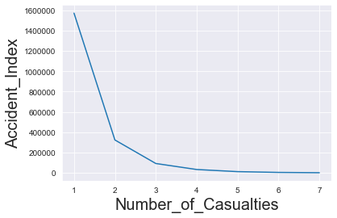
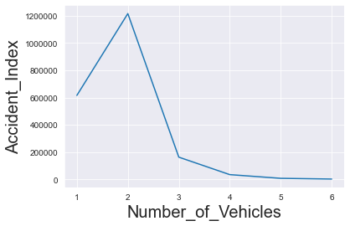
6. Relation of Number of Vehicles with Number of Casualties
Highest number of accidents happened with Two Vehicles and One Casualty. Second Highest Number of Casualties happened with One Vehicles and Two Casualty.

