Slide 1

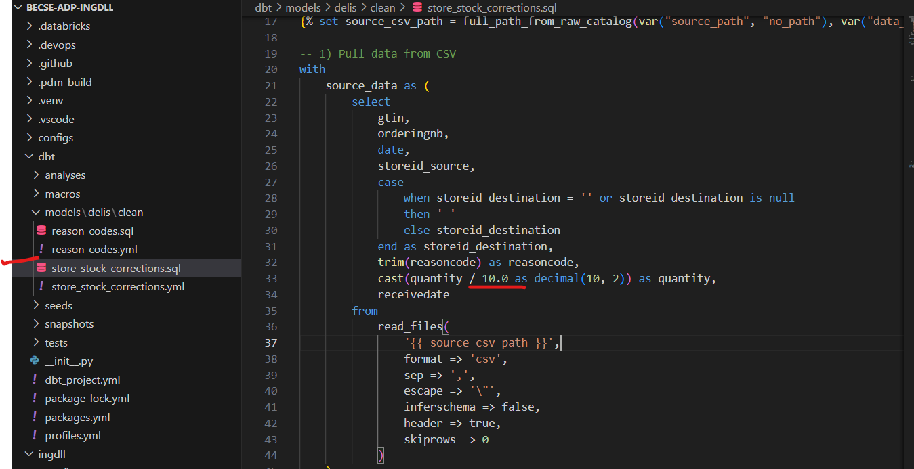
Brand Fee - Adapt calculation logic

Slide 2
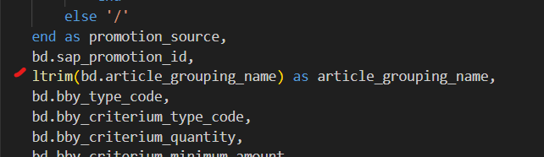
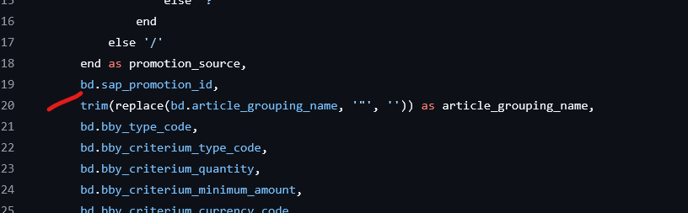
Implement fixes on Bonus Buy Definition
Before
Fix

Slide 3
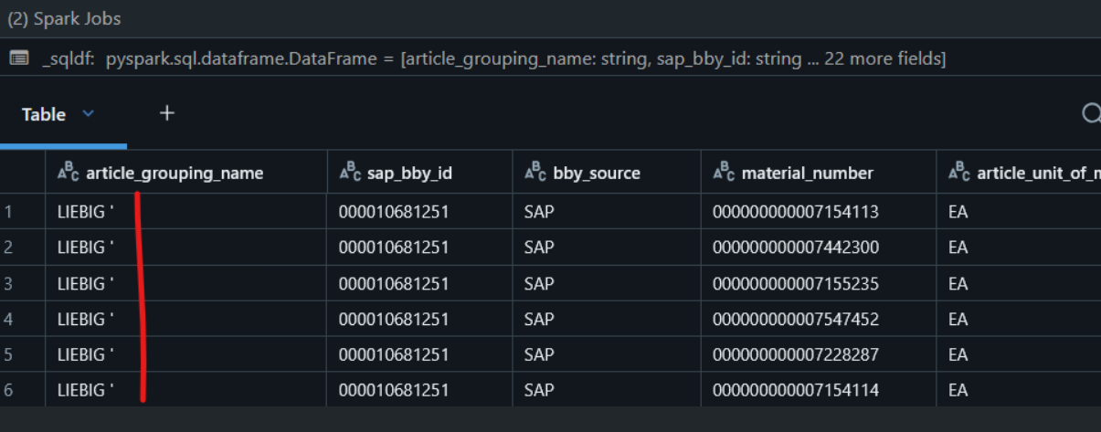
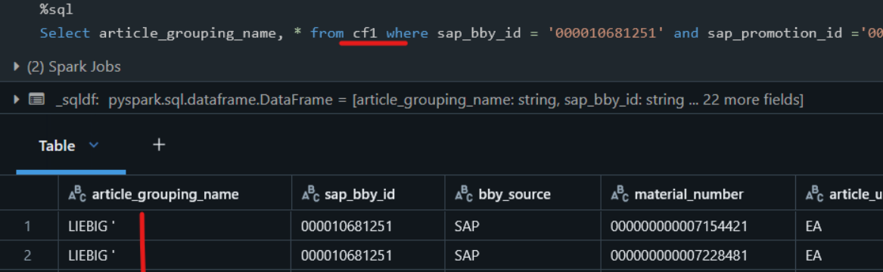
Implement fixes on Bonus Buy Definition
Result-cf2
Result-cf1

