Slide 1


Slide 2

PREFACE
ABOUT THE BOOK
This book contains 200 very important React interview questions.
ABOUT THE AUTHOR
Happy Rawat has around 15 years of experience in software development. He helps candidates in clearing technical interview in tech companies.

Slide 3

Chapters
Hooks
7. useState/ useEffect
8. useContext/ useReducer
9. useCallback/ useMemo/…
10. Short Answer
Fundamentals
1. React-Basics - I
2. React-Basics - II
3. Project Files & Folders
4. JSX
5. Components (Functional/Class)
6. Routing
Advance
11. LifeCycle Methods - I
12. LifeCycle Methods - II
13. Controlled Components
14. Code Splitting
15. React - Others
Bonus
20. JS Essentials for React
Redux
16. Action/ Store/ Reducer
17. Core Principles/ Pros-Cons
18. Short Answer
19. Thunk/ Middleware/ Flux

Slide 4

1: React-Basics - I
Q1. What is React? What is the Role of React in software development?
Q2. What are the Key Features of React?
Q3. What is DOM? What is the difference between HTML and DOM?
Q4. What is Virtual DOM? Difference between DOM and Virtual DOM?
Q5. What are React Components? What are the main elements of it?
Q6. What is SPA(Single Page Application)?
Q7. What are the 5 Advantages of React?
Q8. What are the Disadvantages of React?
Q9. What is the role of JSX in React? (3 points)
Q10. What is the difference between Declarative & Imperative syntax?
Back to main index

Slide 5





Q. What is React? What is the Role of React in software development?
UI/ Client/ Frontendend
API Server/ Middleware
Database Server
Request
Response
CSS, HTML & Javascript
(languages)
C# / Java / PHP
(languages)
SQL
(languages)
React (library)/ Angular
(framework)
.NET(C#) / Spring(Java) / Laravel(PHP)
(framework)
SOL Server / Oracle
(RDBMS)
back to chapter index

Slide 6
Q. What is React? What is the Role of React in software development?
3 Main Point about React:
React is an open source Javascript Library.
React is used for building user interfaces(UI).
React simplifies the creation of SPA by using reusable components.
back to chapter index

Slide 7
Q. What are the Key Features of React?
7 Key Features of React
1. Virtual DOM
2. Component Based Architecture
3. Reusability & Composition
5. Declarative Syntax
7. React Hooks
6. Community & Ecosystem
4. JSX
(JavaScript XML)
back to chapter index

Slide 8
Q. What are the Key Features of React?
1. Virtual DOM:
React utilizes a virtual representation of the DOM, allowing efficient updates by minimizing direct manipulation of the actual DOM, resulting in improved performance.
2. Component-Based Architecture:
React structures user interfaces as modular, reusable components, promoting a more maintainable and scalable approach to building applications.
3. Reusability & Composition:
React enables the creation of reusable components that can be composed together, fostering a modular and efficient development process.
4. JSX (JavaScript XML):
JSX is a syntax extension for JavaScript used in React, allowing developers to write HTML-like code within JavaScript, enhancing readability and maintainability.
5. Declarative Syntax:
React have a declarative programming style(JSX), where developers focus on "what" the UI should look like and React handles the "how" behind the scenes. This simplify the code.
6. Community & Ecosystem:
React benefits from a vibrant and extensive community, contributing to a rich ecosystem of libraries, tools, and resources, fostering collaborative development and innovation.
7. React Hooks:
Hooks are functions that enable functional components to manage state and lifecycle features, providing a more concise and expressive way to handle component logic.
back to chapter index

Slide 9
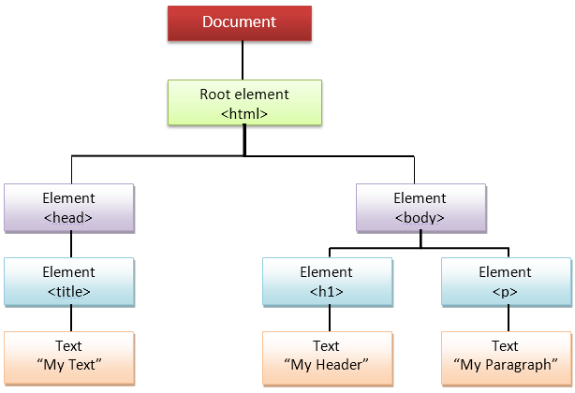
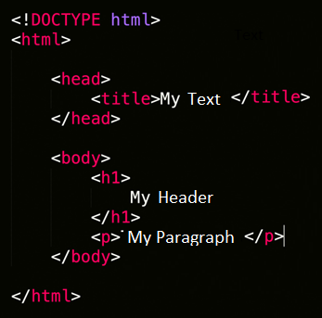
Q. What is DOM? What is the difference between HTML and DOM?
DOM(Document Object Model) represents the web page as a tree-like structure which allows JavaScript to dynamically access and manipulate the content and structure of a web page.
DOM Tree(Real)
Static HTML
back to chapter index

Slide 10
Q. What is Virtual DOM? Difference between DOM and Virtual DOM?
React uses a virtual DOM to efficiently update the UI without re-render the entire page, which helps improve performance and make the application more responsive.
Reconciliation
(React Libraries)
Virtual DOM
DOM Tree(Real)
back to chapter index

Slide 11
Q. What is Virtual DOM? Difference between DOM and Virtual DOM?
DOM | Virtual DOM
1. DOM is actual representation of the webpage. | Virtual DOM is lightweight copy of the DOM.
2. Re-renders the entire page when updates occur. | Re-renders only the changed parts efficiently.
3. Can be slower, especially with frequent updates. | Optimized for faster rendering.
4. Suitable for static websites and simple applications | Ideal for dynamic and complex single-page applications with frequent updates
back to chapter index

Slide 12
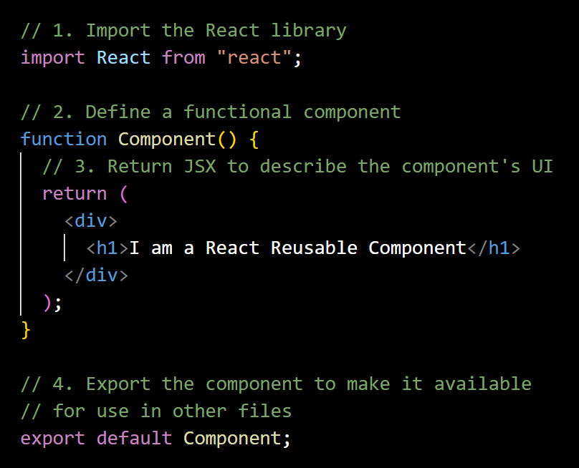
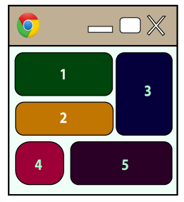

Q. What are React Components? What are the main elements of it?
In React, a component is a reusable building block for creating user interfaces.
back to chapter index
Notes:
// 1. Import the React library
import React from "react";
// 2. Define a functional component
function Component() {
// 3. Return JSX to describe the component's UI
return (
<div>
<h1>I am a React Reusable Component</h1>
</div>
);
}
// 4. Export the component to make it available
// for use in other files
export default Component;
// index.js
const root = ReactDOM.createRoot(document.getElementById("root"));
root.render(<Component></Component>);

Slide 13
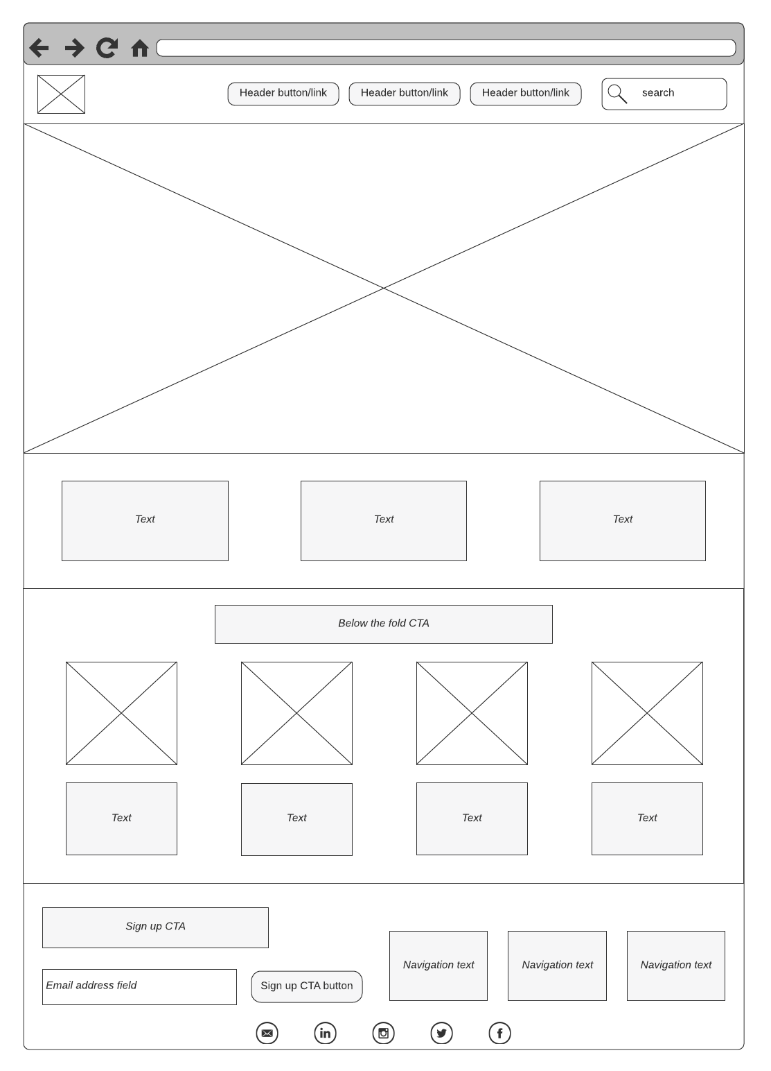
Q. What is SPA(Single Page Application)?
A Single Page Application (SPA) is a web application that have only one single web page.
Whenever user do some action on the website, then in response content is dynamically updated without refreshing or loading a new page.
back to chapter index
Notes:
Use the same of Top 30 Questions

Slide 14

Q. What are the 5 Advantages of React?
1. Simple to build Single Page Application (by using Components)
2. React is cross platform and open source(Free to use)
3. Lightweight and very fast (Virtual DOM)
4. Large Community and Ecosystem
5. Testing is easy
back to chapter index

Slide 15


Q. What are the Disadvantages of React?
React is not a good choice for very small applications.
back to chapter index

Slide 16
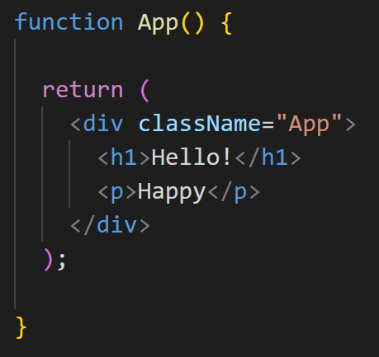
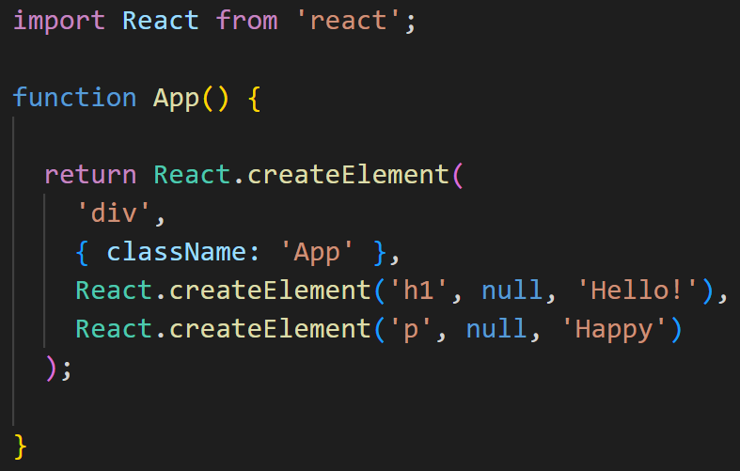
Q. What is the role of JSX in React? (3 points)
JSX stands for JavaScript XML.
JSX is used by React to write HTML-like code.
JSX is converted to JavaScript via tools like Babel. Because Browsers understand JavaScript not JSX.
Babel
back to chapter index

Slide 17
Q. What is the difference between Declarative & Imperative syntax?
7 Key Features of React
1. Virtual DOM
2. Component Based Architecture
3. Reusability & Composition
5. Declarative Syntax
7. React Hooks
6. Community & Ecosystem
4. JSX
(JavaScript XML)
back to chapter index

Slide 18
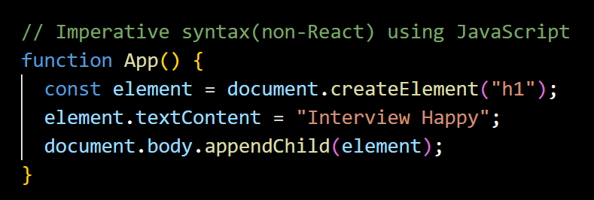
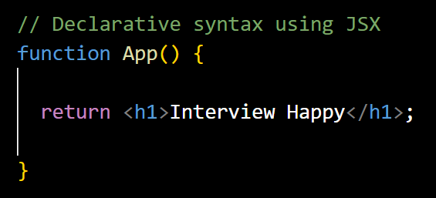

Q. What is the difference between Declarative & Imperative syntax?
Declarative syntax focuses on describing the desired result without specifying the step-by-step process.
JSX in React is used to write declarative syntax.
Imperative syntax involves step by step process to achieve a particular goal.
JavaScript has an imperative syntax.
back to chapter index
Notes:
import React from "react";
import ReactDOM from "react-dom";
// Declarative syntax using JSX
function App() {
return <h1>Interview Happy</h1>;
}
// Imperative syntax(non-React) using JavaScript
// function App() {
// const element = document.createElement("h1");
// element.textContent = "Interview Happy";
// document.body.appendChild(element);
// }
export default App;

Slide 19
2: React-Basics - II
Q1. What is Arrow Function Expression in JSX?
Q2. How to Setup React first project?
Q3. What are the Main Files in a React project?
Q4. How React App Load and display the components in browser?
Q5. What is the difference between React and Angular?
Q6. What are other 5 JS frameworks other than React?
Q7. Whether React is a Framework or a Library? What is the difference?
Q8. How React provides Reusability and Composition?
Q9. What are State, Stateless, Stateful and State Management terms?
Q10. What are Props n JSX?
Back to main index

Slide 20
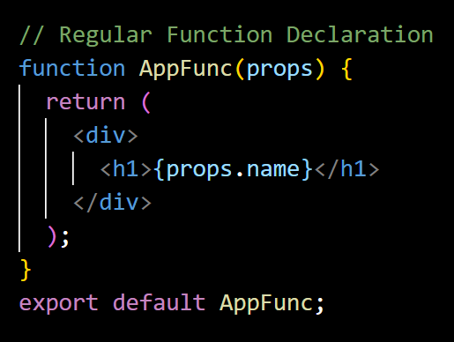
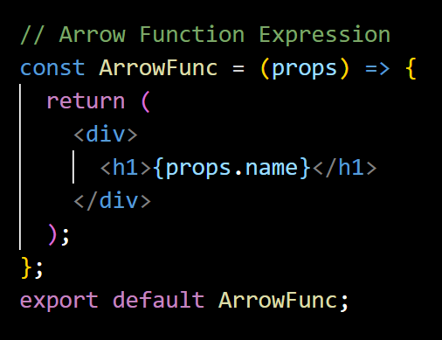
Q. What is Arrow Function Expression in JSX?
The arrow function expression syntax is a concise way of defining functions.
=
back to chapter index
Notes:
import React from "react";
// Arrow Function Expression
const ArrowFunc = (props) => {
return (
<div>
<h1>{props.name}</h1>
</div>
);
};
export default ArrowFunc;

Slide 21
Q. How to Setup React first project?
1. Install Node.js from below link:
https://nodejs.org/en/download
2. Install code editor (VS Code):
https://code.visualstudio.com/download
3. Create first React Project (Open VS Code -> Terminal -> New Terminal)
run command: “npx create-react-app my-app”
4. Open Project
Click File -> Open Project Folder “my-app”
5. Run Project
Open terminal(ctrl + ‘) key -> run “npm start”
back to chapter index
Notes:
Use the same of Top 30 Questions

Slide 22
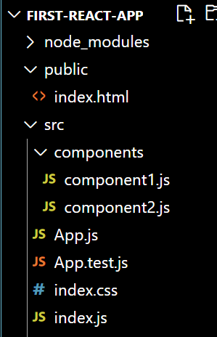
Q. What are the Main Files in a React project?
Main Files in a React project:
index.html: Single page for React application.
Components/component1.js: Your application components.
App.js: Main component or container or Root component.
App.test.js(Optional): Used for writing tests for the App.js file.
Index.css(Optional): This is a global CSS file that serves as the main stylesheet for the entire application.
index.js: Entry point for JavaScript. Renders the main React component (App) into the root DOM element.
back to chapter index

Slide 23



Q. How React App Load and display the components in browser?
Request
Single Page
index.html
Display
Entry Point(JS)
index.js
Comp1.js
Comp1.js
App.js
Root Component
Comp1.js
back to chapter index

Slide 24
Q. How React App load and display the components in browser?
index.html
Single page which loads index.js by React libraries
index.js
Replace root element of index.html file by App component
App.js
Root component which is the container of all the child components.
ChildComponent.js
Custom child components placed over app component.
back to chapter index

Slide 25



Q. What is the difference between React and Angular?
React | Angular
React and Angular both are used to create single page UI applications using components.
1. React is a JavaScript library | Angular is a complete framework.
2. React uses a virtual DOM which makes it faster. | Angular uses a real DOM
3. React is smaller in size and lightweight and therefore faster sometime. | Angular is bigger because it is a complete framework.
4. React depends on external libraries for many complex features, so developer has to write many lines of code for complex functionalities. | Since Angular is a complete framework, therefore it provide built-in support for features like routing, forms, validation, and HTTP requests.
5. React is simple to learn and more popular than Angular. | 5. Angular is slightly difficult to learn as it has Typescript, OOPS concept and many more thing.
back to chapter index
Notes:
What is the difference between React and Angular?
Before differences, lets’ first see the similarity between them.
React and Angular both are used to create single page UI applications using components. Ok.
Now the first fundamental difference between them is.
React is a JavaScript library, where as Angular is a complete UI development framework.
Second difference is
React uses a virtual DOM which makes it faster.
I will explain virtual DOM in upcoming questions.
But Angular uses only the real DOM which is slightly difficult to render and therefore not as faster as virtual DOM.
Hence here React is the clear winner.
Third difference is
React is smaller in size and lightweight and therefore again faster sometimes.
Where as Angular is bigger because it is a complete framework therefore it is not lightweight.
Here again React is the winner.
Now when I say faster, don’t think if Angular can load a page in 5 seconds.
Than React can load the same page in 1 second.
Faster in sense if React can load a page in 1 second than Angular can load the page in 1.1 or 1.2 second.
That is again depends on the complexity of the page also.
Next difference is, React depends on external libraries for many complex features, so developer has to write many lines of code for complex functionalities.
But since Angular is a complete framework, therefore it provide built-in support for features like routing, forms, validation, and HTTP requests.
Therefore developer has to write less lines of code and therefore Angular is the winner here.
So for very very complex UI applications which are interacting with multiple API’s, Angular is slightly a better choice.
Fifth and last difference is, React is simple to learn and more popular than Angular.
And therefore it has more jobs and more support from online community.
Whereas Angular is slightly difficult to learn as it has Typescript, OOPS concept and many more things.
So basically if you already know classes, object, inheritance, dependency basically server side programming concepts.
Than only Angular will be easy for you, otherwise it is difficult to learn as comparison to React.
So for simple learning React is the winner here.
Alright, I think now you know the differences between them.
And you also know which one should you choose in which situation. Right.

Slide 26
Q. What are other 5 JS frameworks other than React?
JS frameworks/ libraries
Angular
Vue.js
AngularJS
Backbone.js
Ember.js
back to chapter index

Slide 27

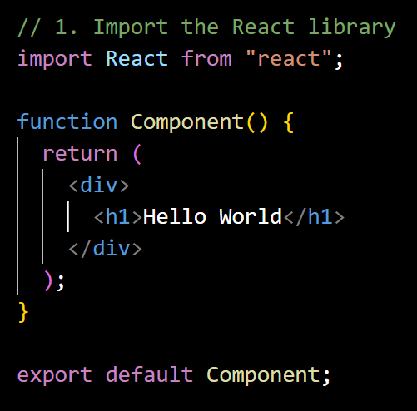
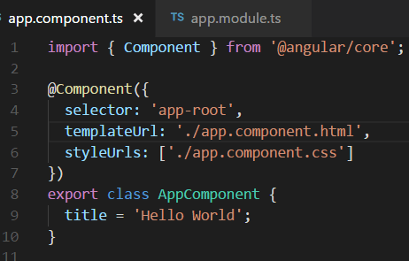
Q. Whether React is a Framework or a Library? What is the difference?
Library: Developers import the libraries at the top and then used its functions in components.
React is commonly referred to as a JavaScript library.
Framework: Developers need to follow a specific structure or pattern defined by the framework.
Angular is a framework.
back to chapter index

Slide 28
Q. How React provides Reusability and Composition?
React provides reusability and composition through its component-based architecture.
Reusability: Once you create a component, you can re-use it in different parts of your application or even in multiple projects.
Composition: Composition is creating new and big components by combining existing small components. Its advantage is, change to one small component will not impact other components.
10
10
back to chapter index

Slide 29
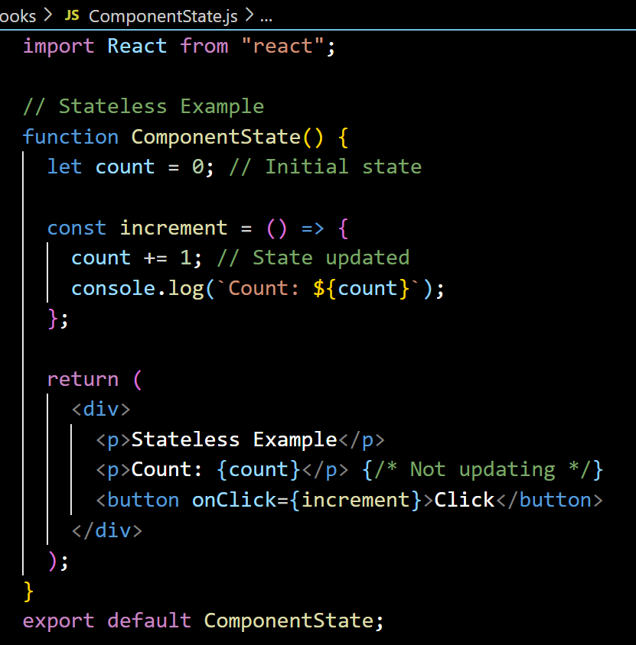
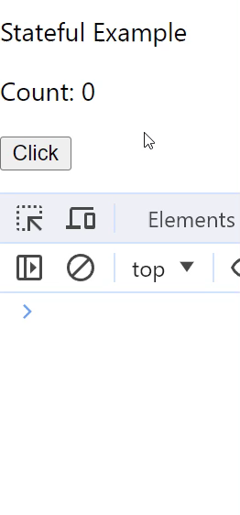
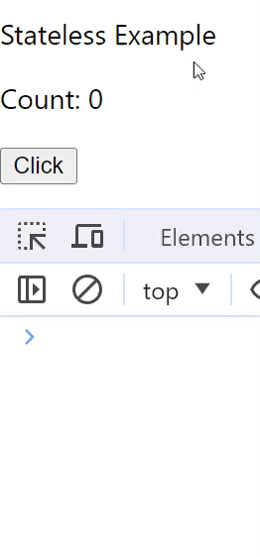
Q. What are State, Stateless, Stateful and State Management terms?
"state" refers to the current data of the component.
Stateful or state management means, when a user performs some actions on the UI, then the React application should be able to update and re-render that data or state on the UI.
back to chapter index

Slide 30
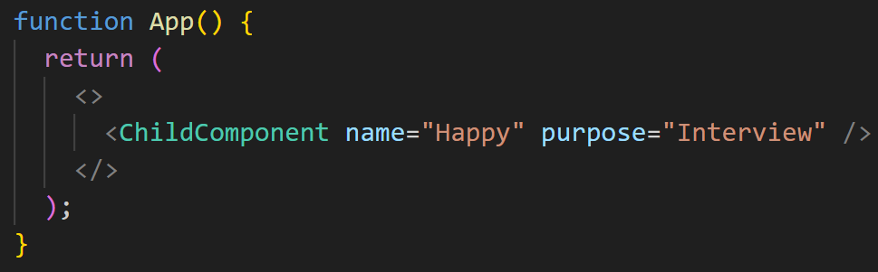
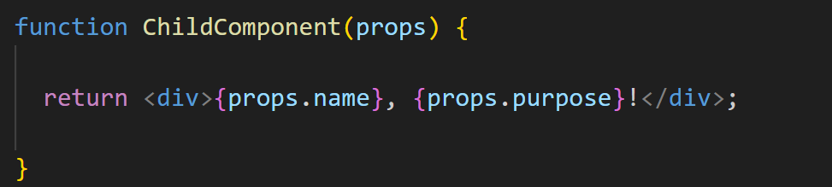
Q. What are Props n JSX?
props (properties) are a way to pass data from a parent component to a child component.
back to chapter index
Notes:
function App() {
return (
<>
<ChildComponent name="Happy" purpose="Interview" />
</>
);
}
function ChildComponent(props) {
return (
<div>
{props.name}, {props.purpose}
</div>
);
}

Slide 31
3: React Project - Files & Folders
Q1. What is NPM? What is the role of node_modules folder?
Q2. What is the role of public folder in React?
Q3. What is the role of src folder in React?
Q4. What is the role of index.html page in React?
Q5. What is the role of index.js file and ReactDOM in React?
Q6. What is the role of App.js file in React?
Q7. What is the role of function and return inside App.js?
Q8. Can we have a function without a return inside App.js?
Q9. What is the role of export default inside App.js?
Q10. Does the file name and the component name must be same in React?
Back to main index

Slide 32
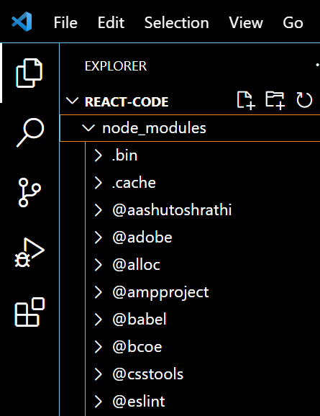
Q. What is NPM? What is the role of node_modules folder?
NPM(Node Package Manager) is used to manage the dependencies for your React project, including the React library itself.
node_modules folder contains all the dependencies of the project, including the React libraries.
back to chapter index

Slide 33
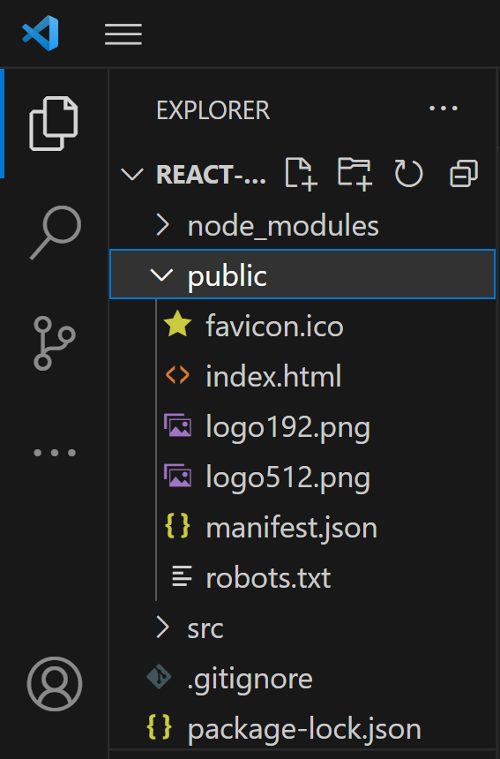
Q. What is the role of public folder in React?
Public folder contains static assets that are served directly to the user's browser, such as images, fonts, and the index.html file.
back to chapter index

Slide 34
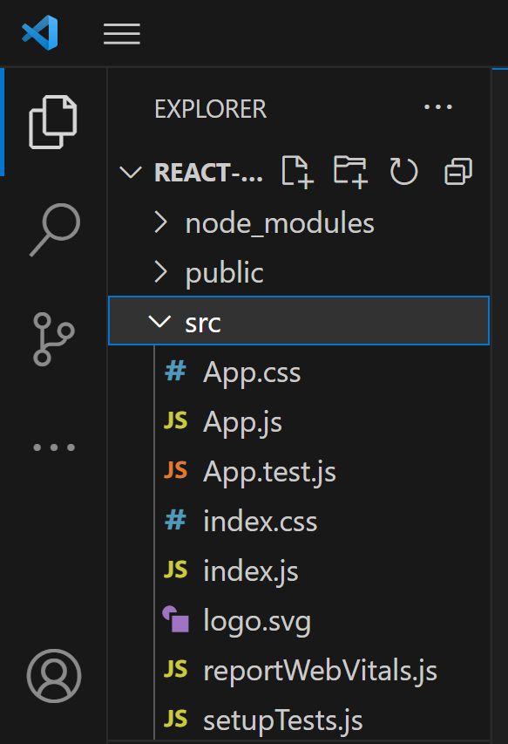
Q. What is the role of src folder in React?
src folder is used to store all the source code of the application which is then responsible for the dynamic changes in your web application.
back to chapter index

Slide 35
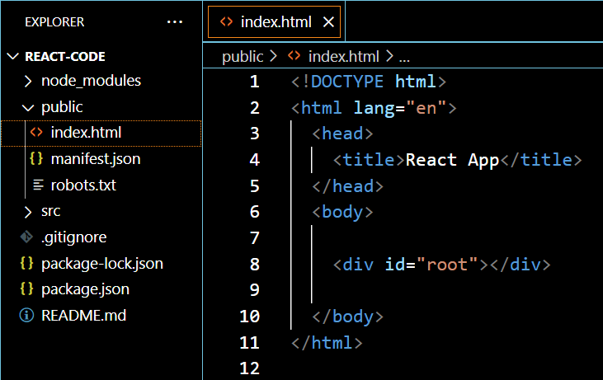
Q. What is the role of index.html page in React?
index.html file is the main HTML file(SPA) in React applcication.
Here the div with “id=root” will be replaced by the component inside index.js file.
back to chapter index
Notes:
<!-- index.html -->
<!DOCTYPE html>
<html lang="en">
<head>
<title>React App</title>
</head>
<body>
<div id="root"></div>
</body>
</html>

Slide 36
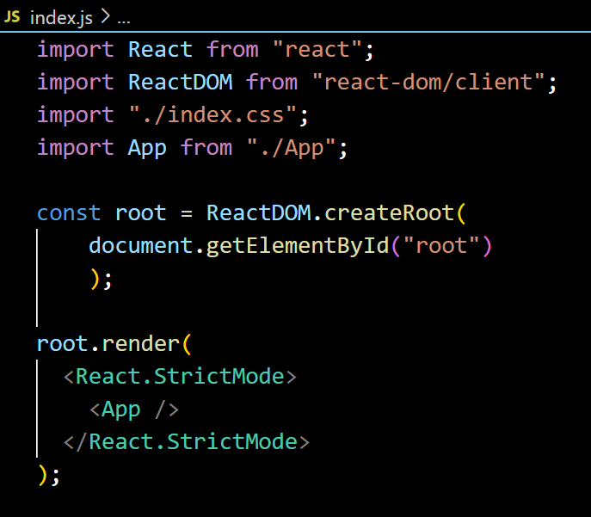
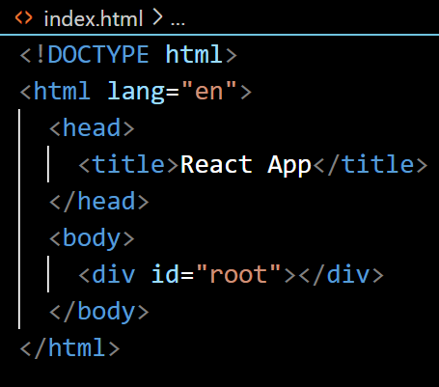
Q. What is the role of index.js file and ReactDOM in React?
ReactDOM is a JavaScript library that renders components to the DOM or browser.
The index.js file is the JavaScript file that replaces the root element of the index.html file with the newly rendered components.
back to chapter index
Notes:
// index.js
const root = ReactDOM.createRoot(document.getElementById("root"));
root.render(<App></App>);

Slide 37
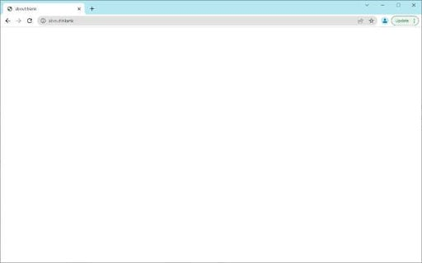
Q. What is the role of App.js file in React?
Root Component (App.js)
Component 1
Component 2
Component 3
Component 4
back to chapter index

Slide 38
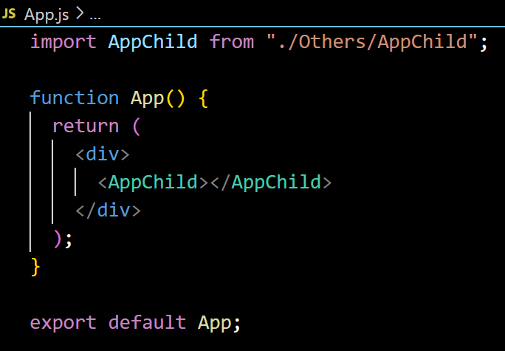
Q. What is the role of App.js file in React?
App.js file contain the root component(App) of React application.
App component is like a container for other components.
App.js defines the structure, layout, and routing in the application.
back to chapter index

Slide 39
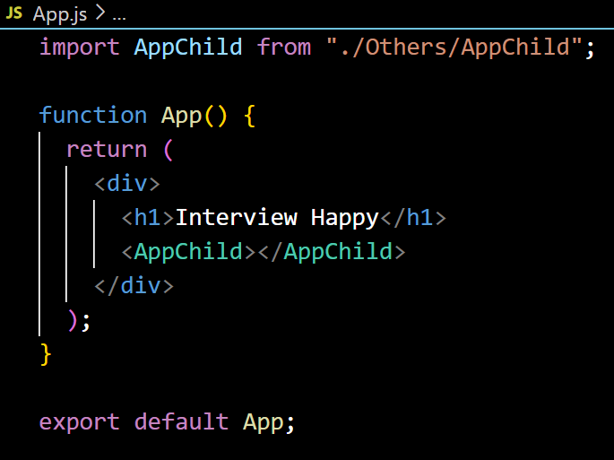
Q. What is the role of function and return inside App.js?
The function keyword is used to define a JavaScript function that represents your React component.
function is like a placeholder which contains all the code or logic of component.
The function takes in props as its argument (if needed) and returns JSX
return is used to return the element from the function.
back to chapter index

Slide 40
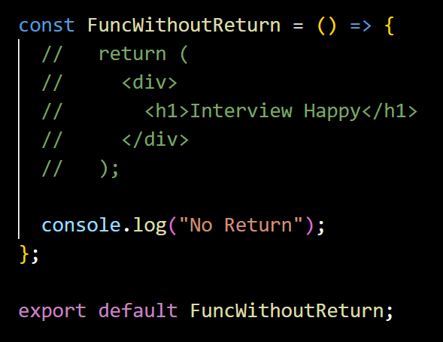
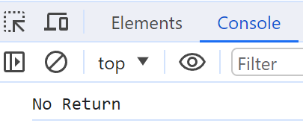
Q. Can we have a function without a return inside App.js?
Yes, a function without a return statement is possible.
In that case, your component will not render anything in UI.
The common use case is for logging purpose.
back to chapter index
Notes:
import React from "react";
const FuncWithoutReturn = () => {
// return (
// <div>
// <h1>Interview Happy</h1>
// </div>
// );
console.log("No Return");
};
export default FuncWithoutReturn;

Slide 41
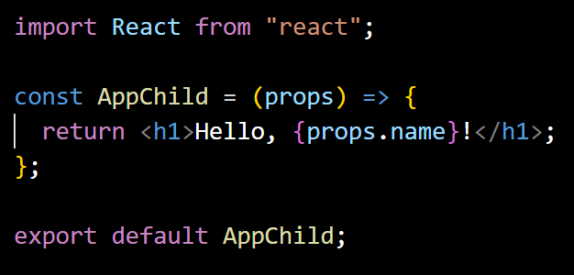
Q. What is the role of export default inside App.js?
Export statement is used to make a component available for import using “import” statement in other files.
back to chapter index

Slide 42

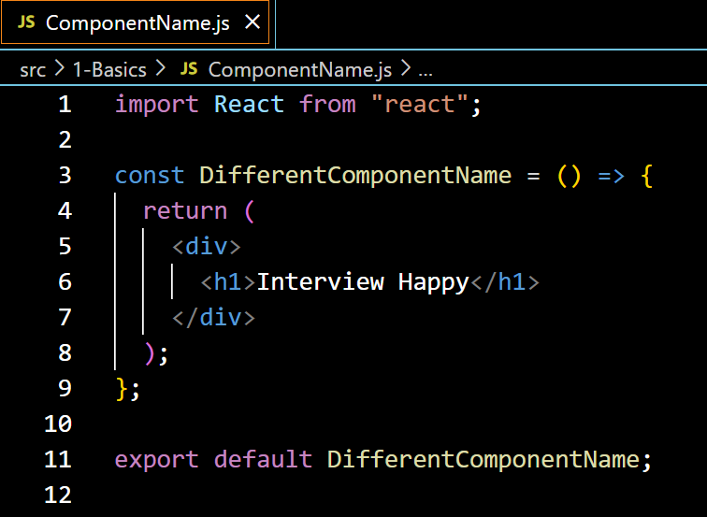
Q. Does the file name and the component name must be same in React?
No, the file name and the component name don't have to be the same.
However, it is recommended to keep them same for easier to organize and understand your code.
back to chapter index

Slide 43
4: JSX
Q1. What is the role of JSX in React? (3 points)
Q2. What are the 5 Advantages of JSX?
Q3. What is Babel?
Q4. What is the role of Fragment in JSX?
Q5. What is Spread Operator in JSX?
Q6. What are the types of Conditional Rendering in JSX?
Q7. How do you iterate over a list in JSX? What is map() method?
Q8. Can a browser read a JSX File?
Q9. What is Transpiler? What is the difference between Compiler & Transpiler?
Q10. Is it possible to use JSX without React?
Back to main index

Slide 44
Q. What is the role of JSX in React? (3 points)
JSX stands for JavaScript XML.
JSX is used by React to write HTML-like code.
JSX is converted to JavaScript via tools like Babel. Because Browsers understand JavaScript not JSX.
Babel
back to chapter index
Notes:
import React from "react";
function App() {
return (
<div className="App">
<h1>Hello!</h1>
<p>Happy</p>
</div>
);
}

Slide 45
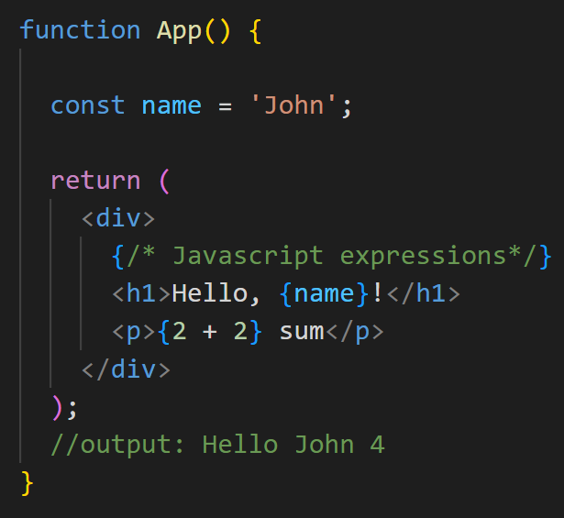
Q. What are the 5 Advantages of JSX?
Advantage of JSX
3. Support JavaScript expressions
1. Improve code readability and writability
2. Error checking in advance(Type safety)
4. Improved performance
5. Code reusability
back to chapter index
Notes:
Top 30 Interview Questions

Slide 46
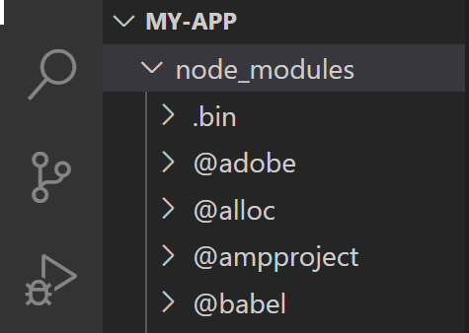


Q. What is Babel?
Babel in React is used to transpile JSX syntax into regular JavaScript which browser can understand.
Babel
back to chapter index

Slide 47
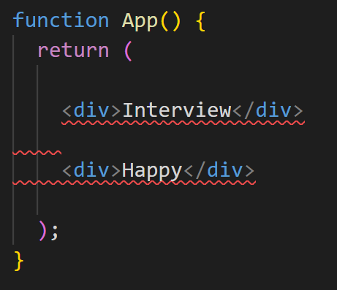
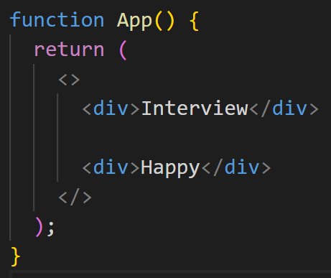
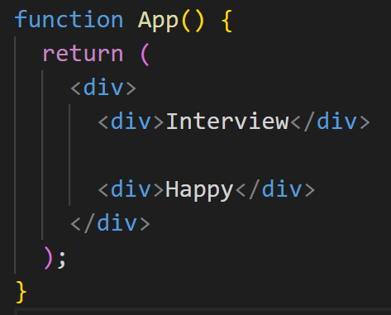
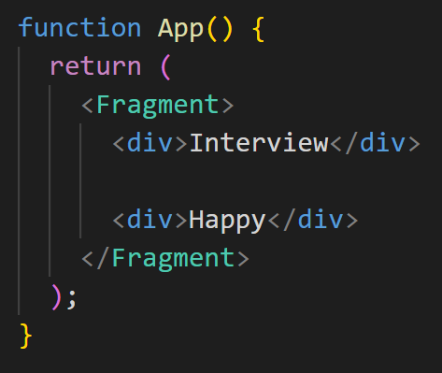
Q. What is the role of Fragment in JSX?
Separate elements(Error)
Fragment (<>, <Fragment>)
In React, a fragment is a way to group multiple children's elements.
Using a Fragment prevents the addition of unnecessary nodes to the DOM.
back to chapter index
Notes:
import React from "react";
function App() {
return (
<>
<div>Interview</div>
<div>Happy</div>
</>
);
}

Slide 48
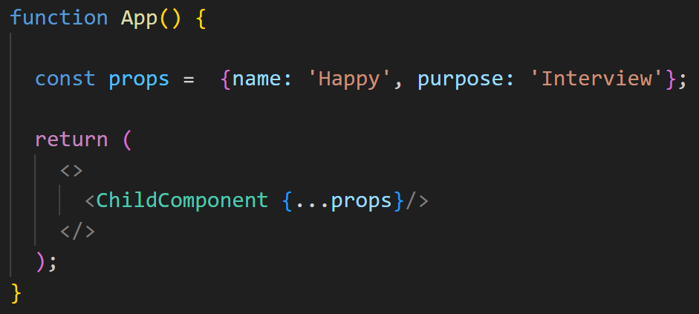
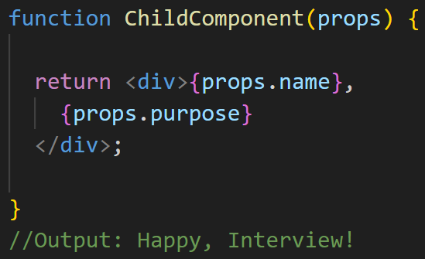
Q. What is Spread Operator in JSX?
The spread operator (...) is used to expand or spread an array or object.
back to chapter index
Notes:
import React from "react";
function App() {
const props = { name: "Happy", purpose: "Interview" };
return (
<>
<ChildComponent {...props} />
</>
);
}
function ChildComponent(props) {
return (
<div>
{props.name}, {props.purpose}
</div>
);
}

Slide 49
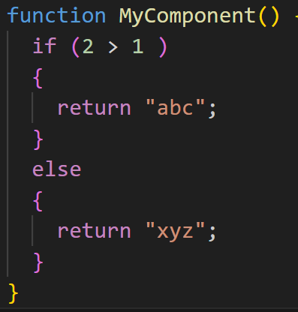
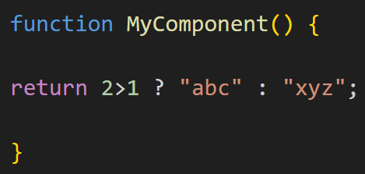
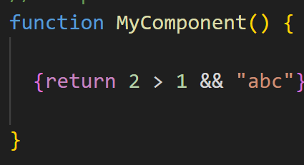
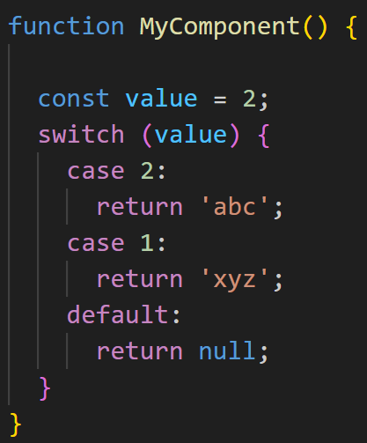
Q. What are the types of Conditional Rendering in JSX?
Conditional Rendering
2. Ternary operator
3. && operator
1. If/else statements
4. Switch statement
back to chapter index

Slide 50
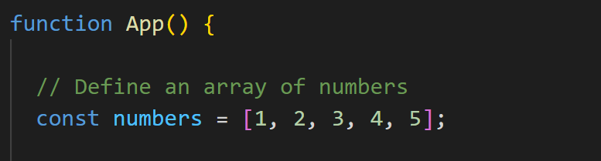
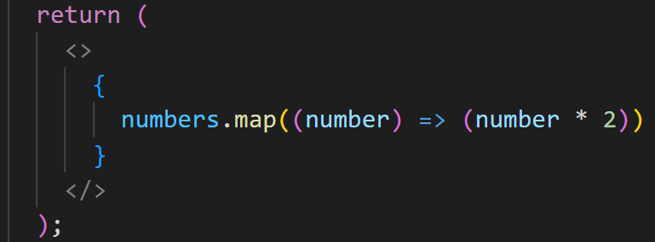

Q. How do you iterate over a list in JSX? What is map() method?
map() method allows you to iterate over an array and modify its elements using a callback function.
back to chapter index

Slide 51
Q. Can a browser read a JSX File?
No, browsers cannot directly interpret or understand JSX files.
Babel takes JSX and converts it into equivalent JavaScript code that browsers can understand.
back to chapter index

Slide 52
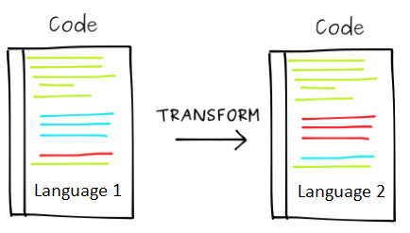
Q. What is Transpiler? What is the difference between Compiler & Transpiler?
A Transpiler is a tool that converts source code from one high-level programming language(JSX) to another high-level programming language(JavaScript). Example: Babel
A compiler is a tool that converts high-level programming language(Java) into a lower-level language(machine code or bytecode).
back to chapter index

Slide 53
Q. Is it possible to use JSX without React?
Yes, it's possible to use JSX without React by creating your own transpiler like Babel.
However, this is not recommended since JSX is tightly integrated with React and relies on many React-specific features.
back to chapter index

Slide 54
5: Components - Functional/ Class
Q1. What are React Components? What are the main elements of it?
Q2. What are the Types of React components? What are Functional Components?
Q3. How do you pass data between functional components in React?
Q4. What is Prop Drilling in React?
Q5. Why to Avoid Prop Drilling? In how many ways can avoid Prop Drilling?
Q6. What are Class Components In React?
Q7. How to pass data between class components in React?
Q8. What is the role of this keyword in class components?
Q9. What are the 5 differences btw Functional components & Class components?
Back to main index

Slide 55
Q. What are React Components? What are the main elements of it?
In React, a component is a reusable building block for creating user interfaces.
back to chapter index

Slide 56
Q. What are the Types of React components? What are Functional Components?
Functional components are declared as a JavaScript function.
They are stateless component, but with the help of hooks, they can now manage state also.
Types of Components
1. Functional Components
2. Class Components
back to chapter index
Notes:
Basic

Slide 57
Q. How do you pass data between functional components in React?
props (properties) are a way to pass data from a parent component to a child component.
back to chapter index

Slide 58
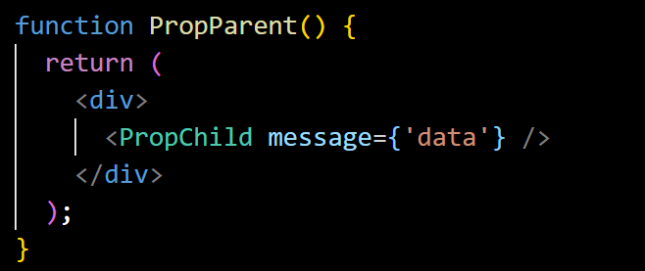
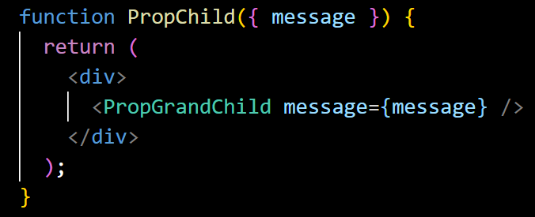
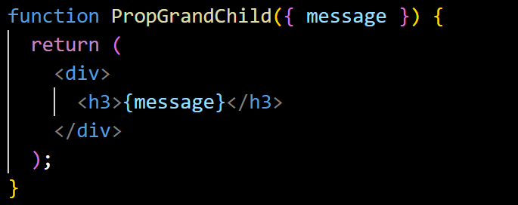
Q. What is Prop Drilling in React?
Prop drilling is the process of passing down props through multiple layers of components.
Parent Component
Data
Child Component
Data
Gran Child Component
Data
back to chapter index
Notes:
import React, { useState } from "react";
import PropChild from "./PropChild";
function PropParent() {
return (
<div>
<PropChild message={'data'} />
</div>
);
}
export default PropParent;
import React from "react";
import PropGrandChild from "./PropGrandChild";
function PropChild({ message }) {
return (
<div>
<PropGrandChild message={message} />
</div>
);
}
export default PropChild;
import React from "react";
function PropGrandChild({ message }) {
return (
<div>
<h3>{message}</h3>
</div>
);
}
export default PropGrandChild;

Slide 59
Q. Why to Avoid Prop Drilling? In how many ways can avoid Prop Drilling?
Root App
Data
Root App
Data
Data
Parent 1
Parent 2
Parent 1
Parent 2
Data
Data
Child 1
Child 2
Child 1
Child 2
Using Prop Drilling
Avoiding Prop Drilling
back to chapter index

Slide 60
Q. Why to Avoid Prop Drilling? In how many ways can avoid Prop Drilling?
5 Ways to avoid Prop Drilling
3. Using Component Composition
1. Using Context API
2. Using Redux
4. Using Callback Functions
5. Using Custom Hooks
Why to avoid Prop Drilling:
Maintenance: Prop drilling can make code harder to maintain as changes in data flow require updates across multiple components.
Complexity: It increases code complexity and reduces code readability.
Debugging: Debugging becomes challenging when props need to be traced through numerous components.
back to chapter index

Slide 61

Q. What are Class Components In React?
Class components are defined using JavaScript classes.
They are stateful components by using the lifecycle methods.
The render method in a class component is responsible for returning JSX.
Types of Components
1. Functional Components
2. Class Components
back to chapter index
Notes:
import React, { Component } from 'react';
class AppClass extends Component {
render() {
return <h1>Interview Happy</h1>;
}
}
export default AppClass;

Slide 62



Q. How to pass data between class components in React?
this.props can be used in child component to access properties/ data passed from parent component.
back to chapter index
Notes:
import React, { Component } from 'react';
import ChildComponent from './ChildComponent';
class ParentComponent extends Component {
render() {
const dataToSend = "Hello from Parent!";
return (
<div>
<ChildComponent message={dataToSend} />
</div>
);
}
}
export default ParentComponent;
import React, { Component } from 'react';
class ChildComponent extends Component {
render() {
return (
<div>
<p>Message: {this.props.message}</p>
</div>
);
}
}
export default ChildComponent;

Slide 63
Q. What is the role of this keyword in class components?
this keyword is used to refer to the instance of the class.
back to chapter index

Slide 64
Q. What are the 5 differences btw Functional components & Class components?
Functional Component | Class Component
1. Syntax: Defined as a JS function. | Defined as a JS(ES6) class.
2. State: Originally stateless but can now maintain state using hooks. | Can manage local state with this.state.
3. Lifecycle methods: No | Yes
4. Readability: more readable & concise. | Verbose(complex).
5. this keyword: No | Yes (Access props using this.props)
6. Do not have render method. | Have render method.
back to chapter index

Slide 65
6: Routing
Q1. What is Routing and Router in React?
Q2. How to Implement Routing in React?
Q3. What are the roles of <Routes> & <Route> component in React Routing?
Q4. What are Route Parameters in React Routing?
Q5. What is the role of Switch Component in React Routing?
Q6. What is the role of exact prop in React Routing?
Back to main index

Slide 66

Q. What is Routing and Router in React?
Routing
Routing allows you to create a single-page web application with navigation, without the need for a full-page refresh.
React Router
React Router is a library for handling routing and enables navigation and rendering of different components based on the URL.
back to chapter index

Slide 67




Q. How to Implement Routing in React?
Command to install router:
back to chapter index
Notes:
import React from "react";
import { Routes, Route, Link } from "react-router-dom";
const Home = () => <h2>Home</h2>;
const About = () => <h2>About</h2>;
const Contact = () => <h2>Contact</h2>;
const AppRoute = () => (
<div>
<nav>
<ul>
<li>
<Link to="/">Home</Link>
</li>
<li>
<Link to="/about">About</Link>
</li>
<li>
<Link to="/contact">Contact</Link>
</li>
</ul>
</nav>
<Routes>
<Route path="/" element={<Home />} />
<Route path="/about" element={<About />} />
<Route path="/contact" element={<Contact />} />
</Routes>
</div>
);
export default AppRoute;
// index.js
const root = ReactDOM.createRoot(document.getElementById("root"));
root.render(
<Router>
<AppRoute />
</Router>
);

Slide 68
Q. How to Implement Routing in React?
Step 1
Install React Router
Step 2
Create Navigation
Step 3
Create Routes
back to chapter index

Slide 69
Q. What are the roles of <Routes> & <Route> component in React Routing?
The <Routes> component is used as the root container for declaring your collection of routes.
The <Route> component is used to define a route and specify the component that should render when the route matches.
  For example, in this code if user enter “websitename.com/about” in url, then matching “About” component will be rendered.
back to chapter index

Slide 70

Q. What are Route Parameters in React Routing?
Route parameters in React Router are a way to pass dynamic values(data) to the component as part of the URL path.
back to chapter index
Notes:
{/* userId is the route parameter */}
<Route path="/users/:userId" component={UserProfile} />

Slide 71

Q. What is the role of Switch Component in React Routing?
Switch component ensures that only the first matching <Route> is rendered and rest are ignored.
  For example, Switch is commonly used to handle 404 or "not found" routes.
back to chapter index
Notes:
import { Switch, Route } from "react-router-dom";
<Switch>
<Route path="/users" element={<UsersList />} />
<Route path="/users/:id" element={<UserProfile />} />
{/* without exact (default behavior)*/}
{/* match "about", "/about/team", "/about/contact" etc. */}
<Route path="/about" component={About} />
</Switch>;

Slide 72


Q. What is the role of exact prop in React Routing?
exact prop is used with the <Route> component to match exactly to the provided path.
back to chapter index
Notes:
{/* with exact */}
{/* only match "about"*/}
<Route path="/about" exact component={About} />

Slide 73
7: Hooks -useState/ useEffect
Q1. What are React Hooks? What are the Top React Hooks?
Q2. What are State, Stateless, Stateful and State Management terms?
Q3. What is the role of useState() hook and how it works?
Q4. What is the role of useEffect(). How it works and what is its use?
Q5. What is Dependency Array in useEffect() hook?
Q6. What is the meaning of the empty array [] in the useEffect()?
Back to main index

Slide 74

Q. What are React Hooks? What are the Top React Hooks?
React Hooks are inbuilt functions provided by React that allow functional components to use state and lifecycle features.
Before Hooks, class components lifecycle methods were used to maintain state in React applications.
To use React Hook first we first have to import it from React library:
1. useState:
State
2. useEffect:
Side effects
3. useContext:
Context
4. useReducer:
Complex state
5. useCallback:
Memoization
6. useMemo:
Performance
7. useRef:
Refs
Synchronous Side effects.
8. useLayoutEffect:
back to chapter index

Slide 75
Q. What are State, Stateless, Stateful and State Management terms?
"state" refers to the current data of the component.
Stateful or state management means, when a user performs some actions on the UI, then the React application should be able to update and re-render that data or state on the UI.
back to chapter index

Slide 76

Q. What is the role of useState() hook and how it works?
back to chapter index
Notes:
import React, { useState } from "react";
function UseState() {
// array destructuring
const [count, setCount] = useState(0);
const increment = () => {
setCount(count + 1);
console.log(`Count: ${count + 1}`);
};
return (
<div>
<p>Stateful Example</p>
<p>Count: {count}</p> {/* Updating */}
<button onClick={increment}>Click</button>
</div>
);
}
export default UseState;
// state is the current state value.
// setState is a function that used to update the state.
//const [state, setState] = useState(initialValue);
//const [stateVariable, stateUpdaterFunction] = useState(initialState);

Slide 77

Q. What is the role of useState() hook and how it works?
The useState hook enables functional components to manage state.
useState() working: usestate() function accept the initial state value as the parameter and returns an array with two elements:
The first element is the current state value (count in this code).
Second element is the function that is used to update the state (setCount in this code).
The concept of assign array elements to individual variables is called array destructuring.
back to chapter index

Slide 78

Q. What is the role of useEffect(). How it works and what is its use?
The useEffect Hook in React is used to perform side effects in functional components.
For example, data fetching from API, subscriptions or any other operation that needs to be performed after the component has been rendered.
2. Rendered after side effects by useEffect(eg: Loading data from external API)
Rendered initially
back to chapter index

Slide 79


Q. What is the role of useEffect(). How it works and what is its use?
2 points to remember about useEffect():
useEffect() is called after the component renders. Example, side effects.
useEffect() function will accept two parameter: (Effect function, dependency array).
Browser Output
back to chapter index
Notes:
import React, { useEffect } from "react";
function UseEffect() {
useEffect(() => {
const fetchData = async () => {
const response = await fetch(
"https://jsonplaceholder.typicode.com/posts/1"
);
const result = await response.json();
console.log("Title:", result.title);
};
fetchData();
}, []);
return (
<div>
<p>Data is being fetched...</p>
</div>
);
}
export default UseEffect;

Slide 80


Q. What is Dependency Array in useEffect() hook?
Dependencies arrays(optional) act as triggers for useEffect to rerun; meaning if any of dependencies values change, the code inside useEffect() will be executed again.
back to chapter index

Slide 81


Q. What is Dependency Array in useEffect() hook?
back to chapter index
Notes:
import React, { useState, useEffect } from "react";
const UseEffectDependencies = () => {
const [data, setData] = useState(null);
const [userId, setUserId] = useState(1);
useEffect(() => {
const fetchData = async () => {
const response = await fetch(
`https://jsonplaceholder.typicode.com/users/${userId}`
);
const result = await response.json();
setData(result);
};
fetchData();
}, [userId]);
return (
<div>
<h2>Data Fetching with Dependencies</h2>
<label>User ID: </label>
<input
type="number"
value={userId}
onChange={(e) =>
setUserId(Number(e.target.value))}
/>
{data && (
<div>
<h3>User Details:</h3>
<pre>{JSON.stringify(data, null, 2)}</pre>
</div>
)}
</div>
);
};
export default UseEffectDependencies;

Slide 82

Q. What is the meaning of the empty array [] in the useEffect()?
An empty array [] indicates that the effect function should only run once.
back to chapter index

Slide 83
8: Hooks - useContext/ useReducer
Q1. What is the role of useContext() hook?
Q2. What is createContext() method? What are Provider & Consumer properties?
Q3. When to use useContext() hook instead of props in real applications?
Q4. What are the similarities between useState() and useReducer() hook?
Q5. What is useReducer() hook? When to use useState() and when useReducer()?
Q6. What are the differences between useState() and useReducer() Hook?
Q7. What are dispatch & reducer function in useReducer Hook?
Q8. What is the purpose of passing initial state as an object in UseReducer?
Back to main index

Slide 84
Q. What is the role of useContext() hook?
Prop drilling is the process of passing down props through multiple layers of components.
Root App
Data
Root App
Data
Data
Parent 1
Parent 2
Parent 1
Parent 2
Data
Data
Child 1
Child 2
Child 1
Child 2
Using Prop Drilling
Avoiding Prop Drilling
back to chapter index

Slide 85




Q. What is the role of useContext() hook?
useContext in React provides a way to pass data from parent to child component without using props.
back to chapter index
Notes:
import { createContext } from "react";
const MyContext = createContext();
export default MyContext;
import React from "react";
import MyContext from "./1-UseContext";
import Child from "./1-Child";
const Parent = () => {
const contextValue = "Hello from Context!";
return (
<MyContext.Provider value={contextValue}>
{/* Your component tree */}
<Child></Child>
</MyContext.Provider>
);
};
export default Parent;
import React, { useContext } from "react";
import MyContext from "./1-UseContext";
const Child = () => {
const contextValue = useContext(MyContext);
return <p>{contextValue}</p>;
// return (
// <MyContext.Consumer>
// {(contextValue) => <div>{contextValue}</div>}
// </MyContext.Consumer>
// );
};
export default Child;

Slide 86
Q. What is createContext() method? What are Provider & Consumer properties?
createContext() function returns an object with Provider and Consumer properties.
The Provider property is responsible for providing the context value to all its child components.
useContext() method or Consumer property can be used to consume the context value in child components.
back to chapter index

Slide 87
Q. When to use useContext() hook instead of props in real applications?
Use useContext instead of props when you want to avoid prop drilling and access context values directly within deeply nested components.
1. Theme Switching (Dark/ Light)
2. Localization (language selection)
3. Centralize Configuration Settings
You can centralize and pass the theme selection of the application from the parent to all the deep child components.
You can centralize and pass the language selection of the application from the parent to all the child components.
4. User Preferences
Common configuration settings like API endpoints can be centralized and change in the parent component will pass the setting to all its child components
5. Notification System
Any other user preferences apart from theme and localization can also be centralized.
Components that trigger or display notifications can access the notification state from the context.
Props are good
useContext is good
Component 1
Component 2
Component 1
Component 2
Component 3
Component 4
back to chapter index

Slide 88


Q. What are the similarities between useState() and useReducer() hook?
back to chapter index
Notes:
// useReducer for managing complex state
import React, { useReducer } from "react";
const UseReducer = () => {
const i = { count: 0 }; // "i" is object
const [state, dispatch] = useReducer(fnReducer, i);
const increment = () => {
dispatch({ type: "INCREMENT" });
};
const decrement = () => {
dispatch({ type: "DECREMENT" });
};
return (
<div>
<p>Count: {state.count}</p>
<button onClick={increment}>Increment</button>
<button onClick={decrement}>Decrement</button>
</div>
);
};
// Reducer function
const fnReducer = (state, action) => {
switch (action.type) {
case "INCREMENT":
return { count: state.count + 1 };
case "DECREMENT":
return { count: state.count - 1 };
default:
return state;
}
};
export default UseReducer;
// Structure
//const [state, dispatch] = useReducer(reducer, initialState);
// const initialState = {
// user: {
// name: 'John',
// age: 30,
// },
// isLoggedIn: false,
// };
// const [state, dispatch] = useReducer(reducer, initialState);

Slide 89
Q. What are the similarities between useState() and useReducer() hook?
3 Similarities between useState() and useReducer() hook:
  Both hooks provide a way to update state and trigger a re-render of the component.
  Both useState and useReducer return an array with two elements:
    First element is current state
    Second element is a function that can be used to update the state.
back to chapter index

Slide 90
Q. What is useReducer() hook? When to use useState() and when useReducer()?
back to chapter index
Notes:
// useReducer for managing complex state
import React, { useReducer } from "react";
const UseReducer = () => {
const i = { count: 0 }; // "i" is object
const [state, dispatch] = useReducer(fnReducer, i);
const increment = () => {
dispatch({ type: "INCREMENT" });
};
const decrement = () => {
dispatch({ type: "DECREMENT" });
};
return (
<div>
<p>Count: {state.count}</p>
<button onClick={increment}>Increment</button>
<button onClick={decrement}>Decrement</button>
</div>
);
};
// Reducer function
const fnReducer = (state, action) => {
switch (action.type) {
case "INCREMENT":
return { count: state.count + 1 };
case "DECREMENT":
return { count: state.count - 1 };
default:
return state;
}
};
export default UseReducer;
// Structure
//const [state, dispatch] = useReducer(reducer, initialState);
// const initialState = {
// user: {
// name: 'John',
// age: 30,
// },
// isLoggedIn: false,
// };
// const [state, dispatch] = useReducer(reducer, initialState);

Slide 91

Q. What is useReducer() hook? When to use useState() and when useReducer()?
back to chapter index

Slide 92

Q. What is useReducer() hook? When to use useState() and when useReducer()?
useReducer() is an alternative to the useState() hook when dealing with complex state in your components.
Component (Event Handler)
Dispatch
Reducer (Function)
Complex State Update
Component
Re-render
back to chapter index

Slide 93
Q. What are the differences between useState() and useReducer() Hook?
useState | useReducer
1. useState is simpler to use and used for managing simple state values. | useReducer is more appropriate for complex state logic or when the next state depends on the previous one.
2. It is suitable for managing a single piece of state. | It is well-suited for managing multiple pieces of state that needs to be updated together.
3. The useState hook takes an initial state as an argument and returns an array with two elements: the current state and a function to update the state. | The useReducer hook takes a reducer function and an initial state as arguments and returns the current state and a dispatch function.
back to chapter index

Slide 94
Q. What are dispatch & reducer function in useReducer Hook?
dispatch function is returned by the useReducer hook, and it is used to dispatch actions(type) to reducer function that trigger state updates.
The reducer function is a function responsible for updating the state based on the action received from dispatch function.
back to chapter index

Slide 95

Q. What is the purpose of passing initial state as an object in UseReducer?
By setting initial state as an object, you can manage complex states with useReducer functions.
back to chapter index

Slide 96
9: Hooks - useCallback/ useMemo/ useRef/ useLayoutEffect
Q1. What is the role of useCallback() hook in React?
Q2. What parameters does the useCallback hook accept & what does it returns?
Q3. What is the role of useMemo() Hook?
Q4. What is the role of useRef() Hook?
Q5. What is useLayoutEffect() Hook? Compare it with useEffect() hook.
Q6. When to use useLayoutEffect() Hook?
Back to main index

Slide 97



Q. What is the role of useCallback() hook in React?
The useCallback hook is used to memorize functions in functional components.
When passing function as a prop from parent component to child component, then passing memorized function avoid unnecessary re-creation of the function on each render.
back to chapter index
Notes:
import React from "react";
const UseCallbackChild = ({ onIncrement }) => {
return (
<div>
<button onClick={onIncrement}>
Increment</button>
</div>
);
};
export default UseCallbackChild;
// const memoizedCallback = useCallback(callback, dependencies);
import React, { useState, useCallback } from "react";
import UseCallbackChild from "./UseCallbackChild";
const UseCallbackParent = () => {
const [count, setCount] = useState(0);
// Without useCallback
// const handleIncrement = () => {
// setCount(count + 1);
// };
// With useCallback
const handleIncrement = useCallback(() => {
setCount(count + 1);
}, [count]);
return (
<div>
<p>Count: {count}</p>
{/* Pass the memoized callback to the ChildComponent */}
<UseCallbackChild onIncrement={handleIncrement} />
</div>
);
};
export default UseCallbackParent;

Slide 98
Q. What parameters does the useCallback hook accept & what does it returns?
The useCallback hook returns the memoized version of the callback function.
The first parameter is the callback function that you want to memorize.
The second parameter is an array of dependencies. It specifies the values that, when changed, will cause the memoized callback to be re-created.
back to chapter index

Slide 99

Q. What is the role of useMemo() Hook?
The useMemo hook is a performance optimization function that memorizes the result of a computation.
The advantage is it prevent unnecessary recalculations and rendering. It is particularly useful when dealing with expensive calculations.
userMemo accept two parameters:
  The first argument of useMemo() is a function that performs some expensive computation and return some result(processData).
  The second argument([data]) is an array of dependencies ([data]). The memorized value will only be recalculated if this dependency will change.
useMemo returns a memorized version of the calculated value.
back to chapter index
Notes:
import React, { useMemo } from 'react';
const UseMemo = ({ data }) => {
const processedData = useMemo(() => {
// Expensive computation on data
return processedData(data);
}, [data]);
return (
<div>
{/* Render using the memoized value */}
{processedData}
</div>
);
};
export default UseMemo;

Slide 100


Q. What is the role of useRef() Hook?
The useRef hook is primarily used for accessing and interacting with the DOM elements.
The advantage is, the useRef hook persists across renders and does not trigger re-renders when it changes.
back to chapter index
Notes:
import React, { useRef } from "react";
const UseRef = () => {
// Create a ref to hold a reference to the element
const inputRef = useRef();
// Function to focus the input element
const focusInput = () => {
inputRef.current.focus();
};
return (
<div>
<input ref={inputRef} type="text" />
{/* Button click will focus on input element */}
<button onClick={focusInput}>Focus Input</button>
</div>
);
};
export default UseRef;

Slide 101
Q. What is useLayoutEffect() Hook? Compare it with useEffect() hook.
Rendered after side effects by useEffect(eg: Loading data from external API)
Rendered initially
back to chapter index

Slide 102

Q. What useLayoutEffect() Hook? Compare it with useEffect() hook.
Same Code
back to chapter index
Notes:
import React, { useState, useLayoutEffect } from "react";
function UseLayoutEffect() {
const [data, setData] = useState({});
useLayoutEffect(() => {
const fetchData = async () => {
const response = await fetch(
"https://jsonplaceholder.typicode.com/posts/1"
);
const result = await response.json();
setData(result);
};
fetchData();
}, []);
return (
<div>
<p>Title: {data.title}</p>
</div>
);
}
export default UseLayoutEffect;

Slide 103
Q. What useLayoutEffect() Hook? Compare it with useEffect() hook.
useLayoutEffect
useLayoutEffect run synchronously with the UI rendering.
This means useLayoutEffect can block the browser from updating the UI.
useEffect
useEffect runs asynchronously and is scheduled after the UI has been rendered.
This means useEffect won't block the browser from updating the UI.
back to chapter index

Slide 104



Q. When to use useLayoutEffect() Hook?
For example, below the paragraph element style(bold/ normal) is dependent on the side effect data, then we use useLayoutEffect.
back to chapter index
Notes:
import React, { useState, useLayoutEffect } from "react";
const UseLayoutEffectUse = () => {
const [data, setData] = useState(null);
useLayoutEffect(() => {
const fetchData = async () => {
// Fetch API data
const response = await fetch(
"https://jsonplaceholder.typicode.com/posts/1"
);
const result = await response.json();
setData(result);
// Update styles based on the fetched data
const element = document.getElementById("myElement");
if (element && result && result.title) {
element.style.fontWeight = "bold";
}
};
fetchData();
}, []);
return (
<div>
<p id="myElement">Update this element
to bold after data fetch</p>
{data && <p>{data.title}</p>}
</div>
);
};
export default UseLayoutEffectUse;

Slide 105
Q. When to use useLayoutEffect() Hook?
The useLayoutEffect hook in React should be used when you need to perform actions that involve manipulating the layout of the DOM based on side effects, such as data fetching.
In other words, you want the layout changes to be reflected before the browser paints the updated UI.
back to chapter index

Slide 106
10: Hooks - Best Practices/ Short Answer
Q1. What are the Rules or Best Practices for hooks implementation?
Q2. What are Custom Hooks?
Q3. Tell 3 scenarios in which you can use useEffect() hook?
Q4. What useState() hook return in React?
Q5. How can you conditionally run effects with useEffect?
Q6. What problem do React Hooks solve?
Q7. What is the advantage of React Hooks over Lifecycle methods?
Q8. What is Context API?
Q9. What are the uses of all the Hooks in React?
Back to main index
Notes:
import React, { useState, useEffect } from "react";
function MyComponentRule1() {
// Use Hooks at the Top Level
const [count, setCount] = useState(0);
// Remaining code of component...
}
function MyComponent2Rule1() {
// Component code...
// Hook at middle or bottom
const [count, setCount] = useState(0);
}
function MyComponentRule2() {
// Only call Hooks from React Components
const [count, setCount] = useState(0);
}
function someFunction() {
// Not from normal or nested JS functions
const [count, setCount] = useState(0);
}
function MyComponent1Rule3() {
// Keep Hooks order consistent
const [count, setCount] = useState(0);
const [text, setText] = useState("");
}
function MyComponent2Rule3() {
// Don't change hook order
const [text, setText] = useState("");
const [count, setCount] = useState(0);
}

Slide 107



Q. What are the Rules or Best Practices for hooks implementation?
Rules or Best Practices for hooks implementation
Hooks can only be called at the top level of a component.
Hooks can only be called directly inside React components.
Keep hooks order consistent.
back to chapter index

Slide 108


Q. What are Custom Hooks?
Custom Hooks in React are JavaScript functions developed by developers to encapsulate reusable logic for their applications.
back to chapter index
Notes:
import { useState } from "react";
// Custom Hook for managing a counter
const useCustomHook = (initialValue = 0) => {
const [count, setCount] = useState(initialValue);
const increment = () => setCount(count + 1);
const decrement = () => setCount(count - 1);
return { count, increment, decrement };
};
export default useCustomHook;
import React from "react";
import useCustomHook from "./3-useCustomHooks";
const UseCustomHookUse = () => {
const { count, increment, decrement } = useCustomHook();
return (
<div>
<p>Count: {count}</p>
<button onClick={increment}>Increment</button>
<button onClick={decrement}>Decrement</button>
</div>
);
};
export default UseCustomHookUse;

Slide 109
Q. What useState() hook return in React?
1. StateVariable is the current state value.
1. stateUpdaterFunction is a function that used to update the state.
back to chapter index

Slide 110
Q. Tell 3 scenarios in which you can use useEffect() hook?
useEffect() hook can be used for:
1. Fetching data from external API.
2. For managing subscriptions or event listeners.
3. For manual DOM manipulations.
4. For setting up timers or intervals.
back to chapter index

Slide 111

Q. How can you conditionally run effects with useEffect?
In React, you can conditionally run effects with the useEffect hook by placing the if-else condition inside the hook itself.
back to chapter index
Notes:
import React, { useState, useEffect } from "react";
const UseEffectCondition = () => {
const [shouldRunEffect, setShouldRunEffect] = useState(true);
useEffect(() => {
// Conditionally run the effect
if (shouldRunEffect) {
// Your effect code here
console.log("Effect ran!");
}
}, [shouldRunEffect]); // Include any dependencies if needed
return (
<div>
<p>Conditionally Run Effect Example</p>
<button onClick={() => setShouldRunEffect(!shouldRunEffect)}>
Toggle Effect
</button>
</div>
);
};
export default UseEffectCondition;

Slide 112
Q. What problem do React Hooks solve?
React Hooks solve problems related to managing state, lifecycle, and side effects in functional components
back to chapter index

Slide 113
Q. What is the advantage of React Hooks over Lifecycle methods?
Simplicity: Hooks eliminate the need for class components, making the code more readable and reducing boilerplate.
back to chapter index

Slide 114
Q. What is Context API?
Context API is a broader concept for the creation of context and its management.
It can be achieved by using useContect Hook.
back to chapter index

Slide 115
Q. What are the uses of all the Hooks in React?
1. useState:
State
2. useEffect:
Side effects
3. useContext:
Context
4. useReducer:
Complex state
5. useCallback:
Memorize function
6. useMemo:
Memorize function result
7. useRef:
Refs
Synchronous Side effects.
8. useLayoutEffect:
back to chapter index

Slide 116
Q. What are the uses of all the Hooks in React?
1. useState:
Used for adding state to functional components.
2. useEffect:
Enables performing side effects in functional components, such as data fetching.
3. useContext:
Allows functional components to consume values from a React context.
4. useReducer:
Provides an alternative to useState when the state logic is more complex.
5. useCallback:
Memoizes a callback function to prevent unnecessary re-renders of child components.
6. useMemo:
Memoizes the result of a function to optimize performance by avoiding unnecessary recalculations.
7. useRef:
Creates a mutable object that persists across renders (used for interacting with DOM elements).
8. useLayoutEffect:
Similar to useEffect but fires synchronously after all DOM mutations.
back to chapter index

Slide 117
11: Components LifeCycle Methods - I
Q1. What are Component life cycle phases?
Q2. What are Component life cycle methods?
Q3. What are Constructors in class components? When to use them?
Q4. What is the role of super keyword in constructor?
Q5. What is the role of render() method in component life cycle?
Q6. How the State can be maintained in a class component?
Q7. What is the role of componentDidMount() method in component life cycle?
Back to main index

Slide 118
Q. What are Component life cycle phases?
Component Life Cycle Phases
1. Mounting Phase
(Component creation started)
2. Updating Phase
(Component updates)
3. Unmounting Phase
(Removal from the DOM )
This phase occurs when an instance of a component is being created and inserted into the DOM.
This phase occurs when a component is being re-rendered as a result of changes to either its props or state.
This phase occurs when a component is being removed from the DOM.
back to chapter index

Slide 119
Q. What are Component life cycle methods?
Component lifecycle methods are special methods that get called at various stages of a component's life.
Component Life Cycle
Mounting Phase
Updating Phase
Unmounting Phase
constructor()
getDerivedStateFromProps()
render()
componentDidMount()
getDerivedStateFromProps()
shouldComponentUpdate()
render()
getSnapshotBeforeUpdate()
componentDidUpdate()
componentWillUnmount()
back to chapter index

Slide 120

Q. What are Constructors in class components? When to use them?
constructor is a special method that is called when an instance of the class is created.
Constructor is used for initializing the component's state or performing any setup that is needed before the component is rendered.
Component Life Cycle
Mounting Phase
Updating Phase
Unmounting Phase
constructor()
back to chapter index
Notes:
import React, { Component } from "react";
class ConstructorExample extends Component {
constructor(props) {
super(props);
// Initialize the state
this.state = {
count: 0,
};
}
render() {
return <h2>Count: {this.state.count}</h2>;
}
}
export default ConstructorExample;

Slide 121
Q. What is the role of super keyword in constructor?
super keyword is used in the constructor of a class component to call the constructor of the parent class.
This is necessary to ensure that the initialization logic of the parent class is executed.
back to chapter index

Slide 122
Q. What is the role of render() method in component life cycle?
Component Life Cycle
Mounting Phase
Updating Phase
Unmounting Phase
constructor()
getDerivedStateFromProps()
render()
componentDidMount()
getDerivedStateFromProps()
shouldComponentUpdate()
render()
getSnapshotBeforeUpdate()
componentDidUpdate()
componentWillUnmount()
back to chapter index

Slide 123

Q. What is the role of render() method in component life cycle?
Render() method returns the React elements that will be rendered to the DOM.
back to chapter index

Slide 124


Q. How the State can be maintained in a class component?
Two step process to maintain state:
this.setState() method is used to update the state.
this.state property is used to render the update state in DOM.
back to chapter index
Notes:
import React, { Component } from "react";
class StateComponent extends Component {
constructor(props) {
super(props);
this.state = {
count: 0, // Initializing the state
};
}
render() {
return (
<div>
<h2>Counter: {this.state.count}</h2>
<button onClick={this.handleInc}>Inc</button>
</div>
);
}
handleInc = () => {
this.setState((prevState) => ({
count: prevState.count + 1,
}));
};
}
export default StateComponent;

Slide 125
Q. What is the role of componentDidMount() method in component life cycle?
Component Life Cycle
Mounting Phase
Updating Phase
Unmounting Phase
constructor()
getDerivedStateFromProps()
render()
componentDidMount()
getDerivedStateFromProps()
shouldComponentUpdate()
render()
getSnapshotBeforeUpdate()
componentDidUpdate()
componentWillUnmount()
back to chapter index

Slide 126
Q. What is the role of componentDidMount() method in component life cycle?
1. Rendered after constructor initialization.
2. Rendered after componentDidMount() to run Side effects(ex: loading data from external API) and then call render() method of updating phase again.
back to chapter index

Slide 127


Q. What is the role of componentDidMount() method in component life cycle?
componentDidMount() lifecycle method in React is the part of mounting phase and is called after a component has been rendered to the DOM.
Mostly used for side effects. For example, external data fetching or setting up subscriptions.
back to chapter index
Notes:
import React, { Component } from "react";
// pseudocode: Fetch data from API using
// componentDidMount life cycle method
class CompDidMount extends Component {
constructor(props) {
// 1. Component intialization
this.state = {
data: null
};
}
// 2. componentDidMount is called after
// the component is added to the DOM
componentDidMount() {
// 3. Fetch data from an API and
// update state with fetch data
fetchData().then((data) => {
this.setState({
data: data
});
});
}
// 4. Render the component's UI using
// the fetched data
render() {
return (
<div>
<p>Data: {this.state.data}</p>
</div>
);
}
}
export default CompDidMount;

Slide 128
12: Components LifeCycle Methods - II
Q1. What is the role of componentDidUpdate() method in component life cycle?
Q2. What is the role of componentWillUnmount() method in component life cycle?
Q3. How do you initialize state in a class component?
Q4. In which lifecycle phase component will be re-rendered?
Q5. What will happen if you don’t define a constructor in your React component?
Q6. Why we need class components when we already have functional components?
Q7. What are the 5 main methods of component lifecycle?
Back to main index

Slide 129
Q. What is the role of componentDidUpdate() method in component life cycle?
Component Life Cycle
Mounting Phase
Updating Phase
Unmounting Phase
constructor()
getDerivedStateFromProps()
render()
componentDidMount()
getDerivedStateFromProps()
shouldComponentUpdate()
render()
getSnapshotBeforeUpdate()
componentDidUpdate()
componentWillUnmount()
back to chapter index

Slide 130
Q. What is the role of componentDidUpdate() method in component life cycle?
1. Rendered after constructor initialization.
2. Rendered after componentDidMount() Side effects.
3. For any property or state change, componentDidUpdate() method will refetch the data and re-rendered in the DOM.
back to chapter index

Slide 131

Q. What is the role of componentDidUpdate() method in component life cycle?
componentDidUpdate() lifecycle method is the part of updating phase and is called after a component has been updated(property of state change).
For example, after data is initially fetched by the componentDidMount method, if the user changes some property in the component (e.g., triggering a re-render with updated props or state), then the componentDidUpdate method can be used to re-fetch data again.
back to chapter index
Notes:
import React, { Component } from "react";
class CompDidUpdate extends Component {
constructor(props) {
this.state = { data: null,};
}
componentDidMount() {
fetchData().then((data) => {
this.setState({ data: data });
});
}
componentDidUpdate(prevProps) {
// Fetch new data if userId property changes
if (this.props.userId !== prevProps.userId) {
fetchData().then((data) => {
this.setState({ data: data });
});
}
}
render() {
return <div>Data: {this.state.data}</div>;
}
}
export default CompDidUpdate;

Slide 132
Q. What is the role of componentWillUnmount() method in component life cycle?
Component Life Cycle
Mounting Phase
Updating Phase
Unmounting Phase
constructor()
getDerivedStateFromProps()
render()
componentDidMount()
getDerivedStateFromProps()
shouldComponentUpdate()
render()
getSnapshotBeforeUpdate()
componentDidUpdate()
componentWillUnmount()
back to chapter index

Slide 133

Q. What is the role of componentWillUnmount() method in component life cycle?
1. Rendered after constructor() initialization.
2. Rendered after componentDidMount().
3. Re-rendered after, componentDidUpdate() on any state or property change.
3. Before unmounting of component, componentWillUnmount() will do the cleanup task.
back to chapter index

Slide 134

Q. What is the role of componentWillUnmount() method in component life cycle?
componentWillUnmount() lifecycle method is called just before a component is unmounted and removed from the DOM.
It is used for cleanup tasks, freeing up resources or canceling any ongoing processes. For example, remove event listener or unsubscribe from any external service.
back to chapter index
Notes:
import React, { Component } from "react";
// pseudocode: componentWillUnmount
class MyComponent extends Component {
constructor(props) {
// Intialize component...
}
componentDidMount() {
// Add event listner
document.addEventListener("click", this.handleClick);
}
componentWillUnmount() {
// 1. Clean up operations
document.removeEventListener("click", this.handleClick);
// 2. Unsubscribe or close connections
externalService.unsubscribe(this.subscription);
}
}
// ...

Slide 135
Q. How do you initialize state in a class component?
In a React class component, state is initialized in the constructor.
back to chapter index

Slide 136
Q. In which lifecycle phase component will be re-rendered?
In the updating phase component will be re-rendered if any props or state is changed.
Component Life Cycle Phases
1. Mounting Phase
(Component creation started)
2. Updating Phase
(Component updates)
3. Unmounting Phase
(Removal from the DOM )
back to chapter index

Slide 137

Q. What will happen if you don’t define a constructor in your React component?
If you don't define a constructor in your React component, React will automatically create a default constructor for you. This default constructor will call the constructor of the base class (Component) using super(props).
back to chapter index

Slide 138
Q. Why we need class components when we already have functional components?
Previously, class components were used for managing state in React applications since functional components were stateless. However, with the introduction of hooks, functional components can also handle the state.
When we need class components now?
To manage existing projects(legacy code), especially those built before the introduction of hooks.
To support some third-party libraries that might still be written as class components.
To support component lifecycle methods of the existing legacy code.
back to chapter index

Slide 139

Q. What are the 5 main methods of component lifecycle?
Component Life Cycle Main Methods
1. constructor()
2. render()
3. componentDidMount()
4. componentDidUpdate()
5. componentWillUnmount()
back to chapter index
Notes:
import React, { Component } from "react";
// pseudocode: summary
class CompleteClassComponent extends Component {
constructor(props) {
// 1. Initialize the component
}
render() {
// 2. Render the component
}
componentDidMount() {
// 3. Component is mounted to the DOM
}
componentDidUpdate(prevProps, prevState) {
// 4. Component is updated in the DOM
}
componentWillUnmount() {
// 5. Component is about to be removed from the DOM
}
}
export default CompleteClassComponent;

Slide 140
Q. What are the 5 main methods of component lifecycle?
1. constructor()
Initializes the component's state and automatically called when the component is being created.
2. render()
Returns UI elements based on the current state and props;
3. componentDidMount()
4. componentDidUpdate()
Invoked after the component has been added to the DOM; used for data fetching and subscribing to external data sources.
5. componentWillUnmount()
Invoked after a component's state or props have been updated and it has been re-rendered; used for handling side effects after updates.
Called just before a component is unmounted and removed from the DOM; used for cleanup tasks and releasing resources.
back to chapter index

Slide 141
13: Controlled & Uncontrolled Components
Q1. What are Controlled Components in React?
Q2. What are the Differences btw Controlled & Uncontrolled Components?
Q3. What are characteristics of controlled components?
Q4. What are the advantages of using controlled components in React forms?
Q5. How to handle forms in React?
Q6. How can you handle multiple input fields in a controlled form?
Q7. How do you handle form validation in a controlled component?
Q8. In what scenarios might using uncontrolled components be advantageous?
Back to main index

Slide 142


Q. What are Controlled Components in React?
A controlled component is a component whose form elements (like input fields or checkboxes) are controlled by the state of the application.
back to chapter index
Notes:
import React, { useState } from "react";
const Controlled = () => {
// State to store the input value
const [inputValue, setInputValue] = useState("");
// Event handler for input changes
const handleInputChange = (e) => {
// Update the state with the new input value
setInputValue(e.target.value);
};
return (
<div>
{/* Input controlled by the state*/}
<input type="text" value={inputValue}
onChange={handleInputChange} placeholder="Type..."/>
{/* Display the current state value */}
<p>You typed: {inputValue}</p>
</div>
);
};
export default Controlled;

Slide 143

Q. What are the Differences btw Controlled & Uncontrolled Components?
back to chapter index
Notes:
import React, { useRef } from "react";
const Uncontrolled = () => {
// Create a ref to access the input value
const inputRef = useRef(null);
const handleClick = () => {
// Access the input value directly using ref
const value = inputRef.current.value;
alert(`You typed: ${value}`);
};
return (
<div>
{/* Uncontrolled input with ref */}
<input type="text" ref={inputRef}
placeholder="Type something..." />
<button onClick={handleClick}>Click</button>
</div>
);
};
export default Uncontrolled;

Slide 144
Q. What are the Differences btw Controlled & Uncontrolled Components?
Controlled Components | Uncontrolled Components
1. Values are controlled by React state. | Values are not controlled by React state.
2. Event handlers update React state. | No explicit state update; values can be accessed directly from the DOM.
3. Don’t depend on useRef(). | Commonly uses useRef() to access form element values.
4. Re-renders on state changes. | Less re-rendering since values are not directly tied to React state.
5. A recommended and standard practice for form handling in React. | Useful in certain scenarios but less commonly considered a best practice.
back to chapter index

Slide 145
Q. What are characteristics of controlled components?
Characteristics of controlled components:
State Control: The value of the form element is stored in the component's state.
Event Handling: Changes to the form element trigger an event (e.g., onChange for input fields).
State Update: The event handler updates the component's state with the new value of the form element.
Re-rendering: The component re-renders with the updated state, and the form element reflects the new value.
back to chapter index
Notes:
import React, { useState } from "react";
const Controlled = () => {
// State to store the input value
const [inputValue, setInputValue] = useState("");
// Event handler for input changes
const handleInputChange = (e) => {
// Update the state with the new input value
setInputValue(e.target.value);
};
return (
<div>
{/* Input controlled by the state*/}
<input type="text" value={inputValue}
onChange={handleInputChange} placeholder="Type..."/>
{/* Display the current state value */}
<p>You typed: {inputValue}</p>
</div>
);
};
export default Controlled;

Slide 146
Q. What are the advantages of using controlled components in React forms?
Top 3 benefits of using controlled components in React forms:
In controlled components, form elements have their values managed by React state, ensuring a single source of truth.
This approach facilitates predictable and synchronized updates, making it easier to implement features such as form validation, and dynamic rendering, and seamless integration with React's lifecycle methods.
Controlled components offer better control and maintainability compared to uncontrolled components, making them the best practice for handling forms in React applications.
back to chapter index

Slide 147
Q. How to handle forms in React?
The preferred and recommended approach for handling forms in React is by using controlled components.
back to chapter index

Slide 148
Q. How can you handle multiple input fields in a controlled form?
Maintain separate state variables for each input field and update them individually using the onChange event.
back to chapter index

Slide 149
Q. How do you handle form validation in a controlled component?
By using conditional rendering based on the state and validate input values before updating the state.
back to chapter index

Slide 150
Q. In what scenarios might using uncontrolled components be advantageous?
Uncontrolled components can be beneficial when integrating with non-React libraries, or when dealing with forms where controlled components are not possible.
back to chapter index

Slide 151
14: Code Splitting
Q1. What is Code Splitting in React?
Q2. How to Implement Code Splitting in React?
Q3. What is the role of Lazy and Suspense methods in React?
Q4. What are the Pros and Cons of Code Splitting?
Q5. What is the role of the import() function in code splitting?
Q6. What is the purpose of the fallback prop in Suspense?
Q7. Can you dynamically load CSS files using code splitting in React?
Q8. How do you inspect and analyze the generated chunks in a React application?
Back to main index

Slide 152
Q. What is Code Splitting in React?
Code splitting is a technique to split the JavaScript bundle into smaller chunks, which are loaded on-demand.
Bundle project files
.css
Each chunk Loaded on demand
.css
All in one Request
.js
.js
.png
.png
.sass
.sass
Without Code Splitting
With Code Splitting Implemented
back to chapter index

Slide 153
Q. How to Implement Code Splitting in React?
3 steps for Code splitting in React:
Use React.lazy() to lazily import components.
Wrap components with Suspense to handle loading.
Configure your build tool (e.g., Webpack) for dynamic imports.
back to chapter index

Slide 154




Q. How to Implement Code Splitting in React?
back to chapter index
Notes:
import React from "react";
// CodeSplit.js: Component
const CodeSplit = () => {
return <div>My component!</div>;
};
export default CodeSplit;
// App.js
import React, { lazy, Suspense } from "react";
const CodeSplit = lazy(() => import("./14-Code Splitting/CodeSplit"));
function App() {
return (
<div>
<Suspense fallback={<div>Loading...</div>}>
<CodeSplit />
</Suspense>
</div>
);
}
export default App;
// webpack installation command
// npm install webpack webpack-cli --save-dev
// webpack.config.js: under root
const path = require('path');
module.exports = {
// other webpack configuration...
output: {
filename: '[name].bundle.js',
path: path.resolve(__dirname, 'dist'),
},
};

Slide 155
Q. What is the role of Lazy and Suspense methods in React?
React.lazy is a function that allows you to load a component lazily.
It enables code splitting by allowing you to import a component asynchronously/ dynamically, meaning component is loaded only when needed only.
The Suspense component is used to display a fallback UI while the lazily loaded component is being fetched.
back to chapter index

Slide 156
Q. What are the Pros and Cons of Code Splitting?
5 Pros of Code Splitting:
1. Faster Initial Load Time:
Code splitting reduces the initial load time of your application by only loading the necessary code for the current view or feature. Good for performance.
2. Optimized Bandwidth Usage:
By loading only, the code needed for a specific page, it reduces the amount of data transferred over the network. Good for slow network.
3. Improved Caching:
Smaller, more focused code chunks are more likely to be cached by the browser.
4. Parallel Loading:
Multiple smaller chunks can be loaded simultaneously, leading to faster overall loading times.
5. Easier Maintenance:
Code splitting can make your codebase more modular, independent and easier to maintain.
back to chapter index

Slide 157
Q. What are the Pros and Cons of Code Splitting?
5 Cons of Code Splitting:
1. Complexity:
Implementing code splitting introduces additional complexity to your application. This complexity can make the development process slow.
2. Tooling Dependencies:
Proper code splitting often requires specific build tools and configurations, such as Webpack and Babel. Managing these tools is challenging.
3. Potential for Runtime Errors:
Dynamically loading code at runtime can introduce the possibility of runtime errors. Careful testing is necessary to catch such issues.
4. Increased Number of Requests:
Code splitting may increase the number of HTTP requests needed to fetch all the necessary chunks. This can impact performance.
5. Learning Curve:
Developers who are new to code splitting may need time to understand the concepts and best practices. This can be a challenging.
back to chapter index

Slide 158
Q. What is the role of the import() function in code splitting?
The import() function returns a promise that allow dynamic loading of modules.
back to chapter index

Slide 159
Q. What is the purpose of the fallback prop in Suspense?
The fallback prop provides a loading indicator or UI while the dynamically imported component is being loaded.
back to chapter index

Slide 160
Q. Can you dynamically load CSS files using code splitting in React?
Yes, using dynamic import() for CSS files allows you to load styles on-demand along with the corresponding components.
back to chapter index

Slide 161
Q. How do you inspect and analyze the generated chunks in a React application?
Use tools like Webpack Bundle Analyzer to analyze the size and composition of chunks.
back to chapter index

Slide 162
15: React - Others
Q1. What is a Higher-Order Component in React?
Q2. What are the 5 ways to Style React components? Explain Inline Styles?
Q3. What are the differences between React & React Native?
Q4. What is GraphQL?
Q5. What are the Top 3 ways to achieve state management? When to use what in React?
Q6. How can you Implement Authentication in a React application?
Q7. What is the use of React Profiler?
Q8. What is the difference between fetch & axios for api calls in React?
Q9. What are the popular Testing Libraries for React?
Q10. How can you Optimize Performance in a React application?
Q11. Explain Reactive Programming with example?
Q12. In how many ways can we implement Reactive Programming in React?
Q13. How to pass data from child component to parent Component in React?
Back to main index

Slide 163




Q. What is a Higher-Order Component in React?
A Higher-Order Component is a component which takes another component as an argument and adds extra features to another component.
HOC can be used for providing logging functionality to all the components in a reusable way.
back to chapter index
Notes:
import React from "react";
// HocLogger.js: High Order Component
const HocLogger = (HocUse) => {
return function WithLogger(props) {
console.log("I am from logger");
return <HocUse />;
};
};
export default HocLogger;
import React from "react";
import Hoc from "./HocLogger";
// HocUse.js: Normal Component will HOC
const HocUse = () => {
return <div>My Component Content</div>;
};
export default Hoc(HocUse);

Slide 164


Q. What are the 5 ways to Style React components? Explain Inline Styles?
5 ways to Style React components
3. CSS-Modules
1. Inline Styles
2. CSS Stylesheets
4. Global Stylesheets
5. CSS Frameworks
back to chapter index
Notes:
import React from "react";
const AppInlineStyle = () => {
return (
<div>
<h1 style={inlineStyles.title}>Inline</h1>
</div>
);
};
const inlineStyles = {
title: {
color: "blue",
fontSize: "24px",
},
};
export default AppInlineStyle;

Slide 165
Q. What are the differences between React & React Native?
React | React Native
1. React is a library | React Native is a framework.
2. React is used for building web interfaces. | React Native is used for building mobile applications.
3. Run on Web browsers. | Run on iOS and Android platforms.
4. HTML and CSS are used for UI. | Native UI components (e.g., View, Text) are used for UI.
5. Deployed as web applications. | Deployed through app stores(e.g., App Store, Google Play).
back to chapter index

Slide 166


Q. What is GraphQL?
GraphQL is a query language for APIs (Application Programming Interfaces) and a runtime for executing those queries with your existing data.
GraphQL and React are often used together. React components can use GraphQL queries to fetch the data required for rendering.
back to chapter index

Slide 167
Q. What are the Top 3 ways to achieve state management? When to use what in React?
1. useState Hook:
When to use: Simple component-level state.
2. Context API:
When to use: Prop drilling avoidance for sharing global data.
Reason: Simplifies data passing through the component tree, reducing the need for manual prop drilling.
3. Redux:
When to use: Large-scale applications with complex state.
Reason: Centralized store and actions provide a predictable state management pattern, aiding in debugging and scalability.
Reason: Ideal for applications having small components and isolated state because it is Lightweight and built into React only.
back to chapter index

Slide 168





Q. How can you Implement Authentication in a React application?
Front-end/ Client-side
Middleware/ Server-side/ Backend
1. POST: {username, password}
2. Authenticate &
create JWT Token
3. Return Response {JWT token}
4. Store JWT token at local storage
5. Request Data {JWT token: Header}
6. Validate token signature
8. Display data on browser
7. Send Data
back to chapter index

Slide 169

Q. What is the use of React Profiler?
React Profiler is a set of tools in React that allows developers to profile(analyze) the performance of a React application.
back to chapter index
Notes:
// Wrap the section of code you want to profile
// with the React.Profiler component.
<React.Profiler id="example" onRender={callback}>
{/* Your code to profile */}
</React.Profiler>;
// Define a callback function (onRender) that
// will be called whenever the component tree
// within the Profiler is committed.
function callback(id,phase,actualDuration,baseDuration,
startTime,commitTime
) {
// Process profiling data
// Start time, End Time, Execution Time
}

Slide 170


Q. What is the difference between fetch & axios for api calls in React?
fetch is a built-in JavaScript function, so it doesn't require any additional libraries.
fetch returns Promises, making it easy to work with asynchronous code using async/await syntax.
If you want to keep http requests simple, fetch is a good choice.
Axios is a third-party library, that simplifies the process of making HTTP requests.
Axios allows you to use interceptors, which can be good for tasks like request/response logging, authentication, and error handling.
If you want to intercept http request/response, or improve error handling then Azios has more features to do it.
back to chapter index
Notes:
fetch("https://api.example.com/data")
.then((response) => response.json())
.then((data) => console.log(data))
.catch((error) => console.error("Error:", error));
// installation command: npm install axios
import axios from "axios";
axios
.get("https://api.example.com/data")
.then((response) => console.log(response.data))
.catch((error) => console.error("Error:", error));

Slide 171
Q. What are the popular Testing Libraries for React?
Testing Libraries in React
Jest
React Testing Library
Enzyme
Cypress
back to chapter index

Slide 172
Q. How can you Optimize Performance in a React application?
1. Memoization with useMemo and useCallback:
2. Optimizing Renders with React.Fragment:
3. Lazy Loading with React.lazy:
4. Code Splitting:
5. Optimizing Images and Assets
back to chapter index

Slide 173
Q. How can you Optimize Performance in a React application?
1. Memoization with useMemo and useCallback:
Use this hooks to memoize values and, reducing unnecessary recalculations.
2. Optimizing Renders with React.Fragment:
Use it to avoid unnecessary wrapper elements that could cause additional DOM nodes.
3. Lazy Loading with React.lazy:
Use it to load components lazily, reducing the initial bundle size and improving initial loading performance.
4. Code Splitting:
Employ code splitting to divide your application into smaller chunks that are loaded on demand, improving initial load times.
5. Optimizing Images and Assets:
Compress and optimize images, use responsive images, and leverage lazy loading for images to reduce network and rendering overhead.
back to chapter index

Slide 174

Q. Explain Reactive Programming with example?
Reactive programming is a programming paradigm that focuses on reacting to changes and events in a declarative and asynchronous manner.
Declarative means a programming style where you write the code for what you want to achieve, rather than specifying step-by-step how to achieve it. For example, JSX in React has declarative syntax.
Asynchronously means an action that does not block other actions.
Live Search Suggestion
back to chapter index

Slide 175
Q. In how many ways can we implement Reactive Programming in React?
1. State and Props
Reacting to changes in local component state and passing data reactively through props.
2. React Hooks:
Leveraging useState and useEffect hooks for managing state and side effects in functional components.
3. Event Handling:
Reacting to user interactions through event handling and updating state accordingly.
4. Context API:
Sharing and managing global state reactively across components using the Context API.
5. Redux:
Using state management libraries like Redux for managing complex application state reactively.
6. Component Lifecycle Methods:
Using class components and lifecycle methods for handling side effects and updates.
7. Async/Await:
Utilizing async/await syntax for handling asynchronous operations reactively.
8. RxJS and Observables:
Leveraging RxJS for handling asynchronous operations and data streams in a reactive manner.
back to chapter index

Slide 176


Q. How to pass data from child component to parent Component in React?
Parent provides a callback function to child and then child component can then invoke this callback to pass data back to the parent.
back to chapter index

Slide 177
16: Redux - Component/ Action/ Store/ Reducer
Q1. What is the role of Redux in React?
Q2. When to use Hooks and when to use Redux in React applications?
Q3. What is the Flow of data in React while using Redux?
Q4. How to install Redux for React application?
Q5. What are Action Creators in React Redux?
Q6. Difference between Action Creators, Action Object & Action Type?
Q7. Explain React Component Structure while using Redux?
Q8. What is the role of Store in React Redux?
Q9. What is the role of Reducer in Redux?
Back to main index

Slide 178
Q. What is the role of Redux in React?
Redux is an open-source JavaScript library used for state management.
Redux provides a centralized store that holds the entire state of an application and allows components to access and update the state in a predictable manner.
Component1
Dispatcher
Action
Component2
Reducer
Store
(Centralize state)
Dispatcher
Action
Component3
Action
Dispatcher
Action
Component4
Dispatcher
back to chapter index

Slide 179




Q. When to use Hooks and when to use Redux in React applications?
Use React with Hooks when:
Your application is small or medium (5-50 Components)
Your application has simple state management.
State is specific to components.
Use React with Redux when:
Your application is big or complex (>50 Components)
Your application has complex global state management.
Share state among multiple components.
back to chapter index

Slide 180
Q. What is the Flow of data in React while using Redux?
Flow of Data in React-Redux application
Reducer
(reducer.js)
(Previous state, action)
(New/ Current state)
Component
(Component.js)
Store
(store.js)
(Current state)
Interaction (click, mouse etc.)
Action Dispatch
(Component.js)
Action Creators
(action.js)
back to chapter index

Slide 181

Q. How to install Redux for React application?
Install the necessary packages using npm
(run this command):
back to chapter index

Slide 182


Q. What are Action Creators in React Redux?
Action creators are functions that create and return action objects.
back to chapter index
Notes:
// actions.js
// Action creator function
export const increment = () => ({
type: 'INCREMENT' // Action type
});
// Action creator function
export const decrement = () => ({
type: 'DECREMENT' // Action type
});

Slide 183


Q. Difference between Action Creators, Action Object & Action Type?
Action creator functions are functions that create and return action objects.
Action object are plain JavaScript objects returned by action creator functions.
An action type is a string constant that defines the type of action.
back to chapter index
Notes:
// Action creator
const increment = (amount) => {
return {
type: "INCREMENT",
payload: {
amount: amount,
},
};
};
// Action object
const incrementAction = increment(2);
incrementAction = {
type: "INCREMENT",
payload: { amount: 2 },
};
// Action type
var actionType = incrementAction.type;

Slide 184
Q. Explain React Component Structure while using Redux?
Example video of expected state management:
Flow of Data in React-Redux application
Reducer
(reducer.js)
(Previous state, action)
(New state)
Component
(Component.js)
Store
(store.js)
(Current state)
Interaction (click, mouse etc.)
Action Dispatch
(Component.js)
Action Creators
(action.js)
back to chapter index

Slide 185


Q. Explain React Component Structure while using Redux?
back to chapter index
Notes:
// 1. Import Statements
import React from "react";
import { connect } from "react-redux";
import { increment, decrement } from "./1-actions";
// 2. Functional Component
const CounterComponent = ({ count, increment, decrement }) => {
return (
<div>
<h1>Counter: {count}</h1>
<button onClick={increment}>Increment</button>
<button onClick={decrement}>Decrement</button>
</div>
);
};
// 3. Map Redux actions to component props
const mapDispatchToProps = {
increment,
decrement,
};
// CounterComponent.js
// Map Redux state to component props
const mapStateToProps = (state) => {
return {
count: state.counter.count,
};
};
// 5. Connect the component to Redux store
export default connect(mapStateToProps, mapDispatchToProps)(CounterComponent);

Slide 186
Q. Explain React Component Structure while using Redux?
5 Steps to implement Redux integration in component:
Import dependencies like connect function and action creators.
Define Functional Component to render & display elements.
Define function to dispatch action to reducer via store.
Define function to get state from Redux store back to component.
Connect both the above functions and the component to Redux store by connect() function.
back to chapter index

Slide 187

Q. What is the role of Store in React Redux?
Redux store enables the application to update state using the defined reducer.
Redux Store is a centralized place for holding the state of all the components in the application.
Flow of Data in React-Redux application
Reducer
(reducer.js)
(Previous state, action)
(New state)
Component
(Component.js)
Store
(store.js)
(Current state)
Interaction (click, mouse etc.)
Action Dispatch
(Component.js)
Action Creators
(action.js)
back to chapter index
Notes:
// store.js
import { configureStore } from '@reduxjs/toolkit';
import counterReducer from './reducer';
const store = configureStore({
reducer: {
counter: counterReducer,
},
});
export default store;

Slide 188

Q. What is the role of Reducer in Redux?
A reducer is a function that takes the previous state and an action as arguments and returns the new state of the application.
Reducer
(reducer.js)
(Previous state, action)
(New state)
Store
(store.js)
back to chapter index
Notes:
// reducer.js
const counterReducer = (state = { count: 0 }, action) => {
switch (action.type) {
case "INCREMENT":
return { count: state.count + 1 };
case "DECREMENT":
return { count: state.count - 1 };
default:
return state;
}
};
export default counterReducer;

Slide 189
17: Redux - Core Principles/ Pros-Cons/ Local & Redux State
Q1. Explain the Core Principles of Redux?
Q2. List 5 benefits of using Redux in React?
Q3. What are the differences between local component state & Redux state?
Q4. What are the challenges or disadvantages while using Redux?
Back to main index

Slide 190
Q. Explain the Core Principles of Redux?
Flow of Data in React-Redux application
1. Single Source of Truth (Store)
2. State is Read-Only (Unidirectional)
3. Changes using Pure Functions (Reducers)
4. Actions Trigger State Changes (Actions)
5. Predictable State Changes (Actions)
Reducer
(reducer.js)
(Previous state, action)
Component
(Component.js)
Store
(store.js)
(Current state)
Interaction (click, mouse etc.)
Action Creators
(action.js)
back to chapter index

Slide 191
Q. Explain the Core Principles of Redux?
1. Single Source of Truth:
The entire application state is stored in one place, simplifying data management and ensuring a consistent view of the application.
2. State is Read-Only:
State cannot be directly modified. To make changes to the state, you need to dispatch an action. This ensures that the state transitions are explicit and traceable.
3. Changes using Pure Functions (Reducers):
This ensures predictability and consistency because pure functions returns the same result if the same arguments are passed.
4. Actions Trigger State Changes:
Plain JavaScript objects (actions) describe state changes, guiding the store to invoke reducers and update the application state accordingly.
5. Predictable State Changes with Actions:
State changes are determined by actions, fostering a predictable flow of data and simplifying debugging in response to specific actions.
back to chapter index

Slide 192
Q. List 5 benefits of using Redux in React?
1. Predictability & Centralization:
The application state is stored in a single, predictable and centralize source (the store).
2. Maintainability:
For larger application, Redux is a structured and scalable approach for managing state.
3. Debuggability:
Redux has powerful developer tools that make it easier to trace and debug state changes.
4. Interoperability:
Redux can be used with various JavaScript frameworks and libraries.
5. Community & Ecosystem:
Redux has a large and active community, resulting in a rich ecosystem of tools and extensions.
back to chapter index

Slide 193
Q. What are the differences between local component state & Redux state?
Local Component State | Redux State
1. Scope: Limited to the component where defined. | Global and accessible across components.
2. Management: Managed internally by the component. | Managed externally by the Redux store.
3. Performance: Generally, more performant for small-scale applications. | More performant for large applications.
4. Complexity: Simpler to set up and manage. | Comparatively complex to manage.
5. Testing: Simpler to test with component-specific state. | Requires more comprehensive testing due to global nature and interactions between components.
back to chapter index

Slide 194
Q. What are the challenges or disadvantages while using Redux?
1. Boilerplate Code
2. Learning Curve
3. Verbosity and Complexity
4. Overhead for Small Projects
5. Global State for Local Components
6. Integration with Non-React Libraries
back to chapter index

Slide 195
Q. What are the challenges or disadvantages while using Redux?
1. Boilerplate Code:
Implementing Redux requires writing extensive boilerplate code in action, reducer, store, increasing code volume and complexity.
2. Learning Curve:
Understanding Redux concepts can be challenging, posing a learning curve for developers, especially those new to React state management.
3. Verbosity and Complexity:
As projects grow, Redux code may become verbose and complex, demanding careful management of actions and reducers.
4. Overhead for Small Projects:
In small projects, Redux may introduce unnecessary complexity, potentially outweighing its benefits in development efficiency.
5. Global State for Local Components:
Overusing Redux for local state introduces unnecessary complexity, as not all state requires a global scope.
6. Integration with Non-React Libraries:
Integrating Redux with non-React libraries or frameworks may demand additional effort and customization, potentially adding complexity to the project.
back to chapter index

Slide 196
18: Redux - Short Answer
Q1. What is Provider Component? How components getting the state from Redux store?
Q2. What is the role of Connect function in React-Redux?
Q3. What are the 4 Important Files in React-Redux project?
Q4. How to structure the project and maintain state in multiple components?
Q5. Explain the concept of immutability in the context of Redux?
Q6. Which are the typical properties of an Action object in React-Redux project?
Q7. Difference btw mapDispatchToProps & mapStateToProps in the connect?
Q8. What is the meaning of Unidirectional Data Flow in Redux?
Q9. How does Redux handle communication between components?
Q10. What is Payload property in Redux?
Back to main index

Slide 197


Q. What is Provider Component? How components getting the state from Redux store?
Provider component of react-redux will make the Redux store available to all connected components.
back to chapter index

Slide 198

Q. What is the role of Connect function in React-Redux?
The connect function is used to make the connection between a React component and the Redux store.
back to chapter index

Slide 199
Q. What are the 4 Important Files in React-Redux project?
Important File for Redux Implementation:
actions.js: Defines action creators.
reducer.js: Update the state based on the action and previous state received from the store.
store.js: Stores the updated state received from reducer and export it to the components.
CounterComponent.js: React component connected to Redux, uses state and actions to render UI and handle user interactions.
src/
|-- actions.js
|-- reducer.js
|-- store.js
|-- CounterComponent.js
|-- App.js
|-- index.js
back to chapter index

Slide 200
Q. How to structure the project and maintain state in multiple components?
Single component project structure
Multiple component project structure
src/
|-- actions/
| |-- counterActions.js
| |-- userActions.js
|
|-- reducers/
| |-- counterReducer.js
| |-- userReducer.js
|
|-- store/
| |-- configureStore.js
|
|-- components/
| |-- CounterComponent.js
| |-- UserComponent.js
|
|-- App.js
|-- index.js
Root Component(App.js)
Root Component(App.js)
CounterComponent
CounterComponent
UserComponent
src/
|-- actions.js
|-- reducer.js
|-- store.js
|-- CounterComponent.js
|-- App.js
|-- index.js
back to chapter index

Slide 201
Q. Explain the concept of immutability in the context of Redux?
In Redux, immutability is the principle that once an object (such as the state which is readonly) is created, it cannot be changed or modified directly.
To make changes to the state, you need to dispatch an action.
back to chapter index

Slide 202

Q. Which are the typical properties of an Action object in React-Redux project?
2 Typical properties in most of the React-Redux project:
Type: Type describes the type of action being performed.
Payload: Carries data from mostly from external API’s.
back to chapter index

Slide 203
Q. Difference btw mapDispatchToProps & mapStateToProps in the connect?
mapDispatchToProps() function dispatches action to the store to update the state using a reducer.
mapStateToProps() function gets the state for the component from Redux store.
back to chapter index

Slide 204
Q. What is the meaning of Unidirectional Data Flow in Redux?
In a unidirectional data flow architecture, data follows a single, clear path.
Redux enforces this pattern to provide a predictable state management mechanism.
Flow of Data in React-Redux application
Reducer
(reducer.js)
(Previous state, action)
(New state)
Component
(Component.js)
Store
(store.js)
(Current state)
Interaction (click, mouse etc.)
Action Dispatch
(Component.js)
Action Creators
(action.js)
back to chapter index

Slide 205
Q. How does Redux handle communication between components?
Redux handles communication between components through a centralized state management system(store).
Component1
Dispatcher
Action
Component2
Reducer
Store
(Centralize state)
Dispatcher
Action
Component3
Action
Dispatcher
Action
Component4
Dispatcher
back to chapter index

Slide 206
Q. What is Payload property in Redux?
Along with the action type, payload property in Redux actions holds the data being sent to the reducer.
Payload contains information necessary for the reducer to update the state based on the action.
back to chapter index

Slide 207
19: Redux - Thunk/ Middleware/ Error Handling/ Flux
Q1. What is the difference between Regular Action creator & Thunk action creator?
Q2. Explain the concept of Middleware in React-Redux?
Q3. How can you handle Asynchronous Operations & side-effect in React-Redux?
Q4. How does Error Handling work in Redux?
Q5. What is the difference between Flux & Redux?
Back to main index

Slide 208


Q. What is the difference between Regular Action creator & Thunk action creator?
A regular action creator returns a plain JavaScript object with a type property, describing the type of action to be performed.
3 main points about Thunks:
A Thunk action creator is a function that returns another function.
This returned function dispatched to the Redux store.
Thunks are used to handle complex asynchronous operations, such as data fetching or API calls, based on which the action will be decide.
back to chapter index
Notes:
// Regular action creator
export const increment = () => ({
type: "INCREMENT",
});
// Usage in a component file
dispatch(increment());
// Thunk action creator
// export const fetchData = () => (dispatch) => {
// // Asynchronous logic, e.g., API call using fetch
// fetch("https://api.example.com/data")
// .then((response) => response.json())
// .then((data) => dispatch({ type: "SUCCESS", payload: data }))
// .catch((error) => dispatch({ type: "FAILURE", payload: error.message }));
// };
// Usage in a component
dispatch(fetchData());
export const fetchData = () => async (dispatch) => {
try {
const data = await api.fetchData();
dispatch({ type: "FETCH_SUCCESS", payload: data });
} catch (error) {
dispatch({ type: "FETCH_ERROR", payload: error.message });
}
};

Slide 209

Q. Explain the concept of Middleware in React-Redux?
Middleware provides a mechanism to add extra functionality to the Redux store.
Middleware can intercept actions, modify them, or execute additional logic in actions before they reach the reducers.
Flow of Data in React-Redux application with Middleware
Reducer
(reducer.js)
(Previous state, action)
(New state)
Component
(Component.js)
Store
(store.js)
(Current state)
Middleware
API
Interaction (click, mouse etc.)
Action Dispatch
(Component.js)
Action Creators
(action.js)
back to chapter index
Notes:
import { configureStore } from "@reduxjs/toolkit";
import rootReducer from "./reducers";
// store.js
// Configure the Redux store
// with middleware
const store = configureStore({
reducer: rootReducer,
middleware: [thunk],
});

Slide 210

Q. How can you handle Asynchronous Operations & side-effect in React-Redux?
Use middleware and Redux Thunk action creators to handle asynchronous operations.
back to chapter index

Slide 211

Q. How does Error Handling work in Redux?
Error handling in Redux can be done by using try-catch blocks in action creator, middleware and reducers.
back to chapter index
Notes:
export const fetchData = () => async (dispatch) => {
try {
const data = await api.fetchData();
dispatch({ type: "FETCH_SUCCESS", payload: data });
} catch (error) {
dispatch({ type: "FETCH_ERROR", payload: error.message });
}
};

Slide 212
Q. What is the difference between Flux & Redux?
Flux is an architecture pattern. It provides a set of design principles for organizing code to manage state in a unidirectional data flow.
Redux is a library that implements the Flux architecture.
back to chapter index

Slide 213

20: JS for React - Basics
Q. What is JavaScript? What is the role of JavaScript engine?
Q. What are client side and server side?
Q. What are variables? What is the difference between var, let, and const?
Q. What are some important string operations in JS?
Q. What are selectors in JS?
Q. What is the difference between getElementById, getElementsByClassName and getElementsByTagName?
Q. What is the difference between querySelector() and querySelectorAll()?
Q. What are data types in JS?
Q. What are the types of conditions statements in JS?
Q. What is a loop? What are the types of loops in JS?
Q. What is Scope in JavaScript?
Q. What is Hoisting in JavaScript?
Back to main index

Slide 214



Q. What is JavaScript? What is the role of JavaScript engine?
JavaScript is a programming language that is used for converting static web pages to interactive and dynamic web pages.
A JavaScript engine is a program present in web browsers that executes JavaScript code.
JavaScript Engines
V8
(Chrome)
Spider-Monkey
(Firefox)
Chakra
(Edge)
Javascript-Core
(Safari)
back to chapter index
Notes:
<Show the below example while showing>
<!DOCTYPE html>
<html>
<head>
<title>Static HTML Example</title>
</head>
<body>
<h1>Welcome to my page</h1>
<p>This is a static HTML page.</p>
<button>Click me</button>
<p id="demo"></p>
<script>
// This is a simple JavaScript code that changes the text of a paragraph when a button is clicked
var btn = document.querySelector('button');
var demo = document.getElementById('demo');
btn.addEventListener('click', function() {
demo.innerHTML = "Hello, World!";
});
</script>
</body>
</html>

Slide 215


Q. What is JavaScript? What is the role of JavaScript engine?
back to chapter index
Notes:
<!DOCTYPE html>
<html>
<head>
<title>Static HTML Example</title>
</head>
<body>
<h1>Welcome to my page</h1>
<p>This is a static HTML page.</p>
<button>Click me</button>
<p id="demo"></p>
<script>
// This is a simple JavaScript code that changes the text of a paragraph when a button is clicked
var btn = document.querySelector('button');
var demo = document.getElementById('demo');
btn.addEventListener('click', function() {
demo.innerHTML = "Hello, World!";
});
</script>
</body>
</html>

Slide 216




Q. What are Client side and Server side?
A server is a device, computer, or software application that provides services, resources, or functions to clients.
A client is a device, application, or software component that requests and consumes services or resources from a server.
back to chapter index

Slide 217


Q. What are variables? What is the difference between var, let, and const ?
Variables are used to store data.
back to chapter index

Slide 218





Q. What are variables? What is the difference between var, let, and const ?
var creates a function-scoped variable.
let creates a block-scoped variable
const can be assigned only once, and its value cannot be changed afterwards.
back to chapter index

Slide 219

Q. What are some important string operations in JS?
back to chapter index

Slide 220


Q. What are some important string operations in JS?
back to chapter index

Slide 221


Q. What are selectors in JS?
Selectors in JS help to get specific elements from DOM based on IDs, class names, tag names.
DOM Selector methods
getElementById()
getElementsByClassName()
getElementsByTagName()
querySelector()
querySelectorAll()
back to chapter index

Slide 222

Q. What is the difference between getElementById, getElementsByClassName and getElementsByTagName?
back to chapter index
Notes:
<!-- Q. What is the difference between
getElementById, getElementsByClassName and getElementsByTagName?-->
<!DOCTYPE html>
<html>
<head>
<title>DOM Methods</title>
</head>
<body>
<div id="myDiv" class="myClass">1</div>
<div class="myClass">2</div>
<p class="myClass">3</p>
<script src="index.js"></script>
</body>
</html>
//getElementById - select a single element
const elementById = document.getElementById("myDiv");
console.log(elementById.innerHTML);
// Output: 1
//getElementsByClassName - select multiple elements that
//share the same class name
const elements = document.getElementsByClassName("myClass");
for (let i = 0; i < elements.length; i++) {
console.log(elements[i].textContent);
}
// Output: 1 2 3
//getElementsByTagName - select multiple elements based
//on their tag name
const elementsTag = document.getElementsByTagName("div");
for (let i = 0; i < elementsTag.length; i++) {
console.log(elementsTag[i].textContent);
}
// Output: 1 2

Slide 223


Q. What is the difference between querySelector() and querySelectorAll()?
back to chapter index
Notes:
<!DOCTYPE html>
<html>
<head>
<title></title>
</head>
<body>
<div class="myClass">Element 1</div>
<div class="myClass">Element 2</div>
<div class="myClass">Element 3</div>
<script src="index.js"></script>
</body>
</html>
// Using querySelector() - returns the first element
var element = document.querySelector('.myClass');
console.log(element.textContent);
// Output: Element 1
// Using querySelectorAll() - returns all the elements
var elements = document.querySelectorAll('.myClass');
elements.forEach(function(element) {
console.log(element.textContent);
});
// Output: Element 1, Element 2, Element 3

Slide 224


Q. What are data types in JS?
A data type determines the type of variable.
Types of Data Types
Primitive
Non-Primitive
Numbers
Strings
Booleans
Undefined
Null
Object
Array
Function
Date
RegExp
back to chapter index

Slide 225

Q. What are the types of conditions statements in JS?
back to chapter index

Slide 226



Q. What are the types of conditions statements in JS?
Types of condition statements
2. Ternary operator
1. If/ else statements
3. Switch statement
back to chapter index
Notes:
let x = 5;
if (x > 10) {
console.log("1");
} else if (x < 5) {
console.log("2");
} else {
console.log("3");
}
// Output: '3'
let y = 20;
let z = y > 10 ? "1" : "0"
console.log(z);
// Output: '1'
let a = 5
switch (a) {
case 1:
console.log("1");
break;
case 5:
console.log("2");
break;
default:
console.log("3");
}
// Output: '2'

Slide 227


Q. What is a loop? What are the types of loops in JS?
JavaScript loops
for
while
do-while
for…of
for…in
A loop is a programming way to run a piece of code repeatedly until a certain condition is met.
1. Initialization
2. Condition
3. Increment
back to chapter index
Notes:
//for-loop
for (let i = 0; i < 5; i++) {
console.log(i);
}
//Output: 0 1 2 3 4

Slide 228



Q. What is Scope in JavaScript?
Scope determines where variables are defined and where they can be accessed.
Global
Function
Block
back to chapter index
Notes:
//Global - accessbile anywhere
let globalVariable = "global";
greet();
function greet() {
//Function - accessbile inside function only
let functionVariable = "function";
if (true) {
//Block - accessbile inside block only
let blockVariables = "block";
console.log(blockVariables); //Output: block
console.log(functionVariable); //Output: function
console.log(globalVariable); //Output: global
}
console.log(functionVariable); //Output: function
console.log(globalVariable); //Output: global
}
console.log(globalVariable); //Output: global

Slide 229


Q. What is Hoisting in JavaScript?
Hoisting is a JavaScript behavior where functions and variable declarations are moved to the top of their respective scopes during the compilation phase.
Hoisting
Function hoisting
Variable Hoisting
back to chapter index
Notes:
//Global - accessbile anywhere
let globalVariable = "global";
function greet() {
console.log(globalVariable);
//Output: global
}
greet();
console.log(globalVariable);
//Output: global
function greet1() {
//Local variable - limited access
let localVariable = "local";
console.log(localVariable);
//Output: local
}
greet1();
//Local variable not accessible
//outside the scope
console.log(localVariable);
// Error: localVariable is not defined

Slide 230
20: JS for React - Arrays & Functions
Q. What are Arrays in JS? How to get, add & remove elements from arrays?
Q. What is the indexOf() method of an Array?
Q. What is the difference between find() and filter() methods of an Array?
Q. What is the slice() method of an Array?
Q. What is the difference between push() and concat() methods of an Array?
Q. What is the difference between pop() and shift() methods of an Array?
Q. What is the difference map() and forEach() array methods of an Array?
Q. What is Array Destructuring in JS?
Q. What are Functions in JS? What are the types of function?
Q. What is the difference between named & anonymous functions?
Q. What is function expression in JS?
Q. What are Arrow Functions in JS? What is it use?
Q. What are Callback Functions? What is it use?
Q. What is Higher-order function In JS?
Q. What are Pure and Impure functions in JS?

Slide 231



Q. What are Arrays in JS? How to get, add & remove elements from arrays?
An array is a data type that allows you to store multiple values in a single variable.
Array1
Multiple
Variables
Array2
Array3
Array4
back to chapter index

Slide 232
Q. What are Arrays in JS? How to get, add & remove elements from arrays?
Arrays methods
Get
Add
Remove
Modify
push()
concat()
pop()
shift()
splice()
indexOf()
find()
filter()
Slice()
Others
map()
forEach()
join()
length
sort()
reverse()
reduce()
some()
every()
back to chapter index

Slide 233

Q. What are Arrays in JS? How to get, add & remove elements from arrays?
Pictorial representation of important method of arrays
back to chapter index

Slide 234

Q. What is the indexOf() method of an Array?
IndexOf() method gets the index of a specified element in the array.
back to chapter index
Notes:
// Example array
const array = [1, 2, 3, 4, 5];
let a = array.indexOf(3);
console.log(a);
// Output: 2

Slide 235
Q. What is the difference between find() and filter() methods of an Array?
Array methods for getting elements
find()
filter()
slice()
find() method get the first element that satisfies a condition.
filter() method get an array of elements that satisfies a condition.
back to chapter index
Notes:
// Example array
const array = [1, 2, 3, 4, 5];
let c = array.find((num) =>
num % 2 === 0);
console.log(c);
// Output: 2
let d = array.filter((num) =>
num % 2 === 0)
console.log(d);
// Output: [2, 4]

Slide 236

Q. What is the slice() method of an Array?
Array methods for getting elements
find()
filter()
slice()
Slice() method get a subset of the array from start index to end index(end not included).
back to chapter index
Notes:
const array = ["a", "b", "c", "d", "e"];
let e = array.slice(1, 4);
console.log(e);
// Output: ['b', 'c', 'd']

Slide 237



Q. What is the difference between push() and concat() methods of an Array?
Array methods for adding elements
Push()
concat()
Push() will modify the original array itself.
Concat() method will create the new array and not modify the original array.
back to chapter index
Notes:
let array1 = [1, 2];
// Using push()
array1.push(3, 4);
console.log(array1);
// Output: [1, 2, 3, 4]
let array2 = [5, 6];
// Using concat()
console.log(array2.concat(7, 8));
// Output: [5, 6, 7, 8]
console.log(array2);
//original array is not modified
// Output: [5, 6]

Slide 238


Q. What is the difference between pop() and shift() methods of an Array?
Array methods for removing elements
pop()
shift()
pop() will remove the last element of the array
Shift() will remove the first element of the array
back to chapter index
Notes:
// Using pop()
let arr1 = [1, 2, 3, 4];
let popped = arr1.pop();
console.log(popped);
// Output: 4
console.log(arr1);
// Output: [1, 2, 3]
// Using shift()
let arr2 = [1, 2, 3, 4];
let shifted = arr2.shift();
console.log(shifted);
// Output: 1
console.log(arr2);
// Output: [2, 3, 4]

Slide 239



Q. What is the difference map() and forEach() array methods of an Array?
Array methods for modification and iteration
map()
forEach()
The map() method is used when you want to modify each element of an array and create a new array with the modified values.
The forEach() method is used when you want to perform some operation on each element of an array without creating a new array.
back to chapter index
Notes:
// Using map()
let arr1 = [1, 2, 3];
let mapArray = arr1.map((e) => e * 2);
console.log(mapArray);
//map return a new array
// Output: [2, 4, 6]
// Using forEach()
let arr2 = [1, 2, 3];
arr2.forEach((e) => {
console.log(e * 2);
});
//Does not return anything
// Output: 2 4 6
console.log(arr2);
// Output: [1, 2, 3]

Slide 240
Q. What is Array Destructuring in JS?
Array destructuring allows you to extract elements from an array and assign them to individual variables in a single statement.
Array destructuring is introduced in ECMAScript 6 (ES6).
Structuring
Array1
Multiple
Variables
Array2
Destructuring
Array3
Array4
back to chapter index
Notes:
// Example array
const fruits = ['apple', 'banana', 'orange'];
// Array destructuring
const [firstFruit, secondFruit, thirdFruit] = fruits;
// Output
console.log(firstFruit); // Output: "apple"
console.log(secondFruit); // Output: "banana"
console.log(thirdFruit); // Output: "orange"

Slide 241

Q. What is Array Destructuring in JS?
back to chapter index
Notes:
// Example array
const fruits = ['apple', 'banana', 'orange'];
// Array destructuring
const [firstFruit, secondFruit, thirdFruit] = fruits;
// Output
console.log(firstFruit); // Output: "apple"
console.log(secondFruit); // Output: "banana"
console.log(thirdFruit); // Output: "orange"

Slide 242

Q. What are Functions in JS? What are the types of function?
A function is a reusable block of code that performs a specific task.
Function keyword
Function name
Parameters list
Function body
Function call
Argument list
back to chapter index
Notes:
//Q. What is function in JS?
//A function is a reusable block of code that
//performs a specific task
//Function example
function sum(a, b) {
let c = a + b;
console.log(c);
}
//Call Function
sum(5, 10);
//Output: 15

Slide 243
Q. What are Functions in JS? What are the types of function?
Types of Functions
Named Function
Anonymous Function
Function Expression
Arrow Function
IIFE
Callback Function
Higher-Order Function
back to chapter index

Slide 244


Q. What is the difference between named and anonymous functions?
When to use what in applications?
Named functions have a name identifier
Anonymous functions do not have a name identifier and cannot be referenced directly by name.
Use named functions for big and complex logics.
Use when you want to reuse one function at multiple places.
Use anonymous functions for small logics.
Use when want to use a function in a single place.
back to chapter index
Notes:
// Named function
//Function declaration
function sum(a, b) {
return a + b;
}
console.log(sum(5, 3));
// Output: 8
// Anonymous function
console.log(function(a, b) {
return a * b;
}(4, 5));
// Output: 20

Slide 245


Q. What is function expression in JS?
A function expression is a way to define a function by assigning it to a variable.
back to chapter index
Notes:
// Anonymous function expression
const add = function(a, b) {
return a + b;
};
console.log(add(5, 3));
// Output: 8
// Named function expression
const addNamed = function sum(a, b) {
return a + b;
};
console.log(addNamed(5, 3));
// Output: 8

Slide 246



Q. What are Arrow Functions in JS? What is it use?
Arrow functions, also known as fat arrow functions, is a simpler and shorter way for defining functions in JavaScript.
Parameters list
Function body
back to chapter index
Notes:
// Traditional approach
function add(x, y)
{
return x + y;
}
console.log(add(5, 3));
// Output: 8
// Arrow function
const addArrow = (x, y) => x + y;
console.log(addArrow(5, 3));
// Output: 8

Slide 247





Q. What are Callback Functions? What is it use?
A callback function is a function that is passed as an argument to another function.
Higher-order function
Callback function
back to chapter index
Notes:
function add(x, y)
{
return x + y;
}
let a = 3, b = 5;
let result = add(a, b);
console.log(result);
// Output: 8
function display(x, y, operation){
var result = operation(x, y)
console.log(result);
}
display(10, 5, add);
display(10, 5, multiply);
display(10, 5, substract);
display(10, 5, divide);

Slide 248






Q. What is Higher-order function In JS?
A Higher order function:
Take one or more functions as arguments(callback function) OR
Return a function as a result
Callback function
High-order function
back to chapter index

Slide 249


Q. What are Pure and Impure functions in JS?
A pure function is a function that always produces the same output for the same input.
Pure functions cannot modify the state.
Pure functions cannot have side effects.
An impure function, can produce different outputs for the same input.
Impure functions can modify the state.
Impure functions can have side effects.
back to chapter index
Notes:
// Pure function
function add(a, b) {
return a + b;
}
console.log(add(3, 5));
// Output: 8
console.log(add(3, 5));
// Same Output: 8
// Impure function
let total = 0;
function addToTotal(value) {
total += value;
return total;
}
console.log(addToTotal(5));
// Output: 5
console.log(addToTotal(5));
// Not same output: 10

Slide 250
20: JS for React - Objects & Events
Q. What are Objects in JS?
Q. What is the difference between an array and an object?
Q. How do you add or modify or delete properties of an object?
Q. What are Events? How are events triggered?
Q. What are the types of events in JS?
Q. What is Event Object in JS?
Q. What is Event Delegation in JS?
Q. What is Event Bubbling In JS?
Q. What is Event Capturing in JS?

Slide 251

Q. What are Objects in JS?
back to chapter index

Slide 252

Q. What are Objects in JS?
An object is a data type that allows you to store key-value pairs.
Object
String/ number/ boolean/ null/ undefined
Array
Object
Function
back to chapter index
Notes:
//Object Example
let person = {
name: "Happy",
hobbies: ["Teaching", "Football", "Coding"],
greet: function () {
console.log("Name: " + this.name);
},
};
console.log(person.name);
// Output: "Happy"
console.log(person.hobbies[1]);
// Output: "Football"
person.greet();
// Output: "Name: Happy"

Slide 253



Q. What is the difference between an array and an object?
back to chapter index
Notes:
// Array
var fruits = ["apple", "banana", "orange"];
// Object
var person = {
name: "Amit",
age: 25,
city: "Delhi"
};

Slide 254

Q. How do you add or modify or delete properties of an object?
back to chapter index
Notes:
//Blank object
var person = {};
// Adding Properties
person.name = "Happy";
person.age = 35;
person.country = "India"
// Modifying Properties
person.age = 30;
// Deleting Properties
delete person.age;
console.log(person)
// Output:
//{name: 'Happy', country: 'India'}

Slide 255

Q. What are Events? How are events triggered?
back to chapter index

Slide 256

Q. What are Events? How are events triggered?
Events are actions that happen in the browser, such as a button click, mouse movement, or keyboard input.
Event
Event handler/ Callback function
back to chapter index
Notes:
<!DOCTYPE html>
<html lang="en">
<head>
<title>Document</title>
</head>
<body>
<button id="myButton">Click Me</button>
<script src="index.js"></script>
</body>
</html>
// Get the reference of button in a variable
var button = document.getElementById("myButton");
// Attach an event handler to the button
button.addEventListener("click", handleClick);
// Event handler function
function handleClick() {
alert("button clicked");
}

Slide 257
Q. What are the types of events in JS?
Click Event: addEventListener('click', handler)
Mouseover Event: addEventListener('mouseover', handler)
Keydown Event: addEventListener('keydown', handler)
Keyup Event: addEventListener('keyup', handler)
Submit Event: addEventListener('submit', handler)
Focus Event: addEventListener('focus', handler)
Blur Event: addEventListener('blur', handler)
Change Event: addEventListener('change', handler)
Load Event: addEventListener('load', handler)
Resize Event: addEventListener('resize', handler)
Event
back to chapter index

Slide 258


Q. What is Event Object in JS?
Whenever any event is triggered, the browser automatically creates an event object and passes it as an argument to the event handler function.
The event object contains various properties and methods that provide information about the event, such as the type of event, the element that triggered the event etc.
back to chapter index
Notes:
<!DOCTYPE html>
<html lang="en">
<head>
<title>Event Object Example</title>
</head>
<body>
<button id="myButton">Click Me</button>
<script src="index.js"></script>
</body>
</html>
// Get the button element
var button = document.getElementById("myButton");
// Attach event listener to the button element
button.addEventListener("click", handleClick);
// Event handler function
function handleClick(event) {
// Accessing properties of the event object
console.log("Event type:", event.type);
console.log("Target element:", event.target);
}

Slide 259


Q. What is Event Delegation in JS?
back to chapter index
Notes:
<!DOCTYPE html>
<html lang="en">
<head>
<title>Document</title>
</head>
<body>
<ul id="myList">
<li>Item 1</li>
<li>Item 2</li>
<li>Item 3</li>
</ul>
<script src="index.js"></script>
</body>
</html>
var parentList = document.getElementById("myList");
// Attach event handler to parent element
parentList.addEventListener("click", handleItemClick);
// Event handler function
function handleItemClick(event) {
var target = event.target;
if (target.tagName === "LI") {
console.log("Clicked:", target.textContent);
}
}

Slide 260



Q. What is Event Delegation in JS?
Event delegation in JavaScript is a technique where you attach a single event handler to a parent element to handle events on its child elements.
back to chapter index
Notes:
<!DOCTYPE html>
<html lang="en">
<head>
<title>Document</title>
</head>
<body>
<ul id="myList">
<li>Item 1</li>
<li>Item 2</li>
<li>Item 3</li>
</ul>
<script src="index.js"></script>
</body>
</html>
var parentList = document.getElementById("myList");
// Attach event handler to parent element
parentList.addEventListener("click", handleItemClick);
// Event handler function
function handleItemClick(event) {
var target = event.target;
if (target.tagName === "LI") {
console.log("Clicked:", target.textContent);
}
}

Slide 261



Q. What is Event Bubbling In JS?
back to chapter index
Notes:
<!DOCTYPE html>
<html lang="en">
<head>
<title>Document</title>
</head>
<body>
<div id="outer">
<div id="inner">
<button id="myButton">Click Me</button>
</div>
</div>
<script src="index.js"></script>
</body>
</html>
// Get the reference of elements
var outer = document.getElementById("outer");
var inner = document.getElementById("inner");
var button = document.getElementById("myButton");
// Attach event handlers with elements
outer.addEventListener("click", handleBubbling);
inner.addEventListener("click", handleBubbling);
button.addEventListener("click", handleBubbling);
function handleBubbling(event) {
console.log("Bubbling: " + this.id);
}

Slide 262

Q. What is Event Bubbling In JS?
Event bubbling is the process in JavaScript where an event triggered on a child element propagates up the DOM tree, triggering event handlers on its parent elements.
back to chapter index
Notes:
<!DOCTYPE html>
<html lang="en">
<head>
<title>Document</title>
</head>
<body>
<div id="outer">
<div id="inner">
<button id="myButton">Click Me</button>
</div>
</div>
<script src="index.js"></script>
</body>
</html>
// Get the reference of elements
var outer = document.getElementById("outer");
var inner = document.getElementById("inner");
var button = document.getElementById("myButton");
// Attach event handlers with elements
outer.addEventListener("click", handleBubbling);
inner.addEventListener("click", handleBubbling);
button.addEventListener("click", handleBubbling);
function handleBubbling(event) {
console.log("Bubbling: " + this.id);
}

Slide 263


Q. What is Event Capturing in JS?
back to chapter index
Notes:
<!DOCTYPE html>
<html lang="en">
<head>
<title>Document</title>
</head>
<body>
<div id="outer">
<div id="inner">
<button id="myButton">Click Me</button>
</div>
</div>
<script src="index.js"></script>
</body>
</html>
// Get the reference of elements
var outer = document.getElementById("outer");
var inner = document.getElementById("inner");
var button = document.getElementById("myButton");
// Attach event handlers with elements
outer.addEventListener('click', handleCapture, true);
inner.addEventListener('click', handleCapture, true);
button.addEventListener('click', handleCapture, true);
function handleCapture(event) {
console.log("Capturing: " + this.id);
}

Slide 264

Q. What is Event Capturing in JS?
Event capturing is the process in JavaScript where an event is handled starting from the highest-level ancestor (the root of the DOM tree) and moving down to the target element.
back to chapter index
Notes:
<!DOCTYPE html>
<html lang="en">
<head>
<title>Document</title>
</head>
<body>
<div id="outer">
<div id="inner">
<button id="myButton">Click Me</button>
</div>
</div>
<script src="index.js"></script>
</body>
</html>
// Get the reference of elements
var outer = document.getElementById("outer");
var inner = document.getElementById("inner");
var button = document.getElementById("myButton");
// Attach event handlers with elements
outer.addEventListener('click', handleCapture, true);
inner.addEventListener('click', handleCapture, true);
button.addEventListener('click', handleCapture, true);
function handleCapture(event) {
console.log("Capturing: " + this.id);
}

Slide 265
20: JS for React - Error Handling
Q. What is Error Handling in JS?
Q. What is the role of finally block in JS?
Q. What is the purpose of the throw statement in JS?
Q. What is Error propagation in JS?
Q. What are the best practices for error handling?
Q. What are the different types of errors In JS?

Slide 266


Q. What is Error Handling in JS?
Error handling is the process of managing errors.
back to chapter index
Notes:
//try block contains the code that might throw an error
try {
const result = someUndefinedVariable + 10;
console.log(result);
}
//catch block is where the error is handled
catch (error) {
console.log('An error occurred:', error.message);
}
//finally block to execute code regardless of whether
//an error occured or not
finally{
console.log("finally executed");
}
//Output
//An error occurred: someUndefinedVariable is not defined
//finally executed

Slide 267

Q. What is the role of finally block in JS?
Finally, block is used to execute some code irrespective of error.
back to chapter index
Notes:
//try block contains the code that might throw an error
try {
const result = someUndefinedVariable + 10;
console.log(result);
}
//catch block is where the error is handled
catch (error) {
console.log('An error occurred:', error.message);
}
//finally block to execute code regardless of whether
//an error occured or not
finally{
console.log("finally executed");
}
//Output
//An error occurred: someUndefinedVariable is not defined
//finally executed

Slide 268


Q. What is the purpose of the throw statement in JS?
The throw statement stops the execution of the current function and passes the error to the catch block of calling function.
Method1
(try-catch)
Method2
(throw)
back to chapter index
Notes:
function validateUserAge(age) {
if (typeof age !== "number") {
throw new Error("Age must be a number");
}
if (age < 18) {
throw new Error("User must be at least 18 years old");
}
console.log("User age is valid");
}
function UserData() {
try {
validateUserAge(25);
validateUserAge("invalid"); // This will throw an error
validateUserAge(15); // This will not execute
} catch (error) {
console.error("Error:", error.message);
}
}

Slide 269
Q. What is Error propagation in JS?
Error propagation refers to the process of passing or propagating an error from one part of the code to another by using the throw statement with try catch.
Method1
(try-catch)
Method2
(throw)
back to chapter index
Notes:
function validateUserAge(age) {
if (typeof age !== "number") {
throw new Error("Age must be a number");
}
if (age < 18) {
throw new Error("User must be at least 18 years old");
}
console.log("User age is valid");
}
function UserData() {
try {
validateUserAge(25);
validateUserAge("invalid"); // This will throw an error
validateUserAge(15); // This will not execute
} catch (error) {
console.error("Error:", error.message);
}
}

Slide 270

Q. What are the best practices for error handling?
back to chapter index
Notes:
// 1. Use Try Catch and Handle Errors Appropriately
try {
// Code that may throw an error
} catch (error) {
// Error handling and recovery actions
}
// 2. Use Descriptive Error Messages
throw new Error("Cannot divide by zero");
// 3. Avoid Swallowing Errors
try {
// Code that may throw an error
} catch (error) {
// Do not leave the catch blank
}
// 4. Log Errors
try {
// Code that may throw an error
} catch (error) {
console.error("An error occurred:", error);
// Log the error with a logging library
}

Slide 271

Q. What are the different types of errors In JS?
Types of errors
Syntax Error
Reference Error
Type Error
Range Error
back to chapter index
Notes:
// Syntax Error
console.log("Hello, World!"
// Missing closing parenthesis );
// Reference Error
console.log(myVariable);
// myVariable is not defined
// Type Error
const number = 42;
console.log(number.toUpperCase());
// number.toUpperCase is not a function
// Range Error
const array = [1, 2, 3];
console.log(array[10]);
// Index 10 is out of bounds
// URI Error
console.log(decodeURIComponent('%'));
// Malformed URI sequence

Slide 272
20: JS for React - Asynchronous programming
Q. What is asynchronous programming in JS? What is its use?
Q. What is the difference between synchronous and asynchronous programming?
Q. What are the techniques for achieving asynchronous operations in JS?
Q. What is setTimeout()? How is it used to handle asynchronous operations?
Q. What is setInterval()? How is it used to handle asynchronous operations?
Q. What are Promises in JavaScript?
Q. How to implement Promises in JavaScript?
Q. What is the purpose of async/ await? Compare it with Promises?

Slide 273

Q. What is asynchronous programming in JS? What is its use?
back to chapter index

Slide 274

Q. What is asynchronous programming in JS? What is its use?
Asynchronous programming allows multiple tasks or operations to be initiated and executed concurrently.
Asynchronous operations do not block the execution of the code.
Use of Asynchronous Operations
Fetching Data from API
Time taking operations…
Downloading Files
Uploading Files
Animations and Transitions
back to chapter index
Notes:
console.log("Start");
Function1();
Function2();
console.log("End");
// Time taking function
function Function1() {
// Loading Data from an API
// Uploading Files
// Animations
}
function Function2() {
console.log(100 + 50);
}

Slide 275


Q. What is the difference between synchronous and asynchronous programming?
back to chapter index

Slide 276
Q. What are the techniques for achieving asynchronous operations in JS?
Asynchronous Operations Techniques
setTimeout
Async/await
setInterval
Callbacks
Promises
Generators with yield
Event-driven programming
back to chapter index

Slide 277




Q. What is setTimeout()? How is it used to handle asynchronous operations?
setTimeout() is a built-in JavaScript function that allows you to schedule the execution of a function after a specified delay asynchronously.
back to chapter index
Notes:
console.log("start");
// anonymous function as callback
setTimeout(function () {
console.log("I am not stopping anything");
}, 3000); // Start after a delay of 3 second
console.log("not blocked");
// Output:
// start
// not blocked
// I am not stopping anything

Slide 278

Q. What is setInterval()? How is it used to handle asynchronous operations?
setInterval() is a built-in JavaScript function that allows you to repeatedly execute a function at a specified interval asynchronously.
setTimeout
Start Function
Timeout(10 sec)
setInterval
Timeout(10 sec)
Start Function
back to chapter index
Notes:
console.log("start");
setInterval(function () {
console.log("I am not stopping anything");
}, 3000); // Repeat after every 3 second
console.log("not blocked");
// Output:
// start
// not blocked
// I am not stopping anything
// I am not stopping anything
// ...........

Slide 279


Q. What are Promises in JavaScript?
Important points about promises:
Promises in JavaScript are a way to handle asynchronous operations.
A Promise can be in one of three states: pending, resolved, or rejected.
A promise represents a value that may not be available yet but will be available at some point in the future.
back to chapter index

Slide 280

Q. How to implement Promises in JavaScript?
resolve()
reject()
back to chapter index

Slide 281





Q. How to implement Promises in JavaScript?
back to chapter index

Slide 282
Q. What is the purpose of async/ await? Compare it with Promises?
Async-Await
promise constructor/ resolve/ reject
Promises
try{}/ catch()
then()/ catch()
back to chapter index

Slide 283


Q. What is the purpose of async/ await? Compare it with Promises?
Similarities and differences between promises and async-await:
Promises and async/await can achieve the same goal of handling asynchronous operations.
async/await provides a more concise and readable syntax that resembles synchronous code whereas Promises use a chaining syntax with then() and catch() which is not that readable.
async/await still relies on Promises for handling the asynchronous nature of the code.
back to chapter index
Notes:
function fetchData() {
return new Promise((resolve, reject) => {
// asynchronous operation
setTimeout(() => {
resolve("Data has been fetched");
}, 1000);
});
}
// async-await
async function doSomethingAsync() {
try {
const result = await fetchData();
console.log(result);
} catch (error) {
console.error(error);
}
}
doSomethingAsync();
// Promises
fetchData()
.then((result) => {
console.log(result);
})
.catch((error) => {
console.error(error);
});

Slide 284

All the best for your interviews
Never ever give up

