Slide 1
DLSprint, BUET CSE FEST 2022 Applying wav2vec2 for Speech Recognition on Bengali Common Voices Dataset
Team YellowKing
H.A.Z Sameen Shahgir
Khondker Salman Sayeed
Abdullah Al Fahad
Somonindro Roy

Slide 2
What we will talk about:
Khondker Salman Sayeed:
Wav2vec2 Model choice justification.
Key features of chosen model.
H.A.Z Sameen Shahgir:
Preprocessing, Training and Postprocessing
Limitations
Possible Improvements

Slide 3
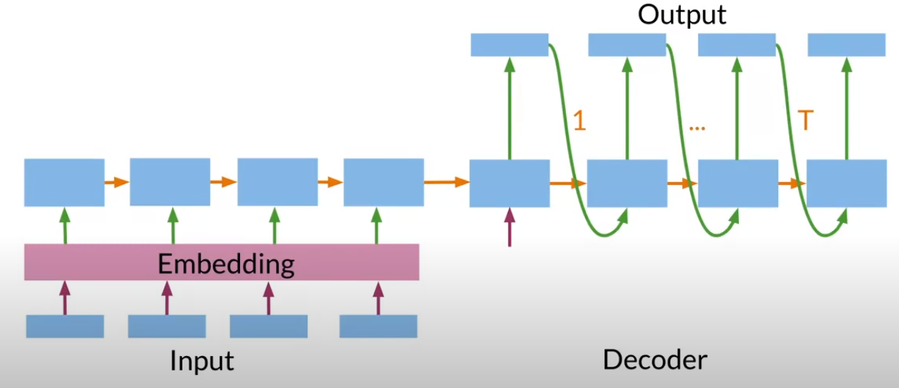
Limitations of RNN:
The natural first approach was using RNN models.
But we then considered the fact that, RNNs are purely sequential. Which makes them harder and slower to train.
They have the “vanishing gradient” problem.
As a result, we looked beyond RNNs, and into more recent Transformer based models.
[image taken from:https://www.coursera.org/learn/attention-models-in-nlp/lecture/glNgT/transformers-vs-rnns]

Slide 4
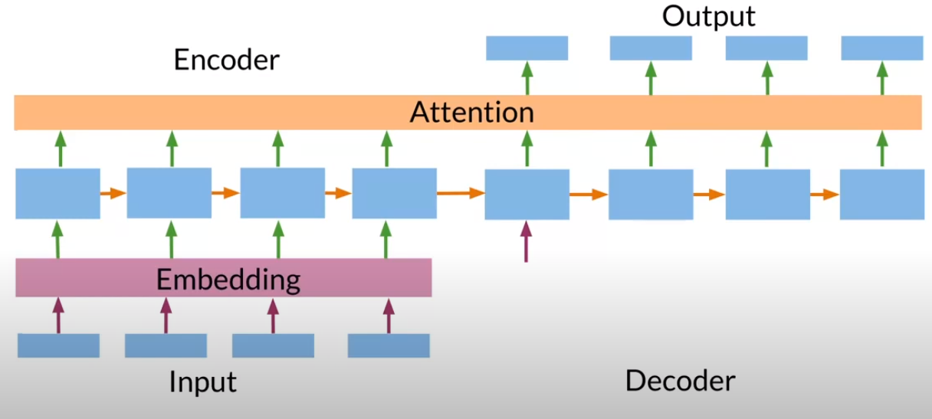
Transformer:
Processes the input sequence as a whole, as opposed to traditional RNN sequential approach.
Faster training, “Forgetting” past weights solved.
Learns relationships between words using multihead attention mechanisms.
Uses positional encoding to take input sequence position into account.
[image from: https://ai.facebook.com/blog/wav2vec-20-learning-the-structure-of-speech-from-raw-audio/]

Slide 5
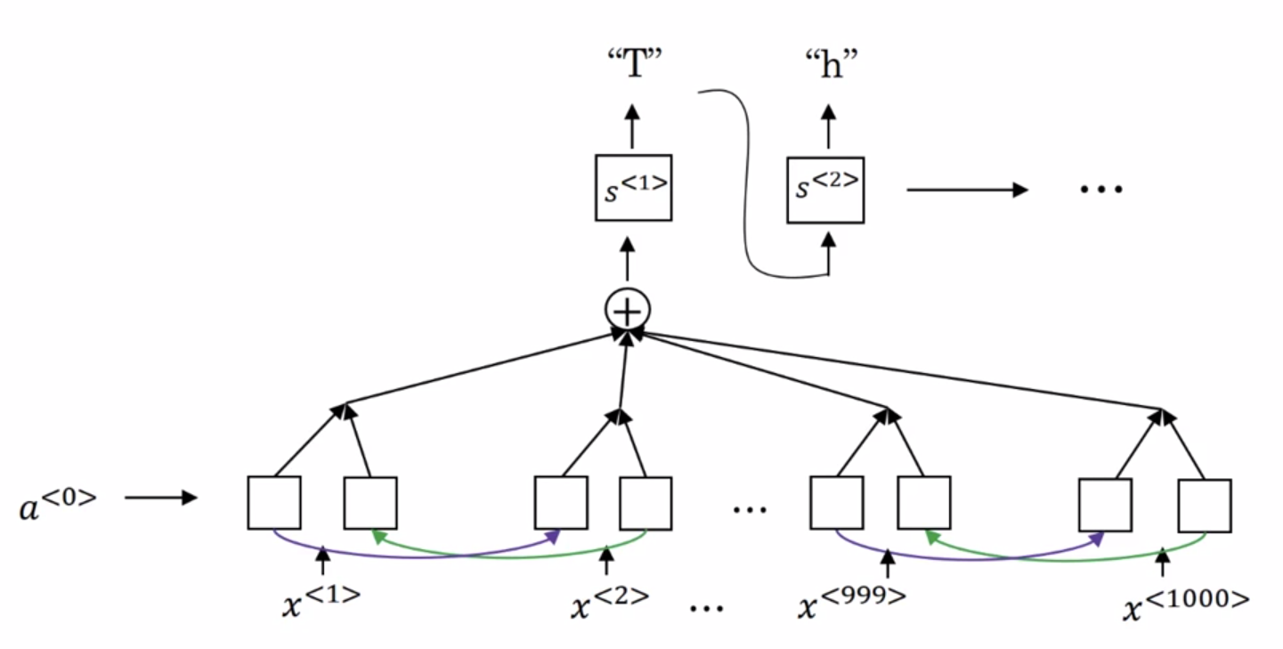
Attention:
Allows a Neural Network to put more weight into considering a specific part of the input sequence more than others.
This attention weights are learned using another attention network.
This scheme is more akin to how humans recognize speech.
[image from: https://www.coursera.org/learn/nlp-sequence-models/]

Slide 6
CTC:
Connectionist Temporal Classification
In speech recognition the number of input time steps is way larger than that of the output.
The CTC cost function allows the RNN to generate an output of repeated letters corresponding to the higher input time steps, that is condensed into words and sentences.

Slide 7
Meta’s wav2vec2:
We came across this model in this competition’s resources.
It is a Transformer based, state-of-the-art self-supervised model.
wav2vec 2.0 word-error-rate (WER) matches or surpasses the very recent supervised learning algorithms while using 100x less labeled data.

Slide 8
Approach of wav2vec2:
Speech is inherently continuous, and segments between words, letters is not obviously clear.
This model addresses that by being pre-trained on multiple languages to identify speech units before learning to transcript a specific language.
This approach of “pre-training” on multiple language to generalize speech unit learning is called XLSR.

Slide 9
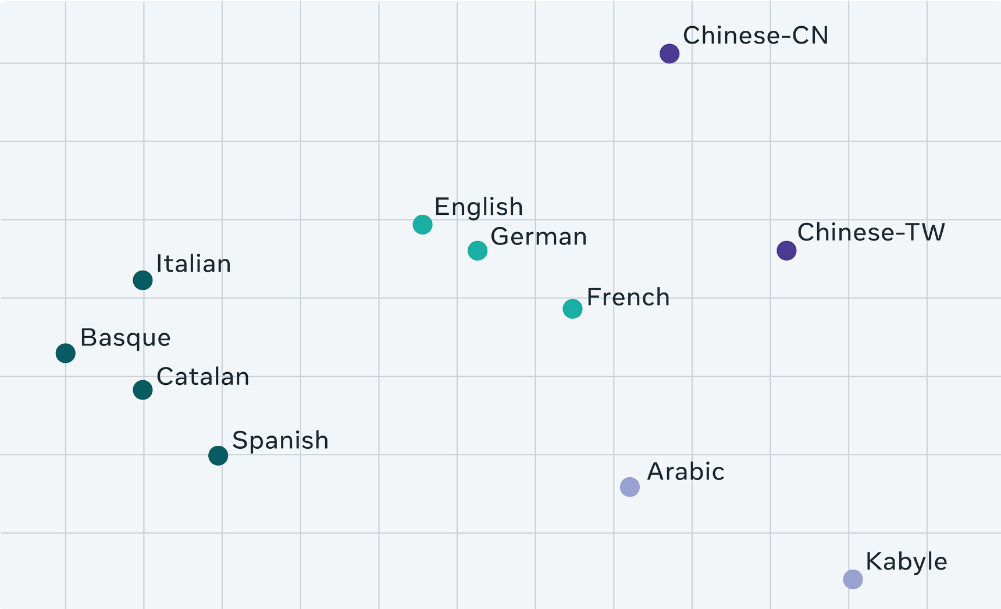
XLSR:
Training on different languages allow for low resource languages to benefit from training on sibling languages.
For example, identification of Bengali word units are benefitted by pre-training on Hindi, Nepali, Assamese, Urdu, Telegu etc. South Asian languages.
Pre-training in larger datasets improve performance.
[image from: https://ai.facebook.com/blog/wav2vec-20-learning-the-structure-of-speech-from-raw-audio/]

Slide 10
Finetuning wav2vec2:
This pre-trained “speech unit” learned model needs to be trained specifically in the language to transcribe. This is called “fine-tuning” the pre-trained model.
We fine-tuned wav2vec 2.0 to Bengali Common Voice Speech Dataset.

Slide 11
About the Dataset
Dataset Basic Features:
Train Split: 206,951
Validation Split: 7747
Test Split: 7747
Headers:
client_id,path,sentence,up_votes,down_votes,age,gender,accents,locale

Slide 12
Practical Analysis
Criterion | Count
upvotes > downvotes | 37405
upvotes < downvotes | 5536
upvotes = downvotes = 0 | 161380
upvotes > downvotes and 1s ≤ duration ≤ 10s | 36919
Voted Data Count: 42941
Percentage of Voted Data that were downvoted: 12.89%
Remark: Downvoted data mostly comprised of cases where the reader misspoke and started again from the start.

Slide 13
Selection of Data for Training and Validation
Training Phase 1 (Epochs 71):
Training: 36919 train samples with upvotes > downvotes and 1s ≤ duration ≤ 10s.
Testing: 7747 validation samples.
Remarks: We sacrificed 486 samples outside the desired duration threshold for faster training.
Training Phase 2 (Epochs 7): :
37405 training samples and 7747 validation samples were combined, shuffled and split into 85:15 ratio.
Training: 38379 samples.
Testing: 6773 samples.
Remarks: This data was used for a final 7 epochs with low learning rate and weight decay.

Slide 14
Preprocessing Functions
Starting and trailing silence removed
Unicode normalization
Tokenization of labels

Slide 15
Training Phase 1
Training done using the Transformers library maintained by huggingface.co (pytorch pipeline)
We started with the following metrics:
learning_rate: 5e-05
weight_decay=0.0035
optimizer: Adam with betas=(0.9,0.999) and epsilon=1e-08
lr_scheduler_warmup_steps: 2000
Epochs: 71

Slide 16
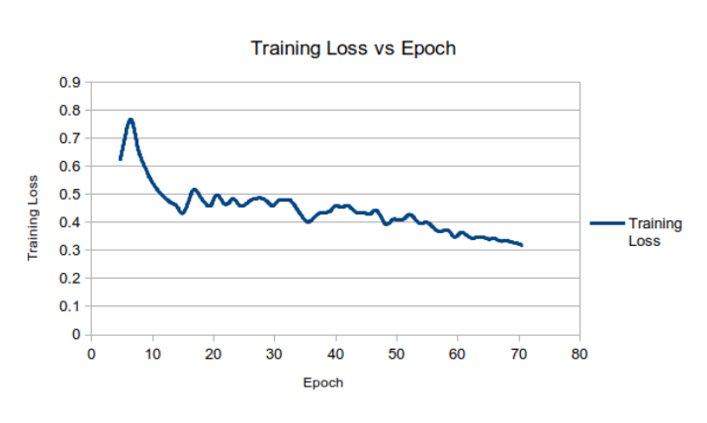
Outcome of Training Phase 1: Training Loss
71 epochs

Slide 17
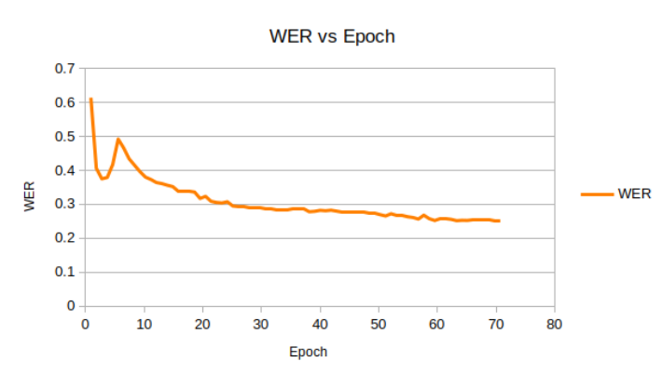
Outcome of Training Phase 1: WER on Evaluation Set

Slide 18
Training Phase - 2
Evaluation WER plateaued about 0.25-0.26 around epoch 55
16 more epochs of training didn’t help (WER 0.2524)
We decided to use Training Data – 2 with the following parameters:
learning_rate: 5e-07
weight_decay=0.0000025
gradient_accumulation_steps: 2
optimizer: Adam with betas=(0.9,0.999) and epsilon=1e-08
lr_scheduler_warmup_steps: 500
num_epochs: 7

Slide 19
Outcome of Training Phase 2
Epoch | Training Loss | WER
1.26 | 0.2552 | 0.1497
2.51 | 0.2482 | 0.15
3.77 | 0.2497 | 0.1498
5.02 | 0.2474 | 0.1499
6.28 | 0.2493 | 0.1499
Observation: Training Loss decreased slightly. WER rate remained steady.
Paradoxically, this produced a noticeable improvement to the Levenshtein Mean Distance Score on Competition Testing, now 2.60753 (down from 2.6446).

Slide 20
Post Processing
Unicode Normalization
(Slight improvement)
Appending the ”devanagari danda” [Unicode#2404]
(Slight improvement)
Use of Language Model IndicCorp | AI4Bharat IndicNLP
Major improvement, the Levenshtein Mean Distance Score decreased from 3.30648 to 2.72243 once applied using an intermediate model. The LM was used consistently thereafter.

Slide 21

Limitations of Our Implementation – 1 (Non-exhaustive)
Foreign (English) Words:
common_voice_bn_31576554.mp3,
তখন তিনি ফায়ার অ্যান্ড মুখ পদ্ধতিতে এগোতে থাকেন।
Subpar Noise Immunity:
common_voice_bn_31589928.mp3,
তার বাবা মা আলাদা হয়ে গেছে পরে গুজোব হয়েছে এবং কার মাকে তারা কেবা জাতে খেলা হয়েছে।

Slide 22
Limitations of Our Implementation – 2 (Non-exhaustive)
Over-enunciated pronunciation:
common_voice_bn_30992535.mp3,
যার সামনে আছে রাই ফেনী।
Misspelling Misspoken but Well Contextualized Words:
common_voice_bn_31622782.mp3,
তবে তিনি বুধ দেখে কখনোই ভয় পাননি।
Under-enunciated words:
common_voice_bn_31557871.mp3
নারায়ণের অপন্যামমুখন্দ।

Slide 23
Possible Improvements
A dedicated model pretrained on Bengali (instead of cross lingual data).
Audio Augmentation for better noise immunity.
More high-quality data!

Slide 24
Acknowledgements
Bengali common voice speech dataset for automatic speech recognition, 2022. Samiul Alam et al.
Wav2vec2, Alexei Baevski et al.
Attention is all you need, Ashish Vaswani et al.
Pytorch: An imperative style, high-performance deep learning library. Adam Paszke et al.
IndicNLPSuite: Monolingual Corpora, Divyanshu Kakwani et al.
Bengali Unicode Normalizer, MD. Nazmuddoha Ansary.

