Slide 1
LOGIN
Username……….
Password………
Role……………..
LOGIN
Forgot password

Slide 2

HOME FOODS ASIAFOOD ERUOPFOOD
Search
ADD+

Slide 3
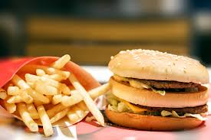

Name:
Country :
Price :
Name:
Country :
Price :
EDIT
DELETE
EDIT
DELETE

Slide 4

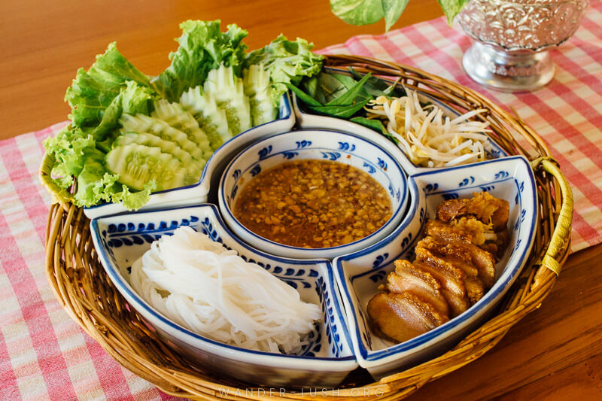
Name:
Country :
Price :
Name:
Country :
Price :

Slide 5
FOODS
Food_id PK Food_name Price Image Category_id FK
CATEGORY
Category_id Category_name picture
1
*
USERS
User_id PK Username Role Password Proflie
ERD

