Slide 1
Adaptive layout
for iPhone Duo
Adapting an existing app with SwiftUI and UIKit
Somendra Yadav
Senior Software Engineer at Microsoft
Notes:
Introduction. Presenter: Somendra. Objective: explain how to adapt an existing application to changing display and window sizes using SwiftUI and UIKit, while preserving content, control reachability and state. The following slides connect APIs, code and UI examples.

Slide 2
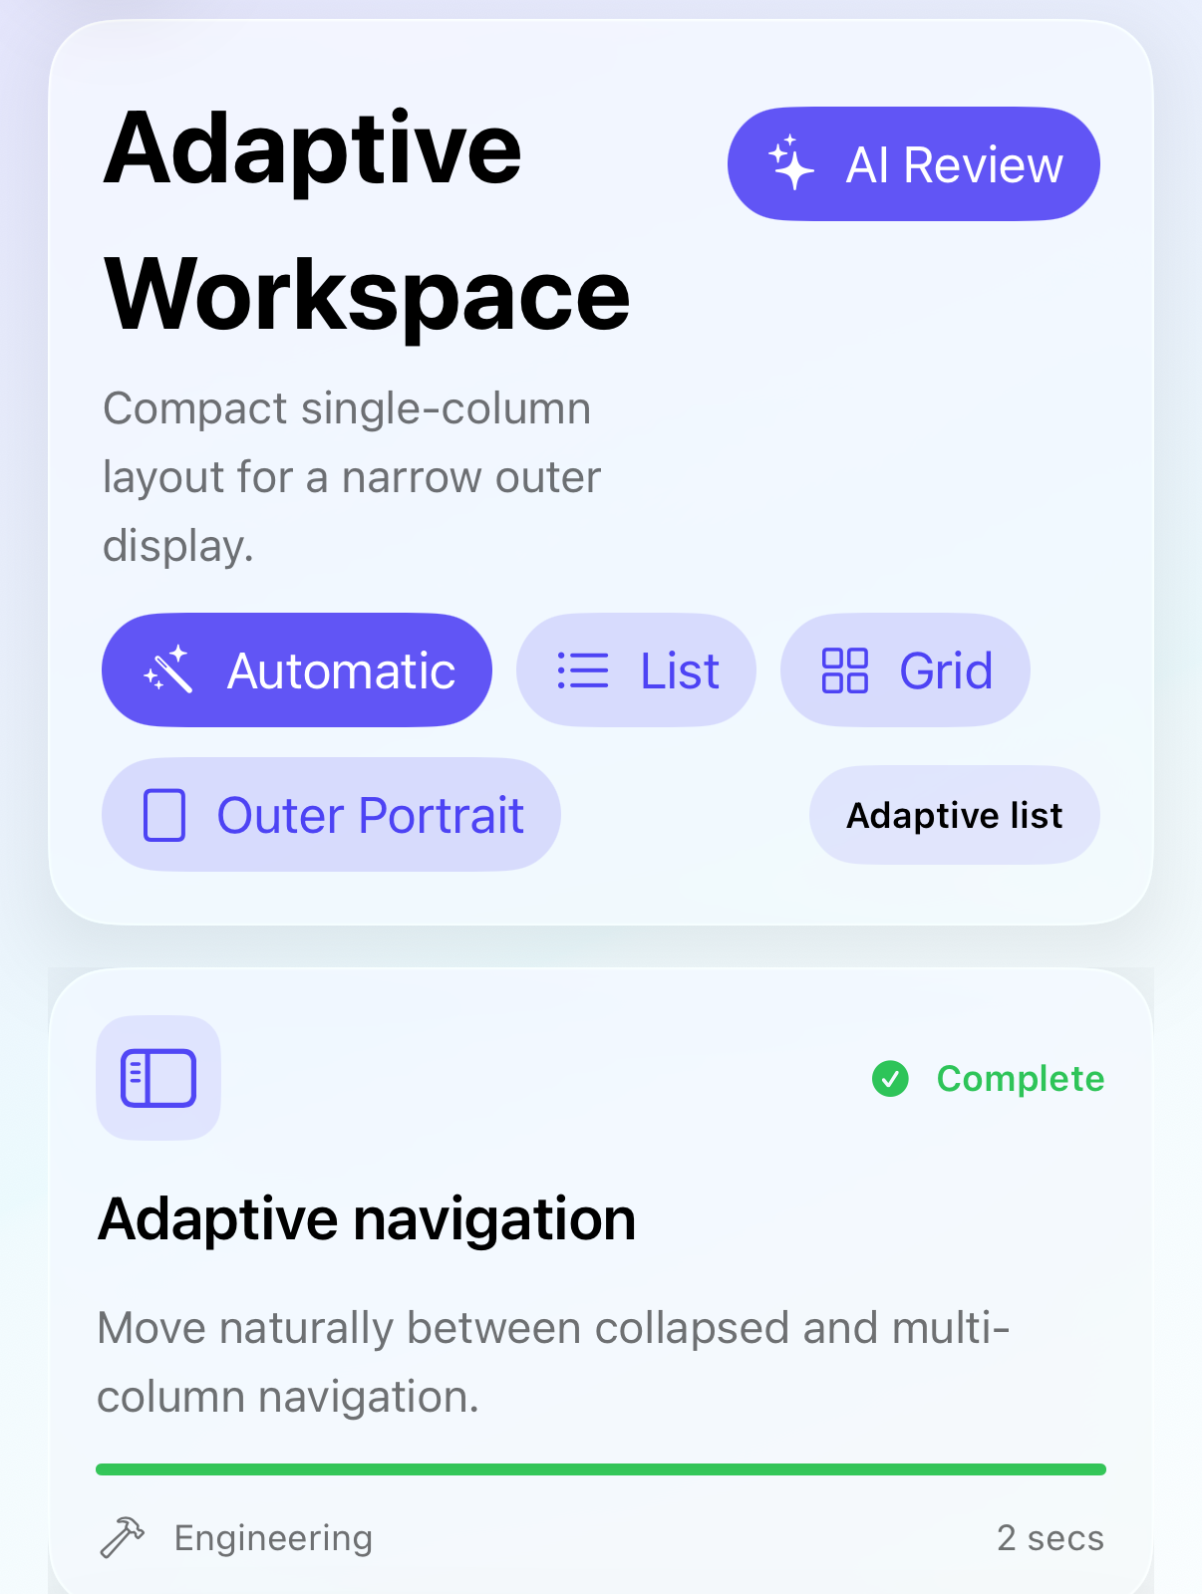
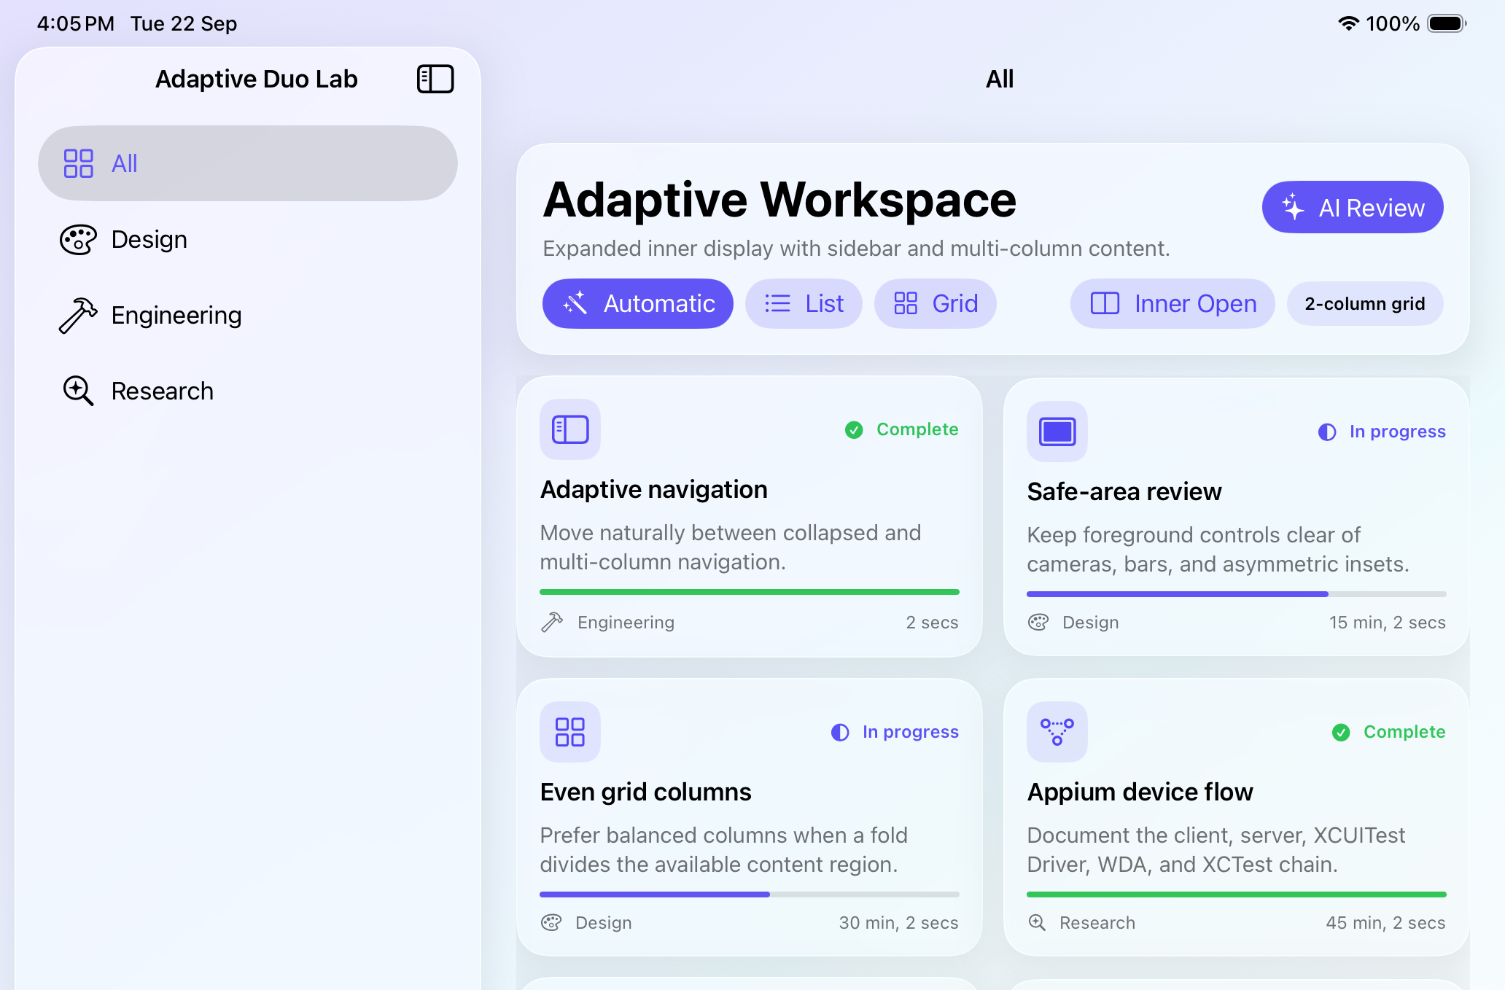
The existing app across screen sizes
SwiftUI and UIKit APIs for an existing app that resizes without losing the user’s task.
Project: narrow
Project: wide
Layout problem
Fixed rows and screen assumptions break as the window changes.
Target behavior
Controls stay reachable. Content reflows. Selection and data persist.
02
Notes:
These are the project’s own earlier captures: Docs/Screenshots/01_outer_portrait.png and 02_inner_open.png. The labels in the app are demonstration presets, not detection of real hardware. They establish the existing app hierarchy and content, not successful execution of the latest changes. The source now includes native Workspace, Review and Settings tabs plus API Lab, which these earlier captures predate. The objective is one adaptable application, with native navigation and targeted custom layout changes. All evidence links remain in speaker notes. No source/reference slides are included.
https://developer.apple.com/videos/play/tech-talks/111466/
https://developer.apple.com/videos/play/tech-talks/111461/
https://www.avanderlee.com/swiftui/iphone-duo-simulator/

Slide 3
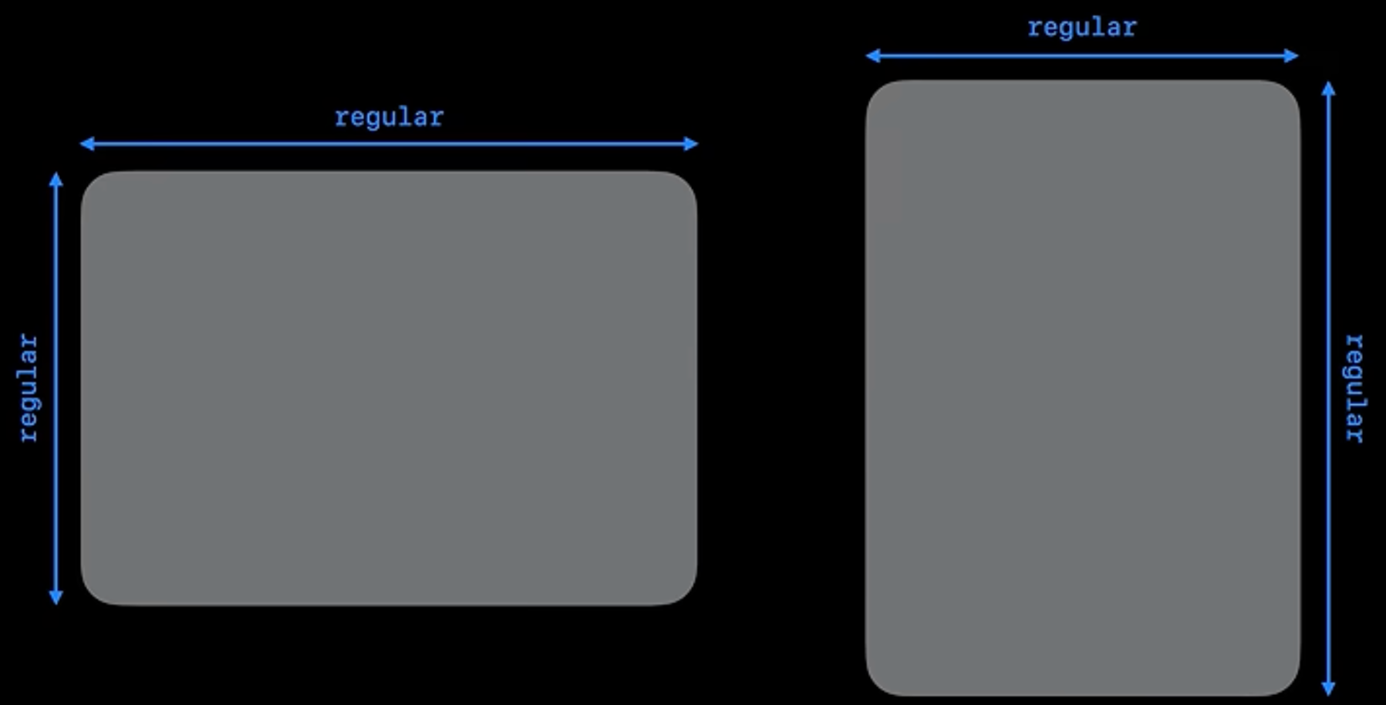
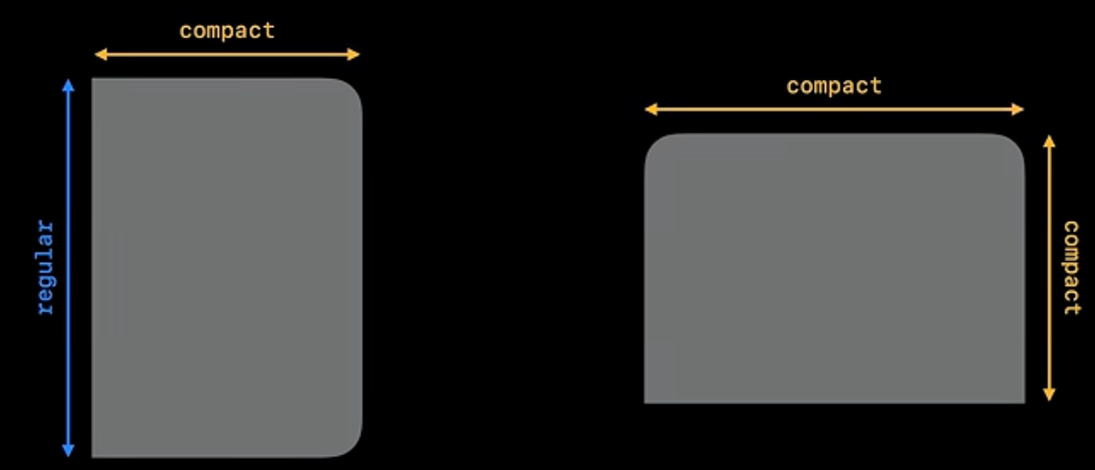
Window geometry and size classes
GeometryReader is iOS 13+. AnyLayout is iOS 16+. The current window supplies the layout input.
SwiftUI: local width drives an app fit rule
Apple: the window can change both axes
GeometryReader { proxy in
let layout = proxy.size.width >= 600
? AnyLayout(HStackLayout(spacing: 16))
: AnyLayout(VStackLayout(spacing: 16))
layout {
SummaryCard()
ProgressCard()
}
}
600 pt is an example content threshold.
Size classes describe the current window.
AnyLayout preserves the children’s identity.
UIKit: view.bounds and traitCollection
Screen only if needed:
view.window?.windowScene?.screen
Use local bounds and traits. UIRequiresFullScreen does not prevent open/close resizing.
03
Notes:
LayoutAPIDemo.swift now implements AnyLayout with persistent title/completion state, local width and Dynamic Type. The 600-point slide threshold is illustrative; this demo uses 640 points as a content-fit rule. UIKitAPIDemo.swift reads the local view traitCollection.displayScale.
Code excerpts are condensed patterns. App-provided callbacks and helper views need enclosing declarations; the named source files contain the complete examples. Apple reference UI illustrates system behavior, while existing project captures show the earlier app. Native SDK compilation and runtime testing remain pending.
https://developer.apple.com/documentation/swiftui/geometryreader
https://developer.apple.com/documentation/swiftui/anylayout
https://developer.apple.com/documentation/swiftui/environmentvalues/horizontalsizeclass
https://developer.apple.com/documentation/swiftui/environmentvalues/verticalsizeclass
https://developer.apple.com/documentation/uikit/uiscreen/main
https://developer.apple.com/documentation/uikit/uiwindowscene/screen
https://developer.apple.com/videos/play/tech-talks/111461/?time=166

Slide 4
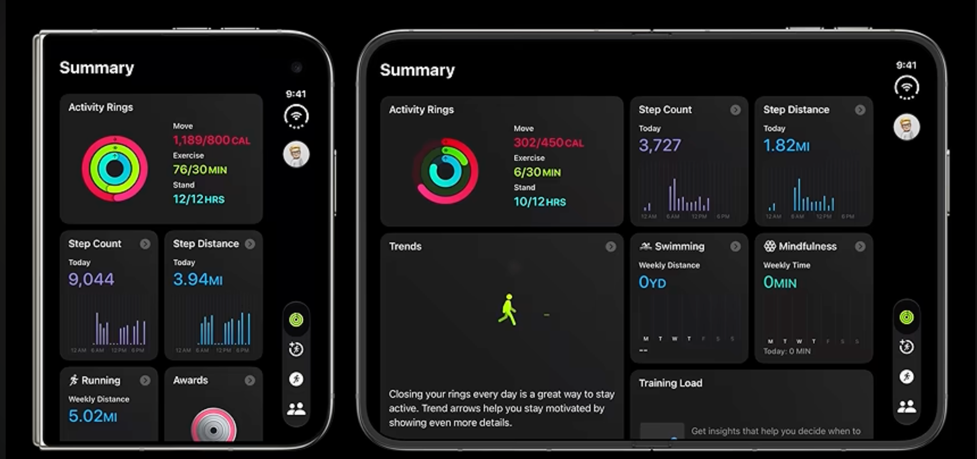
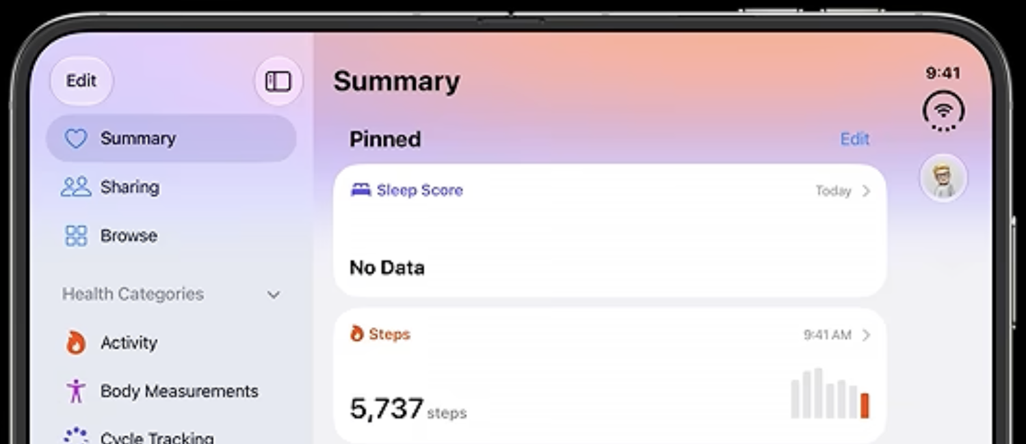
Native tabs and the optional sidebar
Tab is iOS 18+. defaultTabBarPlacement is iOS 27+. Keep the same destinations across sizes.
Native TabView pattern with sidebar preference
Apple: tabs at the display edge
TabView(selection: $selectedTab) {
Tab("Workspace",
systemImage: "square.grid.2x2",
value: AppTab.workspace
) {
workspace
}
Tab("Review",
systemImage: "checkmark.seal",
value: AppTab.review
) {
review
}
}
.tabViewStyle(.sidebarAdaptable)
.defaultTabBarPlacement(.sidebar)
Apple: optional sidebar navigation
API Lab includes a tab/sidebar session. UIKit has a matching example. iOS 17 keeps native tab-item fallbacks.
04
Notes:
TabAPIDemo.swift is now an interactive full-screen tab session with shared note state, sidebarAdaptable, defaultTabBarPlacement (native compile path) and defaultAdaptableTabBarPlacement for iPad. UIKitAPIDemo.swift hosts UITabBarController, sidebar mode and preferredPlacement in a separate session. The code shown is a condensed pattern; RootView itself continues to own the main three destinations.
Code excerpts are condensed patterns. App-provided callbacks and helper views need enclosing declarations; the named source files contain the complete examples. Apple reference UI illustrates system behavior, while existing project captures show the earlier app. Native SDK compilation and runtime testing remain pending.
https://developer.apple.com/documentation/swiftui/tabview
https://developer.apple.com/documentation/swiftui/tab
https://developer.apple.com/documentation/swiftui/view/defaulttabbarplacement(_:)
https://developer.apple.com/documentation/swiftui/tabviewstyle/sidebaradaptable
https://developer.apple.com/documentation/uikit/uitabbarcontroller/sidebar
https://developer.apple.com/videos/play/tech-talks/111461/?time=323
https://developer.apple.com/videos/play/tech-talks/111462/

Slide 5
Adaptive navigation with NavigationSplitView
iOS 16+. Native navigation collapses into a stack when the window is compact.
RootView: existing sidebar and detail
Your project: sidebar and workspace
NavigationSplitView {
List(selection: $selectedCategory) {
ForEach(WorkCategory.allCases) { item in
NavigationLink(value: item) {
Label(item.rawValue,
systemImage: item.symbol)
}
}
}
} detail: {
workspaceDetail
}
UI effect
UIKit equivalent: UISplitViewController
Keep selection and shared data above
layout alternatives.
A wide window can show more hierarchy.
A narrow window preserves access
through native stack navigation.
RootView retains the selection and shared data while navigation adapts.
05
Notes:
This condensed excerpt mirrors RootView.workspace. workspaceDetail represents the existing DashboardView call with filteredItems and its bindings. It is a named helper for readability, not a new API or declaration already in RootView. WorkCategory, selectedCategory and filtered data are project-owned. The same SwiftData container and navigation state survive layout changes. Do not wrap an existing NavigationSplitView detail in an extra NavigationStack merely to attach a toolbar. The screenshot is a crop of Docs/Screenshots/02_inner_open.png. Separate app-to-app Split View multitasking from this within-app navigation container.
https://developer.apple.com/documentation/swiftui/navigationsplitview
https://developer.apple.com/documentation/uikit/uisplitviewcontroller
https://developer.apple.com/videos/play/tech-talks/111461/?time=301

Slide 6
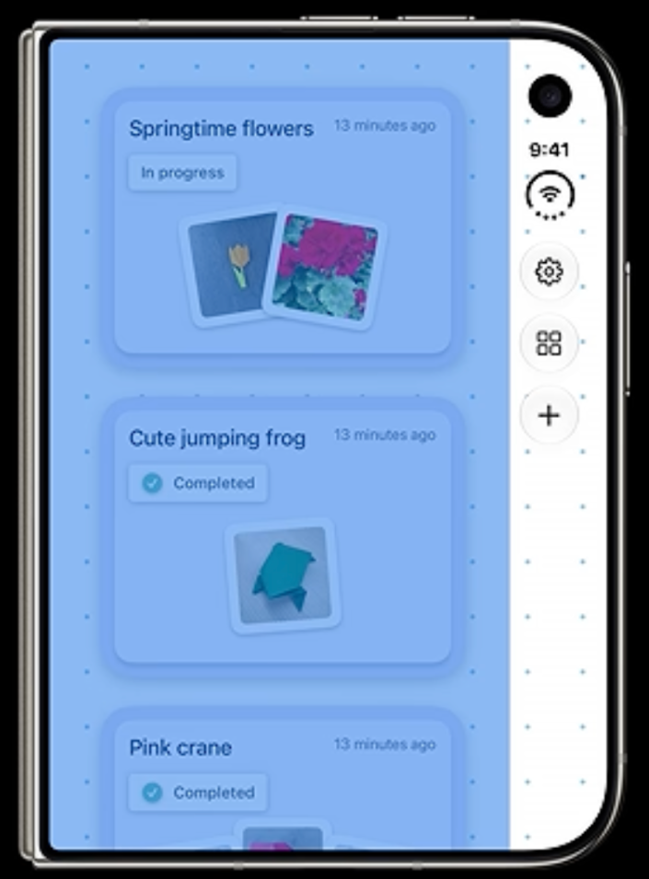
Safe areas and asymmetric insets
Foreground content respects each inset. Decorative backgrounds can extend behind the bars.
SwiftUI: separate the background from content
Apple: foreground safe area
ZStack {
Color.blue.opacity(0.12)
.ignoresSafeArea(.container)
ScrollView {
VStack(alignment: .leading, spacing: 16) {
WorkspaceControls()
RecordCards()
}
.padding()
}
}
UI effect
UIKit: constrain to safeAreaLayoutGuide.
For manual frames, use
view.bounds.inset(by: view.safeAreaInsets).
Content clears the side control lane.
Opposing insets can differ.
Test both sides of Split View.
Background-only ignoresSafeArea is already used. Apply foreground fixes wherever custom content needs them.
06
Notes:
WorkspaceControls and RecordCards are illustrative app-owned foreground views. SwiftUI foreground respects the safe area by default. ignoresSafeArea(.container) here applies only to the decorative color. UIKit Auto Layout should constrain foreground to safeAreaLayoutGuide; for manual layout update foregroundView.frame = view.bounds.inset(by: view.safeAreaInsets) during layout and backgroundView.frame = view.bounds. Do not double one side’s inset to calculate usable width. Layout margins can also be asymmetric and are distinct from safe areas. SafeAreaInset adds app-owned content while preserving the inset contract where appropriate. Test rotation, keyboard, RTL and both Split View positions. The provided image is Apple reference UI and the background behavior is implemented in DashboardView.
https://developer.apple.com/documentation/swiftui/view/ignoressafearea(_:edges:)
https://developer.apple.com/documentation/uikit/uiview/safearealayoutguide
https://developer.apple.com/documentation/uikit/uiview/safeareainsets
https://developer.apple.com/videos/play/tech-talks/111461/?time=427
https://developer.apple.com/videos/play/tech-talks/111466/?time=393

Slide 7
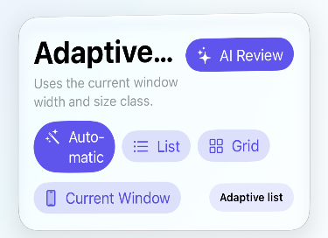
Content reflow and overlapping controls
iOS 16+. The app supplies alternatives; SwiftUI selects the first one that fits.
Header pattern used by the existing app
Your project: earlier compressed controls
ViewThatFits(in: .horizontal) {
HStack(spacing: 12) {
layoutButtons
poseControl
decisionBadge
}
.fixedSize(horizontal: true, vertical: false)
VStack(alignment: .leading, spacing: 12) {
layoutControls
poseControl
decisionBadge
}
}
What changes
Controls can move from row to column.
Card titles grow vertically. Accessibility
text uses the app’s single-column fallback.
ViewThatFits handles the control row. Large text uses one content column.
07
Notes:
The excerpt condenses DashboardHeader alternatives. WorkItemCard separately uses multiline fixedSize for title and summary. layoutButtons, layoutControls, poseControl and decisionBadge are existing view properties; item belongs to WorkItemCard. The actual code also contains a Spacer in the row and a nested fitting alternative in the stacked path. The screenshot shows the old compression problem, not after-fix proof. The actual Dashboard also uses a compact menu in short windows. AdaptiveLayoutPolicy supplies accessibility fallbacks. Avoid blanket fixedSize on large views and provide scrollability for content that cannot fit vertically. Swift excerpts are condensed view-builder patterns. App-defined helper views/properties are identified in notes. They require the enclosing View and appropriate availability annotations. Source excerpts omit unrelated modifiers. New 27.1 APIs are beta and require a matching SDK. Apple visuals demonstrate the named behavior, not a Simulator run of this project.
https://developer.apple.com/documentation/swiftui/viewthatfits
https://developer.apple.com/documentation/swiftui/view/fixedsize(horizontal:vertical:)
Source: Sources/Views/DashboardView.swift and Sources/Views/WorkItemCard.swift
Grid follow-up: LazyVGrid with GridItem(.adaptive(minimum: minWidth)) can size columns by a readable content width. Use @ScaledMetric for minWidth and a one-column branch for dynamicTypeSize.isAccessibilitySize. This is an optional adoption pattern, not the existing policy implementation. The app already preserves explicit List/Grid choices. The detailed guide includes the code. Source: https://developer.apple.com/documentation/swiftui/viewthatfits and https://developer.apple.com/documentation/swiftui/griditem/size-swift.enum/adaptive(minimum:maximum:)

Slide 8
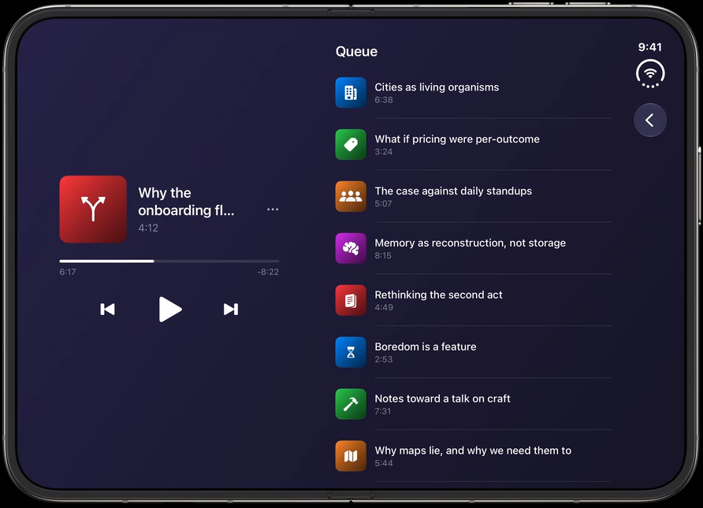
ArrangementView for related content
iOS 27.1 beta. Use it for related content, separately from navigation hierarchy.
API Lab pattern · condensed content views
Apple example: player and queue
ArrangementView {
RecordList(items: items)
} secondary: {
SummaryView(items: items)
}
.arrangementViewStyle(.split)
Primary contains every record.
Summary has another navigation route.
The demo uses a split ratio and also
includes a separate overlay example.
What changes
The system arranges the related views.
The app still preserves access when a
secondary view is not displayed.
API Lab demonstrates native split and overlay arrangements. Workspace keeps its separate pose previews.
08
Notes:
SystemArrangementDemo.swift now contains native split axes, splitArrangementLayoutRatio(0.35), splitArrangementAxis diagnostics, and a separate overlay arrangement with overlayArrangementEdge and overlayArrangementZIndex. All records remain in primary. These are API Lab examples, not an automatic replacement of Workspace pose previews.
Code excerpts are condensed patterns. App-provided callbacks and helper views need enclosing declarations; the named source files contain the complete examples. Apple reference UI illustrates system behavior, while existing project captures show the earlier app. Native SDK compilation and runtime testing remain pending.
https://developer.apple.com/documentation/swiftui/arrangementview
https://developer.apple.com/documentation/swiftui/view/splitarrangementlayoutratio(_:)
https://developer.apple.com/documentation/swiftui/overlayarrangementviewstyle
https://developer.apple.com/videos/play/tech-talks/111463/?time=799

Slide 9
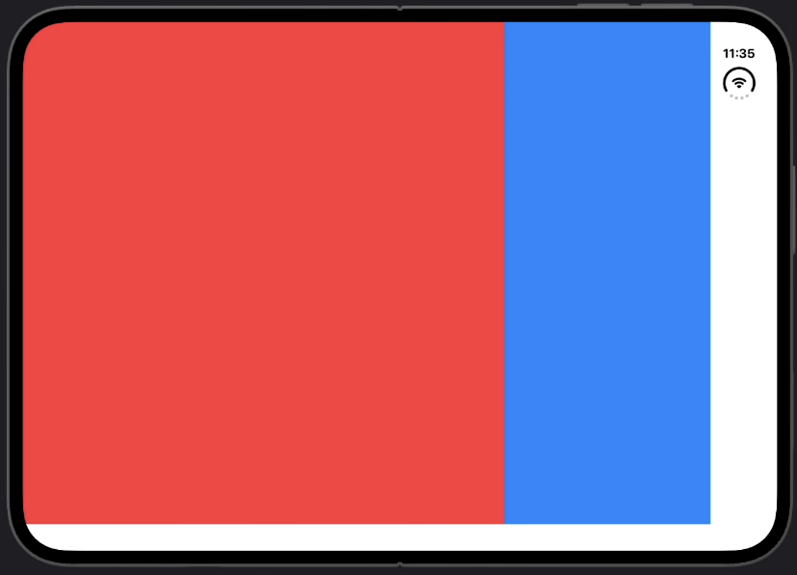
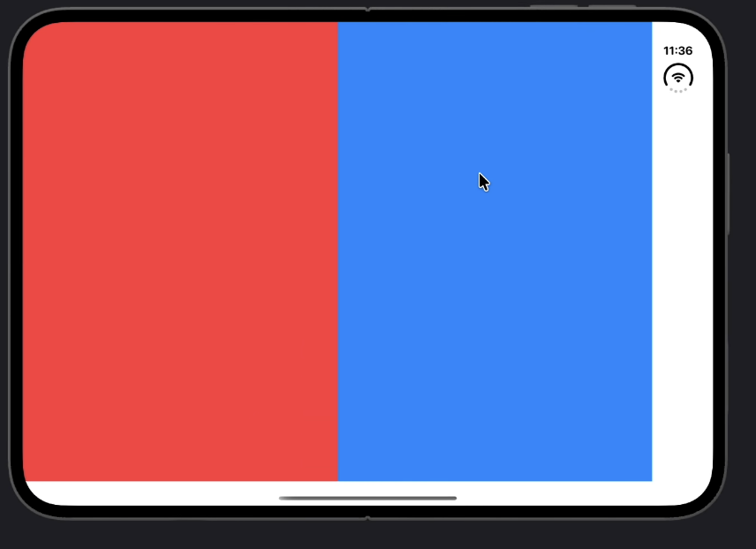
Split axes and size preferences
iOS 27.1 beta. The arrangement chooses the layout within the preferences you supply.
SwiftUI configuration
Preferred ratio: 0.3
ArrangementView {
Color.red
} secondary: {
Color.blue
.splitArrangementLayoutRatio(0.3)
}
.arrangementViewStyle(
.split.axes(.horizontal)
)
Horizontal split with no ratio override
Separate limits for each axis
.splitArrangementLayoutRatio(
maxHorizontal: 0.3,
maxVertical: 0.5
)
09
Notes:
The one-argument ratio is a preferred fraction for the modified child, not a guaranteed allocation. The six-parameter overload also supports per-axis minima, ideals and maxima; omitted parameters default to nil. maxHorizontal:0.3 and maxVertical:0.5 are upper limits. The two captures show different configurations, not a before/after claim about every pose. Code-only duplicate captures 11.25.07 and 11.28.58 show the horizontal-axis modifier, which is transcribed as editable Swift. The 11.27.32 capture supplies the per-axis maximum example.
Supplied code and Simulator captures illustrate these API examples. They are separate from the AdaptiveDuoLab project captures. Condensed editable Swift excerpts require the matching SDK and their enclosing app declarations.
Screenshot sources: Screenshot 2026-09-26 at 11.25.07 AM.png; Screenshot 2026-09-26 at 11.27.32 AM.png; Screenshot 2026-09-26 at 11.28.30 AM.png; Screenshot 2026-09-26 at 11.28.58 AM.png; Screenshot 2026-09-26 at 11.29.22 AM.png
https://developer.apple.com/documentation/swiftui/view/splitarrangementlayoutratio(_:)
https://developer.apple.com/documentation/swiftui/view/splitarrangementlayoutratio(minhorizontal:idealhorizontal:maxhorizontal:minvertical:idealvertical:maxvertical:)
https://developer.apple.com/videos/play/tech-talks/111463/?time=720

Slide 10
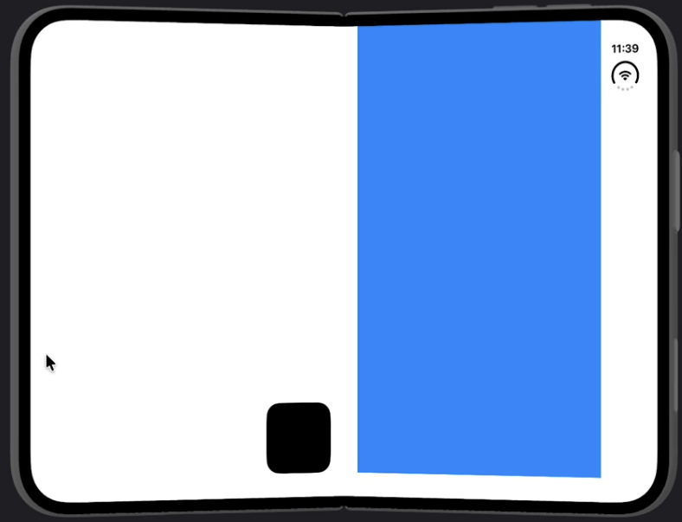
Overlay placement around the fold
iOS 27.1 beta. Related foreground and background content can adapt to separate regions.
SwiftUI edge preferences
Supplied folded presentation
ArrangementView {
FloatingControls()
.overlayArrangementEdge(.leading)
} secondary: {
DetailContent()
.overlayArrangementEdge(.trailing)
}
.arrangementViewStyle(.overlay)
Presentation state
@Environment(\.overlayArrangementZIndex)
private var zIndex
Edge preferences guide displacement.
The system still chooses the final placement.
10
Notes:
overlayArrangementEdge sets a preferred destination when an overlay arrangement displaces content into separate regions. The two supplied views use leading and trailing preferences. The overlay Z index can drive a compact foreground representation. FloatingControls and DetailContent are illustrative app views; SystemArrangementDemo.swift contains the integrated working example. Preserve foreground/background semantics and access to both views.
Supplied code and Simulator captures illustrate these API examples. They are separate from the AdaptiveDuoLab project captures. Condensed editable Swift excerpts require the matching SDK and their enclosing app declarations.
Screenshot sources: Screenshot 2026-09-26 at 11.34.08 AM.png
https://developer.apple.com/documentation/swiftui/view/overlayarrangementedge(_:)
https://developer.apple.com/documentation/swiftui/environmentvalues/overlayarrangementzindex
https://developer.apple.com/videos/play/tech-talks/111463/?time=801

Slide 11
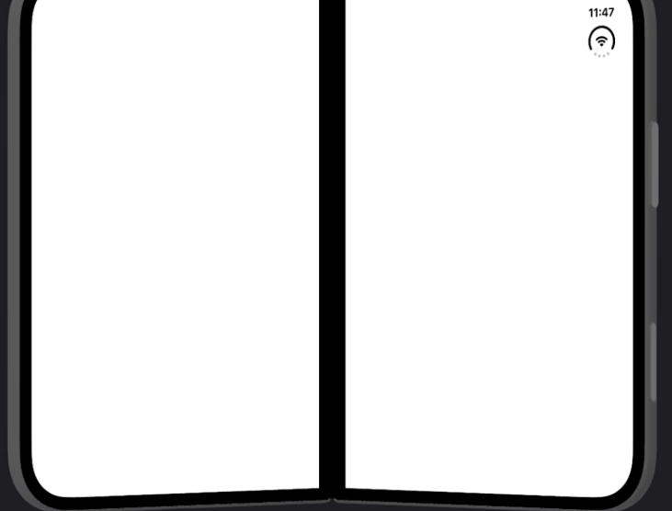
Reserved regions for custom layout
iOS 27.1 beta. Querying a region does not move your custom UI.
API Lab · measured values in local space
Supplied example: a division region
GeometryReader { proxy in
let divisions = proxy.reservedRegions(
kind: .division,
options: .includeInactive
)
let occlusions = proxy.reservedRegions(
kind: .occlusion,
options: .includeInactive
)
RegionInspector(
divisions: divisions.filter { $0.isActive },
occlusions: occlusions.filter { $0.isActive }
)
}
What changes
The black strip visualizes the region.
Custom controls still need avoidance.
Active frames already include margins.
API Lab includes live region inspection and control avoidance. Empty or inactive regions remain valid results.
11
Notes:
SystemArrangementDemo.swift now provides NativeRegionAvoidanceDemo in addition to the region inspector. ReservedRegionPlacement.swift explicitly computes a fitting control rectangle around active intersecting division and occlusion frames and preserves a standard-toolbar Review route. Apple documents that ReservedRegion.frame already includes its interactive margins; do not expand them a second time. Seven focused geometry tests are included but have not run in Xcode. This slide excerpt shows the query/inspection stage.
Code excerpts are condensed patterns. App-provided callbacks and helper views need enclosing declarations; the named source files contain the complete examples. Apple reference UI illustrates system behavior, while existing project captures show the earlier app. Native SDK compilation and runtime testing remain pending.
https://developer.apple.com/documentation/swiftui/geometryproxy/reservedregions(kind:options:layoutdirectionbehavior:)
https://developer.apple.com/documentation/swiftui/reservedregion
https://developer.apple.com/videos/play/tech-talks/111463/?time=500
https://developer.apple.com/videos/play/tech-talks/111466/?time=568
https://developer.apple.com/videos/play/tech-talks/111461/?time=488
Screenshot updated to supplied 11.45.54 AM capture. It draws the division rectangle; it is not proof of custom content avoidance. Querying a region and placing controls around it are separate steps.

Slide 12
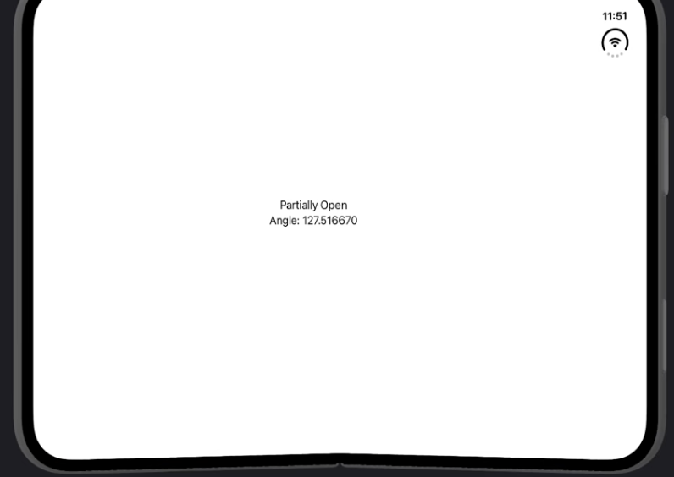
Hinge state and diagnostics
iOS 27.1 beta. DeviceHinge exposes physical state when a hinge is available.
SwiftUI diagnostic view
Supplied diagnostic output
@State private var hinge: DeviceHinge?
var body: some View {
Group {
if let hinge {
Text(hinge.angle.degrees,
format: .number)
} else {
Text("No hinge available")
}
}
.onHingeChange { _, context in
hinge = context.hinge
}
}
Detail from the capture
Closed, fully open or partially open
Keep layout decisions based on local space,
reserved regions and system containers.
12
Notes:
The supplied capture uses DeviceHinge.status with closed, fullyOpen and partiallyOpen cases and displays angle.degrees. The editable excerpt simplifies it to angle plus a nil fallback. onHingeChange observes old and new contexts. The integrated app uses it as a read-only diagnostic. Ordinary iPhones need a useful no-hinge state. Physical angle is not used as a universal layout breakpoint.
Supplied code and Simulator captures illustrate these API examples. They are separate from the AdaptiveDuoLab project captures. Condensed editable Swift excerpts require the matching SDK and their enclosing app declarations.
Screenshot sources: Screenshot 2026-09-26 at 11.47.27 AM.png
https://developer.apple.com/documentation/swiftui/devicehinge
https://developer.apple.com/documentation/swiftui/view/onhingechange(isenabled:_:)
https://developer.apple.com/videos/play/tech-talks/111464/

Slide 13
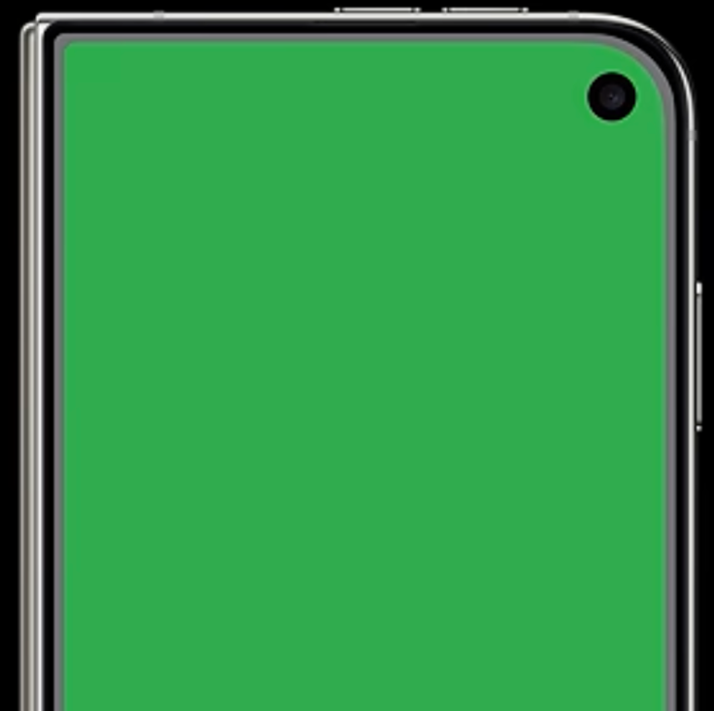
Concentric corners
ConcentricRectangle and UICornerConfiguration were introduced in iOS 26.
SwiftUI shape and UIKit view configuration
Apple example: a concentric corner detail
// SwiftUI decorative background
ConcentricRectangle()
.fill(Color.green)
.padding(8)
.ignoresSafeArea()
// UIKit view configuration
myView.cornerConfiguration = .corners(
radius: .containerConcentric()
)
Use an iOS 26 availability guard.
Keep a compatible rounded-shape fallback
when supporting earlier versions.
What changes
The curve responds to its container.
A single hard-coded corner radius cannot
represent every containing screen shape.
API Lab has SwiftUI and UIKit corner comparisons. Change the inset and compare concentric with fixed corners.
13
Notes:
LayoutAPIDemo.swift now uses ConcentricRectangle with a containing RoundedRectangle and inset slider. UIKitAPIDemo.swift uses UICornerConfiguration with fixed outer and container-concentric inner corners, plus older-OS fallbacks. Apple screenshot illustrates system geometry, not a fresh run of this project.
Code excerpts are condensed patterns. App-provided callbacks and helper views need enclosing declarations; the named source files contain the complete examples. Apple reference UI illustrates system behavior, while existing project captures show the earlier app. Native SDK compilation and runtime testing remain pending.
https://developer.apple.com/documentation/swiftui/concentricrectangle
https://developer.apple.com/documentation/uikit/uicornerconfiguration-swift.struct
https://developer.apple.com/documentation/uikit/uicornerconfiguration-swift.struct/corners(radius:)
https://developer.apple.com/documentation/uikit/uicornerradius-swift.struct/containerconcentric(minimum:)
https://developer.apple.com/videos/play/tech-talks/111461/?time=274

Slide 14
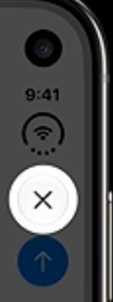
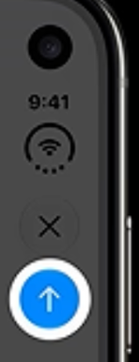
Native toolbar actions
cancellationAction is iOS 14+. topBarPinnedTrailing is iOS 27. Keep an older-OS placement fallback.
SwiftUI: semantic toolbar placements
Apple: close, then the prominent action
.toolbar {
ToolbarItem(placement: .cancellationAction) {
Button("Close", systemImage: "xmark") {
dismiss()
}
}
ToolbarItem(placement: .topBarPinnedTrailing) {
Button("Send", systemImage: "arrow.up") {
send()
}
}
}
Close
Prominent action
UIKit: leadingItemGroups for close
pinnedTrailingGroup for the prominent action
The container adapts the bar.
Placement describes each action’s role.
Keep a title and a working action.
The SwiftUI and UIKit toolbar demos use real actions, native containers and semantic placements.
14
Notes:
ToolbarAPIDemo.swift now uses cancellationAction and topBarPinnedTrailing for working Close/Pin actions. UIKitToolbarAPIDemo.swift uses leadingItemGroups, trailingItemGroups, pinnedTrailingGroup, toolbarItems and UINavigationController.setToolbarHidden(false, animated:false). The illustrated Send callback remains an explanatory example; the app uses local Review, Pin, Sort, Add and Summary actions.
Code excerpts are condensed patterns. App-provided callbacks and helper views need enclosing declarations; the named source files contain the complete examples. Apple reference UI illustrates system behavior, while existing project captures show the earlier app. Native SDK compilation and runtime testing remain pending.
https://developer.apple.com/documentation/swiftui/toolbaritemplacement/cancellationaction
https://developer.apple.com/documentation/swiftui/toolbaritemplacement/topbarpinnedtrailing
https://developer.apple.com/documentation/uikit/uinavigationitem/leadingitemgroups
https://developer.apple.com/documentation/uikit/uinavigationitem/pinnedtrailinggroup
https://developer.apple.com/documentation/uikit/uinavigationitem/leftitemssupplementbackbutton
https://developer.apple.com/videos/play/tech-talks/111462/?time=300
https://developer.apple.com/videos/play/tech-talks/111462/?time=324
https://developer.apple.com/videos/play/tech-talks/111462/?time=144

Slide 15
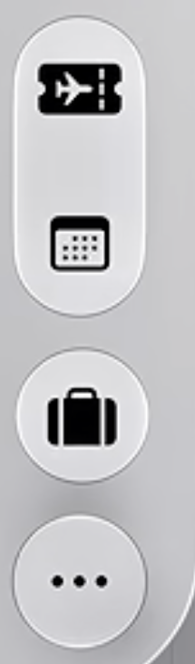
Overflow priority and compression
visibilityPriority and ToolbarOverflowMenu are iOS 27. Compression preference is iOS 27.1 beta.
API Lab: priority, overflow and compression
Apple: one system overflow menu
.toolbar {
ToolbarItem {
Button("Review", systemImage: "checkmark",
action: review)
}
.visibilityPriority(.high)
ToolbarOverflowMenu {
Button("Export report", action: export)
Button("Reset preview", action: reset)
}
}
.toolbarVerticalCompressionBehavior(
.prefersToolbarItems
)
Priority
High priority delays an action’s overflow.
Compression
This preference compresses tabs first.
API Lab includes selectable priorities and compression, with working actions in the system overflow menu.
15
Notes:
ToolbarAPIDemo.swift now calls ToolbarOverflowMenu, visibilityPriority and toolbarVerticalCompressionBehavior. Select preferences before opening the native session and observe competition between native tabs/actions. UIKitToolbarAPIDemo.swift demonstrates visibilityPriority, verticalBarCompressionBehavior, and additionalOverflowItems using UIDeferredMenuElement.uncached. The slide callbacks illustrate configuration; executable lab actions manipulate local records rather than exporting or resetting user data.
Code excerpts are condensed patterns. App-provided callbacks and helper views need enclosing declarations; the named source files contain the complete examples. Apple reference UI illustrates system behavior, while existing project captures show the earlier app. Native SDK compilation and runtime testing remain pending.
https://developer.apple.com/documentation/swiftui/toolbarcontent/visibilitypriority(_:)
https://developer.apple.com/documentation/swiftui/toolbaroverflowmenu
https://developer.apple.com/documentation/swiftui/view/toolbarverticalcompressionbehavior(_:)
https://developer.apple.com/documentation/swiftui/toolbarverticalcompressionbehavior/preferstoolbaritems
https://developer.apple.com/documentation/uikit/uibarbuttonitem/visibilitypriority
https://developer.apple.com/documentation/uikit/uinavigationitem/verticalbarcompressionbehavior
https://developer.apple.com/documentation/uikit/uinavigationitem/additionaloverflowitems
https://developer.apple.com/videos/play/tech-talks/111462/?time=700

Slide 16
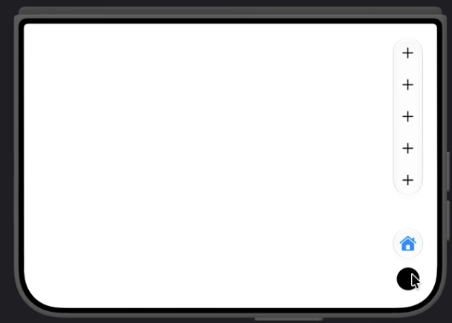
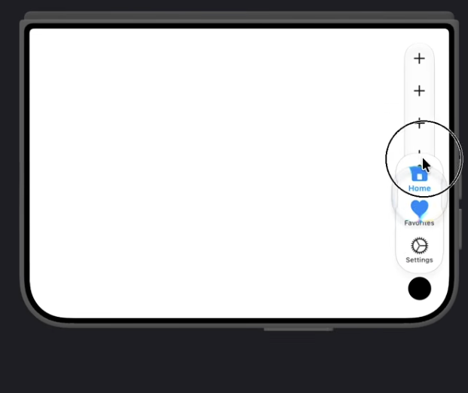
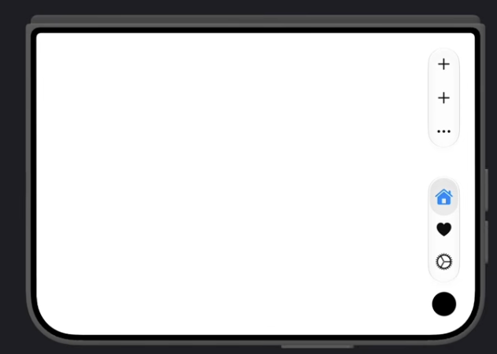
Vertical space and action reachability
iOS 27.1 beta. A compression preference decides which controls keep more vertical space.
.toolbarVerticalCompressionBehavior(.prefersToolbarItems)
Toolbar actions stay visible
Other tabs remain reachable
Actions can use overflow
The tab representation compresses
while the action group keeps room.
The expanded tab choices still
include every destination.
The ellipsis holds actions that
no longer fit in the visible group.
16
Notes:
The complete modifier and prefersToolbarItems value are visible in the 11.40.32 screenshot and transcribed into editable code. 11.41.01 shows five visible actions with compressed tabs. 11.41.20 shows expanded tab choices, but a still does not prove a triggering gesture. 11.42.59 shows toolbar overflow and all three tabs. Its preference argument is clipped, so do not claim that capture explicitly uses prefersTabBar. The examples illustrate reachability under competition, not one guaranteed state sequence.
Supplied code and Simulator captures illustrate these API examples. They are separate from the AdaptiveDuoLab project captures. Condensed editable Swift excerpts require the matching SDK and their enclosing app declarations.
Screenshot sources: Screenshot 2026-09-26 at 11.40.32 AM.png; Screenshot 2026-09-26 at 11.41.01 AM.png; Screenshot 2026-09-26 at 11.41.20 AM.png; Screenshot 2026-09-26 at 11.42.59 AM.png
https://developer.apple.com/documentation/swiftui/view/toolbarverticalcompressionbehavior(_:)
https://developer.apple.com/documentation/swiftui/toolbarverticalcompressionbehavior
https://developer.apple.com/videos/play/tech-talks/111462/

Slide 17
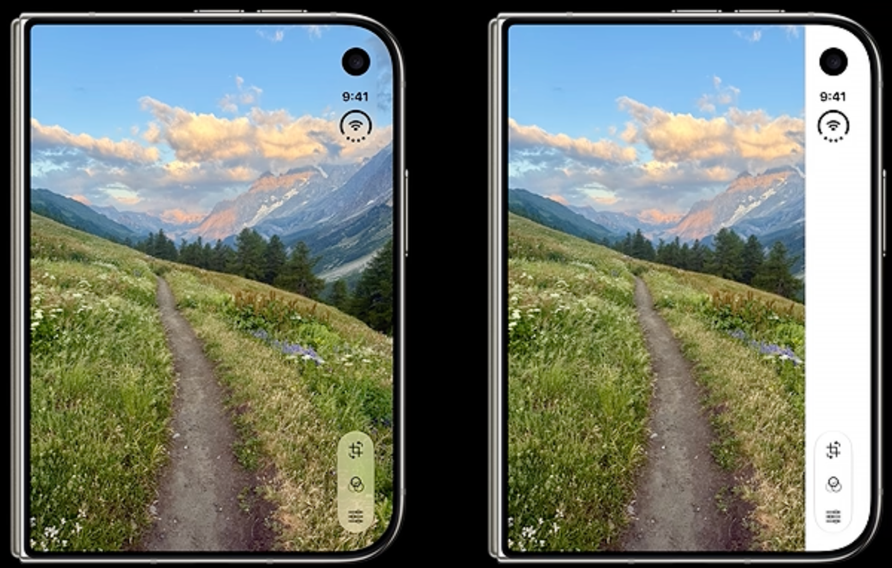
Custom controls in vertical bars
toolbarVerticalEdge and UIKit verticalBarEdge are iOS 27.1 beta. Use availability and SDK guards.
SwiftUI: a compact representation with a title
Apple: different bar backgrounds
struct ReviewControl: View {
@Environment(\.toolbarVerticalEdge) private var edge
let review: () -> Void
var body: some View {
Button(action: review) {
if edge != nil {
Label("Review", systemImage: "checkmark")
.labelStyle(.iconOnly)
} else {
Label("Review", systemImage: "checkmark")
.labelStyle(.titleAndIcon)
}
}
}
}
UIKit equivalent trait
traitCollection.verticalBarEdge
The preferred edge may exist while hidden.
Check legibility with Reduce Transparency.
Keep titles available for accessibility.
ToolbarItem { ReviewControl(review: review) }
.axisBehavior(.verticalPreferred)
API Lab compares custom control axes and preferred-edge adaptation. Actions also remain reachable in the content.
17
Notes:
ToolbarAPIDemo.swift now calls axisBehavior, reads toolbarVerticalEdge and compacts a custom Review control. Toolbar vertical/minimization preferences are selectable at session launch. UIKitToolbarAPIDemo.swift uses UIBarButtonItem.axisBehavior and traitCollection.verticalBarEdge. The edge denotes a supported preferred context, not current visibility. All actions retain a content route.
Code excerpts are condensed patterns. App-provided callbacks and helper views need enclosing declarations; the named source files contain the complete examples. Apple reference UI illustrates system behavior, while existing project captures show the earlier app. Native SDK compilation and runtime testing remain pending.
https://developer.apple.com/documentation/swiftui/environmentvalues/toolbarverticaledge
https://developer.apple.com/documentation/swiftui/toolbarcontent/axisbehavior(_:)
https://developer.apple.com/documentation/swiftui/label
https://developer.apple.com/documentation/uikit/uitraitcollection/verticalbaredge
https://developer.apple.com/documentation/uikit/uiverticalbaredge
https://developer.apple.com/videos/play/tech-talks/111462/?time=607
https://developer.apple.com/videos/play/tech-talks/111462/?time=636

Slide 18
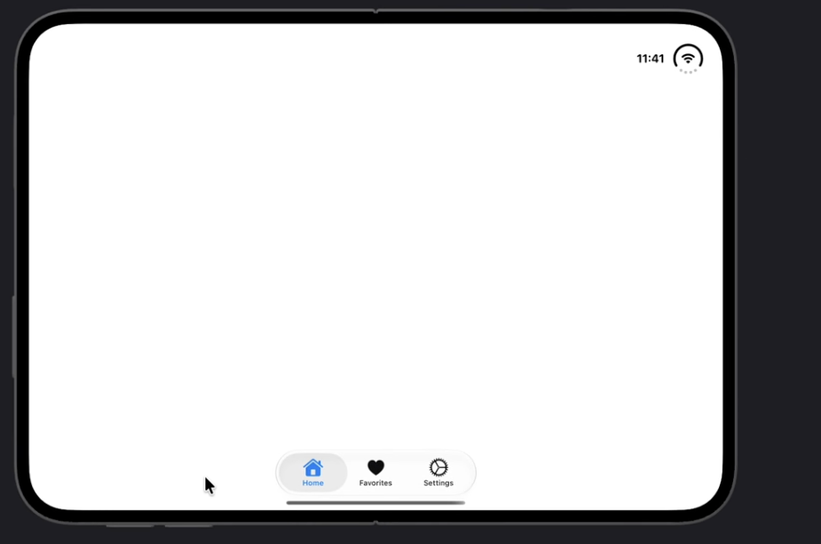
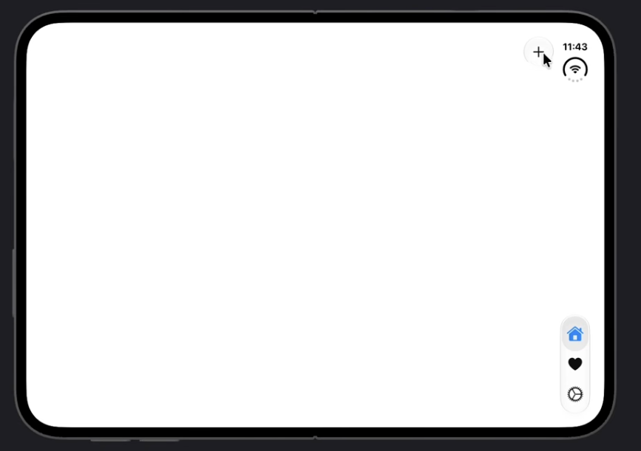
Presentation and item axis choices
Two controls at different scopes. Keep presentation preferences stable while the user resizes.
Presentation: horizontal bars
Item: horizontal-only action
TabView {
appTabs
}
.toolbarVerticalBehavior(.disabled)
ToolbarItem {
Button("Add", systemImage: "plus",
action: addItem)
}
.axisBehavior(.horizontalOnly)
The supplied example keeps tabs at the bottom.
Use this choice for a suitable presentation.
The Add item stays horizontal while tabs can
still use the vertical edge.
18
Notes:
toolbarVerticalBehavior(.disabled) controls the presentation preference and is available in iOS27.1. Do not dynamically switch it for each physical pose. axisBehavior(.horizontalOnly) controls a toolbar item and is available in iOS27.1 beta. The two examples have different scope. appTabs and addItem are condensed app-owned declarations. Supplied 11.38.02 shows bottom tabs; 11.39.52 shows Add at the top with tabs vertically arranged.
Supplied code and Simulator captures illustrate these API examples. They are separate from the AdaptiveDuoLab project captures. Condensed editable Swift excerpts require the matching SDK and their enclosing app declarations.
Screenshot sources: Screenshot 2026-09-26 at 11.38.02 AM.png; Screenshot 2026-09-26 at 11.39.52 AM.png
https://developer.apple.com/documentation/swiftui/view/toolbarverticalbehavior(_:)
https://developer.apple.com/documentation/swiftui/toolbarcontent/axisbehavior(_:)
https://developer.apple.com/videos/play/tech-talks/111462/

Slide 19
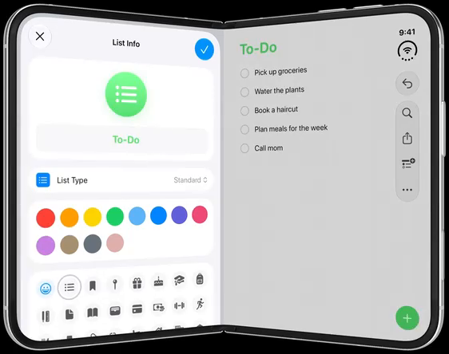
Adaptive sheets and presentations
sheet is iOS 13+. NavigationStack and presentationDetents in this pattern require iOS 16+.
Native sheet pattern with shared parent state
Apple: sheet clear of the fold
@State private var showsAudit = false
// Inside the presenting view's body:
Button("Layout Review") {
showsAudit = true
}
.sheet(isPresented: $showsAudit) {
NavigationStack {
ReviewContent()
.navigationTitle("Layout Review")
}
.presentationDetents([.medium, .large])
}
What changes
The system positions the sheet and bars.
Custom controls still need fitting.
Scrolling content may cross the fold.
API Lab includes an editable sheet with detents.
The parent retains its draft during resizing.
API Lab also includes a popover, alert and action menu. The toolbar demo compares vertical-bar preferences.
19
Notes:
PresentationAPIDemo.swift now provides a working sheet with presentationDetents, popover, alert and menu. Draft state belongs to the presenting view. ToolbarAPIDemo.swift separately demonstrates toolbarVerticalBehavior preferences. Native system geometry determines physical placement.
Code excerpts are condensed patterns. App-provided callbacks and helper views need enclosing declarations; the named source files contain the complete examples. Apple reference UI illustrates system behavior, while existing project captures show the earlier app. Native SDK compilation and runtime testing remain pending.
https://developer.apple.com/documentation/swiftui/view/sheet(ispresented:ondismiss:content:)
https://developer.apple.com/documentation/swiftui/view/presentationdetents(_:)
https://developer.apple.com/documentation/swiftui/view/toolbarverticalbehavior(_:)
https://developer.apple.com/videos/play/tech-talks/111466/?time=564
https://developer.apple.com/videos/play/tech-talks/111466/?time=568

Slide 20
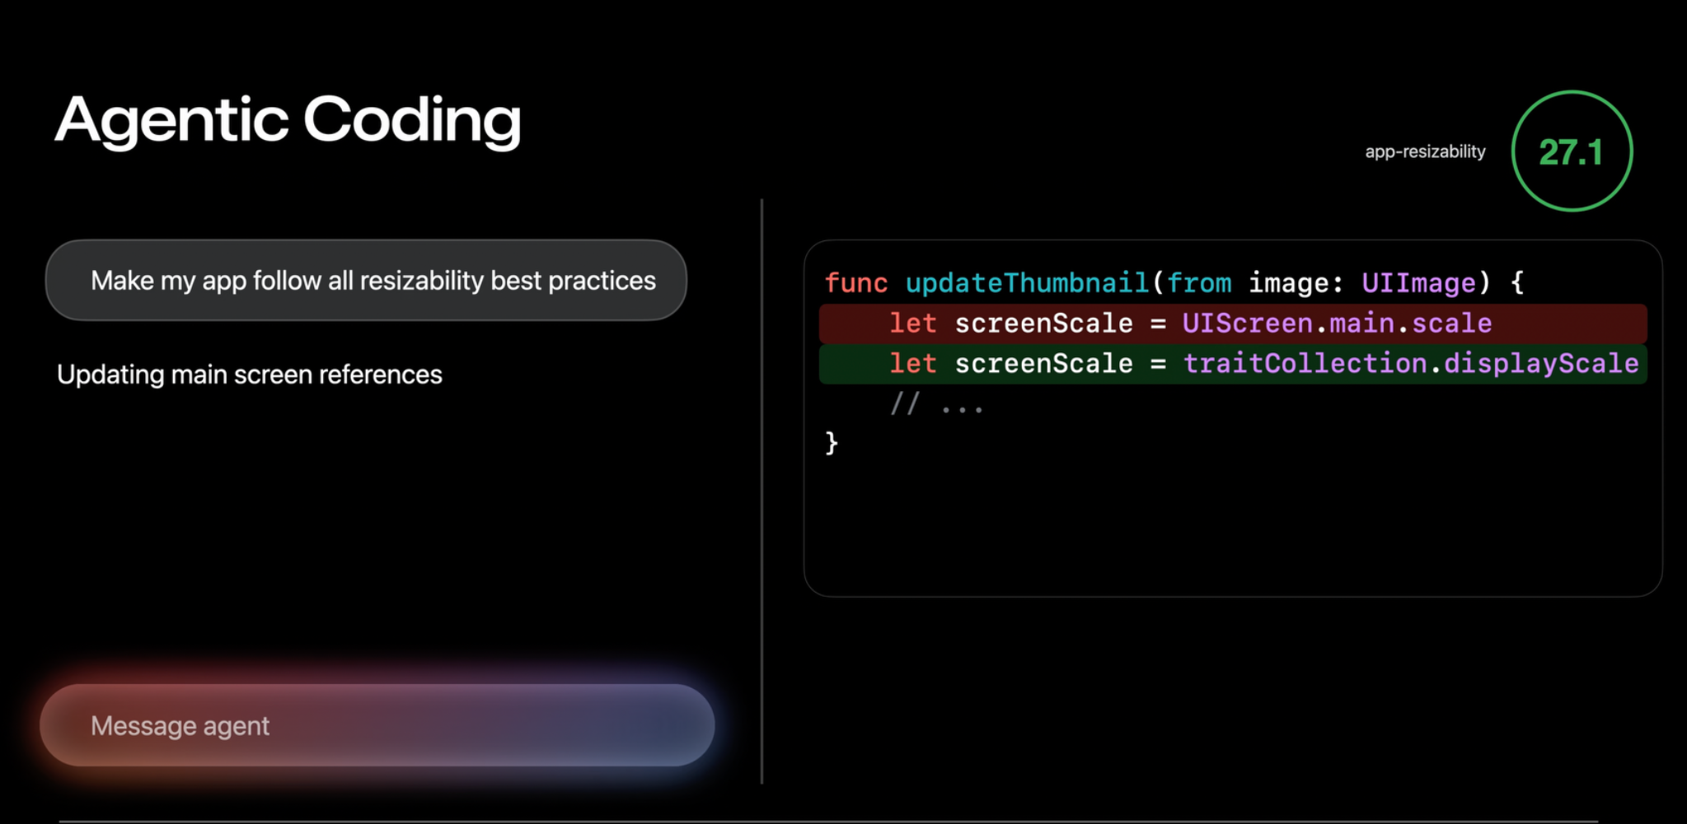
App Resizability in Xcode 27.1
Apple’s coding skill helps an agent update source across an existing project.
Apple’s example: replace a global screen assumption
1. Inspect the workspace
Ask the skill to review resizing,
local geometry and safe areas.
2. Review the changes
Check state ownership and
older-OS fallbacks in the diff.
3. Build and resize
Validate the updated UI on
ordinary iPhones and Duo.
let screenScale = traitCollection.displayScale
The skill edits source during development. Native containers handle adaptation while the app runs.
20
Notes:
Apple renamed the app modernization skill to App Resizability in Xcode27.1 and expanded it to SwiftUI and iPhone Duo. The supplied screenshot is from Prepare your app for iPhone Duo and demonstrates replacing UIScreen.main.scale with traitCollection.displayScale inside a view/controller context. This is a development-time source-change workflow, not a SwiftUI runtime modifier. In Xcode Coding Assistant choose the available App Resizability skill and ask it to review AdaptiveDuoLab.xcworkspace. Review changes, build the baseline/native paths, and validate resize transitions. The bundled Apple skill was not executed here. The included Docs/Apple_App_Resizability_Workflow.md provides the whole-workspace prompt and export guidance.
Sources: https://developer.apple.com/videos/play/tech-talks/111461/?time=552 and https://developer.apple.com/videos/play/wwdc2026/278/?time=847
Screenshot supplied by the user: Screenshot 2026-09-26 at 11.15.13 AM.png. No speaker names appear on the slide.

Slide 21
Migration of the existing app
Eight interactive API Lab routes share the existing app. Keep build compatibility and validate each environment.
Source changes and build compatibility
Validation while the window changes
#if DUO_SDK
if #available(iOS 27.1, *) {
NativeArrangementContent(
items: items, category: category
)
} else {
fallback("Requires iOS 27.1")
}
#else
fallback("Use the baseline layout")
#endif
State continuity
Keep the same selection, draft and records.
Avoid resetting identity with .id(width).
Layout and accessibility
Open, close, rotate and multitask.
Test large text, overflow and both edges.
Performance
Keep iOS 17 support and shared SwiftData.
Review every screen with App Resizability.
Build both the baseline and native paths.
Keep body inexpensive. Profile transitions
with Instruments and realistic data.
The examples now have source implementations. Xcode compilation and device validation remain the next step.
21
Notes:
The project now has 25 API catalog entries and eight interactive routes. All original 16 catalog entries have source calls; onHingeChange remains an intentional diagnostic rather than a navigation trigger. CameraAPIDemo.swift includes user-started rear-camera preview and an optional CameraCaptureAccessory via sceneAccessory. Camera permission and accessory availability remain required. The native path is behind DUO_SDK and iOS27.1 checks. Swift grammar, package membership and scripts are checked here; no Xcode compilation, Swift tests, Simulator execution or bundled Apple skill execution occurred.
Code excerpts are condensed patterns. App-provided callbacks and helper views need enclosing declarations; the named source files contain the complete examples. Apple reference UI illustrates system behavior, while existing project captures show the earlier app. Native SDK compilation and runtime testing remain pending.
https://developer.apple.com/documentation/swiftui/anylayout
https://developer.apple.com/documentation/swiftui/view/id(_:)
https://developer.apple.com/videos/play/tech-talks/111461/?time=552
https://developer.apple.com/videos/play/wwdc2026/278/
https://developer.apple.com/videos/play/wwdc2026/269/
https://developer.apple.com/videos/play/wwdc2026/8003/
https://developer.apple.com/videos/play/wwdc2025/306/
https://developer.apple.com/videos/play/wwdc2025/266/
https://developer.apple.com/documentation/xcode/understanding-and-improving-swiftui-performance

Slide 22
Thank you
Somendra Yadav
Senior Software Engineer at Microsoft
Notes:
Closing slide. Presenter: Somendra.

