Slide 1

TEAM Collective_Outliers Debabrata Panda Somya Ranjan Patra COLLEGE: National Institute of Technology, Rourkela
Team leader mail id : somyawrestlemania28@gmail.com
Machine Learning Code Gladiators 2021

Slide 2
Brief description of the problem at hand:
Life is improving as a result of technological advancements.
The use of technology for malicious reasons is also on the rise. The suspicious activities are increasing ranging from dos attacks, phishing, hacking etc.
Phishing is a type of social engineering where an attacker sends a fraudulent (e.g., spoofed, fake, or otherwise deceptive) message designed to trick a person into revealing sensitive information to the attacker or to deploy malicious software on the victim's infrastructure like ransomware.
Phishing is the act of presenting a piece of bait to an unsuspecting computer user in the hopes that they would bite. A malicious actor will employ virtual bait in the form of an email (generally) with a link to try to attract the user to click on that link – whereupon they will be 'hooked' and most likely infected with malware and a whole world of agony and expense.
Phishing is one of the most significant dangers to your online accounts and data because these attacks pose as a trustworthy firm or person, and they employ social engineering techniques to make victims more likely to fall for the scam.
Phishing is still the most common way for cybercriminals to infect victims' devices. Corporate personnel are especially vulnerable since they are frequently used as a point of access into sensitive data.
Our task is to read the data and create a model based on the data analysis to identify if the website is legitimate or a phishing website

Slide 3
Solution proposed and description:
Raw Dataset:
1) Phishing Train and Test datasets
2) Training Data has 8955 rows and 32 columns
3) Test Data has 2100 rows and 31 columns
4) Training Data is more or less balanced(5 : 4 : :1 : -1)
5) Binary Classification Problem(Supervised Learning)
Exploring Dataset:
1) One column is the primary key
2) Remaining columns are all categorical columns
3) Nominal categorical features with values 1, -1 and 0 representing legit, phishing website and in doubt respectively
4) No Null values, No noise in data and No Duplicate rows
Feature Importance :
1) Important Features were selected using chi-square contingency test
2) Features were arranged according to their chi2 values
3) Pandas’ DataFrame.crosstab() method was used to obtain the contingency table
4) Scipy was used to carry out the chi square test.
Model Selection:
1) Neural Network with the following parameter settings was chosen:
(activation : ‘relu’,
dropout ratio : 0.1,
batch size : 32,
epochs: 256,
layers : (160,100,60),
optimiser : SGD)
Model Training and Evaluation:
1) Xgboost and Random Forest were tried primarily due to many tuning parameters.
2) ParametersTuned using GridsearchCV
3) Decision Tree were discarded due to low performance
4) Metrics : ROCAUC score
5) Neural Networks were tuned using Keras Classifier.
Preparation of training data:
Train Test Split was used from sklearn with a test ratio of 0.2
Trained the model on it and obtained the ROCAUC score for train and test and compared them.
3) Precision metric was also used as in this case False Positives are most important.
4) Both ML models and neural networks were used to train the data.

Slide 4
Technology Stack :
NumPy library was used to handle arrays
Pandas library was used for Data Cleaning , Data Manipulation, DataFrame Formation and Analysis
ScikitLearn was used for machine learning purposes, to prepare training data, model training and model evaluation
Joblib was used to save best performing model
XGBoost, Random Forest, SVM ,etc models were imported and trained
Keras for neural network building and training
Metrics used were ROCAUC score, Precision and accuracy_score to check the precisions and efficiency of different models
Train-Test-split was imported from sklearn to prepare the training data
Scipy was used to carry out chi-square test for feature importance

Slide 5
Approach
As per our task we had to predict the genuine and phishing websites for the provided test dataset. To perform this segregation we were provided with Phishing Training dataset.
Processing the data: We had same columns in both Training and Test datasets. Neither had noisy data. The values were nominal categorical i.e, 1 meant legitimate, -1 meant phishing and 0 meant suspicious data. There were no missing values or duplicate rows.
To perform binary classification we used models like Random Forest, Xgboost, SVM. These models have many parameters that can be tuned to obtain good score on the leaderboard.
We know the if we falsely predict that a phishing website is legit it can be extremely dangerous. So in this case we had to give importance to False Positives. Hence precision metric was also used besides ROCAUC.
GridsearchCV was used for hyperparameters optimisation. Some steps were taken to achieve good score:
1) Balancing dataset 4) Tuning layers, epochs and learning rate of Neural Networks
2) Using stratified split 5) Batch normalisation and drop out ratio
3) Using Voting Classifier
After scoring around 97.9403 on the leader board, we merged the predicted test data with existing training data to obtain more data in order to achieve more efficient training.

Slide 6

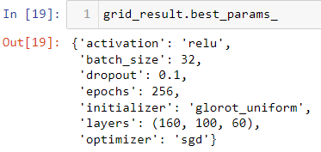
Demo/ Screenshot :
Neural Network model was chosen for prediction:
ROCAUC score:
Model parameters:

Slide 7
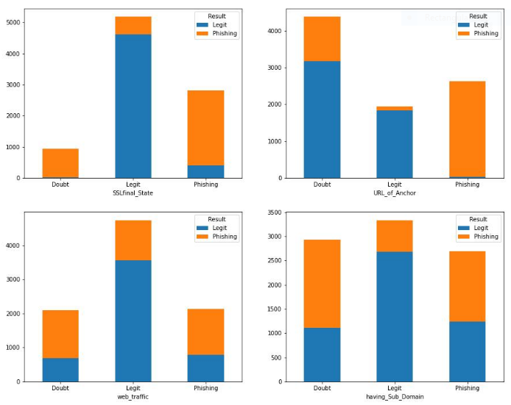
Demo/ Screenshot :
Most Important Columns:

Slide 8
Challenges
Initially we secured a high score on the leaderboard and there was very less margin for more improvement. We really had to try hard to increase the score afterwards
After combining the predicted test set with existing training data the dataset became slightly imbalanced with a ratio 3:2 compared to previous 5:4. So we had balance those for better accuracy
We had to check for overfitting regularly
Ensembling all the models using Voting Classifier could not improving the result.
Essential feature selection was a challenge, but necessary because unimportant features were harming model performance. So essential features were given more priority while model is trained.

Slide 9
Source code as ZIP or Github URL:
https://github.com/Somya-Patra/CGL22

Slide 10
Thank you

