Slide 1

Seasonal Agriculture Performance Analysis
Somya Pachauri
Dronacharya Group Of Institution
AICTE STU ID : STU6a17d3fc107231779946492

Slide 2

PROBLEM STATEMENT
Agricultural activities are influenced by seasonal variations in environmental conditions, farming practices, resource availability, and market conditions — causing performance to differ from one season to another.
This project analyzes the given agricultural dataset to investigate seasonal differences in performance by identifying meaningful patterns, trends, relationships, and variations within the data.

Slide 3
Project Description
• This project analyzes a dataset of 4,000 farm records across 8 Indian states, covering three farming seasons — Kharif, Rabi, and Zaid.
• The analysis explores yield, profit, water usage, and environmental factors to understand how agricultural performance varies by season.
• It involves data cleaning, exploratory data analysis, visualization, and statistical testing (ANOVA) using Python.
• The project concludes with evidence-based recommendations to support better seasonal agricultural planning.

Slide 4

WHO ARE THE END USERS?
Farmers planning seasonal crop selection
Agricultural planners and government departments
Agri-business companies and input suppliers
Policy makers designing seasonal agriculture schemes
Researchers studying seasonal farming trends

Slide 5

Technology Used
Python
Pandas & NumPy (data cleaning and analysis)
Matplotlib & Seaborn (data visualization)
SciPy (statistical testing — ANOVA)
Jupyter Notebook / Google Colab

Slide 6
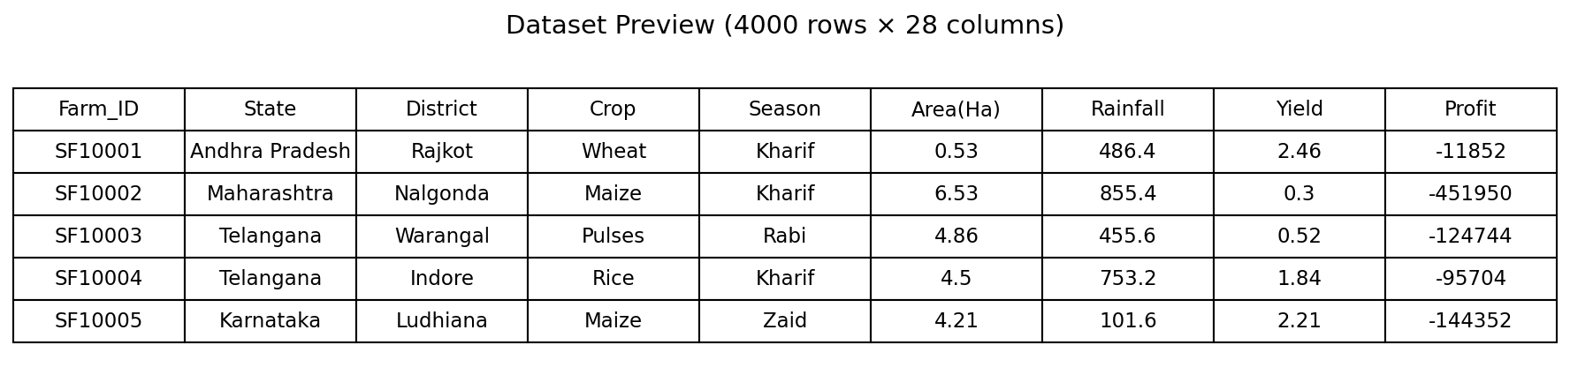
RESULTS
Data Loading & Initial Exploration

Slide 7
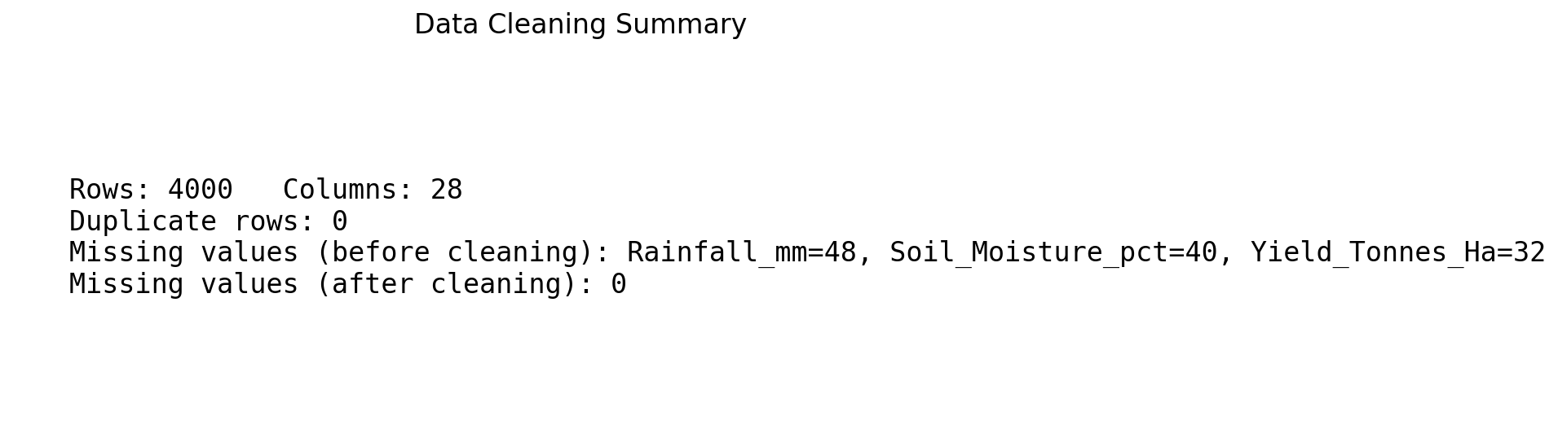
RESULTS
Data Cleaning Summary (Missing Values & Duplicates)

Slide 8
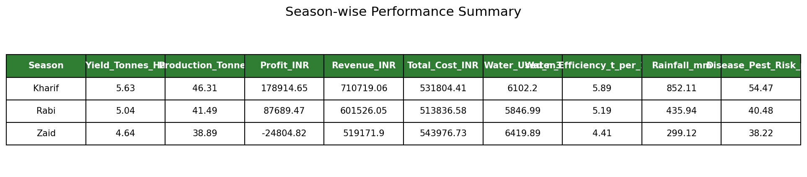
RESULTS
Season-wise Performance Summary

Slide 9
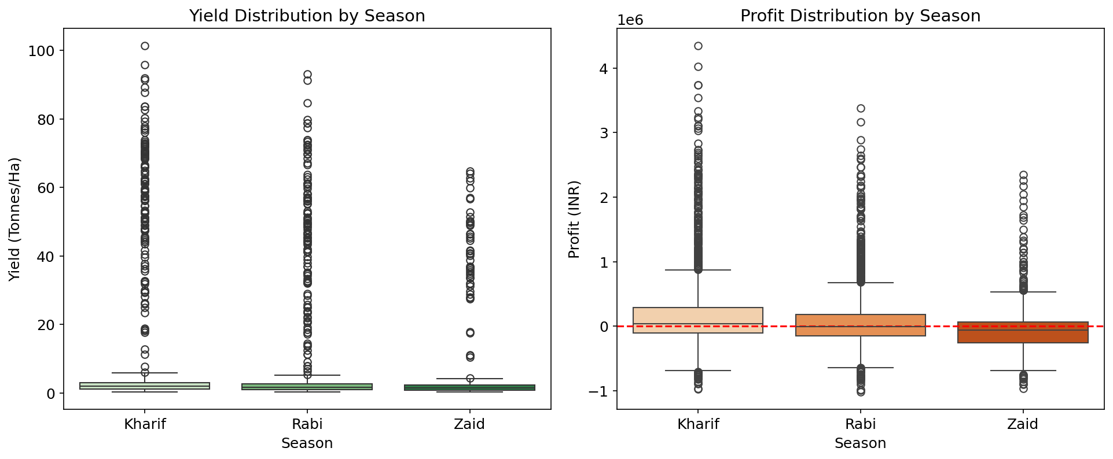
RESULTS
Yield & Profit Distribution by Season

Slide 10
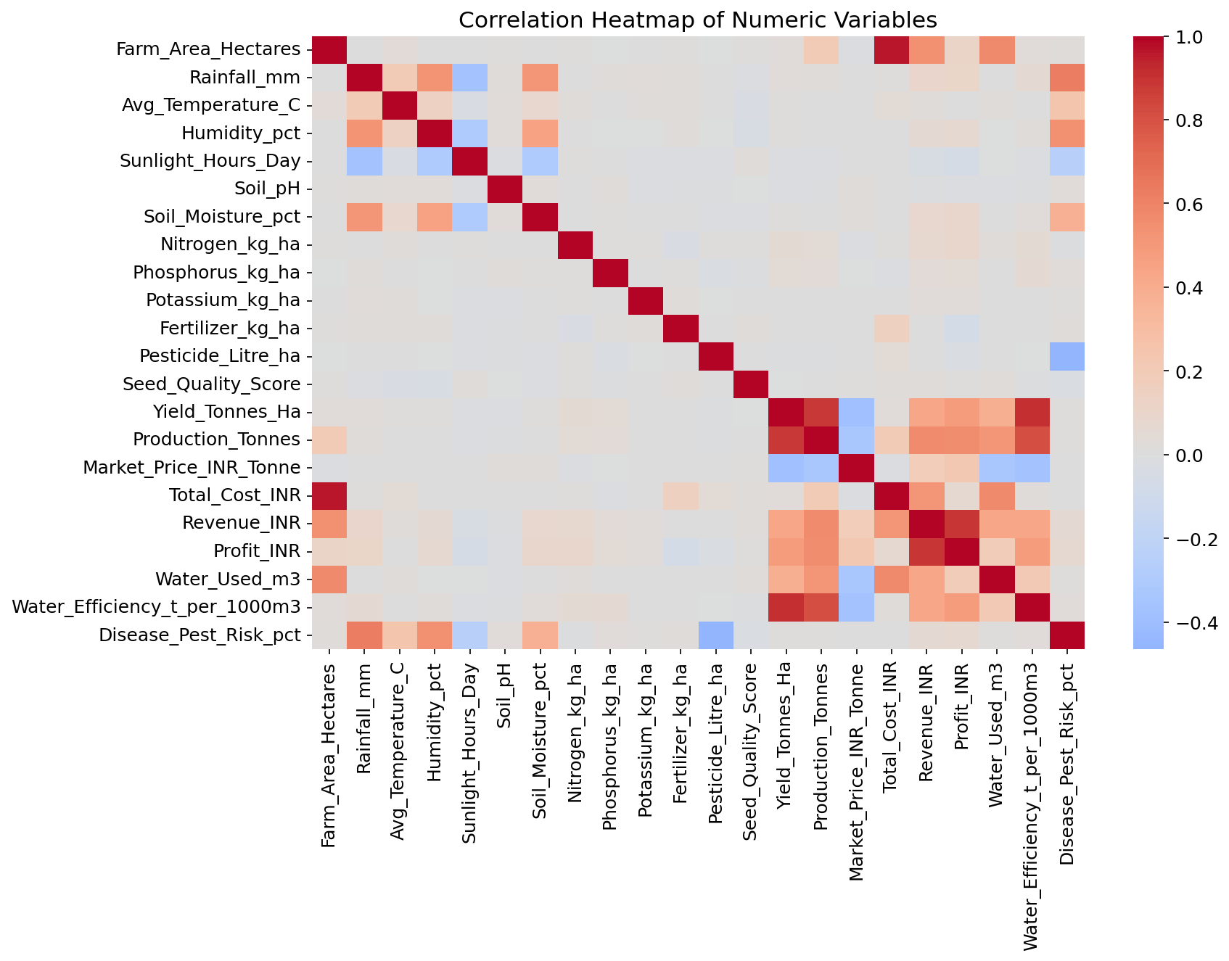
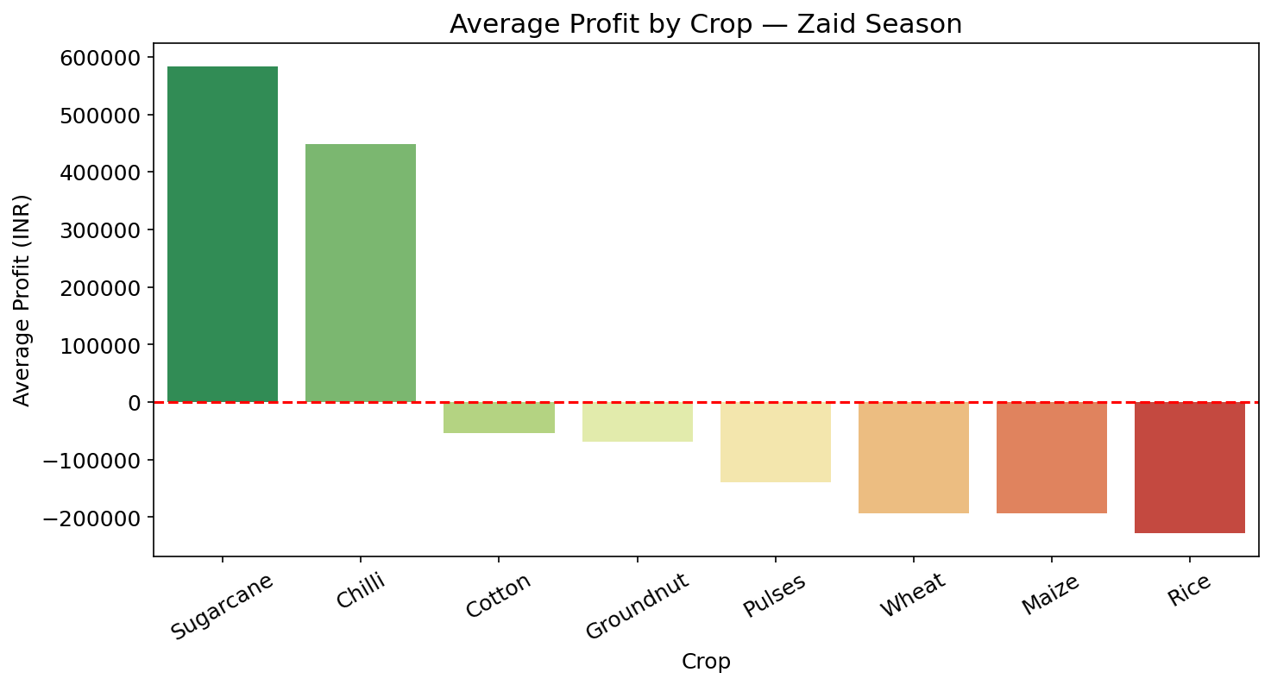
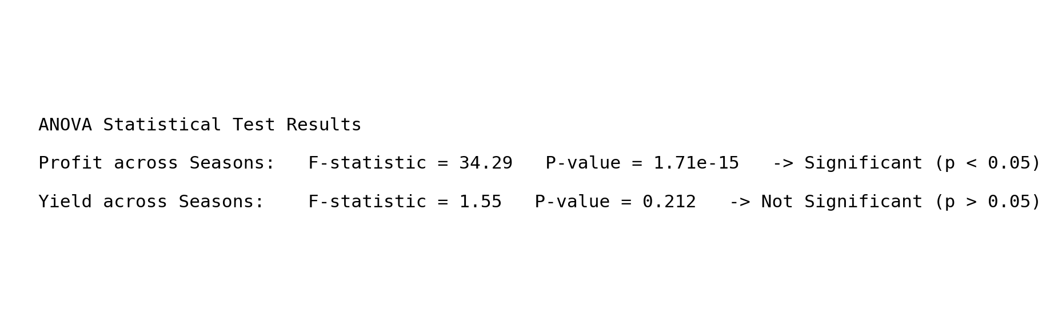
RESULTS
Correlation Heatmap, Zaid Crop Profitability & ANOVA Test Results

Slide 11
Future scope
• Predictive modeling to forecast profit and yield for upcoming seasons using machine learning.
• Crop recommendation system suggesting the most profitable crop for each season and region.
• Integration of real-time weather and soil sensor data for dynamic, up-to-date insights.
• Expansion of the dataset to cover more states, crops, and multiple years for stronger trend analysis.
• Market price forecasting to help farmers time their sales for maximum revenue.
• An interactive dashboard for farmers and policymakers to explore seasonal insights easily.

Slide 12
GitHub Link
GitHub Repository:
https://github.com/Somya1231code/Seasonal_Agriculture_Performance_Analysis

Slide 13

VOIS Course completion certificate -
Course name- Data Visualization

Slide 14
Thank You
.
.

