Slide 1
E-cart
Somya Kumari TEK Systems

Slide 2
Project overview
E-Cart is a comprehensive e-commerce platform designed to streamline online shopping experiences. It provides a robust system for users to browse, purchase, and manage orders while offering an efficient backend for admins to manage the platform.
Scope:
The platform includes two primary interfaces:
User Dashboard: A user-friendly interface where customers can browse products, place orders, and manage their accounts.
Admin Dashboard: A powerful toolset for administrators to manage product listings, oversee transactions, and analyze platform performance.

Slide 3
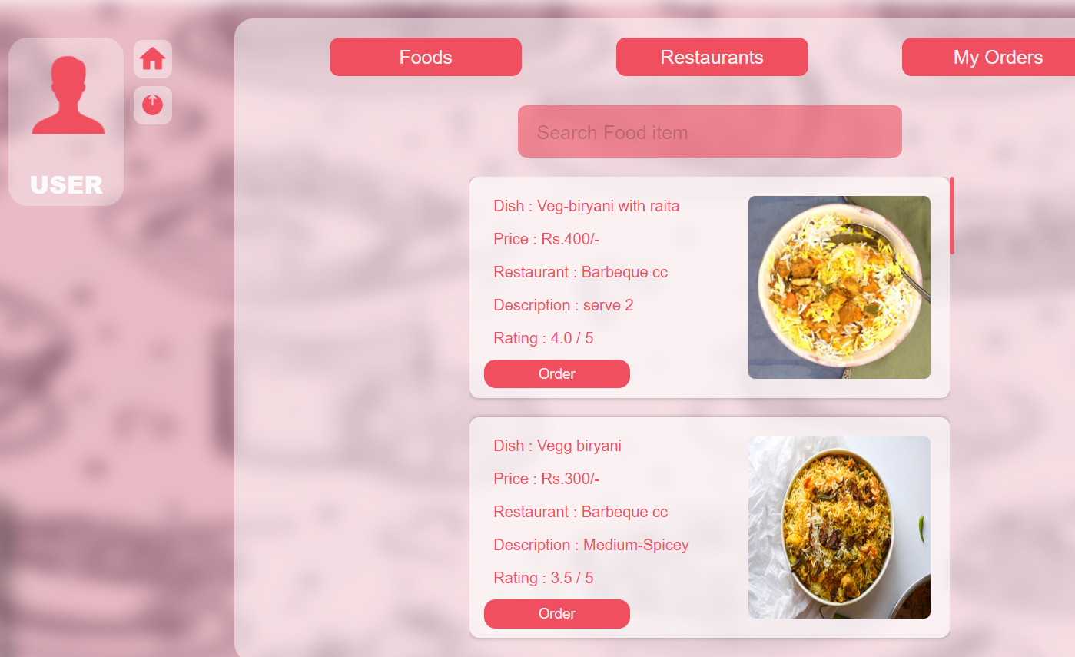
Users Dashboard
Restaurant browsing and categorization
Cart management and checkout process
Order history
User profile customization
Reviews and ratings

Slide 4
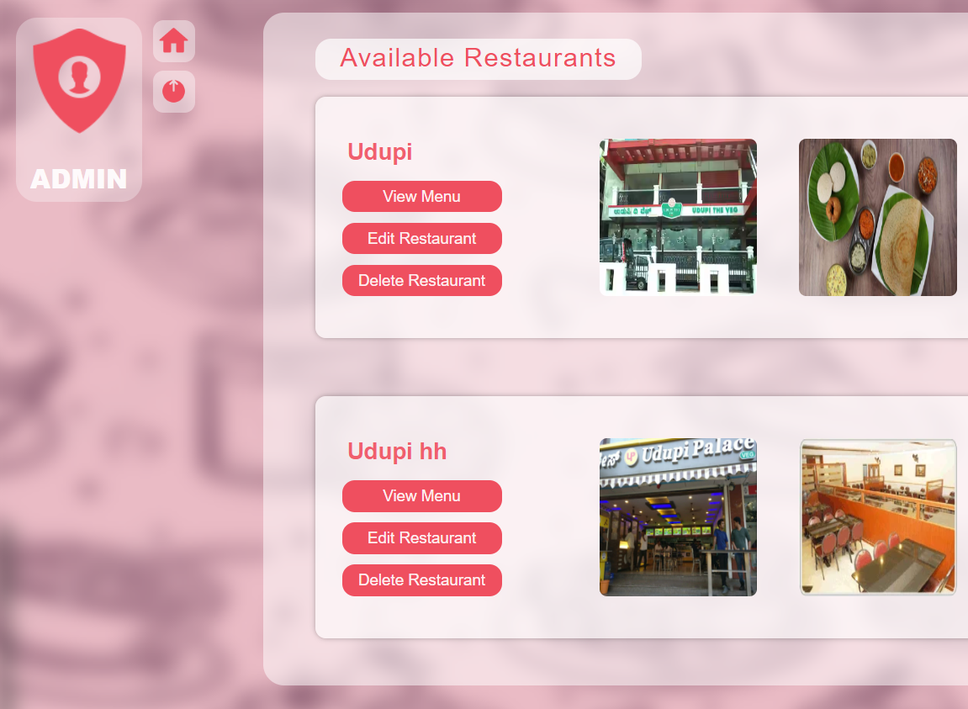
Admin Dashboard
Restaurant management (add, edit, delete listings)
Manage restaurants
Manage food items
Multi menu with images upload
Role-based access control

Slide 5
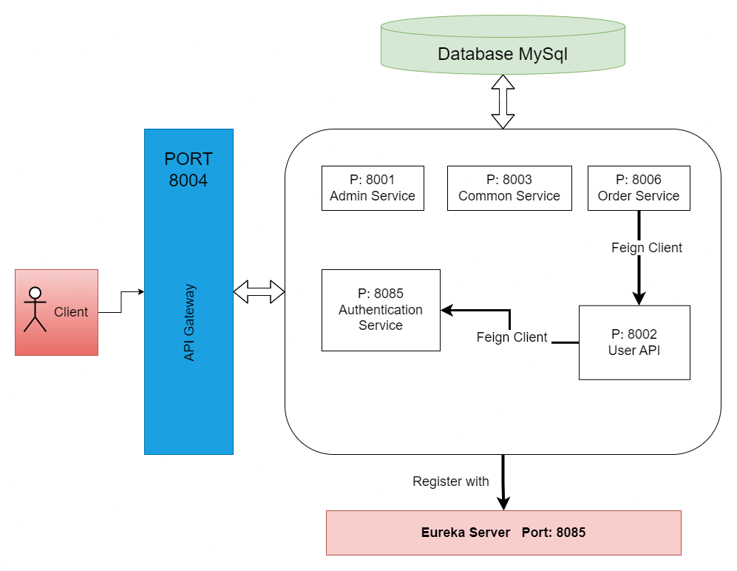
HLD & LLD

Slide 6
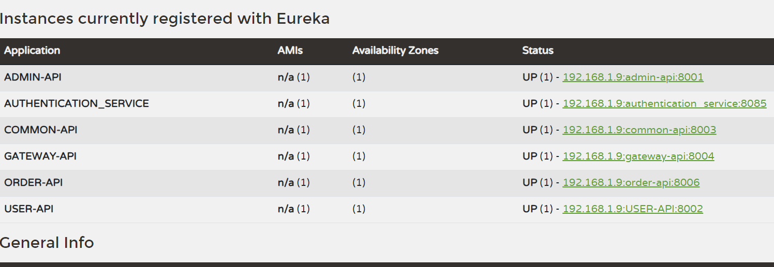
Eureka server

Slide 7
Documentations
Api Contracts : https://docs.google.com/document/d/1KOaok_Nx82RPk6FnyrBOzOE_nTMdR9809FSXelecCVs/edit?usp=sharing
Git Repo
Thank You

