Slide 1

SHRI VAISHNAV VIDHYAPEETH VISHWAVIDYALAYA Department of Computer Science and Engineering
Submitted by : Submitted to:
Mr. Gaurav Choudhary
ENROLL NO. | NAME
17100BTCMCI01696 | SOMYA JAIN
17100BTCMCI01688 | SALONI YADAV
17100BTCMCI01689 | SAMRIDDHI TIWARI

Slide 2
DRIVER DROWSINESS DETECTION
This system will alert the driver when drowsiness is detected.
Drowsiness detection is a safety technology that can prevent accidents that are caused by drivers who fell asleep while driving.

Slide 3
PROBLEM STATEMENT
Due to the number of car accidents caused by drivers only because they fall asleep while they drive, thus it creates a gap for making an error. When the driver has been driving for hours or is woken up early for work, it creates a gap for making an error. This error could cause his/her death as well as other people who are driving or passing by.

Slide 4
DESCRIPTION
There are different types of methods for measuring the drowsiness of the driver are mentioned which includes Physiological measures, Behavioral measures. Using those methods an intelligence system can be developed which would alert the driver in case drowsy condition and prevent accidents.
The model will be trained by synthetic eye dataset.
The approach for entire system development is explained using a flow chart which includes capturing the image in real time continuously, then dividing it into frames. Then each frame is analyzed to find face first. If a face is detected then the next task is to locate the eyes. After the positive result of detecting eye the amount of closure of eye is determined and compared with the reference values for the drowsy state eye. If a drowsy condition is found out then the driver is alarmed, otherwise the loop of finding face and detecting drowsy condition is carried out.

Slide 5
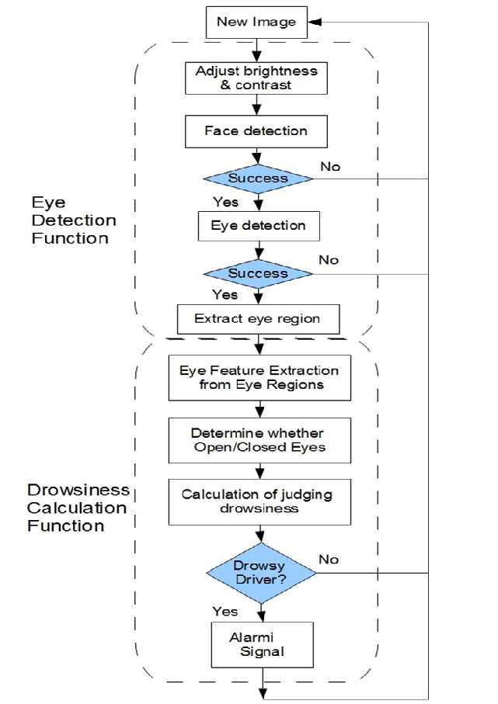
FLOW CHART

Slide 6
TECHNOLOGY USED
DEEP LEARNING
The model will be trained using dataset.
IMAGE PROCESSING
Image detected will be converted to grey scale and then will be processed in ……accordance with dataset
PYTHON
Libraries used are :
Keras
Opencv
Tensorflow
Scikit learn
numpy

Slide 7
RESULT OBTAINED
The model should be able to correctly classify a sequence of consecutive frames from unseen videos.
Thus our model warns drowsy drivers with an alarm, after successful eye-detection and tracking with computer vision and deep learning techniques (CNN and LSTM models)

Slide 8
.
.
THANK YOU

