Slide 1
MangoByte
Tether
Persistent goal enforcement across AI sessions
Archit Nigam and Somyadeep Tarat
Review 3, 25 October 2026
Notes:
Tether is an Agentic AI project. Team and member names come from output/presentations/MangoByte_Tether_Review_2.pptx. Project description and current implementation: README.md. This review reflects repository evidence available on 25 October 2026.

Slide 2
Problem Statement & Objectives
AI agents can lose the approved objective across long sessions, handoffs and restarts.
Preserve goals, constraints and milestones outside conversation history.
Check proposed work before it changes a saved report.
Require human approval for scope changes and uncertain claims.
Notes:
Problem and objectives: Tether_Final_PRD_v4.pdf as summarized in docs/PRD_CONTEXT.md; README.md. The initial evidence demonstration compares AWS, Azure and GCP for a startup, using supplied synthetic cost and deployment references. Tether seeks persistent goal enforcement. It does not yet establish comprehensive semantic correctness or a measured reduction in drift.

Slide 3
Proposed Solution & Key Innovation
A versioned goal contract records the authorized objective, sources and allowed topics.
A deterministic gateway checks identity, scope, evidence, numbers and declared effects.
ALLOW commits supported work. REVIEW needs a human decision. BLOCK stops the write.
Only approved changes create a new goal version. Earlier versions remain available.
Notes:
Sources: engine/schemas.py, engine/validator.py, engine/executor.py, engine/goal_evolution.py and docs/PULL_VERIFICATION.md. The key architectural distinction is that application-owned authorization and durable state sit outside the model context. Agents cannot approve themselves or override mandatory BLOCK checks. Exact supported quotations have a narrow automatic path. Free-form synthesis, comparison and recommendation require substantive review. Review approval revalidates the current contract, evidence and report revision transactionally.

Slide 4
System Architecture & Workflow
The Next.js dashboard sends project and review requests through FastAPI.
Research Agent prepares evidence. A validated handoff feeds the Report Agent.
The gateway validates each proposal before controlled execution and report commit.
SQLite saves contracts, milestones, artifacts and checkpoints for the next session.
Notes:
Architecture: frontend/components/workspace.tsx and frontend/lib/api.ts; backend/main.py, backend/store.py; engine/orchestrator.py, engine/research_agent.py, engine/report_agent.py, engine/handoff.py, engine/validator.py, engine/executor.py and engine/state.py. Sequential workflow: user creates a goal; backend claims durable workflow; Research proposes structured evidence; handoff gateway checks authorized sources; Report proposes content; validator yields ALLOW/REVIEW/BLOCK; approved artifact commits transactionally; source-complete milestone advances; next milestone starts. Browser closure does not stop backend execution. Process restart pauses interrupted work for explicit resume. A single report agent is also available. General requests use a separate single-agent draft path with no browsing or independent fact verification.

Slide 5
Technology Stack & Implementation
Interface: Next.js, React, TypeScript and Tailwind CSS.
Backend: Python, FastAPI and Pydantic schemas. SQLite stores durable state.
Inference: Groq gpt-oss-20b primary, with Ollama qwen3:4b backup and offline mode.
Verification: 133 Python tests pass. Recorded frontend typecheck and build pass.
Notes:
Sources: frontend/package.json, pyproject.toml, backend/requirements.txt, README.md, engine/llm_client.py and engine/config.py. Current local verification on 25 October 2026: .venv/bin/python -m pytest -q --basetemp=.presentation-build/review3/pytest produced 133 passed and one Starlette/httpx deprecation warning in 1.76 seconds. Tests use isolated SQLite databases and scripted model/HTTP doubles, so this count is engineering verification rather than model quality. Frontend typecheck and production build results are recorded in docs/AUTOMATIC_WORKFLOW.md on 24 October 2026, not newly rerun for this deck. Both specialists now use the configured provider. Provider modes: Groq primary with eligible-failure backup, Groq-only for measured comparisons, or Ollama for explicit offline inference. Offline operation requires the local Ollama service and installed model.

Slide 6
Key Features & Functionalities
Automatic milestones, pause/resume and persistent recovery.
Review evidence, approve or reject work, and request revisions.
Versioned scope changes, audit history and replay without duplicate writes.
General drafts require review. A guided demo rehearses safety decisions.
Notes:
Sources: README.md, backend/main.py, backend/store.py, engine/draft_agent.py, engine/validator.py, docs/AUTOMATIC_WORKFLOW.md and docs/LIFECYCLE_UPDATE.md. A revision creates a new proposal and keeps rejected versions. Milestones advance only when committed content covers all required sources. Scope expansion remains explicit: Add serverless comparison then Approve change creates immutable v2/M5. Action keys support idempotent replay. General drafts produce one concise response per proposal, contain UNVERIFIED_DRAFT, do not browse or verify current facts, and always need human review. The general draft route is a newer addition than the recorded guided-demo verification. Evaluation history stores actual proposal runs and remains empty until the evaluation CLI records data. New guided demonstration controls: frontend/components/demo-guide.tsx, backend/demo.py and docs/DEMO_WALKTHROUGH.md. The workflow demo guide can set up a four-milestone project and show scripted ALLOW/REVIEW/BLOCK examples through the actual validator without model calls. These samples use a separate contract and do not modify project history. Scripted examples are not live model results.

Slide 7
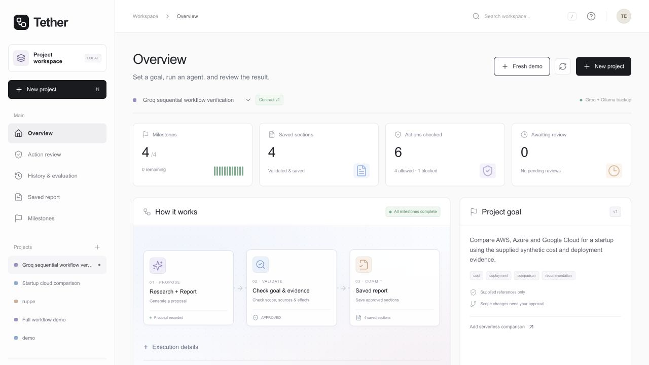
Live Demo / Working Prototype
1. Create a cloud-comparison project.
2. Run Research and Report.
3. Inspect a BLOCK, then review supported synthesis.
4. Show saved sections, goal history and recovery.
Recorded prototype, 24 Oct 2026: 4/4 milestones, 4 saved sections, 0 pending reviews
Cloud reference data: SYNTHETIC_DEMONSTRATION
Notes:
Screenshot source: output/workflow-complete.png, a recorded local product screenshot from 24 October 2026. Supporting report: docs/AUTOMATIC_WORKFLOW.md. This is a recorded run, not a new live inference or a benchmark. The verified workflow used genuine Groq Research and Report calls. It committed cost and deployment sections automatically, blocked an invalid numerical declaration, retained a rejected recommendation that overstated deployment simplicity, then completed all four milestones after correction and human approval. The source descriptions do not establish a deployment-simplicity ranking. All cloud values are SYNTHETIC_DEMONSTRATION, not current vendor prices. On-stage demo: open http://127.0.0.1:3000, create a Cloud comparison project, show action validation and source evidence, approve only supported synthesis, show report and history, approve serverless change to v2/M5 if time allows, then demonstrate saved-state recovery. A page refresh is not a backend restart. A genuine process-restart demonstration requires stopping and restarting FastAPI, then resuming interrupted work. Do not loop on provider quota failures during the presentation.

Slide 8
Future Scope
Evaluate repeated, matched multi-session runs with and without enforcement.
Measure unauthorized commits, source fidelity, recovery and added latency.
Expand semantic drift detection beyond the current conservative rules.
Add broader evidence fixtures, richer evaluation charts and more integrations.
Notes:
Sources: README.md, docs/PULL_VERIFICATION.md, docs/AUTOMATIC_WORKFLOW.md and scripts/evaluate.py. The current evaluation runner compares individual proposals using matched planner inputs and budgets. It does not complete the planned four-session comparative study. Baseline commits are simulated outside product artifacts. Arbitrary prose receives UNVERIFIED source fidelity. Zero commits yield N/A unauthorized rate. Future matched experiments should independently grade hard violations, active version compliance, source fidelity, milestone completion, handoff validity, restart recovery and latency overhead. No measured drift-reduction percentage is justified by the exploratory runs.

Slide 9
Conclusion
Tether preserves authorized goals and checks agent proposals before report writes.
The prototype combines specialist execution, human review and persistent recovery.
A recorded cloud-comparison run completed all four milestones with saved evidence.
Broader semantic guarantees and multi-session improvement measurements remain open.
Notes:
Sources: README.md, engine/validator.py, engine/state.py and docs/AUTOMATIC_WORKFLOW.md. The project demonstrates application-owned enforcement, persistent goal versions and controlled commits. Engineering tests and a recorded successful workflow support implementation claims. Neither those tests nor the demonstration establish general model correctness, perfect drift detection or production readiness.

Slide 10
Agentic AI: Technical Evidence
Required evidence | Implemented evidence
Agent workflow | Sequential Research and Report, validated handoff, single-agent option
Tools and integrations | FastAPI, Pydantic, SQLite, Groq and Ollama
Task execution | Recorded run: 4 milestones complete and 4 sections saved
Failure handling | BLOCK stops writes, human REVIEW, bounded retry, backup and recovery
Notes:
Track selection: Agentic AI. The template lists separate evidence requirements for AI/ML, Agentic AI, Edge AI and Blockchain-Based Finance. Tether meets the Agentic AI presentation scope, so this appendix maps the four applicable evidence categories. These requirements also appear on slides 4–7. Sources: README.md; engine/orchestrator.py, engine/handoff.py, engine/llm_client.py, engine/executor.py; backend/main.py; docs/AUTOMATIC_WORKFLOW.md. Failure handling: hard validation failure never triggers a policy bypass or provider switch. Eligible inference/network/rate-limit failures may use the configured local backup. Short Retry-After values receive one bounded hosted retry. Provider outages stop visibly. Review does not self-approve. SQLite claims serialize local steps, checkpoints retain durable state and repeated action keys do not duplicate commits. Comprehensive semantic evaluation remains future work.

