Slide 1
MangoByte
Tether
Persistent goal alignment across AI sessions
Archit Nigam | Somyadeep Tarat
Review 2 | 24 October 2026
Notes:
Tether is a persistent goal-enforcement workspace. Team MangoByte: Archit Nigam and Somyadeep Tarat. Review 2 status as of 24 October 2026. Sources: supplied Tether PRD and current repository README.md. The user-approved provider update supersedes the original Ollama-only requirement.

Slide 2
Problem Statement & Proposed Solution
AI agents can lose constraints across long sessions, handoffs and restarts.
Tether saves approved goals and milestones independently of chat history.
Every proposed report section is checked before it changes a saved artifact.
Explicit scope approval creates a new contract version; checkpoints restore progress.
Notes:
The product hypothesis is that external goal contracts and pre-action validation reduce unauthorized drift. This is a hypothesis, not a demonstrated benchmark win. Demonstration objective: compare AWS, Azure and GCP on cost and deployment simplicity using only supplied synthetic evidence. Sources: PRD; scenarios/cloud_comparison.json; shared/INTEGRATION.md.

Slide 3
Technology Stack & Technical Approach
Interface: Next.js, React, TypeScript, Tailwind CSS and Lucide icons.
Backend: FastAPI and Pydantic connect typed requests to the Python engine.
State: SQLite stores contracts, artifacts, checkpoints and audit history.
Inference: Groq gpt-oss-20b, with Ollama qwen3:4b as local backup.
Flow: proposal -> validation -> ALLOW, REVIEW or BLOCK -> controlled commit.
Notes:
Groq Free is the primary hosted provider; the configured default is openai/gpt-oss-20b. Ollama qwen3:4b is backup or explicit offline mode. Specialist sessions in the UI use local Ollama. FastAPI loads backend/.env and root .env; credentials remain backend-only and are excluded from Git and public telemetry. SQLite remains local. Sources: engine/llm_client.py; backend/config.py; backend/main.py; frontend/package.json.

Slide 4
Implementation Progress
Dashboard: overview, action review, report artifacts and contract history.
Engine: structured proposals, evidence checks and research/report handoffs.
Lifecycle: approved scope changes, milestone confirmation and restart recovery.
Integration: real Groq calls, safe provider telemetry and replay without duplicate commits.
Notes:
Implementation status comes from the current code, not only the planned PRD. Sequential specialists, checkpoints and lifecycle services are implemented and covered by automated tests. The current live Groq demonstration is a single Report Agent call. Source: engine/orchestrator.py; engine/executor.py; engine/state.py; tests/test_workflow.py; shared/INTEGRATION.md.

Slide 5
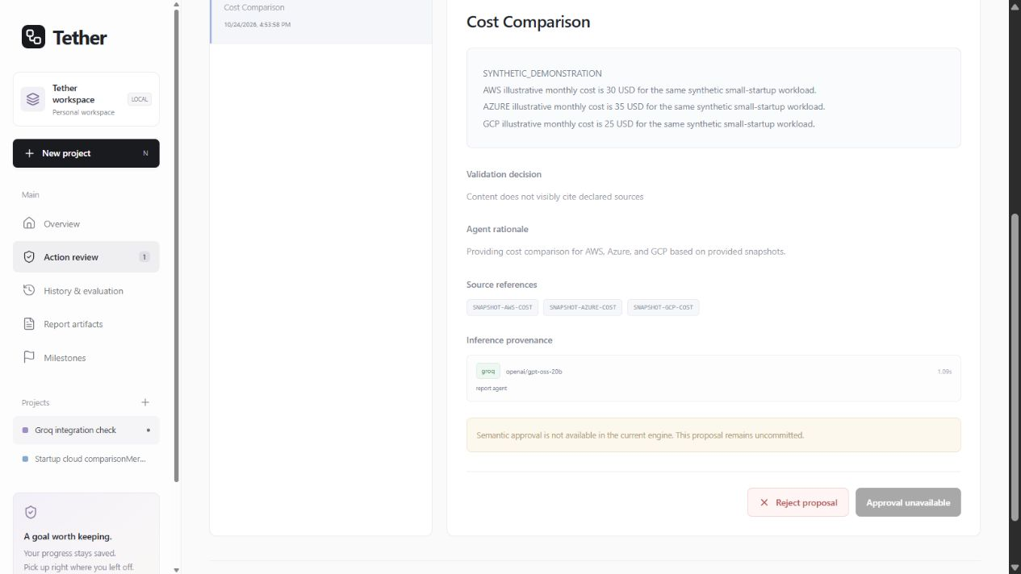
Initial Output/Results
84 automated tests passed
TypeScript and production build passed
Live Groq: ~1.09 s inference attempt
REVIEW; no artifact committed
Actual Groq output: source IDs were not visibly cited. The validator kept the proposal uncommitted.
Notes:
Verification before this deck: 84 tests passed using python -m pytest -q --basetemp=backend/data/pytest-review2; npm run typecheck and npm run build passed. The saved live request used the Next.js API proxy, FastAPI and Groq openai/gpt-oss-20b. Its inference attempt took 1.085 seconds with no fallback. This is one inference-attempt measurement, not end-to-end latency or a benchmark. Output was schema-valid but received REVIEW because reference IDs were not visibly cited; no report artifact committed. Replaying the same action key during the current verification generated no new inference or action. Sources: docs/GROQ_INTEGRATION_CHECK.md; persisted Groq integration check project; screenshot captured from the actual dashboard.

Slide 6
Challenges & Limitations
Citation completeness: the live Groq proposal omitted visible source IDs.
Free-form semantic approval is pending; uncertain prose remains in REVIEW.
Cloud-comparison values are synthetic, not current vendor prices.
No independent baseline comparison or measured goal-drift improvement yet.
Notes:
A valid model response is distinct from a policy-approved artifact. REVIEW cannot currently be approved through the semantic workflow; user rejection is available. Deterministic keyword/evidence checks are conservative and do not prove complete semantic alignment. Synthetic fixture figures must not be represented as current pricing. Independent baseline grading and model-quality evaluation are pending. Sources: engine/validator.py; backend/main.py; scenarios/cloud_snapshot.json; docs/LIFECYCLE_UPDATE.md.

Slide 7
Next Steps & Completion Plan
Next: improve visible source citations in generated report sections.
Then: add semantic review resolution while preserving hard validation blocks.
Evaluate: use the same provider, model and fixture for baseline and Tether.
Finish: rehearse four sessions, polish reporting and add a scoped demo reset.
Notes:
Completion sequence: first repair citation reliability and verify supported sections can commit; then implement auditable review resolution; then collect independent baseline/Tether runs under equivalent model and evidence conditions; finally rehearse initial work, drift pressure, approved serverless change and context-cleared recovery. Current integration fixes include backend environment loading and explicit Tether User-Agent for Groq gateway access. Sources: PRD four-session plan; docs/TEAMMATE_UPDATE.md; docs/GROQ_INTEGRATION_CHECK.md.

