Slide 1
Major Project TITLE: Classification of Retinal Diseases using RESNET Model

Slide 2
Content
Introduction
Literature Review
Objectives
Methodology
Working Model
Conclusion
References

Slide 3
Introduction
Diabetic retinopathy, also known as diabetic eye disease, is a medical condition in which damage occurs to the retina due to diabetes mellitus.
Optic disk is the head of the nerve to the eye.
A micro-aneurysm is a small swelling that forms in the wall of tiny blood vessels.
Exudates are formed due to increased vascular permeability allowing the leakage of fluid and lipoprotein into the retina resulting in thickening of the macula.
Hemorrhages are the lesions represent actual bleeding within the retina, and either are a result of ruptured micro-aneurysm’s or when the capillaries become lately enough to let blood out of the blood vessels.

Slide 4
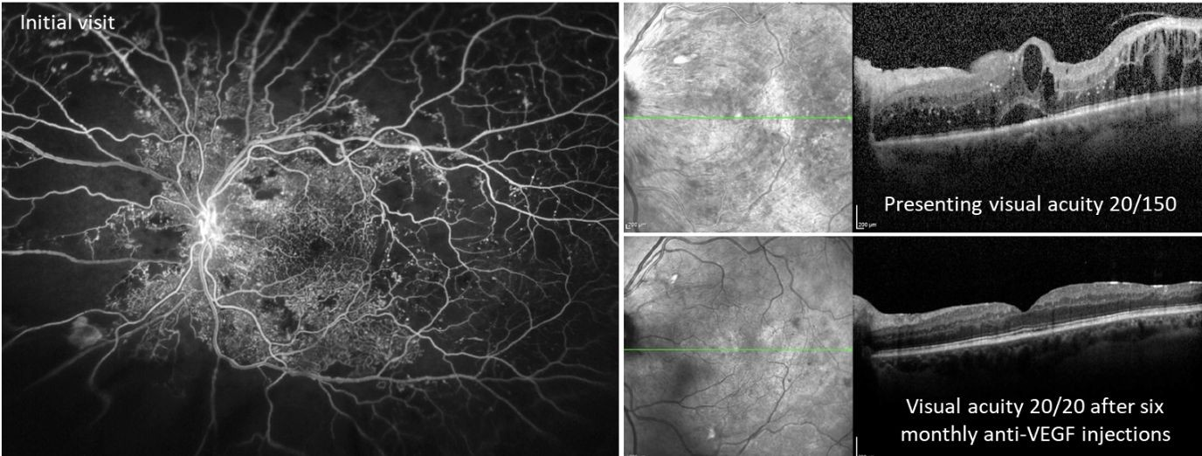
Motivation
Diabetic retinopathy is an eye condition that can cause vision loss and blindness in people who have diabetes.
Our goal is to classify the patients having diabetic retinopathy and not having the same, with a high-resolution fundus image of the retina.

Slide 5
Technical Concepts (Algorithms) used
Using a ResNet (Residual Neural Network) model for the classification of retinal diseases involves several technical concepts and algorithms. When applying ResNet to retinal disease classification, we encountered the following technical concepts and algorithms:
ResNet Architecture: ResNet is a type of Convolutional Neural Network (CNN) designed for deep learning tasks. It utilizes residual connections to train very deep neural networks effectively by preventing the vanishing gradient problem.
Convolutional Layers: These layers automatically extract features from retinal images. They're crucial for recognizing patterns in scans of the retina, helping the model identify signs of various diseases.
Data Augmentation: Techniques like image rotation, scaling, and flipping increase the diversity of the training data, enhancing the model's ability to generalize from a limited dataset.
Transfer Learning: Leveraging pre-trained ResNet models, originally trained on a large dataset like ImageNet, accelerates model training and boosts performance by transferring knowledge learned from one domain to retinal disease classification.
Evaluation Metrics: Metrics such as accuracy, precision, recall, F1-score, and AUC-ROC are used to assess the model's performance, ensuring its ability to correctly identify retinal diseases.

Slide 6

Problem Statement
To develop a computer aided diagnosis tool to detect the presence of diabetic retinopathy and classify whether it is a normal diabetic retinopathy or an abnormal diabetic retinopathy.

Slide 7
Area of Applications
Classifying retinal diseases using a ResNet model has several important applications in the field of ophthalmology and healthcare. Here are some of the key areas where our this project can be applied:
Early Disease Detection: Early detection of retinal diseases such as diabetic retinopathy, age-related macular degeneration, and glaucoma is crucial for timely intervention and treatment. Using a ResNet model for classification can help identify these diseases at an early stage when they are more treatable.
Screening Programs: Governments and healthcare organizations can use automated retinal disease classification to run large-scale screening programs for at-risk populations, such as those with diabetes. This can help identify individuals who need further evaluation and treatment
Patient Triage: In busy healthcare settings, using an automated classification system can help prioritize patients based on the severity of their retinal disease. Patients with more critical conditions can be seen by specialists more quickly.
Research and Clinical Trials: Researchers can use ResNet models to analyze large datasets of retinal images, identifying patterns and trends in disease progression. This can aid in the development of new treatments and therapies.
Clinical Decision Support: Ophthalmologists can use AI-based systems as decision support tools, providing them with additional information and insights when making diagnoses and treatment decisions.

Slide 8
Dataset and input format
Dataset Considerations:
A large and diverse dataset with various retinal images representing different diseases.
Maintaining a balanced distribution of samples across disease classes to prevent training bias
Including diverse data, covering disease severity, age groups, and demographics.
Ensure high-quality, high-resolution images to avoid misclassifications.
Adhere to data privacy regulations (e.g., HIPAA) when collecting and handling medical images.

Slide 9
Dataset and input format
➔ | Input Format:
1. | Retinal images are typically in standard formats (JPEG, PNG, TIFF).
2. | Preprocess images by resizing, normalizing pixel values, and augmenting data.
3. | Organize data into batches for efficient training.
4. | Split the dataset into training, validation, and test sets for model development evaluation.
5. Implement data loaders to efficiently load and process batches of images during training and evaluation.

Slide 10
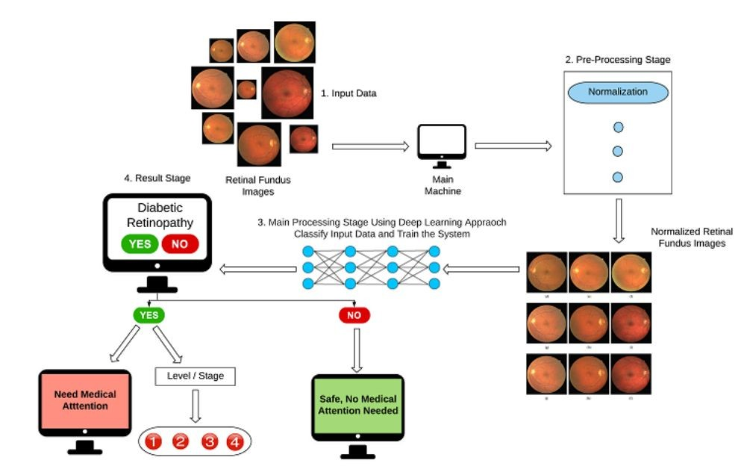
LITERATURE SURVEY - 1
Title: Automatic Classification of Preliminary Diabetic Retinopathy Stages using CNN Journal: International Journal of Advanced Computer Science and Applications Methodology:
In this paper the images from the dataset are classified into two stages after removing the noise on the images by using (CALHE) histogram equalization. Using a deep learning approach, the system will then detect whether a person suffers from Diabetic Retinopathy or not; based on the answer, the system will then classify the level of the disease and finally propose a solution to the patient.
Advantages:
This model not only provides more reliable and accurate results, but it also saves a lot of time and money.
The overall accuracy attained is 84.16%.
Disadvantages:
The trained model in this paper has a huge variation from the real data.
Several other models may be designed which offers better results than
this model.

Slide 11
LITERATURE SURVEY - 2
Title: Diabetic Retinopathy Detection
Journal: International Journal of Engineering and Advanced Technology
Methodology:
This paper used image processing for the detection of DR. Several image processing techniques includes filter, segmentation, classification and image enhancement has been developed for the early detection of Diabetic Retinopathy by the features of exudates, blood vessels, haemorrhages and Micro-aneurysms.
Advantages:
The model developed by this paper is not only helpful for Diabetic retinopathy affected people but can also be used by the melanoma and myeloid leukaemia.
This system attained higher accuracy even with less number of dataset.
Disadvantages:
A negative AI-based finding may give PCPs and patients a false sense of security about the totality of their ocular status.
Overfitting is occurred when this model learns the random noise and irrelevant details from the image dataset.

Slide 12
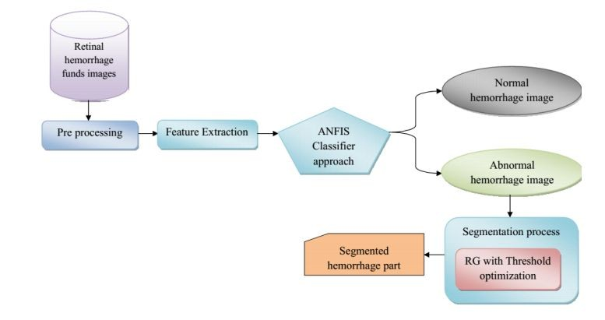
LITERATURE SURVEY - 3
Title: Detection of retinal haemorrhage from fundus images using ANFIS classifier and MRG segmentation.
Journal: Biomedical Research
Methodology: The final goal of retinal haemorrhage detection by feature classification is to perceive whether the image containing haemorrhages or not. In this paper the haemorrhage classification is done by Adaptive Neuro-fuzzy Interface system (ANFIS). Grey Wolf Optimization (GWO) is utilized to segment the haemorrhage portion from the image.
Advantages:
The accuracy level has demonstrated that the algorithm used in this paper is decidedly efficient in perceiving the affected portions of the retinal image.
Splat based image representation makes it easier for clinicians to annotate the boundaries of target objects that may lower the cost of attaining reference standard information for training.
Disadvantages:
This model works only for haemorrhage detection.
The raw retinal fundus images are difficult to process by machine learning algorithms.

Slide 13
LITERATURE SURVEY - 4
Title: Diabetic Retinal Fundus Images: Preprocessing and Feature Extraction For Early Detection of Diabetic Retinopathy
Journal: Biomedical & Pharmacology Journal
Methodology:
In this paper, pre-processing of raw retinal fundus images are performed using extraction of green channel, histogram equalisation, image enhancement and resizing techniques.
The experiments are performed using Kaggle Diabetic Retinopathy dataset, and the results are evaluated by considering the mean value and standard deviation for extracted features.
Advantages:
The result yielded exudate area as the best- ranked feature with a mean difference of 1029.7.
Disadvantages:
Attributes such as red lesions, Kapoor entropy, edema are not extracted in this project.
Classification of diabetic retinopathy images in multiple classes based on the features values and performance is not done properly

Slide 14
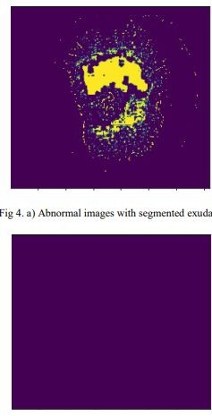
LITERATURE SURVEY - 5
Title: Diabetic Retinopathy Detection using Machine Learning Journal: International Journal of Engineering Research & Technology
Methodology:
This study proposes a machine learning method for extracting three features like exudates, haemorrhages, and micro aneurysms and classification using hybrid classifier which is a combination of support vector machine, k nearest neighbour, random forest, logistic regression, multilayer perceptron network.
Advantages:
After voting of three classifiers, the testing set results in 82% accuracy.
This model provided better segmentation results.
Disadvantages:
Out of 49 test samples, only 36 produced correct prediction.
It produced less accuracy when compared to other papers.

Slide 15
LITERATURE SURVEY - 6
Title: A deep learning system for detecting diabetic retinopathy across the disease spectrum
Journal: Nature communications
Methodology:
DeepDR is used to detect early to late stages of diabetic retinopathy in this paper. They used transfer learning to transfer the DR base network to the three sub-networks of the DeepDR system, rather than directly training randomly initialized sub-networks.
Advantages:
Rather than just generating a DR Grading, the system offers visual hints that help users to identify the presence and location of different lesion types.
The system achieved high sensitivity and accuracy in the whole-process detection of DR from early to late stages.
Disadvantages:
This paper focused only on patients with referable DR who are then referred for specialist eye care.
Microaneurysms cannot be detected accurately using this DeepDR system

Slide 16
LITERATURE SURVEY - 7
Title: Early detection of diabetic retinopathy based on deep learning and ultra‑wide‑field fundus images
Journal: Scientific reports
Methodology:
This paper used deep learning for the detection of DR. Using the segmented ROI image, they employed the deep learning architecture, the residual network with 34-layer (ResNet-34) model as a classifier for the DR detection task.
Advantages:
The ResNet architecture used this model provides advantages in an easier optimization and accuracy gain for deep networks.
The ETDRS 7SF photography was used to capture the retinal images. It captures approximately 90◦ of the retina that is around 30% of the retinal surface
Disadvantages:
The data acquired in this paper is recognized as single-center, single-ethnicity, and single-device one.
The use of ETDRS 7SF requires skilled photographers and is time-consuming.x`

Slide 17
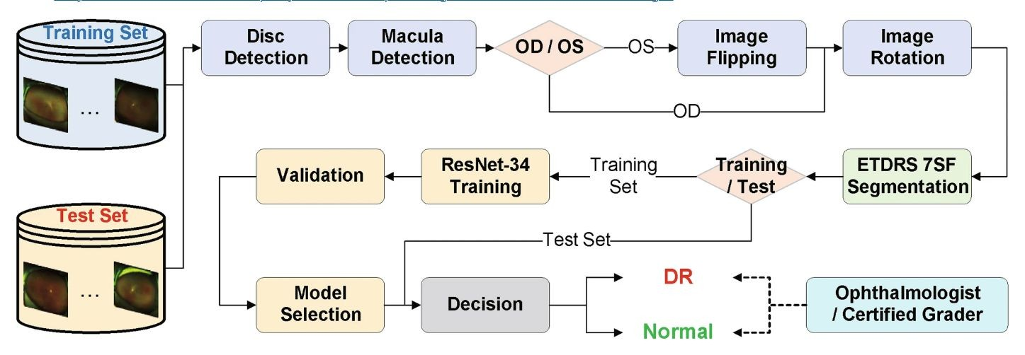
LITERATURE SURVEY - 8
Title: Early detection of diabetic retinopathy based on deep learning and ultra‑wide‑field fundus images
Journal: Scientific reports
Methodology:
This paper used deep learning for the detection of DR. Using the segmented ROI image, they employed the deep learning architecture, the residual network with 34-layer (ResNet-34) model as a classifier for the DR detection task.
Advantages:
The ResNet architecture used this model provides advantages in an easier optimization and accuracy gain for deep networks.
The ETDRS 7SF photography was used to capture the retinal images. It captures approximately 90◦ of the retina that is around 30% of the retinal surface
Disadvantages:
The data acquired in this paper is recognized as single-center, single-ethnicity, and single-device one.
The use of ETDRS 7SF requires skilled photographers and is time-consuming.

Slide 18
Objective
Main Objective
We process the input retinal images into normal or abnormal retinal images.
The web application we develop uses RESNET model for better processing of images.
Sub Objective
In our Study, we classify the images by the way of pre-processing and feature extraction process.
In these processes we transform the raw images into more informative images.

Slide 19
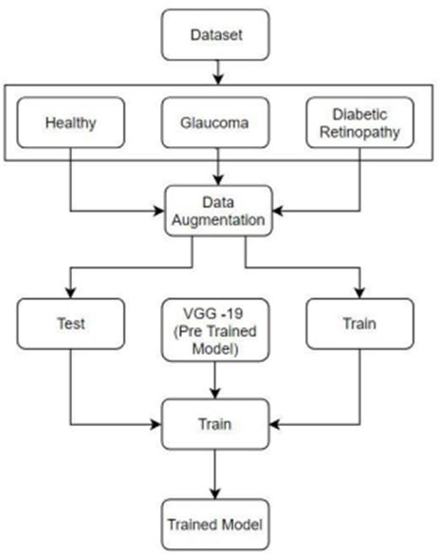
Methodology
Reference Software Model

Slide 20
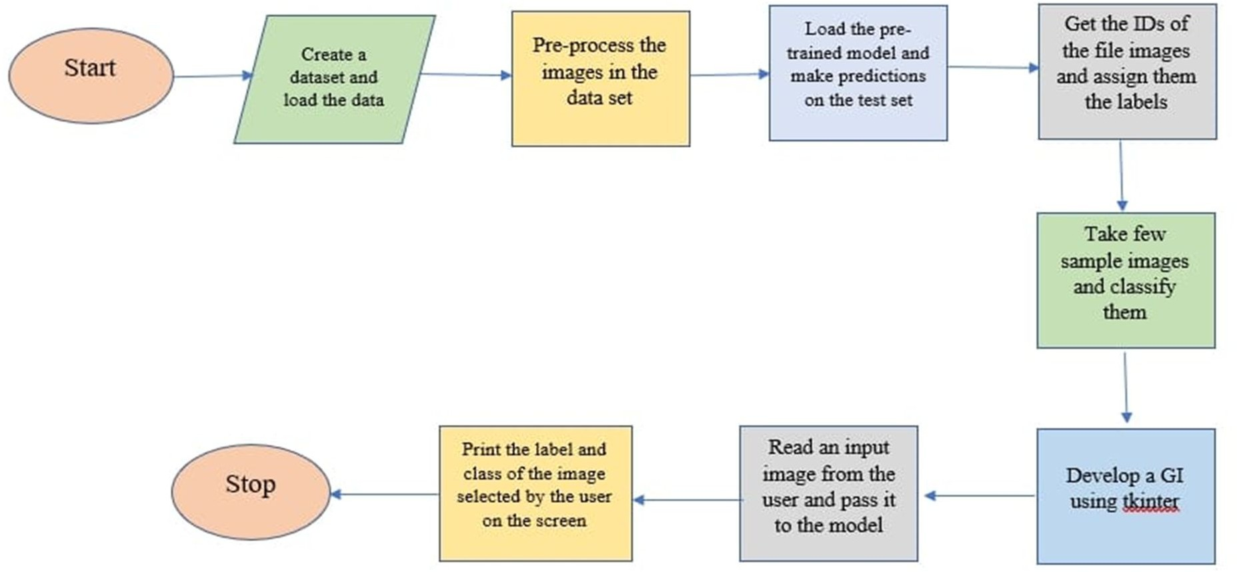
Steps:-

Slide 21
References
Walter, T., Klein, J.-C., Massin, P., Erginay, A. ‘A contribution of image processing to the diagnosis of diabetic retinopathy — detection of exudates in color fundus images of the human retina.’ IEEE Trans. Med. Imaging 21 (10) (2002): 1236–1243
Xiaohui, Z., Chutatape, A. ‘Detection and classification of bright lesions in color fundus images.’ In Proceedings of the International Conference on Image processing (ICIP 04), 2004, vol. 1, pp. 139–142
Varun Gulshan, Subhashini Venugopalan and Rajiv Raman, "Development and Validation of a Deep Learning Algorithm for Detection of Diabetic Retinopathy in Retinal Fundus Photographs", JAMA, vol. 316, no. 22,2016, pp. 2402-2410.
A. Osareh, B. Shadgar, and R. Markham, “A computational-intelligence-based approach for detection of exudates in diabetic retinopathy images,” IEEE Trans. Inf. Technol.., 13(4): pp. 535–545 (2009).
L. Math and R. Fatima, "Adaptive machine learning classification for diabetic retinopathy", Multimedia Tools Appl., vol. 80,Oct. 2020,pp. 5173-5186.
I. U. Morphological, E. Detection, A. Aquino, M. E. Gegúndez-arias, and D. Marín, “Detecting the
Optic Disc Boundary in Digital Fundus Feature Extraction Techniques,” 29(11): pp. 1860–1869 (2010).
R.GargeyaandT.Leng,“Automated identification of diabetic retinopathy using deep learning,” Ophthalmology, vol. 124, no. 7, pp. 962–969, 2017.

Slide 22
References
L. W. Yun, U. R. Acharya, Y. V. Venkatesh, C. Chee, L.C. Min and E.Y.K. Ng, "Identification of different stages of diabetic retinopathy using retinal optical images", Information Sciences, vol. 178, 2008, pp. 106-121.
Tang L, Niemeijer M, Reinhardt J, Garvin MK, AbramoffM. "Splat feature classification with application to retinal hemorrhage detection in fundus Images". IEEE TransactMed Imag 2013; 32: 364-375.
Hatanaka Y, Nakagawa T, Hayashi Y, Hara T, Fujita H.Improvement of automated detection method of hemorrhages in fundus Images. J Med Imaging 2008; 978:5429-5432.
N. Patton, T. M. Aslamc, M. MacGillivrayd, I. J. Dearye, B. Dhillonb, R. H. Eikelboomf, et al., "Retinal image analysis: Concepts applications and potential", Retinal and Eye Research, vol. 25, 2006,pp. 99-127.

Slide 23
Thank You.

