Slide 1
Project Topic : ALU 4-bit CPU Datapath
Name: LE DINH SON
Roll Number: HE204173
Instructor: Shivashish Pal
Completion date: 7/10/2026

Slide 2
4-Bit RISC CPU Datapath
Design and Implementation Using Verilog HDL
3-stage pipeline | 12-bit instructions | Harvard memory | Simulated in Vivado XSim
IF
ID
EX
Notes:
Title slide. Summarises the 2-week project: design, verify and synthesise a small 4-bit pipelined RISC CPU.

Slide 3
Project at a glance
88 / 88
3
12
42 / 50
checks passed across 4 testbenches
pipeline stages: IF, ID, EX
instruction opcodes, 4 reserved
LUTs / flip-flops after synthesis
What was built
A complete 4-bit datapath: ALU, register file, program counter, instruction ROM, data RAM, flag register and a hardwired control unit.
Verified with unit testbenches per module and an end-to-end CPU testbench, then synthesised for an Artix-7 device.

Slide 4
Objectives and scope
Goal
Constraints
Design a 4-bit RISC CPU datapath in Verilog HDL, simulate it, and prove it correct with self-checking testbenches.
Same file set as the reference design, but original code. Two-week schedule. Vivado 2026.1 XSim.
In scope
Out of scope
ALU with flags, 4 registers, 16x12 instruction ROM, 16x4 data RAM, 12 instructions, jump and branch, 3-stage pipeline with flush.
Interrupts, caches, forwarding and stalls (not needed: registers are read in EX), I/O peripherals, FPGA implementation and timing closure.

Slide 5
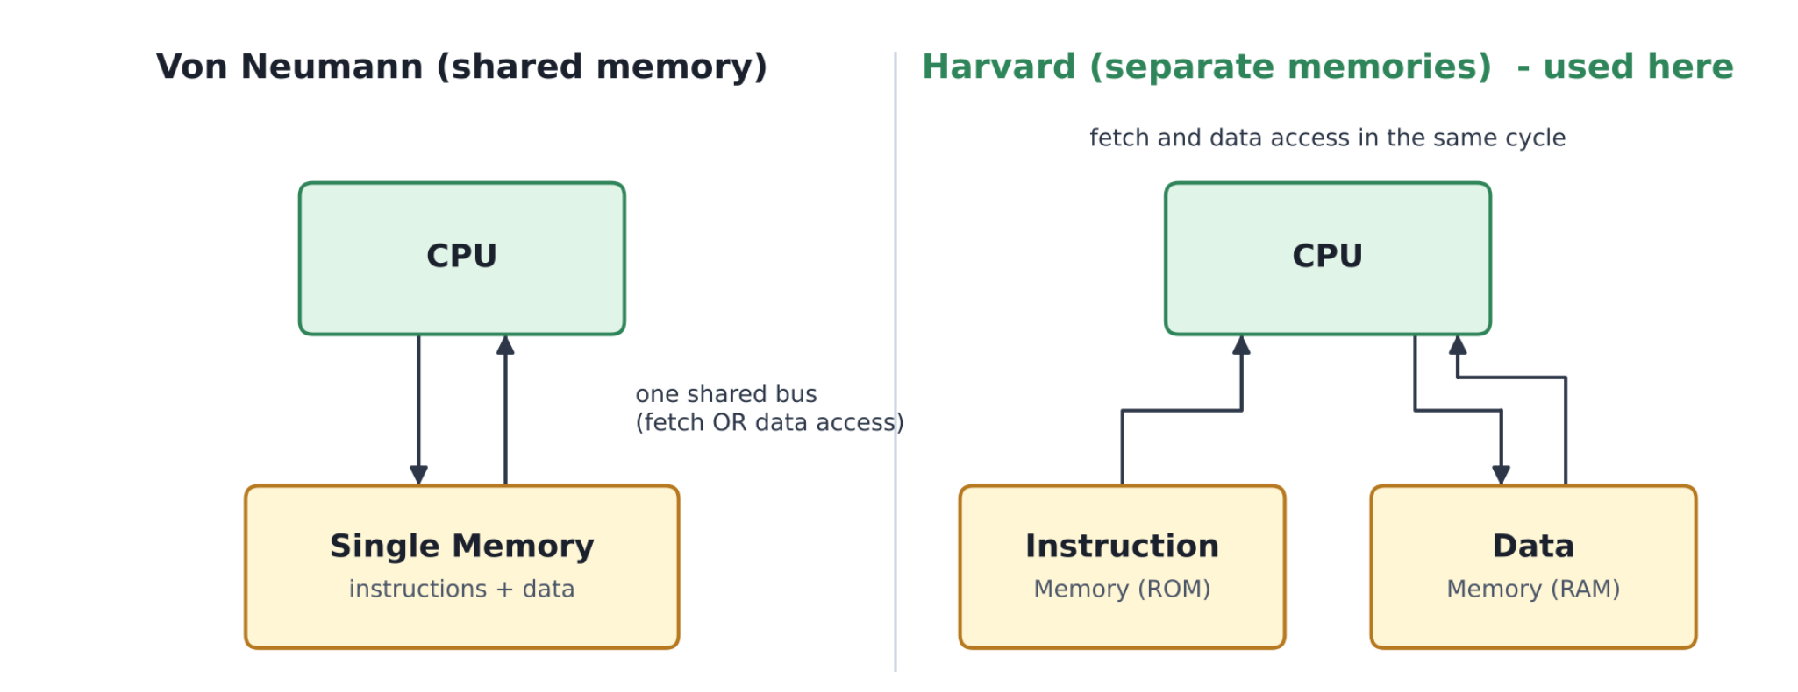
Harvard architecture: separate code and data
Von Neumann
One memory and one bus. Fetch and data access compete.
Harvard (chosen)
Instruction ROM and data RAM are independent, so IF and a memory access can happen in the same cycle.
This is what lets the pipeline fetch the next instruction while EX reads or writes RAM.

Slide 6
12-bit instruction format and instruction set
opcode
[11:8]
Rd
[7:6]
Rs
[5:4]
imm / addr
[3:0]
Opcode | Mnemonic | Operation
0000 | ADD | Rd = Rd + Rs
0001 | SUB | Rd = Rd - Rs
0010 | AND | Rd = Rd & Rs
0011 | OR | Rd = Rd | Rs
0100 | XOR | Rd = Rd ^ Rs
0101 | NOT | Rd = ~Rs
Opcode | Mnemonic | Operation
0110 | LDI | Rd = imm
0111 | MOV | Rd = Rs
1000 | LOAD | Rd = RAM[imm]
1001 | STORE | RAM[imm] = Rs
1010 | JMP | PC = imm
1011 | JZ | if Z: PC = imm
Opcodes 1100 to 1111 are reserved and decode as NOP (0xC00 is used to pad empty ROM words).

Slide 7
Datapath building blocks
ALU
Register file
Program counter
Adder/subtractor, logic unit, zero detector.
4 x 4-bit registers, two read ports, one write port.
4-bit, loads jump target when pc_sel is high.
Instruction memory
Data memory
Flag register
16 x 12-bit ROM, loaded with $readmemh.
16 x 4-bit synchronous RAM.
Zero and carry with separate write enables.
Control unit
Pipeline registers
cpu_top
Decoder and branch unit emit an 11-bit control word.
IR (IF/ID) and pipeline_register (ID/EX).
Wires every module together with muxes.

Slide 8
ALU: seven operations, two flags
alu_ctrl | Operation
0 | ADD
1 | SUB
2 | AND
3 | OR
4 | XOR
5 | NOT
6 | PASS (B)
Subtraction reuses the adder
SUB computes A + ~B + 1. B is XORed with do_sub and do_sub is also the carry-in, so one adder serves both.
b_eff = b ^ {4{do_sub}}; total = a + b_eff + do_sub;
Zero flag
Carry flag
Set when the 4-bit result is 0000.
ADD: carry-out. SUB: 1 means no borrow (ARM style).

Slide 9
Control unit: an 11-bit control word
alu_ctrl
3 bits
alu_src_sel
1 bit
wb_sel
1 bit
reg_we
1 bit
mem_we
1 bit
zero_we
1 bit
carry_we
1 bit
is_jmp
1 bit
is_jz
1 bit
Hardwired
Branch decision
Flag control
No microcode. The decoder maps the opcode straight to the word, so control is combinational and fast.
pc_sel = is_jmp | (is_jz & zero_flag)
flush = pc_sel
Taken in EX, using the live flag.
Only arithmetic and logic ops update zero and carry. LDI, MOV, LOAD, STORE and jumps leave flags alone.

Slide 10
Three-stage pipeline: IF, ID, EX
IF
Fetch
PC addresses ROM. Instruction Register captures the word.
ID
Decode
Control unit decodes the opcode into the 11-bit word. ID/EX register latches it.
EX
Execute
Register read, ALU, RAM access, write-back, flags and branch decision.
▶
▶
No data hazards
Control hazard only
Registers are read and written inside EX, so a result is ready before the next instruction reads it.
A taken jump is known in EX, so the two younger instructions must be flushed.

Slide 11
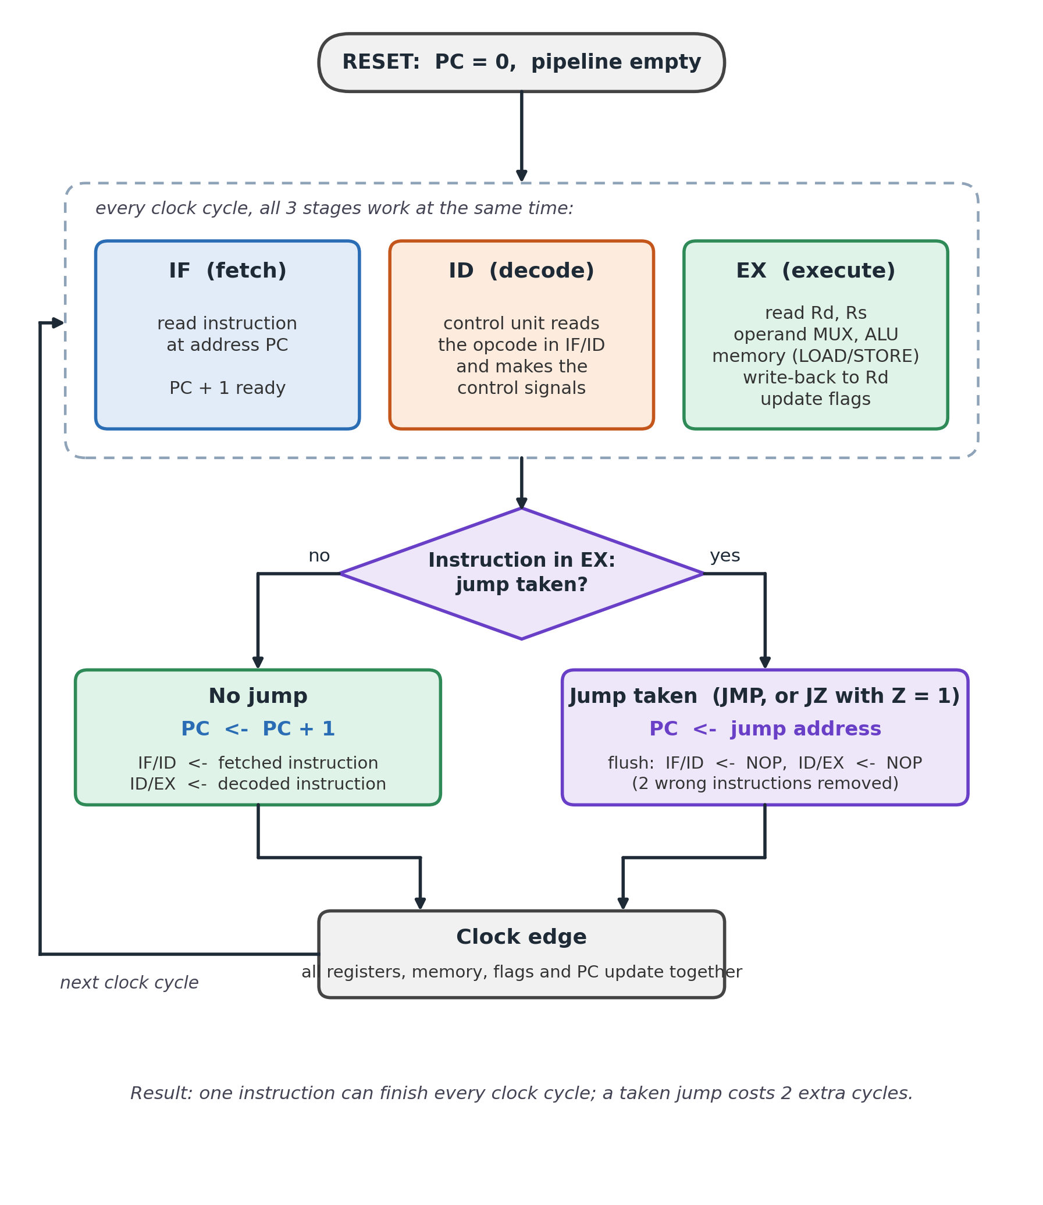
Clock cycle flow and jump flush
Each rising edge
PC advances, IR and ID/EX capture, EX commits results.
On a taken jump
pc_sel loads the target and flush clears IR and ID/EX, inserting 2 bubbles.
Cost: 2 extra cycles per taken jump.

Slide 12
Timing: pipeline needs N+2 clocks, not 2N
Measured
5, 9 and 12 instructions finished in 7, 11 and 14 clocks, matching N+2.
Why
Two cycles fill the pipe once. After that one instruction completes per clock. Jumps add 2 cycles each.

Slide 13
Demo program and expected results
Addr | Hex | Instruction | Result
0 | 645 | LDI R1, 5 | R1 = 5
1 | 683 | LDI R2, 3 | R2 = 3
2 | 060 | ADD R1, R2 | R1 = 8
3 | 6CA | LDI R3, 10 | R3 = 10
4 | 470 | XOR R1, R3 | R1 = 2
5 | A05 | JMP 5 | loop (flush)
Exercises
Immediate load, ALU add, XOR, and an unconditional jump that triggers the flush.
Padding
Empty ROM words hold C00 (NOP) so every .mem file has 16 lines.
Three further programs cover arithmetic, logic and jump behaviour (prog_arith, prog_logic, prog_jump).

Slide 14
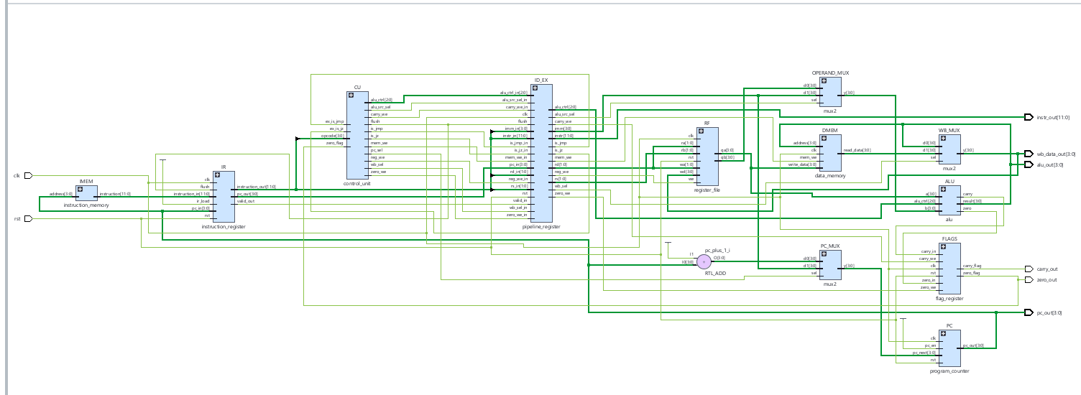
Elaborated Schematic

Slide 15
Verification plan: 88 self-checking assertions
Unit level
ALU, register file and control unit are tested alone.
System level
tb_cpu checks registers, RAM and flags after each program.
Result
All 88 passed in Icarus and Vivado.

Slide 16
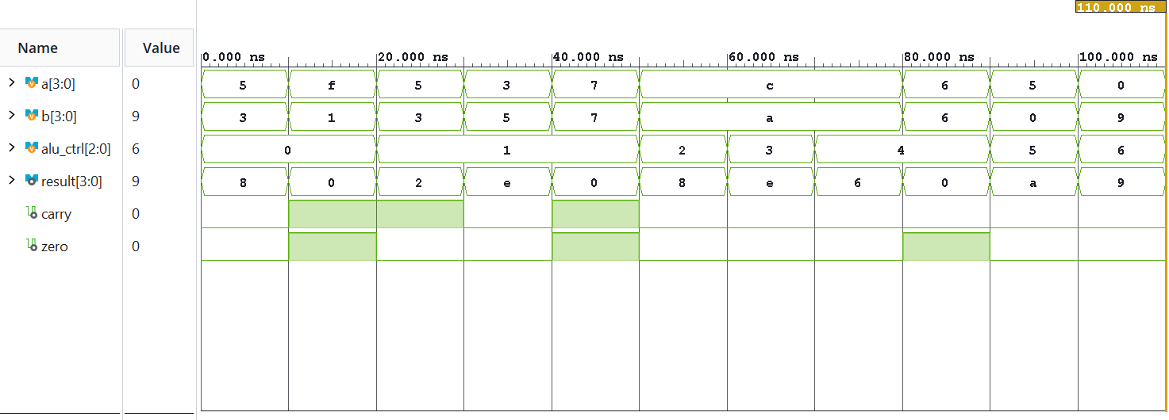
ALU testbench: tb_alu
Vivado XSim, tb_alu: a, b, alu_ctrl, result, carry, zero
Finish time
Flags
Example
110 ns, 11 of 11 checks passed.
carry and zero pulse only where expected.
C AND A = 8; PASS passes B (9).

Slide 17
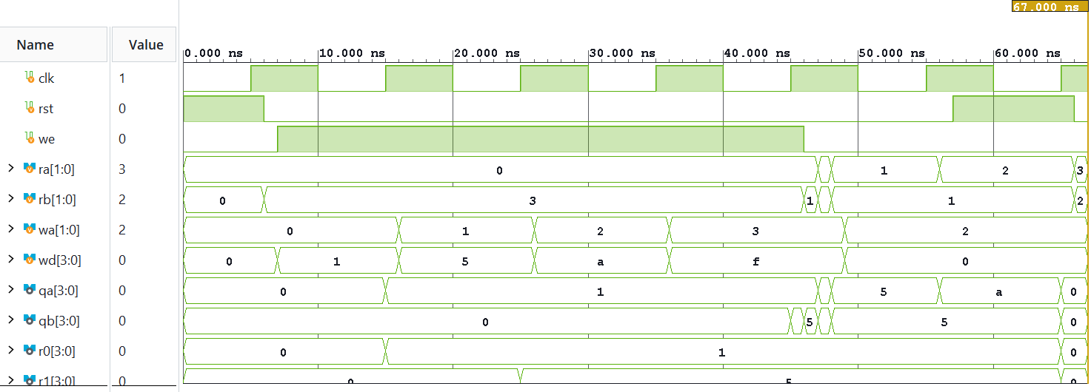
Register file testbench
Vivado XSim, tb_register_file
Finish time
Write
Read
67 ns, 11 of 11 checks passed.
Data lands only when reg_we is high.
Two ports read independently.

Slide 18
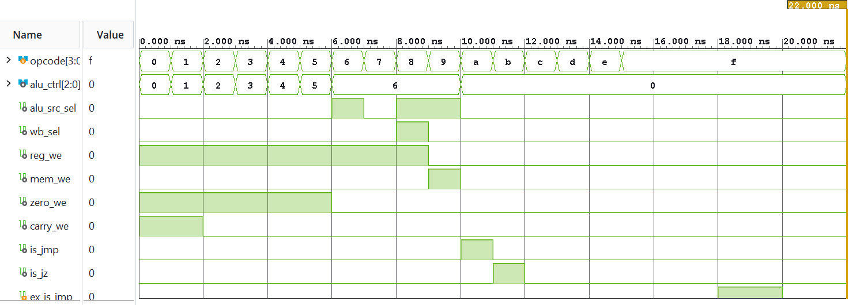
Control unit testbench
Vivado XSim, tb_control_unit
Finish time
Decode
Branch
22 ns, 22 of 22 checks passed.
Each opcode gives the expected word.
pc_sel follows is_jmp and is_jz & zero.

Slide 19
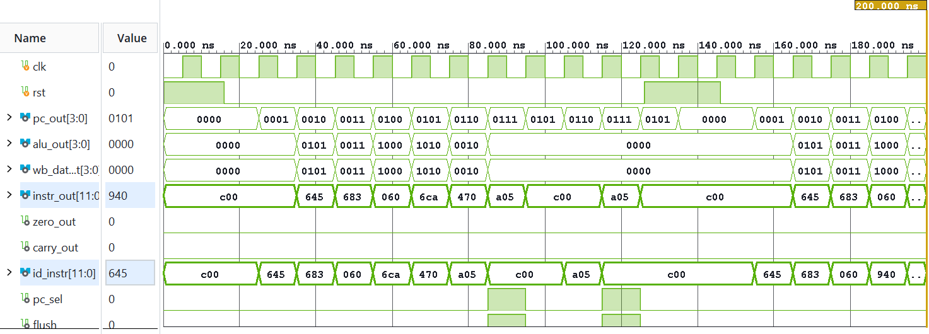
CPU demo run: pipeline in action
Vivado XSim, tb_cpu: pc_out, alu_out, instr_out, id_instr, pc_sel, flush
Fetch
Execute
Flush
instr_out shows 645, 683, 060, 6CA, 470, A05.
alu_out: 5, 3, 8, A, 2 as predicted.
pc_sel and flush pulse together at JMP.

Slide 20
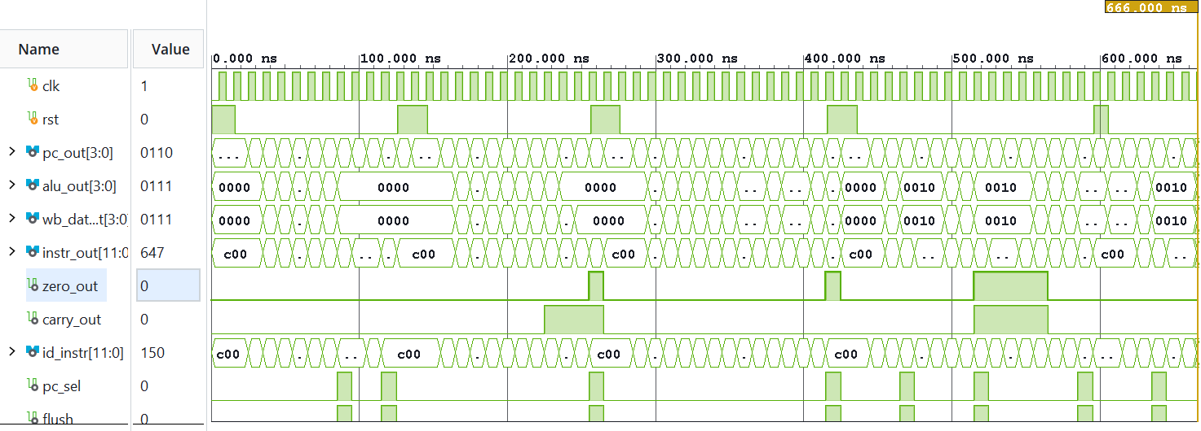
Full tb_cpu run: 666 ns, 44 of 44 passed
Vivado XSim, tb_cpu full run with zero_out, carry_out, pc_sel and flush
Programs
Reset
Outcome
program, arith, logic and jump run in turn.
rst between programs restarts PC at 0000.
44 of 44 checks passed.

Slide 21
Results summary
Testbench | Checks | Passed | Finish time
tb_alu | 11 | 11 | 110 ns
tb_register_file | 11 | 11 | 67 ns
tb_control_unit | 22 | 22 | 22 ns
tb_cpu | 44 | 44 | 666 ns
Total | 88 | 88 | -
Two tools agree
Icarus Verilog 12 pre-check and Vivado XSim gave identical results.
Waveforms match
Signals match the hand-computed expected tables.
Finish times are the simulator stop time reported by Vivado.

Slide 22
Vivado workflow
1
2
3
Create project
(Artix-7 xc7a12ti)
Add design sources + program.mem
Add testbenches to sim_1
4
5
6
Run behavioural simulation
Add clk.xdc, run synthesis
Review utilisation

Slide 23
Problems met and how they were fixed
Problem | Fix
simulate.log cannot be removed on re-run | Close the simulation first (close_sim -force)
Synth 8-4445: could not open program.mem | Add program.mem to Design Sources as a Memory File
26 critical warnings: Cannot set load (clk.xdc) | Delete set_load lines, keep only create_clock
Not enough words in .mem file | Pad every .mem file to 16 lines with C00
None of these affect correctness; they are tool-flow issues.

Slide 24
Synthesis result
42
50
13
28
LUTs
Flip-flops
Cells in top level
I/O ports
Small footprint
Note
The whole CPU fits in a few dozen LUTs on an Artix-7, so it is easy to port to a real board.
Figures come from the Vivado Design Runs table. Timing slack (WNS) is not reported here and should be read from the timing summary after implementation.

Slide 25
Limitations and future work
Limitations
Branch penalty
4-bit data and 16-word memories. Taken jumps cost 2 cycles. No interrupts, stack or subroutines.
Deciding the branch in EX is simple and safe but wastes two fetched instructions each time.
Next steps
Hardware
Add a branch predictor or move the decision earlier; widen the datapath to 8 bits; add CALL and RET.
Run implementation, assign pins and test on an FPGA board with switches and LEDs.

Slide 26
Conclusion
A working 4-bit, 3-stage pipelined RISC CPU in original Verilog.
12 instructions, 7 ALU operations, Harvard memories, hardwired control.
88 of 88 checks passed in Icarus and Vivado XSim.
Pipeline finishes N instructions in N+2 clocks; jumps flush 2 bubbles.
Synthesises to 42 LUTs and 50 flip-flops.
Thank you

