Slide 1

DATA STRUCTURES & ALGORITHMS
Student Name: DANG NGOC SON
Student ID: BH01045
Class: SE06302
Assessor Name: DINH VAN DONG

Slide 2
Contents:
A stack ADT, a concrete data structure for a First In First out (FIFO) queue
Two sorting algorithms
Two network shortest path algorithms

Slide 3
1. A stack ADT, a concrete data structure for a First In First out (FIFO) queue 1.1 ADT 1.2 FIFO queue

Slide 4
1.1 A stack ADT
1.2.1 Definition
Definition: A Stack is an ADT that follows the Last In, First Out (LIFO) principle. The most recent element added is the first to be removed.
Operations:
Push: Adding an element to the top of the stack.
Pop: Removing the top element from the stack.
Peek/Top: Viewing the top element without removing it.
IsEmpty: Checking if the stack is empty.

Slide 5
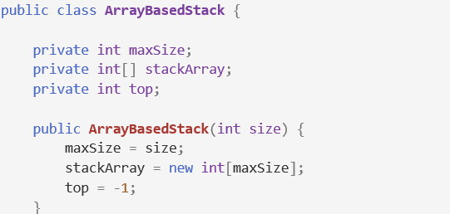
1.1 A stack ADT
1.1.2 Initialize the stack
The ArrayBasedStack class implements a stack using an array. It has three main attributes: maxSize for the stack's capacity, stackArray to store the stack elements, and top, which indicates the index of the top element (initialized to -1 to represent an empty stack). The constructor initializes these attributes based on the given size.

Slide 6

1.1 A stack ADT
1.1.2 Initialize the stack
The Main class contains the main method, which prints "Array-Based Stack:" and initializes an ArrayBasedStack instance with a maximum size of 5, preparing it for further stack operations.

Slide 7

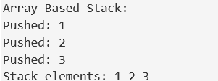
1.1 A stack ADT
1.1.3 Push operation
The code arrayStack.push(1); arrayStack.push(2); arrayStack.push(3); adds the integers 1, 2, and 3 to the top of the arrayStack. Each call to push places the integer on the stack, with 3 being the topmost value after all three operations.
Output:

Slide 8
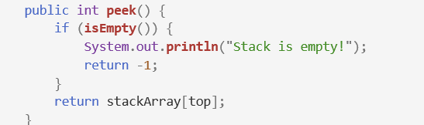
1.1 A stack ADT
1.1.4 Peek operation
The peek method checks if the stack is empty using the isEmpty method. If it is, it prints "Stack is empty!" and returns -1. If the stack has elements, it returns the value at the top of the stack from the stackArray without removing it.
Output:

Slide 9
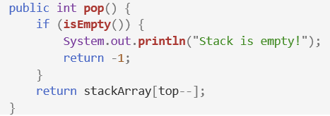

1.1 A stack ADT
1.1.5 Pop operation
The push method adds a new integer to the top of the stack by first checking if the stack is full (i.e., if top equals maxSize - 1). If the stack is full, it outputs "Stack is full!" and exits. If there is space, it increments the top index and stores the new value in stackArray[top], thereby placing the new integer on top of the stack.
Output:

Slide 10

1.1 A stack ADT
1.1.6 Check if the stack is empty
This method checks if the stack is empty by returning true if the top index is -1, indicating that there are no elements in the stack. If there are elements, it returns false.
Output:

Slide 11
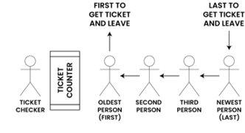
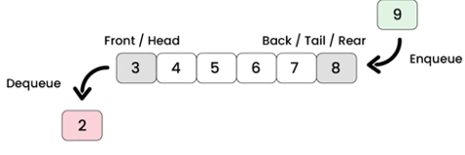
1.1 A stack ADT
1.2.1 Introduction FIFO
In FIFO (First In, First Out), the first item added is the first to be removed. This method is common in queues, where elements are processed in the order they arrive. A queue operates by adding elements at the rear and removing them from the front, ensuring that earlier entries are handled first.
FIFO queue in real life
FIFO queue in Program

Slide 12
1.2 A concrete data structure for a First In First out (FIFO) queue
1.2.2 Definition
A queue can be defined as a linear data structure that maintains a collection of elements in a specific order. The primary characteristics include:
Enqueue Operation: Inserts an element at the back of the queue.
Dequeue Operation: Removes an element from the front of the queue.
Peek/Front Operation: Returns the front element without removing it.
IsEmpty Operation: Checks whether the queue is empty.

Slide 13
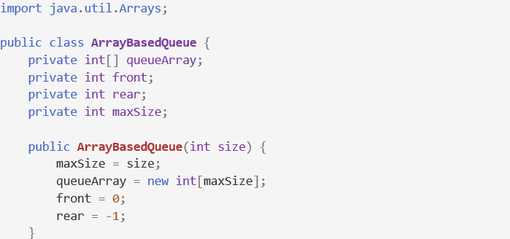
1.2 A concrete data structure for a First In First out (FIFO) queue
1.2.3 Array-Based Implementation
The ArrayBasedQueue class implements a queue using an array. It initializes the queue with a maximum size (maxSize), creates an array (queueArray), sets front to 0 for the first element, and initializes rear to -1, indicating that the queue is empty.

Slide 14
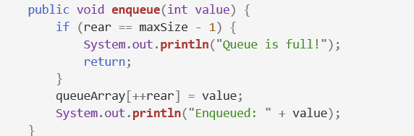
1.2 A concrete data structure for a First In First out (FIFO) queue
1.2.3 Array-Based Implementation
The enqueue method adds an integer to the end of the queue. It checks if the queue is full by comparing the rear index with maxSize - 1. If full, it prints "Queue is full!" and exits. If there’s space, it increments the rear index and adds the value to queueArray[rear].

Slide 15
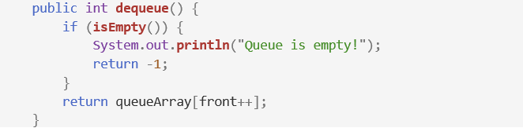
1.2 A concrete data structure for a First In First out (FIFO) queue
1.2.3 Array-Based Implementation
The dequeue method removes and returns the integer value at the front of the queue. It first checks if the queue is empty using the isEmpty method. If the queue is empty, it prints "Queue is empty!" and returns -1. If there are elements in the queue, it retrieves the value at queueArray[front] and then increments the front index, effectively removing the value from the queue.

Slide 16
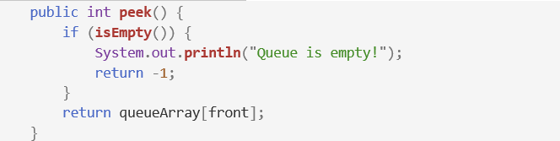

1.2 A concrete data structure for a First In First out (FIFO) queue
1.2.3 Array-Based Implementation
The peek method retrieves the value at the front of the queue without removing it. It checks if the queue is empty; if so, it returns -1 and prints a message. Otherwise, it returns the front element from queueArray[front].(Figure 4.3-4).
The isEmpty method checks if the queue is empty by verifying if front is greater than rear. If true, it means there are no elements in the queue.

Slide 17
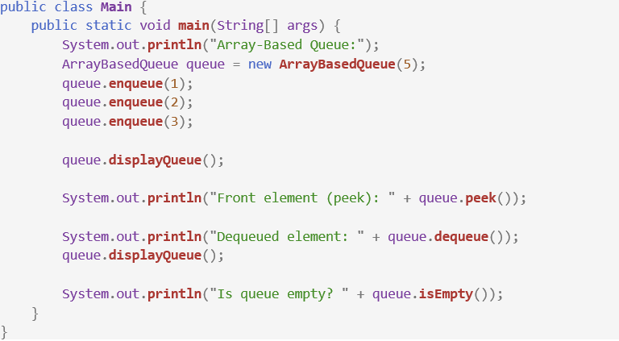
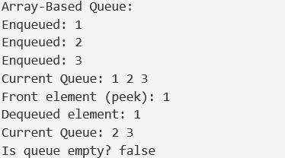
1.2 A concrete data structure for a First In First out (FIFO) queue
1.2.3 Array-Based Implementation
This Main class demonstrates using the ArrayBasedQueue. It initializes a queue with a capacity of 5, enqueues three elements, and displays the queue. It then peeks at the front element, dequeues one element, displays the queue again, and finally checks if the queue is empty.

Slide 18
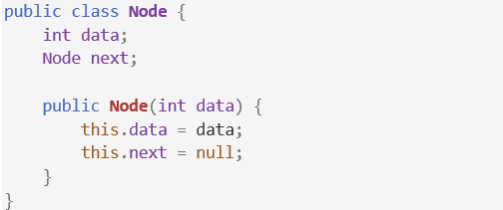
1.2 A concrete data structure for a First In First out (FIFO) queue
1.2.4 Linked List-Based Implementation
Node class:
This Node class represents a single element in a linked list-based queue. It holds integer data (data) and a reference (next) to the next Node in the list. The constructor initializes the data with a given value and sets next to null.

Slide 19
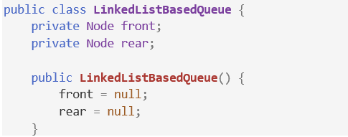
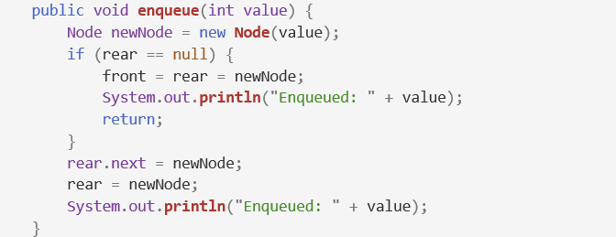
1.2 A concrete data structure for a First In First out (FIFO) queue
1.2.4 Linked List-Based Implementation
Linked List-Based Queue class:
This enqueue method adds a new node with the given value to the end of a linked list-based queue. If the queue is empty (rear is null), the new node becomes both the front and rear of the queue. Otherwise, it links the new node to the current rear and updates rear to point to this new node, then confirms the value was enqueued.

Slide 20
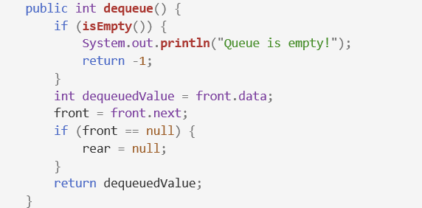
1.2 A concrete data structure for a First In First out (FIFO) queue
1.2.4 Linked List-Based Implementation
Linked List-Based Queue class:
This dequeue method removes and returns the front element from a linked list-based queue. If the queue is empty, it prints "Queue is empty!" and returns -1. Otherwise, it retrieves the value at the front, updates the front pointer to the next node, and if the queue is now empty, sets rear to null.

Slide 21
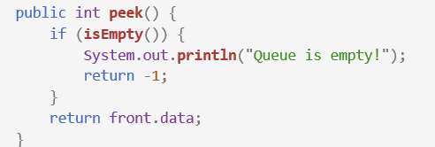

1.2 A concrete data structure for a First In First out (FIFO) queue
1.2.4 Linked List-Based Implementation
Linked List-Based Queue class:
This peek method checks if the queue is empty. If it is, it prints "Queue is empty!" and returns -1. Otherwise, it returns the data of the front element without removing it from the queue. This isEmpty method checks if the queue is empty by verifying if the front pointer is null. If front is null, it returns true, indicating that the queue has no elements; otherwise, it returns false.

Slide 22
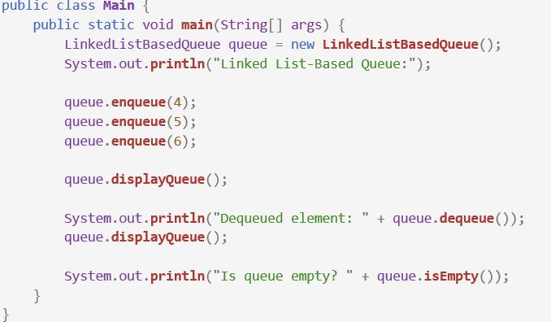
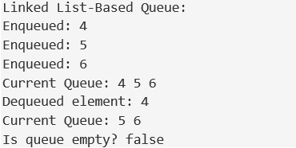
1.2 A concrete data structure for a First In First out (FIFO) queue
1.2.4 Linked List-Based Implementation
Main class:

Slide 23
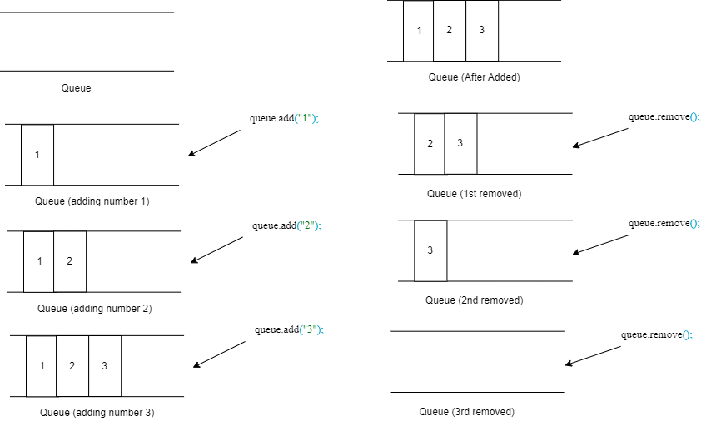
1.2 A concrete data structure for a First In First out (FIFO) queue
1.2.5 Provide a concrete example to illustrate how the FIFO queue works

Slide 24
2. Two sorting algorithms 2.1 Introduction the two sorting algorithms will be comparing 2.2 Time Complexity Analysis 2.3 Space Complexity Analysis 2.4 Stability 2.5 Comparison Table 2.6 Performance Comparison 2.7 Provide a concrete example to demonstrate the differences in performance between the two algorithms

Slide 25
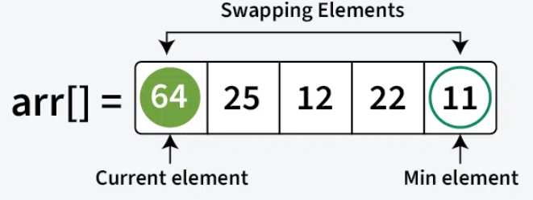
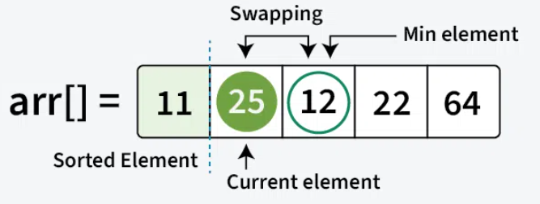
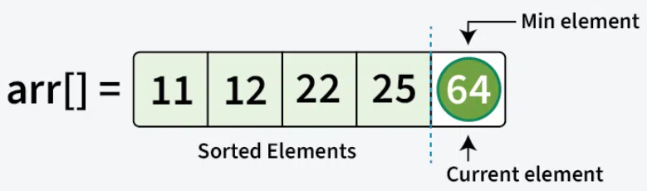
2.1 Introducing the two sorting algorithms will be comparing
2.1.1 Selection Sor
Selection Sort is a sorting algorithm that works by comparing elements. It repeatedly finds the smallest (or largest) element from the unsorted section of an array and swaps it with the first unsorted element. This process is repeated until the entire array is sorted.
The process starts by finding the smallest element and swapping it with the first element, placing it in its correct position. Next, the second smallest element is found and swapped to its correct spot. This continues until all elements are in their proper positions.

Slide 26
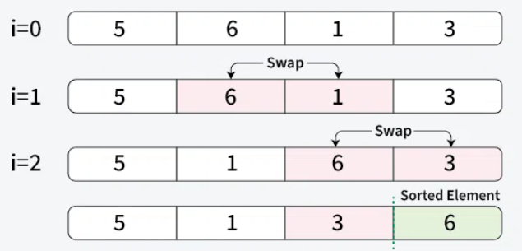
2.1 Introducing the two sorting algorithms will be comparing
2.1.2 Bubble Sort
Bubble Sort is a simple sorting algorithm that repeatedly compares and swaps adjacent elements if they are out of order. While easy to understand, it has a high time complexity, making it inefficient for large datasets.
The process involves multiple passes through the array. After each pass, the largest unsorted element is placed in its correct position at the end. In subsequent passes, the algorithm compares only the remaining unsorted elements, moving the next largest element into its position. This continues until the entire array is sorted.

Slide 27
2.2 Time Complexity Analysis
2.2.1 Selection Sort
Selection Sort has a consistent time complexity of O(n²) across all cases—best, average, and worst—because it always performs the same number of comparisons regardless of the array's initial order. Even when the array is sorted, the algorithm still checks each element, leading to O(n²) complexity in all scenarios. This is due to the need for a full traversal of the unsorted portion to find the minimum in every pass.

Slide 28
2.2 Time Complexity Analysis
2.2.2 Bubble Sort
In the best case, when the array is sorted, Bubble Sort performs N-1 comparisons with no swaps, yielding O(N) complexity. In the worst case, where the array is reversed, it takes (N-1) passes and swaps, resulting in O(N²) complexity. On average, it also performs O(N²) comparisons since the number of comparisons remains the same regardless of element arrangement.

Slide 29
2.3 Space Complexity Analysis
2.3.1 Selection Sort
Selection sort is an in-place sorting algorithm, meaning it sorts elements within the same array without extra memory for a new array. Its space complexity is O(1), as it uses a constant amount of additional memory. This makes selection sort efficient in terms of memory, especially in low-memory environments. It minimizes storage overhead by rearranging elements directly in the input array during the sorting process.

Slide 30
2.3 Space Complexity Analysis
2.3.2 Bubble Sort
Bubble Sort has a space complexity of O(1), indicating that the additional memory required by the algorithm is constant, regardless of the input array's size. The algorithm only requires a fixed amount of extra space to hold temporary variables or indices while sorting. As a result, Bubble Sort is considered highly efficient in terms of space usage since it does not rely on the size of the input and does not necessitate any extra space that scales with the input size.

Slide 31
2.4 Stability
2.4.1 Selection Sort
A sorting algorithm is stable if it preserves the original order of equal elements. Selection Sort is not inherently stable since swapping can change the positions of equal keys. To achieve stability, you can shift elements instead of swapping, allowing the minimum value to be placed correctly while maintaining the order of equal keys.

Slide 32
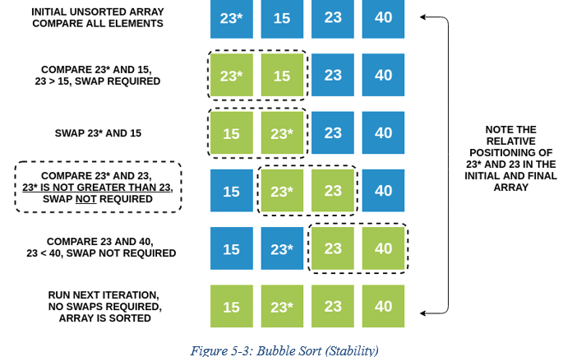
2.4 Stability
2.4.2 Bubble Sort
Bubble Sort is classified as a stable sorting algorithm because it only swaps elements when one is less than the other. If two elements are equal, they remain in their original order since no swapping occurs.
For example, consider the numbers 23 and 23*; their relative positions remain unchanged throughout the sorting procedure. This stability ensures that equal elements retain their initial order in the final sorted array.

Slide 33
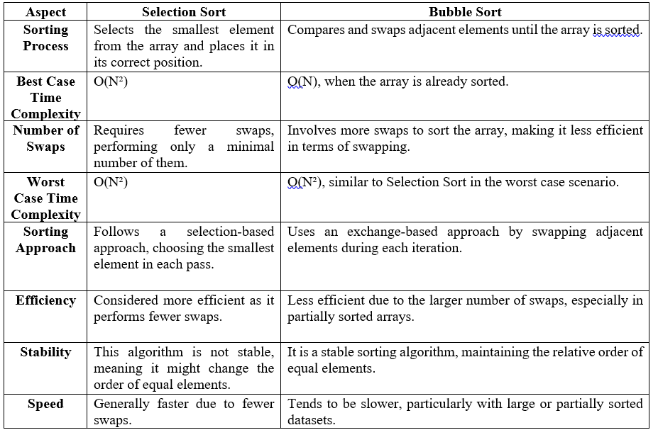
2.5 Comparison Table

Slide 34
2.6 Performance Comparison
Selection Sort excels with nearly sorted data by quickly identifying the minimum element and potentially terminating early if the list is sorted. In contrast, Bubble Sort processes the entire list regardless of order, making it less efficient in similar cases. Thus, Selection Sort generally outperforms Bubble Sort for partially organized data.

Slide 35
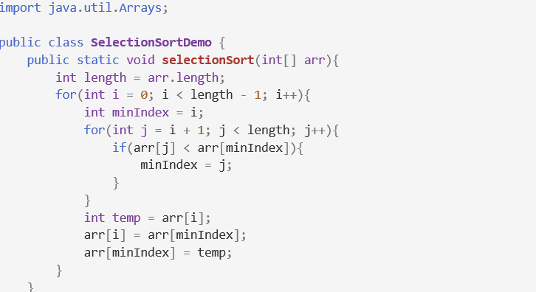
2.7 Provide a concrete example to demonstrate the differences in performance between the two algorithms
2.7.1 Concrete example to demonstrate by Selection sort
The selectionSort method implements the Selection Sort algorithm, sorting an integer array in ascending order by repeatedly finding the smallest element in the unsorted portion and swapping it with the current element. This process continues until the entire array is sorted.

Slide 36
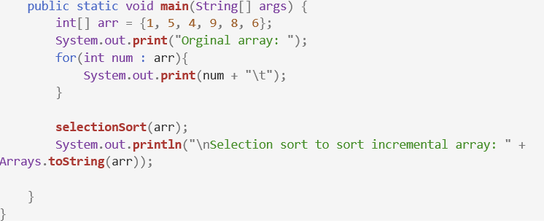
2.7 Provide a concrete example to demonstrate the differences in performance between the two algorithms
2.7.1 Concrete example to demonstrate by Selection sort
Output:

Slide 37
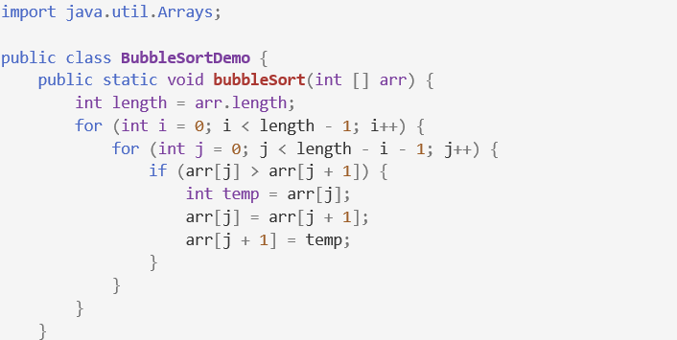
2.7 Provide a concrete example to demonstrate the differences in performance between the two algorithms
2.7.2 Concrete example to demonstrate by Bubble sort
The bubbleSort method implements the Bubble Sort algorithm, sorting an integer array in ascending order by comparing and swapping adjacent elements. This process continues until all elements are sorted, effectively "bubbling" the largest unsorted elements to the end of the array.

Slide 38
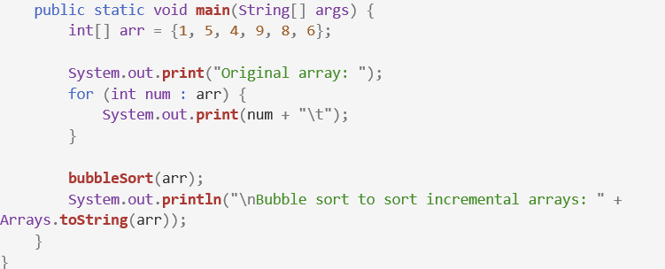
2.7 Provide a concrete example to demonstrate the differences in performance between the two algorithms
2.7.2 Concrete example to demonstrate by Bubble sort
Output:

Slide 39
2.7 Provide a concrete example to demonstrate the differences in performance between the two algorithms
2.7.3 Performance Comparison
After Selection Sort, the array is sorted as {1, 4, 5, 6, 8, 9}, maintaining a time complexity of O(N²). Bubble Sort also results in {1, 4, 5, 6, 8, 9}, swapping adjacent elements. It can achieve O(N) in the best case for sorted data but has O(N²) in average and worst cases. Both algorithms yield the same output, but Selection Sort provides consistent performance, while Bubble Sort may excel with sorted arrays.

Slide 40
3. Two network shortest path algorithms 3.1 Introducing the concept of network shortest path algorithms 3.2 Algorithm 1: Dijkstra's Algorithm 3.3 Algorithm 2: Prim-Jarnik Algorithm 3.4 Performance Analysis

Slide 41
3.1 Introducing the concept of network shortest path algorithms
Shortest path algorithms identify the minimum travel cost from a starting node to a target node in a graph. By evaluating paths based on edge weights, these algorithms optimize time and space efficiency. Common algorithms like Dijkstra's and Bellman-Ford are crucial for applications in navigation and network routing, providing effective solutions for logistical challenges. (

Slide 42
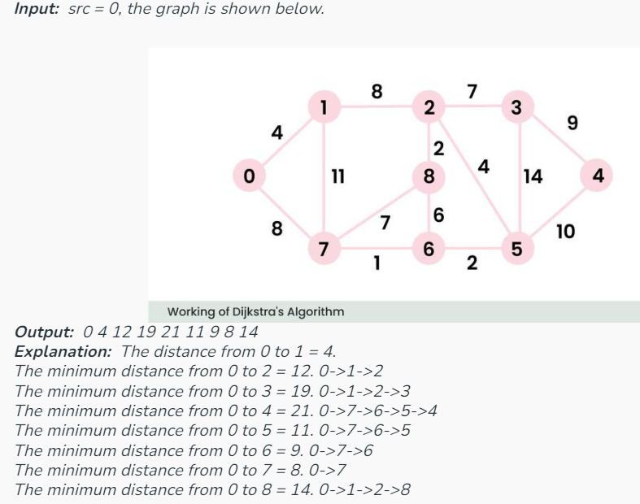
3.2 Algorithm 1: Dijkstra's Algorithm
Dijkstra's algorithm identifies the shortest path from a starting node to every other node in a weighted graph. It works by repeatedly choosing the node with the lowest tentative distance and adjusting the distances to its neighboring nodes. This process gradually reveals the shortest paths and is grounded in the concept of greedy optimization.

Slide 43
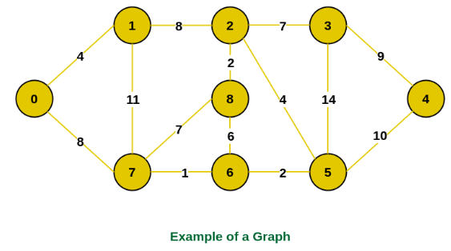
3.3 Algorithm 2: Prim-Jarnik Algorithm
The algorithm initiates with an empty spanning tree and manages two sets of vertices: one for those included in the Minimum Spanning Tree (MST) and another for those not yet included. At each step, it evaluates the edges connecting these sets and selects the one with the lowest weight. Afterward, the vertex at the edge's other end is added to the MST.

Slide 44
3.4 Performance Analysis
Both algorithms serve distinct purposes and have different performance characteristics:
Dijkstra's Algorithm is effective for finding the shortest path in graphs with non-negative weights, typically running in O(V²) for a basic implementation or O(V + E log V) with a priority queue.
Prim's Algorithm focuses on finding the minimum spanning tree, generally performing similarly, with O(V²) for a simple array or O(E log V) using a priority queue.
While they tackle different problems, both algorithms are crucial for network design and optimization.

Slide 45
Thanks for watching!

