Slide 1

DATA STRUCTURES & ALGORITHMS
Student Name: DANG NGOC SON
Student ID: BH01045
Class: SE06302
Assessor Name: DINH VAN DONG

Slide 2
Contents:
A stack ADT, a concrete data structure for a First In First out (FIFO) queue
Two sorting algorithms
Two network shortest path algorithms
Demo: The student management system

Slide 3
1. A stack ADT, a concrete data structure for a First In First out (FIFO) queue 1.1 DSA 1.2 ADT 1.3 Stack and FIFO queue 1.4 Compare different between Stack and Queue

Slide 4
1.1 DSA
DSA (Data Structures and Algorithms), is a field in computer science focused on organizing data (Data Structures) and solving computational problems efficiently (Algorithms). A stack is a specific data structure in DSA that follows the Last In, First Out (LIFO) principle, not FIFO, as described in the question. In contrast, a queue operates on a FIFO basis.

Slide 5
1.2 ADT
ADT (Abstract Data Type) defines a data structure based on its behavior (operations and rules) without specifying implementation details. Examples of ADTs include Stack, Queue, and List, where only the operations are defined rather than the internal workings.

Slide 6
1.3 Stack and FIFO queue
1.3.1 Stack
Definition: A Stack is an ADT that follows the Last In, First Out (LIFO) principle. The most recent element added is the first to be removed.
Operations:
Push: Adding an element to the top of the stack.
Pop: Removing the top element from the stack.
Peek/Top: Viewing the top element without removing it.
IsEmpty: Checking if the stack is empty.

Slide 7
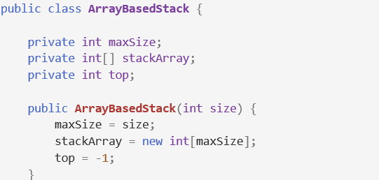
1.3 Stack and FIFO queue
1.3.2 Initialize the stack
Array-Based Stack:
The ArrayBasedStack class implements a stack using an array. It has three main attributes: maxSize for the stack's capacity, stackArray to store the stack elements, and top, which indicates the index of the top element (initialized to -1 to represent an empty stack). The constructor initializes these attributes based on the given size.

Slide 8

1.3 Stack and FIFO queue
1.3.2 Initialize the stack
Array-Based Stack:
The Main class contains the main method, which prints "Array-Based Stack:" and initializes an ArrayBasedStack instance with a maximum size of 5, preparing it for further stack operations.

Slide 9
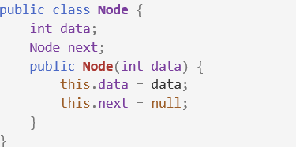
1.3 Stack and FIFO queue
1.3.2 Initialize the stack
Linked-List-Based Stack:
The Node class is a fundamental building block for the linked-list implementation of the stack. It contains two attributes:
data: This integer variable holds the value that the node will store.
next: This is a reference to the next Node in the linked list, allowing us to connect nodes together.

Slide 10
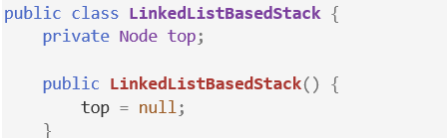

1.3 Stack and FIFO queue
1.3.2 Initialize the stack
Linked-List-Based Stack:
The LinkedListBasedStack class defines a stack structure using a linked list, with a private Node reference named top to indicate the top of the stack. The constructor initializes top to null, indicating that the stack is initially empty.

Slide 11
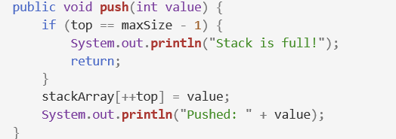
1.3 Stack and FIFO queue
1.3.3 Push operation
Array-Based Stack:
The push method adds a new integer value to the top of the stack. It first checks if the stack is full by comparing the current top index with maxSize - 1. If the stack is full, it prints "Stack is full!" and exits the method. If there is space, it increments the top index and assigns the provided value to stackArray[top], effectively adding the new value to the stack.

Slide 12

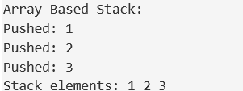
1.3 Stack and FIFO queue
1.3.3 Push operation
Array-Based Stack:
The code arrayStack.push(1); arrayStack.push(2); arrayStack.push(3); adds the integers 1, 2, and 3 to the top of the arrayStack. Each call to push places the integer on the stack, with 3 being the topmost value after all three operations.
Output:

Slide 13
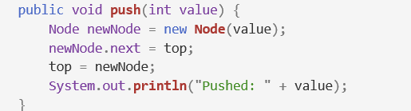
1.3 Stack and FIFO queue
1.3.3 Push operation
Linked-List-Based Stack:
This code defines a push method for a stack data structure. It creates a new Node with a given value, sets this new node's next pointer to the current top of the stack, then updates top to the new node, effectively adding it to the stack. Finally, it prints a message confirming the value pushed.

Slide 14

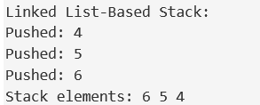
1.3 Stack and FIFO queue
1.3.3 Push operation
Linked-List-Based Stack:
The code linkedListStack.push(4); linkedListStack.push(5); linkedListStack.push(6); adds the integers 4, 5, and 6 to the top of the linkedListStack. Each push operation creates a new node with the given value, linking it to the previous top node, so 6 becomes the topmost value in the stack after all operations.
Output:

Slide 15
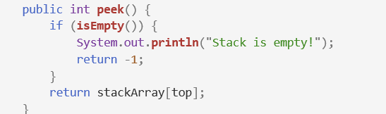
1.3 Stack and FIFO queue
1.3.4 Peek operation
Array-Based Stack:
The peek method checks if the stack is empty using the isEmpty method. If it is, it prints "Stack is empty!" and returns -1. If the stack has elements, it returns the value at the top of the stack from the stackArray without removing it.
Output:

Slide 16
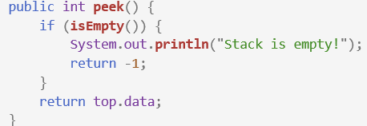
1.3 Stack and FIFO queue
1.3.4 Peek operation
Linked-List-Based Stack:
The peek method checks the top element of the stack without removing it. If the stack is empty, it prints a message and returns -1. If the stack has elements, it returns the value stored in the top node.
Output:

Slide 17
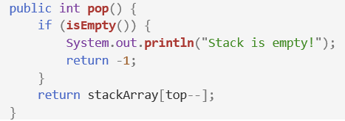

1.3 Stack and FIFO queue
1.3.5 Pop operation
Array-Based Stack:
The push method adds a new integer to the top of the stack by first checking if the stack is full (i.e., if top equals maxSize - 1). If the stack is full, it outputs "Stack is full!" and exits. If there is space, it increments the top index and stores the new value in stackArray[top], thereby placing the new integer on top of the stack.
Output:

Slide 18
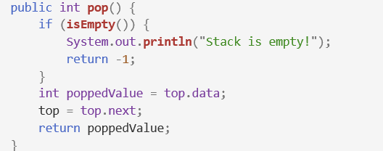

1.3 Stack and FIFO queue
1.3.5 Pop operation
Linked-List-Based Stack:
The pop method removes and returns the top value from the stack. If the stack is empty, it prints "Stack is empty!" and returns -1. Otherwise, it stores the top node's value, updates top to the next node, and returns the stored value.
Output:

Slide 19

1.3 Stack and FIFO queue
1.3.6 Check if the stack is empty
Array-Based Stack:
This method checks if the stack is empty by returning true if the top index is -1, indicating that there are no elements in the stack. If there are elements, it returns false.
Output:

Slide 20

1.3 Stack and FIFO queue
1.3.6 Check if the stack is empty
Linked-List-Based Stack:
This method checks if the linked list-based stack is empty by returning true if the top node is null, indicating there are no elements in the stack. If top is not null, it means the stack contains elements, and the method returns false.
Output:

Slide 21
1.3 Stack and FIFO queue
1.3.7 Comparing Array-Based and Linked List-Based Stack Implementations
Array-Based Stack:
Fixed size, risking wasted space or overflow.
Fast access due to contiguous memory.
Simple implementation with array indexing.
Linked List-Based Stack:
Dynamic size, adapting to element count.
Higher memory use per element for pointers.
More complex implementation with pointers.
Summary: Choose based on application needs, balancing memory and performance.

Slide 22
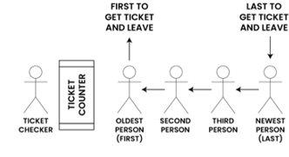
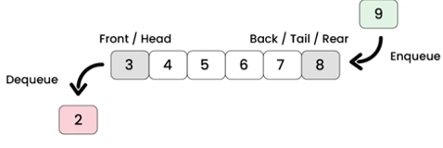
1.3 Stack and FIFO queue
1.3.8 Introduction FIFO
In FIFO (First In, First Out), the first item added is the first to be removed. This method is common in queues, where elements are processed in the order they arrive. A queue operates by adding elements at the rear and removing them from the front, ensuring that earlier entries are handled first.
FIFO queue in real life
FIFO queue in Program

Slide 23
1.3 Stack and FIFO queue
1.3.9 Definition
A queue can be defined as a linear data structure that maintains a collection of elements in a specific order. The primary characteristics include:
Enqueue Operation: Inserts an element at the back of the queue.
Dequeue Operation: Removes an element from the front of the queue.
Peek/Front Operation: Returns the front element without removing it.
IsEmpty Operation: Checks whether the queue is empty.

Slide 24
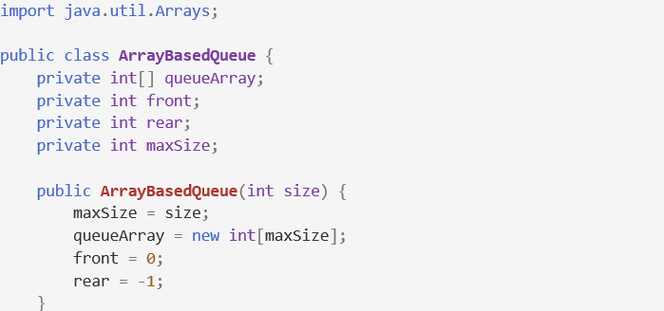
1.3 Stack and FIFO queue
1.3.10 Array-Based Implementation
The ArrayBasedQueue class implements a queue using an array. It initializes the queue with a maximum size (maxSize), creates an array (queueArray), sets front to 0 for the first element, and initializes rear to -1, indicating that the queue is empty.

Slide 25
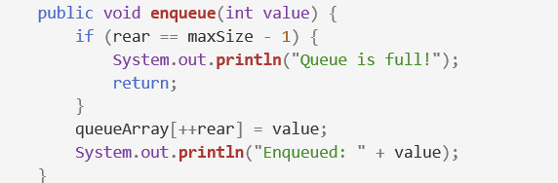
1.3 Stack and FIFO queue
1.3.11 Array-Based Implementation
The enqueue method adds an integer to the end of the queue. It checks if the queue is full by comparing the rear index with maxSize - 1. If full, it prints "Queue is full!" and exits. If there’s space, it increments the rear index and adds the value to queueArray[rear].

Slide 26
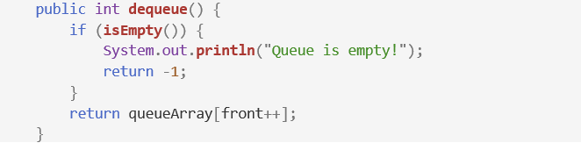
1.3 Stack and FIFO queue
1.3.11 Array-Based Implementation
The dequeue method removes and returns the integer value at the front of the queue. It first checks if the queue is empty using the isEmpty method. If the queue is empty, it prints "Queue is empty!" and returns -1. If there are elements in the queue, it retrieves the value at queueArray[front] and then increments the front index, effectively removing the value from the queue.

Slide 27
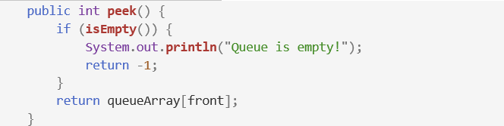

1.3 Stack and FIFO queue
1.3.11 Array-Based Implementation
The peek method retrieves the value at the front of the queue without removing it. It checks if the queue is empty; if so, it returns -1 and prints a message. Otherwise, it returns the front element from queueArray[front].(Figure 4.3-4).
The isEmpty method checks if the queue is empty by verifying if front is greater than rear. If true, it means there are no elements in the queue.

Slide 28
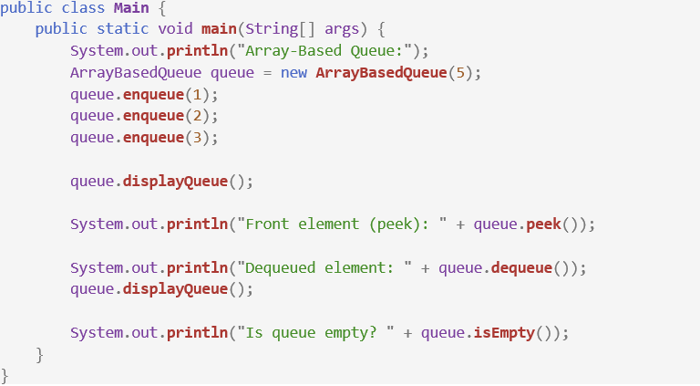
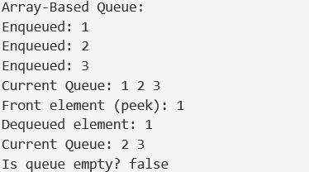
1.3 Stack and FIFO queue
1.3.11 Array-Based Implementation
This Main class demonstrates using the ArrayBasedQueue. It initializes a queue with a capacity of 5, enqueues three elements, and displays the queue. It then peeks at the front element, dequeues one element, displays the queue again, and finally checks if the queue is empty.

Slide 29
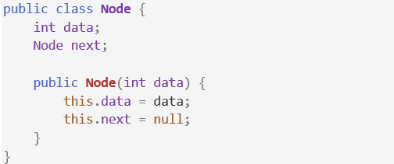
1.3 Stack and FIFO queue
1.3.12 Linked List-Based Implementation
Node class:
This Node class represents a single element in a linked list-based queue. It holds integer data (data) and a reference (next) to the next Node in the list. The constructor initializes the data with a given value and sets next to null.

Slide 30
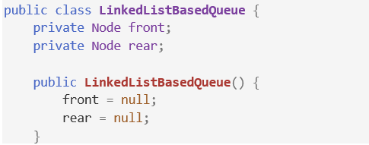
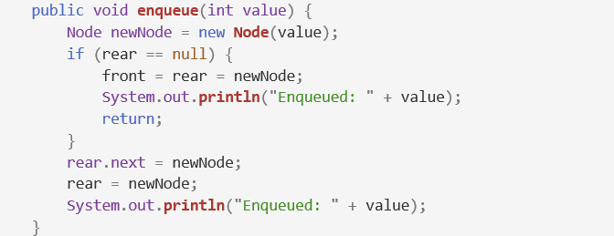
1.3 Stack and FIFO queue
1.3.12 Linked List-Based Implementation
Linked List-Based Queue class:
This enqueue method adds a new node with the given value to the end of a linked list-based queue. If the queue is empty (rear is null), the new node becomes both the front and rear of the queue. Otherwise, it links the new node to the current rear and updates rear to point to this new node, then confirms the value was enqueued.

Slide 31
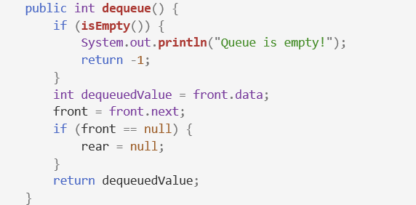
1.3 Stack and FIFO queue
1.3.12 Linked List-Based Implementation
Linked List-Based Queue class:
This dequeue method removes and returns the front element from a linked list-based queue. If the queue is empty, it prints "Queue is empty!" and returns -1. Otherwise, it retrieves the value at the front, updates the front pointer to the next node, and if the queue is now empty, sets rear to null.

Slide 32
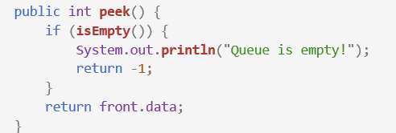

1.3 Stack and FIFO queue
1.3.12 Linked List-Based Implementation
Linked List-Based Queue class:
This peek method checks if the queue is empty. If it is, it prints "Queue is empty!" and returns -1. Otherwise, it returns the data of the front element without removing it from the queue. This isEmpty method checks if the queue is empty by verifying if the front pointer is null. If front is null, it returns true, indicating that the queue has no elements; otherwise, it returns false.

Slide 33
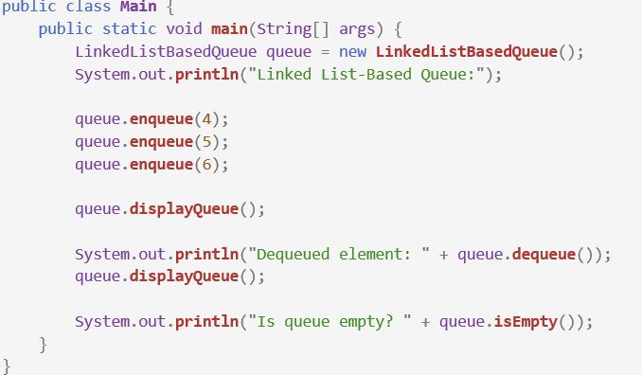
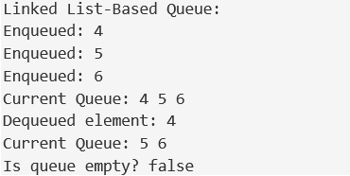
1.3 Stack and FIFO queue
1.3.12 Linked List-Based Implementation
Main class:

Slide 34
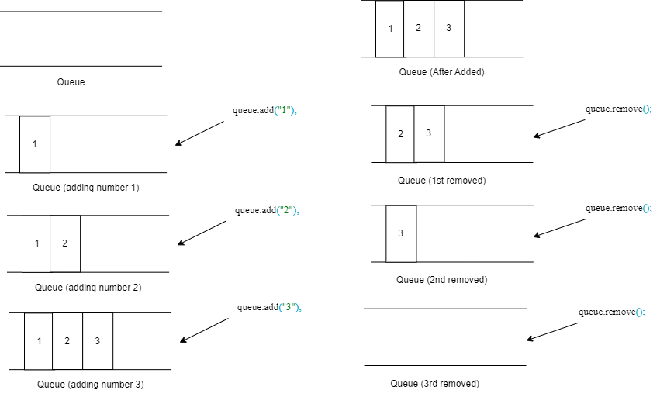
1.3 Stack and FIFO queue
1.3.13 Provide a concrete example to illustrate how the FIFO queue works

Slide 35
1.4 Compare different between Stack and Queue
Stack: Follows LIFO (Last In, First Out); the last item added is the first to be removed. Operations include push, pop, and peek.
Queue: Follows FIFO (First In, First Out); the first item added is the first to be removed. Operations include enqueue, dequeue, and front.

Slide 36
2. Two sorting algorithms 2.1 Introduction the two sorting algorithms will be comparing 2.2 Time Complexity Analysis 2.3 Space Complexity Analysis 2.4 Stability 2.5 Comparison Table 2.6 Performance Comparison 2.7 Provide a concrete example to demonstrate the differences in performance between the two algorithms

Slide 37
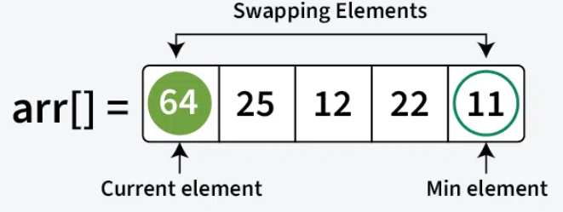
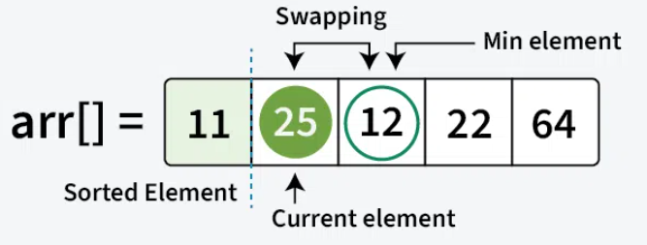
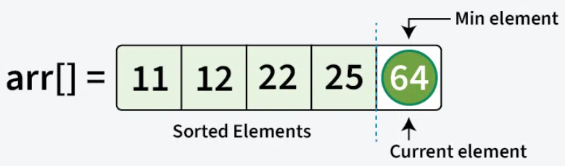
2.1 Introducing the two sorting algorithms will be comparing
2.1.1 Selection Sort
Selection Sort is a sorting algorithm that works by comparing elements. It repeatedly finds the smallest (or largest) element from the unsorted section of an array and swaps it with the first unsorted element. This process is repeated until the entire array is sorted.
The process starts by finding the smallest element and swapping it with the first element, placing it in its correct position. Next, the second smallest element is found and swapped to its correct spot. This continues until all elements are in their proper positions.

Slide 38
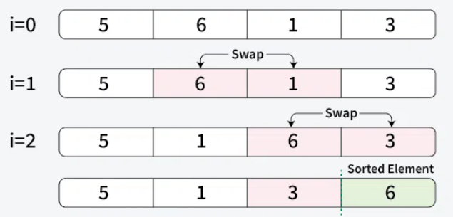
2.1 Introducing the two sorting algorithms will be comparing
2.1.2 Bubble Sort
Bubble Sort is a simple sorting algorithm that repeatedly compares and swaps adjacent elements if they are out of order. While easy to understand, it has a high time complexity, making it inefficient for large datasets.
The process involves multiple passes through the array. After each pass, the largest unsorted element is placed in its correct position at the end. In subsequent passes, the algorithm compares only the remaining unsorted elements, moving the next largest element into its position. This continues until the entire array is sorted.

Slide 39
2.2 Time Complexity Analysis
2.2.1 Selection Sort
Selection Sort has a consistent time complexity of O(n²) across all cases—best, average, and worst—because it always performs the same number of comparisons regardless of the array's initial order. Even when the array is sorted, the algorithm still checks each element, leading to O(n²) complexity in all scenarios. This is due to the need for a full traversal of the unsorted portion to find the minimum in every pass.

Slide 40
2.2 Time Complexity Analysis
2.2.2 Bubble Sort
In the best case, when the array is sorted, Bubble Sort performs N-1 comparisons with no swaps, yielding O(N) complexity. In the worst case, where the array is reversed, it takes (N-1) passes and swaps, resulting in O(N²) complexity. On average, it also performs O(N²) comparisons since the number of comparisons remains the same regardless of element arrangement.

Slide 41
2.3 Space Complexity Analysis
2.3.1 Selection Sort
Selection sort is an in-place sorting algorithm, meaning it sorts elements within the same array without extra memory for a new array. Its space complexity is O(1), as it uses a constant amount of additional memory. This makes selection sort efficient in terms of memory, especially in low-memory environments. It minimizes storage overhead by rearranging elements directly in the input array during the sorting process.

Slide 42
2.3 Space Complexity Analysis
2.3.2 Bubble Sort
Bubble Sort has a space complexity of O(1), indicating that the additional memory required by the algorithm is constant, regardless of the input array's size. The algorithm only requires a fixed amount of extra space to hold temporary variables or indices while sorting. As a result, Bubble Sort is considered highly efficient in terms of space usage since it does not rely on the size of the input and does not necessitate any extra space that scales with the input size.

Slide 43
2.4 Stability
2.4.1 Selection Sort
A sorting algorithm is stable if it preserves the original order of equal elements. Selection Sort is not inherently stable since swapping can change the positions of equal keys. To achieve stability, you can shift elements instead of swapping, allowing the minimum value to be placed correctly while maintaining the order of equal keys.

Slide 44
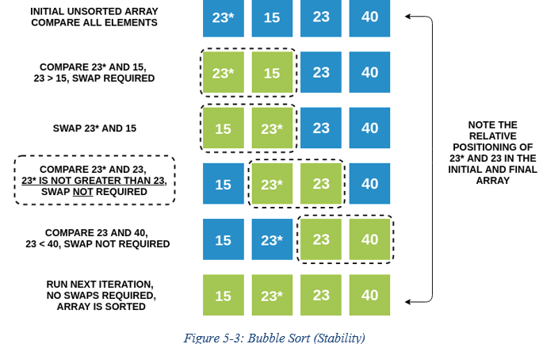
2.4 Stability
2.4.2 Bubble Sort
Bubble Sort is classified as a stable sorting algorithm because it only swaps elements when one is less than the other. If two elements are equal, they remain in their original order since no swapping occurs.
For example, consider the numbers 23 and 23*; their relative positions remain unchanged throughout the sorting procedure. This stability ensures that equal elements retain their initial order in the final sorted array.

Slide 45
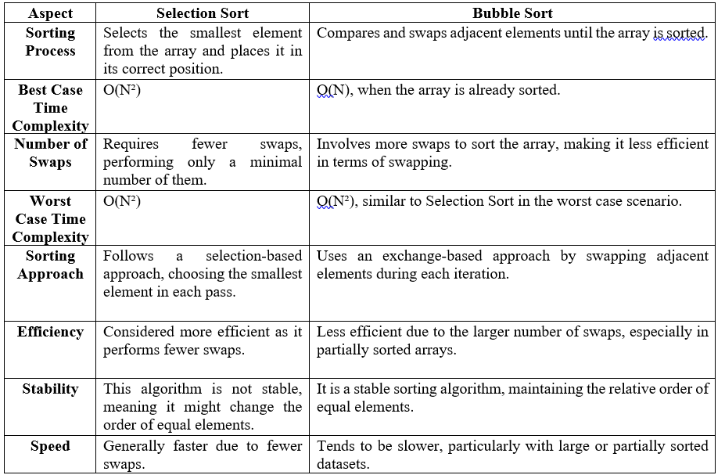
2.5 Comparison Table

Slide 46
2.6 Performance Comparison
Selection Sort excels with nearly sorted data by quickly identifying the minimum element and potentially terminating early if the list is sorted. In contrast, Bubble Sort processes the entire list regardless of order, making it less efficient in similar cases. Thus, Selection Sort generally outperforms Bubble Sort for partially organized data.

Slide 47
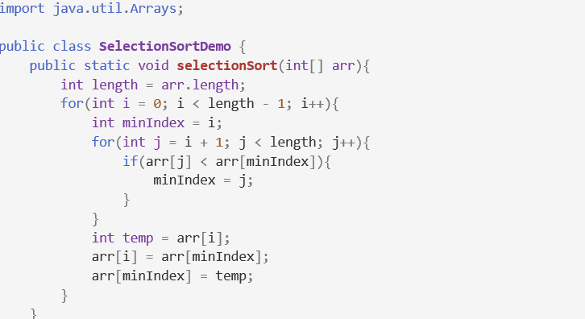
2.7 Provide a concrete example to demonstrate the differences in performance between the two algorithms
2.7.1 Concrete example to demonstrate by Selection sort
The selectionSort method implements the Selection Sort algorithm, sorting an integer array in ascending order by repeatedly finding the smallest element in the unsorted portion and swapping it with the current element. This process continues until the entire array is sorted.

Slide 48
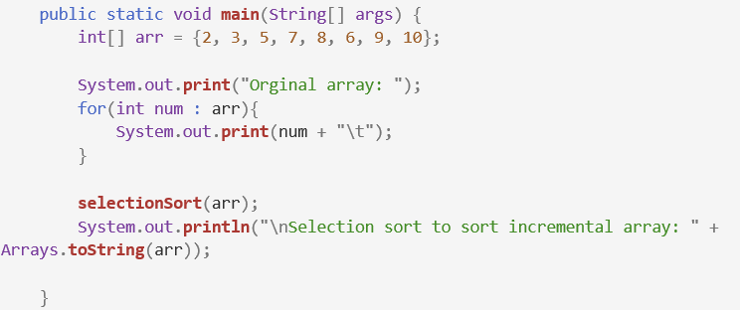
2.7 Provide a concrete example to demonstrate the differences in performance between the two algorithms
2.7.1 Concrete example to demonstrate by Selection sort
Output:

Slide 49
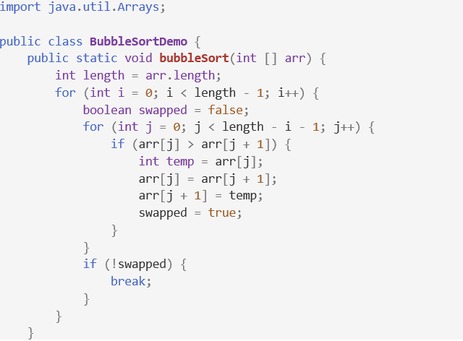
2.7 Provide a concrete example to demonstrate the differences in performance between the two algorithms
2.7.2 Concrete example to demonstrate by Bubble sort
This code performs Bubble Sort with an optimization: it sorts an array by repeatedly swapping adjacent elements if they are in the wrong order. A swapped flag checks if any swaps occurred in each pass. If no swaps are made, the loop stops early, improving efficiency for nearly sorted arrays.

Slide 50
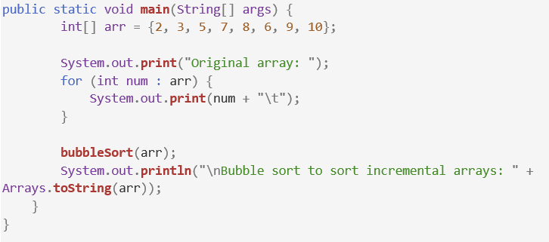
2.7 Provide a concrete example to demonstrate the differences in performance between the two algorithms
2.7.2 Concrete example to demonstrate by Bubble sort
Output:

Slide 51
2.7 Provide a concrete example to demonstrate the differences in performance between the two algorithms
2.7.3 Performance Comparison
After Selection Sort, the array is sorted as {2, 3, 5, 6, 7, 8, 9, 10}, maintaining a time complexity of O(N²). Bubble Sort also results in {2, 3, 5, 6, 7, 8, 9, 10}, swapping adjacent elements. It can achieve O(N) in the best case for sorted data but has O(N²) in average and worst cases. Both algorithms yield the same output, but Selection Sort provides consistent performance, while Bubble Sort may excel with sorted arrays.

Slide 52
3. Two network shortest path algorithms 3.1 Introducing the concept of network shortest path algorithms 3.2 Algorithm 1: Dijkstra's Algorithm 3.3 Algorithm 2: Prim-Jarnik Algorithm 3.4 Performance Analysis

Slide 53
3.1 Introducing the concept of network shortest path algorithms
Shortest path algorithms find the minimum travel cost from a starting node to a target node in a graph by evaluating paths based on edge weights. These algorithms enhance time and space efficiency. Common examples, such as Dijkstra's and Prim-Jarnik algorithms, are essential for applications in navigation and network routing, offering efficient solutions for logistical challenges.

Slide 54
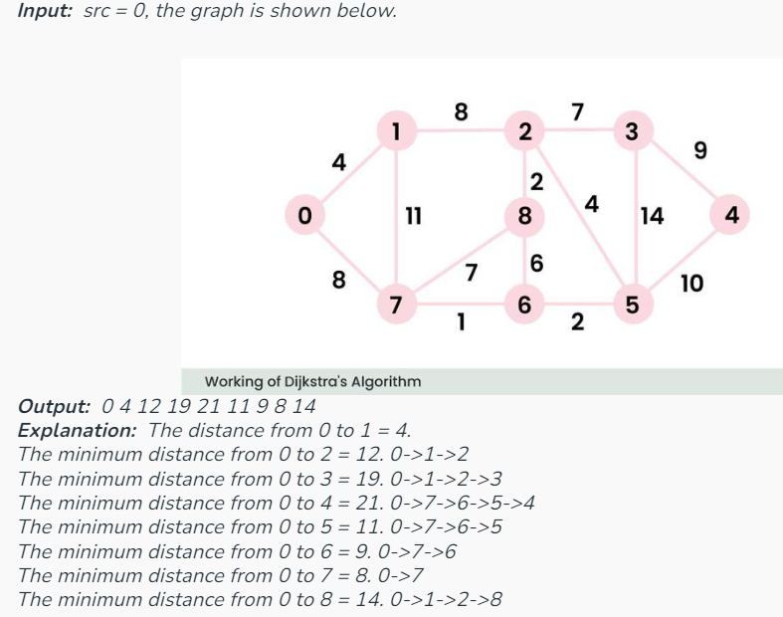
3.2 Algorithm 1: Dijkstra's Algorithm
Dijkstra's algorithm identifies the shortest path from a starting node to every other node in a weighted graph. It works by repeatedly choosing the node with the lowest tentative distance and adjusting the distances to its neighboring nodes. This process gradually reveals the shortest paths and is grounded in the concept of greedy optimization.

Slide 55
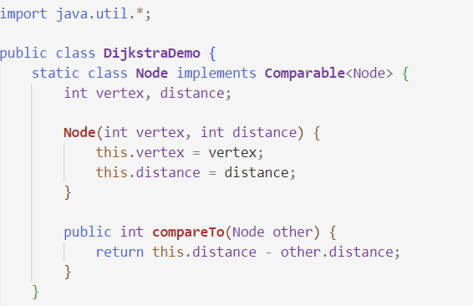
3.2 Algorithm 1: Dijkstra's Algorithm
Demo code:

Slide 56
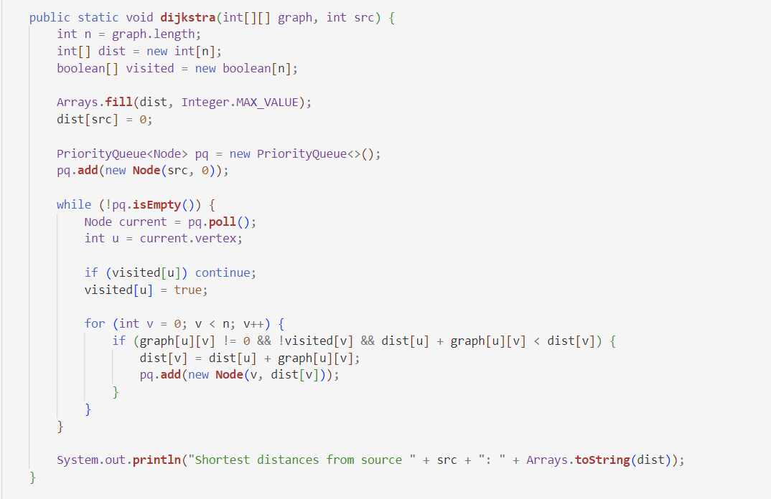
3.2 Algorithm 1: Dijkstra's Algorithm
Demo code:

Slide 57
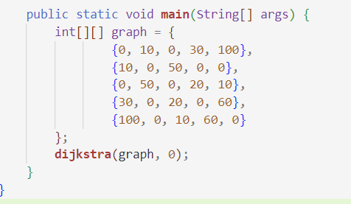

3.2 Algorithm 1: Dijkstra's Algorithm
Demo code:
Output:

Slide 58
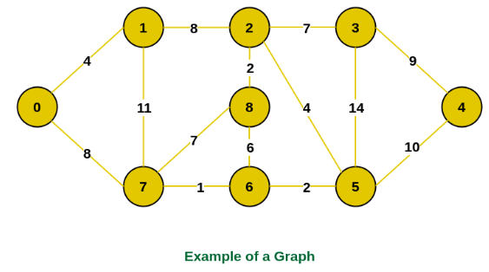
3.3 Algorithm 2: Prim-Jarnik Algorithm
The algorithm initiates with an empty spanning tree and manages two sets of vertices: one for those included in the Minimum Spanning Tree (MST) and another for those not yet included. At each step, it evaluates the edges connecting these sets and selects the one with the lowest weight. Afterward, the vertex at the edge's other end is added to the MST.

Slide 59
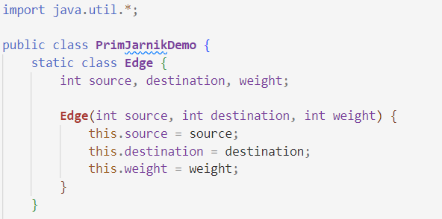
3.3 Algorithm 2: Prim-Jarnik Algorithm
Demo code:

Slide 60
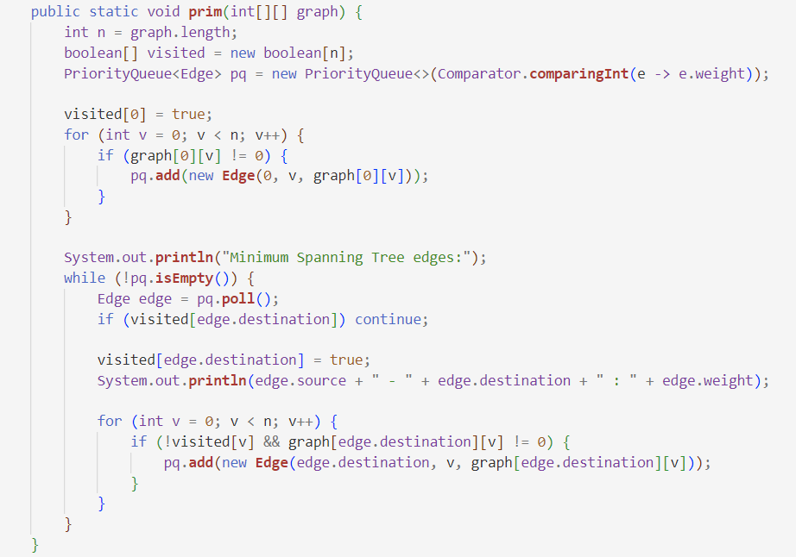
3.3 Algorithm 2: Prim-Jarnik Algorithm
Demo code:

Slide 61
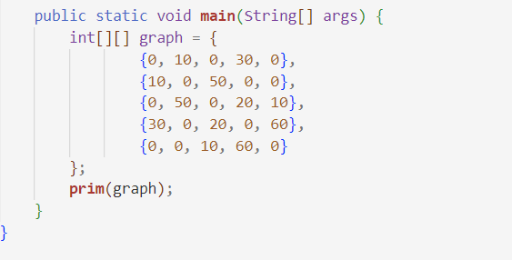
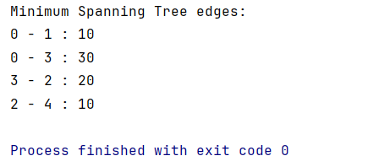
3.3 Algorithm 2: Prim-Jarnik Algorithm
Demo code:
Output:

Slide 62
3.4 Performance Analysis
Both algorithms serve distinct purposes and have different performance characteristics:
Dijkstra's Algorithm is effective for finding the shortest path in graphs with non-negative weights, typically running in O(V²) for a basic implementation or O(V + E log V) with a priority queue.
Prim's Algorithm focuses on finding the minimum spanning tree, generally performing similarly, with O(V²) for a simple array or O(E log V) using a priority queue.
While they tackle different problems, both algorithms are crucial for network design and optimization.

Slide 63
4. Demo: The student management system 4.1 Define the project 4.2 ADT 4.3 Algorithm 4.4 Determine two ways in which the efficiency of an algorithm can be measured, illustrating your answer with an example

Slide 64
4.1 Define the project
The problem at hand involves developing a software application for Soft Development ABK, which will manage student data for small and medium enterprises. Specifically, the application needs to handle student information, including their ID, name, marks, and rank. Additionally, the application must allow users to perform operations such as adding, editing, deleting, sorting, and searching student records.

Slide 65
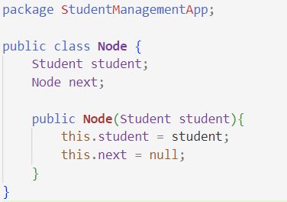
4.2 ADT
Node class:

Slide 66
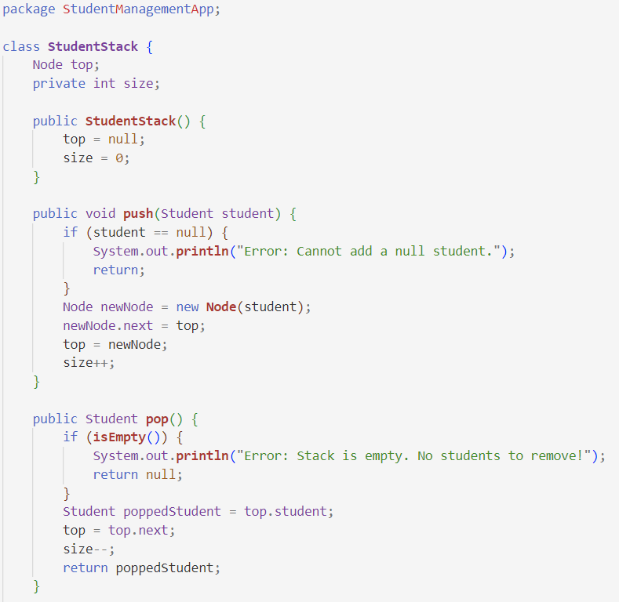
4.2 ADT
StudentStack class:

Slide 67
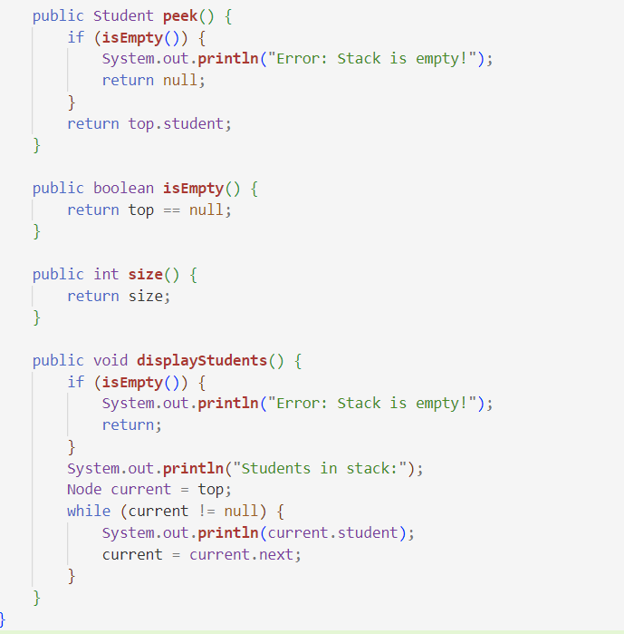
4.2 ADT
StudentStack class:

Slide 68
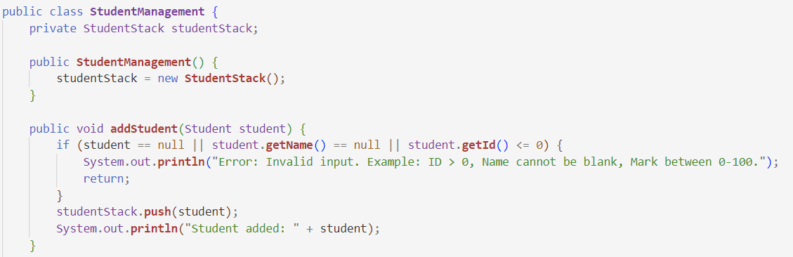
4.3 Algorithms
Add Student

Slide 69

4.3 Algorithms
Update Student

Slide 70


4.3 Algorithms
Peek Student
Display student

Slide 71

4.3 Algorithms
Delete Student

Slide 72

4.3 Algorithms
Sort Student

Slide 73

4.3 Algorithms
Search Student

Slide 74
4.3 Algorithms
Run the Test Cases

Slide 75

4.4 Determine two ways in which the efficiency of an algorithm can be measured, illustrating your answer with an example
Time Complexity and example
Bubble sort

Slide 76

4.4 Determine two ways in which the efficiency of an algorithm can be measured, illustrating your answer with an example
Merge sort

Slide 77


4.4 Determine two ways in which the efficiency of an algorithm can be measured, illustrating your answer with an example
Merge sort

Slide 78

4.4 Determine two ways in which the efficiency of an algorithm can be measured, illustrating your answer with an example
Merge sort

Slide 79
4.4 Determine two ways in which the efficiency of an algorithm can be measured, illustrating your answer with an example

Slide 80
4.4 Determine two ways in which the efficiency of an algorithm can be measured, illustrating your answer with an example
Time Complexity Evaluation:
Bubble Sort (O(n²)): As the input size increases, the execution time increases quadratically. This is evident in the provided example where the time for Bubble Sort grows substantially with the number of students. This makes Bubble Sort impractical for sorting large datasets.
Merge Sort (O(n log n)): Merge Sort, on the other hand, has a much more efficient growth rate. While the execution time increases with larger datasets, it does so at a much slower pace compared to Bubble Sort. This makes Merge Sort more suitable for larger datasets, providing a much better performance as input size grows.
Conclusion:
Bubble Sort is simple to implement but inefficient for larger datasets. It is best suited for small input sizes or educational purposes to demonstrate basic sorting techniques.
Merge Sort is more efficient, especially for larger datasets, and is commonly used in real-world applications where performance is crucial. It demonstrates the advantages of divide-and-conquer algorithms in terms of scalability.

Slide 81
4.4 Determine two ways in which the efficiency of an algorithm can be measured, illustrating your answer with an example
Space Complexity and Example
Space complexity measures the memory an algorithm uses relative to the input size, including memory for input storage, auxiliary structures, and temporary variables. This is crucial for optimizing algorithms in memory-constrained environments.
Example: A program storing student details (ID, Name, Marks) has space complexity O(n). If each student object uses 100 bytes:
For 10 students: 10 × 100 = 1,000 bytes.
For 100 students: 100 × 100 = 10,000 bytes.
This demonstrates how memory usage scales with input size and underscores the importance of efficient data structures and in-place algorithms for large datasets. Balancing time and space complexities ensures overall algorithm efficiency.

Slide 82
Thanks for watching!

