Slide 1

Human Factors in Network Security:
Social Engineering Defenses & Security Awareness Training (Part A)
Authors: Prakriti Dhungel | Ashwini Gondhi | Song Dang
University of North Texas
CSCE 5585

Slide 2
Introduction
The most vulnerable point in cyber attacks are human users
Phishing and social engineering draw on psychology, trust, and urgency
Phishing created by AI makes works of a hacker more real and less visible
Education and vigilance are very important for building up the resistance of users

Slide 3
Literature Review Summary
Training enhances knowledge, yet retention decreases gradually
A majority of researches do not evaluate the real-world office scenario
Participation and interaction have an enormous impact on the results
Just technical protections are not enough, the human aspect is important

Slide 4

Training Effectiveness
Modules based on games and scenarios are more engaging
Temporary changes in behavior often reported
Rarely assessed are the skills keeping over the long period
Reinforcement techniques and permanent training are essential

Slide 5
Phishing-Specific Findings
Research indicates that there is only marginal improvement after 6-8 months.
There is a tendency of employees to avoid or cover compulsory modules.
Active involvement - heightened level of detection.
Sustainable protection [?] one-time training.

Slide 6

Human & Behavioral Factors
Cognitive biases (trust, urgency, authority) used in decisions.
The customs of security are dependent on culture, work pressure and motivation.
Sensitivity is not necessarily safe behavior.
Needs reinforcement by behavior, not by knowledge

Slide 7

Technical vs Human Defense Gap
Deep learning models are good in spotting phishing, though not as good as human beings.
There is a limited number of studies that use AI-detection in combination with user-training.
Phishing that is produced by AI quickly gets sophisticated.
Studies need to combine technological and humanity-based protection.

Slide 8
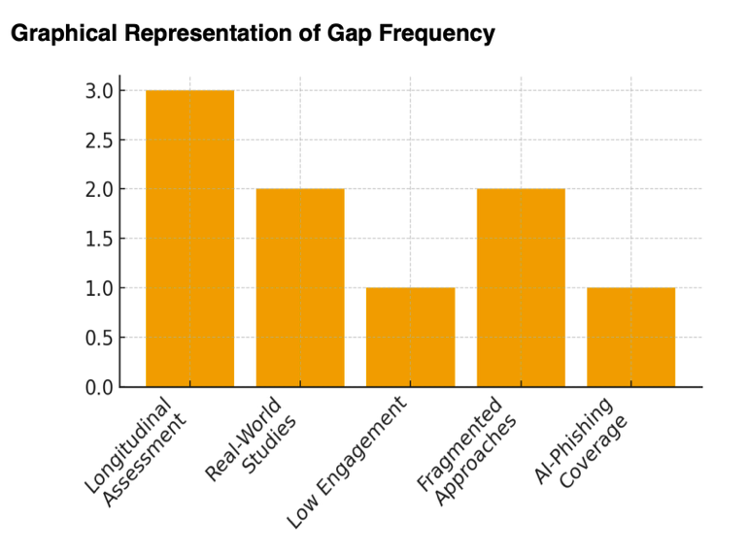
Gap Frequency

Slide 9
Methodology
Approach: Longitudinal, Mixed-Methods, Organization-based study
Phase 1: Pre-test of phishing vulnerability & behavior patterns
Phase 2: Training deployment (interactive + AI simulations)
Phase 3: Follow-up assessments at 1/3/6 months
Real workplace samples → more valid, practical results

Slide 10
Proposed Framework
Multi-Layered Human-Centric Security Awareness Model (MH-SDF).
Constant behavior monitoring + involvement monitoring.
AI-based adaptive phishing simulations.
Individualized learning plans of high-risk users.
Strengthened by building of organizational policies and culture.

Slide 11
Conclusion
Social engineering is more of a threat of people.
Conventional training is effective, though the effect is short-term.
Adaptive learning and long-term assessment are very important.
Resilience framework is proposed to enhance resistance + minimize vulnerability.
Future: deploy model in other industries and combine real-time threat intelligence.

Slide 12
References
(Hoetal.,2025).Understandingtheefficacyofphishingtraininginpractice [Conference paper / journal article]. University / Conference. https://people.cs.uchicago.edu/~grantho/papers/oakland2025_phishing- training.pdf
(Khadkaetal.,2025).Humanfactorsincybersecurity:Aninterdisciplinaryreview. Journal / Publisher. https://link.springer.com/article/10.1007/s10207-025-01032-0
Prümmer,J.,2024).Theeffectivenessofcybersecuritytraining(Master'sthesis/ Dissertation). University of Albany. https://scholarsarchive.library.albany.edu/cgi/viewcontent.cgi?article=1105&contex t=etd
(Marshalletal.,2024).Exploringtheevidenceforemailphishingtraining:Ascoping review. Computers & Security / Journal Name. https://www.sciencedirect.com/science/article/pii/S0167404823006053
(S. Liu,2023) Wi-Fi Energy Detection Testbed (12MTC),, gitHub repository. [Online]. Available: https://github.com/liustone99/Wi-Fi-Energy-Detection-Testbed-12MTC
(Mba, J. F.,2025, July 18). How to implement social Engineering Awareness Training. PurpleSec. https://purplesec.us/learn/social-engineering-awareness-training/
(Verizon,2024). 2024 Data breach investigations report. https://www.verizon.com/business/resources/reports/dbir/
(European Union Agency for Cybersecurity, 2023). Phishing: Attack trends and mitigation strategies. https://www.enisa.europa.eu/publications/phishing
(Li, Z., & Wang, H.,2024). AI-driven social engineering attacks: A survey of emerging threats and defenses. IEEE Access, 12, 12245–12262. https://ieeexplore.ieee.org/document/10411210

Slide 13
Secure Network Design and Implementation
CSCE 5585
Son Dang, Prakriti Dhungel, Ashwini Gondhi

Slide 14
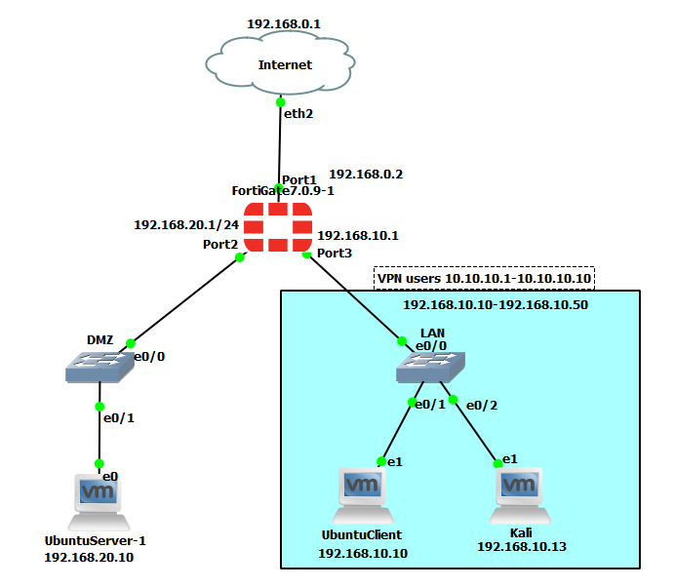
Network Environment
GNS3
FortiGate Firewall
DMZ switch
Lan switch
Servers and clients

Slide 15

Fortigate Firewall
Version 7.0.9
Allowed traffic from LAN to DMZ, LAN to internet, DMZ to internet
Block traffic from DMZ to LAN since DMZ is a public facing server
VPN and IPS functionality

Slide 16
VPN remote access
IP tunneling as part of the Firewall
Remote access for users outside the network
Users connect to private LAN network receive IP address range from 10.10.10.1 - 10.10.10.10

Slide 17
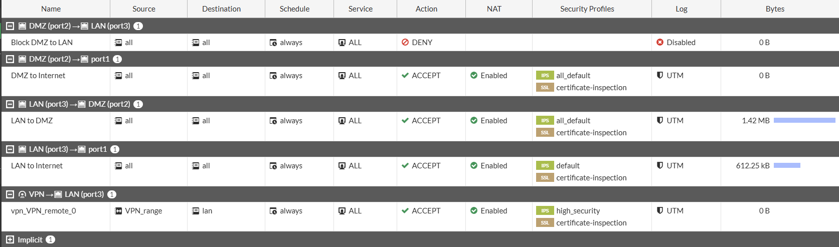
IDS/IPS configuration
Part of the FortiGate firewall functionality

Slide 18
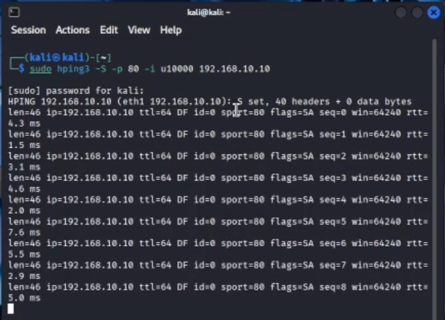
IDS/IPS (continued)
Additionally, we install Wireshark and Suricata on ubuntu client
Simulate a SYN attack using hping3 from Kali -> Ubuntu client

Slide 19
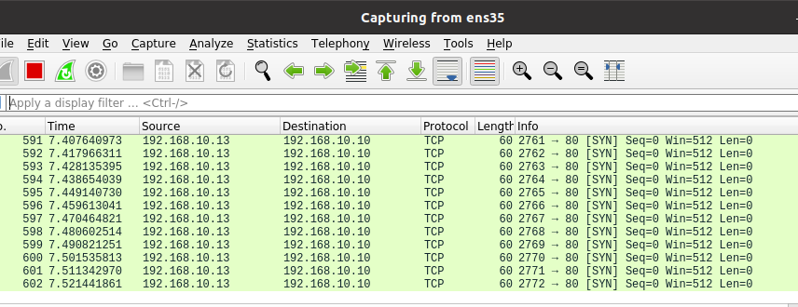
IDS/IPS(continued)
Detect using Wireshark

Slide 20
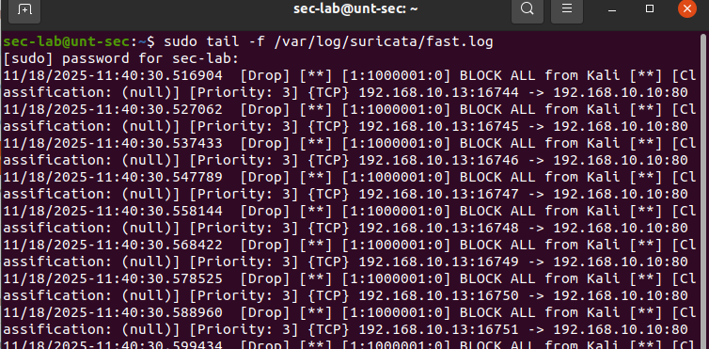
IDS/IPS(continued)
Prevent the attack using Suricata

Slide 21
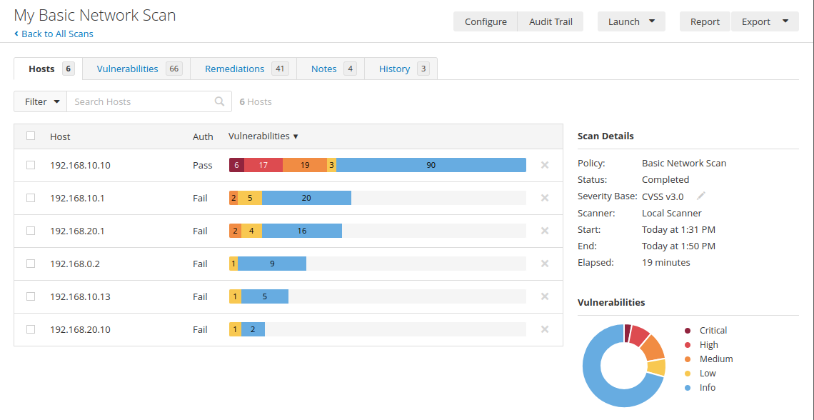
Testing and security assessment
Majority of the Critical/High/Medium are from Ubuntu local security as a result of EOL device and out of date packages from Ubuntu Client
For the network vulnerabilities: SSH weak algorithms and ICMP timestamp request which can allow attacker to map the network

Slide 22
For ICMP, filter ICMP timestamp requests and outgoing timestamp replies
Change the SSH Algorithms via FortiGate CLI
Update the packages in Ubuntu local machines
Mitigation Strategies

Slide 23
References
https://nvd.nist.gov/vuln/detail/CVE-1999-0524
https://nvd.nist.gov/vuln/detail/CVE-2019-0053

