Slide 1
Hardware Description Language Computing Units
2024.03.15 (Friday)

Slide 2
Outlines
Verilog HDL
Labs: Computing Units

Slide 3
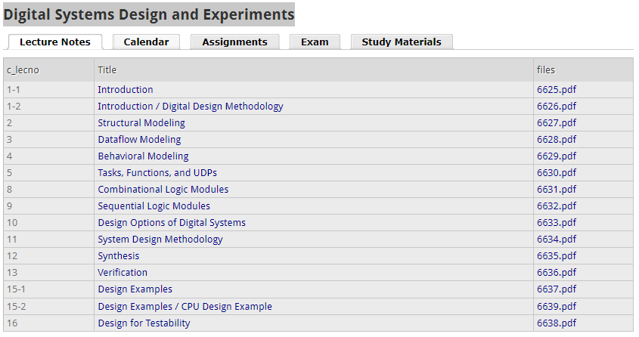
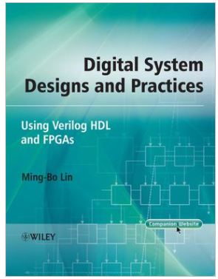
References
Class: Digital Systems Design and Experiments (https://ocw.snu.ac.kr/node/2390)
Books: Digital System Designs and Practices: Using Verilog HDL and FPGAs @Willy 2008

Slide 4
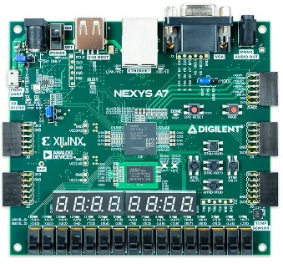
FPGA design flow
Tiny-YOLO3-AIX2022
Function Specification
Function simulation
Text editor: vim, notepad++, VS code
RTL simulator: ModelSim, ISE, Vivado
Behavioral Simulation
RTL design
Xilinx IP
Logic Synthesis
FPGA Implementation (ISE, Vivado)
Synthesize the design
Implementation: mapping, placement and routing
Optimization
Analyze timing, power, resources
Implementation
Timing Analysis
Power, Resource (DSPs, LUTs)
Generate bitstream
FPGA programming

Slide 5
Hardware Description Language (HDL)
HDL is an acronym of Hardware Description Language
Two most commonly used HDLs:
Verilog HDL (also called Verilog for short)
VHDL (Very high-speed integrated circuits HDL)
Features of HDLs:
Design can be described at a very abstract level.
Functional verification can be done early in the design cycle.
Designing with HDLs is analogous to computer programming.

Slide 6
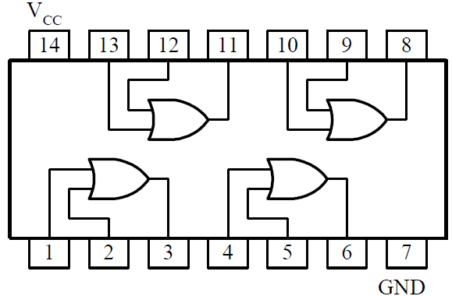
Modules – Hardware Module Concept
The basic unit of a digital system is a module.
Each module consists of:
a core circuit (called internal or body) ---performs the required function
an interface (called ports) ---carries out the required communication between the core circuit and outside.

Slide 7
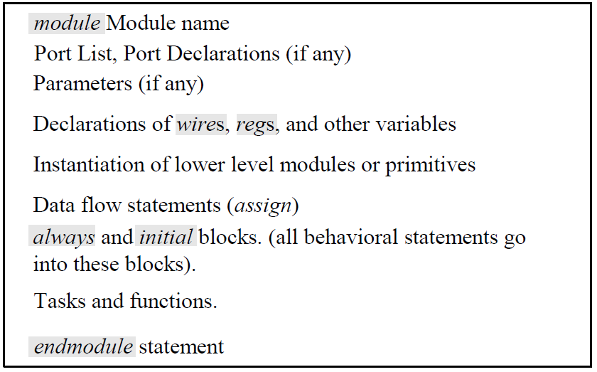
Modules –Verilog HDL modules
module---The basic building block in Verilog HDL.
It can be an element or a collection of lower-level design blocks.

Slide 8
Lexical Conventions
Sized number: <size>`<base format><number>
4`b1001 ---a 4-bit binary number
16`habcd ---a 16-bit hexadecimal number
Unsized number: `<base format><number>
2007 ---a 32-bit decimal number by default
`habc ---a 32-bit hexadecimal number
x or z values: x denotes an unknown value; z denotes a high impedance value.
Negative number: -<size>`<base format><number>
-4`b1001 ---a 4-bit binary number
-16`habcd ---a 16-bit hexadecimal number
”_” and “?”
16`b0101_1001_1110_0000
8`b01??_11?? ---equivalent to a 8`b01zz_11zz

Slide 9
Data types
A net variable
can be referenced anywhere in a module.
must be driven by a primitive, continuous assignment, force … release, or module port.
A variable
can be referenced anywhere in a module.
can be assigned value only within a procedural statement, task, or function.
cannot be an input or inout port in a module.

Slide 10
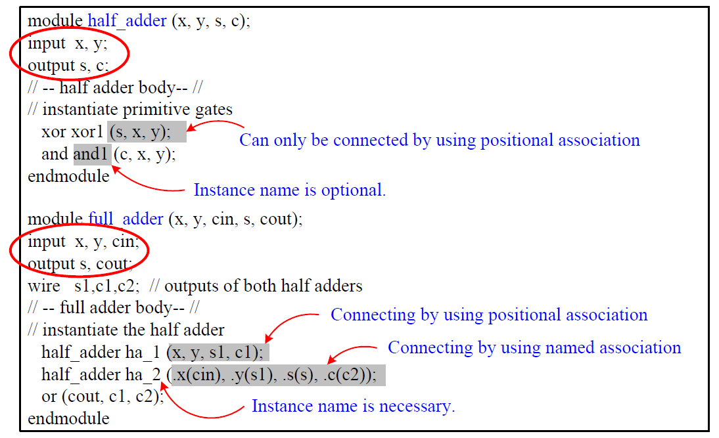
Port Declaration
Port Declaration
input: input ports.
output: output ports.
inout: bidirectional ports
Port Connection Rules
Named association
Positional association

Slide 11
Module Modeling Styles
Structural style
Dataflow style
Behavioral or algorithmic style
Mixed style
In industry, RTL (register-transfer level) means
RTL = synthesizable behavioral + dataflow constructs

Slide 12
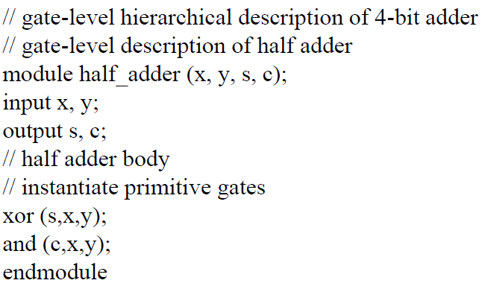
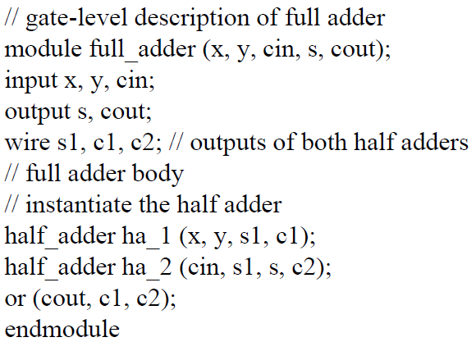
Structural modeling
Structural style
Gate level comprises a set of interconnected gate primitives.
Switch level consists of a set of interconnected switch primitives.
Hierarchical design

Slide 13
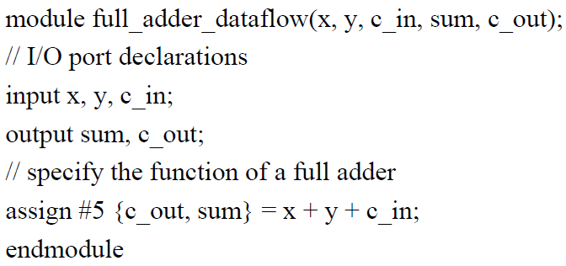
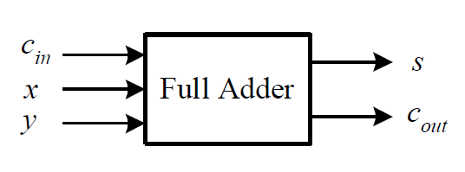
Dataflow modeling
Dataflow style specifies the dataflow (i.e., data dependence) between registers.
Use a set of continuous assignment statements
assign [delay] l_value = expression
delay: the amount of time between a change of operand used in expression and the assignment to l-value.
Continuous statement in a module execute concurrently regardless of the order they appear.

Slide 14
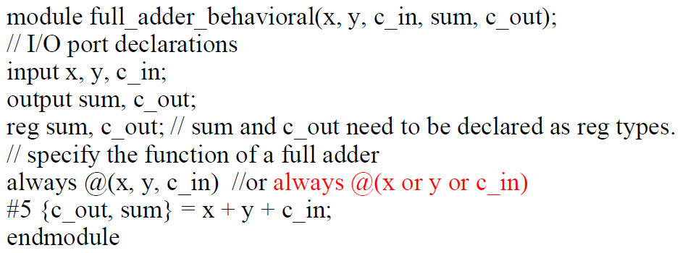
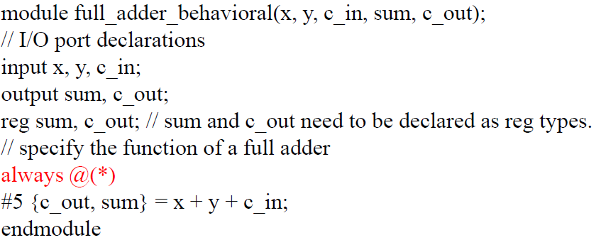
Behavioral modeling
Use two procedural constructs: initial and always
initial statement
Executed only once at simulation time 0
Used to set up initial value of variable data types
always statement
Executed repeatedly
At simulation time 0, both initial and always statements are executed concurrently.

Slide 15
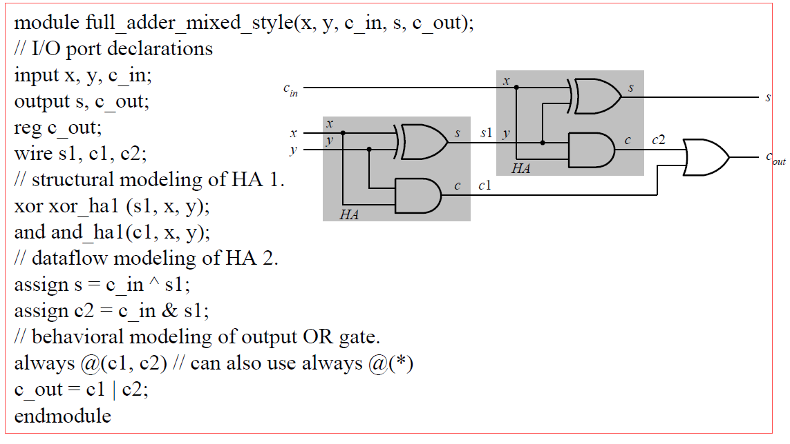
Mixed-Style Modeling
Mixed style is the mixing use of above three modeling styles.
Commonly used in modeling large designs.
structural
dataflow
behavioral

Slide 16
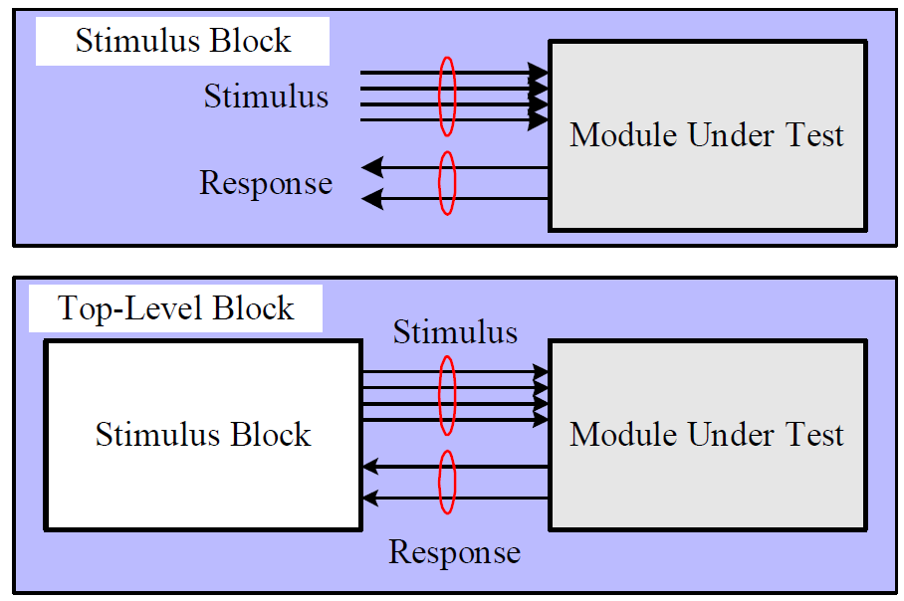
Simulation
Design
Simulation
Verification
Stimulus block: testbench
Unit under test (UUT)
Design under test (DUT)

Slide 17
System Tasks for Simulation
$display displays values of variables, string, or expressions
$display(ep1, ep2, …, epn);
ep1, ep2, …, epn: quoted strings, variables, expressions.
$monitor monitors a signal when its value changes.
$monitor(ep1, ep2, …, epn);
$monitoton enables monitoring operation.
$monitotoff disables monitoring operation.
$stop suspends the simulation.
$finish terminates the simulation.

Slide 18
Time Scale for Simulations
Time scale compiler directive
`timescale time_unit / time_precision
The time_precision must not exceed the time_unit.
Example:
with a timescale 1 ns/1 ps, the delay specification #15 corresponds to 15 ns.
It uses the same time unit in both behavioral and gate-level modeling.
For FPGA designs, it is suggested to use ns as the time unit.

Slide 19
Outlines
Verilog HDL
Labs: Computing Units

Slide 20
Labs
Lab 1: DSP
How to use Vivado IP integrator to generate a DSP?
How to test a DSP unit?
Lab 2: MAC
Multipliers and an adder tree
MAC
Lab 3: Computing units

Slide 21
Lab 1: DSP
Build a multiplier based on a DSP generated by Vivado IP generator
Generate a DSP
Use it to build a multiplier
Make a testbench
Test the multiplier

Slide 22
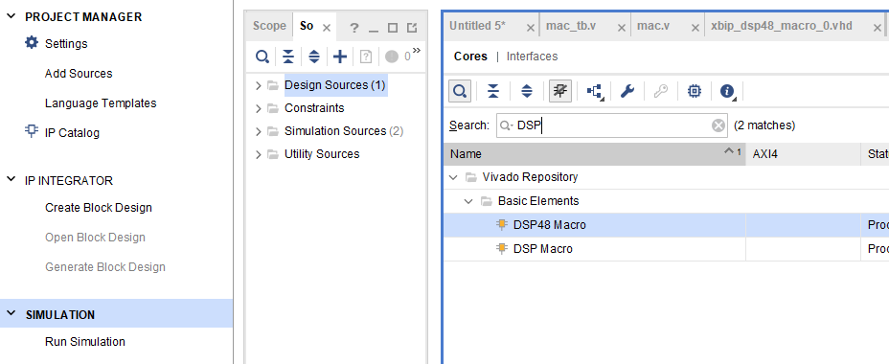
Creating a DSP using Xilinx IP generator
Click “IP Catalog” on Vivado
Search “DSP”
Choose “DSP48 Marco” and double click on it
2
1
3

Slide 23
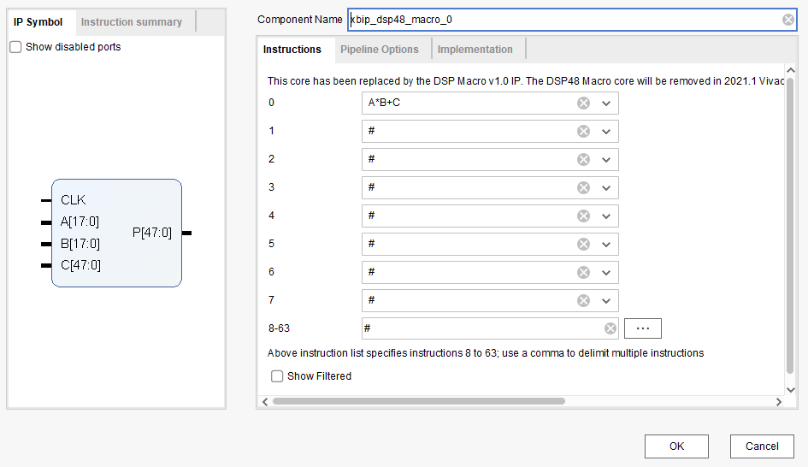
Creating a DSP using Xilinx IP generator
The name of the generated DSP
DSP formula
P = A* B+C
Ports of the DSP
Inputs:
CLK
A[17:0], B[17:0]
C[47:0]
Output:
P[47:0]

Slide 24
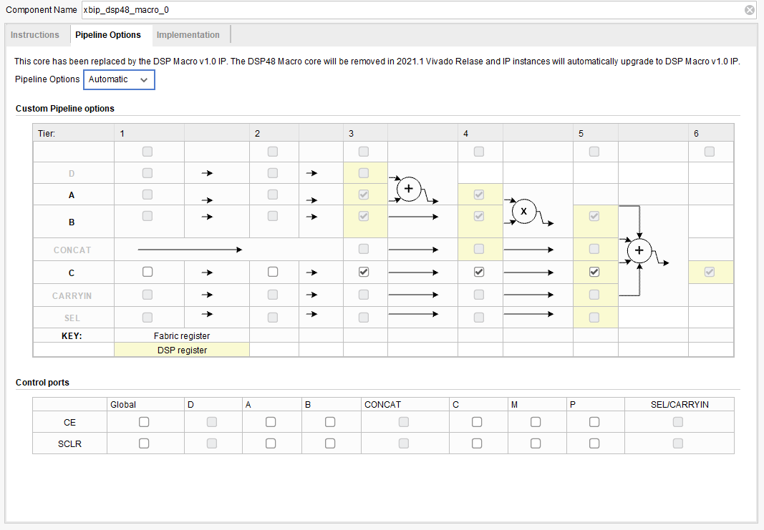
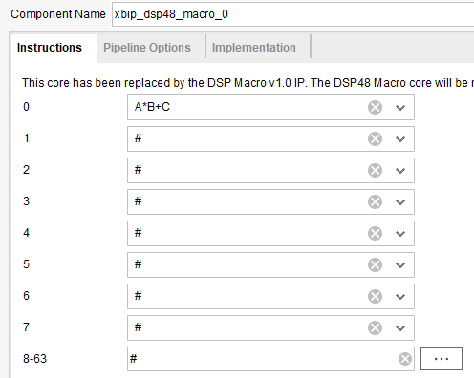
DSP configuration
Pipeline registers (4-cycle delay between an input and an output)
We can choose a specific formula

Slide 25
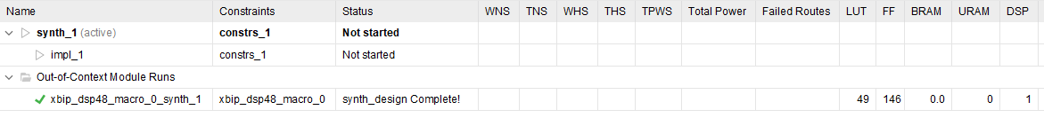
Creating a DSP using Xilinx IP generator
Click “OK” and then “Generate” on the popup window
A DSP is generated
One DSP is used
Hardware resource
Click

Slide 26
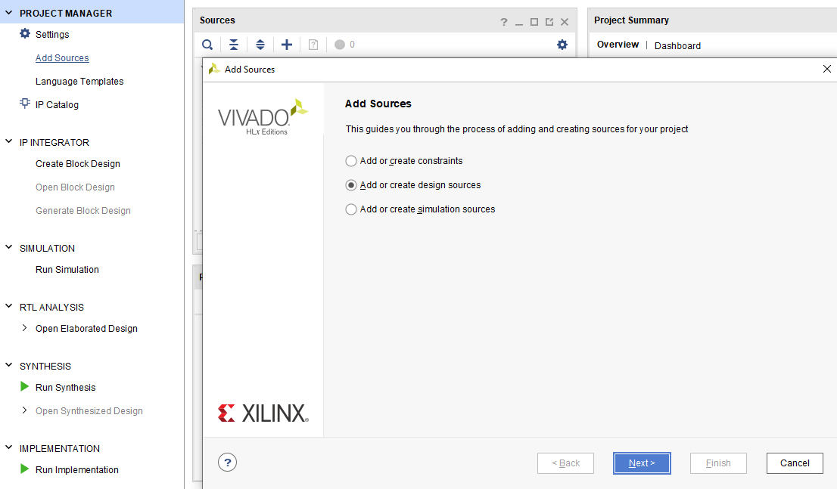
Multiplier (mul.v)
Choose “Add sources” >> “Add or create design sources” >> Click “Next”

Slide 27
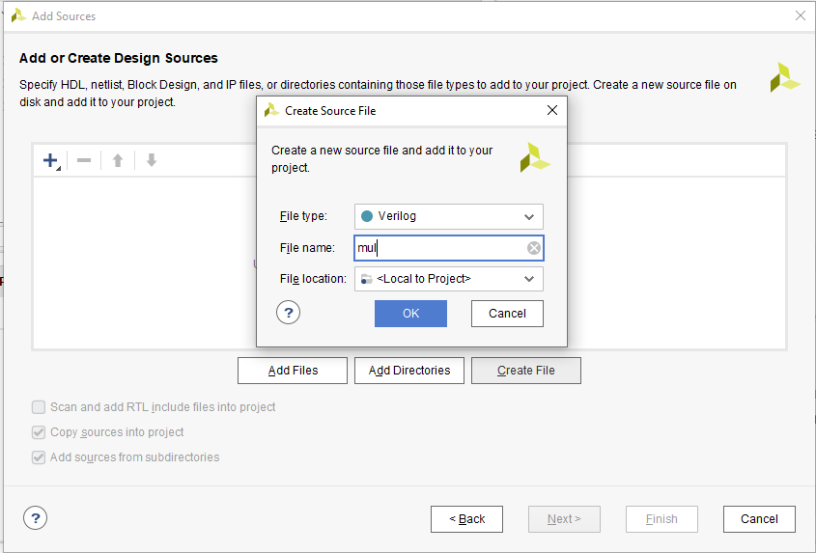
Multiplier (mul.v)
Click “Create File” >> Make a file name “mul” in “Verilog” >> click “OK”
Note: the “mul” code is given.
2
3
1

Slide 28
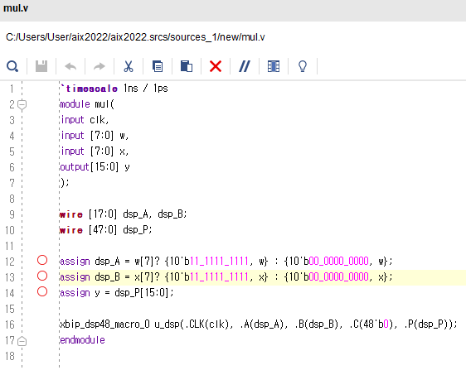
Multiplier (mul.v)
Inputs:
clk // Clock
w[7:0] // Weight
x[7:0] // Input pixel
Output:
y[15:0] // Product
Make inputs and outputs for the DSP
Negative
Positive
2’s complement for a negative number
A DSP instance

Slide 29
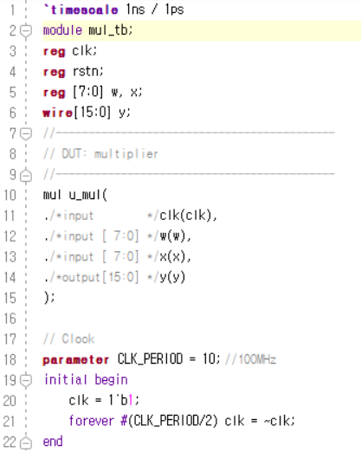
Testbench (mul_tb.v)
Time scale: 1ns
Registers (e.g. clk, w, x) are connected to the inputs
A wire (e.g., y) is connected to the output
Design under test:
multiplier (mul)
A clock signal is defined in an “initial” block
Initialized at 1
State is changed at every 5ns
Clock: 100MHz
(Period = 10ns)

Slide 30
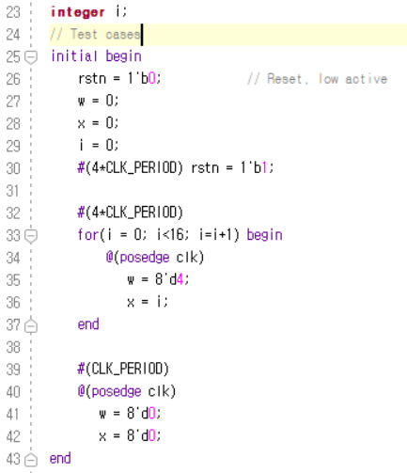
Testbench (mul_tb.v)
Initialized states
Set all registers to default values
Generate test cases in 16 cycles
w: 4
x: 0 -> 1 -> 2 -> … -> 15

Slide 31
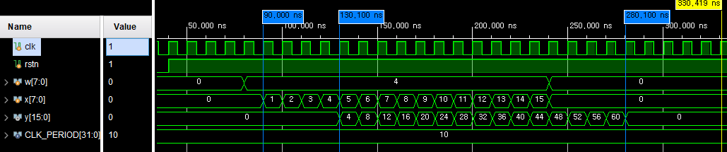
Waveform
In Tab “Simulation”, click on “run simulation” >> “Run behavioral simulation”
Visualize the waveform
Weight (w) is set to 4 in 16 cycles (e.g., 70~230ns)
During the 16 cycles, x is set from 0 to 15
The result (y) is 0, 4, …, 60
For a given input, its output comes out after 4 cycles (e.g., DSP’s pipelined registers)

Slide 32
Lab 2: MAC
Build a MAC
Use multiple multipliers
Adder tree
Make a testbench
Test the MAC

Slide 33
DNN accelerator
Processing Element (PE) Array
An array of multiplication and accumulation (MAC).
Perform convolution operations.
Computing unit or “ALU” of a DNN accelerator
BUS
On-chip buffers (Weight/Input/Output)
Input Fetcher
Weight Fetcher
Norm/Activation
PE
Adder Tree
…
Computing
Elements
Processing Elements (PEs)

Slide 34
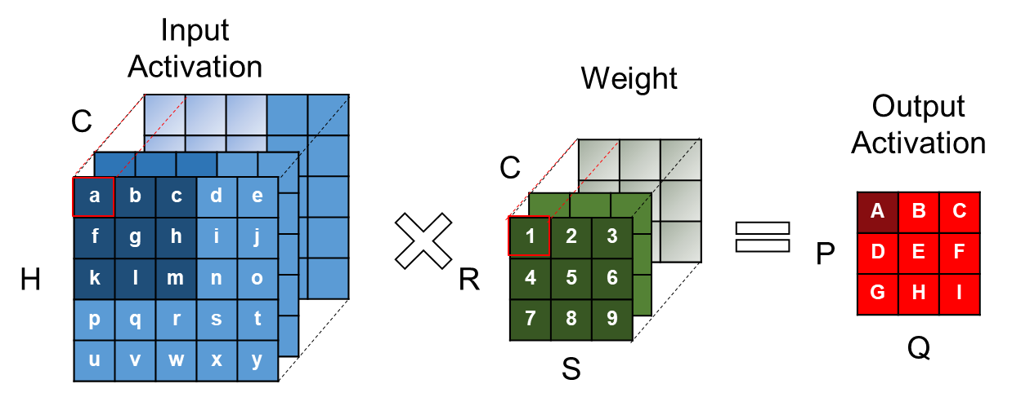
MAC
MAC is a module that performs many multiplications and accumulations in parallel.
Review: convolution
From this example, to calculate output pixel A, we need to calculate:
(a*1 + b*2 + … + m*9) + (a’*1’ + b’*2’ + … + m’*9’) + … + (a’’*1’’ + b’’*2’’ + … + m’’*9’’)
lots of multiplication / accumulation!
a’’
b’’
c’’
a’
b’
c’
1’’
2’’
3’’
1’
2’
3’
6’’
9’’

Slide 35






A simple MAC
In this tutorial, we will give and explain an example MAC module that calculates 16 multiplications and accumulations every cycle.
Inputs are 8 bit 2’s complement numbers
and the output is a 20 bit 2’s complement number
weight
weight
weight
$$…$$
input
input
input
MAC
$$…$$
$$…$$
$$…$$
$$…$$
$$…$$
$$…$$
output

Slide 36

A simple MAC
Compute a sum of 16 products
$$Y=\sum_{i=0}^{15}{w_{i}}∗x_{i}$$
Pseudo code
$y_{0}^{\left(0\right)}= w_{0}∗x_{0},…,y_{15}^{\left(0\right)}= w_{15}∗x_{15}$ // N multipliers
$y_{0}^{\left(1\right)}=y_{0}^{\left(0\right)}+y_{1}^{\left(0\right)},…,y_{7}^{\left(1\right)}=y_{14}^{\left(0\right)}+y_{15}^{\left(0\right)}$ // N/2 adders
$y_{0}^{\left(2\right)}=y_{0}^{\left(1\right)}+y_{1}^{\left(1\right)},…,y_{3}^{\left(2\right)}=y_{6}^{\left(1\right)}+y_{7}^{\left(1\right)}$ // N/4 adders
$y_{0}^{\left(3\right)}=y_{0}^{\left(2\right)}+y_{1}^{\left(2\right)},…,y_{1}^{\left(3\right)}=y_{2}^{\left(2\right)}+y_{3}^{\left(2\right)}$ // N/4 adders
$y_{0}^{\left(4\right)}=y_{0}^{\left(3\right)}+y_{1}^{\left(3\right)}$ // N/4 adders
${Y= y}_{0}^{\left(4\right)}$ // Output

Slide 37
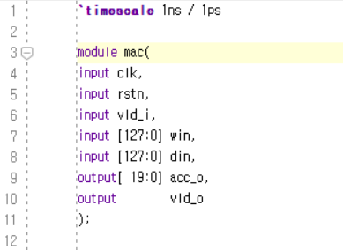

MAC (mac.v)
Compute a sum of 16 products
$$Y=\sum_{i=0}^{15}{w_{i}}∗x_{i}$$
Ports
clk, rstn: clock and reset signals
vld_i: a valid signal for inputs (e.g., win, din)
Inputs win, din
win[7:0] = $w_{0}$, din[7:0] = $x_{0}$
win[15:8] = $w_{0}$, din[15:0] = $x_{0}$
…
Outputs
Accumulated result (acc_o)
A valid signal (vld_o)

Slide 38
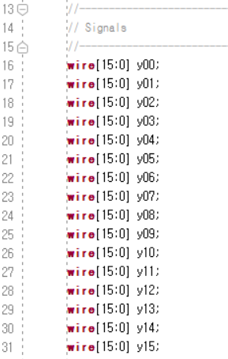
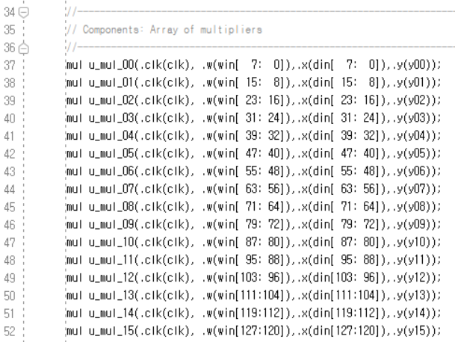

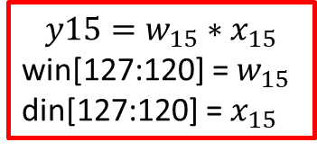
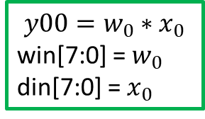
Multiplication (mac.v)
Compute a sum of 16 products
$$Y=\sum_{i=0}^{15}{w_{i}}∗x_{i}$$
Internal signals
16 multipliers running in parallel
$${y00=w}_{0}∗x_{0}$$
win[7:0] = $w_{0}$
din[7:0] = $x_{0}$
$${y15=w}_{15}∗x_{15}$$
win[127:120] = $w_{15}$
din[127:120] = $x_{15}$

Slide 39
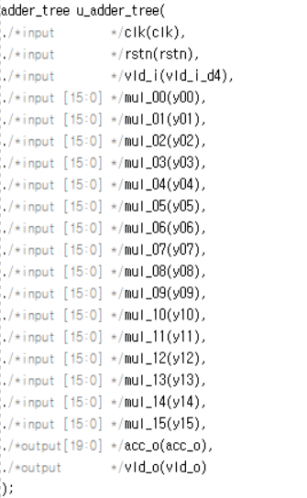
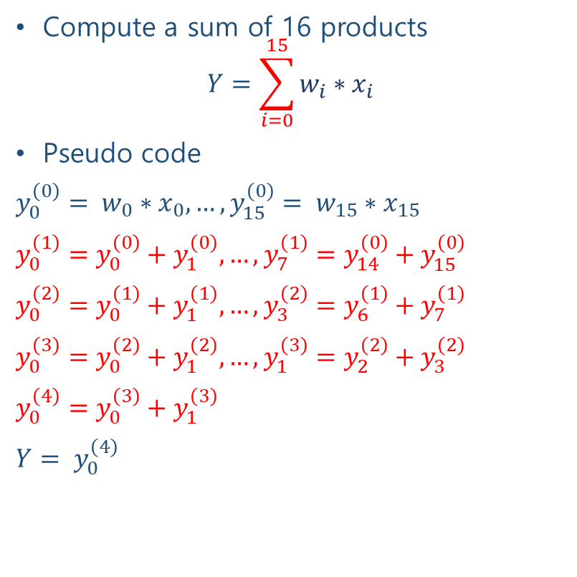
Accumulation (mac.v)
Compute a sum of 16 products
$$Y=\sum_{i=0}^{15}{w_{i}}∗x_{i}$$
Pseudo code
$y_{0}^{\left(0\right)}= w_{0}∗x_{0},…,y_{15}^{\left(0\right)}= w_{15}∗x_{15}$
$y_{0}^{\left(1\right)}=y_{0}^{\left(0\right)}+y_{1}^{\left(0\right)},…,y_{7}^{\left(1\right)}=y_{14}^{\left(0\right)}+y_{15}^{\left(0\right)}$
$y_{0}^{\left(2\right)}=y_{0}^{\left(1\right)}+y_{1}^{\left(1\right)},…,y_{3}^{\left(2\right)}=y_{6}^{\left(1\right)}+y_{7}^{\left(1\right)}$
$y_{0}^{\left(3\right)}=y_{0}^{\left(2\right)}+y_{1}^{\left(2\right)},…,y_{1}^{\left(3\right)}=y_{2}^{\left(2\right)}+y_{3}^{\left(2\right)}$
$y_{0}^{\left(4\right)}=y_{0}^{\left(3\right)}+y_{1}^{\left(3\right)}$
${Y= y}_{0}^{\left(4\right)}$
Internal signals

Slide 40
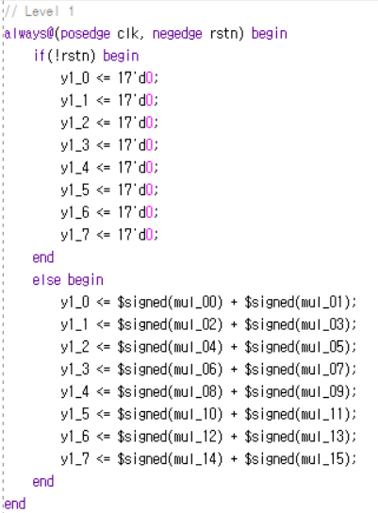
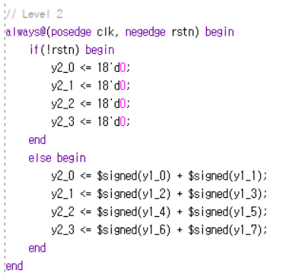
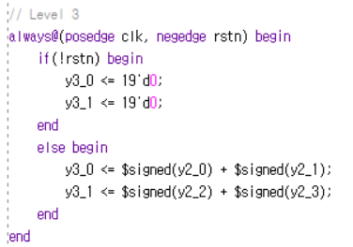
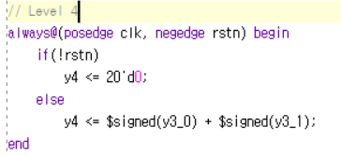

Accumulation (adder_tree.v)
Compute a sum of 16 products
$$Y=\sum_{i=0}^{15}{w_{i}}∗x_{i}$$

Slide 41
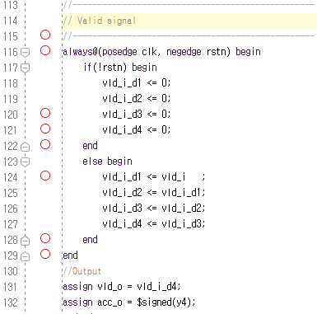
Delays
Calculating delayed valid signals
vld_i: when high, indicates that win and din are valid inputs, and must be calculated
Delays in the adder tree (adder_tree.v)
vld_d: an internal variable to calculate the timing for vld_o to be high
vld_o: when high, indicates that output acc_o is a valid calculation result

Slide 42
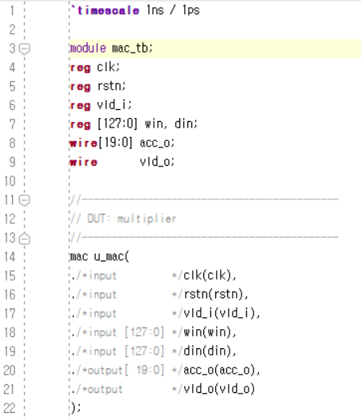
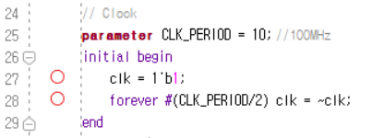
Test bench (mac_tb.v)
Time scale: 1ns
Registers (e.g. clk, win, din) are connected to the inputs
Wires (e.g., acc_o, vld_o) are connected to the output
Clock: 100MHz
A clock signal is defined in an “initial” block
Initialized at 1
State is changed at every 5ns
Design under test: mac

Slide 43
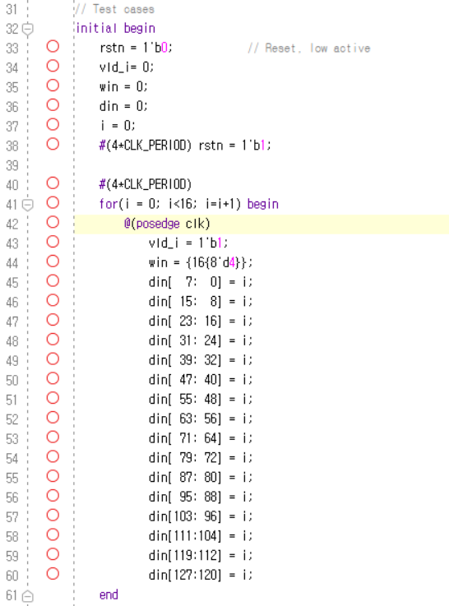
Test bench (mac_tb.v)
Initialized states
Set all registers to default values
Generate test cases in 16 cycles
w: 4
x: 0 -> 1 -> 2 -> … -> 15
Note: we have 16 weights and 16 inputs now.

Slide 44
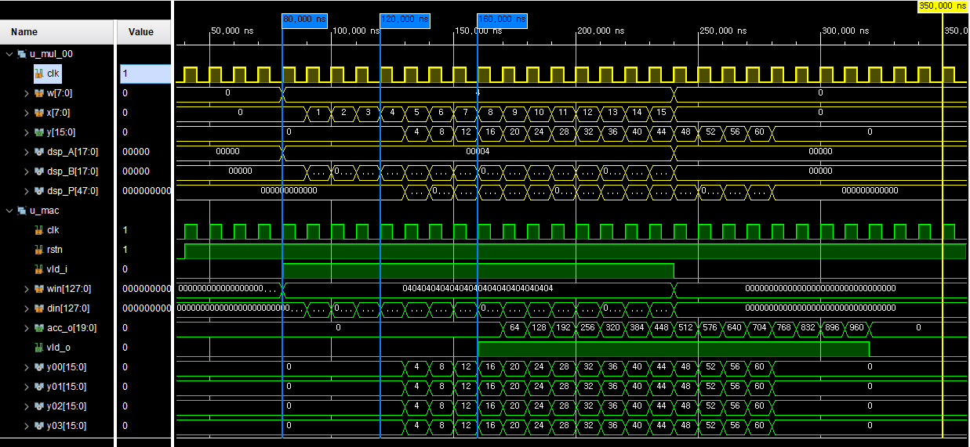
Waveform

Slide 45
Waveform
Visualize the waveform
Weight (w) is set to 4 in 16 cycles (e.g., 70~230ns)
During the 16 cycles, x is set from 0 to 15
The result (y) is 0, 4, …, 60
For a given input, its output comes out after 4 cycles (e.g., DSP’s pipelined registers)

Slide 46
Waveform
Visualize the waveform
Weight (w) is set to 4 in 16 cycles (e.g., 70~230ns)
During the 16 cycles, one input is set from 0 to 15
The result (acc_o) is 0, 64, …, 960
For a given input, its output comes out after 8 cycles

Slide 47
Lab 3: Convolutional layer (Practice)
Convolutional layer
Use four MAC modules
Initialize four sets of filters
Read an image from file
Do convolution

Slide 48
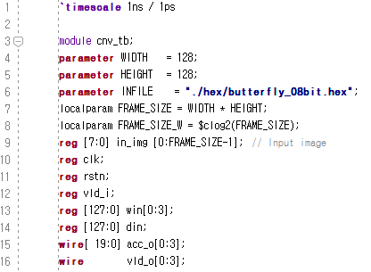
Convolutional layer (cnv_tb.v)
Parameters for an image file, e.g., WIDTH, HEIGHT, file location (INFILE), frame/image size
A buffer to store an image (in_img)
Internal signals
clk, rstn,
vld_i, din[127:0]
Four sets of filters win[0:3][127:0]
acc_o[0:3][19:0]
vld_o[0:3]

Slide 49
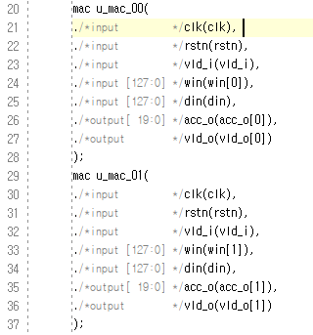
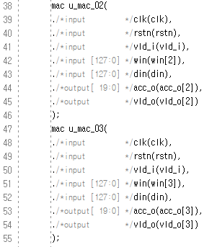
Convolutional layer (cnv_tb.v)
There are four MAC instances
Each module:
Uses one set of convolutional filters, e.g., win
Outputs a specific acc_o

Slide 50
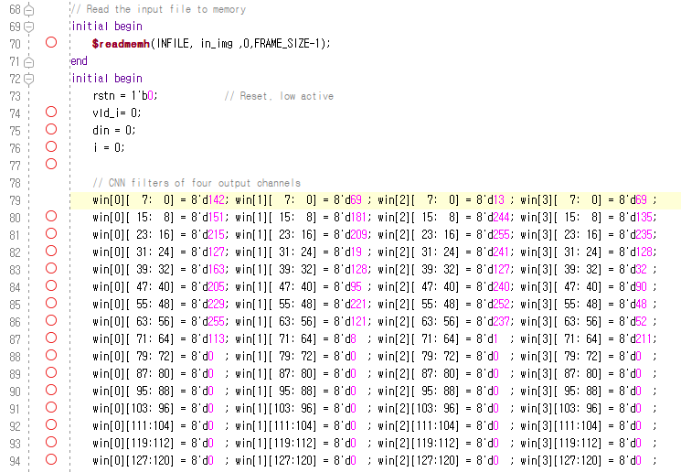

Convolutional layer (cnv_tb.v)
Read the hex file into a buffer
Initialize four set of convolutional filters
Come from a quantized model

Slide 51

Waveform
Make code to generate din

