Slide 1

Project
Proposal
0Th Review

Slide 2


VISVESVARAYA TECHNOLOGICAL UNIVERSITY
Jnana Sangama, Machhe, Belagavi-590018
Project Proposal Presentation
On
“Face Detection Along With Thermal Screening & Attendance At Entrances”
Submitted in partial fulfilment for the award of the Degree (18CSP77) of
Bachelor of Engineering in
Computer Science and Engineering
DEPARTMENT OF COMPUTER SCIENCE AND ENGINEERING
HKBK COLLEGE OF ENGINEERING
(Approved by AICTE & Affiliated to VTU, Belgaum)
22/1, Opp. Manyata Tech Park, Nagawara, Bangalore-560045
Email: info@hkbk.edu.in URL: www.hkbk.edu.in

Slide 3




Sonam Dorji
1HK19cs151
Sonu Kumar S
1HK19CS152
MEMBERS
Surankan Chakraborty
1HK19CS159
(Team Leader)
Sunil Nagar
1HK19CS158

Slide 4

ABSTRACT
Problem: There is a manual thermal checkup at almost every public place. There is no automated public CCTV filtering of people's identities with sequential logging.
Solution: A camera ecosystem which is automated and integrated to detect individuals by their prerecorded facial biometrics, check their heat signature against a threshold, and record that as attendance in a database with the hash of said individual.

Slide 5




OBJECTIVES
Attendance
Logging of the individual with the temperature and timestamp in a database.
Thermal Mapping
Map the heat level of individuals against a threshold
Mask Detection
Detect Masks and obstructions to the face
Facial Recognition
Have to detect registered faces

Slide 6
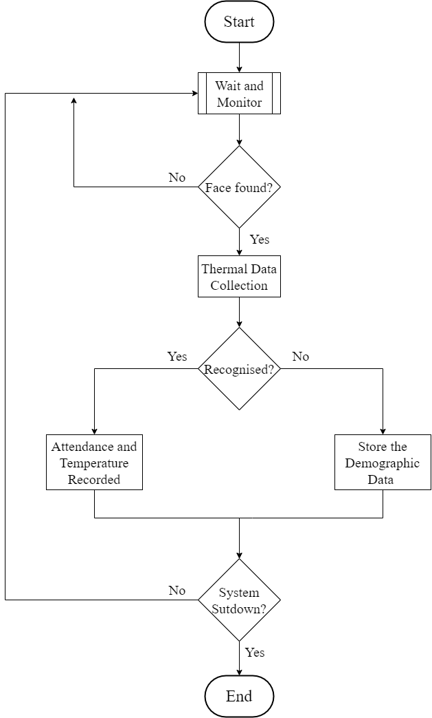


Methodology

Slide 7
Thank You

