Slide 1
ANOTHER ATTEMPT

Slide 2
Important Terms
L
R
α
γ

Slide 3
Key realisations

Slide 4
OBSERVATION 1
standard vamana search fixes Same alpha and R for every node

Slide 5
Stage-1: Adaptive Edge Pruning
the value of alpha and R.
We use adaptive alpha and R for each node instead of fixed values.

Slide 6
What is ρ?
In a given dataset, every node will have a value of ρ.
For every node in a dataset, ρ is a constant value for a given value of “m”.

Slide 7
m and ρ
ρ = distance to nearest mth neighbour/distance to nearest neighbour
m is a value we choose

Slide 8
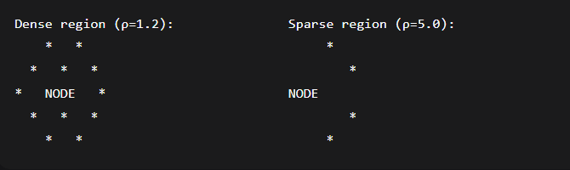
Neighbourhood of a Node

Slide 9
New α
α_u = α_min + (α_max - α_min) / (1 + e^(-β × (ρ_u - ρ_med)))

Slide 10
New R
R_u = clamp( R_base × (1 + γ × log(ρ_u / ρ_med)), R_min, R_max )
clamp(value, min, max) = if value < min → return min
if value > max → return max
else → return value

Slide 11
OBSERVATION 2
Better start plays role.

Slide 12
Stage-2: Highway Network
Instead of starting search from a random point, we assign certain number
pivots(~√N) in the graph evenly spread.
When we were given a query we start the search from the nearest pivot from
that query vector.

Slide 13
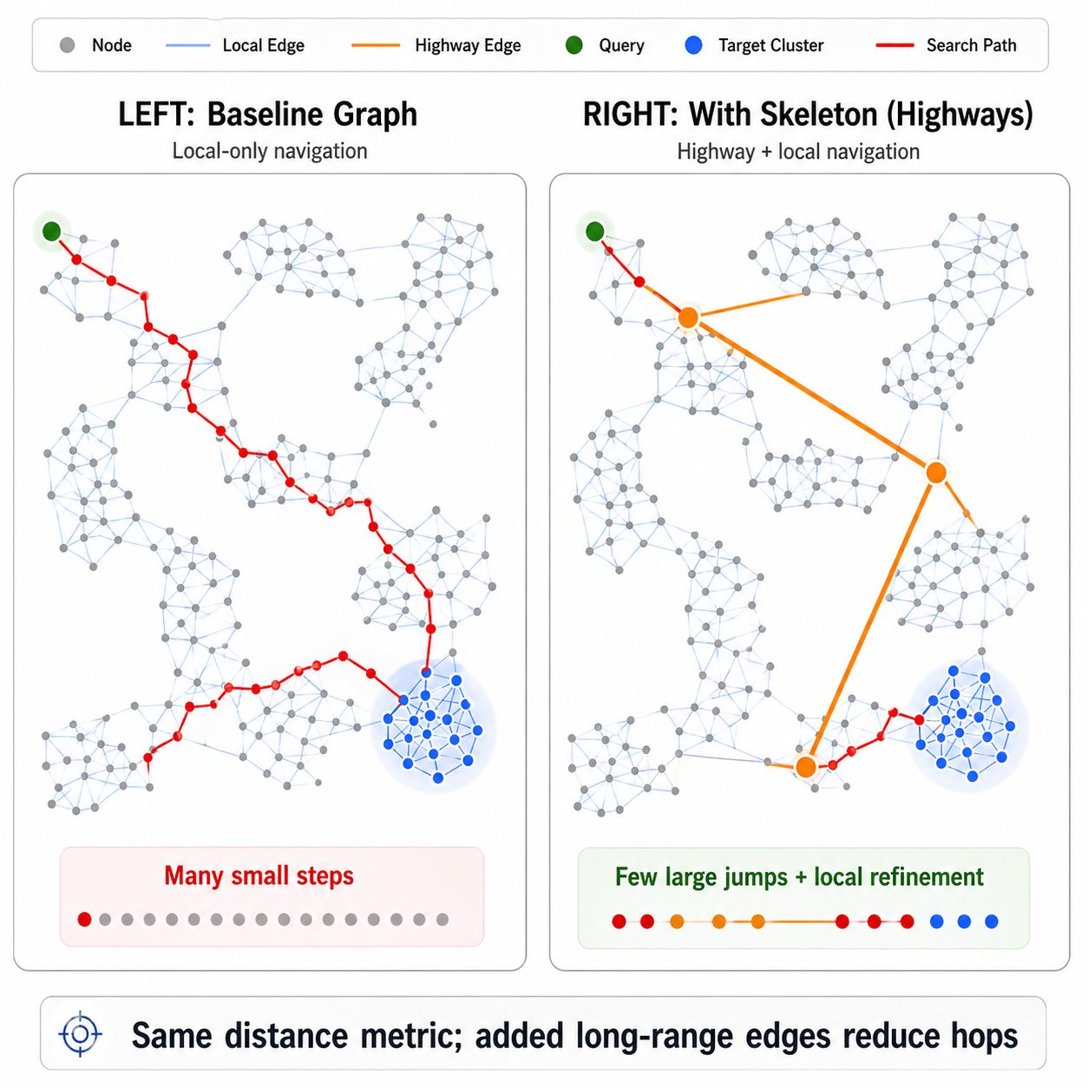

Slide 14
Stage-3: Setting data to pivots
Since we have the pivots now, let’s try to assign some “pivot space” for each
pivot which helps us to find the closest pivot for a given query vector.
How do we do that ?
We’ll look at the cluster of the Graph.

Slide 15
Centroid: Centroid of Cluster
Spread: Tells us about how scattered the data is around the Centroid
Representative: Closest data_point in that dataset to the Centroid
Now let’s try to create pivot space for each pivot, we need to follow these
steps:

Slide 16
Creating a set of vectors
Create/Synthesise our own vectors:
We’ll map each of these synthetic_vectors to the closest pivots and the region where every synthetic_vector mapped to a pivot is called it’s pivot space.
Now since we have these pivot spaces, this makes it alot better. How?
synthetic_vector = centroid + random_noise * spread

Slide 17
Does this solution work significantly good for all values of r and L?

Slide 18
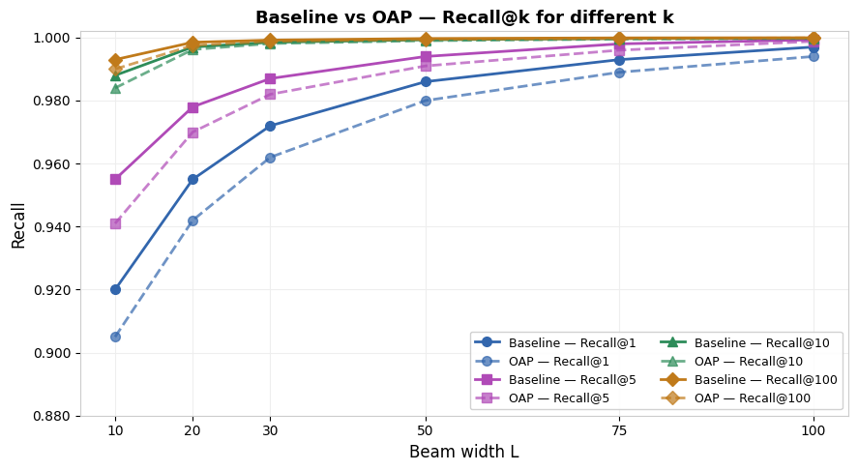
Different R

Slide 19
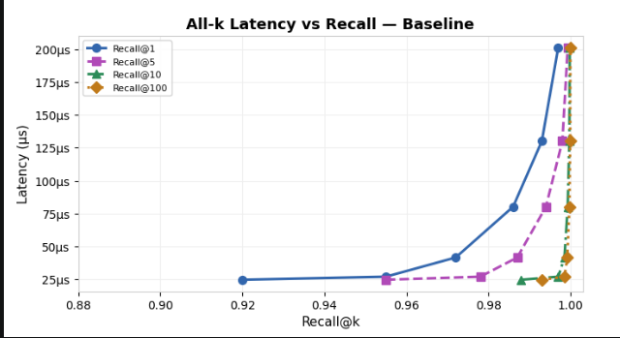

Slide 20
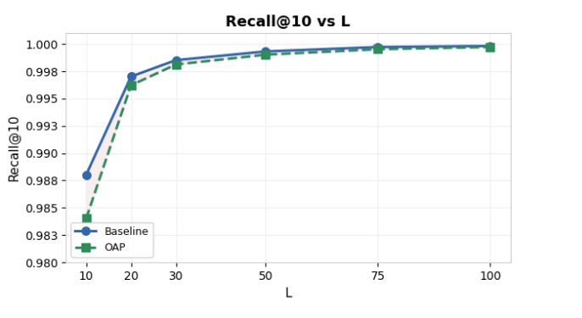
Recall at r=10

Slide 21
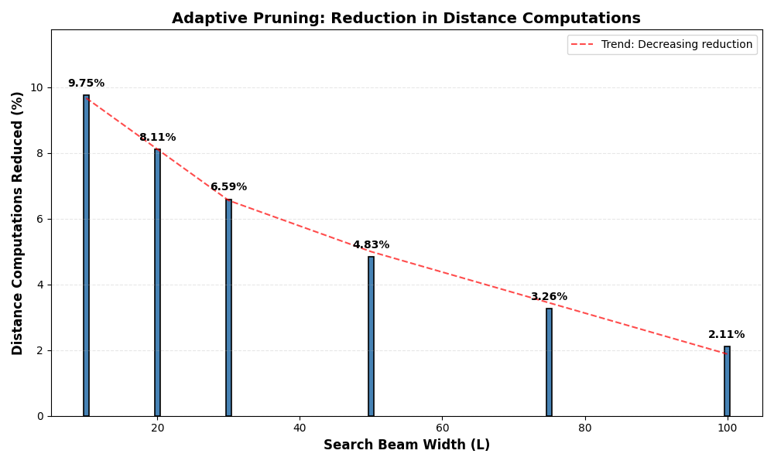

Slide 22
Is This Method Good?

Slide 23
Advantages
It runs Fast.
It can get good accuracy for most of the cases.

Slide 24
Disadvantages
There might be a problem at the edges of pivot spaces.
Might fail for extreme cases.

