Slide 1

SHTT Team

Slide 2

Story
In the football match, bird is a coach.

Slide 3
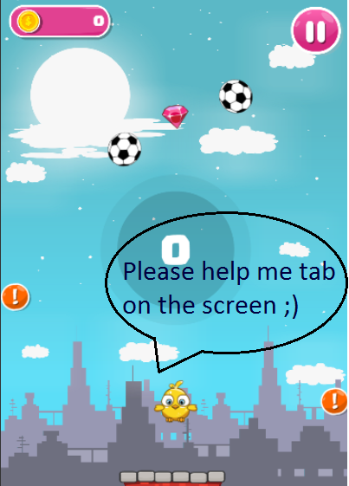
Bird jump in the stadium and try
to avoid balls.
Collect more coins and rubies.

Slide 4


Game players: Select one bird in this sheet
Game challenging: fly and avoid to impact crazy balss

Slide 5
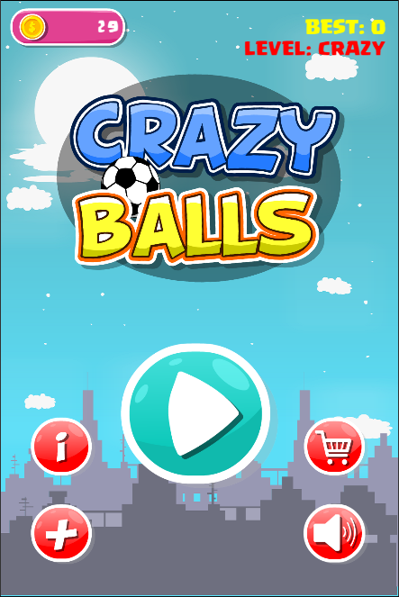
Main menu
Collected coins. Using to buy player or revive.
Best score and current level choosing
Play button.
Click to play game
Team’s information
Shopping for buying player
Level challenging
Sound on/off

Slide 6
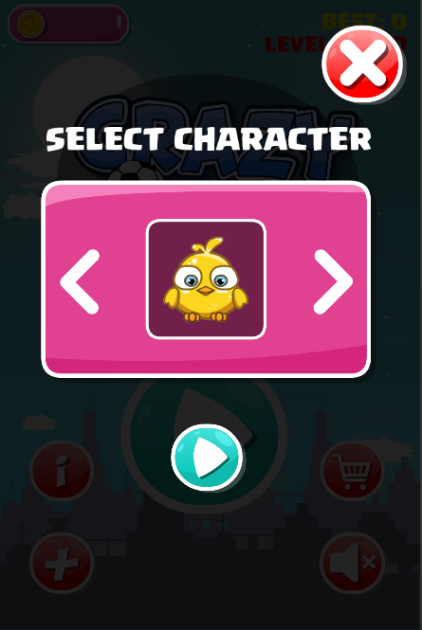
Shop screen
Back to Main Menu
Your bird image
Choose the bird you want
Click to play

Slide 7
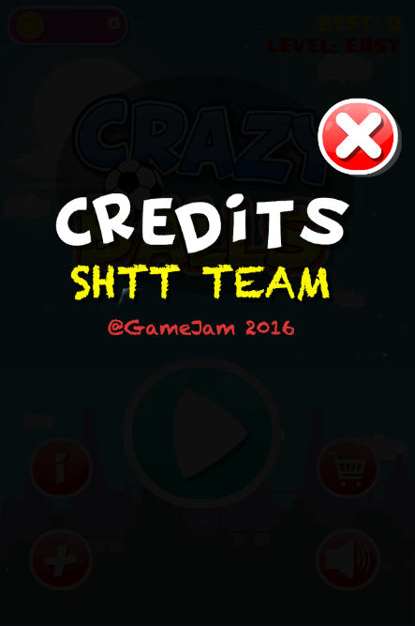
About screen

Slide 8
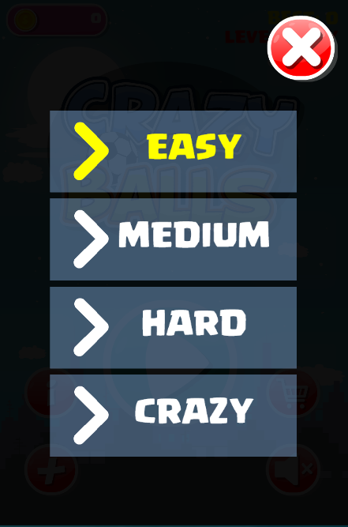
Game mode screen

Slide 9
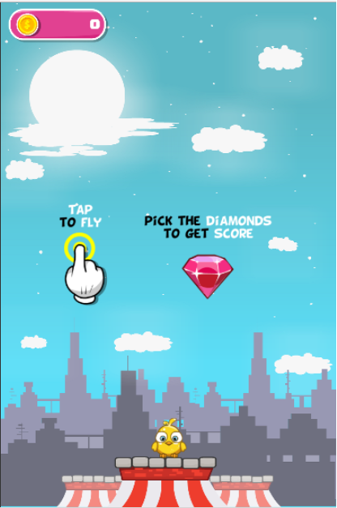
Tutorial screen
The tutorial will show at the first time you start the game

Slide 10
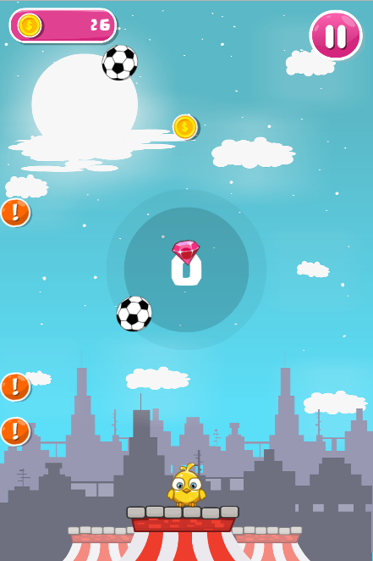
Playing screen
Collected coins. Using to buy player or revive.
Pause game
Coin.
Try to fly to collect it.
Game will be ended if your bird impacts this crazy ball
Diamond.
Using for counting score.
Notice you before crazy ball appears
Score.
This will be added by 1 when you collect 1 diamond
Player – your bird

Slide 11
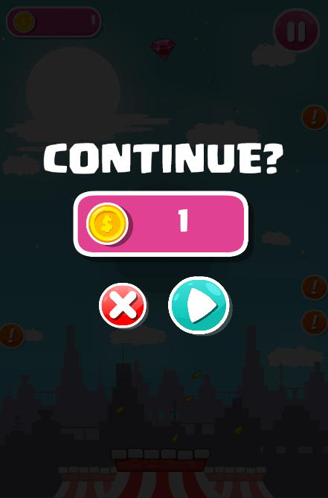
Continue screen
The coin to revival

Slide 12
Now is time to play our game
Let enjoy ;)

