Slide 1
한양또래튜터링 파이썬 개발
소프트웨어학부 17 Minwoo Son
mwson987@gmail.com
010-5756-5692
Notes:
Hello. My name is Minwoo Son, who is participating in this winter internship. Let's start the presentation now.

Slide 2
Index.
Introdution
Environment setting
Why python?
Notes:
The order of presentation is as follows.

Slide 3
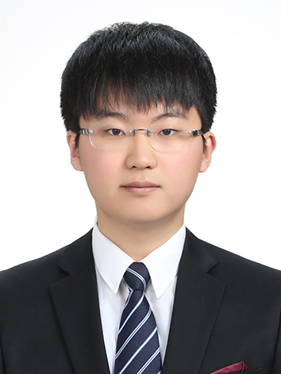
본인 소개
경력
Major career
2021. 12 ~ 2022. 02 : (前) Lablup Inc. Intern
2021. 02 ~ 2021. 11 : 코딩교실 파이썬 교사
2019. 05 ~ 2020. 12 : 국방부 직할 국군지휘통신사령부(Korean Communication Command) SW개발병 웹개발 담당
2018. 06 ~ 2019. 02 : Best of the best 차세대 정보보호리더양성 프로그램 보안컨설팅트랙 7기 수료
2017. 03 ~ : 한양대학교 ERICA캠퍼스 소프트웨어학부
Major projects & Qualifictions
2021. 11 : 정보처리기사
2020. 08 : 전투력측정 시각화시스템 풀스택 구축
2020. 07 : 정보보안산업기사
2019. 12 : 인공지능 전자소모품 소모예측 창고관리시스템 구축
2019. 08 : 전국 MW(마이크로웨이브)수신 통합관리시스템 웹 콘솔 백엔드 개발
2019. 02 : 한국정보보호학회지(JKIISC) ‘안드로이드 악성 앱 탐지율 향상을 위한 특성 분석 및 기계학습 모델에 관한 연구‘ 게재
Notes:
First of all, my introduction. I did these activities before joining Revel Up.

Slide 4
본인 소개
수상
수상 실적
2022. 02 : 제 15회 소프트웨어 역량검정 한양대학교 총장상
2021. 05 : 한양대학교 SW포트폴리오 경진대회 우수상
2020. 06 : 한양대학교 SID-Audition SID상
2019. 12 : 군장병 공개SW역량강화 해커톤 해군참모총장상 (Naval Chief of Staff Award)
2019. 12 : 한양대학교 전공창업경진대회 대상 (Grand prize)
2018. 12 : 2018 ERICA Software-Up Programming Contest 최우수상 (First prize)
Notes:
First of all, my introduction. I did these activities before joining Revel Up.

Slide 5
튜터링 소개
학기 계획
전반기
1주차 : 멘토 소개, 환경 세팅, 파이썬 개요
2주차 : 자료형과 제어문
3주차 : 입출력 및 클래스
4주차 : 자료구조 및 알고리즘
5주차 : 파이썬 프로젝트 1
6주차 : 핵심 알고리즘
7주차 : 핵심 알고리즘
후반기
8주차 : Flask 파이썬 웹개발 1
9주차 : Flask 파이썬 웹개발 2
10주차 : 파이썬 프로젝트 2
Notes:
First of all, my introduction. I did these activities before joining Revel Up.

Slide 6
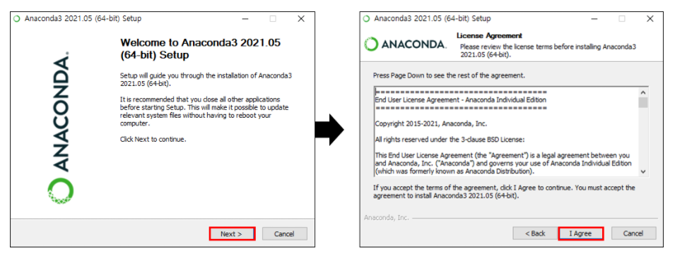

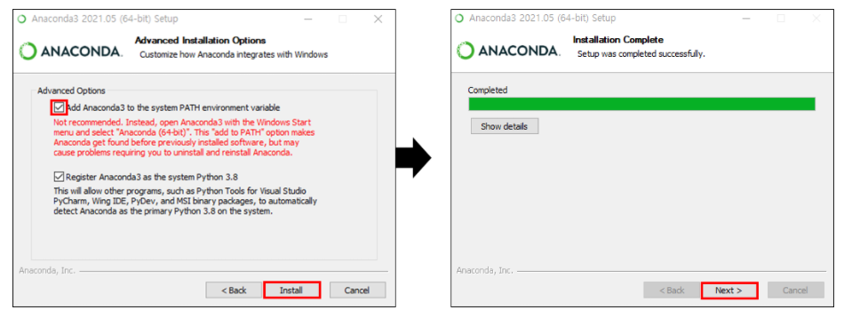
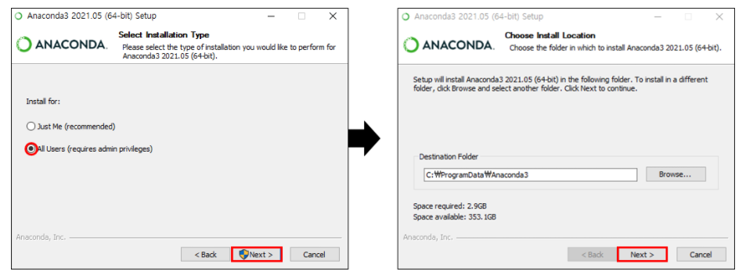
Environment setting
파이썬 설치
아나콘다 설치
https://www.anaconda.com/products/individual
Why we use anaconda?
다양한 파이썬 라이브러리들 존재
우리는 Jupyter notebook 사용할것
인공지능/데이터과학 등등에 사용
Notes:
Here's a summary of what I've done so far. In the first week,
I went through the Backend.ai system setup and machine learning exploration process.
In the ML process, angle change, ZOOM change, edge detection, corner detection, etc. were performed, and the CNN model was customized and changed.
the second week, I built an async chat app using docker. The function is the same as shown in the sheet.
After bootcamp I did issue #329. To solve the issue, the code of agent, manager,
client, and webui was modified and added.

Slide 7

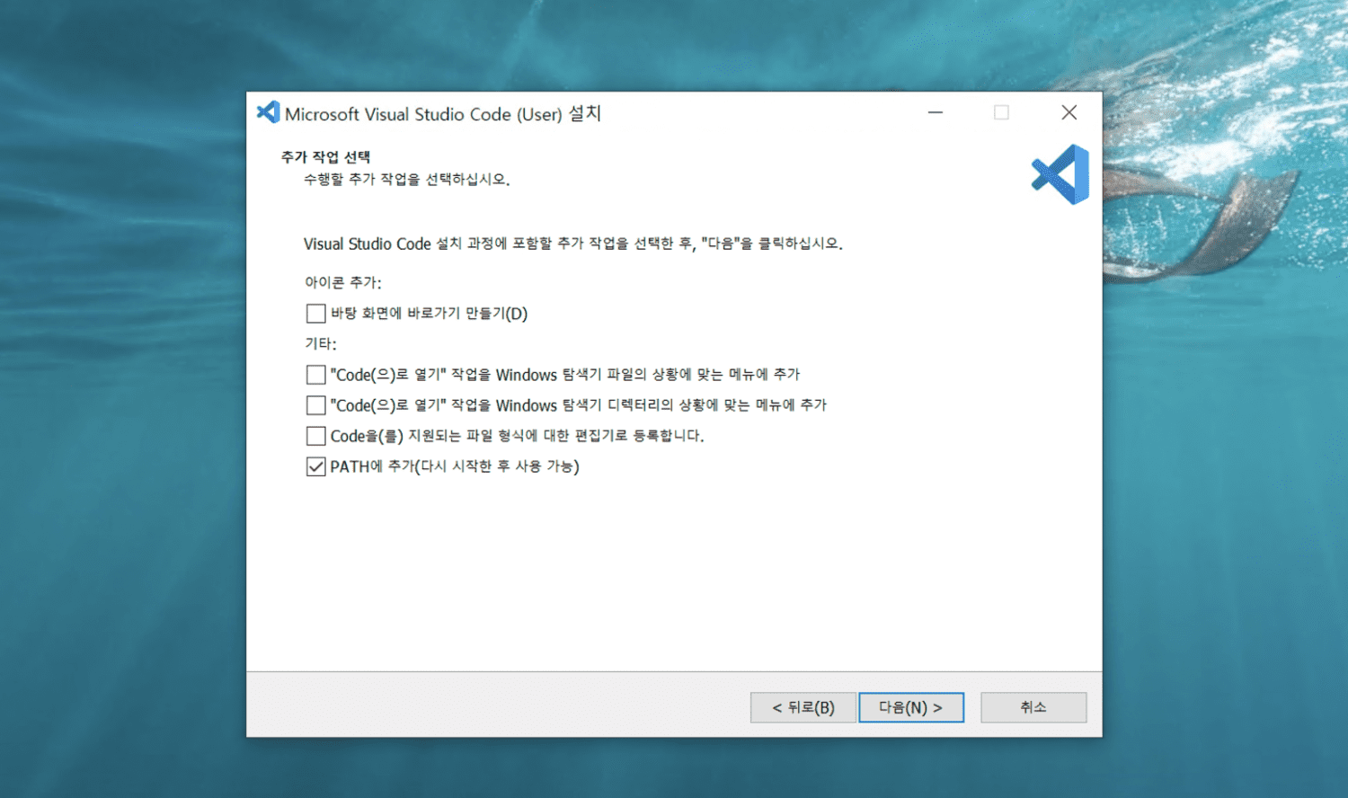
Environment setting
Visual studio code 설치
Visual Studio Code
https://code.visualstudio.com/
Why we install vscode?
요즘 개발자들 대세 개발환경
가벼운 프로그램, 많은 extension
좋은 기능이 많다!
위 화면 빼고 나머지는 다음 눌러서 설치!
PATH에 추가 << 이게 중요합니다!
Notes:
This is a summary of issue 329. This issue was an issue where virtual folders
were stored only in the /home/work path, but changed so that a user's arbitrary path could be used.
While resolving this issue, I had a bit of difficulty in building a separate webui development environment or setting up storage related settings, but I was able to solve it.

Slide 8


Environment setting
Github 가입 & 백준 가입
Github
https://github.com/
Why we sign up github?
개발자들은 대부분 이걸로 협업
오픈소스 플랫폼: 코드공유 가능
개인 코드 저장용으로도 좋다!
Backjoon online judge
https://www.acmicpc.net/
Why we sign up BOJ?
많은 알고리즘 문제 존재
문제별 난이도 제공
Notes:
What you learned through this issue is the same as the sheet.
Since I've only been working on new developments or small-scale development collaborations, I made a commit that didn't match the rules at first. Solving issues allowed me to learn a style of collaboration and how developers work within an organization.
And on the right is the change of client and agent.

Slide 9
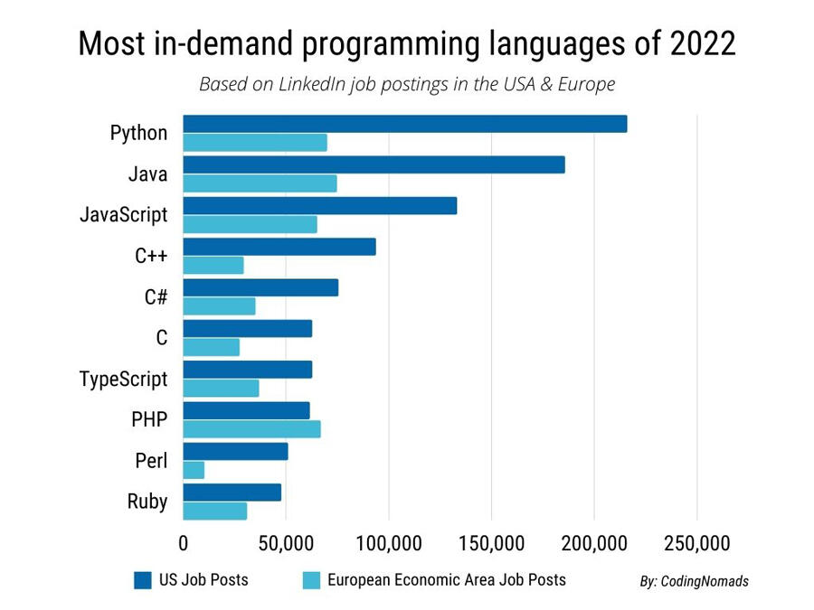

Why python?
파이썬 소개
다른 사람들이 만들어놓은 도구들이 많다.
언어 구조가 쉬워서 입문하기가 좋다.
다양한 프로그램을 이거 하나로 개발가능
Notes:
The test environment is the Mac mini of the Jump Desktop provided.
Here is the result after modification: Changes to the manager and webui are also listed.

Slide 10
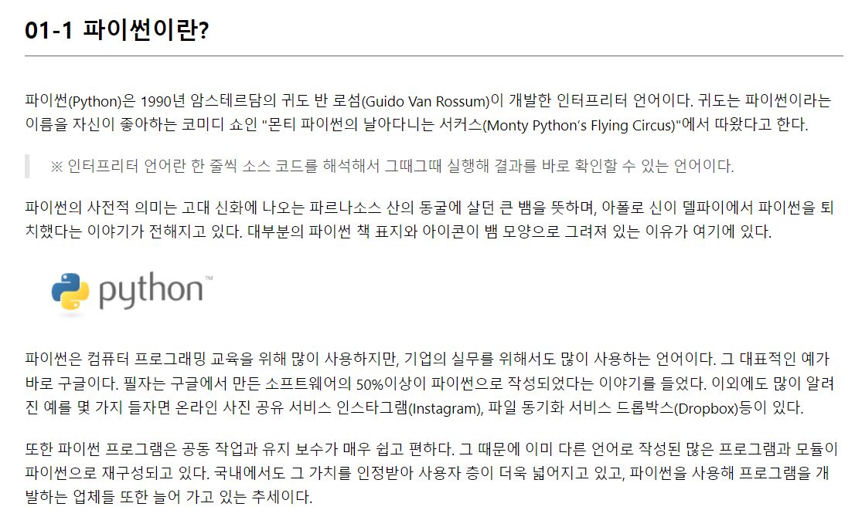
Why python?
파이썬 소개
Notes:
This is the final action image. Above each grey image is the existing behavior.
Feature development has been completed, and grammar and style revision reviews are in progress.
It helped me to kwow of ​​the overall structure as I had to look at almost every part of the Backend.ai ecosystem.

Slide 11
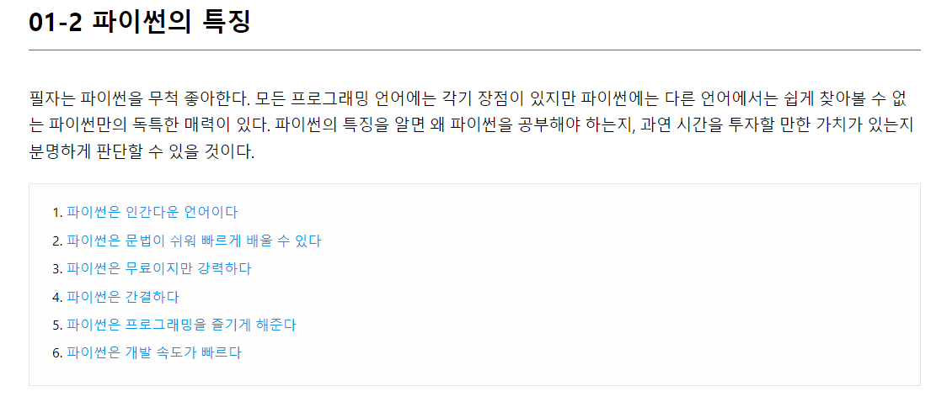
Why python?
파이썬 소개
Notes:
This is the final action image. Above each grey image is the existing behavior.
Feature development has been completed, and grammar and style revision reviews are in progress.
It helped me to kwow of ​​the overall structure as I had to look at almost every part of the Backend.ai ecosystem.

Slide 12
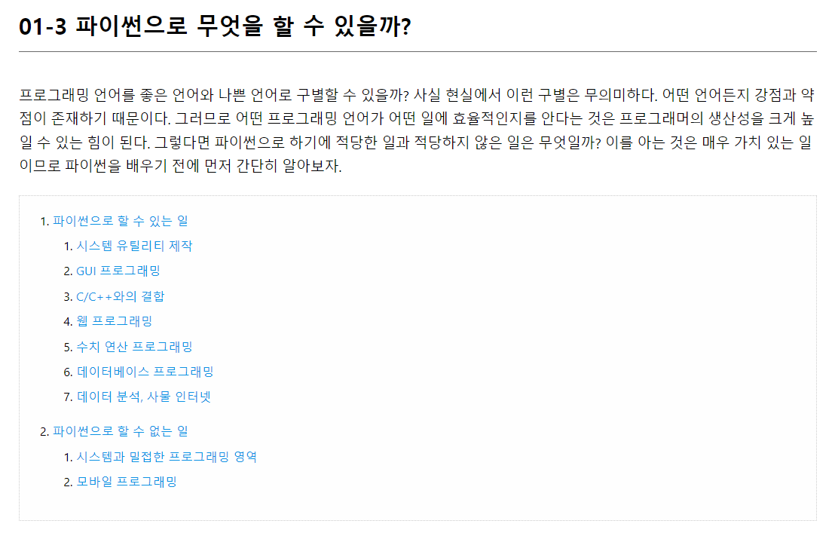
Why python?
파이썬 소개
Notes:
This is the final action image. Above each grey image is the existing behavior.
Feature development has been completed, and grammar and style revision reviews are in progress.
It helped me to kwow of ​​the overall structure as I had to look at almost every part of the Backend.ai ecosystem.

Slide 13
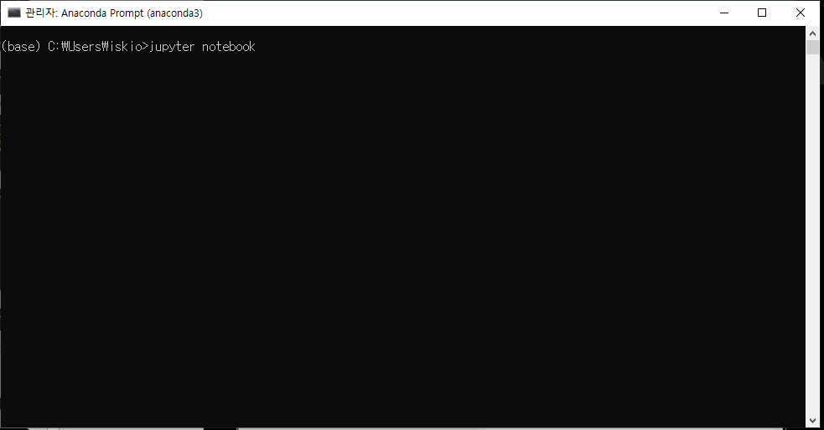
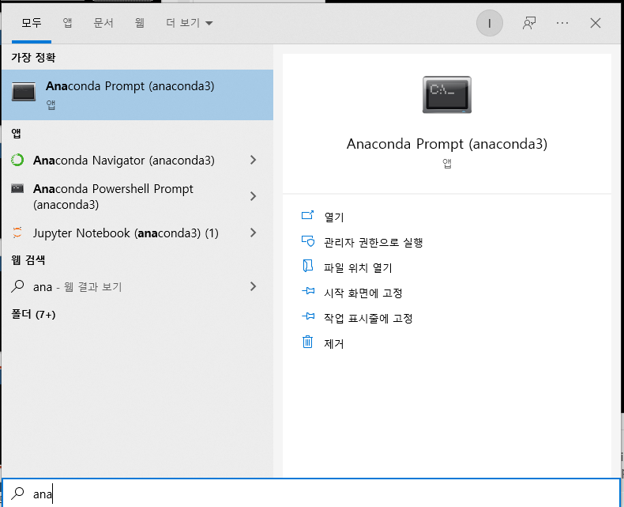
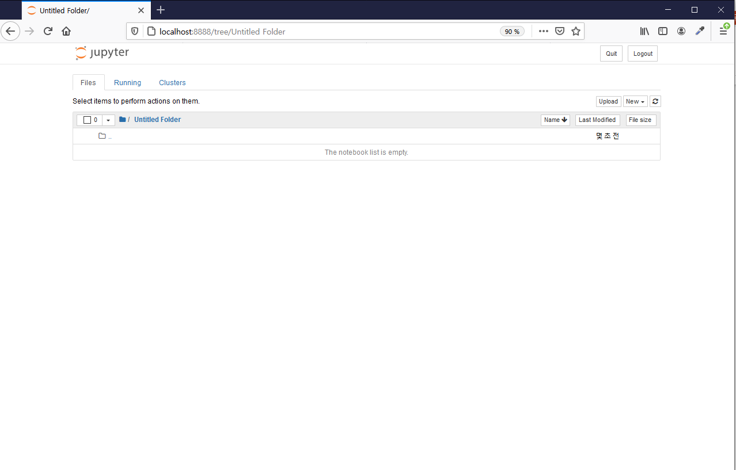
Why python?
주피터 노트북
Notes:
This is the final action image. Above each grey image is the existing behavior.
Feature development has been completed, and grammar and style revision reviews are in progress.
It helped me to kwow of ​​the overall structure as I had to look at almost every part of the Backend.ai ecosystem.

Slide 14
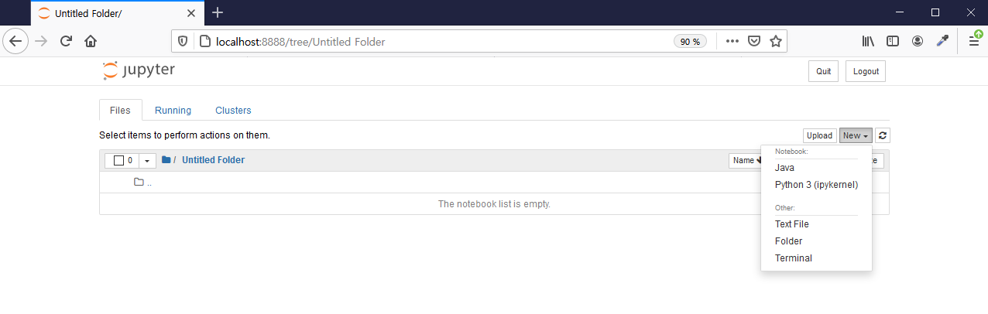
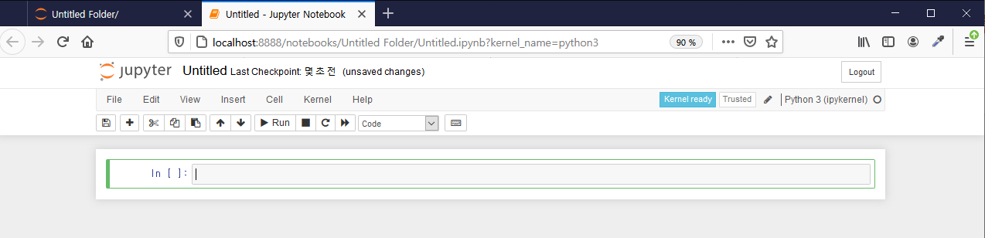
Why python?
주피터 노트북
Notes:
This is the final action image. Above each grey image is the existing behavior.
Feature development has been completed, and grammar and style revision reviews are in progress.
It helped me to kwow of ​​the overall structure as I had to look at almost every part of the Backend.ai ecosystem.

Slide 15
Thank you!
Notes:
What I want to do in the future is to develop a dashboard using Prometheus and Grafana. I am currently studying related content.

