Slide 1

Online Testing System
Main Function: Manage Exam
Bonus Function: Show homepage, profile page
GROUP 1
Febuary 2019
CMC Global

Slide 2
Developers & Functionalities
No | Developer | Use case
1 | Vuong Sy Son | - Update content exam
2 | Nguyen Thi My Duyen | - Show list exam - Search exam - Sort exam
3 | Vu Van Dong | - Show detail exam - Show semester
4 | Nguyen The Hung | - Export exam - Show home page
5 | Luong Van Cong Hai | - Import exam - Update common exam
6 | Nguyen Duc Van | - Delete exam - Filter exam
7 | Pham Thi Phuong | -Create exam -Show profile page

Slide 3
Technologies
Front end: HTML, CSS, Angular, TypeScript, Boostrap
Back end: Java, Spring Boot, Rest API
Logging: slf4j
Testing: JUnit Test, Mockito
Database: SQL Server
Web server: Tomcat 8.5
Tools: Git, Spring Tool Suite, Visual Studio Code

Slide 4
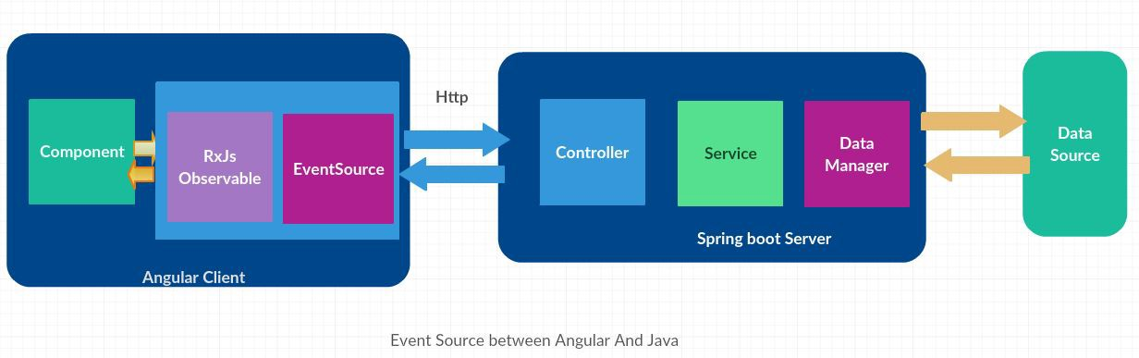
System architecture

Slide 5
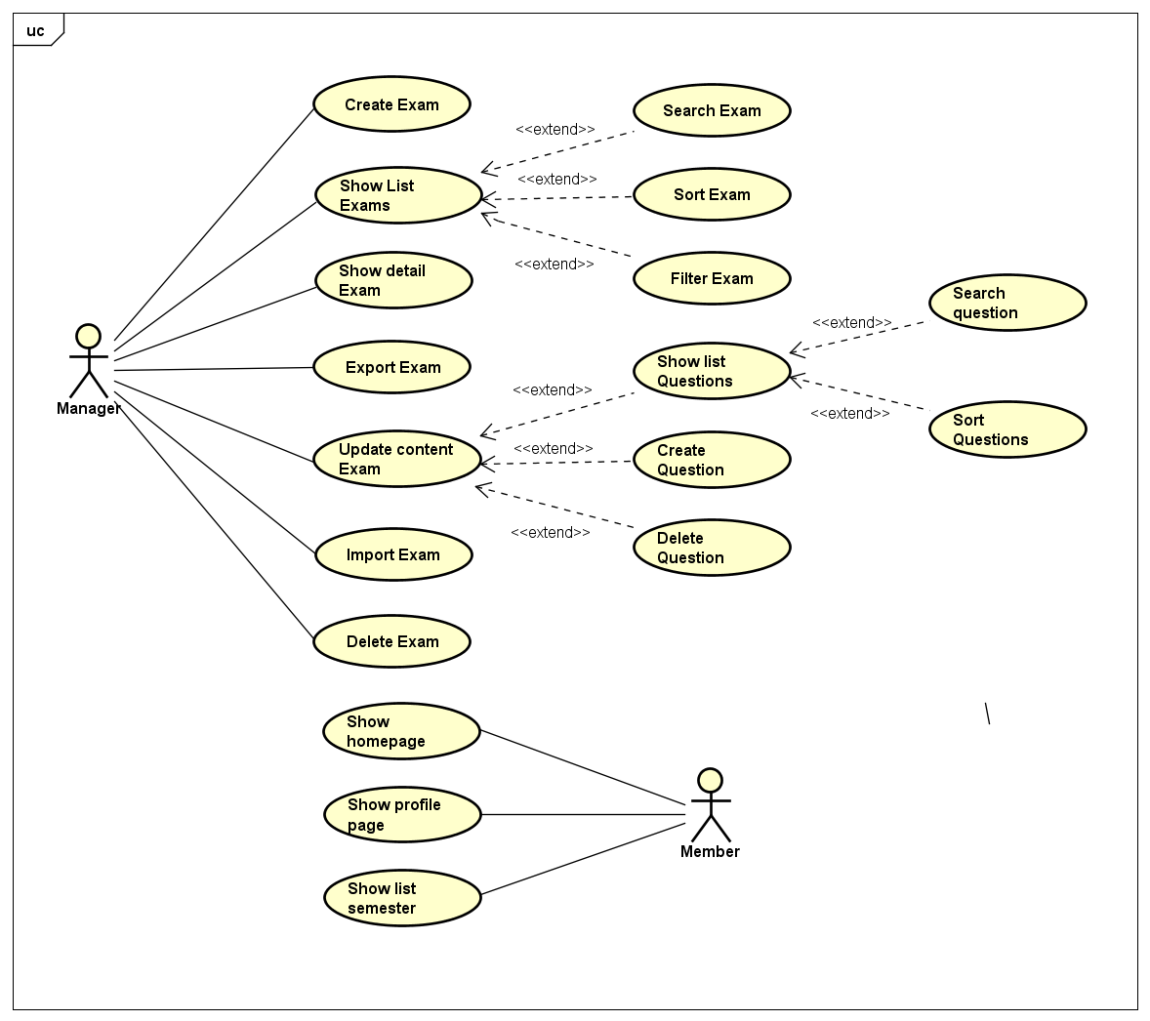
Use Case Diagram

Slide 6
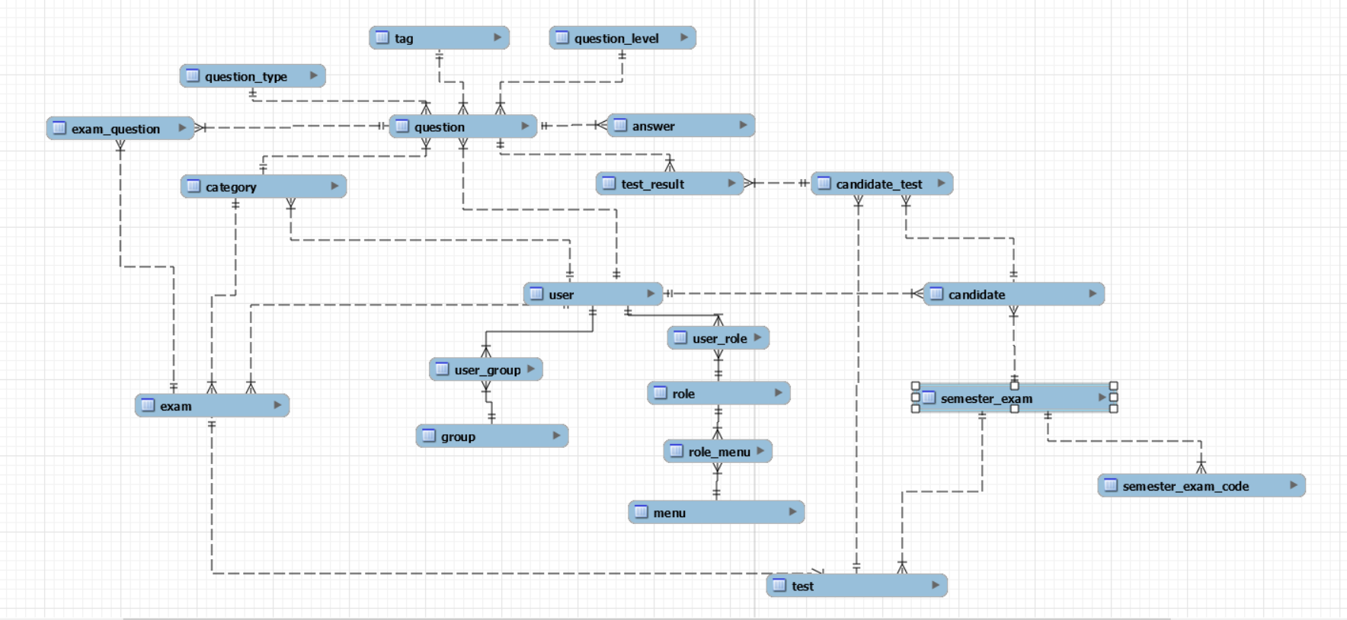
ERD

Slide 7
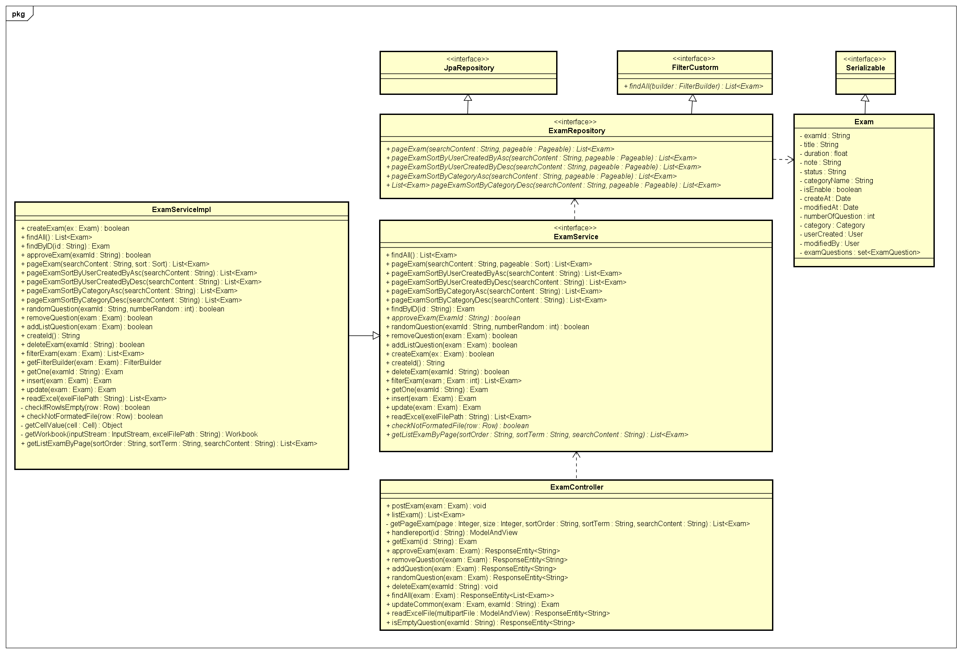
Class diagram of exam
Class Diagram

Slide 8
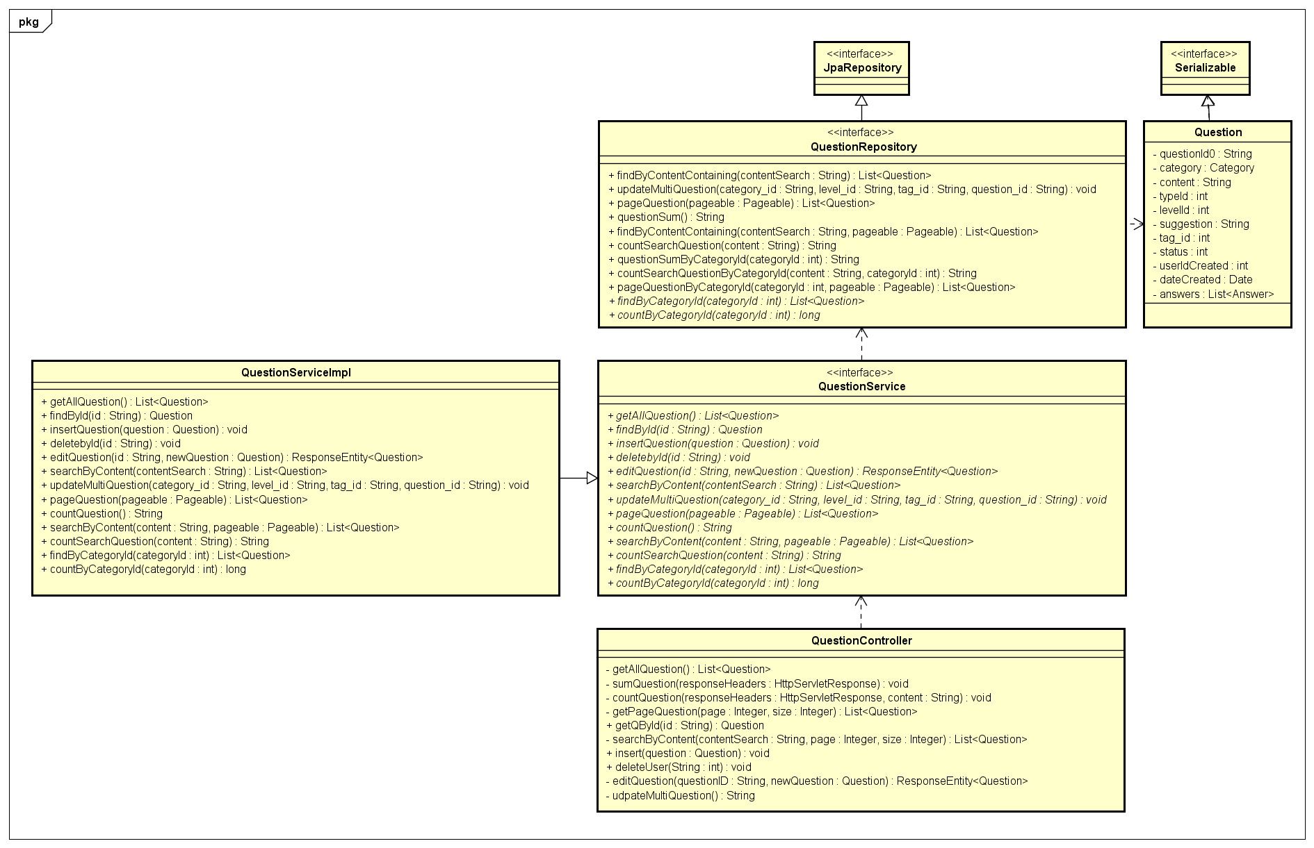
Class diagram of question
Class Diagram

Slide 9
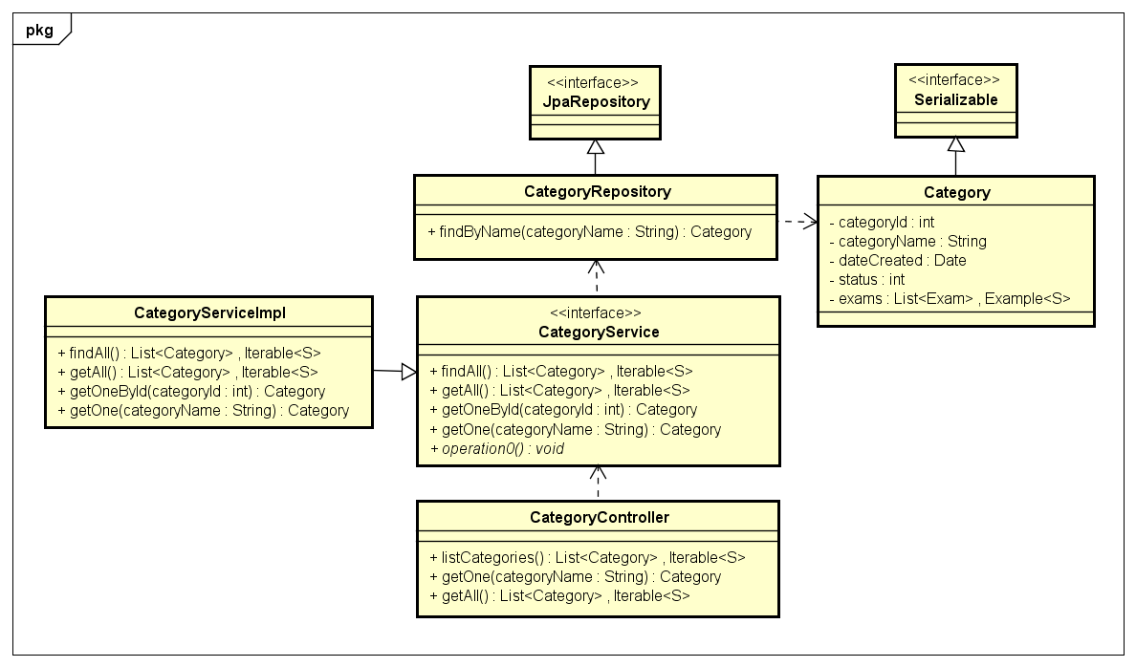
Class Diagram
Class diagram of category

Slide 10
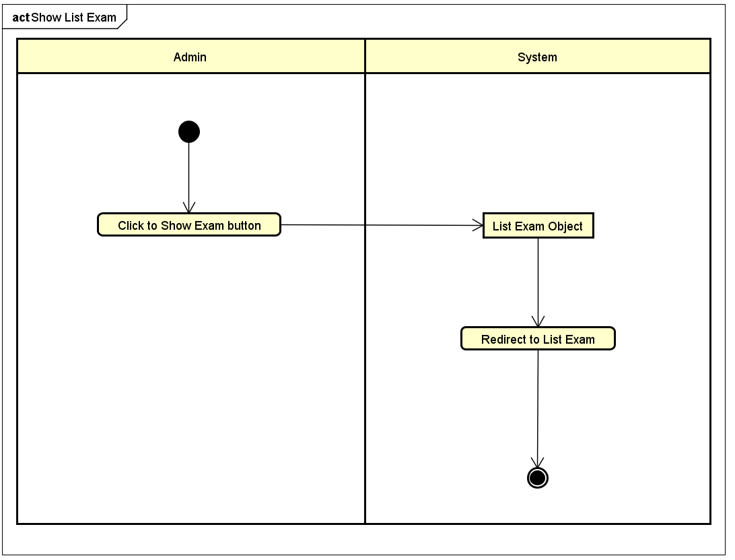
Function: Show list exam
Activity diagram

Slide 11
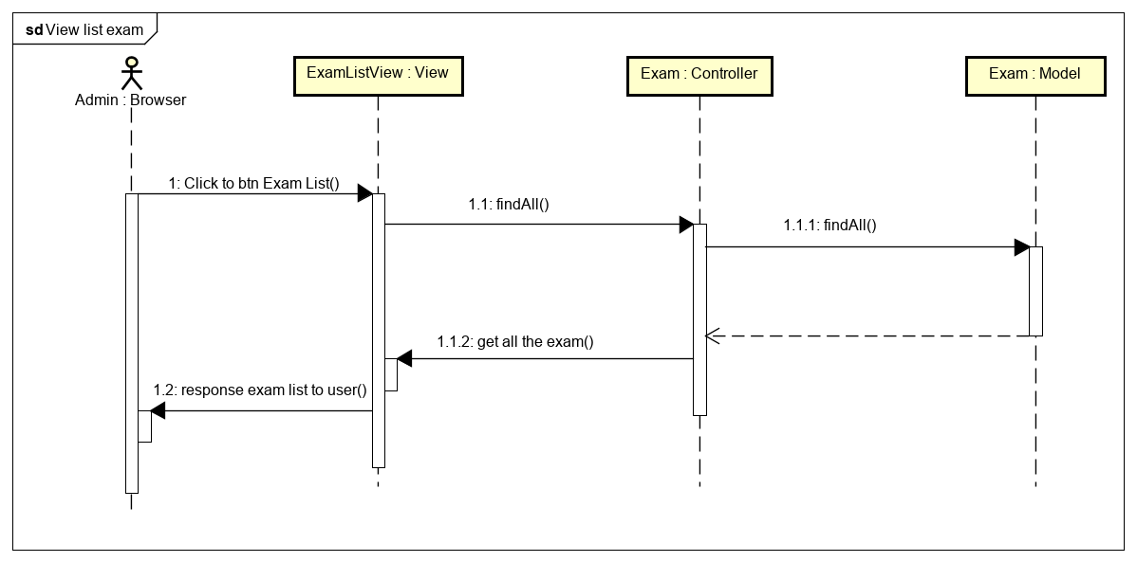
Function: Show list exam
Sequence diagram

Slide 12
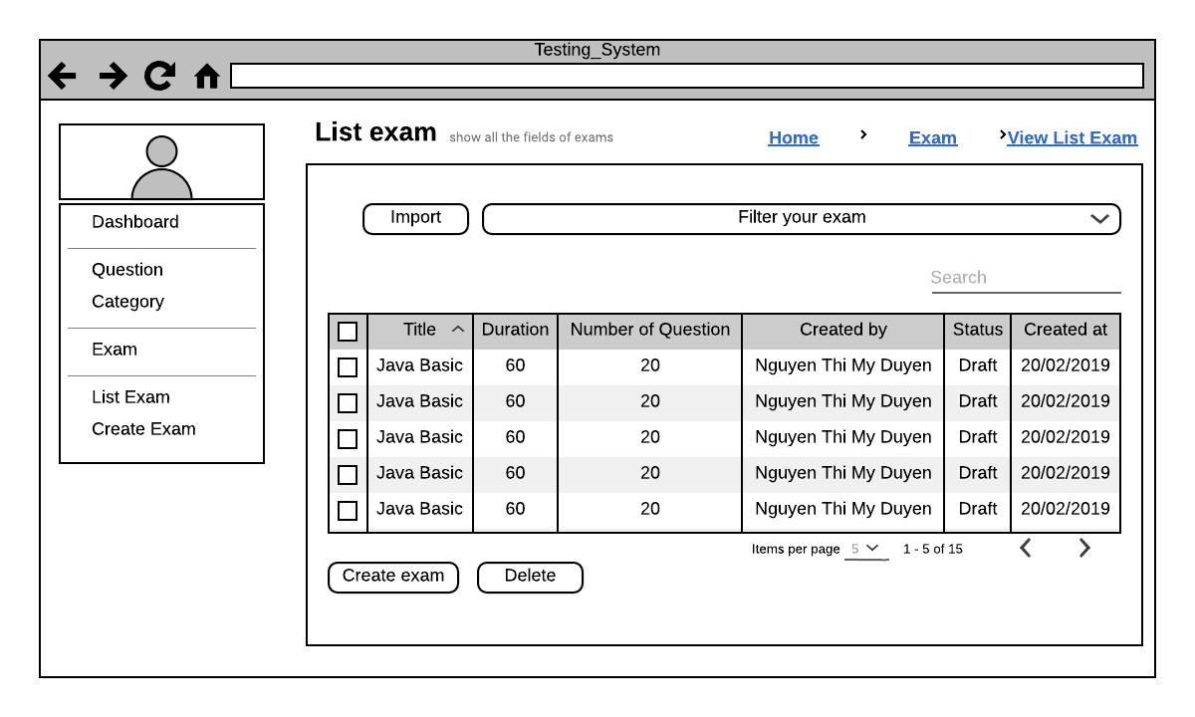
Function: Show list exam
Screen design

Slide 13
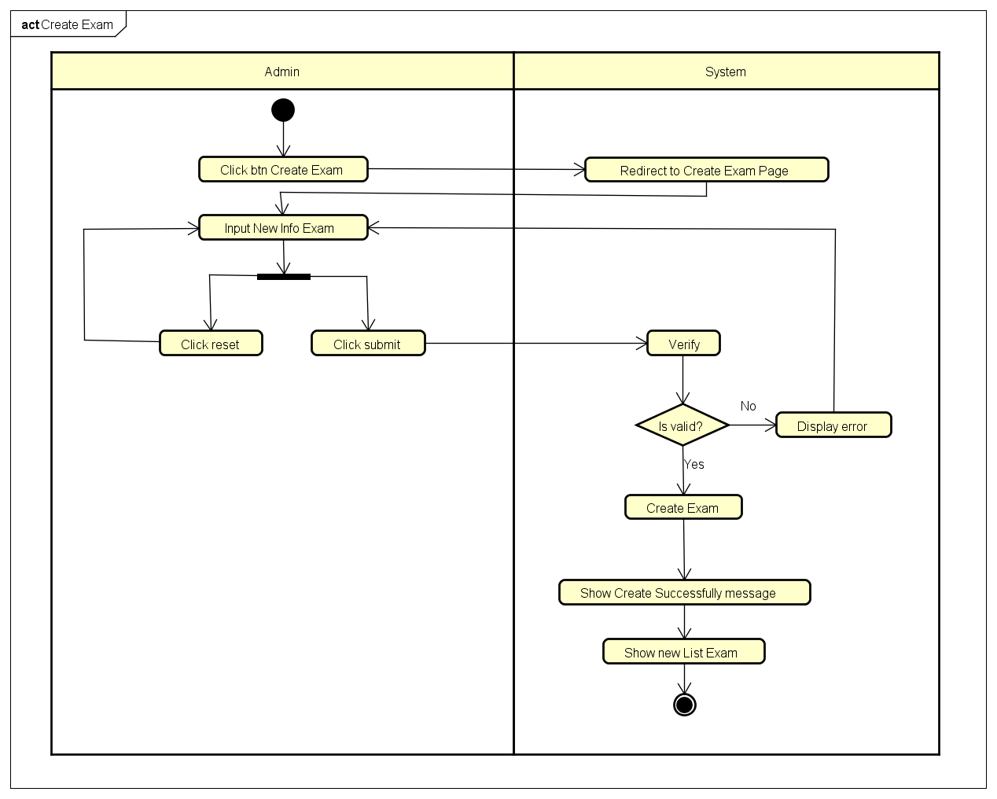
Function: Create exam
Activity diagram

Slide 14
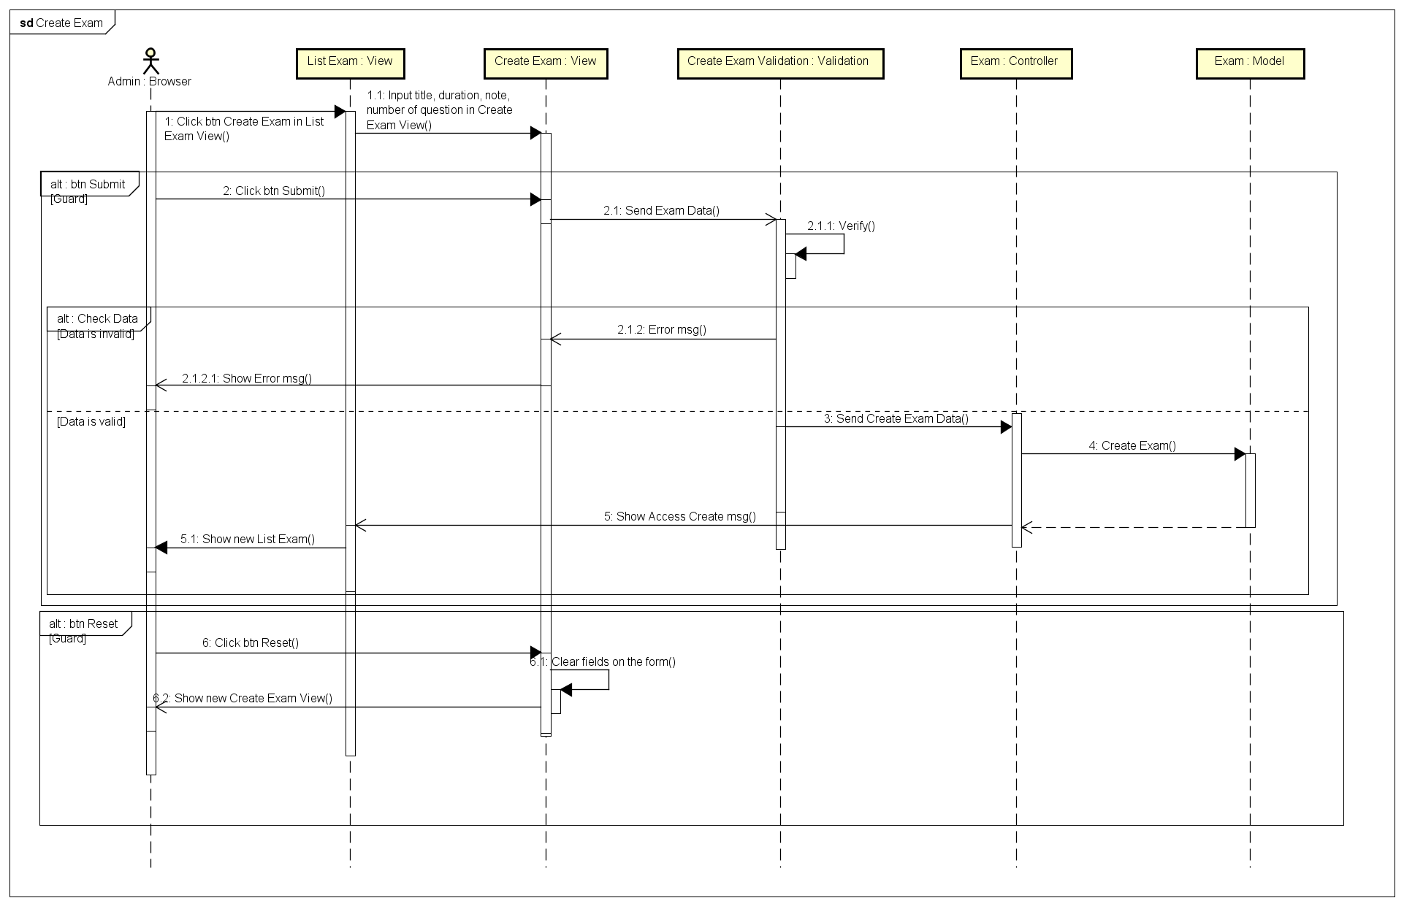
Function: Create exam
Sequence diagram

Slide 15
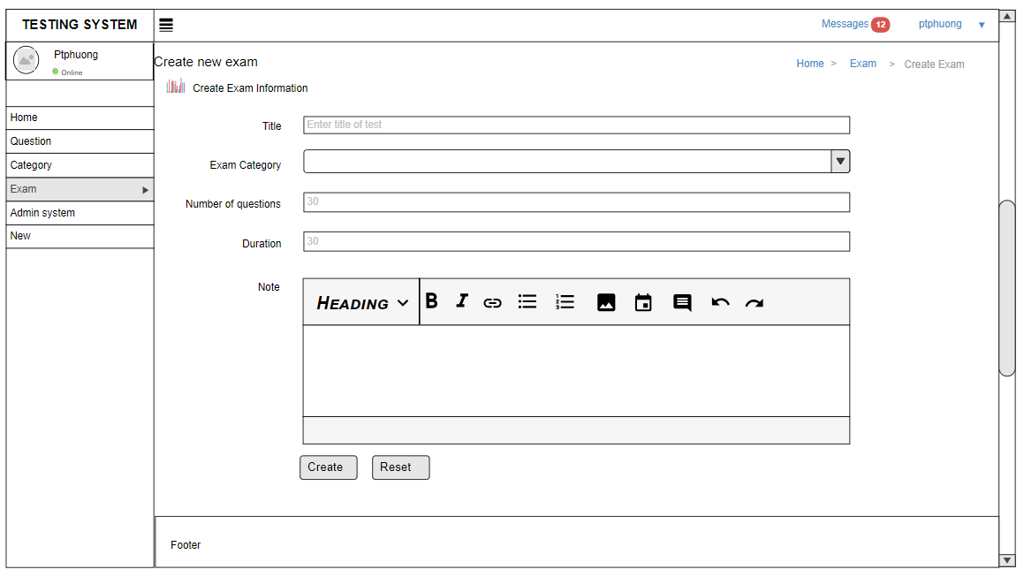
Function: Create exam
Screen design

Slide 16
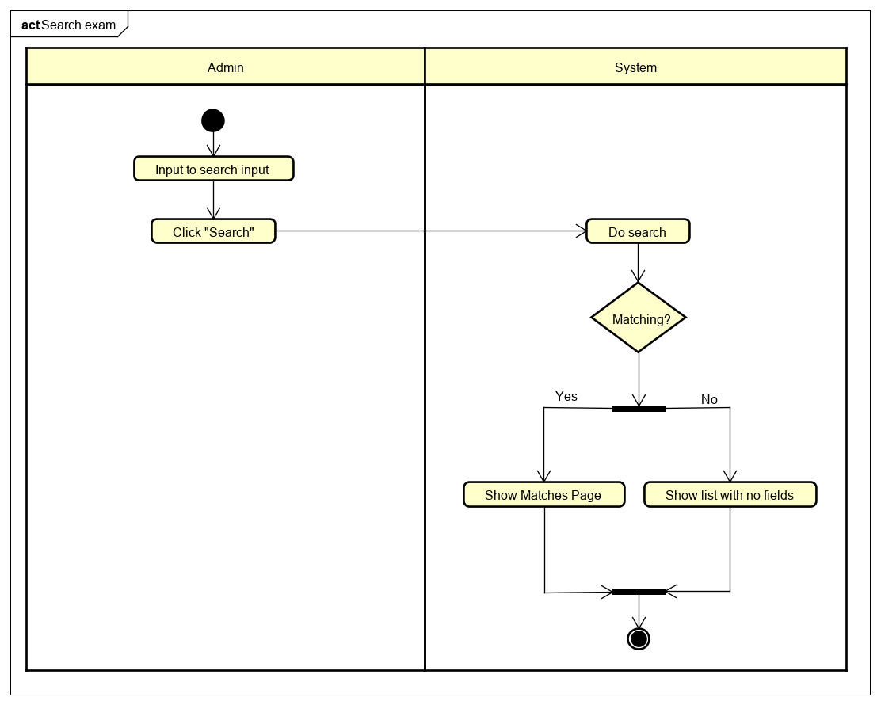
Function: Search exam
Activity diagram

Slide 17
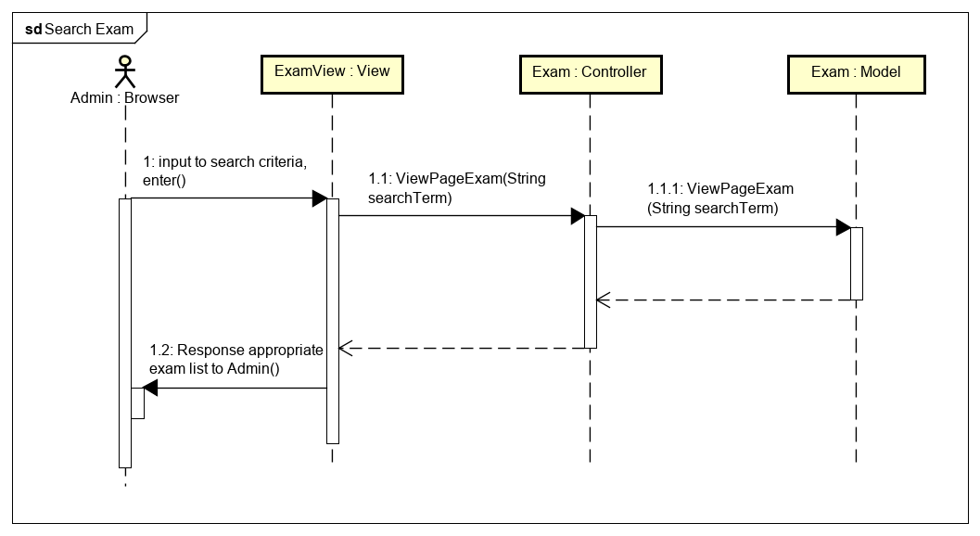
Function: Search exam
Sequence diagram

Slide 18
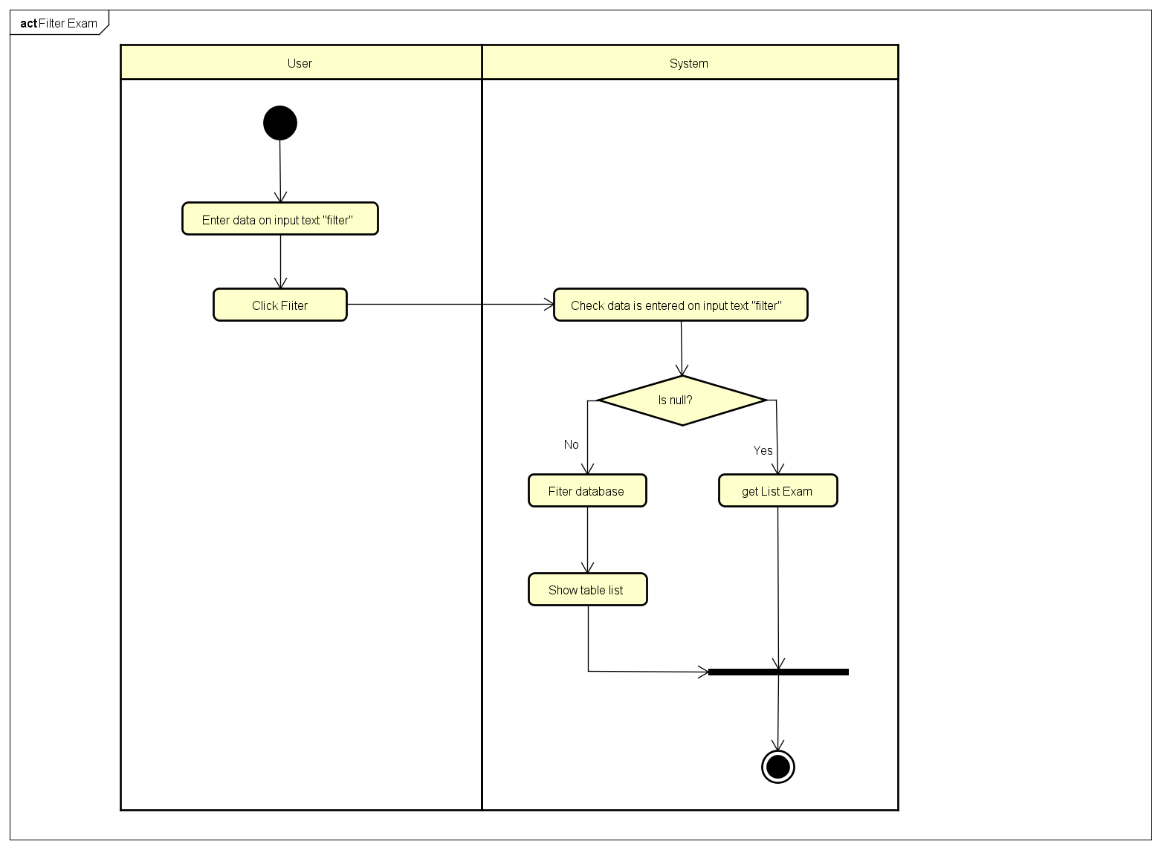
Function: Filter exam
Activity diagram

Slide 19
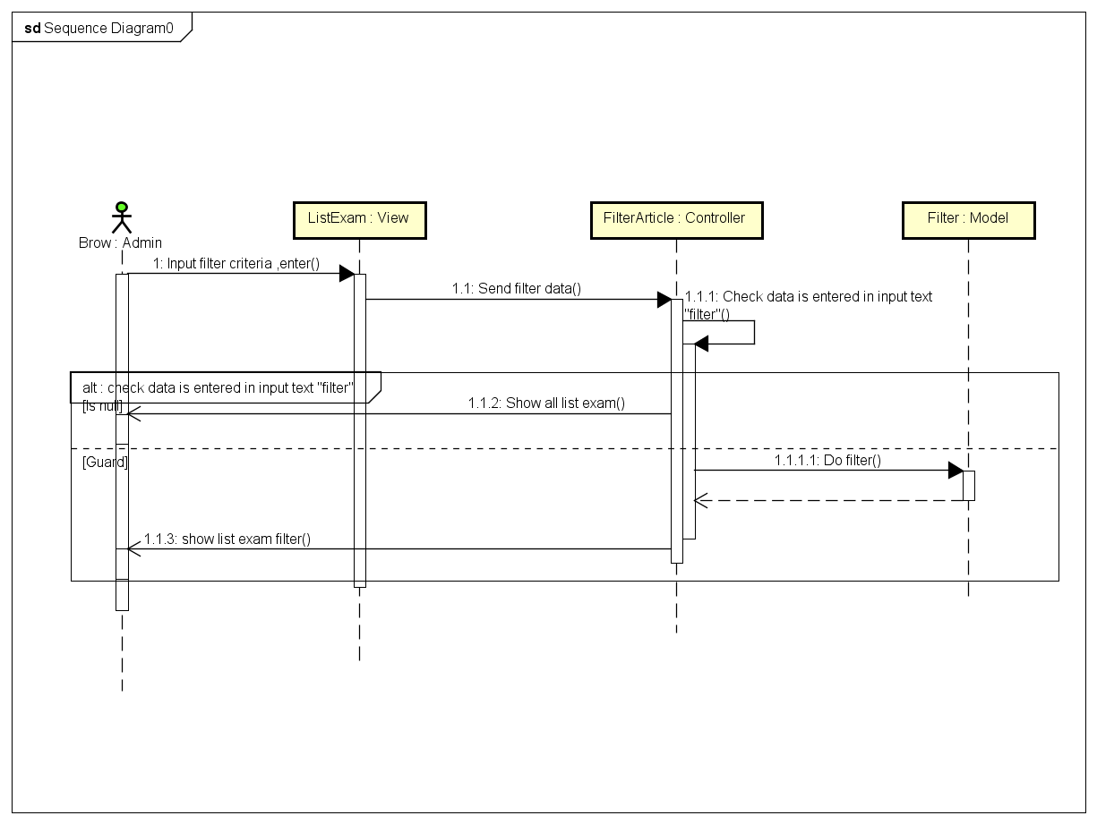
Function: Filter exam
Sequence diagram

Slide 20
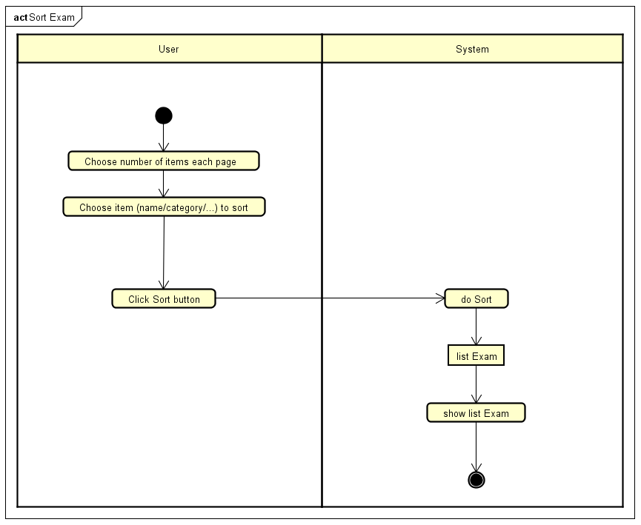
Function: Sort exam
Activity diagram

Slide 21
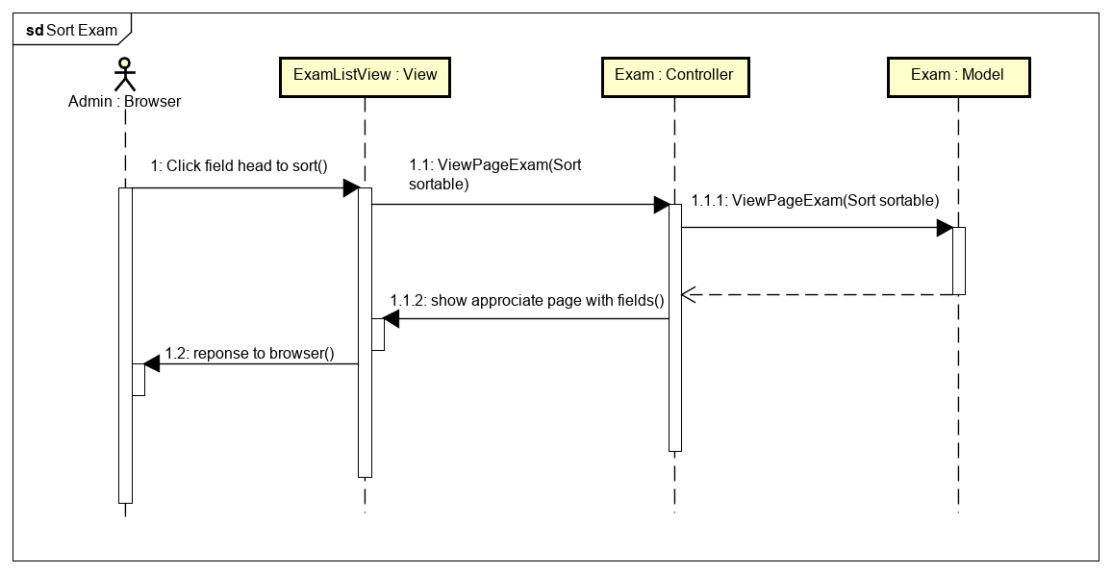
Function: Sort exam
Sequence diagram

Slide 22
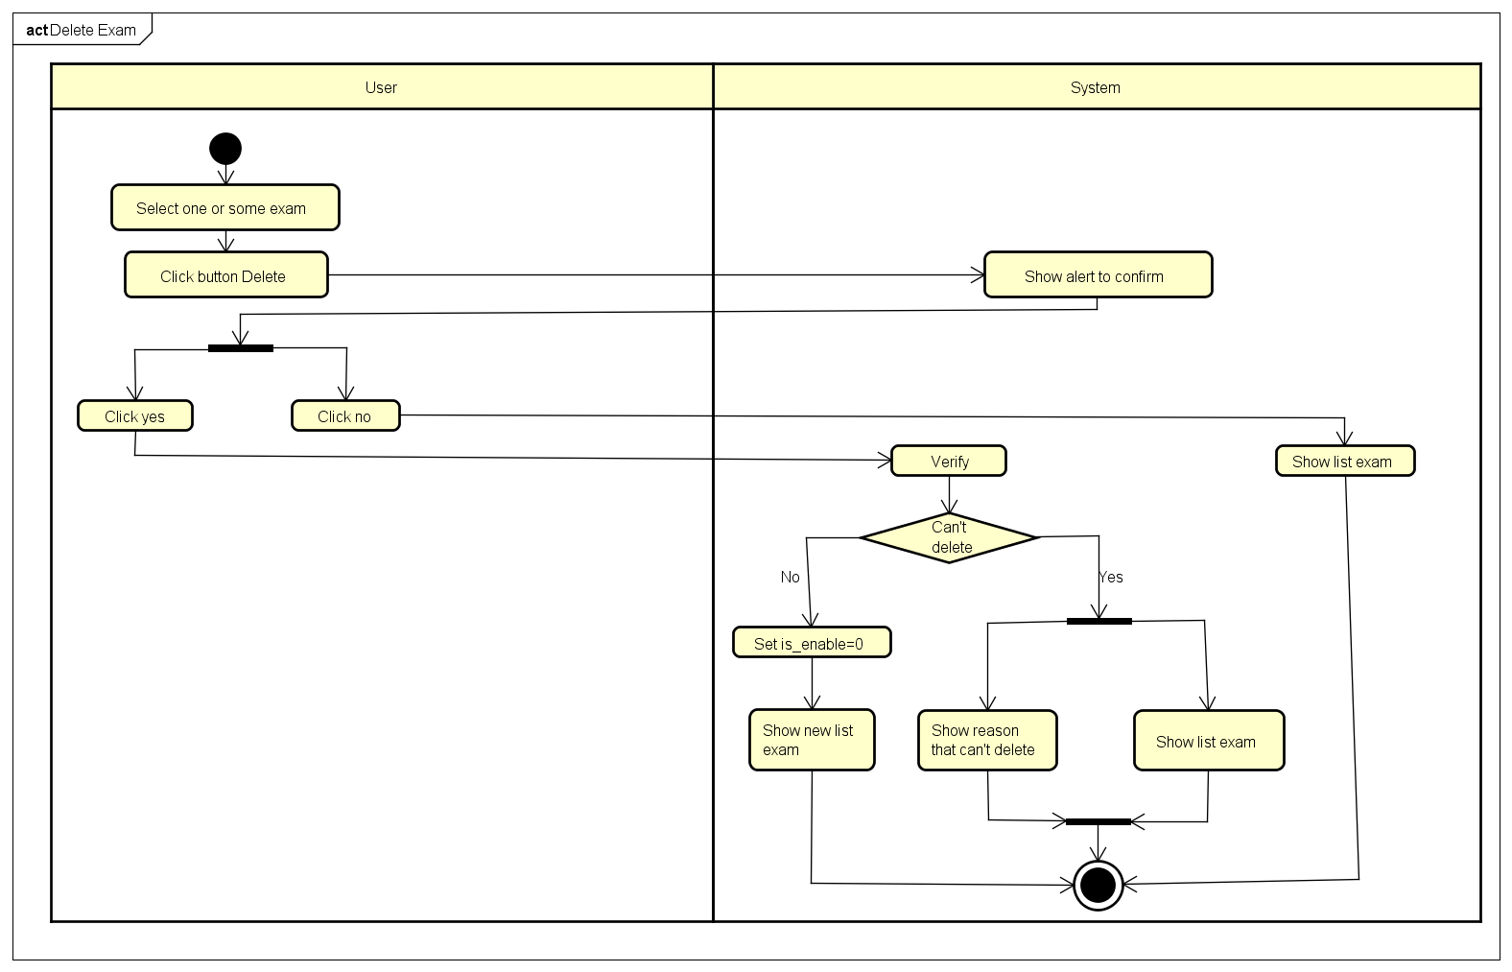
Function: Delete exam
Activity diagram

Slide 23
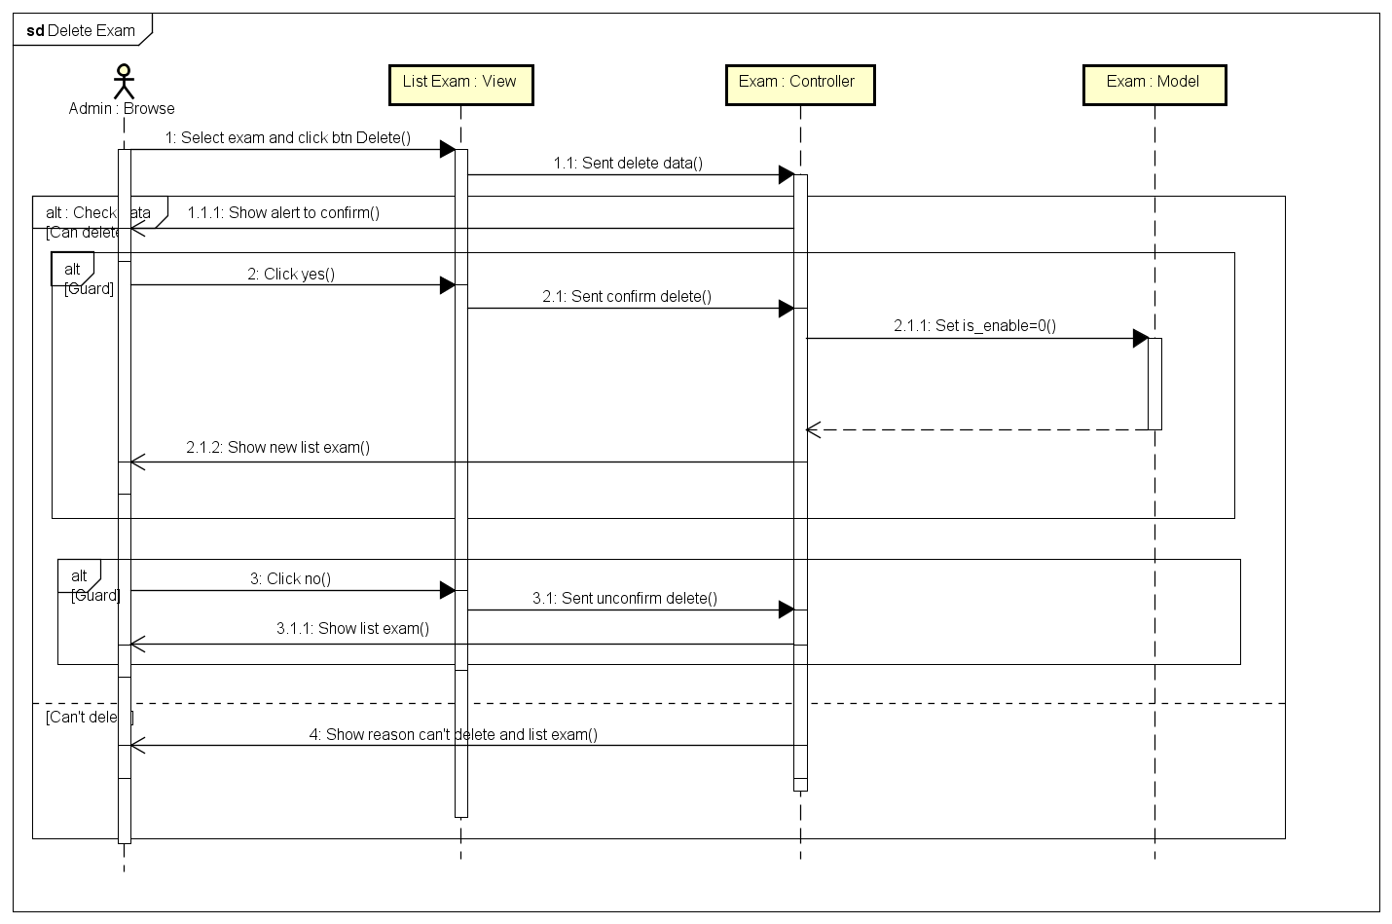
Function: Delete exam
Sequence diagram

Slide 24
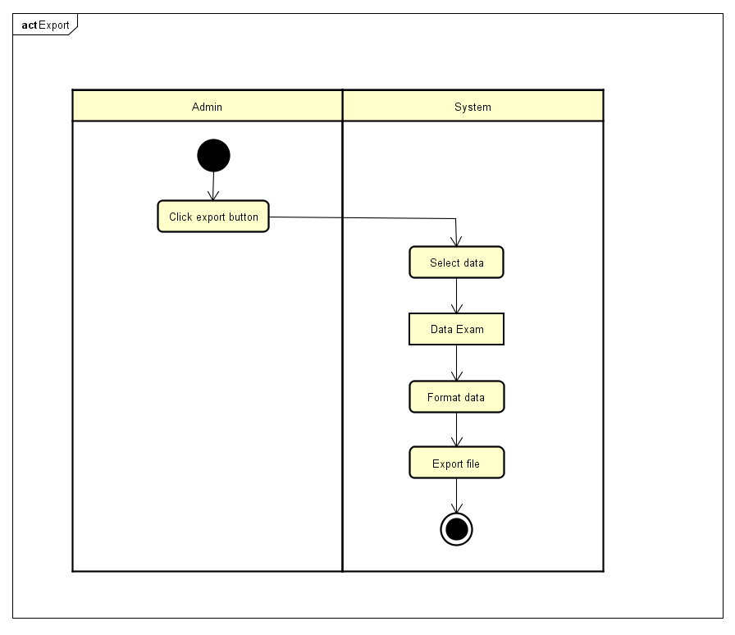
Function: Export exam
Activity diagram

Slide 25
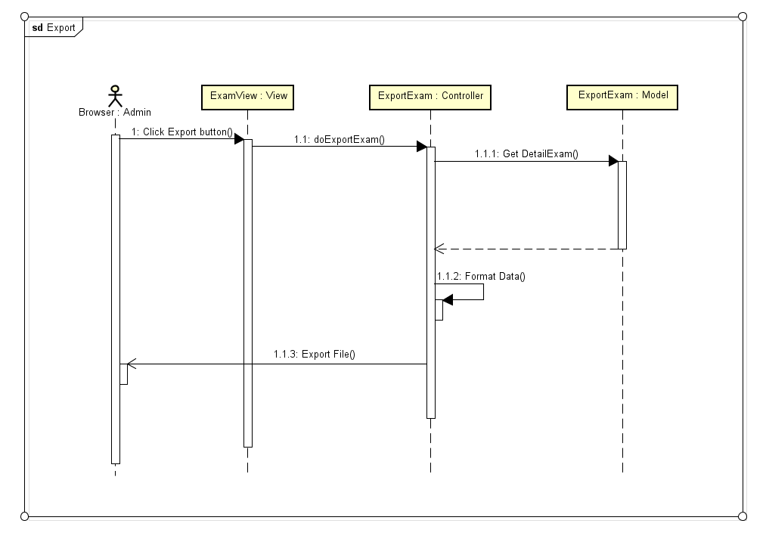
Function: Export exam
Sequence diagram

Slide 26
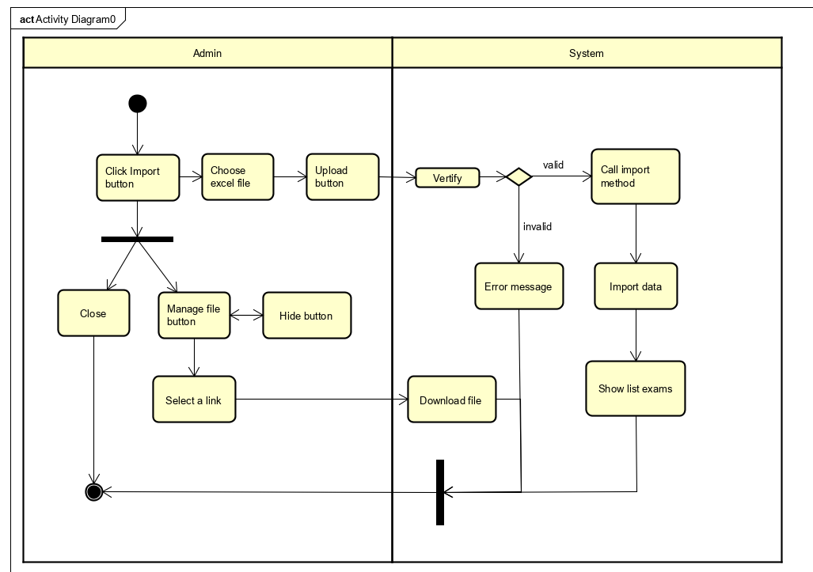
Function: Import exam
Activity diagram

Slide 27
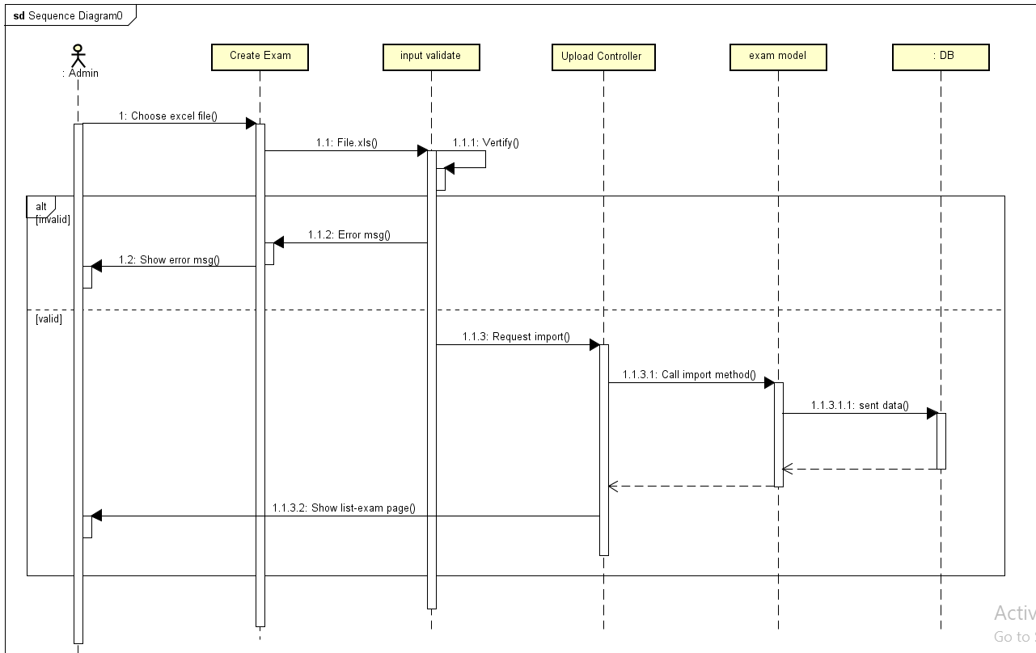
Function: Import exam
Sequence diagram

Slide 28
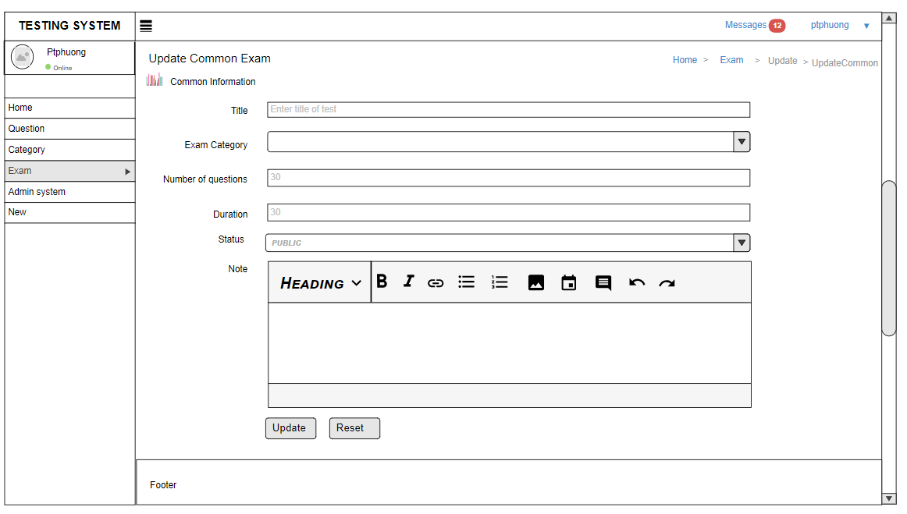
Function: Import exam
Screen design

Slide 29
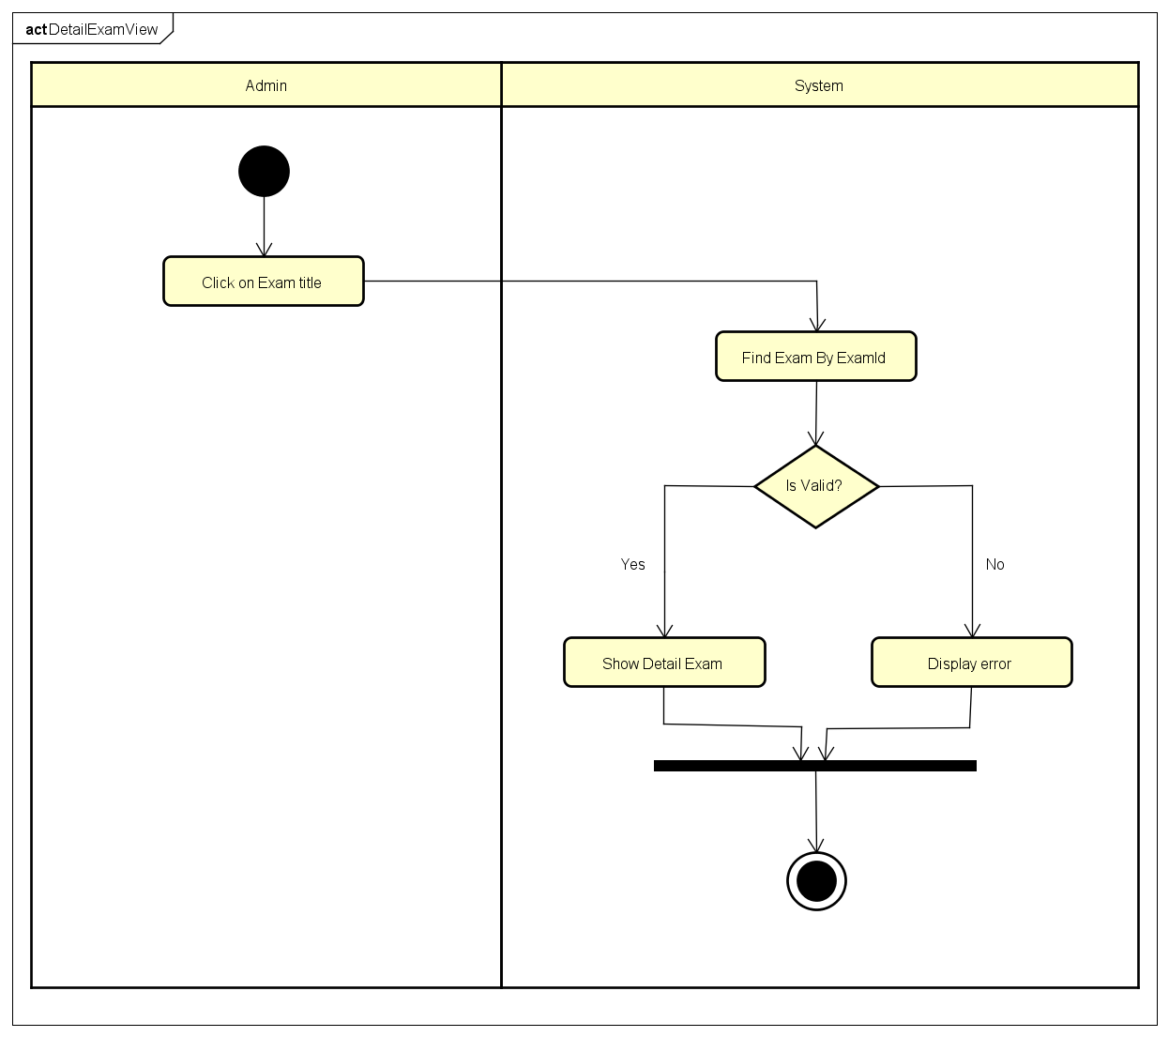
Function: Show detail exam
Activity diagram

Slide 30
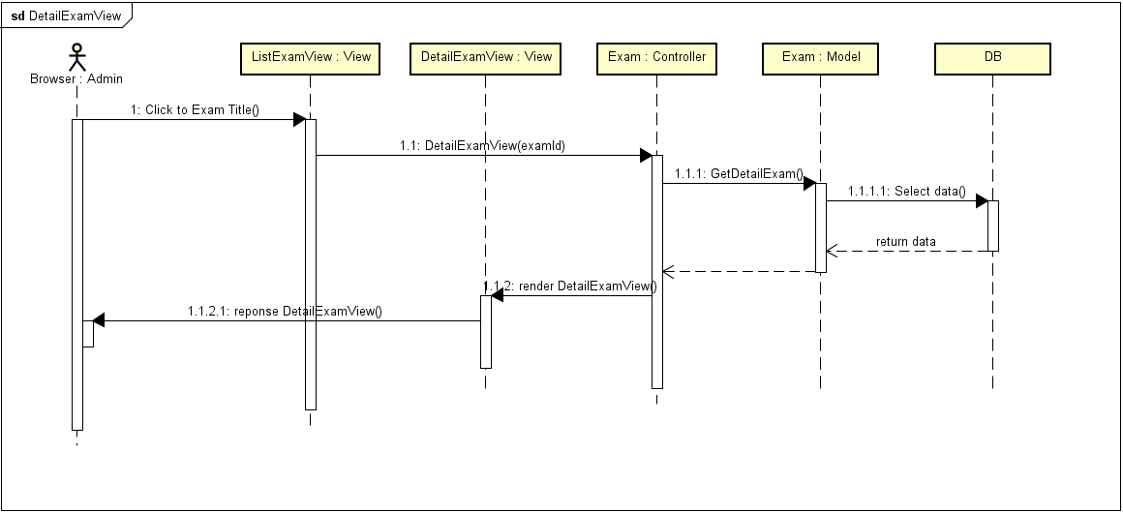
Function: Show detail exam
Sequence diagram

Slide 31
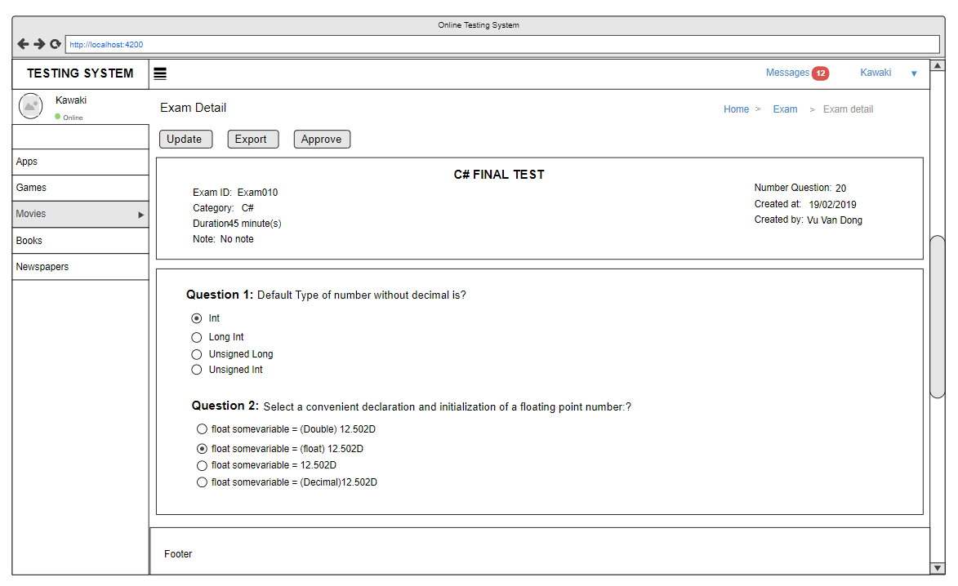
Function: Show detail exam
Screen design

Slide 32
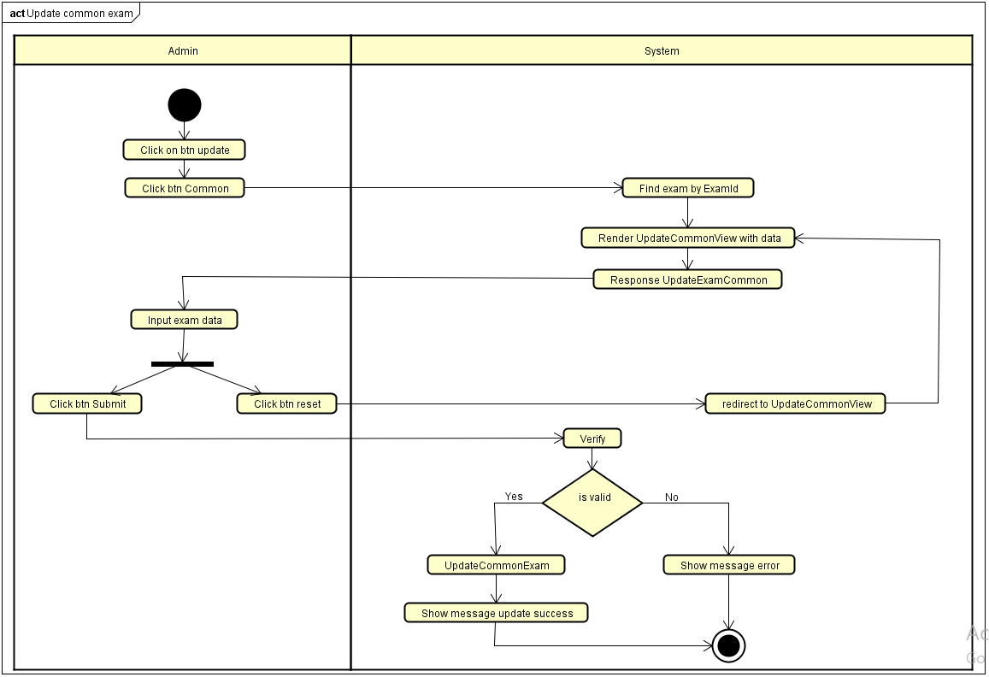
Function: Update common Exam
Activity diagram

Slide 33
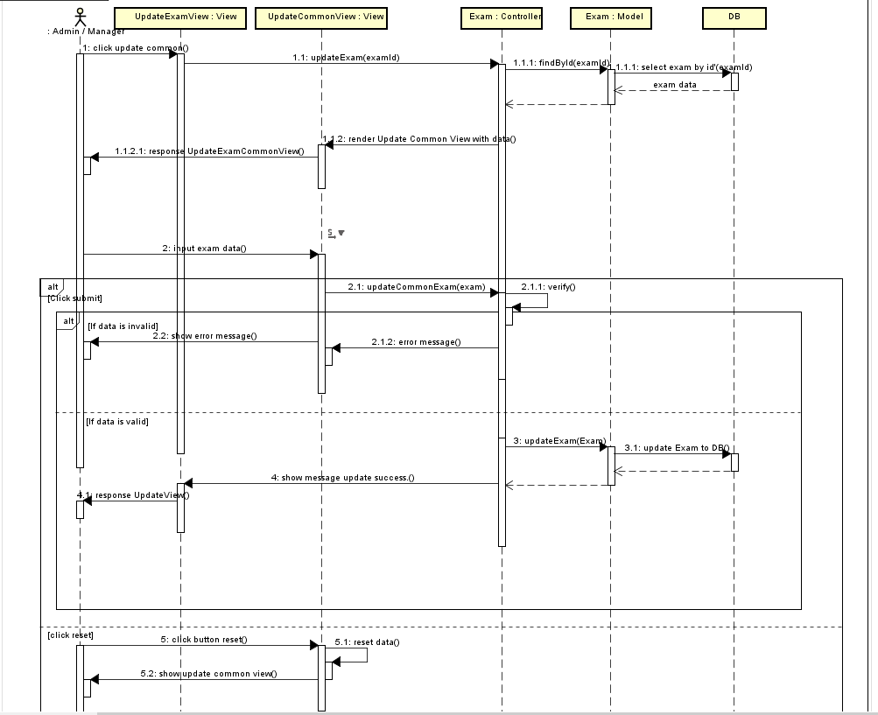
Function: Update common Exam
Sequence diagram

Slide 34
Function: Update common Exam
Screen design

Slide 35
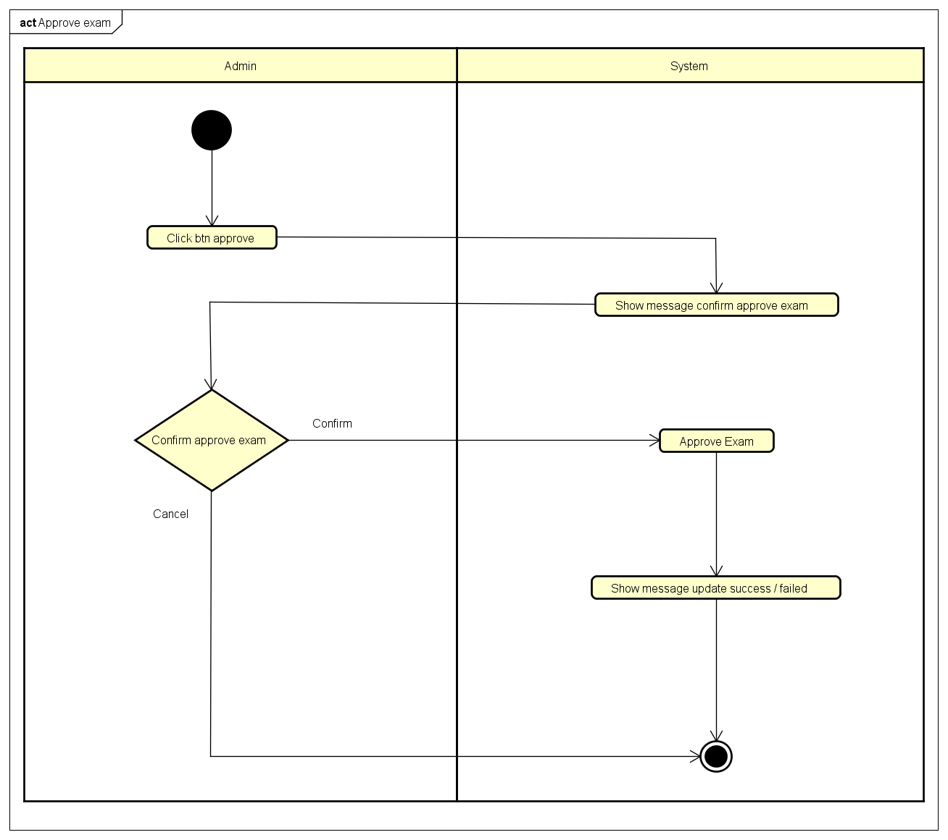
Function: Approve exam
Activity diagram

Slide 36
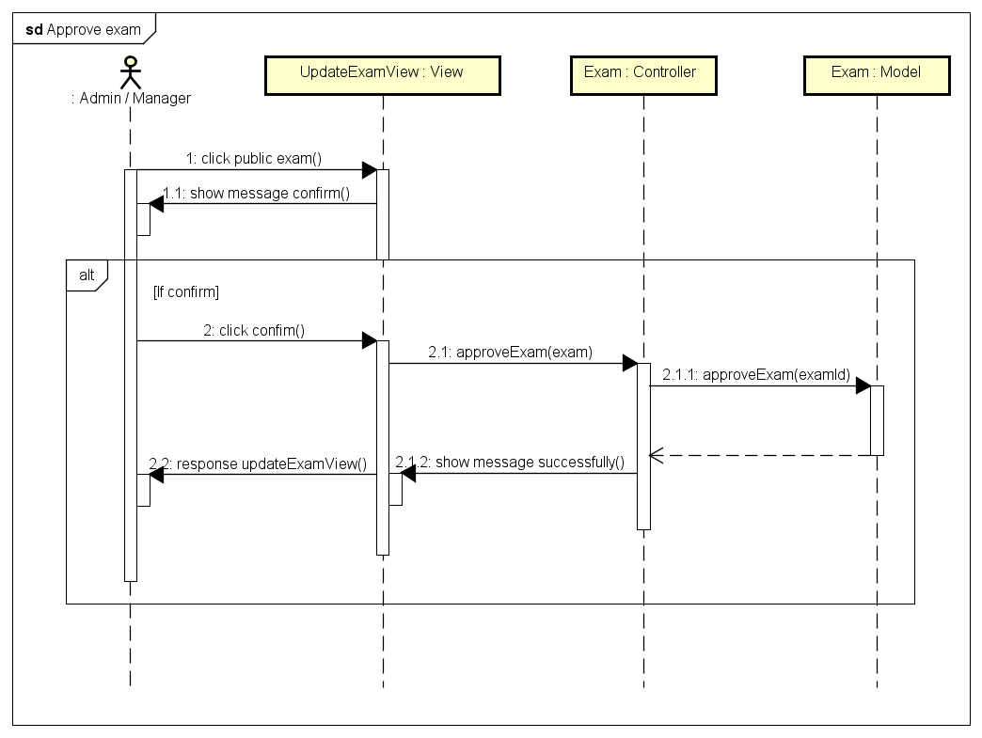
Function: Approve exam
Sequence diagram

Slide 37
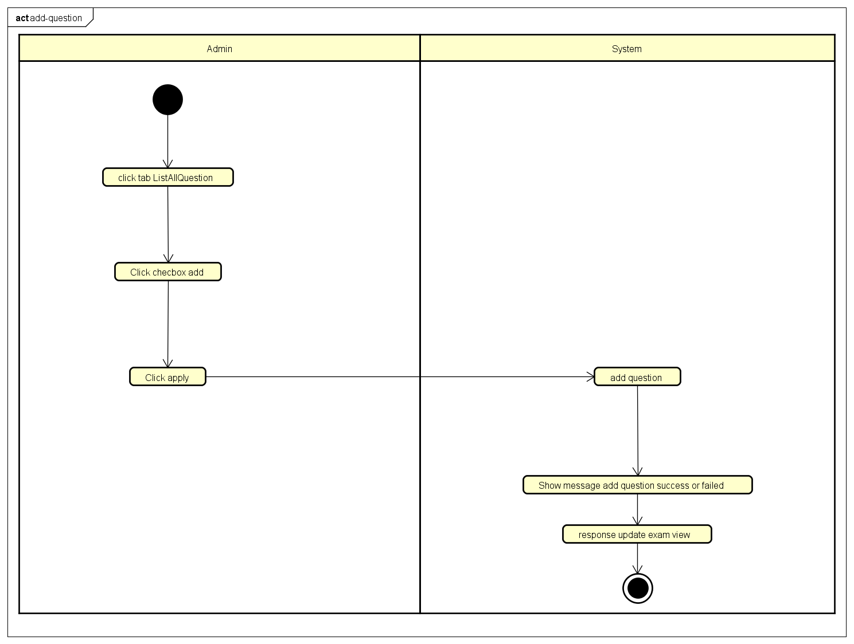
Function: Add question
Activity diagram

Slide 38
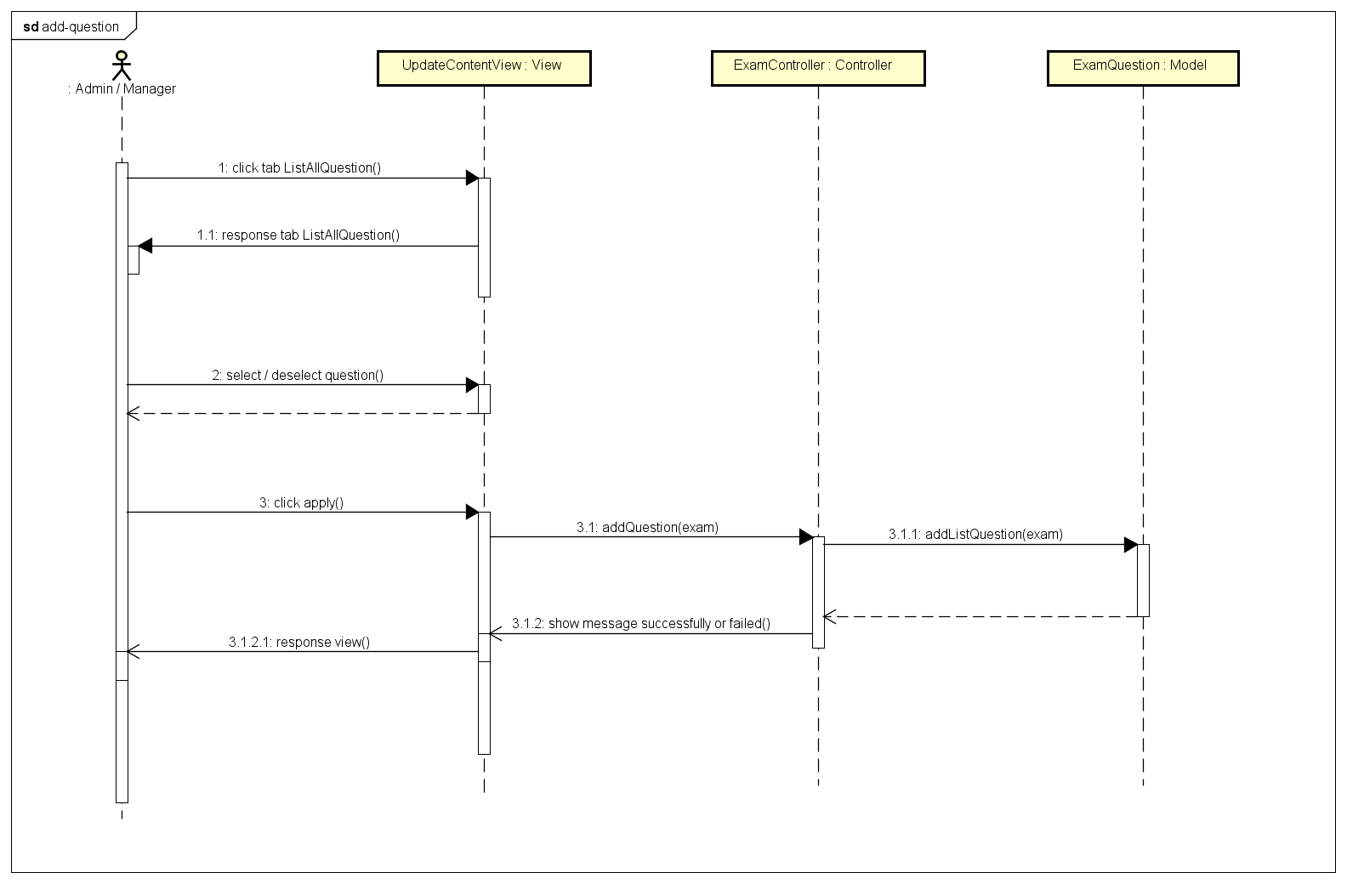
Function: Add question
Sequence diagram

Slide 39
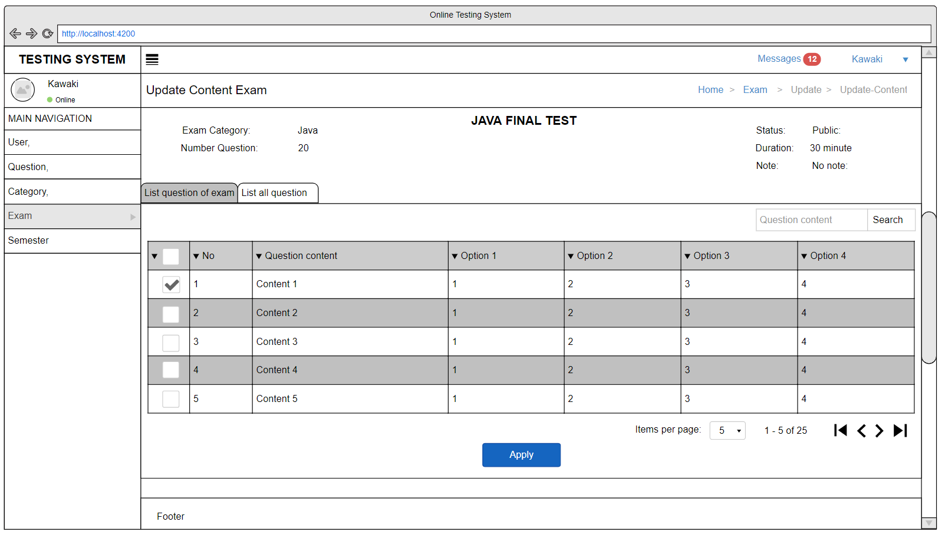
Function: Add question
Screen design

Slide 40
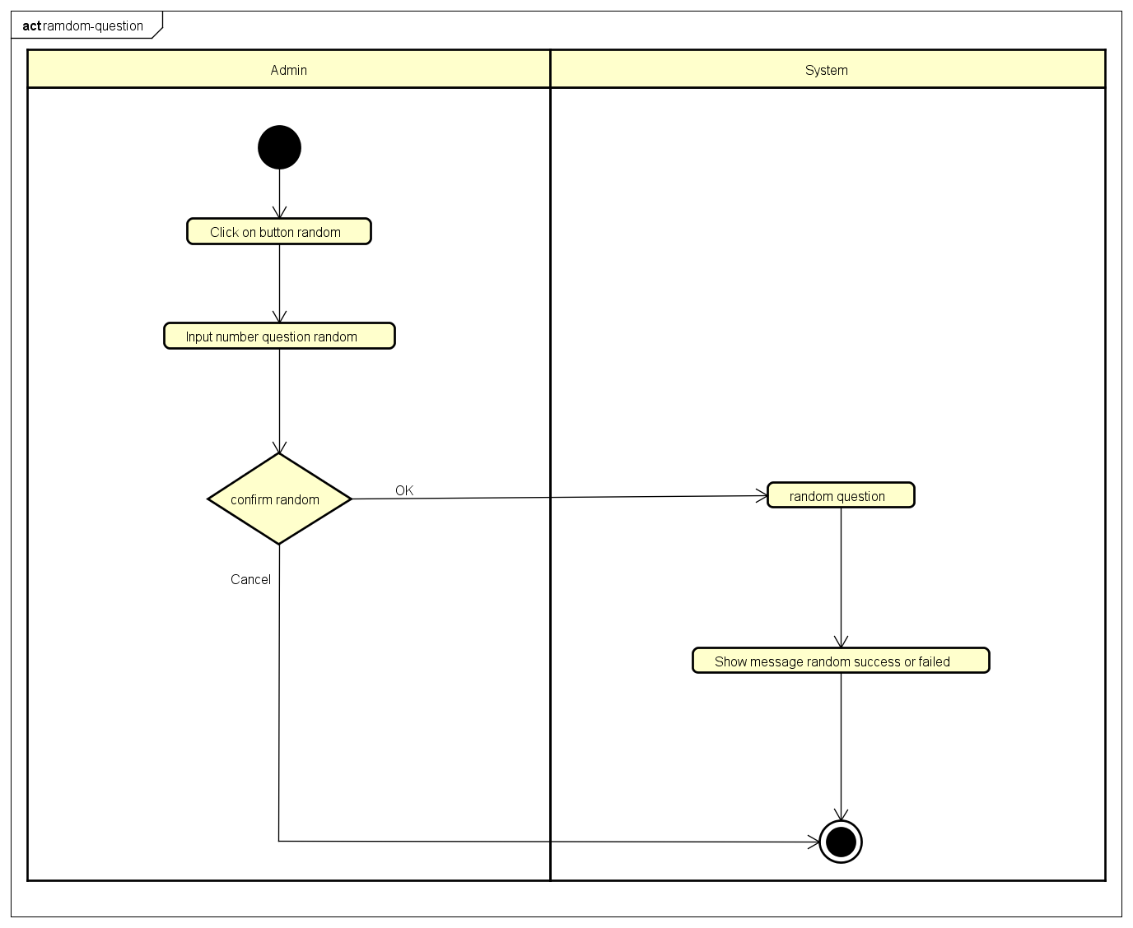
Function: Random question
Activity diagram

Slide 41
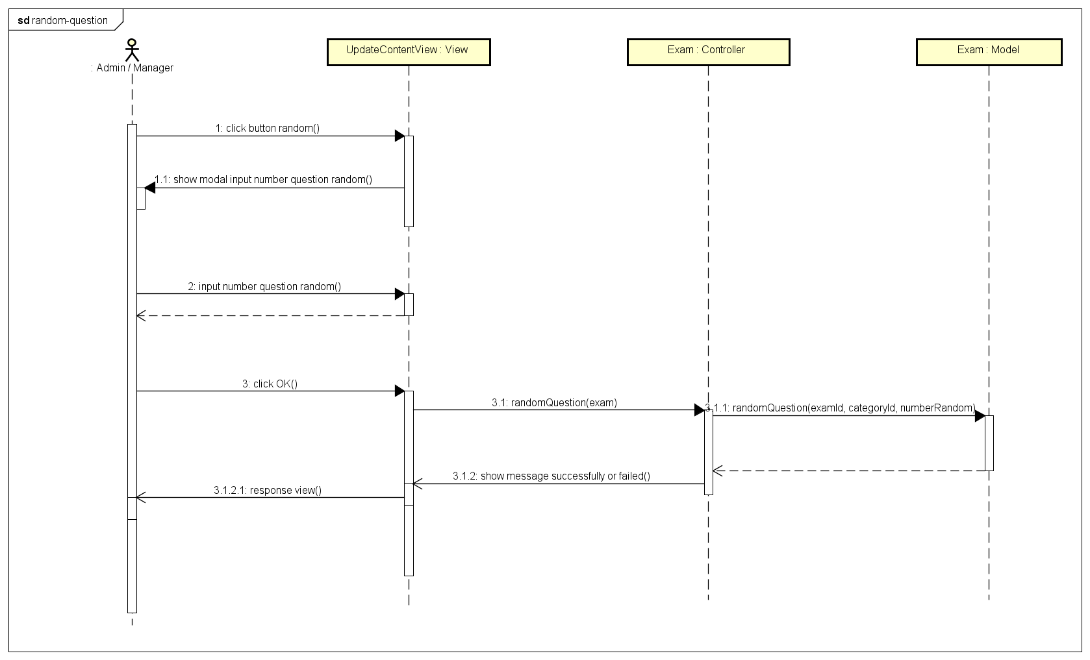
Function: Random question
Sequence diagram

Slide 42
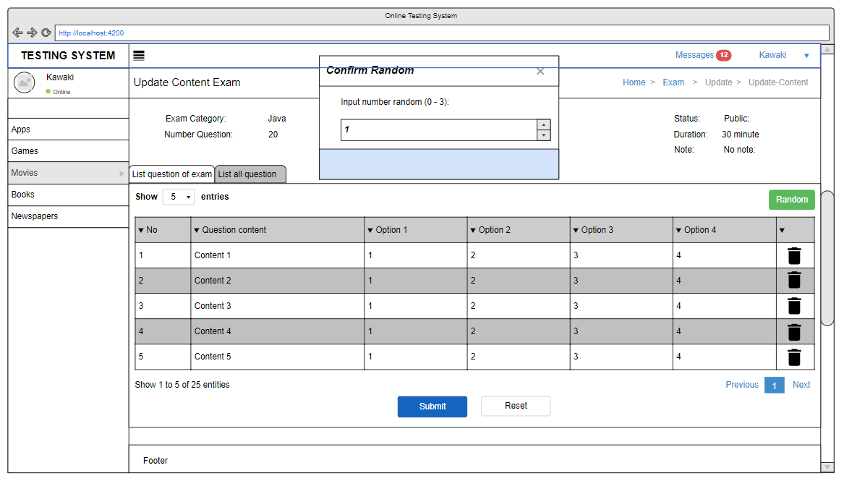
Function: Random question
Screen design

Slide 43
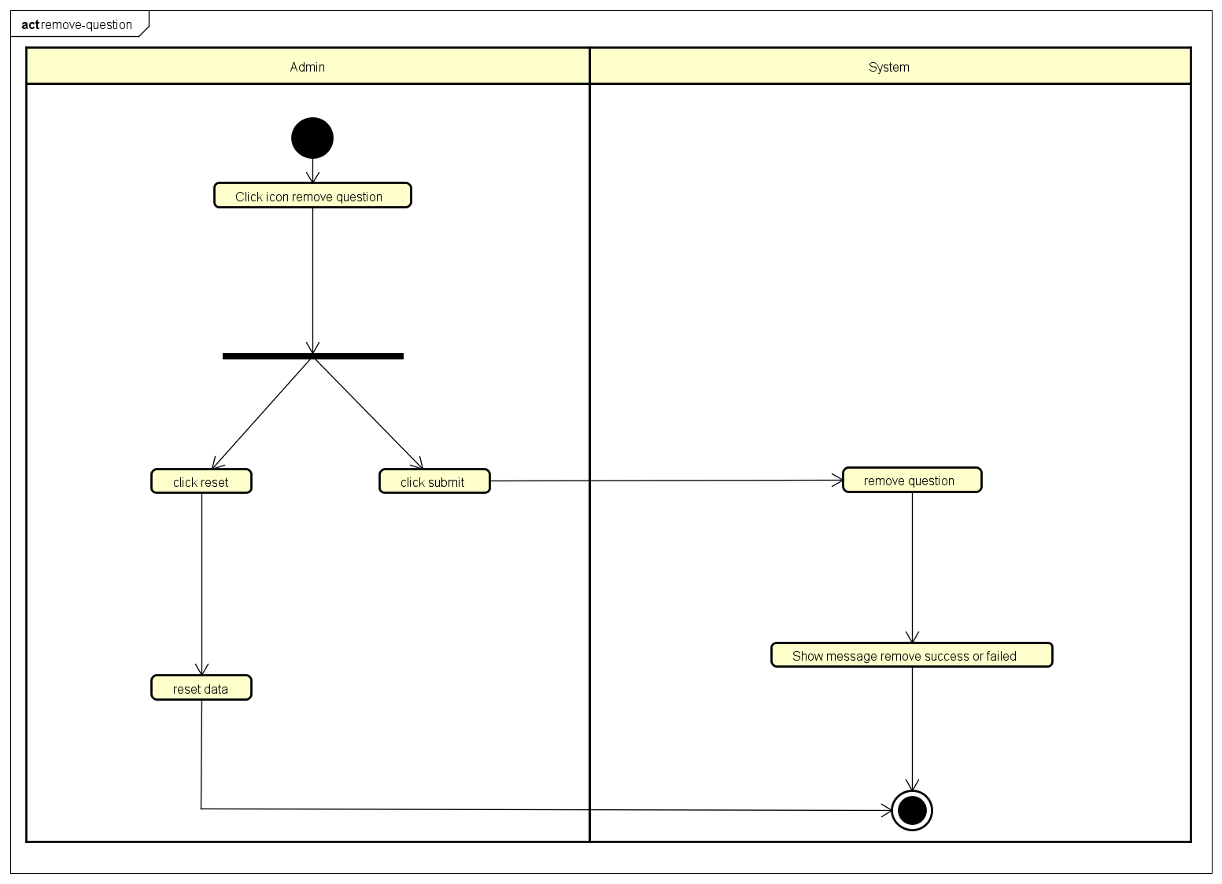
Function: Remove question
Activity diagram

Slide 44
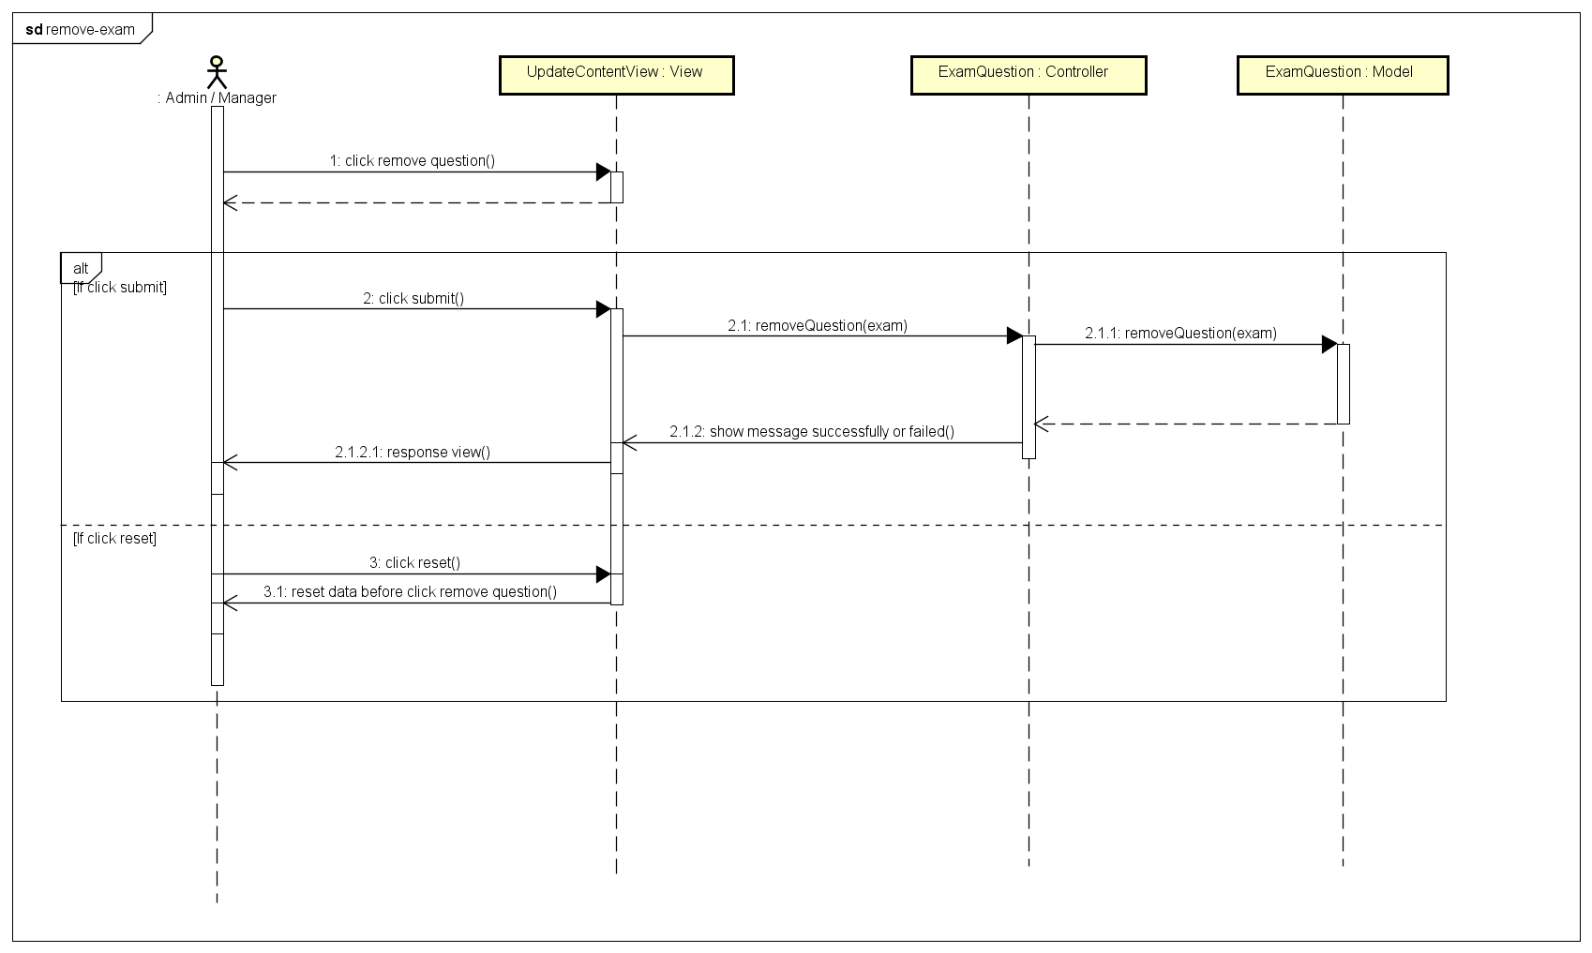
Function: Remove question
Sequence diagram

Slide 45
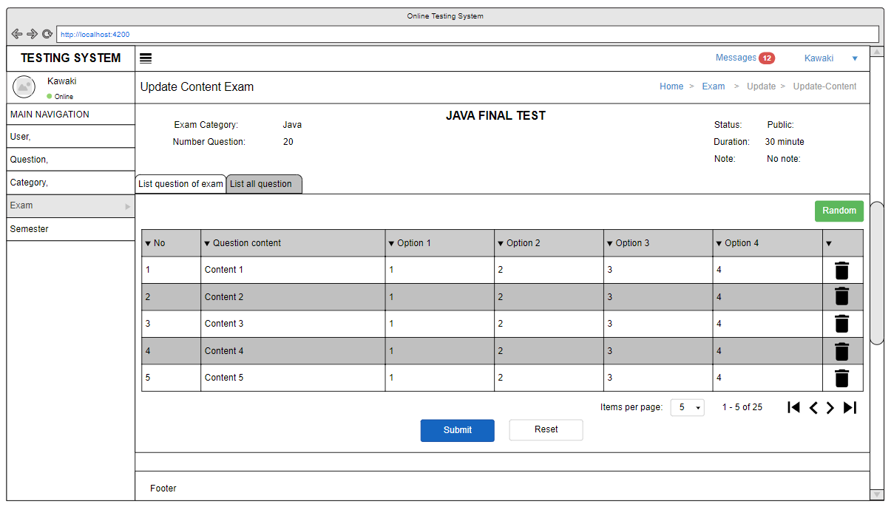
Function: Remove question
Screen design

Slide 46
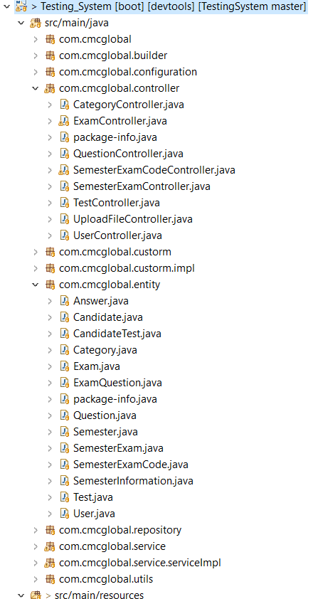
Source tree

Slide 47
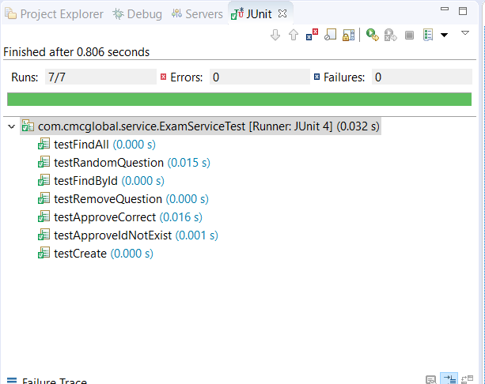
JUnit

Slide 48
Demo
Show list exams: search, sort, filter
Show detail exam
Export exam
Create exam
Import exam
Show homepage
Show profile page
Update exam

Slide 49
Weaknesses and shortcomings
jUnit test case is not enough
Website Interface is beautiful yet

Slide 50
Solutions and future work
Beautiful interface
Complete missing function
Full testing

Slide 51
Thank you !

