Slide 1

Project Title: Analyzing Seasonal Patterns, Agricultural Productivity, Resource Usage and Economic Performance
BY: SONAKSHI JAIN
COLLEGE: ABES ENGINEERING COLLEGE
AICTE STU ID: STU6831ba2f779071748089391

Slide 2

PROBLEM STATEMENT
Agricultural performance is influenced by seasonal variations in environmental conditions, farming practices, resource availability and market conditions. However, raw agricultural data does not clearly explain how crop performance changes across different seasons. This project aims to analyze agricultural data across seasons to identify meaningful patterns, trends, relationships and variations in crop yield, production, resource usage and economic performance. The analysis will help in understanding seasonal differences and support better data-driven agricultural planning.

Slide 3
Project Description
Seasonal Agriculture Performance Analysis is a data analytics project that examines agricultural activities across different seasons and identifies factors that influence agricultural performance. The project involves collecting and understanding the dataset, cleaning and preparing the data, performing exploratory data analysis, comparing agricultural performance across seasons, and identifying relationships between environmental conditions, resource usage and economic outcomes.
The analysis focuses on parameters such as crop yield, production, rainfall, temperature, soil conditions, irrigation, fertilizer usage, water consumption, revenue, cost and profit. Various statistical techniques and visualizations are used to identify seasonal patterns and meaningful differences. The final insights are used to develop data-driven recommendations for better seasonal agricultural planning.

Slide 4

WHO ARE THE END USERS?
Farmers
Select suitable crops for different seasons
Improve irrigation and resource usage
Understand productivity patterns
Government & Agricultural Policymakers
Support agricultural planning
Identify seasonal challenges
Improve resource allocation
Agricultural Planners
Compare seasonal performance
Plan crop production
Identify areas requiring improvement
Agricultural Researchers
Study relationships between environmental conditions and crop performance
Analyze seasonal agricultural trends
Agribusinesses
Understand production and profitability
Support business and crop-planning decisions
Data Analysts
Monitor agricultural KPIs
Generate reports and dashboards
Identify trends and patterns

Slide 5

Technology Used
Python – Data analysis and processing
Pandas – Data cleaning, manipulation and aggregation
NumPy – Numerical calculations
Matplotlib – Data visualization
Seaborn – Statistical charts and correlation analysis
Scikit-learn – Statistical/machine-learning analysis
Jupyter Notebook / Kaggle – Development and analysis environment

Slide 6
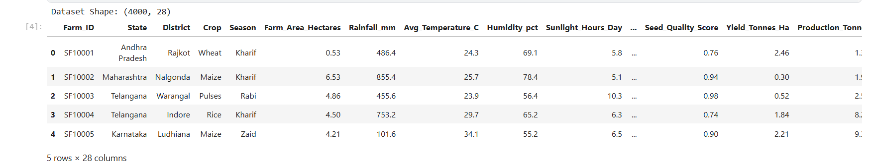
RESULTS
The dataset contains 4,000 agricultural farm records and 28 variables. Each record represents a farm and includes information about its location, crop, season, environmental conditions, soil characteristics, resource utilization, production and economic performance. The dataset is used to analyze seasonal variations and identify factors associated with agricultural productivity and profitability.

Slide 7
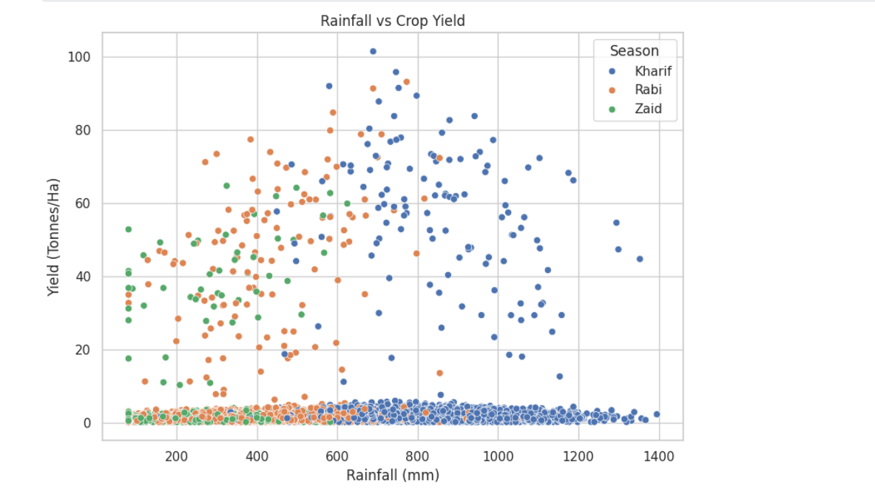
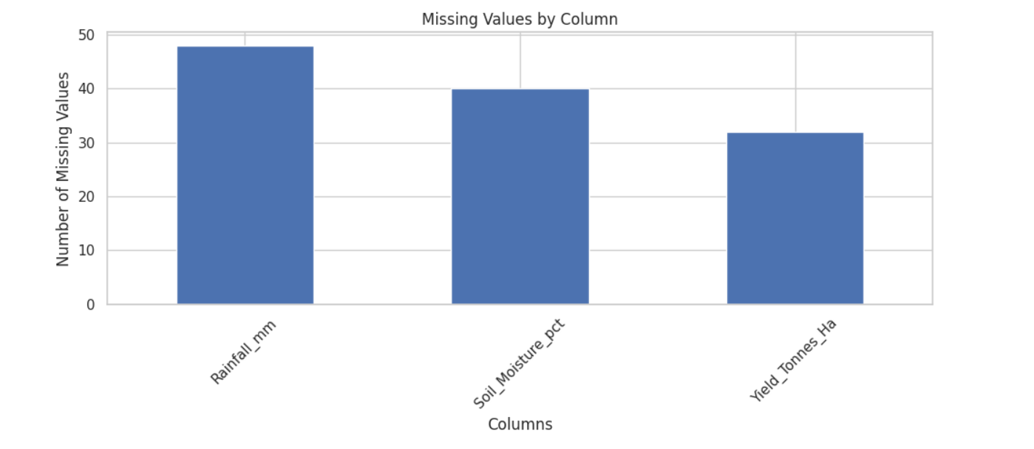
RESULTS
The dataset contained missing observations mainly in rainfall, soil moisture and crop yield. Rainfall had the highest number of missing values. Appropriate data-cleaning and imputation techniques were applied to prepare the dataset for further analysis.
The rainfall-yield analysis indicates that rainfall alone does not determine crop yield. Although some higher-yield observations occur at moderate to high rainfall levels, many observations remain at relatively low yields even when rainfall is high. This suggests that other factors such as soil conditions, crop type, irrigation, fertilizer and temperature may also influence agricultural productivity.

Slide 8
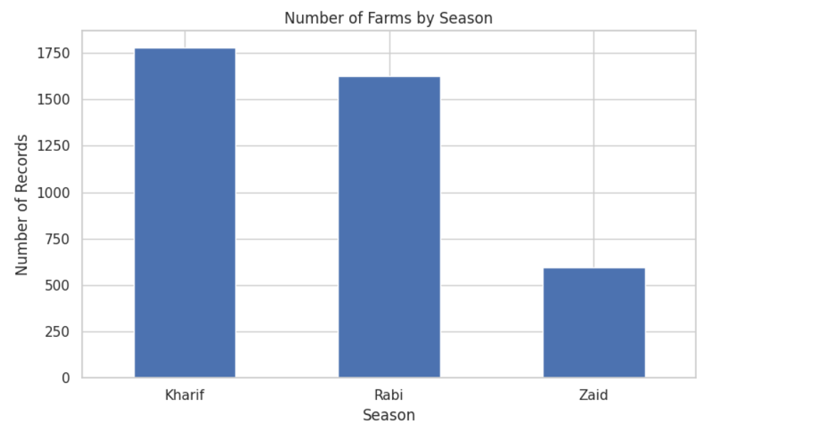
RESULTS
The dataset contains more agricultural records for Kharif and Rabi seasons compared with Zaid. Kharif represents the largest share of observations, whereas Zaid has considerably fewer records. Therefore, seasonal comparisons should consider the difference in sample sizes.

Slide 9
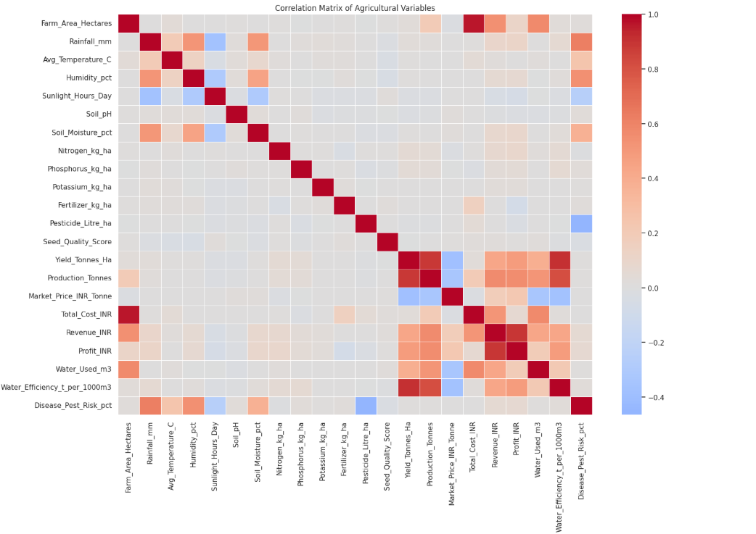
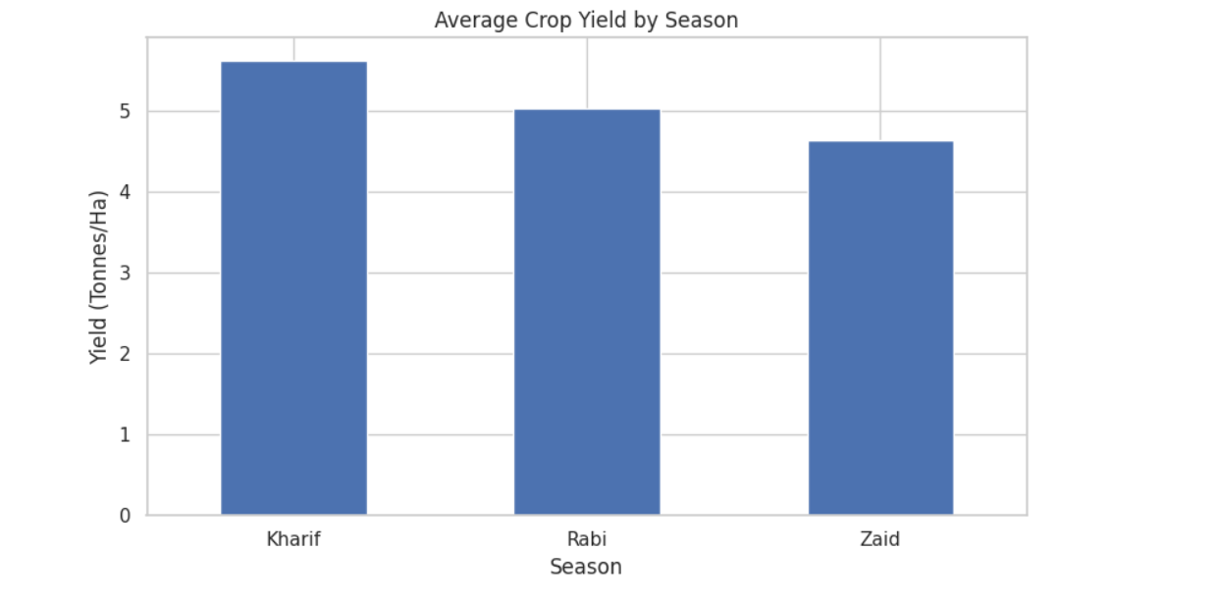
RESULTS
The analysis shows that crop productivity varies across seasons. Kharif records the highest average yield of approximately 5.64 tonnes per hectare, followed by Rabi at 5.08 tonnes per hectare. Zaid has the lowest average yield at approximately 4.67 tonnes per hectare.
The correlation analysis was used to understand relationships among agricultural, environmental and economic variables. Yield shows a strong positive relationship with production and water efficiency. Economic variables such as revenue and profit are also positively related. However, correlation indicates association and does not establish a direct cause-and-effect relationship.

Slide 10
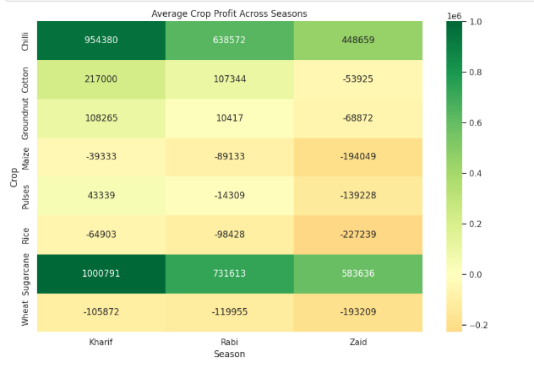
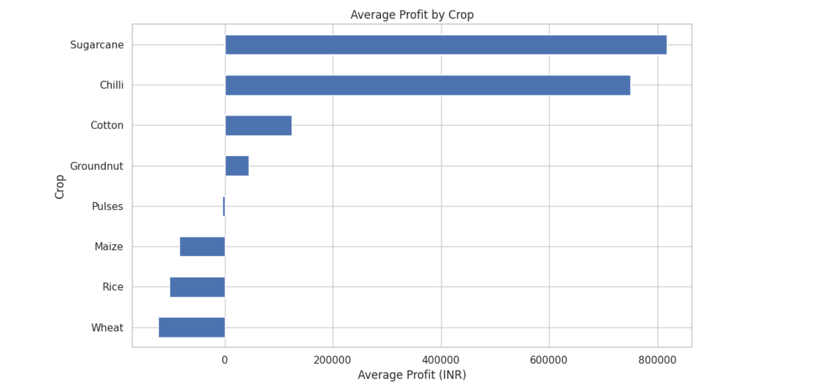
RESULTS
Crop profitability varies substantially across seasons. Sugarcane and Chilli remain the strongest profit-generating crops across all seasons. Several crops, including Maize, Rice and Wheat, show negative average profitability. Zaid generally demonstrates weaker financial performance across multiple crops.
Profitability varies considerably across crops. Sugarcane demonstrates the highest average profit, followed by Chilli and Cotton. In contrast, Wheat, Rice and Maize show negative average profitability in the dataset. This indicates that crop selection and the associated production economics play an important role in overall agricultural performance.

Slide 11
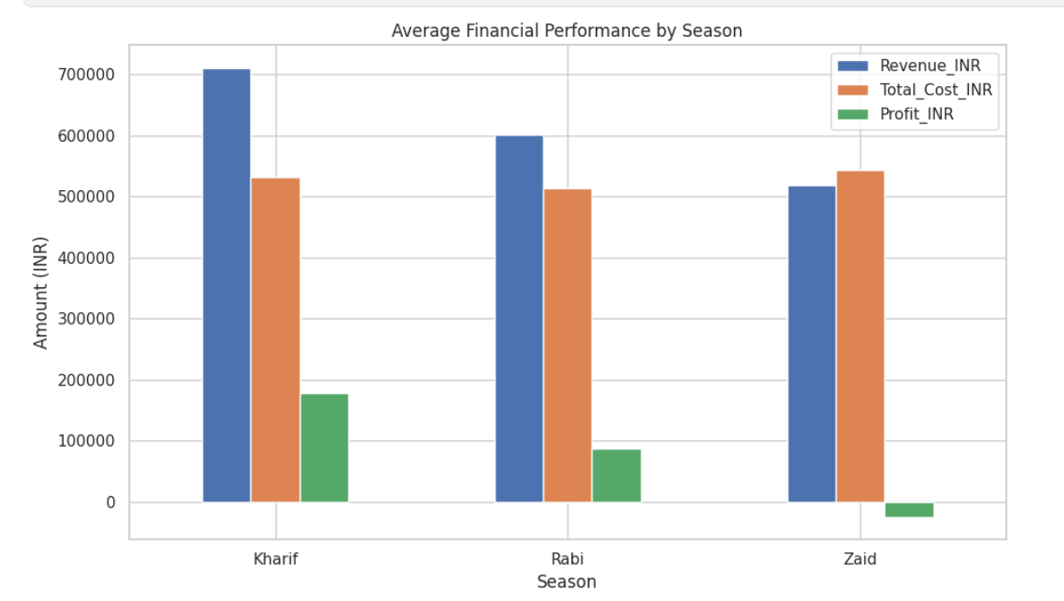
RESULTS
Kharif demonstrates the strongest financial performance, with the highest average revenue and profit. Rabi also generates positive average profit. In contrast, Zaid has higher average costs than revenue, resulting in negative average profitability. This indicates that Zaid requires further investigation into production costs, resource utilization and crop selection.

Slide 12
Future scope
The project can be further expanded by incorporating multi-year agricultural data, real-time weather information, satellite imagery and market-price data. Machine learning models can be developed to predict crop yield, profitability and disease or pest risk for different seasons. An interactive Power BI dashboard can also be developed to allow farmers, agricultural planners and policymakers to monitor seasonal performance and make data-driven decisions.
Future development can also include real-time irrigation monitoring, crop recommendation systems, weather-based alerts and regional-level agricultural forecasting, making the system more useful for practical agricultural planning.

Slide 13
GitHub Link
https://github.com/Sona0223/Seaosonal-agricultural-analysis-.git

Slide 14

VOIS Course completion certificate - Course name- Data Visualization

Slide 15
Thank you
.
.

