Slide 1
Project on
The Battle of Neighborhoods Finding a Better Place in Scarborough, Toronto

Slide 2
Introduction
To help people in exploring better facilities around their neighborhood
To create an analysis of features for a people migrating to Scarborough to search a best neighborhood as a comparative analysis between neighborhoods.
The features include median housing price and better school according to ratings.

Slide 3
Data Section
Foursquare API Data:
Foursquare is a location data provider with information about all manner of venues and events within an area of interest. Such information includes venue names, locations, menus and even photos
Data link
https://en.wikipedia.org/wiki/List_of_postal_codes_of_Canada:_M

Slide 4
Conti..
The data retrieved from Foursquare contained information of venues within a specified distance of the longitude and latitude of the postcodes
1. Neighborhood
2. Neighborhood Latitude
3. Neighborhood Longitude
4. Venue
5. Name of the venue e.g. the name of a store or restaurant
6. Venue Latitude
7. Venue Longitude
8. Venue Category

Slide 5
Methodology
K-means clustering Algorithm
Specify number of clusters K.
Initialize centroids by first shuffling the dataset and then randomly selecting K data points for the centroids without replacement.
Keep iterating until there is no change to the centroids. i.e assignment of data points to clusters isn’t changing.
Compute the sum of the squared distance between data points and all centroids.
Assign each data point to the closest cluster (centroid).
Compute the centroids for the clusters by taking the average of the all data points that belong to each cluster.

Slide 6
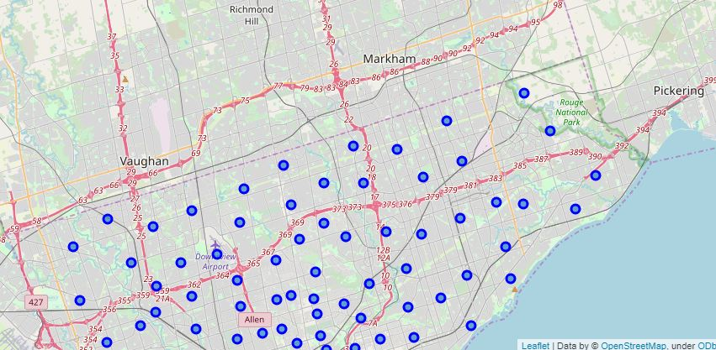
Results
Map of Clusters in Scarborough

Slide 7
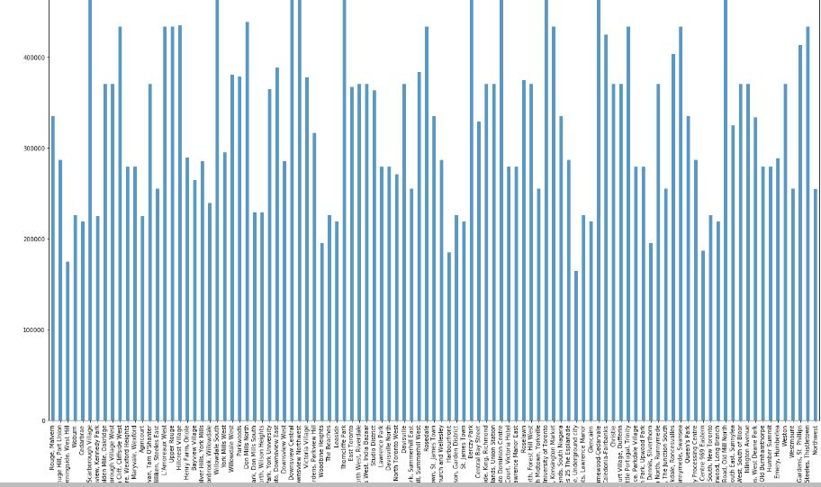
Conti..
Average Housing Price by Clusters in Scarborough

Slide 8
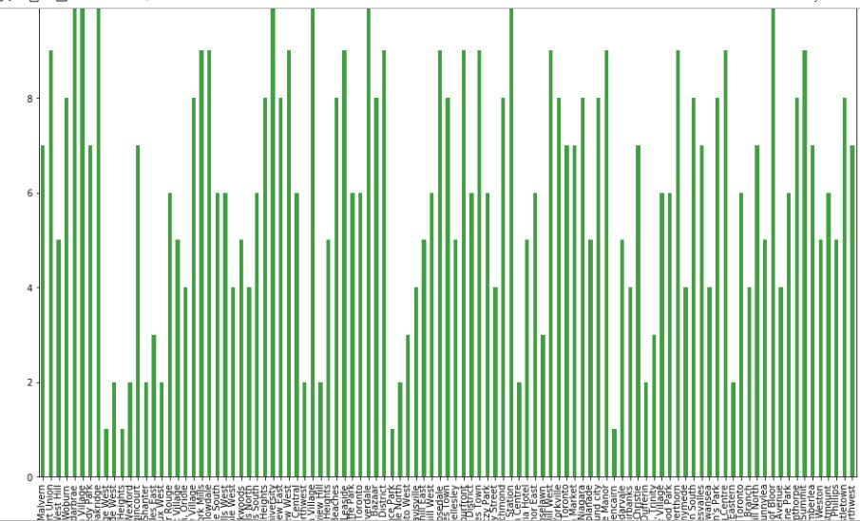
Conti..
School Ratings by Clusters in Scarborough

Slide 9
Conclusion
In this project, using k-means cluster algorithm I separated the neighborhood into 10(Ten) different clusters and for 103 different lattitude and logitude from dataset, which have very-similar neighborhoods around them. Using the charts above results presented to a particular neighborhood based on average house prices and school rating have been made.

