Slide 1

InsightStream: Navigate the News Landscape
BY Sonashree V
Dheekshitha K, Lakshitha B, Sweatha K M, Jennifer A L

Slide 2
Introduction: InsightStream
Interactive news web app
Built using React.js
Delivers live news across categories
Intuitive interface to stay informed
1
Live Content
2
Categorized
3
Easy to Use
Get the latest updates
Browse topics of interest
Stay informed simply

Slide 3





Project Objectives
Live News Content
From external APIs
Category Filters
For targeted browsing
Newsletter Subscription
Keep users engaged
Responsive Design
Optimized for all devices
Interactive Features
Enhance user experience

Slide 4
Technology Stack
React.js
Axios
React Router DOM
CSS
Frontend framework
API integration
Navigation
Styling

Slide 5
Key Features
Navbar Navigation
Trending News
Display
Category-Based Filtering
Search Functionality
Newsletter Subscription
Responsive Design

Slide 6
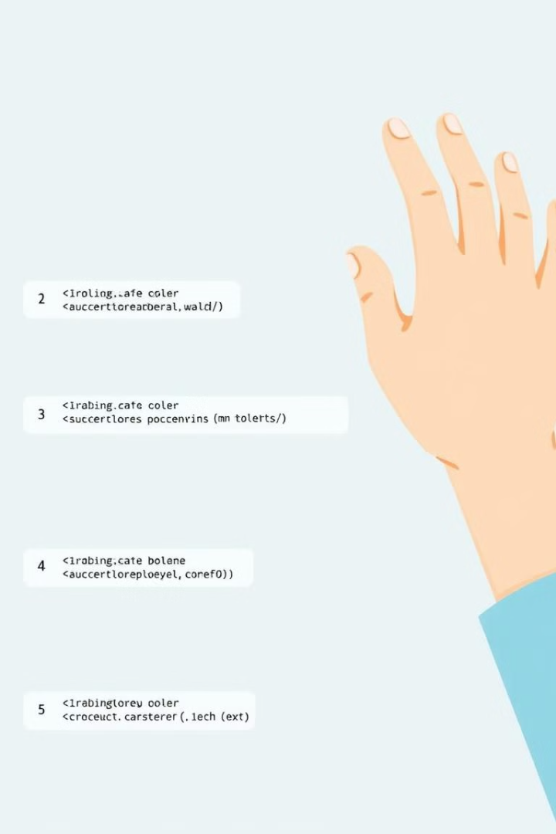
Project Setup Guide
Install Node.js
Install Dependencies
Start Dev Server
Browse Articles

Slide 7
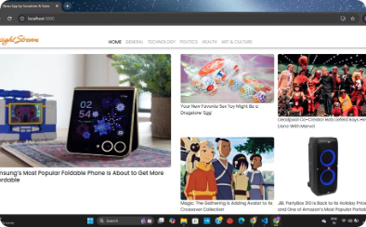
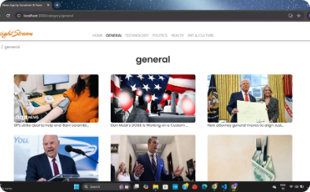
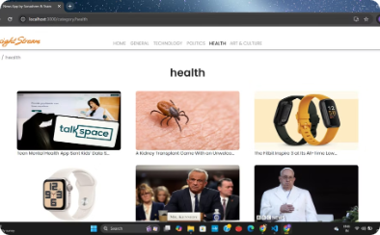
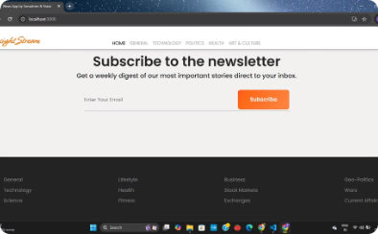
InsightStream Screenshots
Home Page
Category Page - General
Category Page - Health
Newsletter Subscription

Slide 8

Challenges Encountered
1
API Integration
Failure handling
2
Debugging
Network requests
3
Component Architecture
4
Responsive Layout
Design

Slide 9





Future Enhancements
Dark Mode
User Authentication
2
1
3
Multi-Language Support
5
Advanced News API
4
Integration
Commenting System

Slide 10
Conclusion
InsightStream delivers dynamic news content with modern web technologies.
Project demonstrates API integration, responsive design, and interactive features.
1
Dynamic Content
2
Modern Tech
3
API Integration
Always up to date
Cutting-edge design
Seamless data flow
4
Responsive Design
5
Interactive Features
Optimized for all

