Slide 1


Slide 2

INTRODUCTION
Aimed to provide movie booking system to customers to purchase the movie ticket easily.
Two user interface layers:
  Guest Interface (CINESHOW -GI):Customer can book the movie ticket, cancel booking.
  Movie Management Interface (CINESHOW -MMI):Admin can add/edit/delete the movie/theater detail and Staff can print the movie ticket.

Slide 3

BENEFITS
Availability
Enhancement
Automation
Accuracy
User-friendliness
Reusability
Security

Slide 4

CONTEXT DIAGRAM
Account Details
Booking Report
Movie Details
Movie Report
Theater Details
Online Movie Ticket Booking System
Temporary Movie Ticket
Customer Details
Theater Statistics Report

Slide 5
Data Flow Diagram Level I

Slide 6
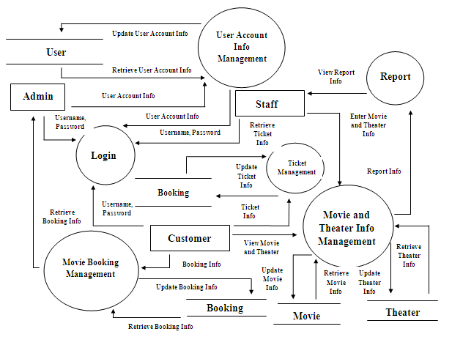

Slide 7
Data Flow Diagram Level II

Slide 8
Movie and Theater Management
Movie
Retrieve Movie Info
Customer
Retrieve Movie Info
Display Movie Info
Retrieve Theater Info
Display Theater Info
Update Movie Info
Retrieve Theater Info
Validate Process Movie and Theater Management
Enter Movie and Theater Info
Theater
Staff
Update Theater Info

Slide 9
Login
Login Id, Password
Update/Delete/ Enter User Account Info
Admin
User
Login Id, Password
Staff
Login
Retrieve User Account Info
Login Id, Password
Customer

Slide 10
User Account Management
Display User Account Info
Retrieve User Account Info
View User Account Info
User Account Info Details
Admin
Validate User Account Info Management
Enter User Account Info
Update User Account Info

Slide 11
Ticket Management
Customer
View Ticket Info
View Movie Info
View Theater Info
Display Ticket Info
Display Movie Info
Display Theater Info
Retrieve Ticket Info
Retrieve Movie Info
Ticket Details
Retrieve Theater Info
Retrieve Ticket Info
Movie Details
Update Ticket Info
Theater Details
Update Movie Info
Retrieve Theater Info
Retrieve Movie Info
Validate Ticket Management Process
Update Theater Info

Slide 12
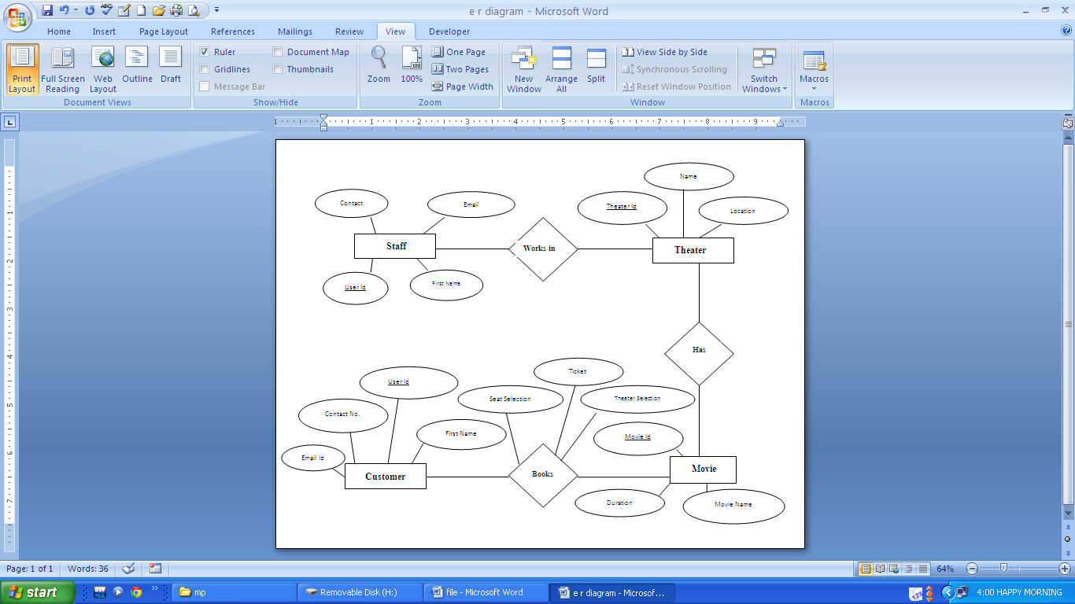
Entity Relationship Diagram

Slide 13
Use Case Diagram

Slide 14
User Account Info Management
Login
Admin
Book Movie Ticket
View Movie and Theater Info
Movie and Theater Info Management
Report Generation
Staff
Customer Info Entry
Customer Info Management
Ticket Generation Management
Customer

Slide 15
SCREENSHOTS

Slide 16
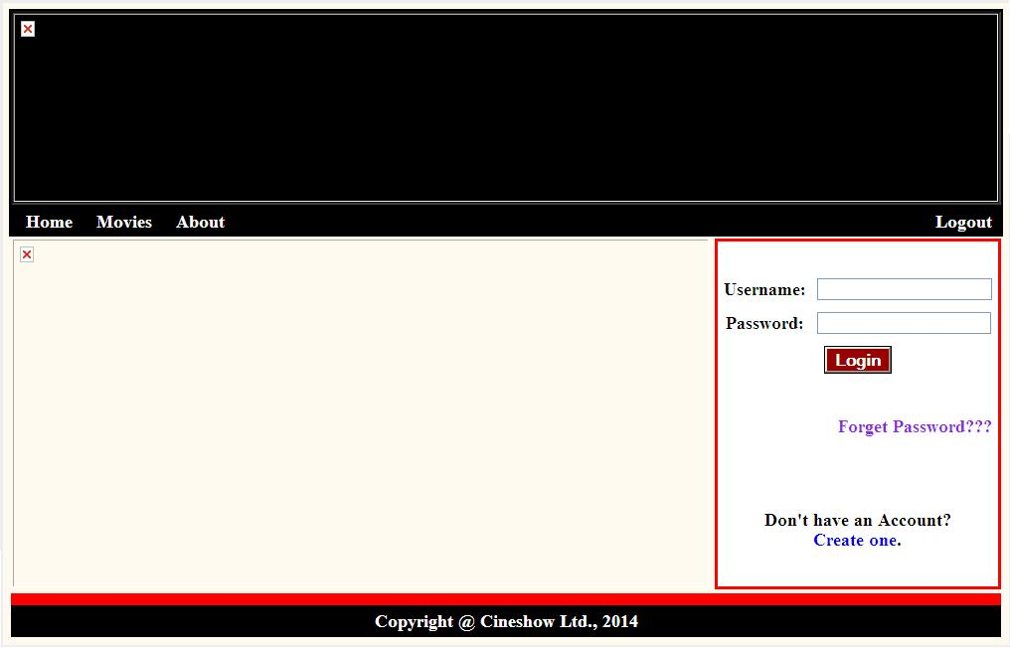



Slide 17
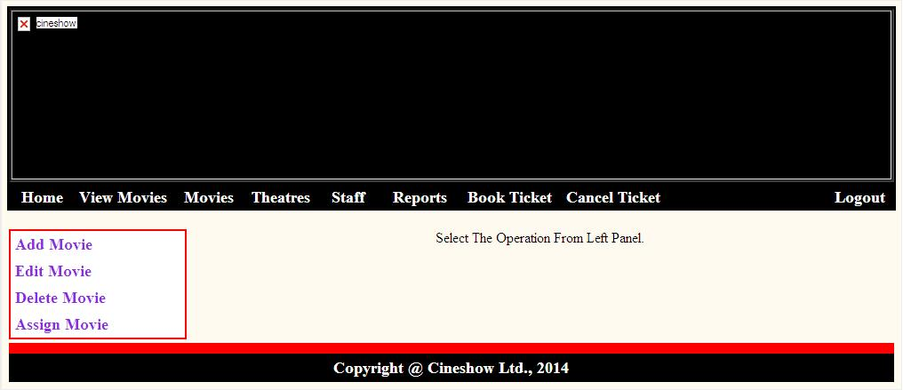

Slide 18
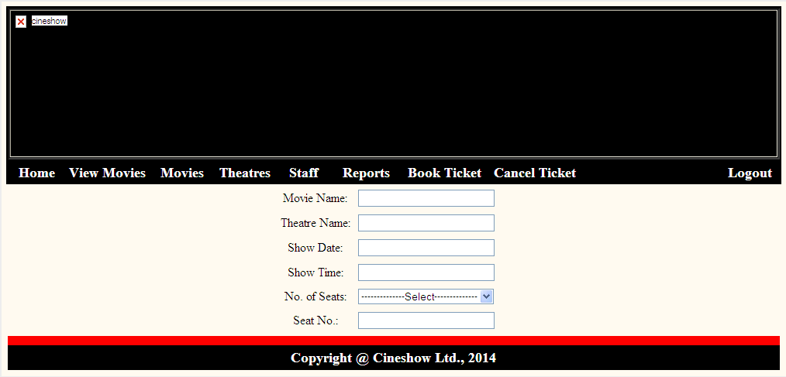
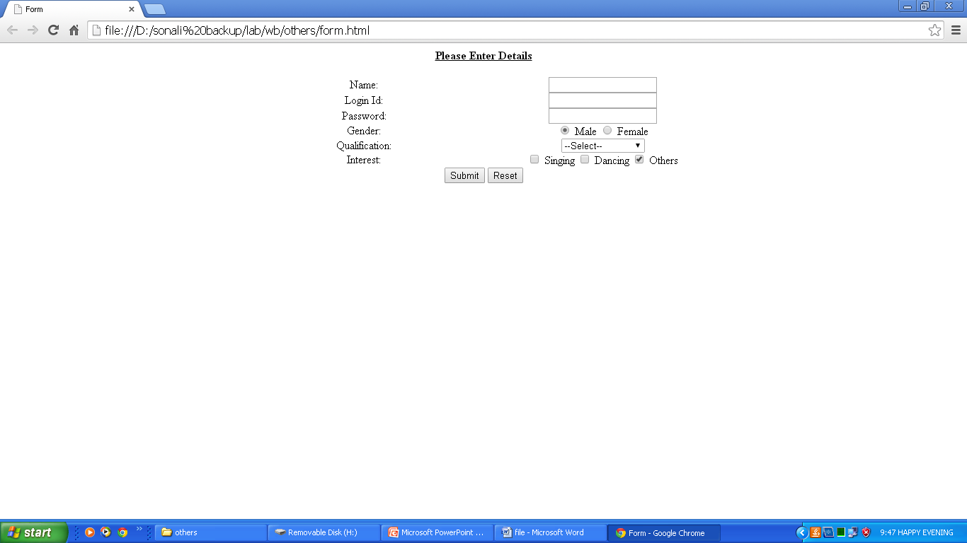

Slide 19

THANK YOU!!!
BY:
Sonali
AU124060202002P
BCA + MCA (INTEGRATED)

