Slide 1


Slide 2

INTRODUCTION
Aimed to provide movie booking system to customers to purchase the movie ticket easily.
Two user interface layers:
Guest Interface (CINESHOW -GI):Customer can book the movie ticket, cancel booking.
Movie Management Interface (CINESHOW -MMI):Admin can add/edit/delete the movie/theater detail and Staff can print the movie ticket.

Slide 3

BENEFITS
Availability
Enhancement
Automation
Accuracy
User-friendliness
Low Cost
Reusability
Security

Slide 4


INPUTS
Account Details
Movie Details
Theater Details
Customer Details
Booking Details

Slide 5
OUTPUTS
Temporary Movie Ticket
Movie Report
Theaters Report
Booking Report

Slide 6
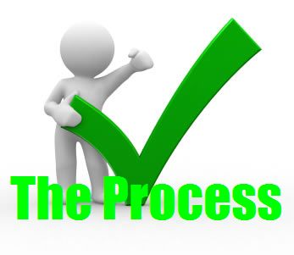
PROCESSES
Login
Movie and Theater Info Management
User Account Info Management
Report Generation
Ticket Generation

Slide 7

F RMS

Slide 8
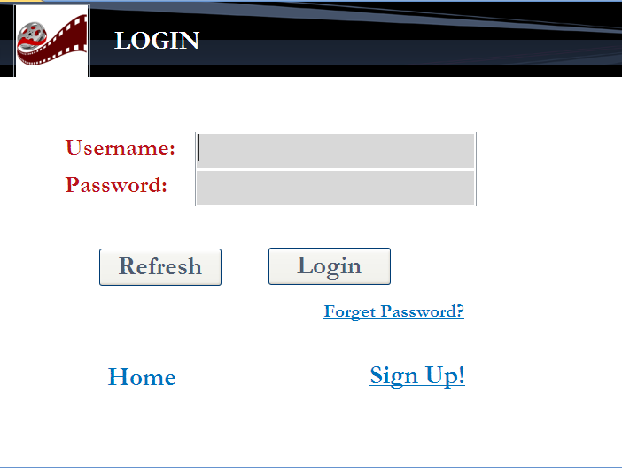

Slide 9
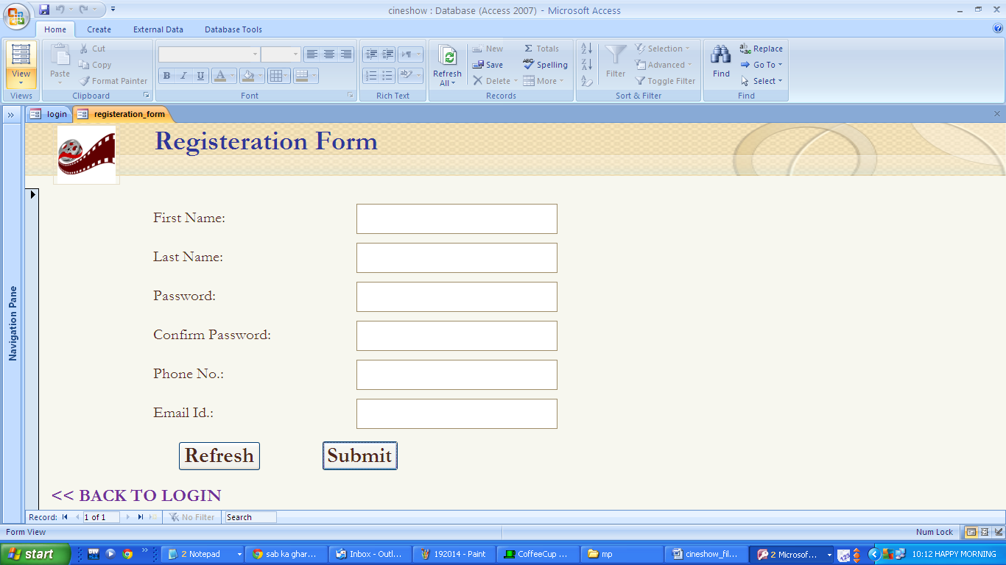

Slide 10
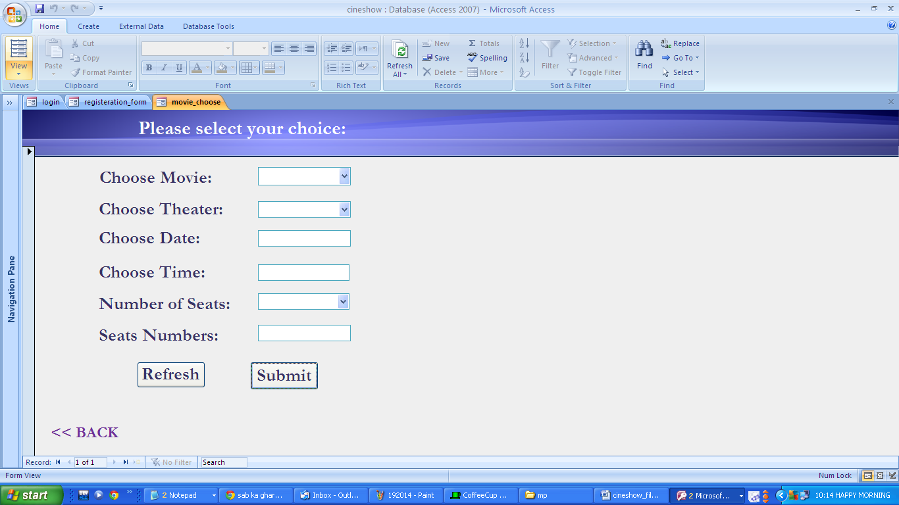

Slide 11
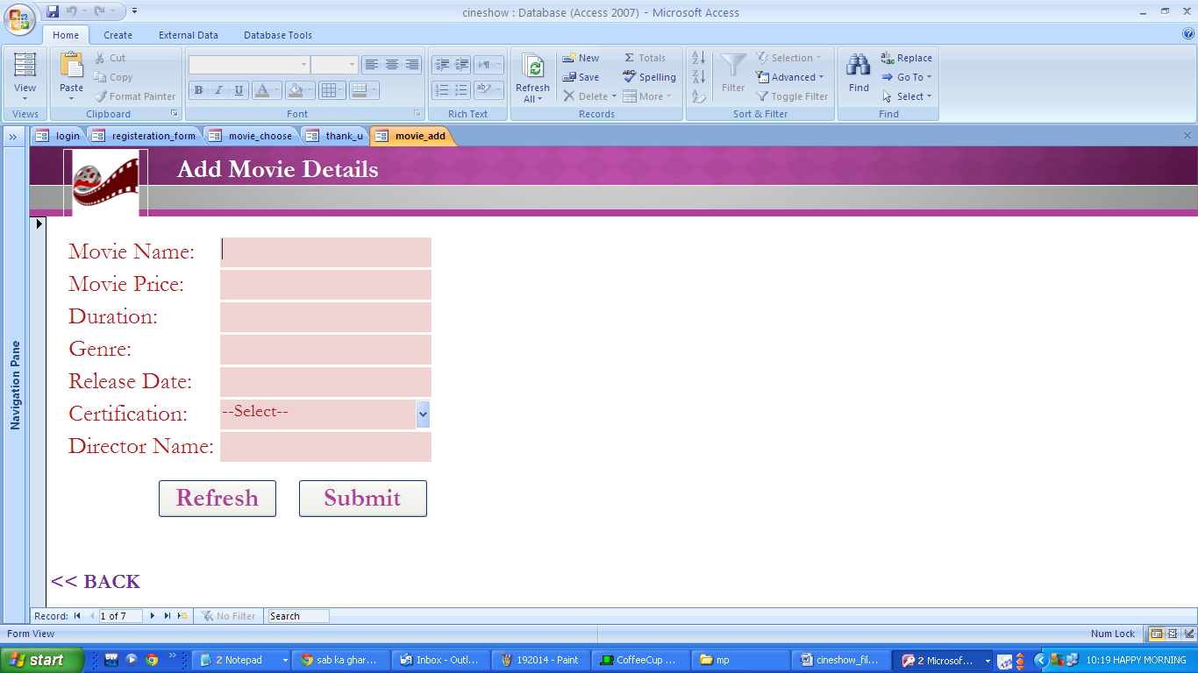

Slide 12

TEMPORARY

Slide 13
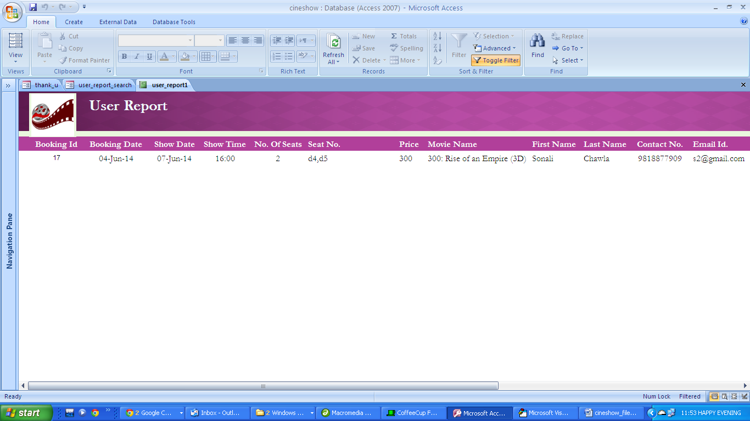
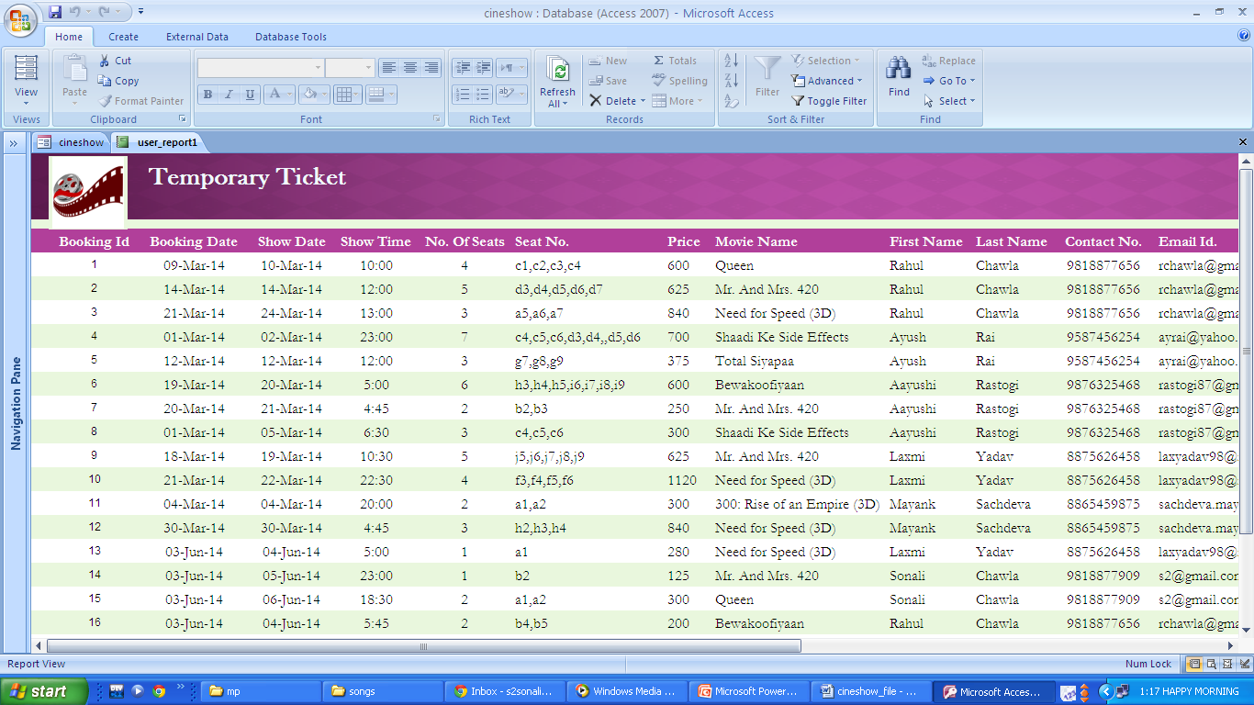


Slide 14

REP RTS

Slide 15
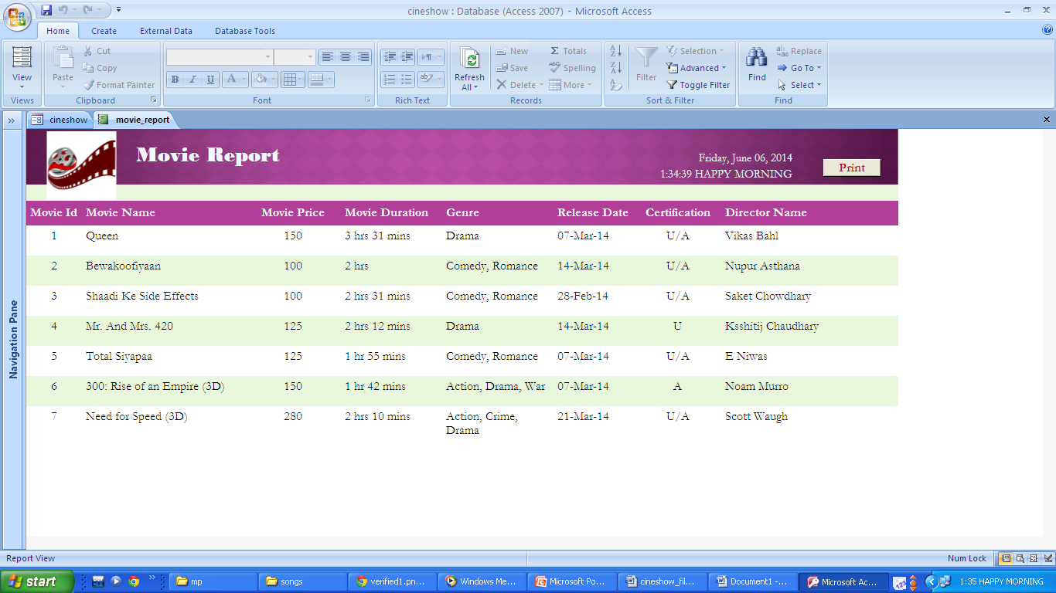

Slide 16
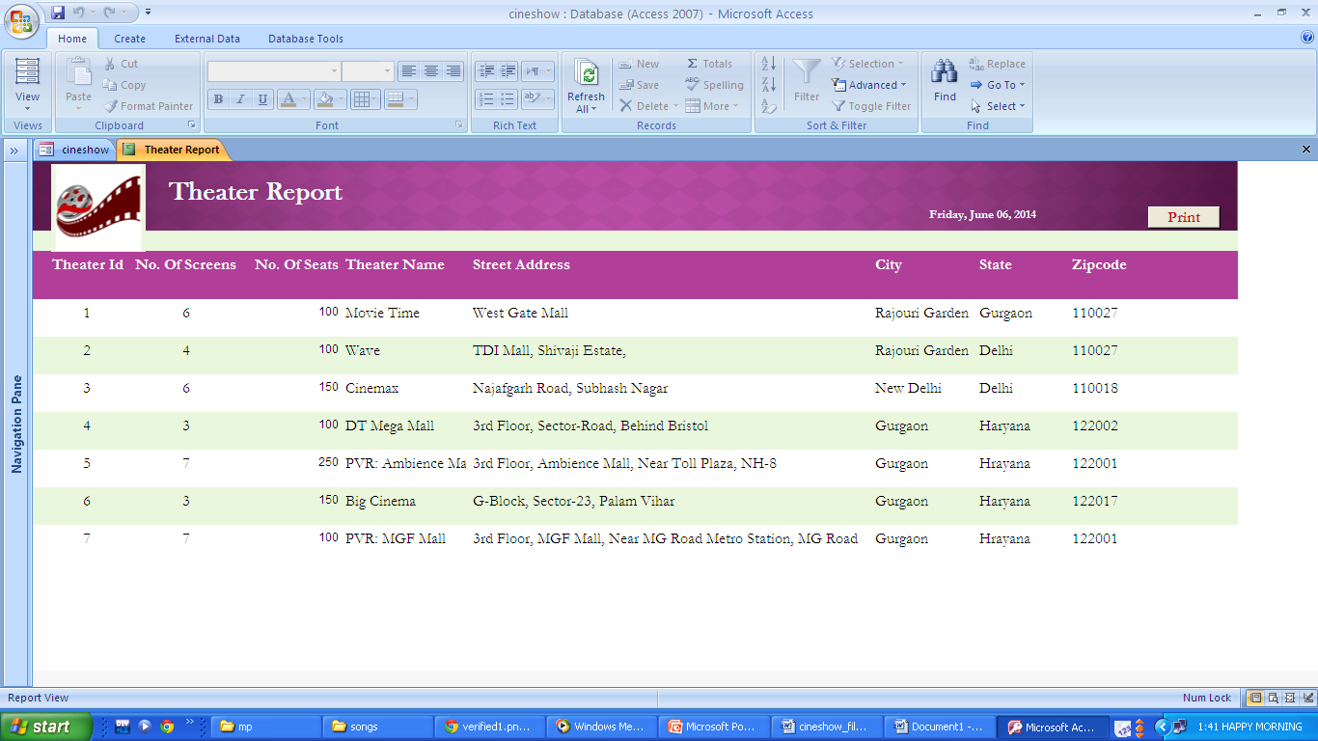

Slide 17
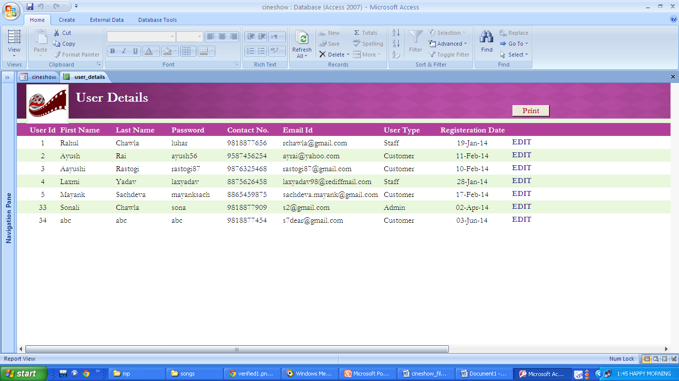

Slide 18

THANK YOU!!!
BY:
Fortune (AU12006030101 P)
Nisha (AU124060202003P)
Sonali (AU124060202002P)

