Slide 1

SPECMAC
The SPECie MAChine
Sonali Chawla
Bhawna Singla
Nisha

Slide 2
INTRODUCTION
SPECMAC: the Specie Machine is a project made for android users to provide information to the android users about the specie scanned from their smart phone.
The framework Specmac is an inspiration from cartoon series Pokémon
The algorithm developed will identify all the features of the specie and match it with the training set to identify the specie.
Machine Learning, a process to make the machine learn all the working is used to make the framework

Slide 3
OBJECTIVE
Build Android app to be used in zoologists for researching in wildlife.
Providing an interactive learning experience
Bridge the gap between Technology and Knowledge
Transmission of knowledge with fun
E-learning in Schools

Slide 4
BASIC CONCEPTS USED
Machine Learning
Making a machine learn something. For this, training set is required.

Slide 5
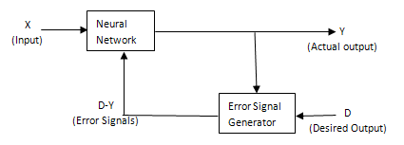
Supervised Learning
Supervised Learning
The learning here is performed with the help of a teacher

Slide 6
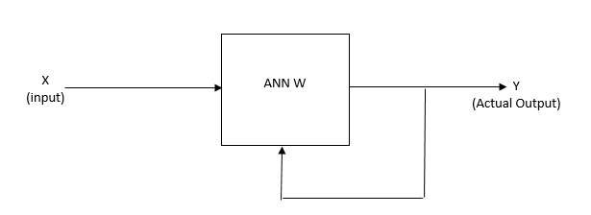
Unsupervised Learning
Unsupervised Learning
This type of learning is performed without the help of a teacher

Slide 7
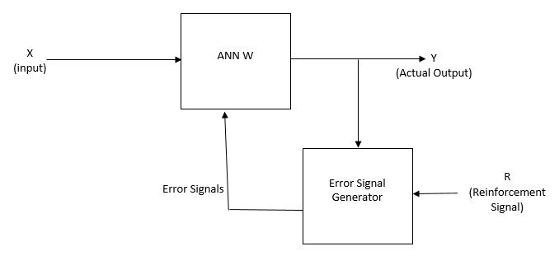
Reinforcement Learning
Reinforcement Learning
This type of learning is done using insertion of an error signal

Slide 8
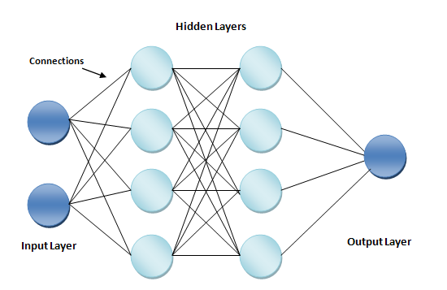
Deep Learning
Huge set of layers before the final layer that train the model very deeply and detailed
DEEP LEARNING
ISKI EXPLANATION NI SAMAJH AAI

Slide 9
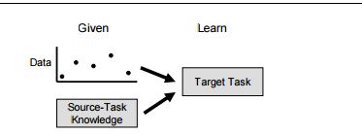
Transfer Learning
Transferring knowledge from one task to another related task. It needs another set of information from the first system to train second system

Slide 10
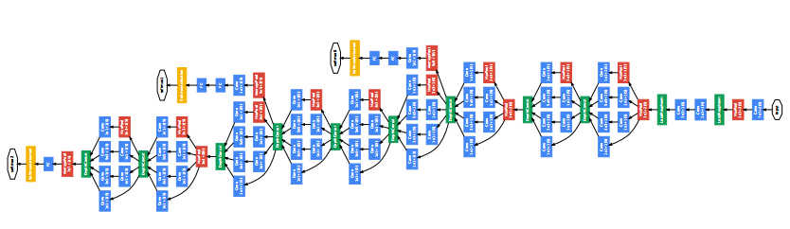
Inception of GoogLeNet
Inception model made by Google works on Tensorflow library. It is used for image classification. Up to 100 images can be input to train the system. GoogLeNet is the neural network algorithm working on this model used by Google.

Slide 11
METHODOLOGY
Conceptualizing the Framework
Software
Feasibility study
Collecting Training Data
Developing Identification Algorithm
Preparing Interfaces
Connecting all elements

Slide 12
TECHNOLOGY USED
Python
Android Studio
TensorFlow
Docker Toolbox
Anaconda

Slide 13
FEASABILITY STUDIES
Economical Feasible
Technical Feasible
Legal Feasible

Slide 14
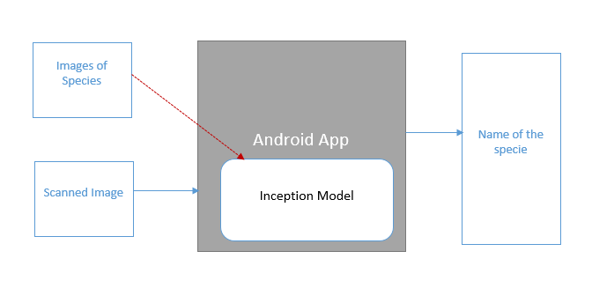
PROJECT STRUCTURE

Slide 15
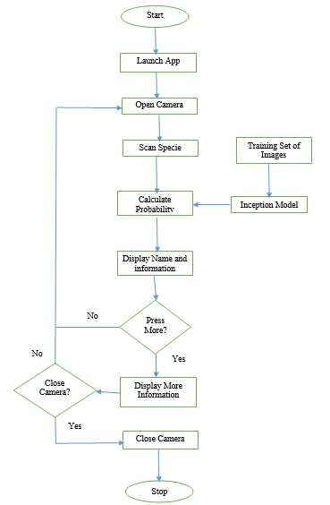
Flow Chart

Slide 16
WORK TILL NOW
Collecting Specie Images
S. No. | Name of the Specie | # of Images Collected
1. | Ant | 472
2. | Buffalo | 372
3. | Butterfly | 603
4. | Cat | 674
5. | Cow | 617
6. | Crow | 485
7. | Dog | 691
8. | Honey Bee | 617
9. | Horse | 793
10. | House Fly | 467
11. | Human | 1375
12 | Mosquito | 261
13. | Parrot | 501
14. | Pig | 401
15. | Pigeon | 496
16. | Rabbit | 654
17. | Rat | 413
18. | Sparrow | 616

Slide 17
Working with Tensorflow

Slide 18
Developing Android App

Slide 19
CONCLUSION
SPECMAC: the Specie Machine is an android application made to detect the species on this Earth.
The framework uses Tensorflow Library with inception model for deep learning
The model takes around 500 images per specie for training set.
Since smartphone is portable, thus, app can be used anywhere.

