Slide 1
Unit 5
System Modeling

Slide 2
System modelling is approach of developing system’s abstract models for representing its different views or perspective.
System modelling helps system analyst to validate the system’s functionality and helps to communicate clearly with the customers about their needs.
It is mainly used for requirement engineering and helps in identifying and validating the requirements of the new system by finding scope and limitation of the existing system.
Now a days system modelling is mainly represented in graphical notations which are based on notations in the Unified Modelling Language (UML). Engineers use these models to discuss design proposals and to document the system for implementation.

Slide 3
System Modeling is the process of developing abstract models of a system with model presenting a different view or perspective of that system. or A System Model represent aspects of a system and its environment. or System Modeling is a mean of representing a world view a detailed view of the system using same kind of Graphical Notation.
Features of a System Model :
• Define the processes that serve the needs of the view under consideration.
• Represent the behavior of the processes and the assumptions on which the behavior is based.
• Explicitly define both a exogenous and endogenous input to the model.
• Represent all linkages(input/output) that will enable engineer to better understand the view.

Slide 4
Existing and Planned System Models
Models of the existing system are used during requirements engineering.
They help clarify what the existing system does and can be used as a basis for discussing its strengths and weaknesses.
These then lead to requirements for the new system.
Models of the new system are used during requirements engineering to help explain the proposed requirements to other system stakeholders.
Engineers use these models to discuss design proposals and to document the system for implementation.
In a model-driven engineering process, it is possible to generate a complete or partial system implementation from the system model.

Slide 5
System Perspectives
External perspective: In this perspective, we model the context or environment of the system.
Interaction perspective: where you model the interactions between a system and its environment, or between the components of a system.
Structural perspective: In this perspective, we model the organization of a system or the structure of the data that is processed by the system.
Behavioral perspective: where you model the dynamic behavior of the system and how it responds to events.

Slide 6
Context Models
Context models represents the operational environment of the system, they represent what lies outside the system boundaries.
Simply show the other systems in the environment, not how the system being developed is used in that environment.
The environment of the system contains social and organisational concerns which directly or indirectly effects on the position of the system boundaries.
Hence, architectural models are used to show the system and its relationship with other systems.
System boundaries are established to define what is inside and what is outside the system.
They show other systems that are used or depend on the system being developed. The position of the system boundary has a profound effect on the system requirements.

Slide 7
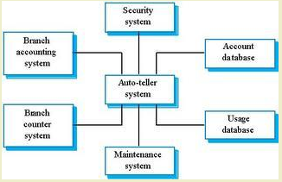
Context models simply show the other systems in the environment, not how the system being developed is used in that environment.

Slide 8
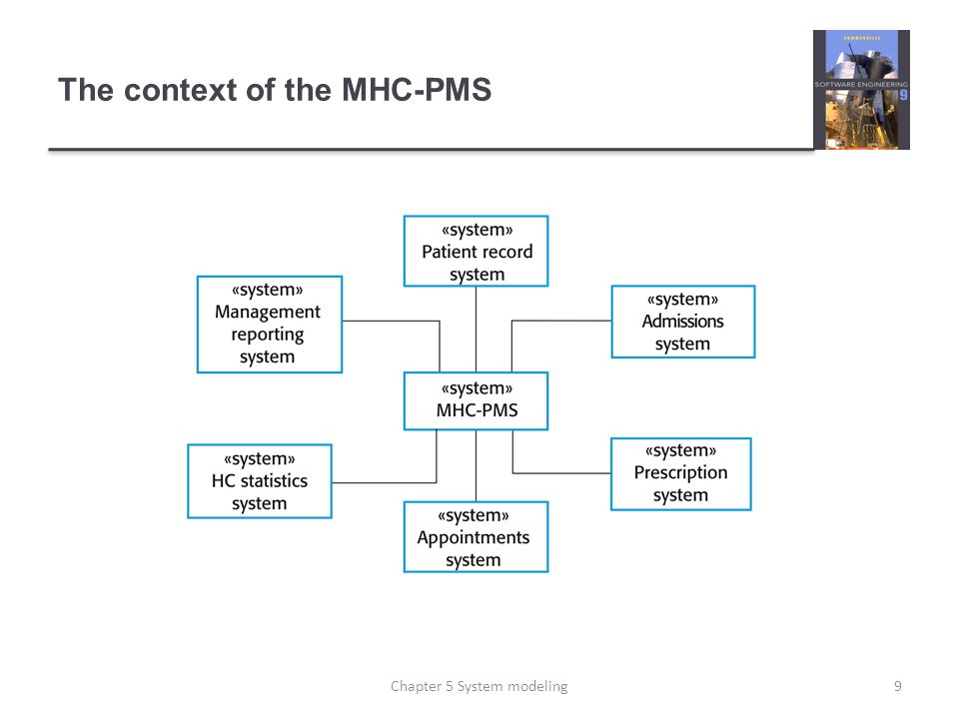

Slide 9
Interaction Model
An interaction model is a design model that binds an application together in a way that supports the conceptual models of its target users.
It is the glue that holds an application together. It defines how all of the objects and actions that are part of an application interrelate, in ways that mirror and support real-life user interactions.
Modelling user interaction is important as it helps to identify user requirements.
Modelling system-to-system interaction highlights the communication problems that may arise.
Modelling component interaction helps us understand if a proposed system structure is likely to deliver the required system performance and dependability.
Use case diagrams and sequence diagrams may be used for interaction modelling.

Slide 10
Use case Modeling
A use cases diagram is a graphical depiction of the interactions among the elements of a system and its external entities called actors. A use case is a methodology used in system analysis to identify, clarifies & organize system requirements.
Use case diagram are consists of actors, use cases and their relationships. A single use case diagram captures a particular functionality of a system.
Purposes of use case diagram
Used together requirement of a system.
Used to get an outside view of a system.
Identify external and internal factors influencing the system.
Show the interacting among the requirements are actors.
It is focus on functional requirement.

Slide 11
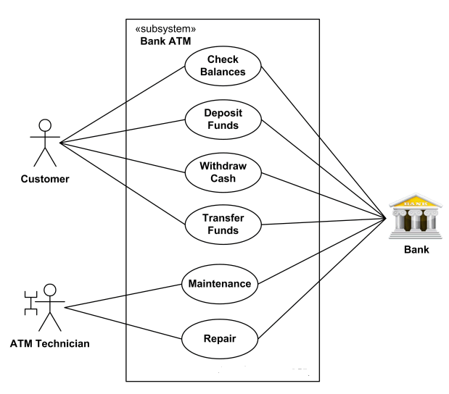

Slide 12
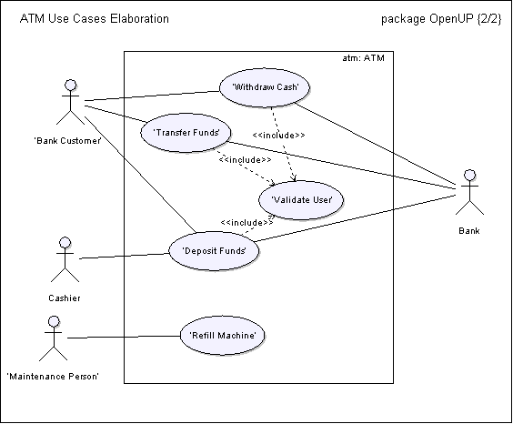
Automated Teller Machine (ATM) use-case model.

Slide 13
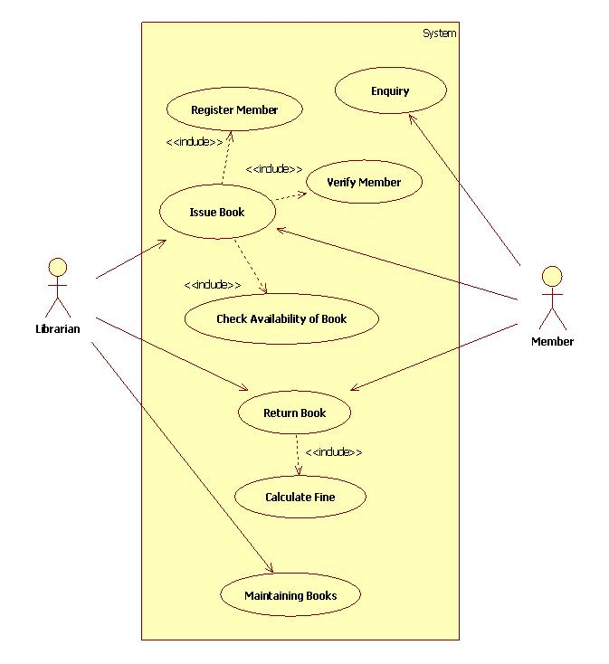

Slide 14
Sequence Diagram
Sequence diagrams are part of the UML and are used to model the interactions between the actors and the objects within a system.
A sequence diagram shows the sequence of interactions that take place during a particular use case or use case instance.
It simply depicts interaction between objects in a sequential order i.e. the order in which these interactions take place. Sequence diagrams describe how and in what order the objects in a system function.
These diagrams are widely used by businessmen and software developers to document and understand requirements for new and existing systems.
The objects and actors involved are listed along the top of the diagram, with a dotted line drawn vertically from these. Interactions between objects are indicated by annotated arrows.

Slide 15
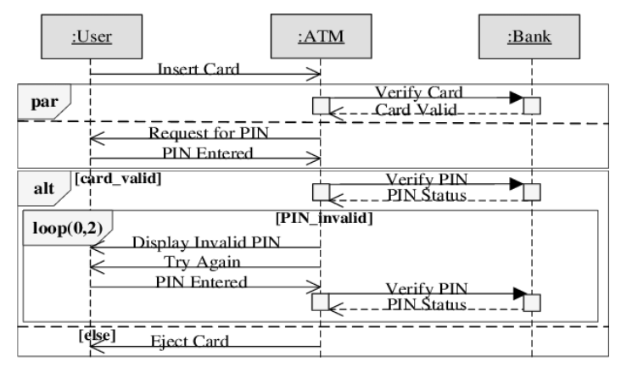

Slide 16
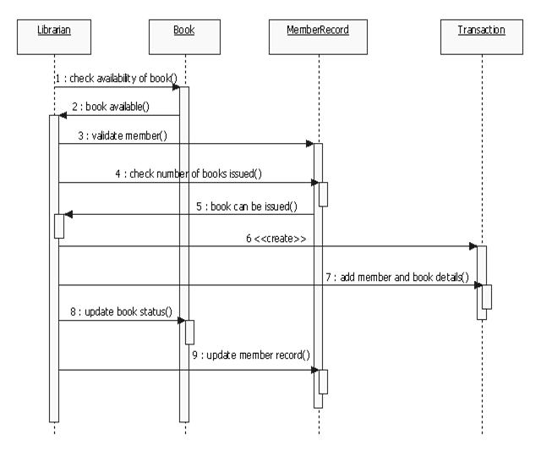

Slide 17
Structural Model
Structural models of software display the organization of a system in terms of the components that make up that system and their relationships.
Structural models may be static models, which show the structure of the system design, or dynamic models, which show the organization of the system when it is executing. You create structural models of a system when you are discussing and designing the system architecture.

Slide 18
Class Diagram
Class diagrams are used when developing an object-oriented system model to show the classes in a system and the associations between these classes.
An object class can be thought of as a general definition of one kind of system object.
An association is a link between classes that indicates that there is some relationship between these classes.
When you are developing models during the early stages of the software engineering process, objects represent something in the real world, such as a patient, doctor, customer, librarian etc.

Slide 19
The class diagram describes the attributes & method (operations) of a class and also the constraints imposed on the system.
The class diagrams are widely used in the modeling of object oriented system because they are the only UML diagrams which can be mapped directly with object oriented languages.

Slide 21
