Slide 1
JAVA 8 MySQL JDBC
Team Miracle Techies
Naznin Shafeek
Sona ES
Samyuktha ES
Athulya Vijayan

Slide 2
JAVA 8 Features

Slide 3
FUNCTIONAL INTERFACES
An Interface that contains exactly one abstract method is known as functional interface.
It can have any number of default, static methods but can contain only one abstract method. It can also declare methods of object class.
Functional Interface is also known as Single Abstract Method Interfaces or SAM Interfaces. It is a new feature in Java, which helps to achieve functional programming approach.
Divided into four types:-
Predicate
Consumer
Supplier
Function

Slide 4
Predicate
It is a functional interface which represents a predicate (boolean-valued function) of one argument. It is defined in the java.util.function package and contains test() a functional method.
Example:-
Predicate<Integer> pr = a -> (a > 18); // Creating predicate
System.out.println(pr.test(10)); // Calling Predicate method
Output:
false

Slide 5
Consumer
It contains an abstract accept() and a default andThen() method. It can be used as the assignment target for a lambda expression or method reference.The Consumer Interface accepts a single argument and does not return any result.
1)accept() -This method accepts one value and performs the operation on the given argument
Syntax: - void accept(T t)
2)andThen()
It returns a composed Consumer wherein the parameterized Consumer will be executed after the first one. If evaluation of either function throws an error, it is relayed to the caller of the composed operation.
Syntax:- default Consumer <T> andThen(Consumer<? super T> after)

Slide 6
Supplier
It represents a function which does not take in any argument but produces a value of type T.
T: denotes the type of the result
The Supplier interface consists of only one function: get()
This method does not take in any argument but produces a value of type T.
Syntax: T get()
Function
It is used to refer method by specifying type of parameter. It returns a result back to the referred function.
Example:-
Function<String, String> fun = FunctionInterfaceExample::show;
System.out.println(fun.apply("Peter"));

Slide 7
LAMBDA EXPRESSIONS
It provides a clear and concise way to represent one method interface using an expression.
It helps to iterate, filter and extract data from collection.
Lambda expression provides implementation of functional interface.It saves a lot of code.
Syntax:-
(argument-list) -> {body}
Example:-
Addable ad1=(a,b)->(a+b);
System.out.println(ad1.add(10,20));

Slide 8
STREAM API
The Stream API is used to process collections of objects desired.
Intermediate Operations:
map: The map method is used to returns a stream consisting of the results of applying the given function to the elements of this stream. List number = Arrays.asList(2,3,4,5); List square = number.stream().map(x->x*x).collect(Collectors.toList());
filter: The filter method is used to select elements as per the Predicate passed as argument. List names = Arrays.asList("Reflection","Collection","Stream"); List result = names.stream().filter(s->s.startsWith("S")).collect(Collectors.toList());
sorted: The sorted method is used to sort the stream.

Slide 9
Terminal Operations:
collect: The collect method is used to return the result of the intermediate operations performed on the stream.
forEach: The forEach method is used to iterate through every element of the stream. List number = Arrays.asList(2,3,4,5); number.stream().map(x->x*x).forEach(y->System.out.println(y));
reduce: The reduce method is used to reduce the elements of a stream to a single value.The reduce method takes a BinaryOperator as a parameter.
List number = Arrays.asList(2,3,4,5); int even = number.stream().filter(x->x%2==0).reduce(0,(ans,i)-> ans+i);

Slide 10
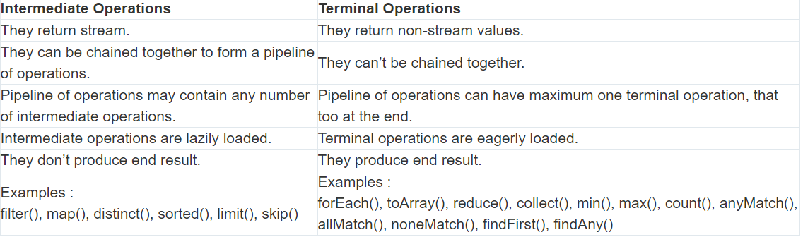

Slide 11
Method References
A method reference is the shorthand syntax for a lambda expression that contains just one method call.
Generic syntax: Method reference
A. To refer to a method in an object
Object :: methodName
B. To print all elements in a list
Following is an illustration of a lambda expression that just calls a single method in its entire execution:
list.forEach(s -> System.out.println(s));

Slide 12
C. Shorthand to print all elements in a list
To make the code clear and compact, In the above example, one can turn lambda expression into a method reference:
list.forEach(System.out::println);

Slide 13
OPTIONAL CLASS
By using Optional, we can specify alternate values to return or alternate code to run. It can help in writing a neat code without using too many null checks.
Example:-
String[] words = new String[10];
Optional<String> checkNull= Optional.ofNullable(words[5]);
if (checkNull.isPresent()) {
String word = words[5].toLowerCase();
System.out.print(word);
}
Else
System.out.println("word is null");

Slide 14
DEFAULT METHODS
Java provides a facility to create default methods inside the interface.
Java 8 introduces default method so that List/Collection interface can have a default implementation of forEach method, and the class implementing these interfaces need not implement the same.
Syntax:
public interface vehicle { default void print() { System.out.println("I am a vehicle!"); } }

Slide 15
DATE and TIME
Java 8 under the package java.time introduced a new date-time API, most important classes among them are :
1)Local : Simplified date-time API with no complexity of timezone handling.
2)Zoned : Specialized date-time API to deal with various timezones.
LocalDate/LocatTime and LocalDateTime API : Use it when time zones are NOT required.
Zoned date-time API : Use it when time zones are to be considered
Examples:-
LocalDateTime current = LocalDateTime.now();
DateTimeFormatter format =
DateTimeFormatter.ofPattern("dd-MM-yyyy HH:mm:ss");

Slide 16
STRING OPERATIONS
join(): This method concatenates a sequence of strings using a specified delimiter
chars(): This method returns a stream of characters from the string.
codePoints(): This method returns a stream of Unicode code points from the string.
repeat(): This method repeats the string a specified number of times
isBlank(): This method returns true if a string is empty or contains only whitespace characters, and false otherwise.
strip(): This method returns a new string with leading and trailing whitespace removed. It is similar to the trim() method, but also removes non-breaking space characters.
lines(): This method returns a stream of lines extracted from the string, separated by line terminators.
formatted(): This method returns a formatted string using the specified format string and arguments.

Slide 17
HashMap Changes
Improved performance: Java 8 introduces several performance improvements to HashMap, including faster iteration, reduced memory consumption, and reduced collisions.
Default methods: Map interface in Java 8 introduces several default methods, which HashMap implements, that provide additional functionality such as forEach, computeIfAbsent, computeIfPresent, and merge.
Lambda expressions: Java 8 introduces lambda expressions, which can be used with HashMap to simplify code and provide a more concise syntax for performing operations on key-value pairs.

Slide 18
HashMap Changes
Method references: Java 8 also introduces method references, which can be used with HashMap to refer to a method that can be used to compute a value based on a key, rather than using a lambda expression.
Stream API: Java 8 introduces the Stream API, which can be used with HashMap to perform various operations on key-value pairs, such as filtering, mapping, and reducing.
Tree-based structure - When a HashMap contains a large number of key-value pairs in a single bucket, the bucket is now represented by a tree structure instead of a linked list. This improves the performance of operations like put, get, and remove in such cases from O(n) to O(log n).

Slide 19
Metaspace
In Java 8, the Metaspace is a part of the memory used by the JVM to store metadata about the classes that are loaded. The Metaspace is not part of the Java heap space and is allocated outside of it.
Automatic memory management - The Metaspace is not a fixed-size region of memory like the PermGen space. Instead, it can expand dynamically to accommodate the metadata of loaded classes. The amount of memory used by the Metaspace can be controlled using the -XX:MaxMetaspaceSize command-line option.
Garbage collection - The Metaspace is not explicitly garbage-collected like the Java heap space. Instead, it relies on the Java garbage collector to reclaim memory when it is no longer needed. This means that memory leaks caused by class loading and unloading are less likely to occur.

Slide 20
Metaspace
Metadata storage - In Java 8, the metadata about loaded classes is stored in native memory instead of Java heap memory. This improves performance by reducing the number of Java heap allocations required.
Class unloading - Classes that are no longer used can be unloaded from the Metaspace by the garbage collector, which frees up memory. This is different from the PermGen space, where classes were never unloaded unless the JVM was restarted.
Out of Memory Errors - If the Metaspace runs out of memory, the JVM will automatically resize it, or if the maximum Metaspace size has been reached, it will throw an OutOfMemoryError.

Slide 21
Map() Method
Example
public class Example {
public static void main(String[] args) {
List<String> words = Arrays.asList("Hello", "World", "Java");
List<Integer> lengths = words.stream()
.map(String::length)
.collect(Collectors.toList());
System.out.println(lengths);
}
}
Output
[5, 5, 4]
map operation is a method that is part of the Stream class. It is used to transform the elements of a stream by applying a function to each element, producing a new stream of transformed elements.
Syntax of map() method
<R> Stream<R> map(Function<? super T,? extends R> mapper)

Slide 22
FlatMap() Method
Example
public class Example {
public static void main(String[] args) {
List<String> words = Arrays.asList("Hello", "World", "Java");
List<String> letters = words.stream()
.flatMap(str -> Stream.of(str.split("")))
.collect(Collectors.toList());
System.out.println(letters);
}
}
Output
[H, e, l, l, o, W, o, r, l, d, J, a, v, a]
flatMap operation is a method that is part of the Stream class. It is used to transform the elements of a stream into a new stream by flattening nested streams into a single stream.
Syntax of flatMap() method
<R> Stream<R> flatMap(Function<? super T,? extends Stream<? extends R>> mapper)

Slide 23
Map vs FlatMap
map() | flatMap()
The function passed to map() operation returns a single value for a single input. | The function you pass to flatmap() operation returns an arbitrary number of values as the output.
One-to-one mapping occurs in map(). | One-to-many mapping occurs in flatMap().
Only perform the mapping. | Perform mapping as well as flattening.
Produce a stream of value. | Produce a stream of stream value.
map() is used only for transformation. | flatMap() is used both for transformation and mapping.

Slide 24
MySQL

Slide 25
MySQL
MySQL is a relational database management system based on the Structured Query Language, which is the popular language for accessing and managing the records in the database.
By learning some basic commands we can work, create and interact with the Database.

Slide 26
Features of MySQL
It allows us to implement database operations on tables, rows, columns, and indexes.
MySQL supports many operating systems with many languages like PHP, PERL, C, C++, JAVA, etc.
MySQL is easy to use.
MySQL supports large number of embedded applications, which makes it very flexible.

Slide 27
Features of MySQL
MySQL follows the working of a client/server architecture.
MySQL is free to use so that we can download it from MySQL official website without any cost.
It can download, install, and execute on most of the available operating systems.

Slide 28
MySQL Create Database Query:
To create a MySQL database
Syntax:
CREATE DATABASE database_name;
Example:
CREATE DATABASE testDB;

Slide 29
MySQL Select/Use Query:
To retrieve records from the database.
Syntax:
USE database_name;
Example:
USE testDB;

Slide 30
MySQL Create Query:
Syntax: To create a table.
CREATE TABLE table_name ( column1 datatype, column2 datatype, column3 datatype, .... );
Example: Creating a table
CREATE TABLE Persons ( PersonID int, LastName varchar(255), FirstName varchar(255), Address varchar(255), City varchar(255));

Slide 31
MySQL Alter Query: To add, update, eliminate or drop columns of a table.
Syntax:
To add columns in a table.
ALTER TABLE table_name
ADD column_name datatype;
Example:
ALTER TABLE Customers
ADD Email Varchar(255);

Slide 32
MySQL Insert Query
To insert new records in an existing table.
Syntax:
INSERT INTO table_name (column1, column2, column3, ...) VALUES (value1, value2, value3, ...);
Example:
INSERT INTO Customers(CustomerName,Country,Age)
VALUES('Tom','Norway',30);

Slide 33
MySQL Update Query
To modify the existing records of a table.
Syntax:
UPDATE table_name
SET column_1 = value1, column_2 = value2
WHERE condition;
Example:
UPDATE items
SET name = ‘Sports’, number = 20
WHERE id = 1;

Slide 34
MySQL Update Query
To modify the existing records of a table.
Syntax:
UPDATE table_name
SET column_1 = value1, column_2 = value2
WHERE condition;
Example:
UPDATE items
SET name = ‘Sports’, number = 20
WHERE id = 1;

Slide 35
MySQL Delete Query
To delete records of a table.
Syntax:
DELETE from table_name
WHERE condition;
Example:
DELETE from items
WHERE id = 1;

Slide 36
MySQL Select/Use Query:
To retrieve records of a table from a database.
Syntax:
SELECT * from table_name;
Example:
SELECT * from items;

Slide 37
MySQL Truncate Table Query
To delete the records of a table without removing its structure.
Syntax:
TRUNCATE TABLE table_name;
Example:
TRUNCATE TABLE items;

Slide 38
MySQL Drop Query
To drop a database, a table or a view in MySQL.
Syntax: To drop a table.
DROP TABLE table_name;
Example:
DROP TABLE items;

Slide 39
MySQL Joins
MySQL JOINS are used with SELECT statement.
It is used to retrieve data from multiple tables.
There are three types of MySQL joins:
MySQL INNER JOIN (or sometimes called simple join)
MySQL LEFT OUTER JOIN (or sometimes called LEFT JOIN)
MySQL RIGHT OUTER JOIN (or sometimes called RIGHT JOIN)

Slide 40
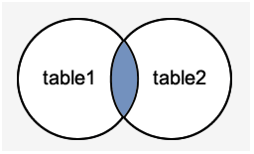
MySQL Inner JOIN
MySQL INNER JOIN is used to return all rows from multiple tables where the join condition is satisfied. It is the most common type of join.
Syntax:
SELECT columns
FROM table1
INNER JOIN table2
ON table1.column = table2.column;

Slide 41
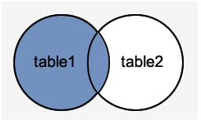
MySQL Left Outer Join
The LEFT OUTER JOIN returns all rows from the left table specified in the ON condition and only those rows from the other table where the join condition is fulfilled.
Syntax:
SELECT columns
FROM table1
LEFT [OUTER] JOIN table2
ON table1.column = table2.column;

Slide 42
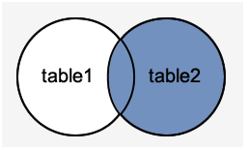
MySQL Right Outer Join
The MySQL Right Outer Join returns all rows from the RIGHT table specified in the ON condition and only those rows from the other table where he join condition is fulfilled.
Syntax:
SELECT columns
FROM table1
RIGHT [OUTER] JOIN table2
ON table1.column = table2.column;

Slide 43
WHERE CLAUSE
The WHERE clause allows you to specify a search condition for the rows returned by a query. The following shows the syntax of the WHERE clause:
SELECT select_list FROM table_name WHERE search_condition;
The search_condition is a combination of one or more expressions using the logical operator AND, OR and NOT

Slide 44
ORDER BY Clause
The ORDER BY clause is used in SQL queries to sort the data returned by a query in ascending or descending order. The ORDER BY clause, like the GROUP BY clause, could be used in conjunction with the SELECT statement.
ASC denotes ascending order, while DESC denotes descending order.
The following is the syntax to use the ORDER BY clause in a SQL statement:
SELECT column_name
FROM tables
[WHERE conditions]
ORDER BY expression [ ASC | DESC ];

Slide 45
GROUP BY clause
The GROUP BY clause is used in SQL queries to organize data that have the same attribute values.
We can often use this clause in collaboration with aggregate functions like SUM, AVG, MIN, MAX, and COUNT to produce summary reports from the database.
The following is the syntax to use GROUP BY clause in a SQL statement:
SELECT column_name
FROM table_name
WHERE condition
GROUP BY column_name;

Slide 46
DDL
DDL is short name of Data Definition Language, which deals with database schemas and descriptions, of how the data should reside in the database.
CREATE - to create a database and its objects like (table, index, views, store procedure, function, and triggers)
ALTER - alters the structure of the existing database
DROP - delete objects from the database
TRUNCATE - remove all records from a table, including all spaces allocated for the records are removed
COMMENT - add comments to the data dictionary
RENAME - rename an object

Slide 47
DML
DML is short name of Data Manipulation Language which deals with data manipulation and includes most common SQL statements such SELECT, INSERT, UPDATE, DELETE, etc., and it is used to store, modify, retrieve, delete and update data in a database.
SELECT - retrieve data from a database
INSERT - insert data into a table
UPDATE - updates existing data within a table
DELETE - Delete all records from a database table
MERGE - UPSERT operation (insert or update)
CALL - call a PL/SQL or Java subprogram

Slide 48
MySQL subquery
MySQL subquery is a query nested within another query such as SELECT, INSERT, UPDATE or DELETE. Also, a subquery can be nested within another subquery. For example, the following query uses a subquery to return the employees who work in the offices located in the USA.
A MySQL subquery is called an inner query while the query that contains the subquery is called an outer query. A subquery can be used anywhere that expression is used and must be closed in parentheses.

Slide 49
Example
For example, the following query uses a subquery to return the employees who work in the offices located in the USA.
SELECT lastName, firstName FROM employees WHERE officeCode IN (SELECT officeCode FROM offices WHERE country = 'USA');

Slide 50
SQL CONDITIONAL EXPRESSION
The CASE Expression
In a simple CASE expression, the SQL searches for the first WHEN……THEN pair for which expr is equal to comparison_expr and returns return_expr.
If above condition is not satisfied, an ELSE clause exists, the SQL returns else_expr. Otherwise, returns NULL.
Syntax: CASE expr WHEN comparison_expr1 THEN return_expr1 [WHEN comparison_expr2 THEN return_expr2 . . . WHEN comparison_exprn THEN return_exprn ELSE else_expr] END

Slide 51
2)GREATEST
Returns the largest value from a list of any number of expressions.
Syntax: GREATEST(expr1, expr2 [, .....] )
Input: SELECT GREATEST('XYZ', 'xyz') from dual;
Output: GREATEST('XYZ', 'xyz') xyz

Slide 52
3) IN
Checks whether a value is present within a set of values and can be used with WHERE, CHECK and creation of views.
Syntax: WHERE column IN (x1, x2, x3 [,......] )
Input: SELECT * from Employee WHERE department_id IN(50, 12);

Slide 53
JDBC

Slide 54
Java JDBC
JDBC stands for Java Database Connectivity.
JDBC is a Java API to connect and execute the query with the database.
It is a part of Java SE (Java Standard Edition).
JDBC API uses JDBC drivers to connect with the database.
There are four types of JDBC drivers:
JDBC-ODBC Bridge Driver,
Native Driver,
Network Protocol Driver, and
Thin Driver

Slide 55
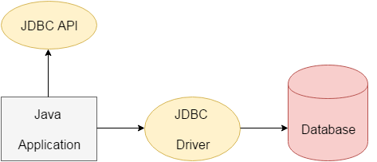
Open Data Base Connectivity

Slide 56
By the help of JDBC API, we can save, update, delete and fetch data from the database.
It is like Open Database Connectivity (ODBC) provided by Microsoft.​
The current version of JDBC is 4.3.​
The java .Sql package contains classes and interfaces for JDBC API. ​
A list of popular interfaces of JDBC API are given below:​ 1) Driver interface​
2) Connection interface​
3) Statement interface​ ​ 4) Row set interface
​
​
​
​
​
​
​
​

Slide 57
JDBC Driver
JDBC Driver is a software component that enables java application to interact with the database.
There are 4 types of JDBC drivers:
1) JDBC-ODBC bridge driver
2) Native-API driver (partially java driver)
3) Network Protocol driver (fully java driver)
4) Thin driver (fully java driver)

Slide 58
JDBC-ODBC bridge driver
The JDBC-ODBC bridge driver uses ODBC driver to connect to the database
The JDBC-ODBC bridge driver converts JDBC method calls into the ODBC function calls.
Native-API driver
The Native API driver uses the client-side libraries of the database.
It is not written entirely in java.
Network Protocol driver
The Network Protocol driver uses middleware (application server) that converts JDBC calls directly or indirectly in to the vendor - specific database protocol.
Thin driver
The thin driver converts JDBC calls directly into the vendor-specific database protocol.

Slide 59
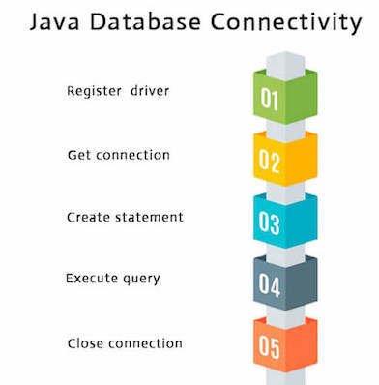
Java Database Connectivity with 5 Steps
There are 5 steps to connect any java application with the database using JDBC.
These steps are as follows:
Register the Driver class
Create connection
Create statement
Execute queries
Close connection

Slide 60
1) Register the driver class
The forName() method of Class is used to register the driver class.
This method is used to dynamically load the driver class.
Syntax of forName() method
public static void forName(String className)throws ClassNotFoundException
2) Create the connection object
The getConnection() method of DriverManager class is used to establish connection with the database.
Syntax of getConnection() method

Slide 61
1) public static Connection getConnection(String url)throws SQLException
2) public static Connection getConnection(String url,String name,String password
3) Create the Statement object
The createStatement() method of Connection interface is used to create statement
The object of statement is responsible to execute queries with the database.
Syntax of createStatement() method
public Statement createStatement()throws SQLException

Slide 62
4) Execute the query
The executeQuery() method of Statement interface is used to execute queries to the database.
Syntax of executeQuery() method
public ResultSet executeQuery(String sql)throws SQLException
5) Close the connection object
By closing connection object statement and ResultSet will be closed automatically.
The close() method of Connection interface is used to close the connection.
Syntax of close() method
public void close()throws SQLException

