Slide 1
AWS CodeCommit, AWS CodeBuild, AWS CodeDeploy, and AWS CodePipeline
Sona E S
245209

Slide 2
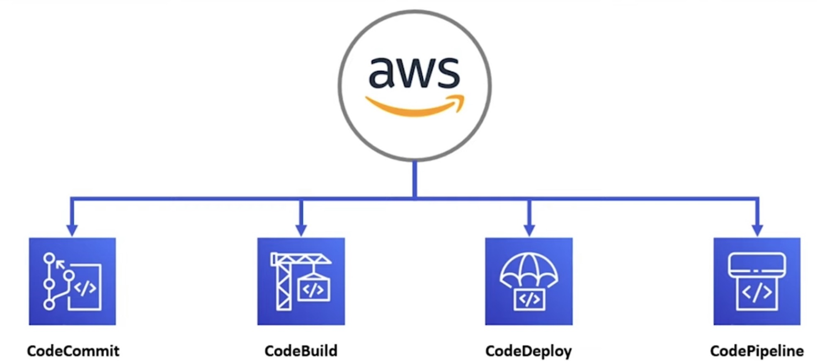
AWS Developer Tools

Slide 3
AWS CodeCommit:
AWS CodeCommit is a fully managed source control service that enables secure and scalable hosting for private Git repositories.
It provides a central repository for storing and managing your source code, allowing seamless collaboration among team members.
CodeCommit integrates with other AWS services and supports features like access control, branch-level permissions, and code reviews.

Slide 4
AWS CodeBuild:
AWS CodeBuild is a fully managed build service that automates the compilation, testing, and packaging of source code into deployable artifacts.
It eliminates the need for managing build infrastructure, automatically scaling compute resources based on your build requirements.
CodeBuild supports a wide range of programming languages, build tools, and third-party integrations, providing flexibility and customization options.

Slide 5
AWS CodeDeploy:
AWS CodeDeploy is a deployment service that automates the process of deploying applications to different compute resources.
It enables consistent and reliable application deployments across various environments, such as Amazon EC2 instances, AWS Lambda functions, and on-premises servers.
CodeDeploy offers features like rolling deployments, blue-green deployments, and automatic rollback capabilities, ensuring smooth and error-free releases.

Slide 6
AWS CodePipeline:
AWS CodePipeline is a fully managed continuous integration and continuous delivery (CI/CD) service.
It allows you to create and manage end-to-end software release pipelines, automating the build, test, and deployment processes.
CodePipeline integrates with CodeCommit, CodeBuild, CodeDeploy, and other tools, enabling you to define flexible and customizable workflows for your CI/CD needs.

Slide 7
steps to create a AWS Code pipeline
Step#1: Create a Code Commit Repository
Step#2: Create Code Build
Step#3: Create Beanstalk App
Step#4: Create Code Pipeline
Step#5: Create Code Deploy

Slide 8
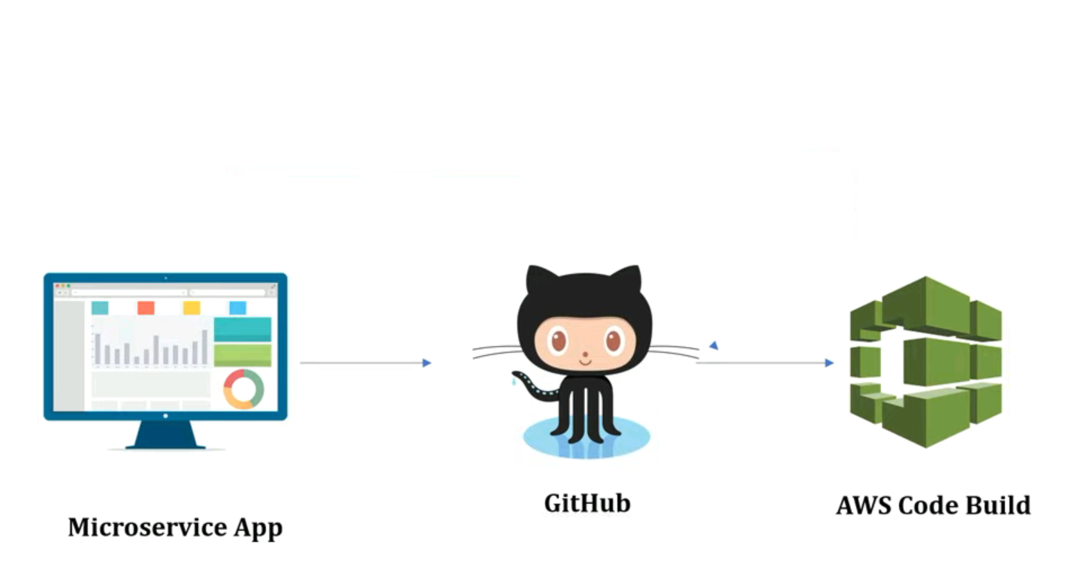
Integration flow

Slide 9
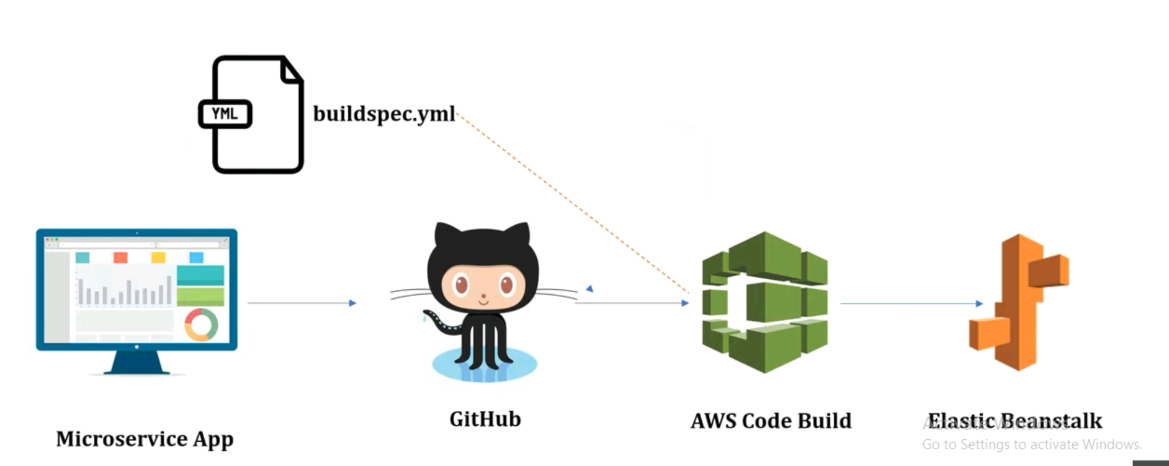

Slide 10
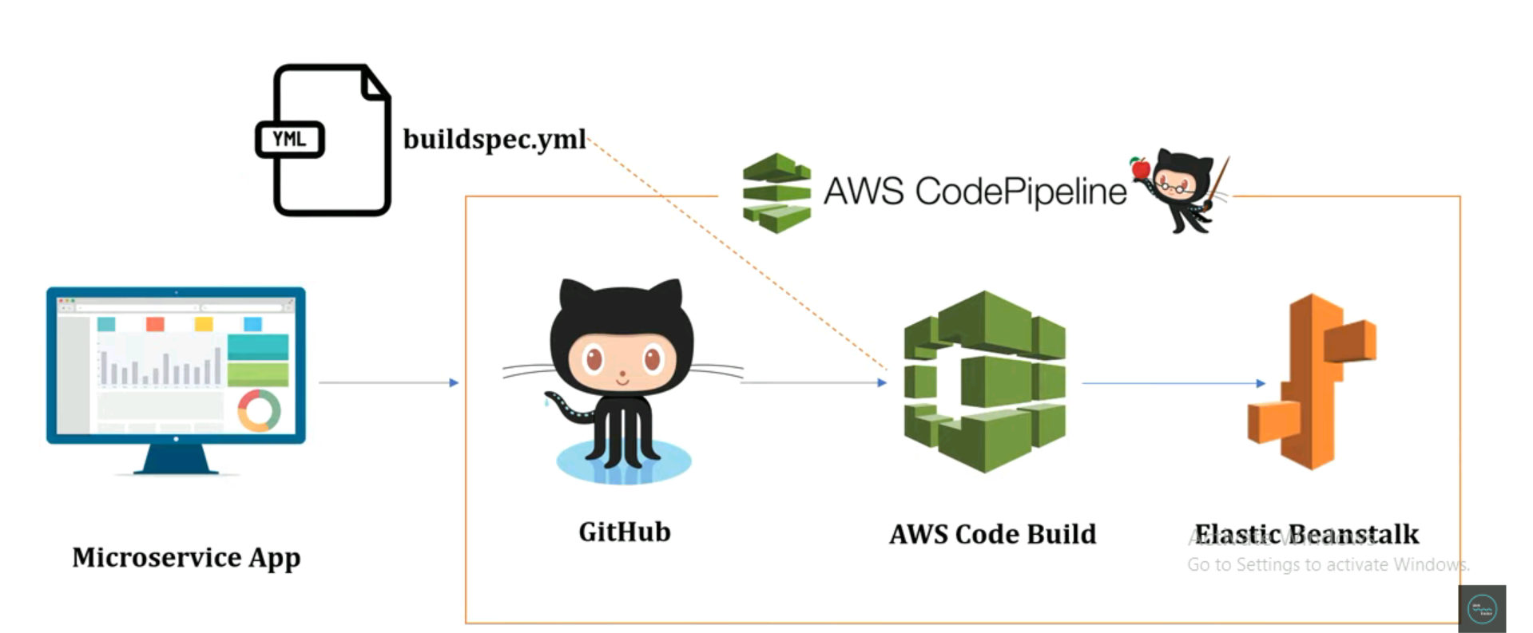

Slide 11
Benefits
Automation of Build , Test and Release Process.
Pipeline History Reports and Pipeline Status Visualizations
Establish a consistent release process.
Speed up delivery while improving quality.
Supports external tools integration for source, build and deploy.

Slide 12
References
https://youtu.be/aHuCeLn72Lg
https://github.com/SonaES/order-service.git

