Slide 1
PROJECT-1
Surayya Begum S
Sonali Gavhane
Supriya Maddi
Surya Teja Kolluri

Slide 2
PROBLEM STATEMENT
The basic idea of the problem is that we have to shift the position of 1 in an array according to the
instructions given by the user such as RIGHT,LEFT,UP,DOWN.
Initially the input may look as follows:
0 1 0 0 0
0 0 0 0 0
0 0 0 0 0
According to the user instructions we have to shift the 1s position and whenever a shift is not
possible, we should leave the state of array unchanged.
Once if user enters the value “1” the program should be terminated.

Slide 3
APPROACH
The main logic behind the problem is to convert index of single dimension array to 2D-array
to verify whether it is valid index.
For simplicity, we made Column & Row as fixed size of 5.
Initially we will first find the index of 0 in 1D-Array, say index.
We will verify, if it is valid case as according to condition.
UP =8
= (r==0)
DOWN = 2
= (r==4)
LEFT = 4
= (c%5==0)
RIGHT = 6
= (c%5==4)
Once verified, then again check changeandGetNewIndex function for traversing purpose

Slide 4
APPROACH
UP = 8
(i==r-1) && (j==c) then set 1 value in array position.
DOWN = 2
(i==r+1) && (j==c) then set 1 value in array position.
LEFT = 4
(i==r) && (j==c-1) then set 1 value in array position.
Right = 6
(i==r) && (j==c+1) then set 1 value in array position.
Shift the 1s position to new index.
Continue this process until “False” at case1 is entered by user

Slide 5
ALGORITHM
The algorithm for the problem is given below :
Step1 :- Array elements are initialized with ‘0’ with the size of 25.
Step2 :- Take the “Enter first direction” input from the users.
Step3 :- Display array according to given input.
Step4 :- Take the input direction from the user and continue step5 & step6 until user enters Exit case.
Step5 :- Verify whether it is valid input or not.
If yes then go to step6 else state remains unchanged.
Step6 :- Traverse the 1s position as according to index value.
index = ChangeandGetNewIndex (row,col,arr,input);
Step7 :- Display the array to output console.

Slide 6
Github link : https://github.com/SonaGavhane/suryyaTeam.git

Slide 7
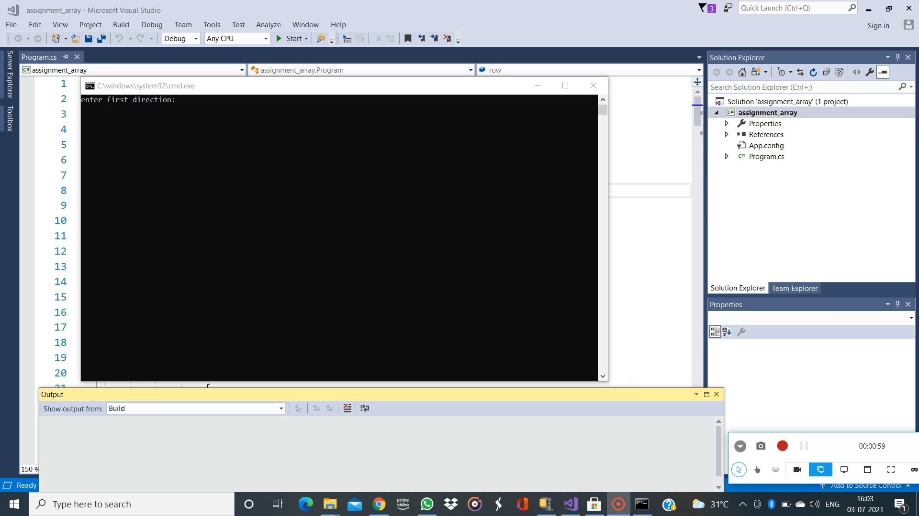
EXECUTION

Slide 8
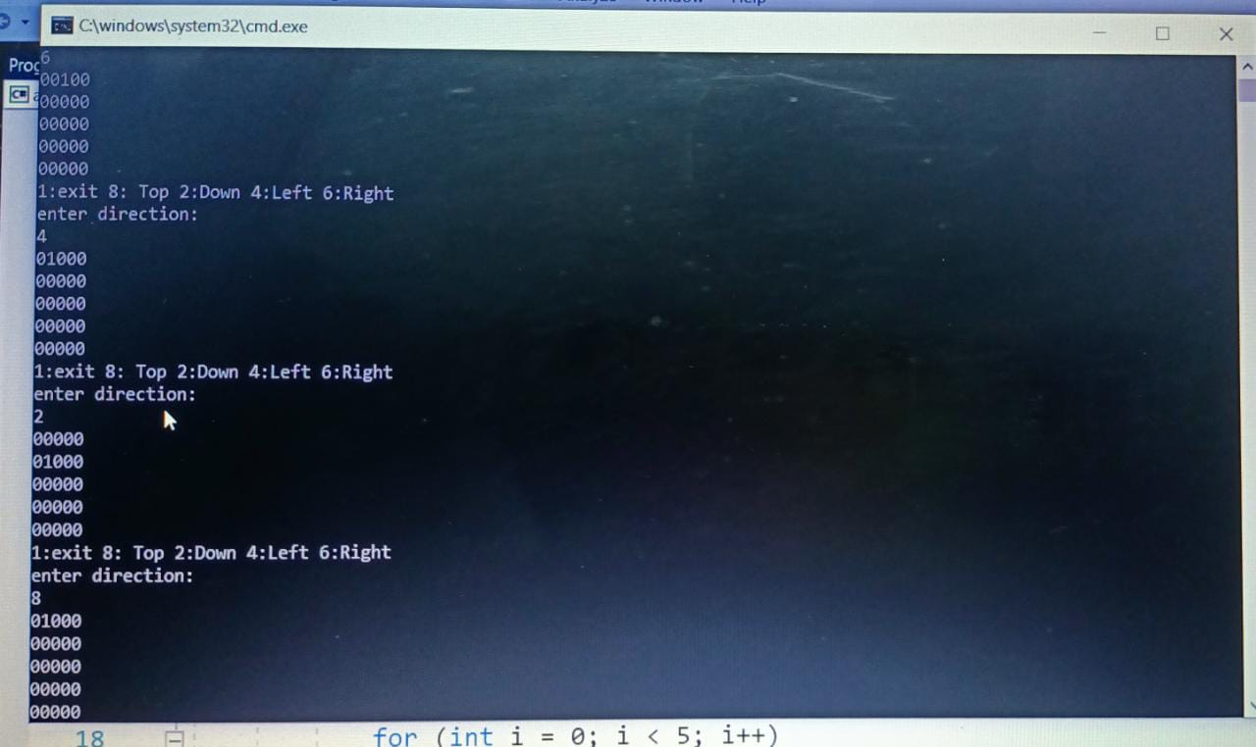
OUTPUT SNAP

Slide 9
Thank you

