Slide 1
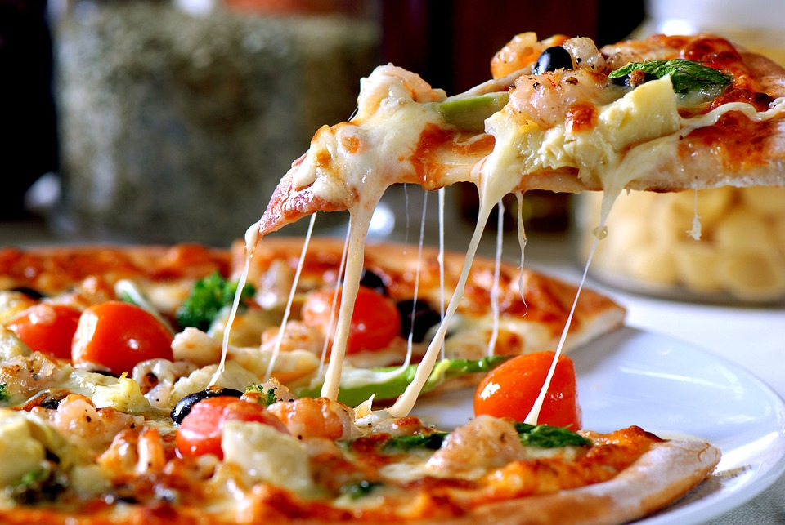
PIZZA SALES
ANALYSIS REPORT
An Analytical Overview of Pizza Sales Performance
USING EXCEL,SQL,POWER BI
- SONA B

Slide 2
Problem Statement
KPI’s REQUIREMENT
We need to analyze key indicators for our pizza sales data to gain insights into our business performance. Specifically, we want to calculate the following metrics:
Total Revenue: The sum of the total price of all pizza orders.
Average Order Value: The average amount spent per order, calculated by dividing the total revenue by the total number of orders.
Total Pizzas Sold: The sum of the quantities of all pizzas sold.
Total Orders: The total number of orders placed.
Average Pizzas Per Order: The average number of pizzas sold per order, calculated by dividing the total number of pizzas sold by the total number of orders.

Slide 3
CHARTS REQUIREMENT
We would like to visualize various aspects of our pizza sales data to gain insights and understand key trends. We have identified the following requirements for creating charts:
1. Hourly Trend for Total Pizzas Sold: Create a stacked bar chart that displays the hourly trend of total orders over a specific time period. This chart will help us identify any patterns or fluctuations in order volumes on a hourly basis.
2. Weekly Trend for Total Orders: Create a line chart that illustrates the weekly trend of total orders throughout the year. This chart will allow us to identify peak weeks or periods of high order activity.
3. Percentage of Sales by Pizza Category: Create a pie chart that shows the distribution of sales across different pizza categories. This chart will provide insights into the popularity of various pizza categories and their contribution to overall sales.
4. Percentage of Sales by Pizza Size: Generate a pie chart that represents the percentage of sales attributed to different pizza sizes. This chart will help us understand customer preferences for pizza sizes and their impact on sales.

Slide 4
5. Total Pizzas Sold by Pizza Category: Create a funnel chart that presents the total number of pizzas sold for each pizza category. This chart will allow us to compare the sales performance of different pizza categories.
6. Top 5 Best Sellers by Revenue, Total Quantity and Total Orders: Create a bar chart highlighting the top 5 best-selling pizzas based on the Revenue, Total Quantity, Total Orders. This chart will help us identify the most popular pizza options.
7. Bottom 5 Best Sellers by Revenue, Total Quantity and Total Orders: Create a bar chart showcasing the bottom 5 worst-selling pizzas based on the Revenue, Total Quantity, Total Orders. This chart will enable us to identify underperforming or less popular pizza options.

Slide 5
CREATEING A DATABASE
create database pizza_db;
use pizza_db;
CREATEING A TABLE
create table pizza_sales
(
order_details_id int,
order_idint,
pizza_idvarchar(20),
quantityint,
order_datedate,
order_timetime,
unit_pricefloat,
total_price float,
pizza_sizevarchar(2),
pizza_categoryvarchar(20),
pizza_ingredientsvarchar(100),
pizza_name varchar(50)
);
select * from pizza_sales;

Slide 6
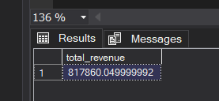
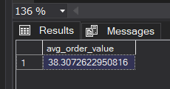
ANALYSIS OF DIFFERENT SQL STATEMENT ON DATA BASE
Total Revenue:
SELECT SUM(total_price) as total_revenue FROM pizza_sales;
2. Average Order Value:
SELECT SUM(total_price)/COUNT(DISTINCT order_id) AS avg_order_value
FROM pizza_sales;

Slide 7
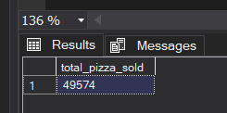
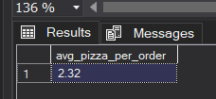
3. Total Pizza Sold
SELECT SUM(quantity) as total_pizza_sold FROM pizza_sales;
4. Total Orders
SELECT COUNT(DISTINCT order_id) AS total_order FROM pizza_sales;
5. Average Pizzas Per Order
SELECT ROUND(SUM(quantity) / COUNT(DISTINCT order_id), 2)
AS avg_pizza_per_order
FROM pizza_sales;

Slide 8
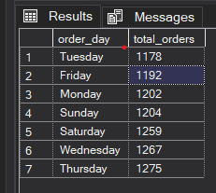
6. Daily Trend for Total Pizzas Sold
SELECT DATENAME(DW,order_date) as order_day ,
COUNT(DISTINCT order_id) as total_orders
FROM pizza_sales
GROUP BY DATENAME(DW,order_date)
ORDER BY total_orders;

Slide 9
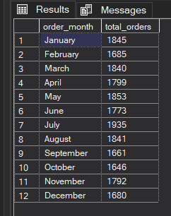
7.Monthly Trend for Total Pizzas Sold
SELECT DATENAME(MONTH, order_date) AS order_month,
COUNT(DISTINCT order_id) AS total_orders
FROM pizza_sales
WHERE order_date IS NOT NULL
GROUP BY DATENAME(MONTH, order_date), MONTH(order_date)
ORDER BY MONTH(order_date);

Slide 10
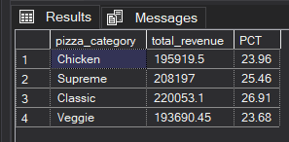
8.Percentage Of Sales By Pizza Category
SELECT pizza_category ,
ROUND(SUM(total_price),2) as total_revenue,
ROUND(SUM(total_price)*100/ (SELECT SUM(total_price)
FROM pizza_sales),2) as PCT
FROM pizza_sales
GROUP BY pizza_category;

Slide 11
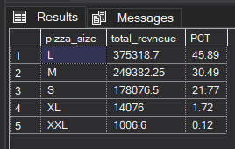
9.Percentage Of Sales By Pizza Size
SELECT pizza_size,
ROUND(SUM(total_price),2) as total_revneue,
ROUND(SUM(total_price)*100/(SELECT SUM(total_price)
FROM pizza_sales),2) as PCT
FROM pizza_sales
GROUP BY pizza_size
order by pizza_size;

Slide 12
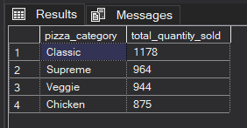
10.Total Pizzas Sold by Pizza Category
SELECT pizza_category ,
SUM(quantity) as total_quantity_sold
FROM pizza_sales
WHERE MONTH(order_date) = 2
GROUP BY pizza_category
ORDER BY total_quantity_sold DESC;

Slide 13
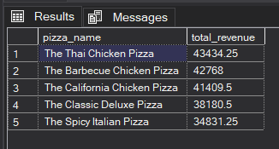
11.Top Five Pizza by Revenue
SELECT TOP 5 pizza_name,
SUM(total_price) as total_revenue
FROM pizza_sales
GROUP BY pizza_name
ORDER BY total_revenue DESC;

Slide 14
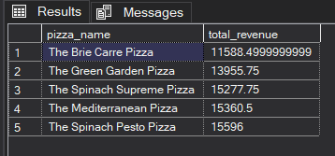
12.Bottom Five Pizza by Revenue
SELECT TOP 5 pizza_name,
SUM(total_price) as total_revenue
FROM pizza_sales
GROUP BY pizza_name
ORDER BY total_revenue ;

Slide 15
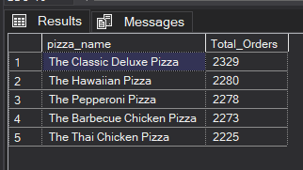
13.Top 5 Pizzas by Total Orders
SELECT TOP 5 pizza_name,
COUNT(DISTINCT order_id) AS Total_Orders
FROM pizza_sales
GROUP BY pizza_name
ORDER BY Total_Orders DESC;

Slide 16
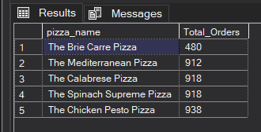
14.Bottom 5 Pizzas by Total Orders
SELECT TOP 5 pizza_name,
COUNT(DISTINCT order_id) AS Total_Orders
FROM pizza_sales
GROUP BY pizza_name
ORDER BY Total_Orders ;

Slide 17
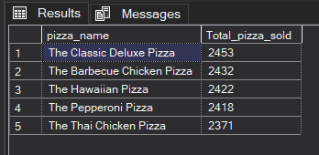
15.Top 5 Pizzas by Quantity
SELECT TOP 5 pizza_name,
SUM(quantity) AS Total_pizza_sold
FROM pizza_sales
GROUP BY pizza_name
ORDER BY Total_pizza_sold DESC ;

Slide 18
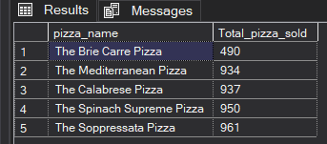
16.Bottom 5 Pizzas by Quantity
SELECT TOP 5 pizza_name,
SUM(quantity) AS Total_pizza_sold
FROM pizza_sales
GROUP BY pizza_name
ORDER BY Total_pizza_sold ;

Slide 19
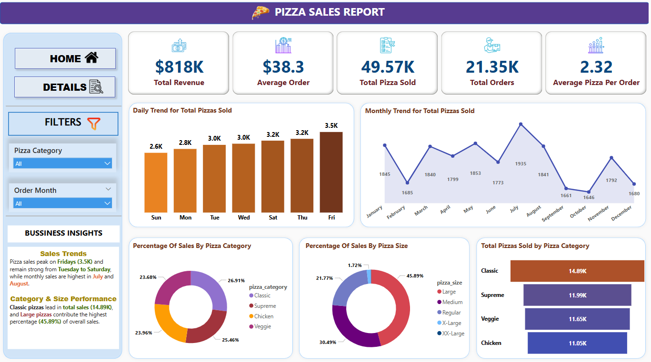
POWER BI REPORT

Slide 20
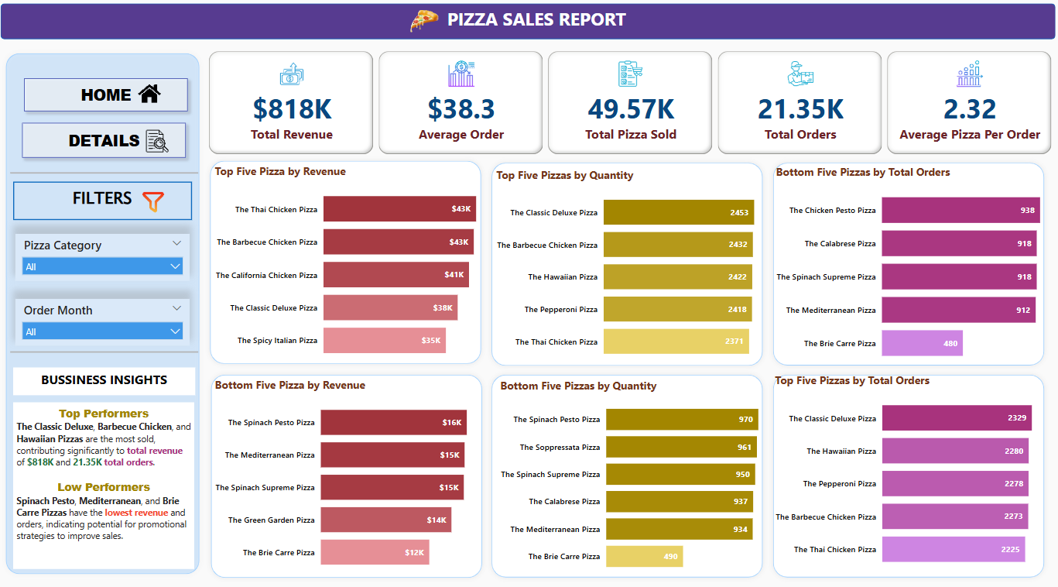

Slide 21
Key Insights
Sales Performance Overview
Total Revenue: $818K
Average Order Value: $38.3
Total Pizzas Sold: 49.57K
Total Orders: 21.35K
Average Pizzas Per Order: 2.32
Sales Trends
The highest number of pizzas were sold on Fridays (3.5K pizzas), followed by Thursdays and Saturdays.
Monthly sales peaked in July and August, with a drop in September and October.
Hourly sales trends indicate peak order times in the evening.
Category & Size Preferences
Classic pizzas are the most sold category (14.89K), followed by Supreme, Veggie, and Chicken.
Large pizzas dominate sales (45.89%), followed by Medium (30.49%) and Regular (21.77%).
Top & Bottom Sellers
Top 5 best-selling pizzas generate the highest revenue and order volumes.
Bottom 5 pizzas show low demand and may need marketing strategies or recipe changes.

Slide 22
Conclusion
Pizza sales exhibit strong seasonal and weekly trends, with weekends and summer months seeing higher sales.
Larger pizza sizes are the preferred choice, contributing significantly to revenue.
Classic and Supreme categories drive major sales, highlighting customer preferences.
Opportunities for growth:
Promotions targeting low-demand months (September & October).
Special deals for less popular pizza categories to improve sales.
Optimizing evening operations to maximize peak-hour sales.
By leveraging these insights, strategic marketing and operational decisions can be made to enhance overall pizza sales performance.

