Slide 1
Unicorn University
Interpretace a prezentace dat ZS 2023/2024: Dashboard: PX Index in Context of Other European Indices
Soňa
Obůrková
17.1.2024

Slide 2
Content
Data
Why these data?
Target group
Dashboard type
Description of each graph
Dashboard testing
Unexpected graphic situations
Copyright © Unicorn Vysoká škola s.r.o.
<číslo>

Slide 3
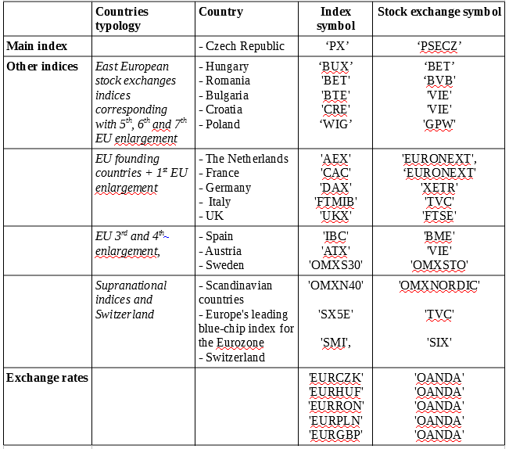
Data
Source: TradingView.com
Main index
Date, open, high, low, close price
Other indices
Index close price
Grouped by countries based on being
in respective EU enlargement wave
To make them better visible in the line graph
Currency exchange rates
Copyright © Unicorn Vysoká škola s.r.o.
<číslo>

Slide 4
Why These Data
My interest in the financial sector
I would like to make diploma thesis on impact of developed financial markets on emerging financial markets represented by the Czech Republic
This dashboard serves as my analysis of the PX Index in context of other developed and emerging indices from other European stock exchanges
Copyright © Unicorn Vysoká škola s.r.o.
<číslo>

Slide 5
Target Group
Those interested in:
European stock exchange indices
Emerging financial markets
Czech stock exchange
Czech PX Index time series
Copyright © Unicorn Vysoká škola s.r.o.
<číslo>

Slide 6
Dashboard Type
Analytical
Works with historical data
Identifies trends
PX Index being compared with other indices
Enables better undestanding of the Czech PX index time series in context of other indices
Copyright © Unicorn Vysoká škola s.r.o.
<číslo>

Slide 7
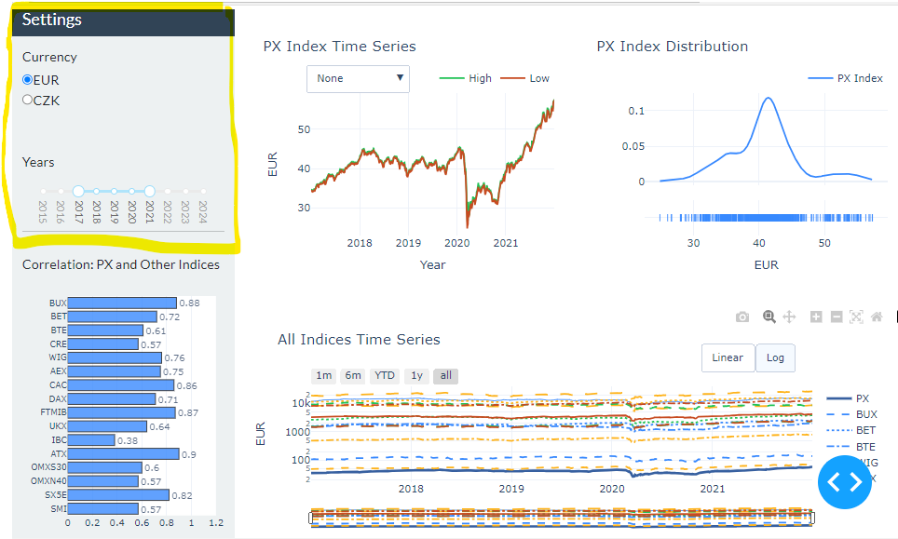
Description of Each Graph
Side section (top left hand side)
Enables filtering by:
Currency – buttons convert currencies from EUR (default) to CZK and vice versa
Applicable on all line and distribution graphs
Year – range slider enables to pick years of interest
Applicable on all graphs in the dashboard
Copyright © Unicorn Vysoká škola s.r.o.
<číslo>

Slide 8
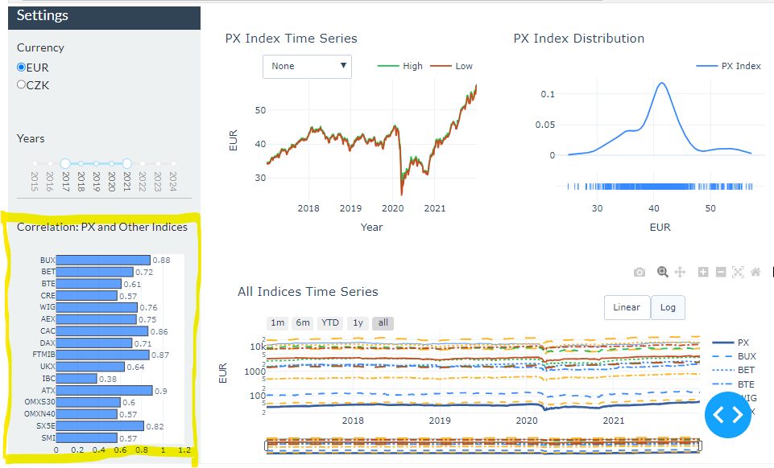
Description of Each Graph
Bar chart:
Pearson coefficient of correlation between PX Index and other indices in the bar chart
The value of each coefficient is available outside of the graph
Copyright © Unicorn Vysoká škola s.r.o.
<číslo>

Slide 9
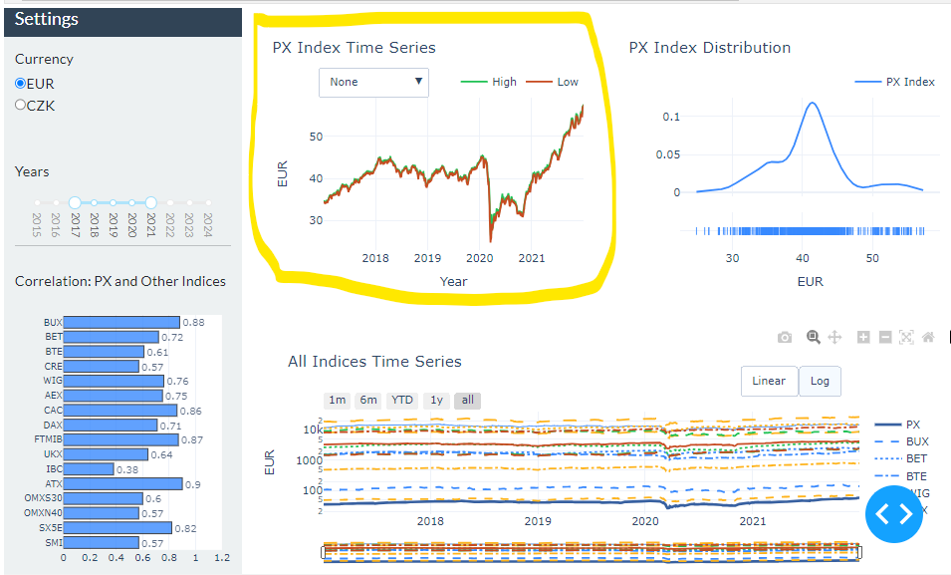
Description of Each Graph
PX Index Time Series:
Four graphs available in this figure three under dropdown
Default graph (None): ‚open‘ and ‚close‘ price of the PX Index in EUR
‚High‘ under dropdown: highest price of the PX index on that day compared with the average highest value in given period of time
‚Low‘ under dropdown: lowest price of the PX index on that day compared with the average lowest value in given period of time
‚High and Low‘ under dropdown: combinations of ‚High‘ and ‚Low‘ graphs from above
Copyright © Unicorn Vysoká škola s.r.o.
<číslo>

Slide 10
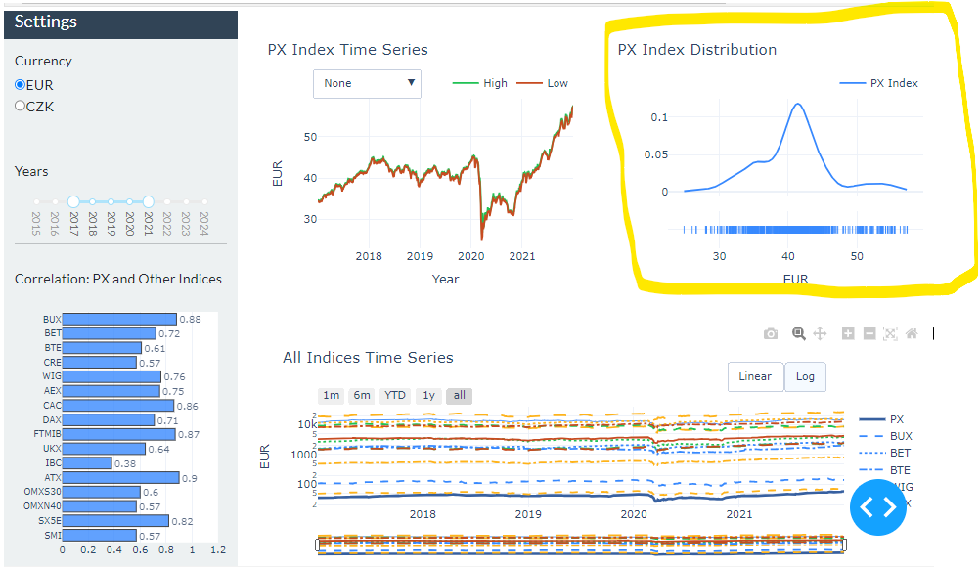
Description of Each Graph
PX Index Distribution:
Shows curve and rug of the PX Index distribution
The curve shows normalized frequency of PX Index data
The rug shows the density of the normalized frequency of the PX Index price
Copyright © Unicorn Vysoká škola s.r.o.
<číslo>

Slide 11
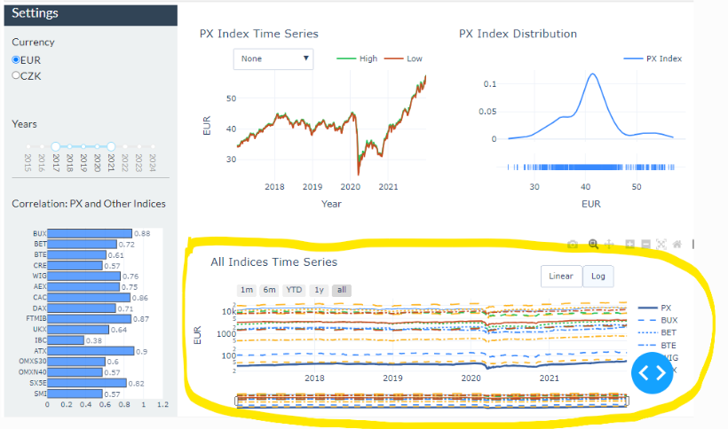
Description of Each Graph
All Indices Time Series:
Both PX Index and other indices in one graph
Filtering in the graph:
Time slider under the graph
Graph button filters to visualize data by the last month, last six months, year-to-date, one year and all available data (default)
Buttons to visualize linear (default) and log data
Indices were grouped by EU enlargement
waves and visualized by colors:
Black: PX Index
Blue: East European stock echanges indices
– EU 5th, 6th and 7th enlargement
Orange: EU founding countries + 1st enlargement
Green: EU 3rd and 4th enlargement
Red: Other indices – supranational European indices and Switzerland
Copyright © Unicorn Vysoká škola s.r.o.
<číslo>

Slide 12
Dashboard Testing
Dashboard testing was carried out thoroughly and bugs were fixed
There should not be any issue with data visualization at the moment
Copyright © Unicorn Vysoká škola s.r.o.
<číslo>

Slide 13
Unexpected Graphic Situations
May be caused in case input parameters of tickers or main index are changed.
Copyright © Unicorn Vysoká škola s.r.o.
<číslo>

Slide 14
Děkuji za pozornost

