Slide 1
Task - Building an AI Pipeline for Image Segmentation and Object Analysis
WASSERSTOFF INNOVATION & LEARNING LABS PRIVATE LIMITED
Submitted by -
Name – SONALI KOLI
Position: Ai Engineer Intern

Slide 2
Task Sheet: Building an AI Pipeline for Image Segmentation and Object Analysis
Objective-
Develop a pipeline using transformers or deep learning models that processes an input image to segment, identify, and analyze objects within the image, and outputs a summary table with mapped data for each object

Slide 3
Introduction
This project uses Deep Learning techniques and computer vision techniques to detect the objects, segment them, label them and get the count of them.

Slide 4
Models -
Importing the libraries that are requested to complete the task.
Using the py-torch, torch –vision .
Load the pre-trained object detection model.
Using the fasterrcnn_resnet50,

Slide 5
COCO classes
COCO_INSTANCE_CATEGORY_NAMES = [
'__background__', 'person', 'bicycle', 'car', 'motorcycle', 'airplane', 'bus',
'train', 'truck', 'boat', 'traffic light', 'fire hydrant', 'N/A', 'stop sign',
'parking meter', 'bench', 'bird', 'cat', 'dog', 'horse', 'sheep', 'cow',
'elephant', 'bear', 'zebra', 'giraffe', 'N/A', 'backpack', 'umbrella', 'N/A',
'N/A', 'handbag', 'tie', 'suitcase', 'fris bee', 'skis', 'snowboard', 'sports ball',
'kite', 'baseball bat', 'baseball glove', 'skateboard', 'surfboard', 'tennis racket',
'bottle', 'N/A', 'wine glass', 'cup', 'fork', 'knife', 'spoon', 'bowl', 'banana',
'apple', 'sandwich', 'orange', 'broccoli', 'carrot', 'hot dog', 'pizza', 'donut',
'cake', 'chair', 'couch', 'potted plant', 'bed', 'N/A', 'dining table', 'N/A', 'N/A',
'toilet', 'N/A', 'tv', 'laptop', 'mouse', 'remote', 'keyboard', 'cell phone',
'microwave', 'oven', 'toaster', 'sink', 'refrigerator', 'N/A', 'book', 'clock',
'vase', 'scissors', 'teddy bear', 'hair drier', 'toothbrush', 'male', 'female']

Slide 6
Steps required for training /prediction-
Function to load and preprocess the image.
Function to perform object detection.
Function to process the predictions and generate a summary table.
Function to display the image with detected objects.
Upload an image

Slide 7
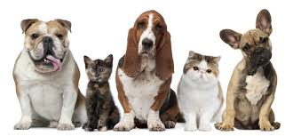
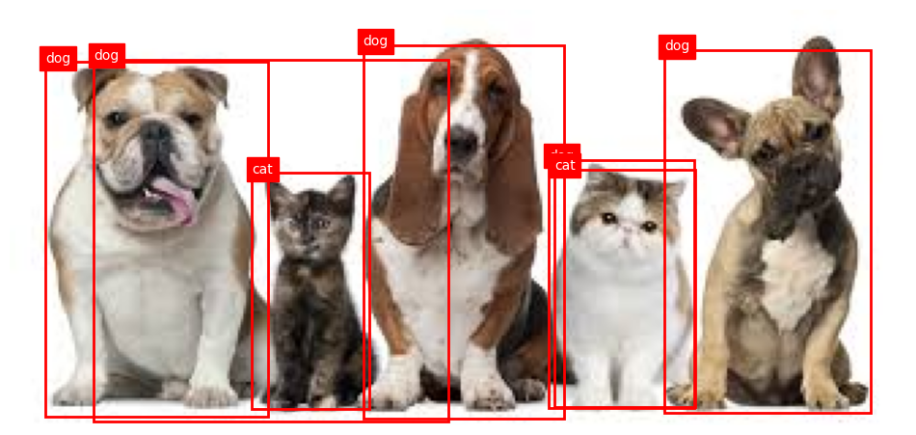
Input /output -

Slide 8
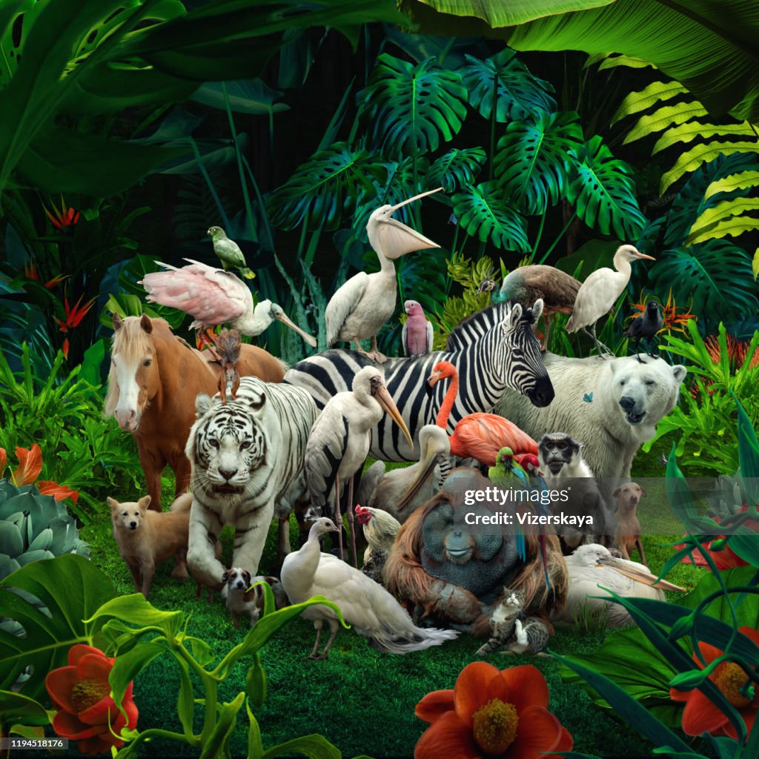
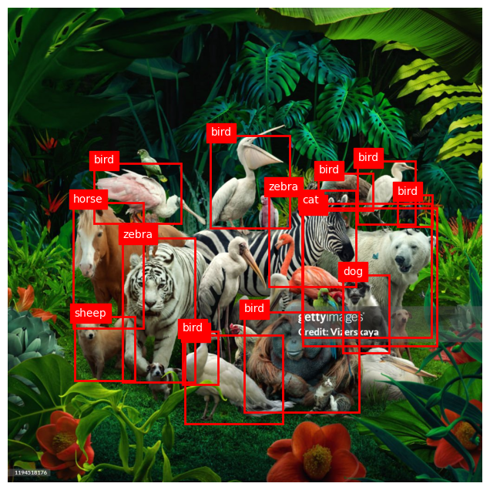
Image 2-

Slide 9
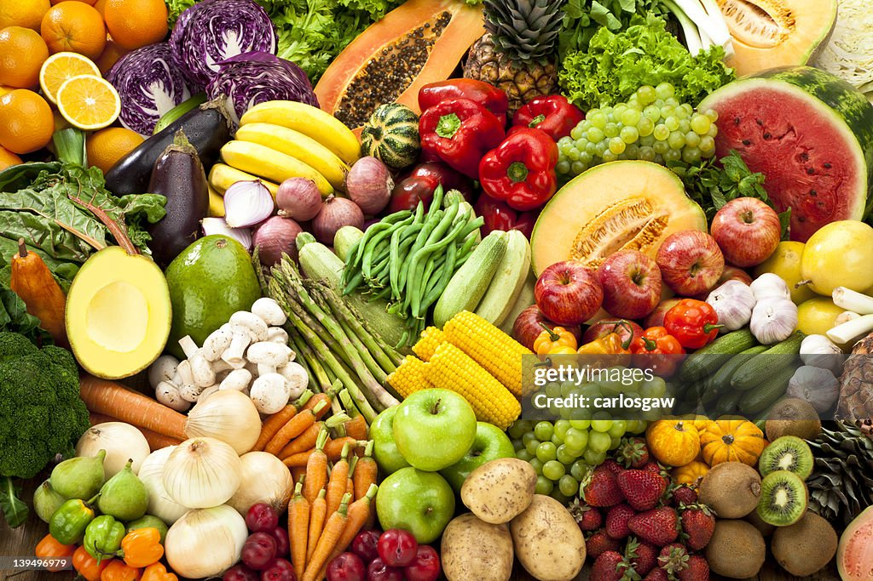
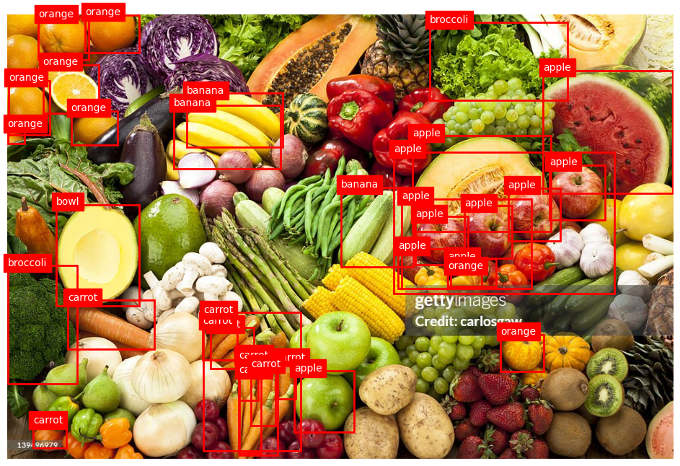
Image 3-

Slide 10
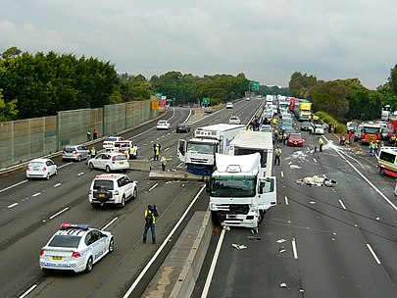
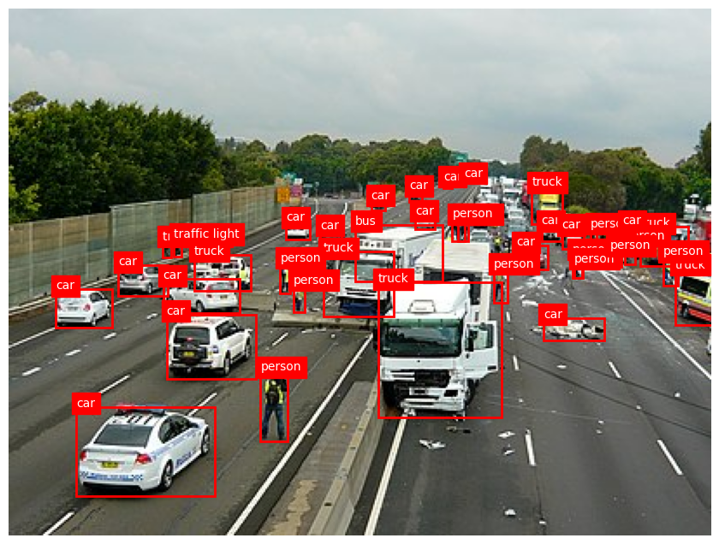
Image 4-

Slide 11
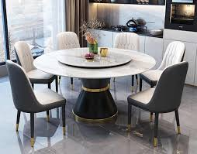
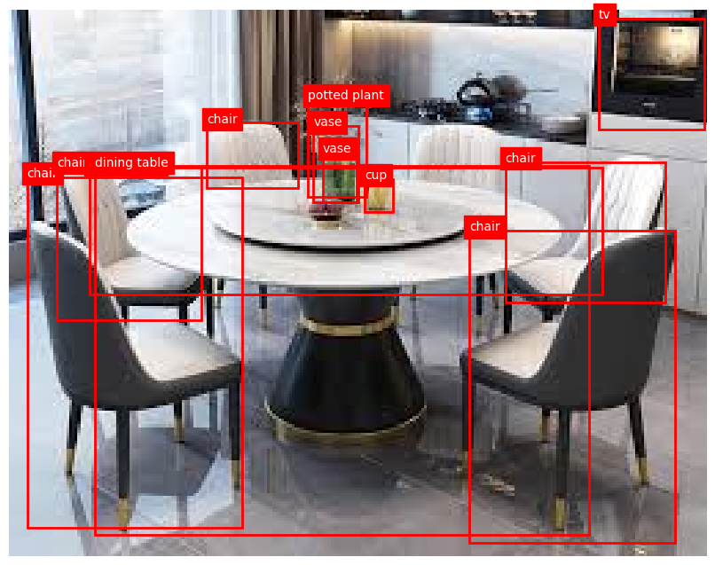
Image 5-

Slide 12
Thank You

