Slide 1

Faculty
Divya MG
divyam@cdac.in
C-DAC, Bangalore
eDAC- Batch: C-DAC Bangalore

Slide 2
Configuration Management Version Control
eDAC- Batch: C-DAC Bangalore

Slide 3
USE CASE
Project Name: “Web based e-Learning tool for the Disabled – LOTUS”
Problem statement or Request for work:
Development of web portal for windows & mobile app for disabled children. The solution for accessibility for the disabled in the domain of e-Learning is for the children's of the age group up to 10 years. The purpose of the implementation is to enhance the learning process of children with autism. This application helps these children to learn with the help of multimedia (i.e. image, audio or video) or 3D content, through a learning environment, that can be accessed over mobile devices.
eDAC- Batch: C-DAC Bangalore

Slide 4
Project development life cycle
Request for work (RFW) is say from client
“Feasibility study”
“Approval” from Client and his management
“Software requirement specification-SRS”
“Project Planning” process
“Various review” process
“Training” process
“Configuration management” process
“Design” process
“Coding”
“Testing” process
“Progress tracking/monitoring” procedures
“Installation” (deployment)
“Maintenance”
“Postmortem analysis”
“Quality assurance”
eDAC- Batch: C-DAC Bangalore

Slide 5
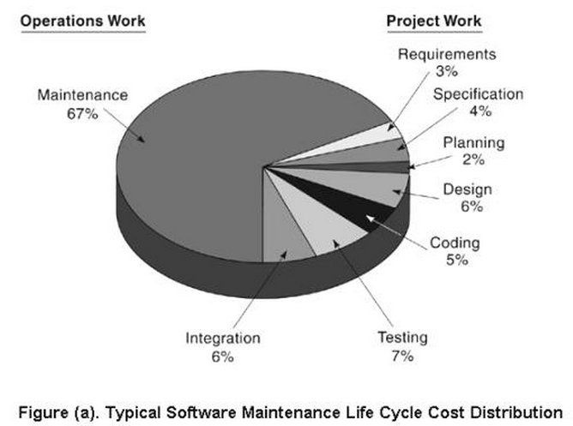
eDAC- Batch: C-DAC Bangalore

Slide 6
Introduction
Configuration management is the management of an evolving software system. When maintaining a system, a CM team is put in place to ensure that changes are in corporated into the system in a controlled way and that records are maintained with details of the changes that have been implemented.
The main configuration management processes are concerned with version control, system building, Change management and release management. Software tools are available to support all of these processes.
Version Control involves keeping track of the different version of software components that are created as changes are made to them. Version control is the management of the changes made within a system, that it has not to be software necessarily.
eDAC- Batch: C-DAC Bangalore

Slide 7
Repository Features (Issues in team work)
Versioning.
  Saves all of these versions to enable effective management of product releases and to permit developers to go back to previous versions
Dependency tracking and change management.
  The repository manages a wide variety of relationships among the data elements stored in it
Requirements tracing.
  Provides the ability to track all the design and construction components and deliverables that result from a specific requirement specification
Configuration management.
  Keeps track of a series of configurations representing specific project milestones or production releases. Version management provides the needed versions, and link management keeps track of interdependencies.
Audit trails.
  Establishes additional information about when, why, and by whom changes are made
eDAC- Batch: C-DAC Bangalore

Slide 8
Baselines
The IEEE (IEEE Std. No. 610.12-1990) defines a baseline as:
    A specification or product that has been formally reviewed and agreed upon, that thereafter serves as the basis for further development, and that can be changed only through formal change control procedures.
A baseline is a milestone in the development of software that is marked by the delivery of one or more Software Configuration Items (SCI) and the approval of these SCIs that is obtained through a formal technical review
eDAC- Batch: C-DAC Bangalore

Slide 9
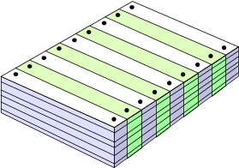
What are the Changes?
changes in
business requirements
changes in
technical requirements
changes in
user requirements
other
documents
software models
Project
Plan
data
Test
code
eDAC- Batch: C-DAC Bangalore

Slide 10
Version Control System
Version Control System (VCS) is a software that helps software developers to work together and maintain a complete history of their work.
The key functions of a VCS are:
  Allows developers to work simultaneously.
  Does not allow overwriting each other’s changes.
  Maintains a history of every version.
The types of VCS :
  Centralized version control system (CVCS).
  Distributed/Decentralized version control system (DVCS).
eDAC- Batch: C-DAC Bangalore

Slide 11
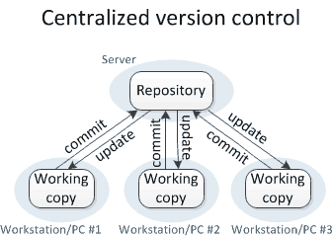
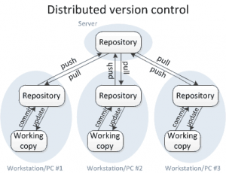
eDAC- Batch: C-DAC Bangalore

Slide 12
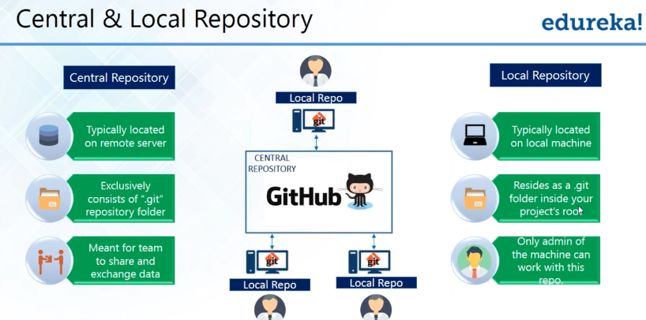
Courtesy: edureka
eDAC- Batch: C-DAC Bangalore

Slide 13
Introduction to GIT
Git is a distributed version-control system for tracking changes in any set of files, originally designed for coordinating work among programmers cooperating on source code during software development. Its goals include speed, data integrity, and support for distributed, non-linear workflows.
Git was created by Linus Torvalds in 2005 for development of the Linux kernel, with other kernel developers contributing to its initial development. Since 2005, Junio Hamano has been the core maintainer. As with most other distributed version-control systems, and unlike most client–server systems, every Git directory on every computer is a full-fledged repository with complete history and full version-tracking abilities, independent of network access or a central server. Git is free and open-source software distributed under GNU General Public License Version 2.
Reference: https://www.tutorialspoint.com/git/
eDAC- Batch: C-DAC Bangalore

Slide 14
Advantages of Git
Free and open source: Git is released under GPL’s open source license. It is available freely over the internet.
Fast and small: As most of the operations are performed locally, it gives a huge benefit in terms of speed. Git does not rely on the central server; that is why, there is no need to interact with the remote server for every operation.
Implicit backup: The chances of losing data are very rare when there are multiple copies of it. Data present on any client side mirrors the repository, hence it can be used in the event of a crash or disk corruption.
Security: Git uses a common cryptographic hash function called secure hash function (SHA1), to name and identify objects within its database. Every file and commit is check-summed and retrieved by its checksum at the time of checkout.
eDAC- Batch: C-DAC Bangalore

Slide 15
No need of powerful hardware: In case of CVCS, the central server needs to be powerful enough to serve requests of the entire team. For smaller teams, it is not an issue, but as the team size grows, the hardware limitations of the server can be a performance bottleneck. In case of DVCS, developers don’t interact with the server unless they need to push or pull changes. All the heavy lifting happens on the client side, so the server hardware can be very simple indeed.
Easier branching: The branch management with Git is very simple. It takes only a few seconds to create, delete, and merge branches.
eDAC- Batch: C-DAC Bangalore

Slide 16
GIT Repository
Local Repository
GIT VCS tool provides a private workplace as a working copy. Developers make changes in their private workplace and after commit, these changes become a part of the repository. Git takes it one step further by providing them a private copy of the whole repository.
Users can perform many operations with this repository such as add file, remove file, rename file, move file, commit changes, and many more.
eDAC- Batch: C-DAC Bangalore

Slide 17

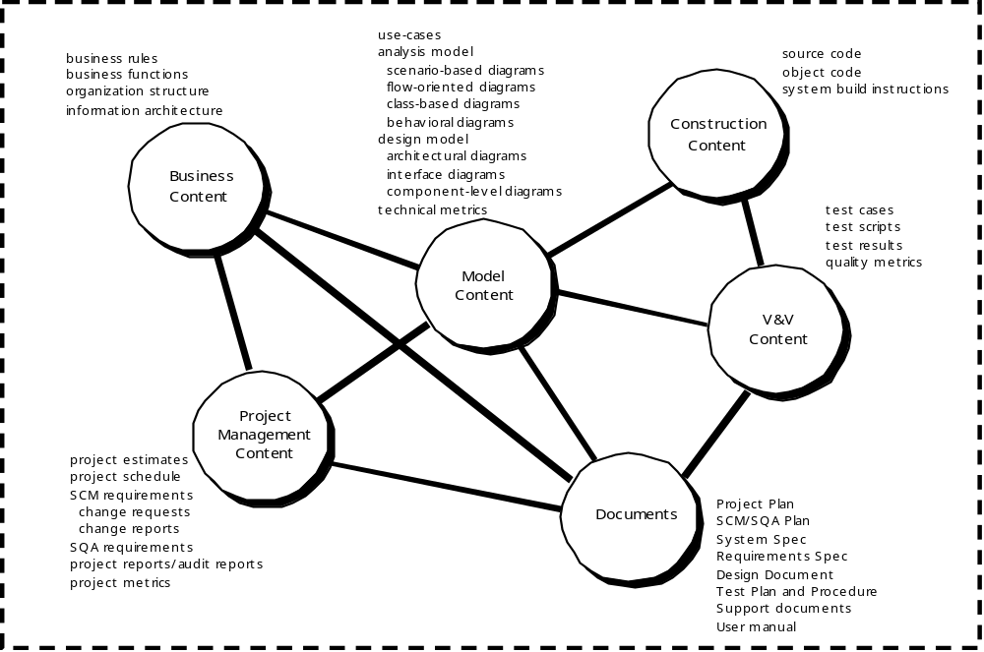
eDAC- Batch: C-DAC Bangalore

Slide 18
Content of the repository
Business content
    Business rules
    Business functions
    Organization structure
    Information architecture
Project management content
    Project estimates
    Project schedule
    SCM requirements
    Change requests
    Change reports
    SQA requirements
    Project reports/audit reports
    Project metrics
Documents
    Project plan
    SCM/SQA plan
    System spec
    Requirements spec
    Design document
    Test plan and procedure
    Support documents
Model content
    Use cases
    Analysis model
    Scenario-based diagrams
    Flow-oriented diagrams
    Class-based diagrams
    Behavioral diagrams
    Design model
    Architectural diagrams
    Interface diagrams
    Component-level diagrams
    Technical metrics
Construction content
    Source code
    Object code
    System build instructions
Verification and Validation content
    Test cases
    Test scripts
    Test results
    Quality metrics
eDAC- Batch: C-DAC Bangalore

Slide 19
Git tree structure
GIT directory structure is organized as follows:
The .git directory holds the details of the local repo. It holds subdirectories for objects, refs, config, index, HEAD, and more.
The objects folder is where the three objects: commit, tree and blob are housed. Each object gets its own sub folder.
The refs folder holds references to all of the objects in the directory. Let's say you have some orphaned objects on branches that no longer exist. You can go into this folder and prune them off of your branch.
The config folder contains all of your configurations including the credentials you use to connect to GitHub; your email and name that you used to configure your global config.
The HEAD file is what contains the pointer or reference to your working directory or branch and its latest commit.
The index file is for when you use git add to stage your files for a commit. They leave the index file after the commit.
eDAC- Batch: C-DAC Bangalore

Slide 20
GIT Workflow
Step 1 − You modify a file from the working directory.
Step 2 − You add these files to the staging area.
Step 3 − You perform commit operation that moves the files from the staging area. After push operation, it stores the changes permanently to the Git repository.
eDAC- Batch: C-DAC Bangalore

Slide 21
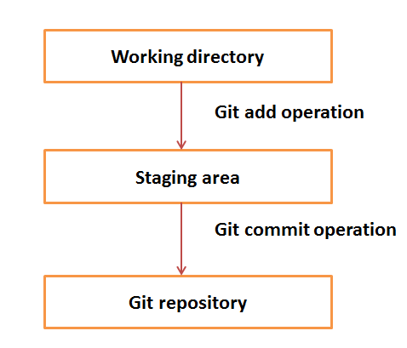
eDAC- Batch: C-DAC Bangalore

Slide 22
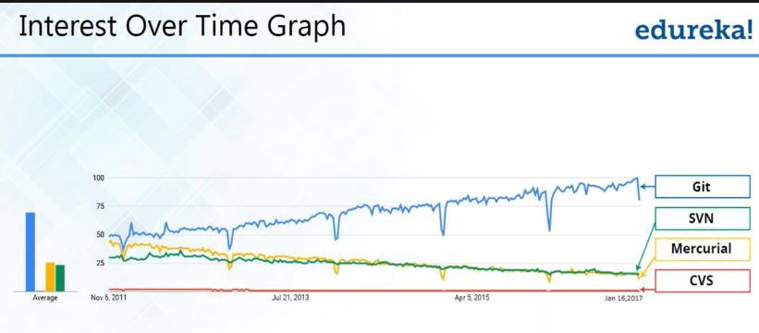
eDAC- Batch: C-DAC Bangalore

Slide 23
Git vs GitHub
GIT | GITHUB
1. It is a software | 1. It is a service
2. It is installed locally on the system | 2. It is hosted on Web
3. It is a command line tool | 3. It provides a graphical interface
4. It is a tool to manage different versions of edits, made to files in a git repository | 4. It is a space to upload a copy of the git repository
Courtesy: https://www.edureka.co/blog/git-vs-github/
eDAC- Batch: C-DAC Bangalore

Slide 24
GIT Operations
Creating Repository: git init
Making Changes : status , add, commit
Parallel Developments: branch, merge, rebase
Syncing Repositories: add origin, push , pull
eDAC- Batch: C-DAC Bangalore

Slide 25
Making Changes
git status
Indicates which files are added to index and are ready to commit
git add
To add files to the index
git commit
It refers to recording snapshots of the repository at a given time. Committed snapshots will never change unless done explicitly
eDAC- Batch: C-DAC Bangalore

Slide 26
Git Branching
The git branch command is actually something of a branch management tool. It can list the branches, create a new branch, delete branches and rename branches.
Most of Git Branching is dedicated to the branch command. In Tracking Branches , the git branch -u option to be use to set up a tracking branch.
The git checkout command is used to switch branches and check content in working directory.
eDAC- Batch: C-DAC Bangalore

Slide 27
Git Merging
The git merge tool is used to merge one or more branches into the branch is checked out. It will then advance the current branch to the result of the merge.
The git merge command was first introduced in Basic Branching. There are very few variations of the merge command — generally just git merge <branch> with the name of the single branch is required to merge in.
eDAC- Batch: C-DAC Bangalore

Slide 28
git log
The git log command is used to show the reachable recorded history of a project from the most recent commit snapshot backwards. By default it will only show the history of the branch you’re currently on, but can be given different or even multiple heads or branches from which to traverse. It is also often used to show differences between two or more branches at the commit level.
eDAC- Batch: C-DAC Bangalore

Slide 29
Schedule
Date | Time | Topics
12 May | 10 to 13 hours | Developing an application in a team. Code Versioning System- GIT Demo - Git | Session1
 | 14 to 16 hours | Software Development Life Cycles Demo - Requirements Engineering | Session2
13 May | 10 to 13 hours | Review of GIT practice Software Development Model- Agile development model | Session3
 | 14 to 16 hours | Demo - Atlassian Jira | Session 3
18 May | 10 to 13 hours | Software Testing | Session 4
 | 14 to 16 hours | Software Testing & Test cases | Session 4
19 May | 10 to 13 hours | Introduction to Selenium & Configuration | Session 5
 | 14 to 16 hours | Test- MCQ (from Session 4 & 5) | 20 Marks
eDAC- Batch: C-DAC Bangalore

Slide 30
Thank You
eDAC- Batch: C-DAC Bangalore

