Slide 1
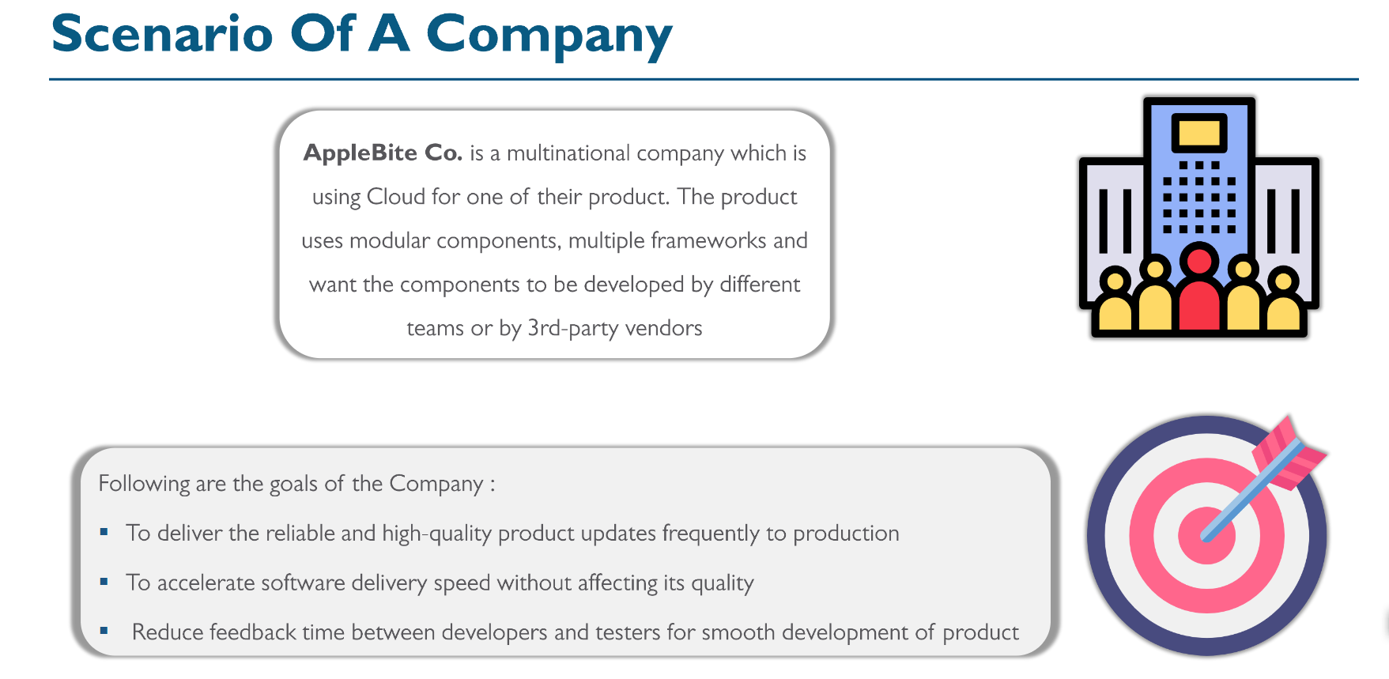

Slide 2
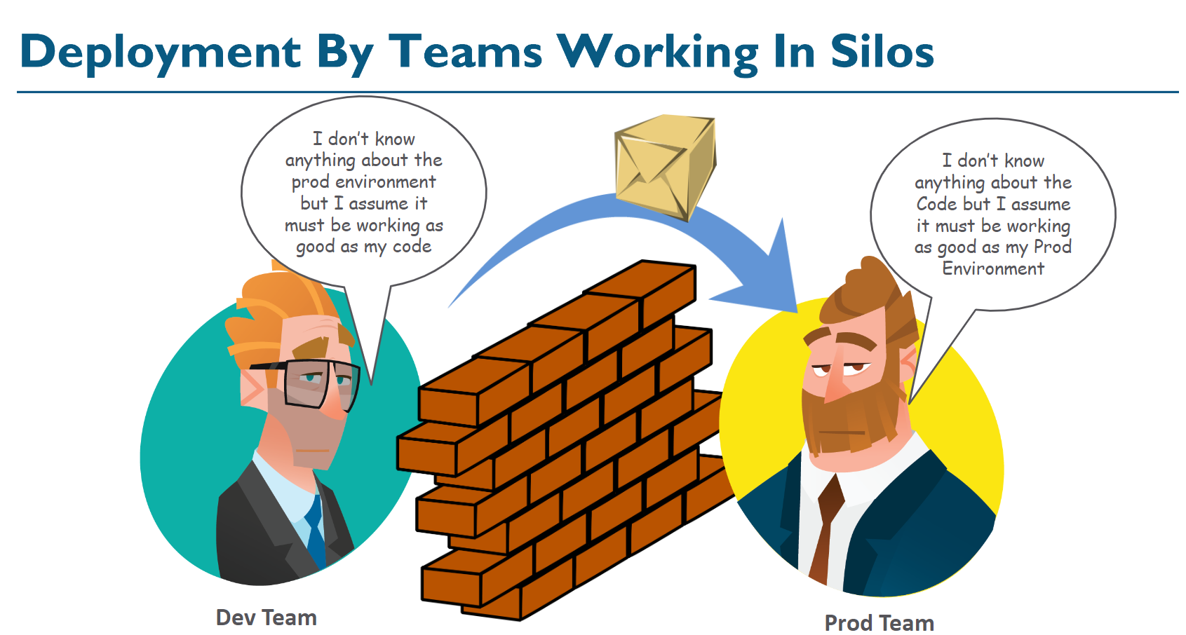

Slide 3
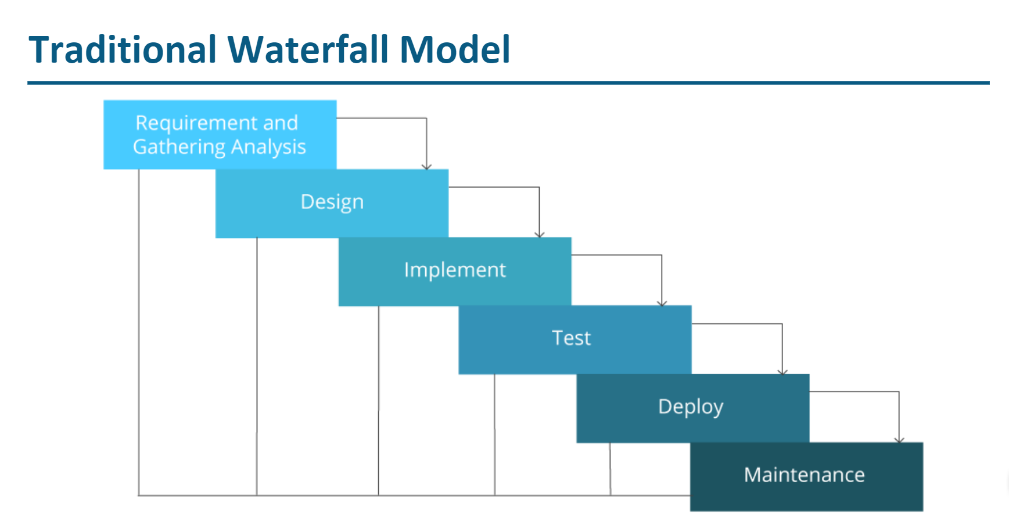

Slide 4
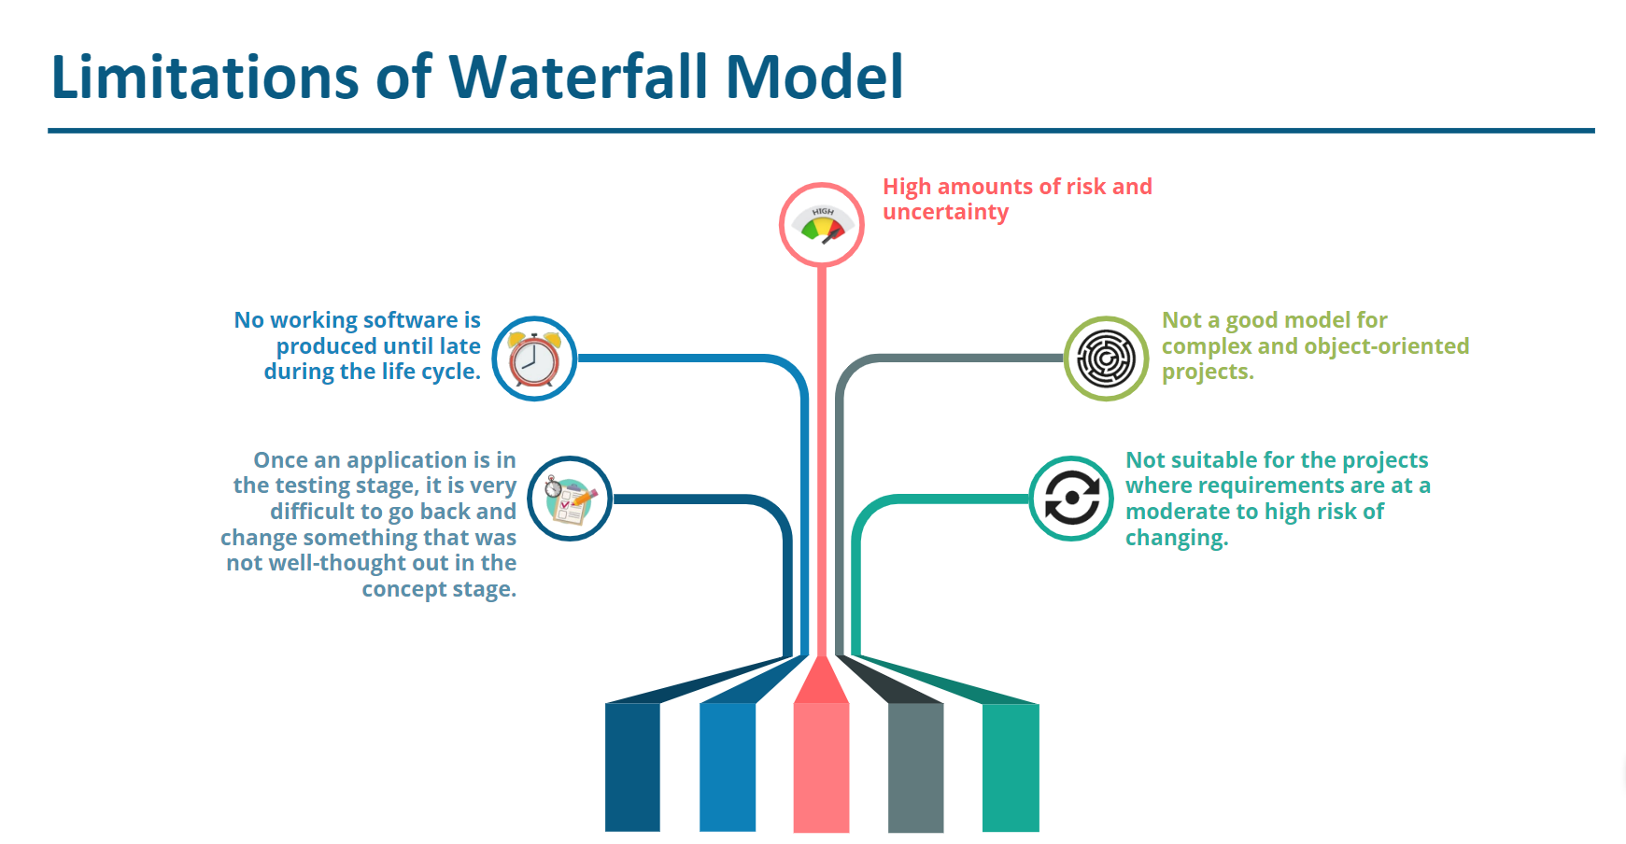

Slide 5
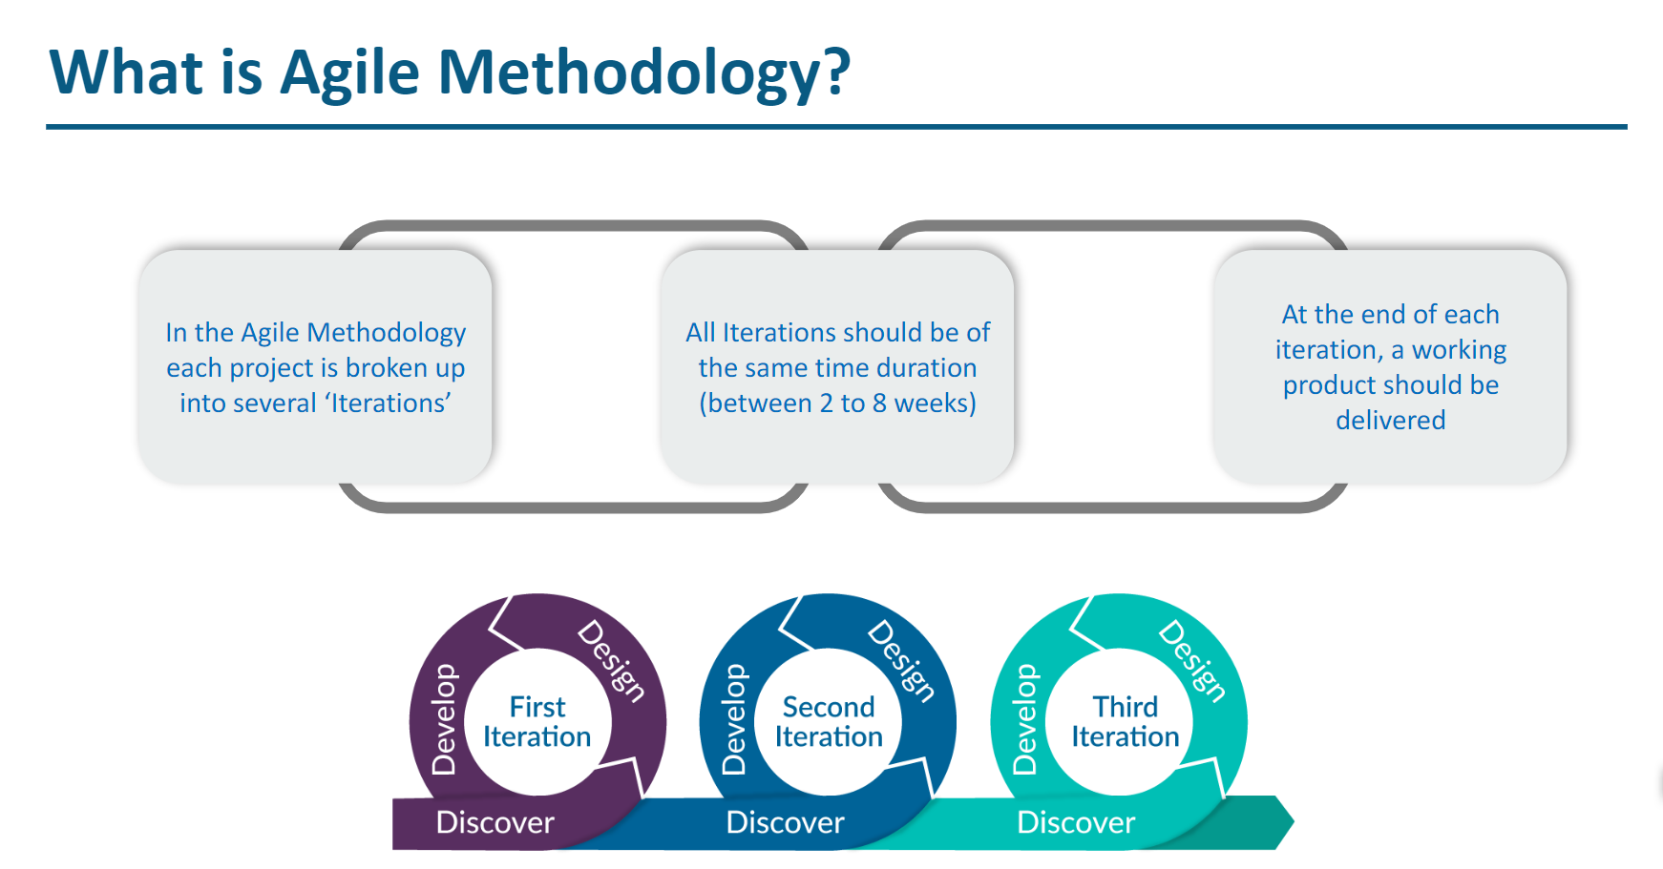

Slide 6
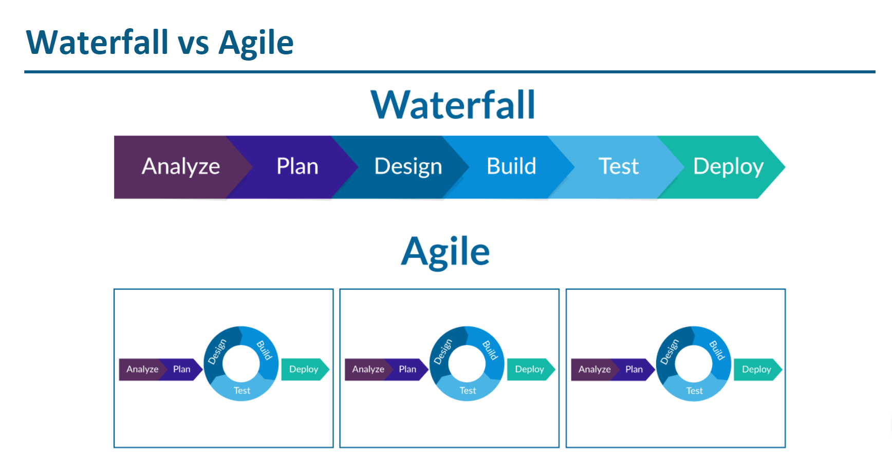

Slide 7
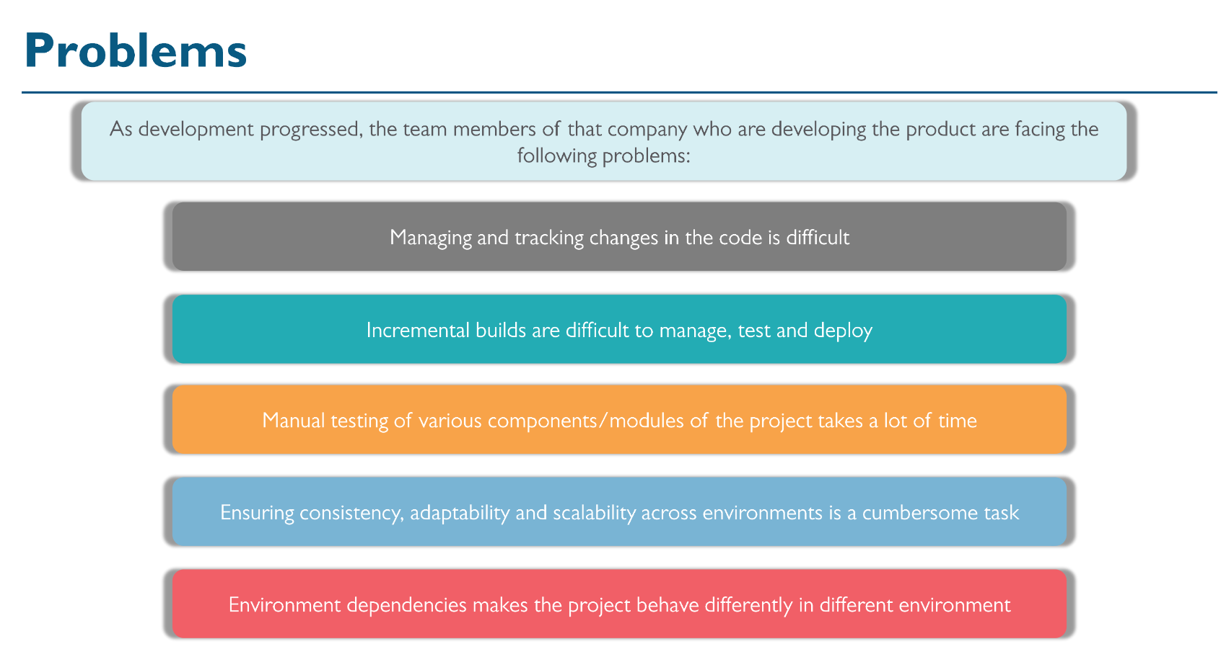

Slide 8
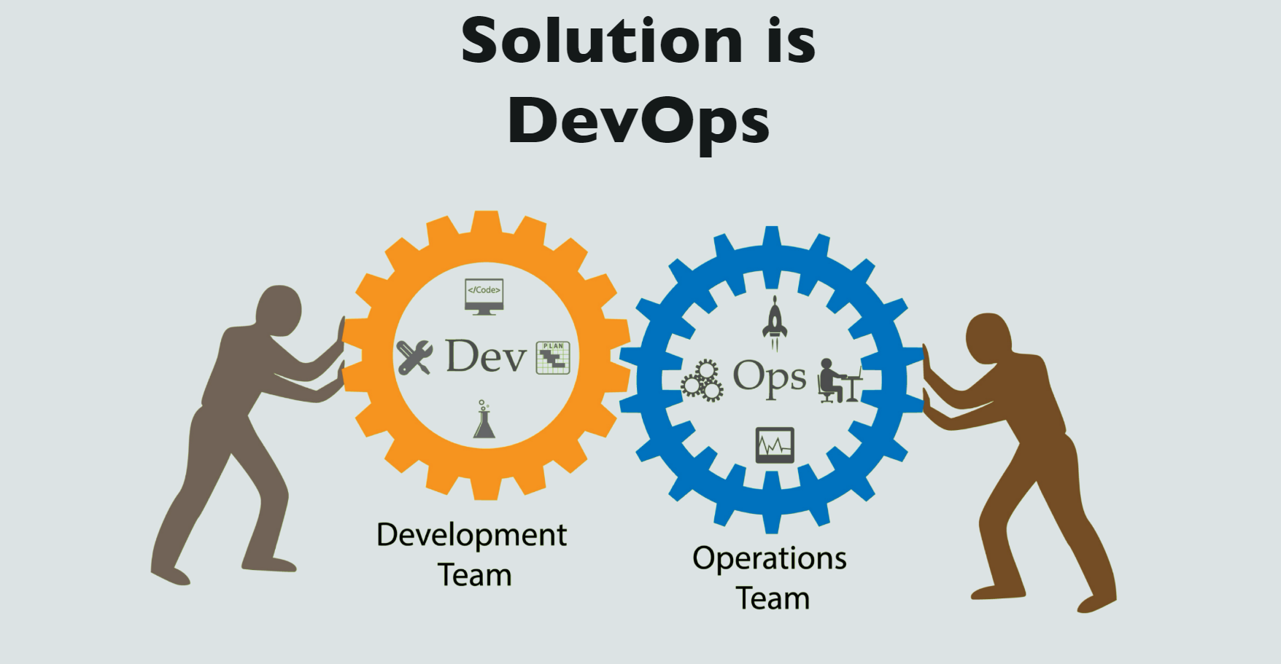

Slide 9
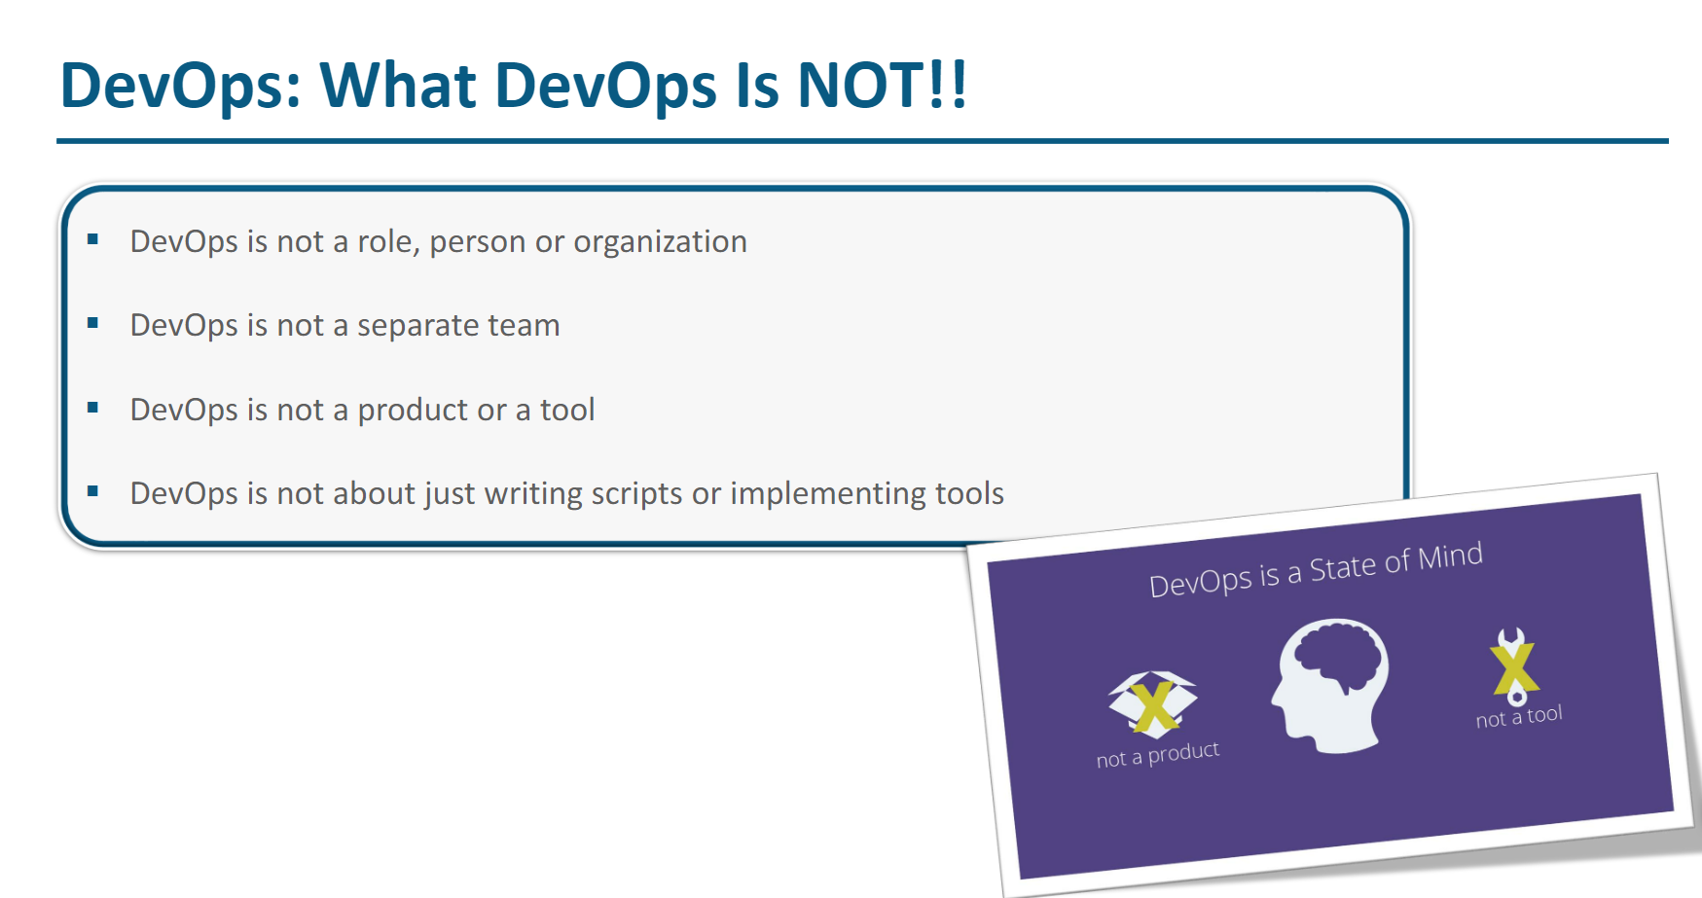

Slide 10
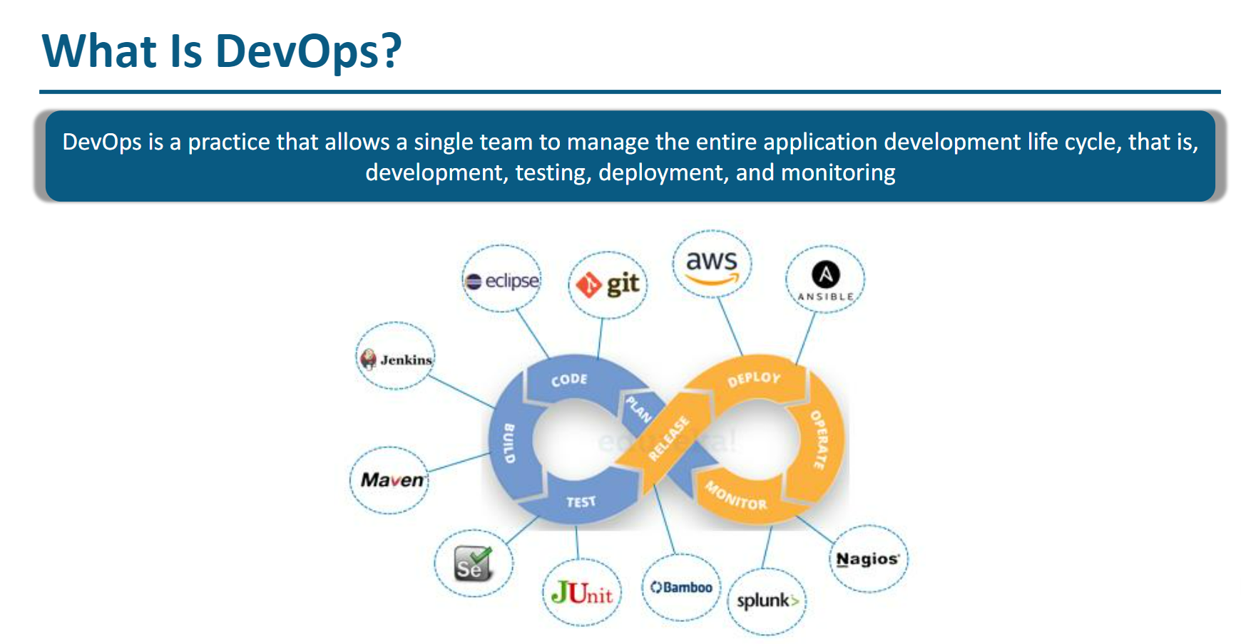

Slide 11
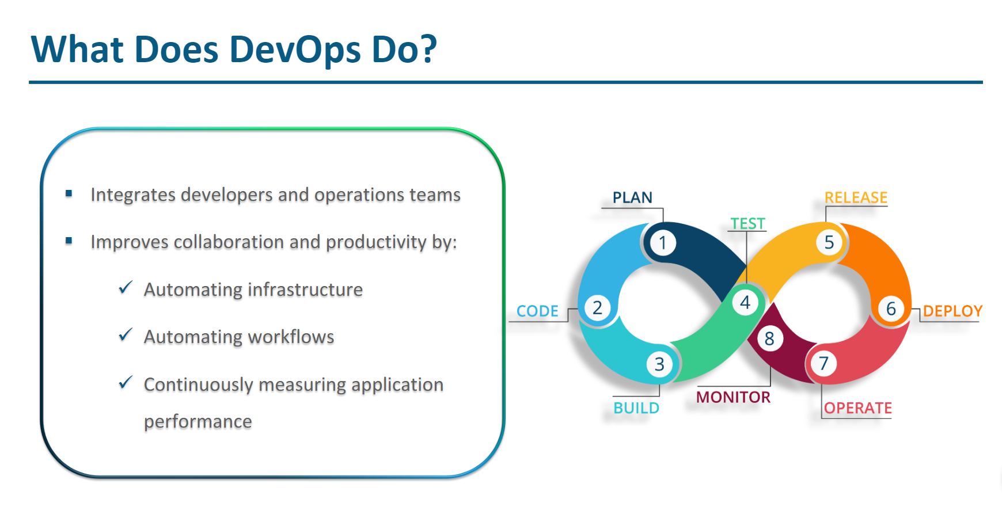

Slide 12
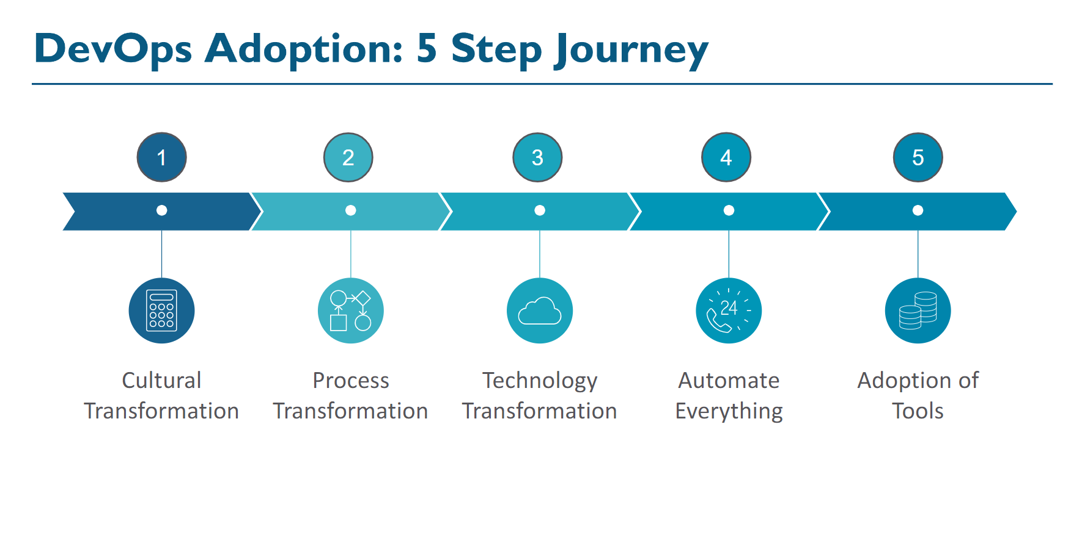

Slide 13
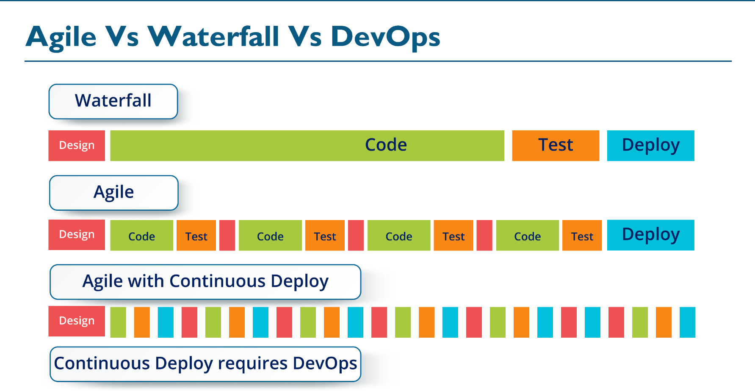

Slide 14
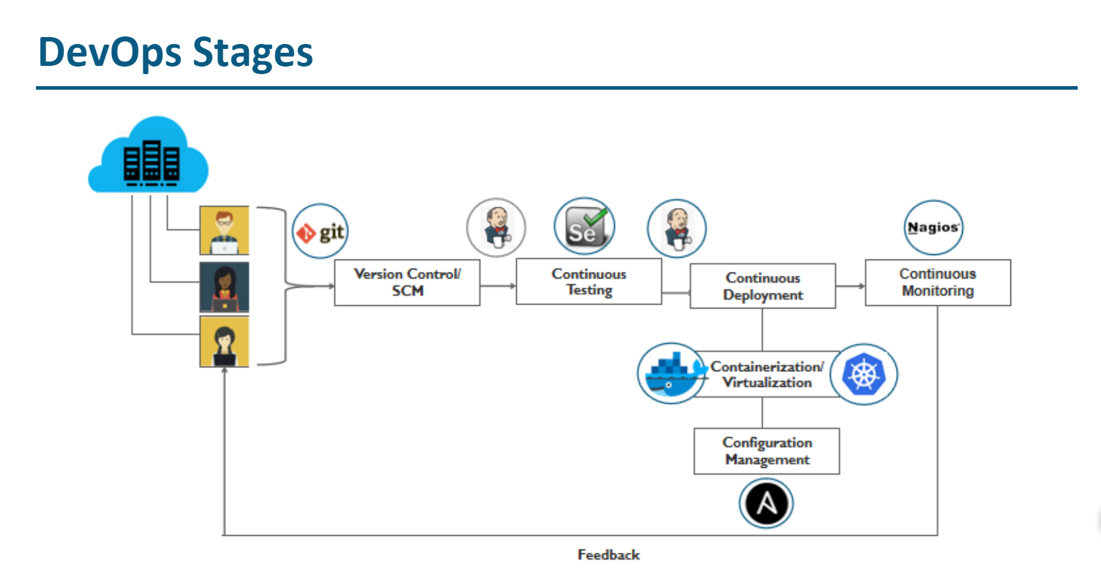

Slide 15
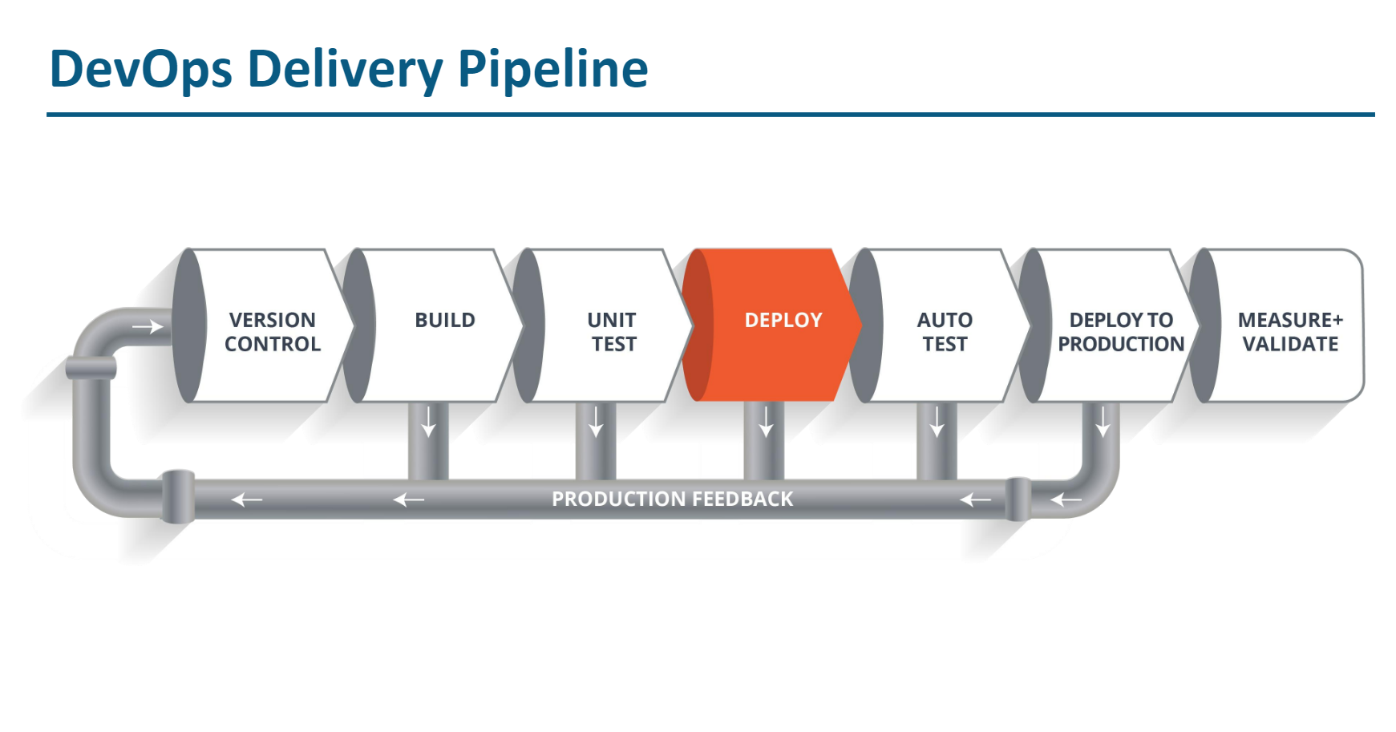

Slide 16
My DevOps Team Structure:
DevOps team structure plays a crucial role in fully leveraging DevOps benefits.
Organizations should ensure that the team is built with the right people with a clear definition of DevOps roles and responsibilities.
DevOps teams comprise professionals from development, quality, security, and the operations segment.
We have a senior person from the organization who would be an ideal person to lead the team, and is referred to as a DevOps Evangelist.
The DevOps evangelist will ensure that the responsibilities of DevOps processes are assigned to the right people.
My DevOps team is led by a senior member of the organization who knows business processes, has the technical expertise, and interacts with all employees. A DevOps evangelist fills in this position.
We decentralizing decision-making which enables the team to share DevOps responsibilities across the board while allowing them to expedite processes.

Slide 17
The smallest DevOps team should comprise the following people; A software developer/tester, automation engineer/automation expert, quality assurance professional, security engineer, and release manager. The granularity of the team ultimately depends on the size of the organization.
In addition to people who are skilled in coding and operations. Strong communication skills, technical expertise, and team player mentality are important traits for a DevOps guy.

Slide 18
DevOps Engineers resposiblity
CI/CD pipelines
Infrastructure management
Continuous Integration
Continuous Delivery / Deployment
Continuous Monitoring
Network and Server management
Cloud Architect

Slide 19
DevOps roles: DevOps Engineer
A DevOps engineer is responsible for designing the right infrastructure required for teams to continuously build and deliver products. The engineer identifies project requirements and customizes the tool stack.
He is well versed with automation tools and security technologies.
Right from the build, test, deployment, and monitoring of a product, the engineer integrates all resources and functions required at every stage of the product lifecycle
In addition, the engineer is involved in team composition, project activities, defining and setting the processes for CI/CD pipelines and external interfaces.

