Slide 1
Agenda:
Start our LAB -
What is Version Control and its benefits
Types of version Control System
Git and its features
Discuss different workflows in Local Repository using GIT
Execute GIT commands on Local

Slide 2
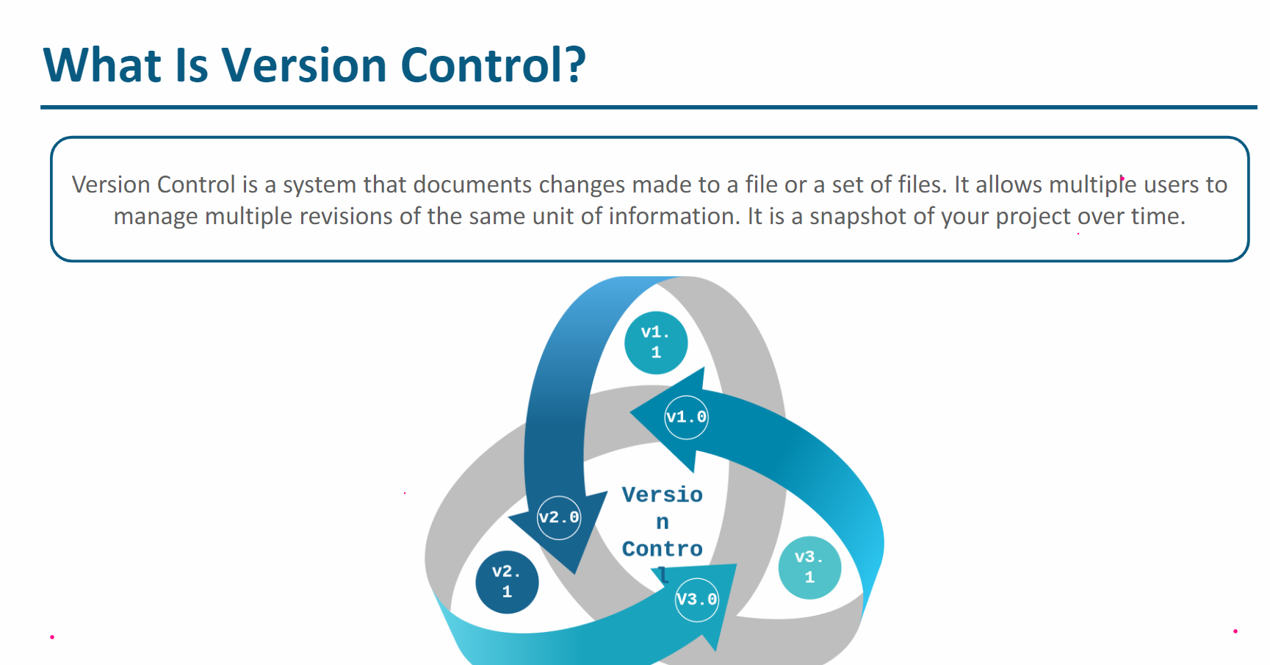

Slide 3
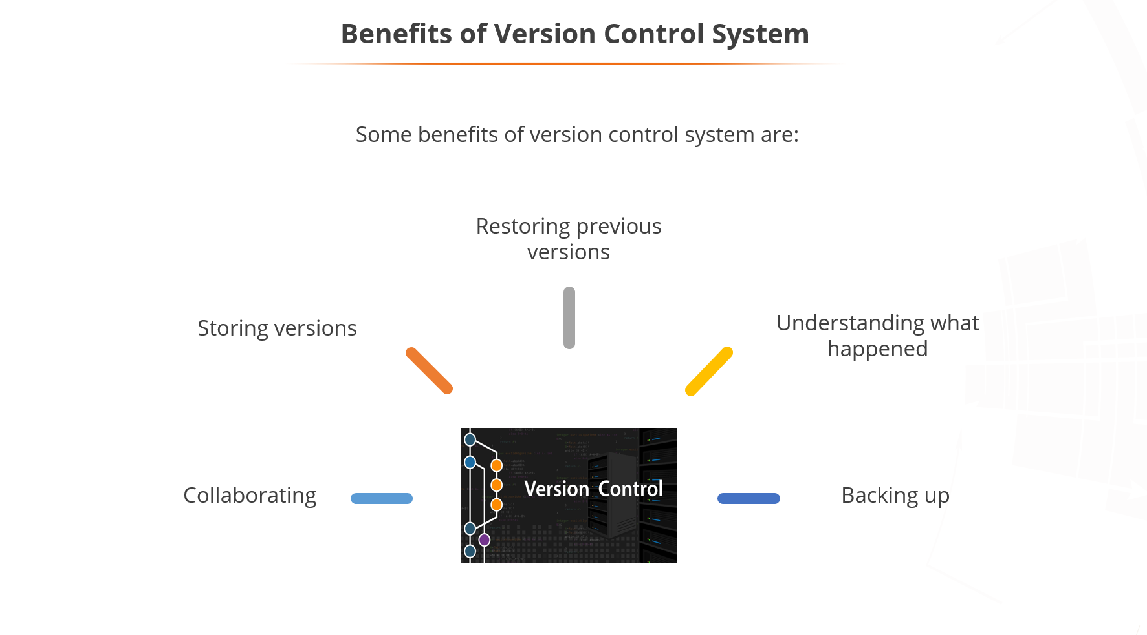

Slide 4
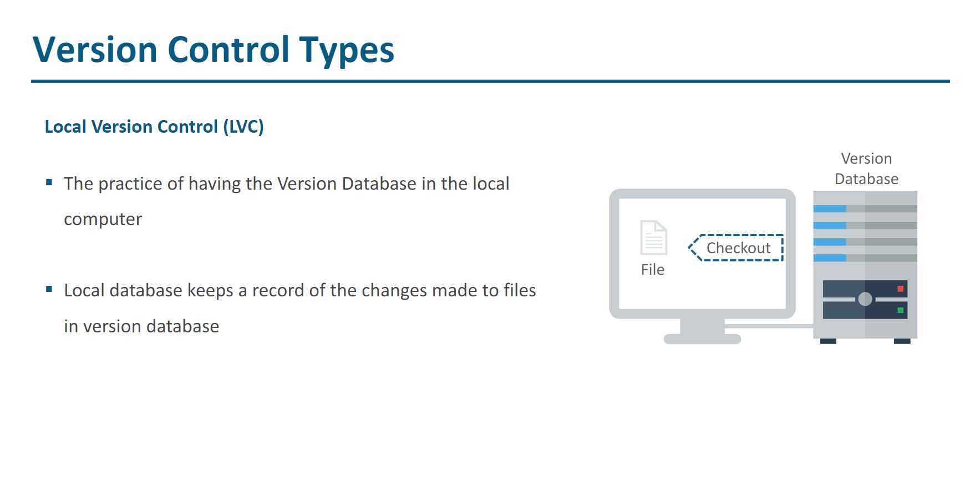

Slide 5
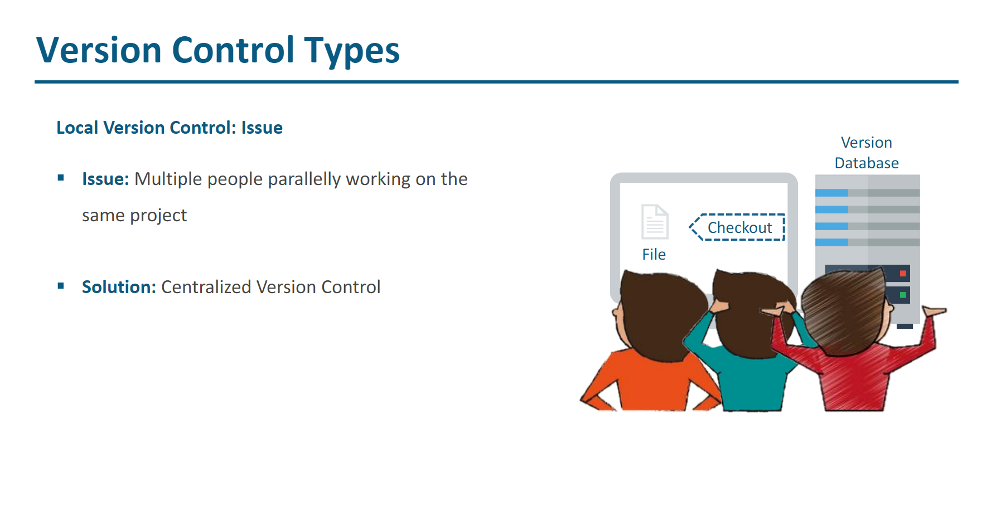

Slide 6
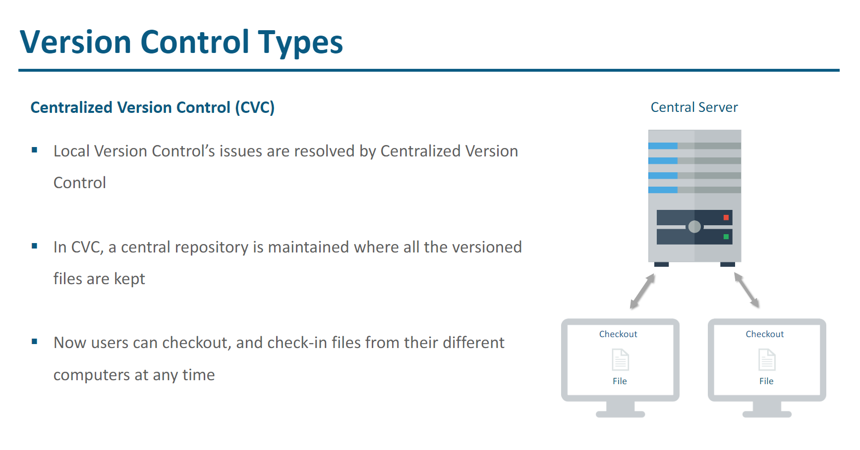

Slide 7
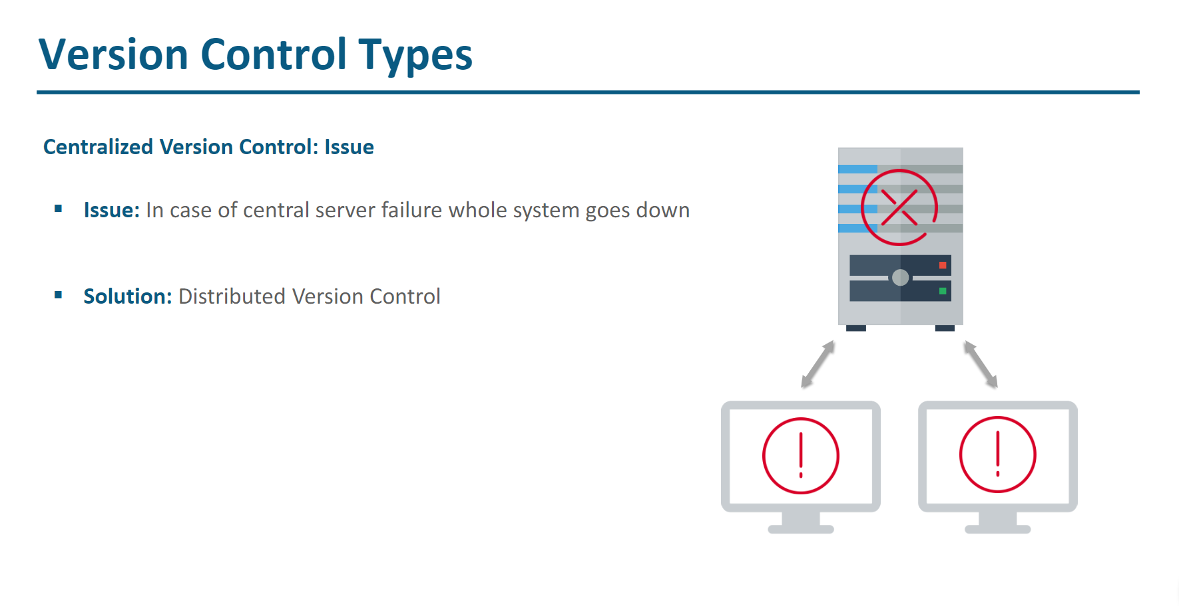

Slide 8
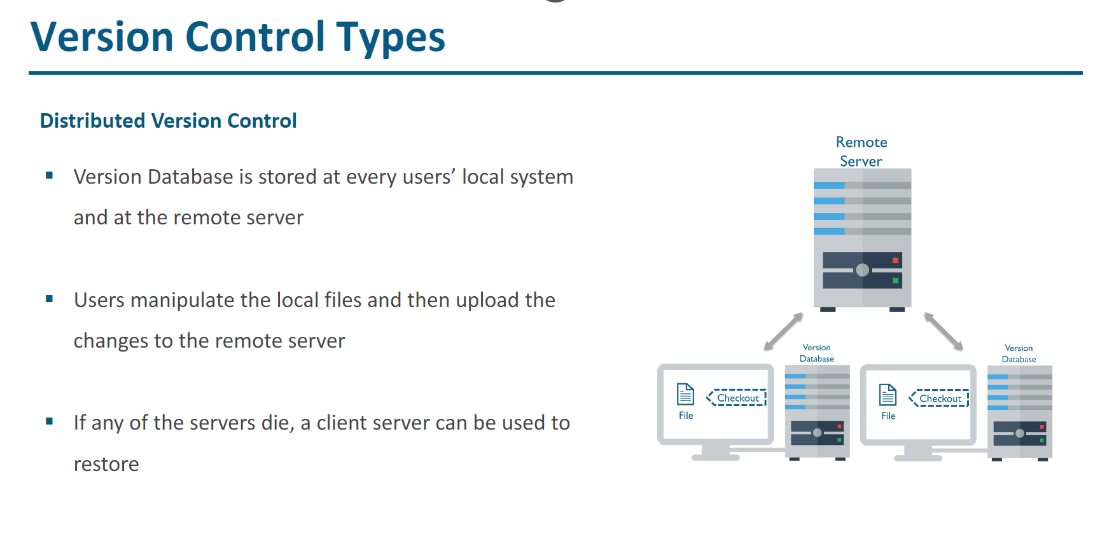

Slide 9
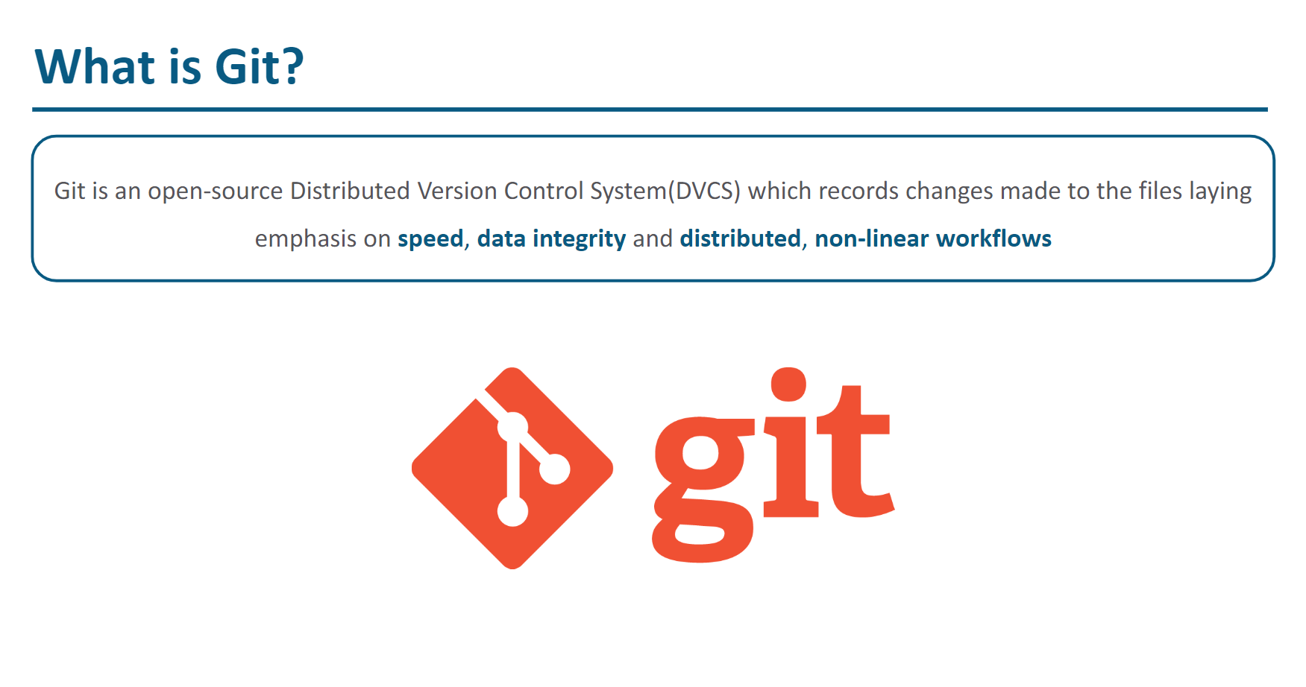

Slide 10
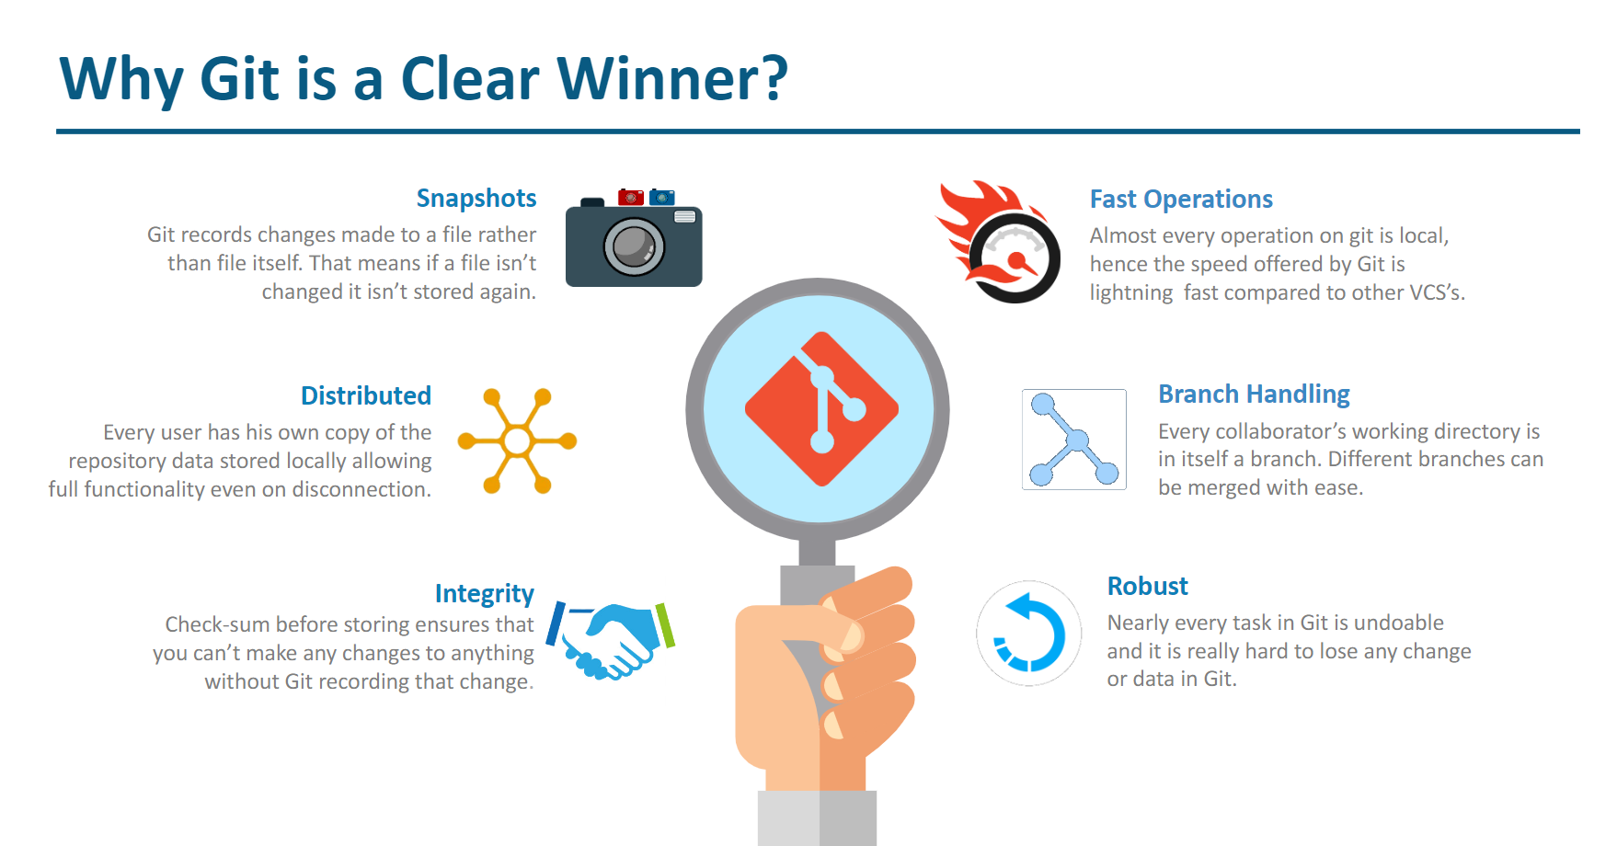

Slide 11
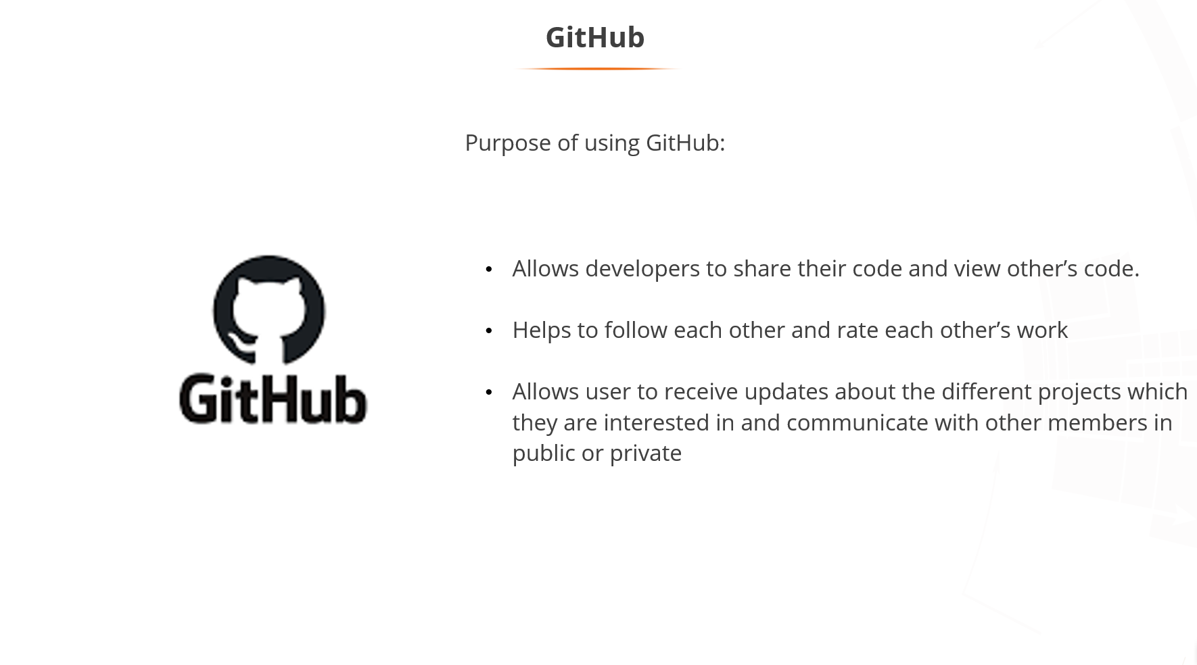

Slide 12
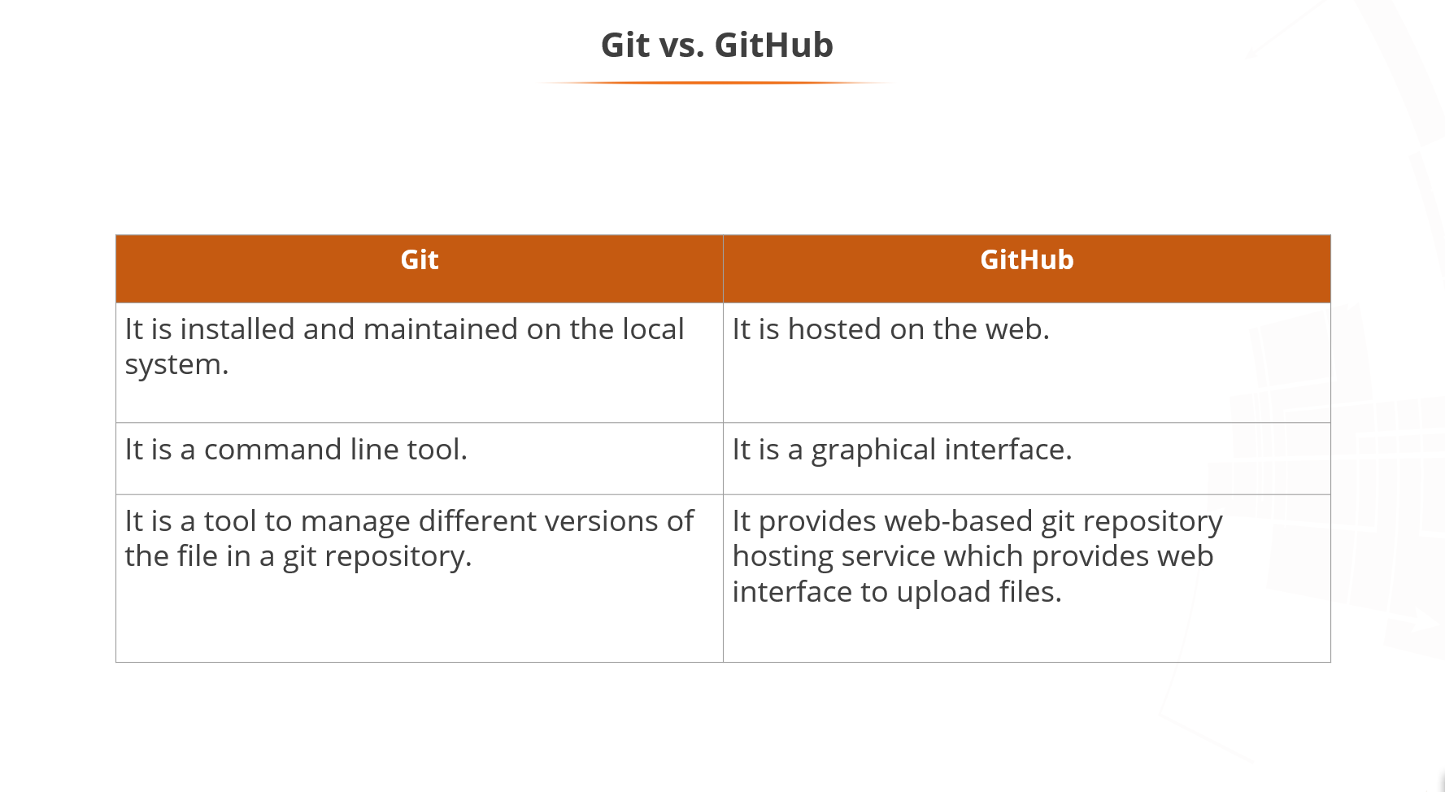

Slide 13
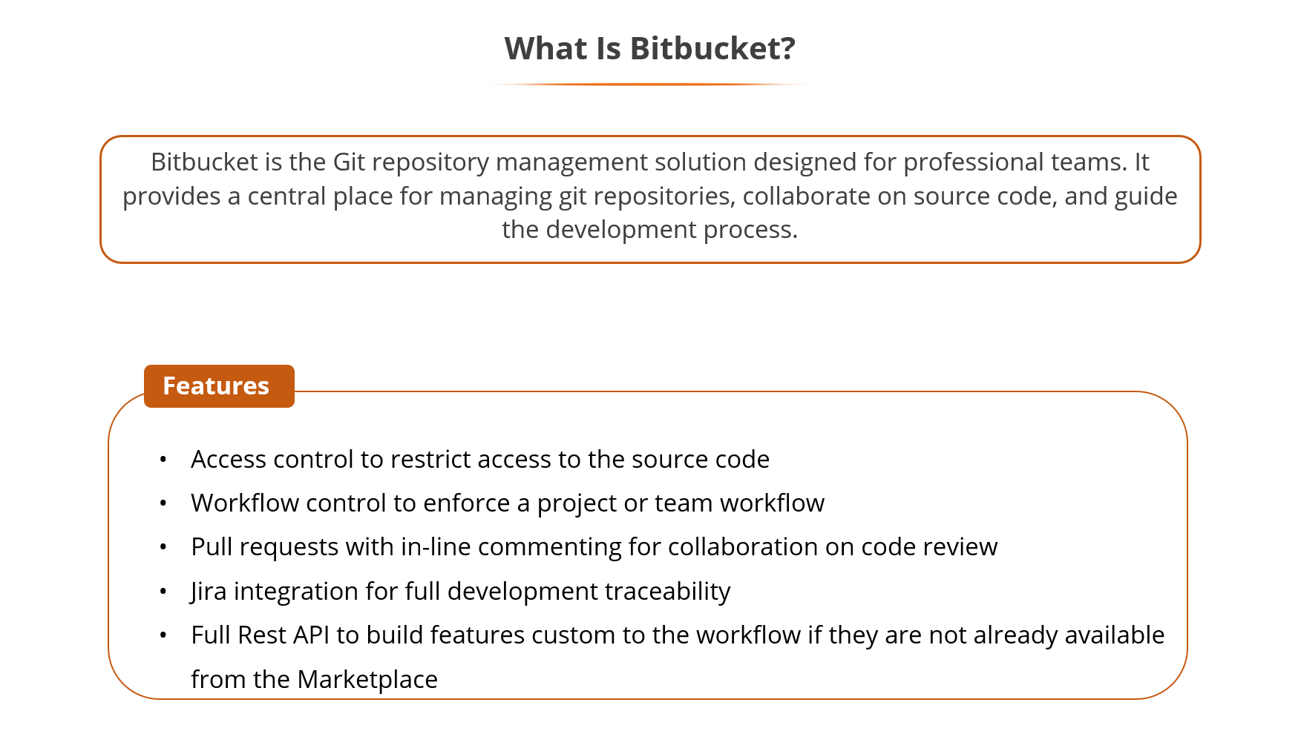

Slide 14
Difference Between GitHub and GitLab
Parameters | GitLab | GitHub
Levels of authentication | With GitLab, setting and modifying access and permissions is easy as per different roles and responsibilities | With GitHub, you can decide whether or not to give read or write access to team members
CI/CD services | GitLab offers in-built CI for free and GitLab CI provides DevOps automation solutions | It needs additional apps like Heroku to leverage CI/CD services
Import and export | GitLab offers rooted documentation on how to import/export data from other vendors | GitHub does not provide detailed documentation for popular Git repositories
Workflow | GitLab emphasizes workflow reliability | GitHub emphasizes workflow speed
Complete platform | GitLab is a packaged complete platform rather than offering choices to create a platform with different apps | GitHub has 374 free apps in its marketplace along with many paid options to boot
Self-hosted installation for private server | With GitLab, you can host a private GitLab version on your virtual machine through a free GitLab plan | Hosting a private server is only possible with the GitHub enterprise plan
Open-sourced | It is open source for community edition | It is open-source
Public repository | It allows developers to make a public repository | It allows developers to leverage the unlimited free repository
Project Analysis | Users can review project development charts | Users cannot get project analysis, but they can review the commit history

Slide 15
Parameters | Bitbucket | GitLab | GitHub
Owner | Atlassian | GitLab Inc | Microsoft
Programming language used to develop the platform | Python | Ruby, Go, Vue.js | Ruby
Best for | Corporate oriented teams | Complete DevOps lifecycle implementation | Major part of development community
Who won’t benefit from it | Small open-source projects | Big open-source projects | Projects that require keeping code out of third-party services
Companies using the platform | Atlassian | GitLab Inc | Microsoft
Open source | It is not open source | It is open source | It is open source
Free private repositories | Unlimited up to 5 team members | Unlimited | Unlimited
Free public repositories | Unlimited | Unlimited | Unlimited
Storage limit | 1GB | 5GB | 500MB
Integrations | Trello, Jira, Bamboo, and Opsgenie | Bugzilla, Jira, and Custom Issue Tracker | Microsoft Teams, Slack, Jira, and Windows Azure
Issue templates or merge request | Bitbucket does not have such functionality | GitLab Inc | Users can ask for issue templates or merge requests
Integrated CI | Bitbucket provides integrated CI functionality | GitLab platform offers Integrated CI functionality | Third-party apps can be used to leverage CI functionalities
Navigation usability | It does not consist of such functionalities | GitLab has navigation usability as a functionality | GitHub has navigation usability as a functionality

Slide 16
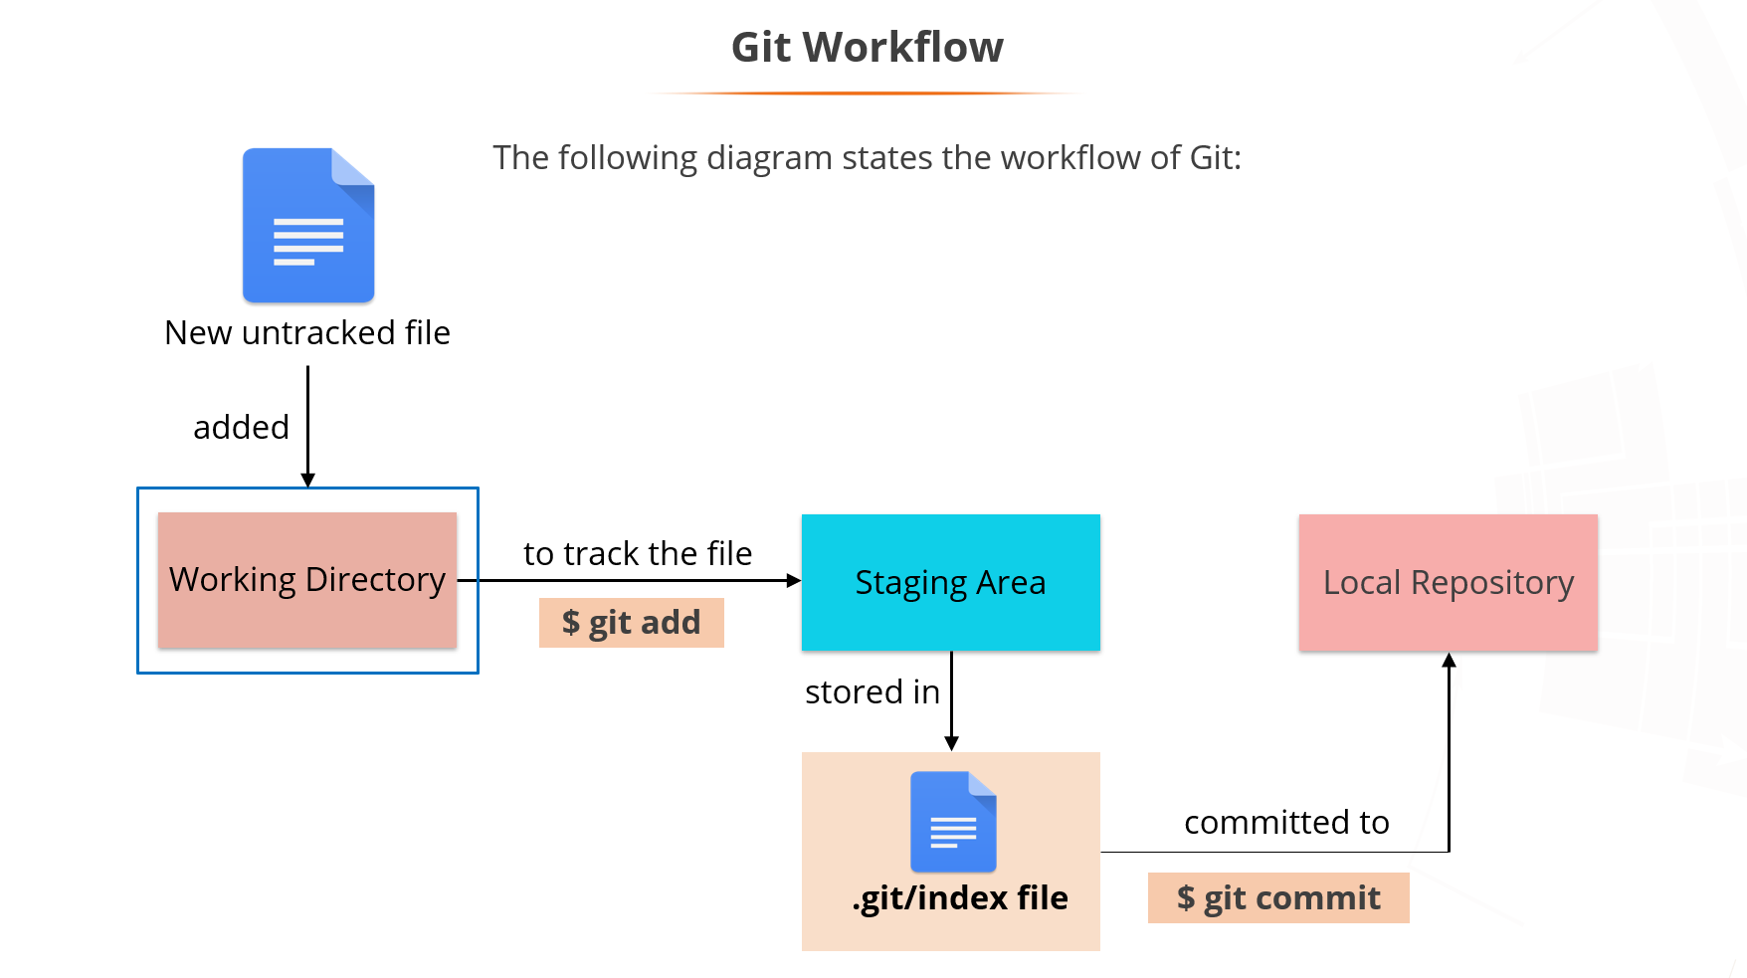

Slide 17
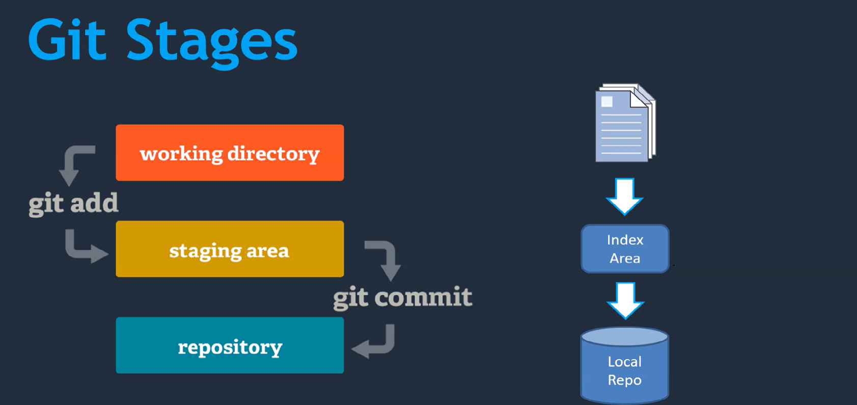

Slide 18
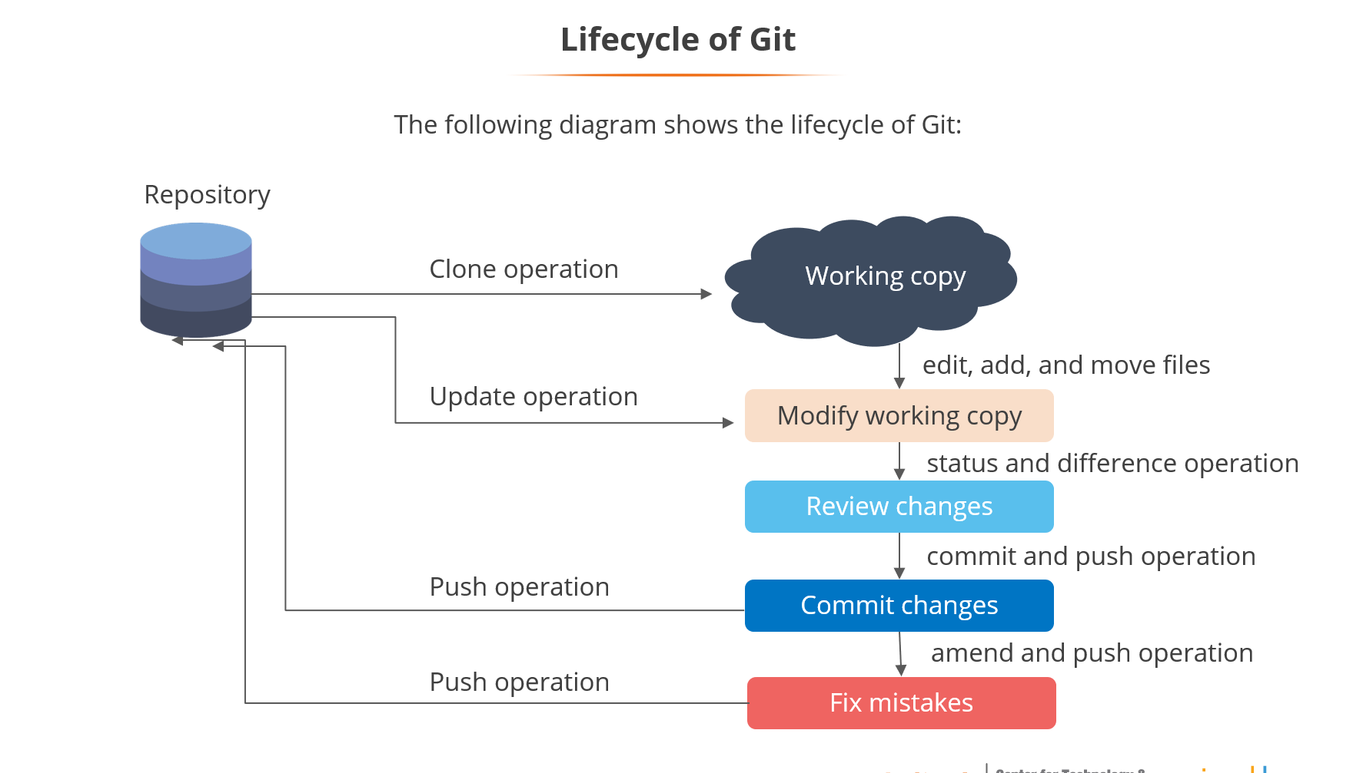

Slide 19
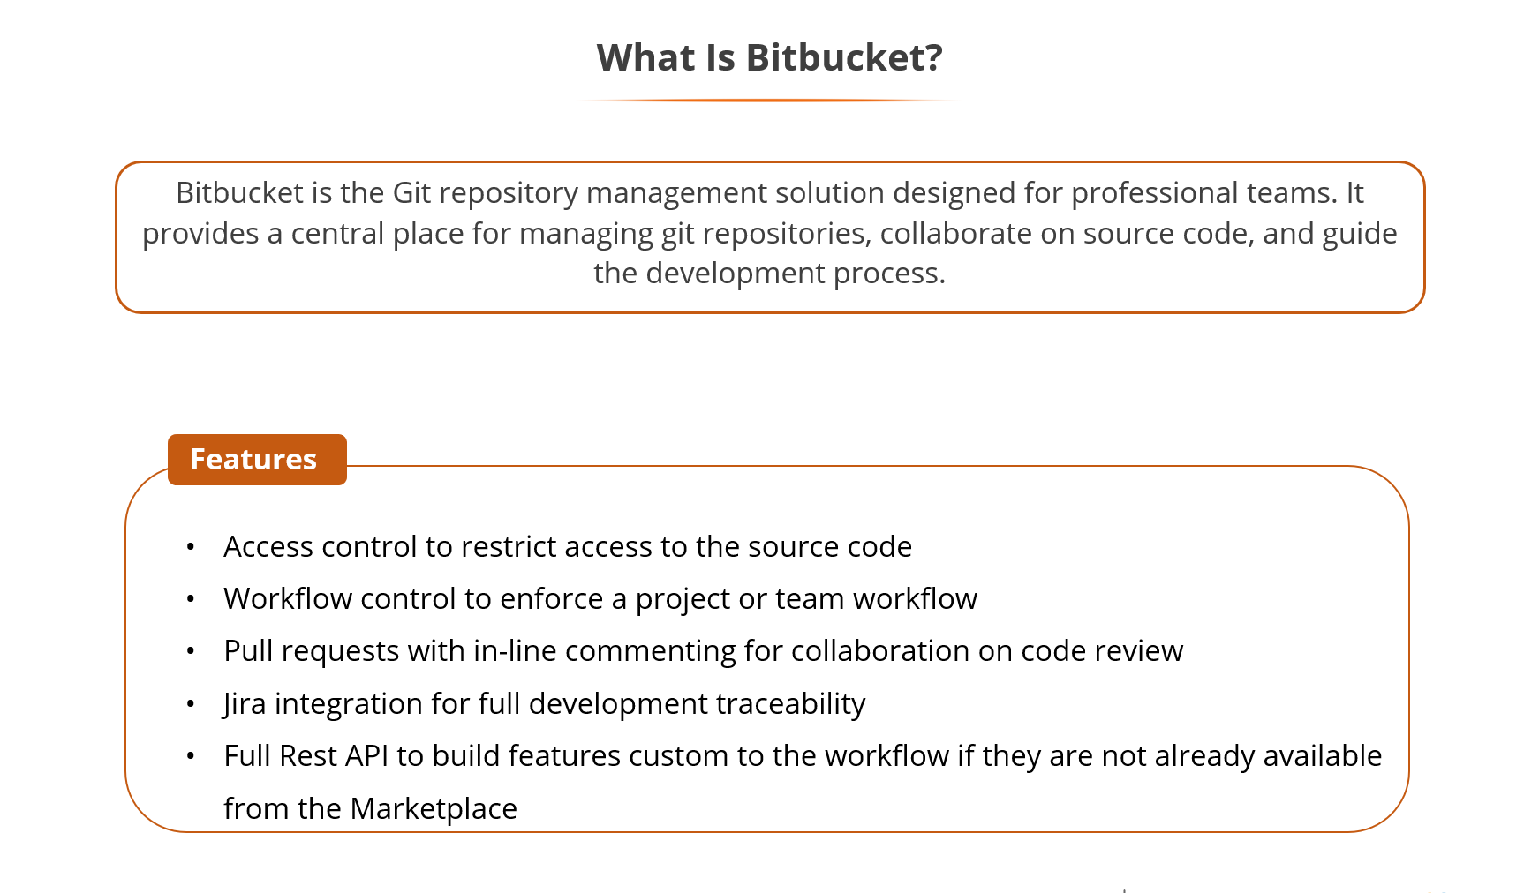

Slide 20
