Slide 1
HOUSING PROJECT

Slide 2
CONTENTS
Problem Statement
Exploratory Data Analysis
Visualization
Data Cleaning
Final Model
Conclusion

Slide 3
PROBLEM STATEMENT
Houses are one of the necessary need of each and every person around the globe and therefore housing and real estate market is one of the markets which is one of the major contributors in the world’s economy. It is a very large market and there are various companies working in the domain. Data science comes as a very important tool to solve problems in the domain to help the companies increase their overall revenue, profits, improving their marketing strategies and focusing on changing trends in house sales and purchases. Predictive modelling, Market mix modelling, recommendation systems are some of the machine learning techniques used for achieving the business goals for housing companies. Our problem is related to one such housing company.

Slide 4
A US-based housing company named Surprise Housing has decided to enter the Australian market. The company uses data analytics to purchase houses at a price below their actual values and flip them at a higher price. For the same purpose, the company has collected a data set from the sale of houses in Australia. The data is provided in the CSV file below.
The company is looking at prospective properties to buy houses to enter the market. You are required to build a model using Machine Learning in order to predict the actual value of the prospective properties and decide whether to invest in them or not. For this company wants to know:
• Which variables are important to predict the price of variable?
• How do these variables describe the price of the house?

Slide 5
EXPLORATORY
DATA
ANALYSIS

Slide 6
In Housing data project we have to predict the Sale price of House . In Housing project there is two datasets : Training dataset and Testing dataset . Training dataset contain 1168 rows and 81 columns and testing dataset contains : 292 rows and 81 columns.
For predicting the Sale Price first we have to import some necessary libraries. After importing the libraries, we can read and load the dataset. After reading the dataset first we have to analyzed it and after that we have to work on columns. We must check which column is necessary for finding the Target variable and which is not so important. Columns which are not much necessary for finding the target variables we can dropped that columns.
We also have to check null values in columns. If any column have null values we have to fill that null values by the mean, median or mode of that column. After filling all the null values
data is ready for the further processing.

Slide 7
VISUALIZATION

Slide 8
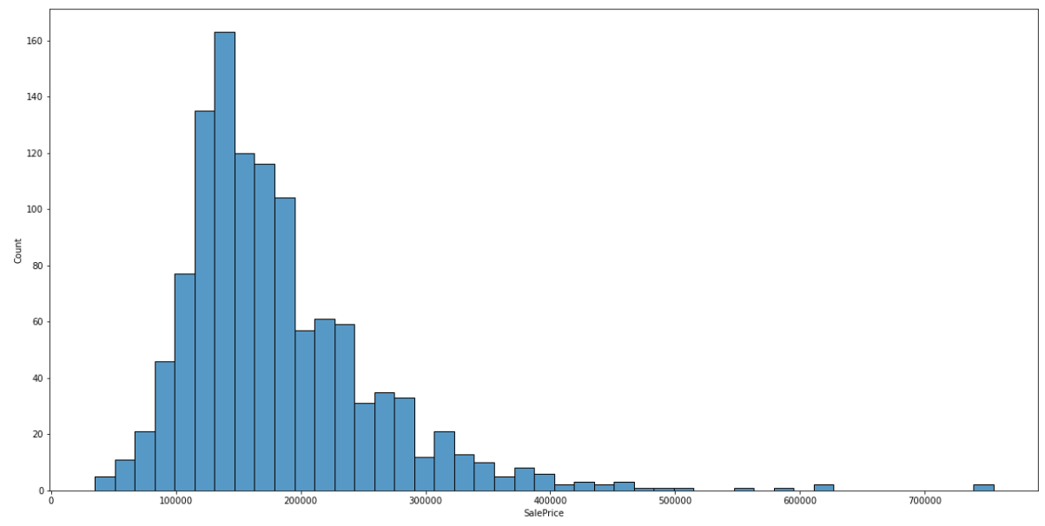
Diagram shows the histplot for Sale Price. Maximum Sale Price for a house is between 100000 to 200000.
Sale Price is a target column which is depend on other columns.
Sale Price of a house is depend on various factors therefor it is called dependent variable.

Slide 9
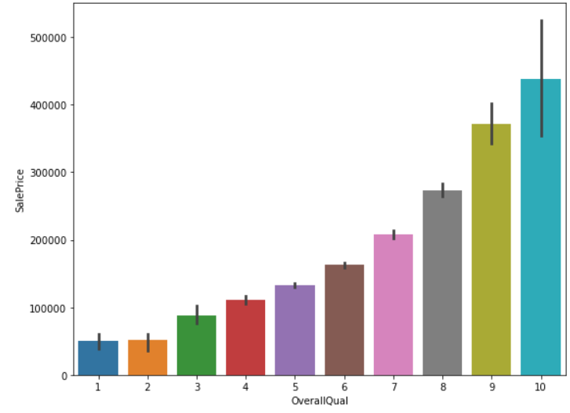
This graph shows the relation between Sale Price and OverallQual column.
Graph shows that Sale Price of a house is depend upon the Quality of a house.
Higher the Quality higher is the Price of a House.

Slide 10
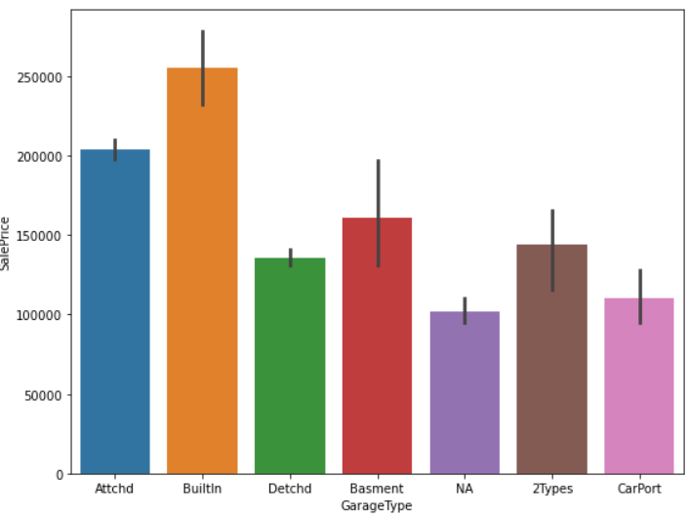
This barplot shows the relation between Sale Price and GarageType.
Graph shows that, House which has builtin Garage has the highest price than the others.
House which has no garage has the lowest price.

Slide 11
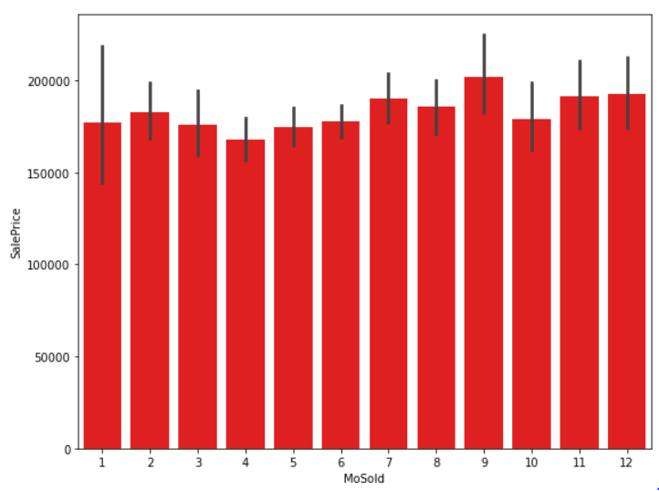
From graph we can say that, in 9 month the price of a house higher than the other months.
In 4th month, Sale price of a House is less than the other.

Slide 12
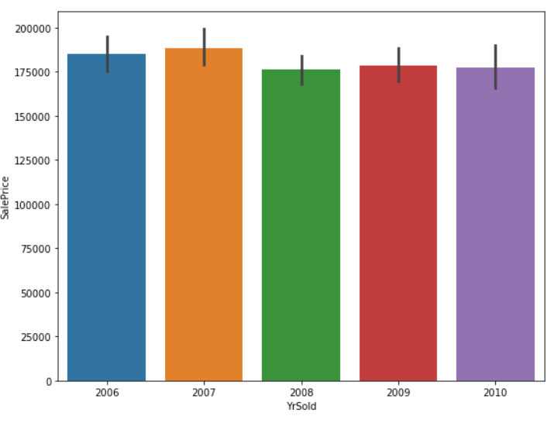
Graph shows the year wise Sale Price of house.
In year 2017 Sale Price of house is highest than the others.

Slide 13
SKEWNESS
Skewness is an asymmetric curve in set of data.
Skewness can be right or positive skewness.
It can be left or negative skewness.
It can be zero or normal skewness.
DATA CONVERSION
Data conversion is an important step in machine learning program.
Objective data is converted into numerical data in Data Conversion.
By using Label Encoder we convert the data.
OUTLIERS
An outlier is something which is different from given data.
Distance of an outliers from the other points is out of range.
After finding Skewness and Outliers we have to remove them. Skewness can be removed by Power Transform or Log Transform and Outliers are removed by using Z Score or Interquartile technique.

Slide 14
Splitting the Data
Data is splitted into two parts; dependent data and independent data.
In splitting process target or dependent column should be drop.
In this program we splitted the data into x and y.
X is an independent variables and y is the dependent variable.
Training Process
After splitting the data in x and y, data is send for training and testing.
Maximum 80% data is send for training and 20% is for testing.
x_train has (786,61) data and x_test has (337,61) data.
y_train has (786,) data and y_test has (337,) data.
r2 Score
It is the proportion of the variation in the dependent variable that is predictable from the independent variable.
r2 score for this model is; 85.30.

Slide 15
Cross Validation Score
Cross validation is an important concept in machine learning.
It can reduces the size of data.
In this program at cross fold 8 the best cv score is;81.31
MODEL TESTING
Testing the model is an important process in machine learning.
For this program we used Linear Regression.
We are testing different different model of regression to get the best cv score.
We did testing on Ridge, Lasso, Extra tree regressor, Random forest regressor, AdaBoost regressor and Decision tree regressor.

Slide 16
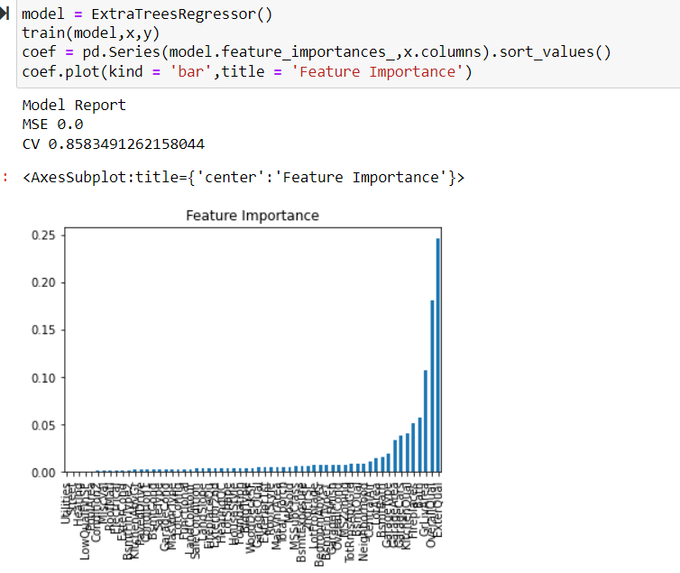
FINAL MODEL
We choose Extra Tree Regressor as our final model without Hyper parameter tuning.
Because cv score for Extra tree regressor is higher than the other model. After using hyper parameter tuning cv score gets reduced so we choose final model without hyper parameter tuning.

Slide 17
CONCLUSION
After testing all the models we chose Extra Tree Regressor model.
CV score for Extra tree regressor model is; 85.83.
But after applying Hyper parameter tuning cv score was; 80.14.
So we chose Extra tree regressor model without hyper parameter tuning.

