Slide 1

PRESENTATION ON QA AUTOMATION USING SELENIUM (JAVA, PYTHON)
By:
Sonal Adhikari

Slide 2
SELENIUM JAVA

Slide 3
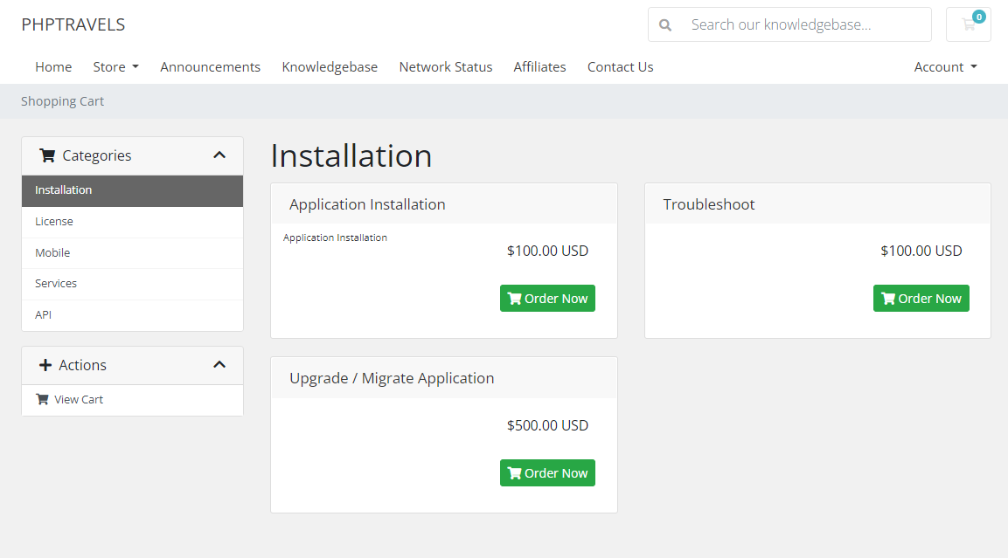
Introduction
Demo site : https://phptravels.org

Slide 4
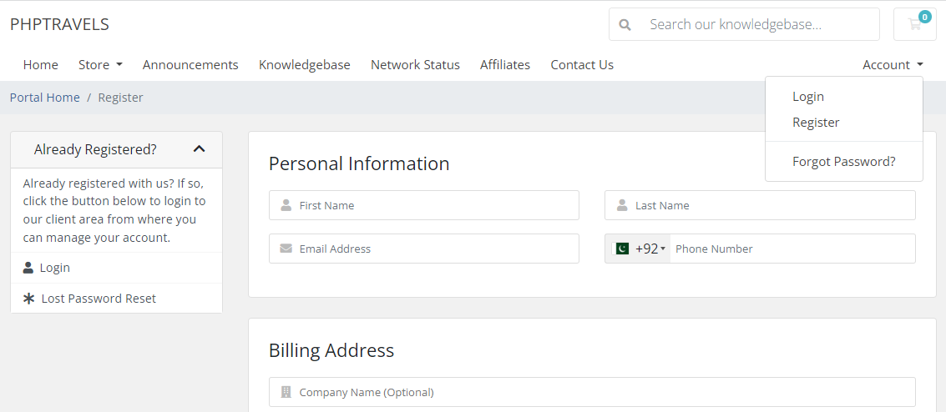
Can register an account and login
Search for articles, browse through categories

Slide 5
Objectives
To implement java selenium
To automate a workflow of the site

Slide 6
Methodology
Key steps:
1. Requirement Analysis
2. Environment Setup
3. Test Case Design
4. Test Execution and Reporting
5. Maintenance

Slide 7
Requirement Analysis
- understand testing requirement for target website
-identified test scenarios and features to be covered

Slide 8
Environment Setup
- installed Java Development Kit and configured
- installed selenium and setup WebDrivers, browser drivers
- added maven dependencies
-incorporated TestNG framework

Slide 9
Test Case Design
- designed test cases for maximum coverage of identified scenarios
- leveraged Java along with selenium to simulate user interaction
- utilized Page Object Model(POM) design pattern

Slide 10
Test Execution and Reporting
- executed test cases using TestNG
- used TestNG annotations to systematically execute test cases
- assigned priority value to the Tests
- navigated between iframes using selenium’s “switchTo()” method
- implemented waiting strategies for elements to be visible
- made use of JavaScriptExecutor to scroll into view
- handled error using try-catch blocks

Slide 11
Test Execution and Reporting
- used logger to log info and error
- generated emailable report using TestNG

Slide 12
Maintenance
- made use of git for maintaining and updating code

Slide 13
Results and Findings
Now let’s look at our demo

Slide 14
Results and Findings
- tested functionalities are working as expected
- problem arised during verification of captcha, which is handled by catching error statement

Slide 15
Conclusion
In this way automation using selenium java is achieved in the given test site.

Slide 16
Continuing,
SELENIUM PYTHON

Slide 17
Summary of things I learned in python :
Data Types and Variables – int, float, strings, Booleans
Operators – arithmetic, logical, comparison, assignment
Control Flow – if, else, elif, loops(for, while), break, continue
Functions
Input and Output
Data Structures – list, tuples, dictionaries, sets
File Handling – open, close, read, write
Exception Handling
Modules and Packages
Object-Oriented Programming (OOP)
Built-in Functions and Libraries
List Manipulation
Lambda Functions

Slide 18
Using these concepts along with pytest, I have done automation using python in the
following site: https://sastotickets.com/
Let’s see the demo.

Slide 19
Thank You!

