Slide 1
Project 3
Title: NutriVis - Visualising Nutritional Profiles of Foods
Group 1
Steph Adey
Sonal Bhosle
Liwei Jiang
Aryan Linga

Slide 2
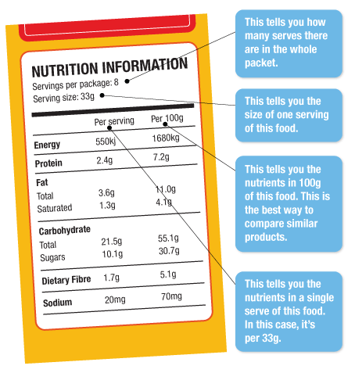
Overview and purpose
By visualising nutritional profiles of various foods, the project allows users to check the specific nutrition values provided by the food of their choice.
The project focuses on the nutrition values listed in the standard food labels; the users who may have specific nutrition needs shall seek professional advice.

Slide 3
Data
The original data consists of 8787 items of food extracted (E) from data.world (retrieved from https://data.world/awram/food-nutritional-values/workspace/file?filename=ABBREV.xlsx)
Transformation (T) of the original data is performed as follows before the visualisation:
Based on the descriptions, the food items have been categorised into 8 common categories: Dairy, Fruits, Grains, Meats, Nuts & Seeds, Seafood, Vegetables, and others.
A final sample of 700 items were selected which consists of 100 for each category(sorted by values in descending order) above except for the broad category “others”.
Both the original dataset and the final sample of 700 food items are then exported as csv and json files and loaded (L) to MongoDB database to store and/or use when needed before the analyses are performed.

Slide 4
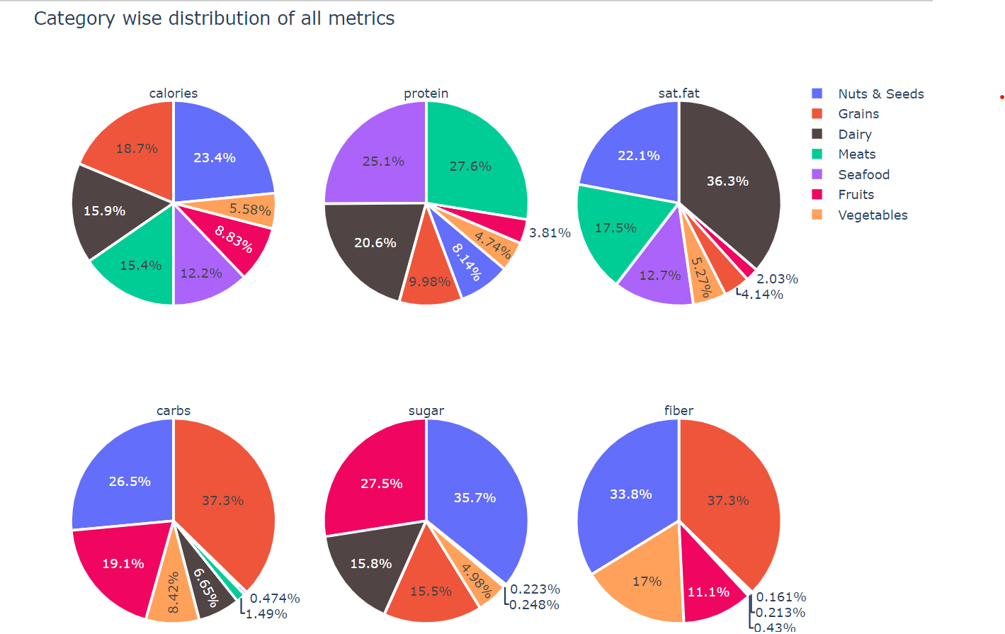
Visualisation 1: Average nutrition values provided by each category

Slide 5
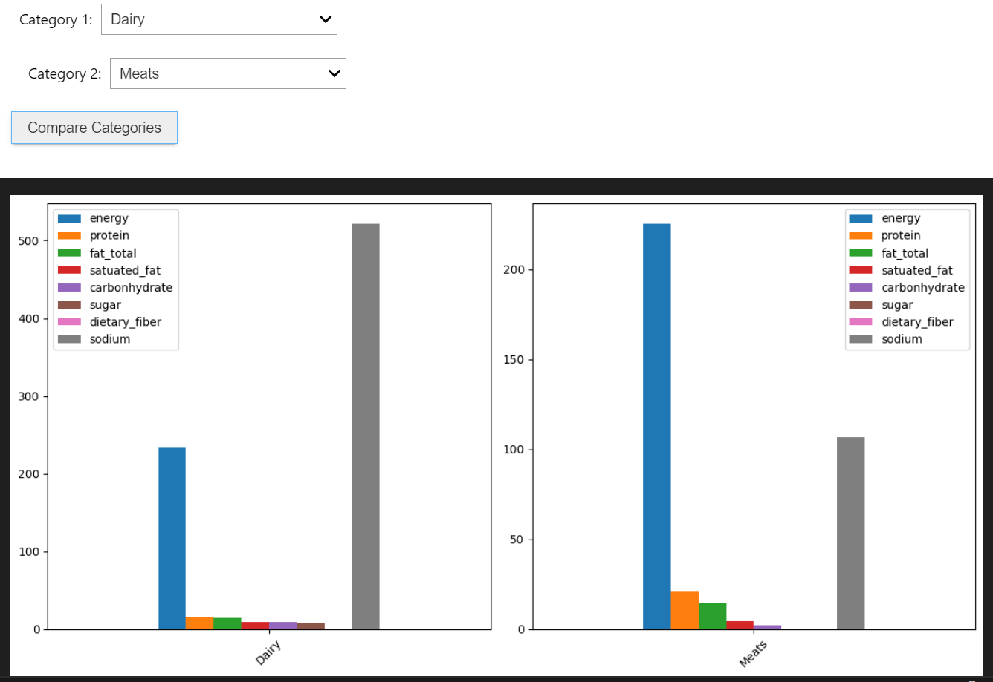
Visualisation 2: a comparison of nutrition values between two categories of your choice

Slide 6
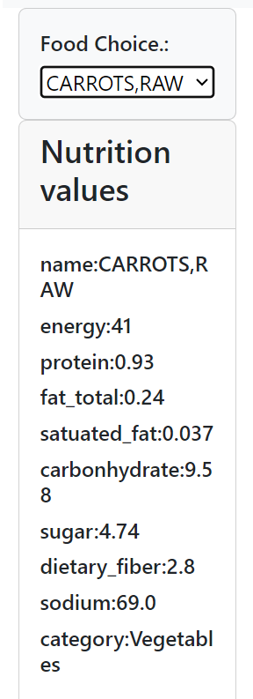
Visualisation 3 (interactive): An example of food label generated

Slide 7
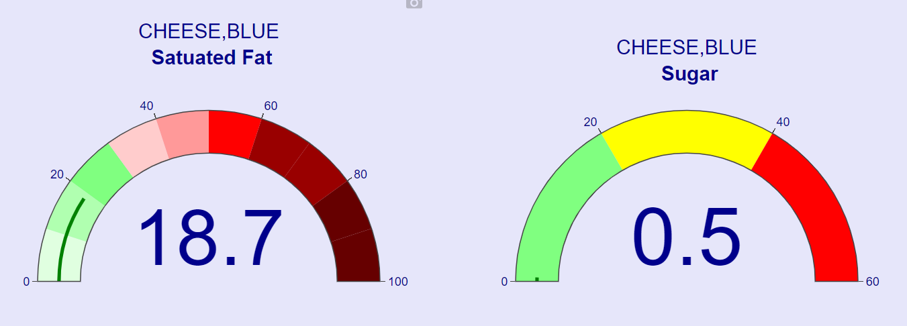
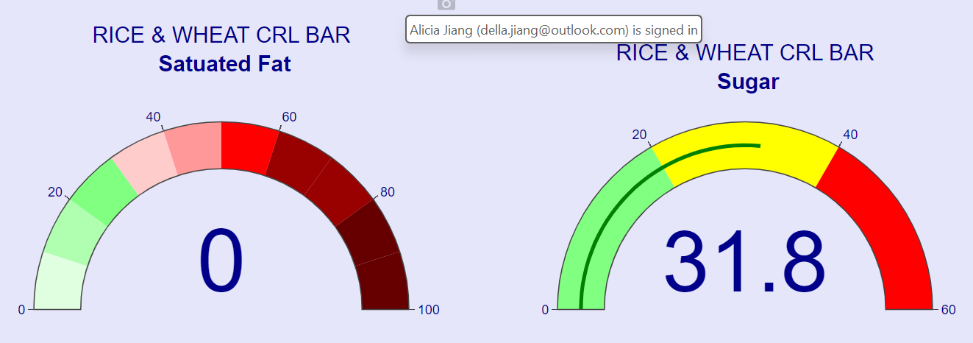
Visualisation 4(interactive): gauge charts

Slide 8


