Slide 1





PRESENTATION 2026
Smarter Insights for Better Care using Health Metrics Dashboard
Student Name
Student Email
Sonal Genani
sgenani4@gmail.com
Mentor Name
Uma Maheshwari Ma’am

Slide 2

Outline
Abstract of the Project
Problem Statement
Proposed Solution
System Architecture
Live Demo of the Project
Embedded Video of Project
Conclusion
Future Scope

Slide 3
Abstract
Analyze healthcare patients' data to generate meaningful insights.
Cleans, processes, and visualizes raw and inconsistent records
Identifies trends in admissions, medical conditions, and hospital performance
Uses Microsoft Excel, Power BI, and Microsoft Copilot
Developing an interactive dashboard for key metrics
Highlights patient distribution, disease burden, length of stay, and cost of care
Integrates AI for insight generation and improved reporting efficiency
Supports proactive, data-driven healthcare decision-making

Slide 4

Problem Statement
Difficulty in correlating variables such as ‘Medical Condition’, ‘Medication’, and ‘Test Results’ to assess treatment success rates.
Lack of unified view of patient history due to fragmented and duplicate records across different hospitals and departments.
Organizations struggle in identifying key performance indicators (KPIs) such as bed occupancy rates, emergency admission trends, due to lack of clean, visualized data which leads to underutilization
Skill gaps amongst clinical staff make it difficult for them to use technology for making analysis faster.
Challenges:
Inconsistent data formats
Weak correlation across clinical variables
Fragmented patient records
Limited KPI visibility

Slide 5

Proposed Solution
The proposed solution leverages a structured five-phase framework consisting of data collection, cleaning, analysis, visualization, and documentation, which would transform fragmented hospital records into actionable insights.
Using Excel and Power BI, we standardize formats, remove duplicates, and compute KPIs such as length of stay and admission trends. Copilot integration enhances analysis by generating summaries, interpreting trends, and recommending preventive care strategies.
Interactive dashboards provide unified patient views; compared to traditional methods, this approach combines AI-driven prompt engineering with visualization, enabling proactive healthcare decisions, optimized resource utilization, and improved patient outcomes.

Slide 6
System Architecture
Data Input / Source
Processing / Analysis
The project used a healthcare dataset in Excel format sourced from Kaggle, uploaded manually and analyzed using Excel, Power BI, and AI tools like Copilot.
Data was cleaned by removing duplicates, handling missing values, and standardizing formats in Excel, then transformed and analyzed using formulas, pivot tables, and Power BI and AI insights.
AI / Tool Integration
Output / Dashboard
Excel was used for initial data cleaning and preprocessing, including handling missing values, removing duplicates, and applying formulas; Power BI was used develop interactive dashboards; Microsoft Copilot were integrated to generate insights, summarize findings, and assist in report writing through natural language prompts.
The final output is an interactive Power BI dashboard supported by a structured report, featuring KPI cards, charts and slicers that visually present key insights such as patient trends, medical conditions, and hospital performance metrics.

Slide 7
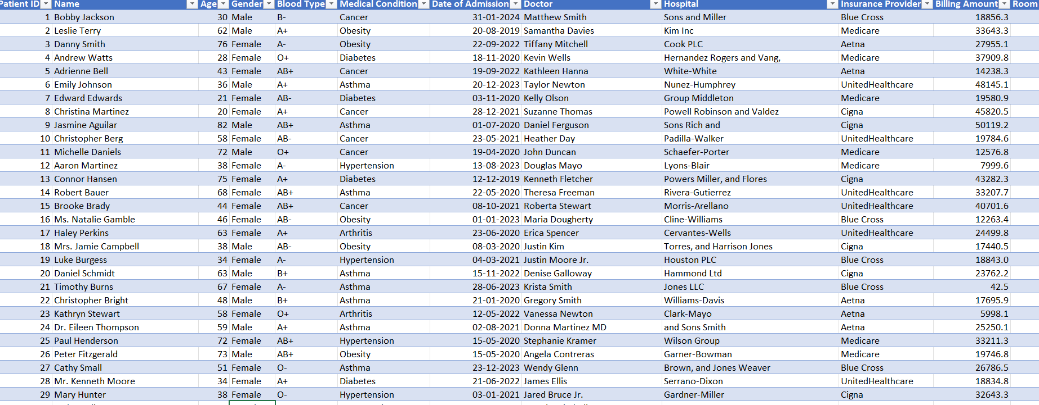
Live Demo of Project
Here's the list of some demo screenshots / features of the project:
This screenshot shows the cleaned healthcare dataset with standardized formats, no duplicates, and consistent, analysis-ready data.
Demo 1
[Add description of Demo 1 here — what this demo shows, key features, and results achieved.]

Slide 8
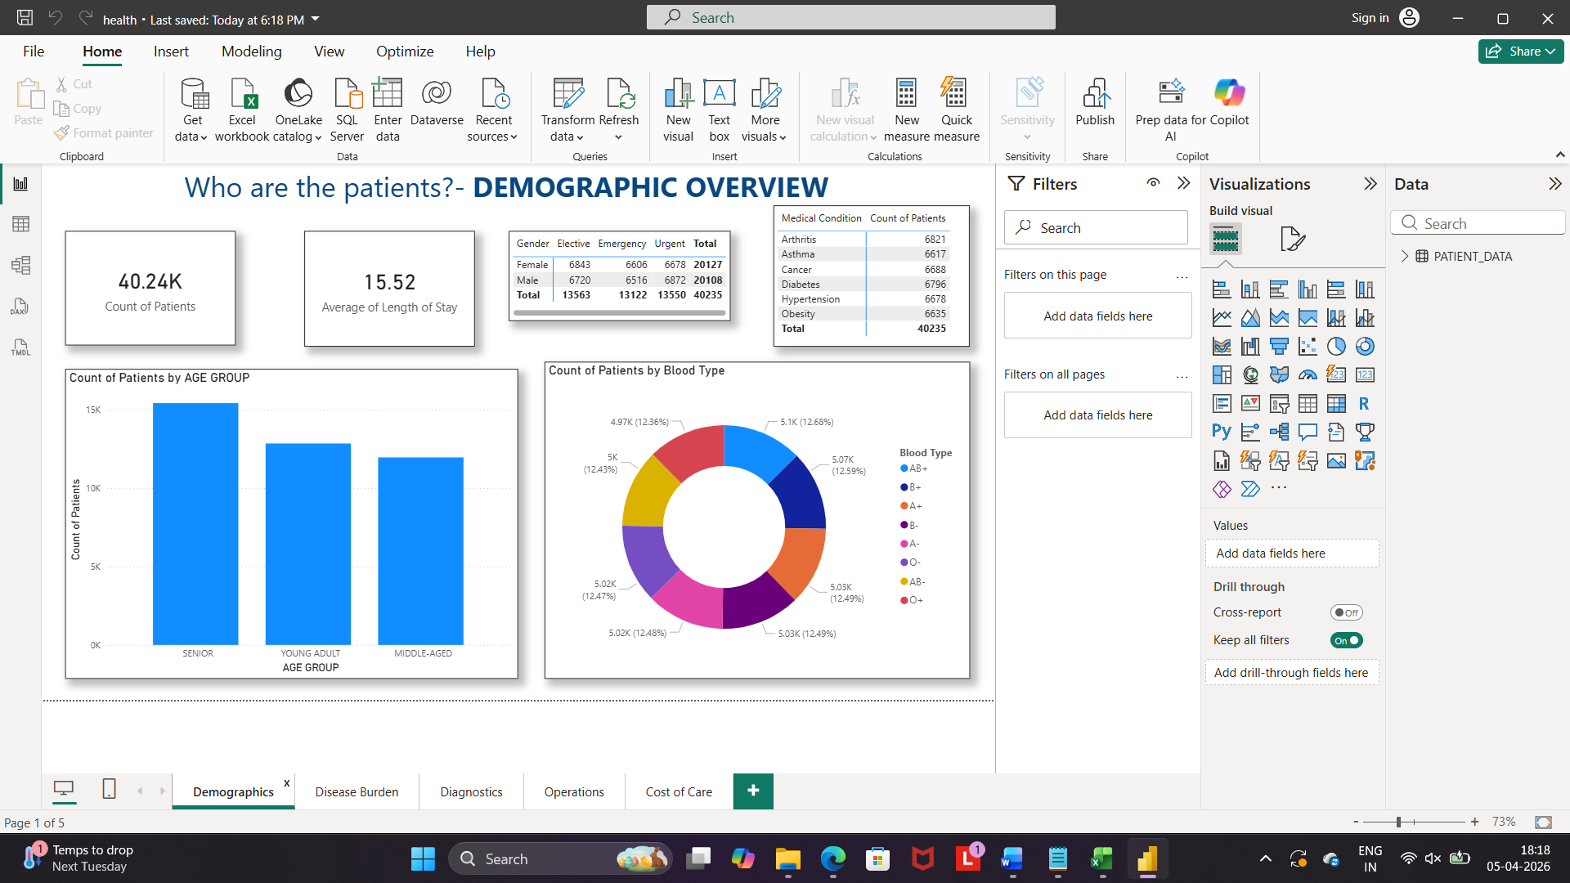
Live Demo of Project
This screenshot displays the Power BI dashboard presenting key healthcare insights through interactive visuals, KPIs, and filters for effective data-driven decision-making.

Slide 9
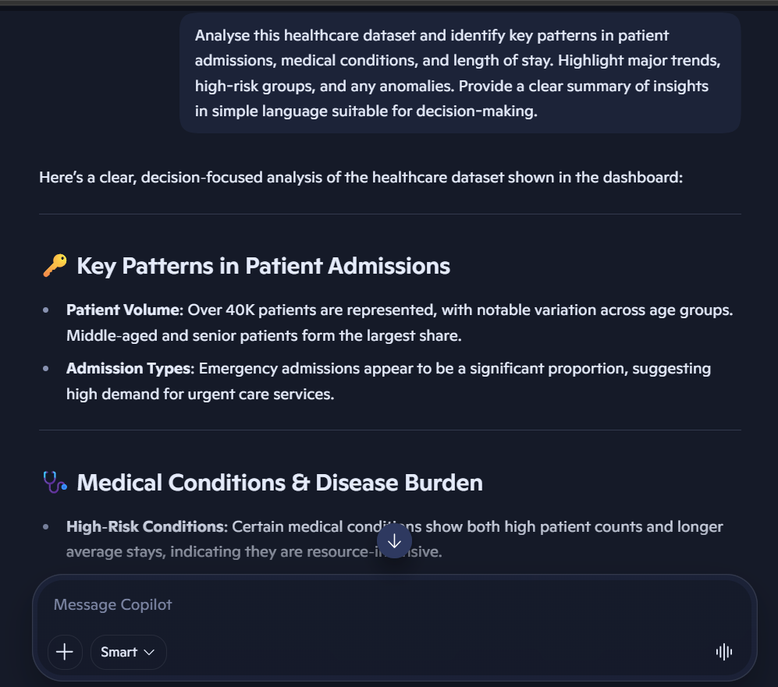
Live Demo of Project
This screenshot shows Microsoft Copilot generating insights and summaries from the healthcare dataset using natural language prompts for faster and clearer analysis.

Slide 10
Video of Project Demo
https://1drv.ms/v/c/D1FD93578F9E8C8C/IQBnqRj4Yu6hTp_tWBOeDdYSAaGVZuHmiJ-zouaw8Fbe6vs?e=SOLEml
▶
[Insert your project demo video.
You can embed a video your live project.]

Slide 11

Conclusion
Fragmented and inconsistent healthcare data is processed to correlate key variables like medical conditions, medications, and test results, affecting accurate assessment of treatment success.
An interactive dashboard is created for unified patient record across hospitals and departments leads to duplication and incomplete patient history, reducing the quality of care and analysis.
As there are skill gaps among clinical staff which restrict the adoption of analytical tools, this Power BI dashboard would help in training and to enable faster, data-driven insights.
CONCLUSION

Slide 12

Future Scope
Future enhancements include integrating real-time data pipelines using APIs or Power Automate to enable live updates.
The project can be extended by applying machine learning models for prediction and anomaly detection.
Developing a web or Power Apps interface will improve accessibility. Expanding the dataset and incorporating advanced dashboard features, along with deeper AI integration, can further enhance scalability, usability, and decision-making impact.

Slide 13
Thank You
AICW Fellowship | Student Project Presentation 2026
LinkedIn | Edunet Foundation

